Slide 1
HL-LHC:
Where are we ?
Where do we go ?
V. Baglin on behalf of WP12
CERN-TE-VSC
4-12-2015

Slide 2
Outline
General Information
WP12: Vacuum
HL-LHC beam screens
Crab cavities
Collimation
Layout
LHCb request
Options
LS2 & LS3
Summary

Slide 3
1. General Information

Slide 4
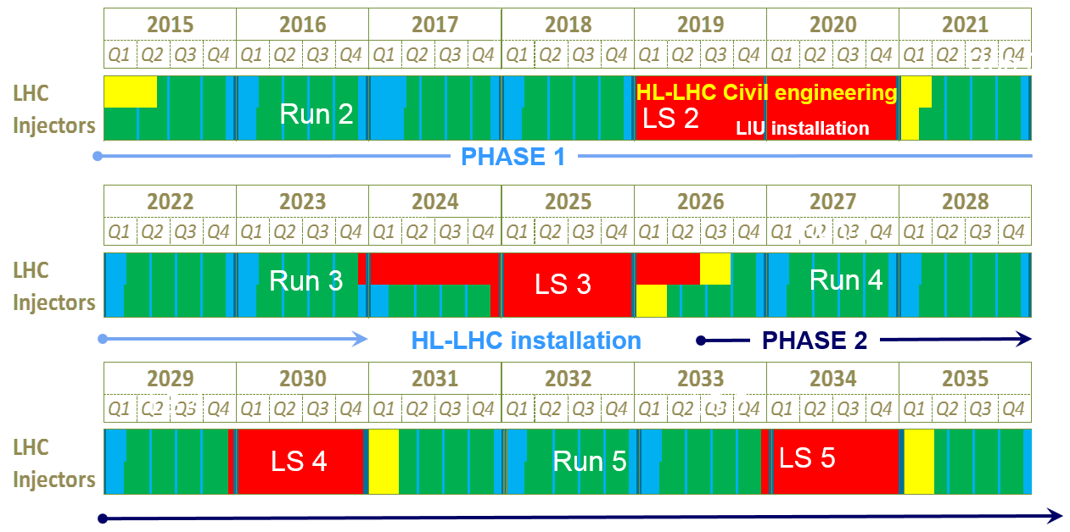
New LHC roadmap: according to MTP 2016-2020
LS2 starting in 2019 => 24 months + 3 months BC
LS3 LHC: starting in 2024 => 30 months + 3 months BC
Injectors: in 2025 => 13 months + 3 months BC
Physics
Shutdown
Beam commissioning
Technical stop
~ 100-
120 fb⁻¹
(Extended) Year End Technical Stop: (E)YETS
30 fb⁻¹
~ 300 fb⁻¹
Goal of 3’000 fb⁻¹ by mid 2030ies
F. Bordry

Slide 5
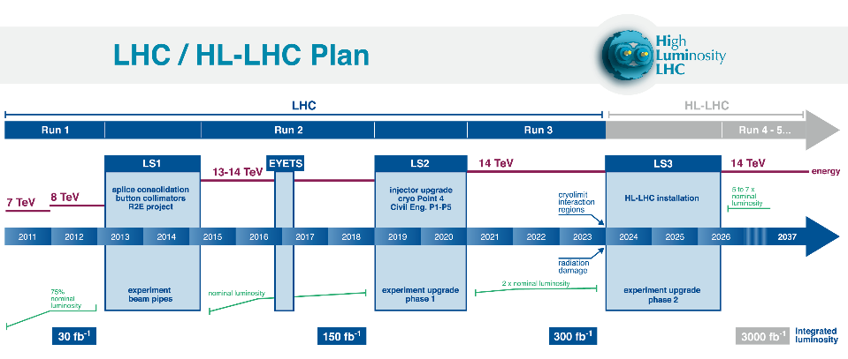
0.75 10³⁴ cm⁻²s⁻¹
50 ns bunch
high pile up ∼40
1.5 10³⁴ cm⁻²s⁻¹
25 ns bunch
pile up ∼40
1.7-2.2 10³⁴ cm⁻²s⁻¹
25 ns bunch
pile up ∼60
Technical limits to lumi increase (Machine & Experiments)
50 ⇒ 25 ns
L. Rossi

Slide 6
Goal of High Luminosity LHC (HL-LHC) as fixed in Nov. 2010
From FP7 HiLumi LHC Design Study application
The main objective of HiLumi LHC Design Study is to determine a hardware configuration and a set of beam parameters that will allow the LHC to reach the following targets:
A peak luminosity of L_{peak} = 5×10³⁴ cm⁻²s⁻¹ with levelling, allowing:
An integrated luminosity of 250 fb⁻¹ per year, enabling the goal of L_{int} = 3000 fb⁻¹ twelve years after the upgrade.
This luminosity is more than ten times the luminosity reach of the first 10 years of the LHC lifetime.
Concept of ultimate performance (use of existing magin) defined:
L_{ult} ≅ 7.5 10³⁴ cm⁻²s⁻¹ and Ultimate Integrated L_{int ult} ∼ 4000 fb⁻¹
LHC should not be the limit, would Physics require more…
L. Rossi

Slide 7
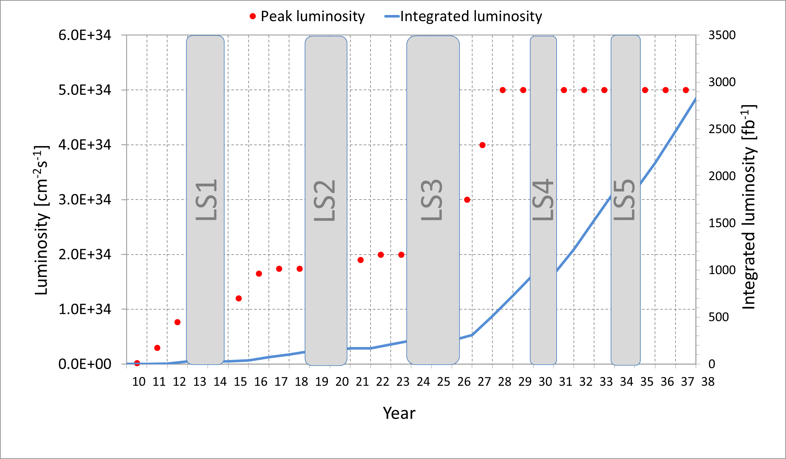
3000 fb⁻¹ would be reached in 2037
M. Lamont
M. Lamont (Lumi plots are maintained by the Head of LHC operation)
Time for proton physics till 2030 is standard; then it increases (no ions and MDs and less Tech Stops.)
Quality management of LHC and its injector is a must to reach the required efficiency (R2E, R2P, spare, performance follow up … )

Slide 8
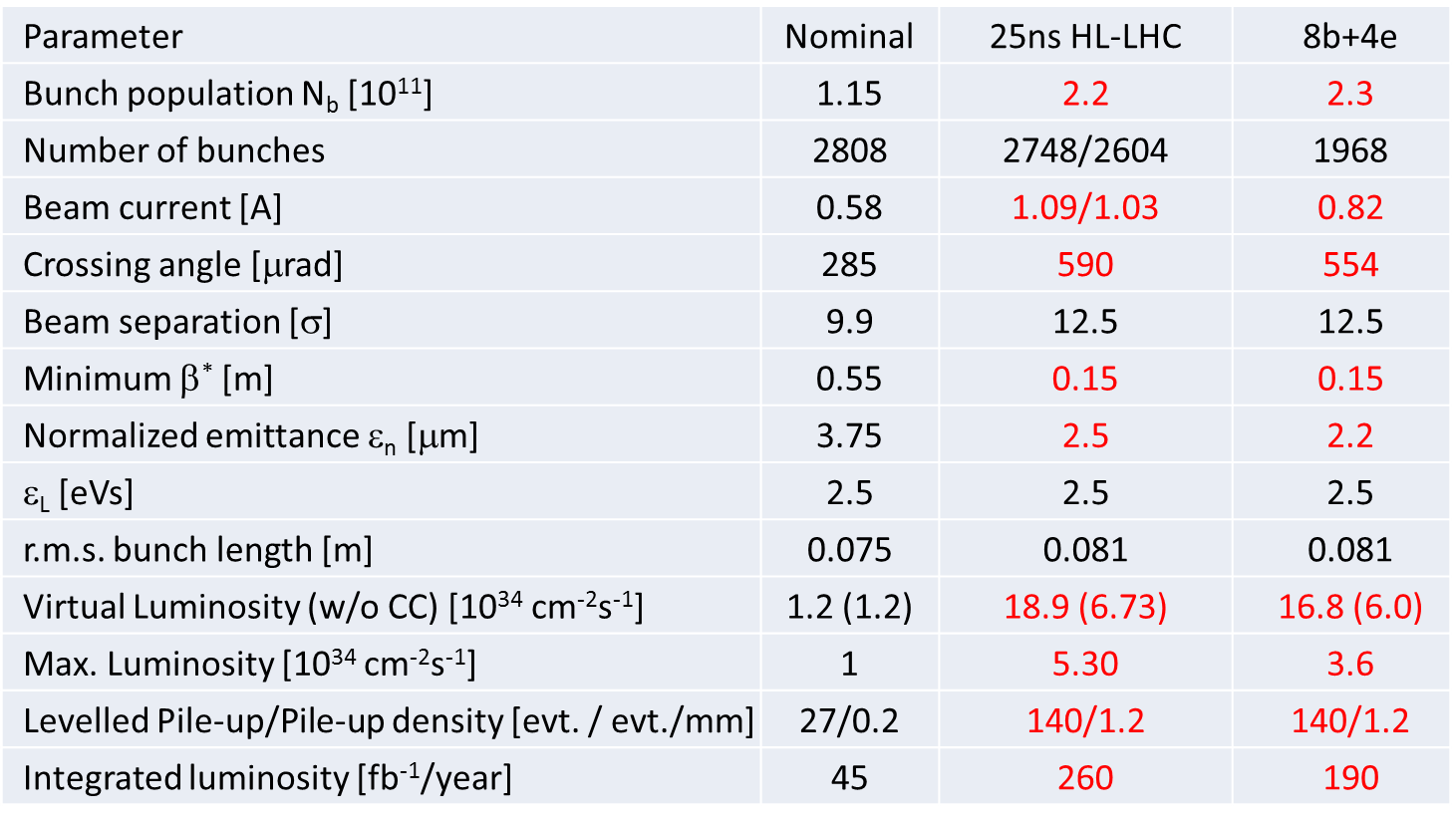

HL-LHC Baseline Parameters - WP2 charge
Back-up scenario
LIU
Impedance, efficiency etc.
New IT Quads & ATS
Crab Cavity
with levelling
Efficiency requires long fill times (6-10 h)
VSC to review performance compatibility with HL-LHC to identify consolidation
and build new systems compatible with HL-LHC
VSC Seminar, CERN, December 5, 2014

Slide 9
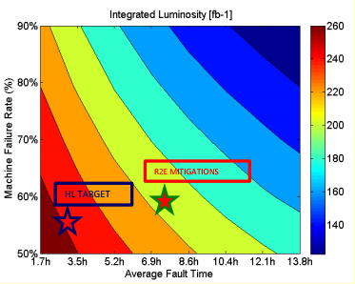
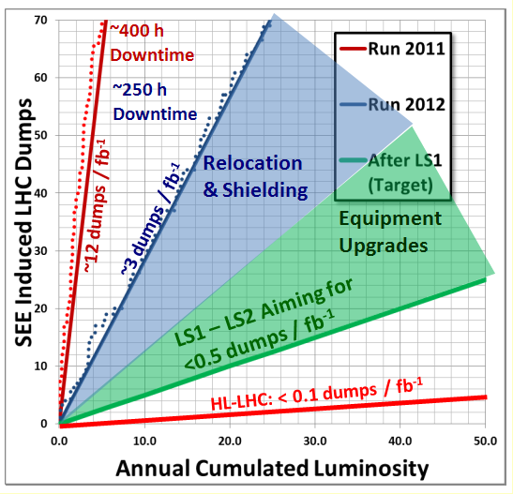
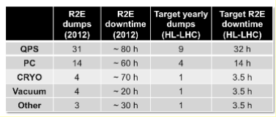
Availability and Downtime
D. Wolmann
M. Brugger
Upgrade of interlocking system (integration to avoid spurious dump)
Reduction of (generous) of interlock levels
R2E
Robust and reliable equipments
Identification of “fast” repair scenario
Etc.
VSC performances:
on track for HL-LHC !
Year | Issue count | Average downtime | Beam dump
2015 | 6 | 2.5 h | 1

Slide 10
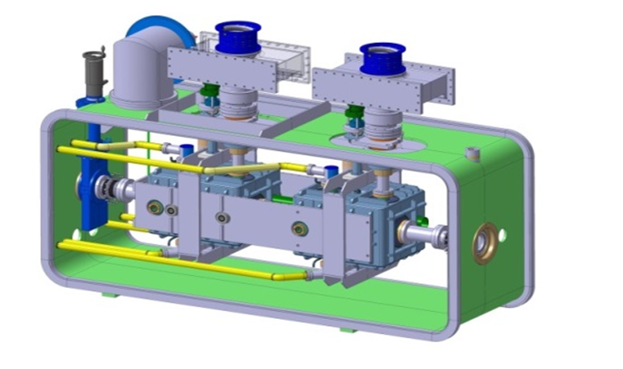
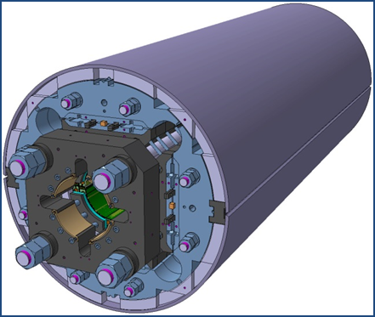
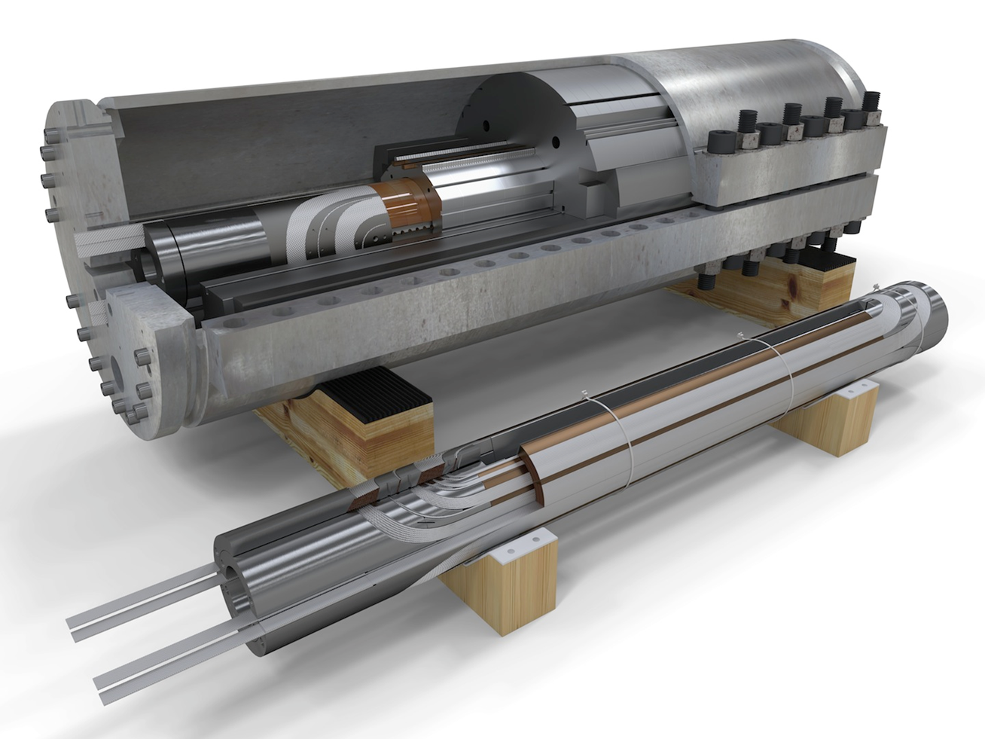
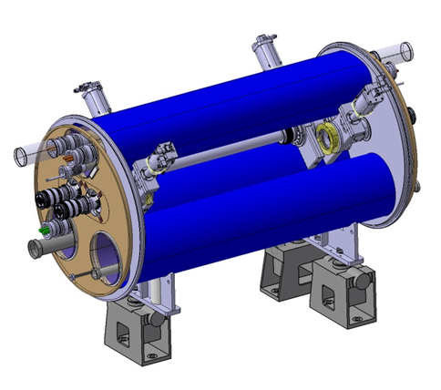
HiLuMi: largest HEP accelerator in construction
ATLAS
CMS
Dispersion Suppressor (DS)
Matching Section (MS)
Interaction Region (ITR)
Modifications
In IP2: new DS collimation in C.Cry.
In IP7 new DS collimation with 11 T
Complete change and new lay-out in IP1-IP5
TAN
D2
CC
Q4
All correctors
Q5 (Q6 @1.9 K?)
New MQ in P6
New collimators
Complete change and new lay-out in IP1-IP5
TAS
Q1-Q2-Q3
D1
All correctors
Heavy shielding (W)
+ Cryogenics, Protection, SC Links, Interface, Vacuum, Diagnostics, Inj/Extr, new infrastruct.
> 1.2 km of LHC !!
L. Rossi
10

Slide 11
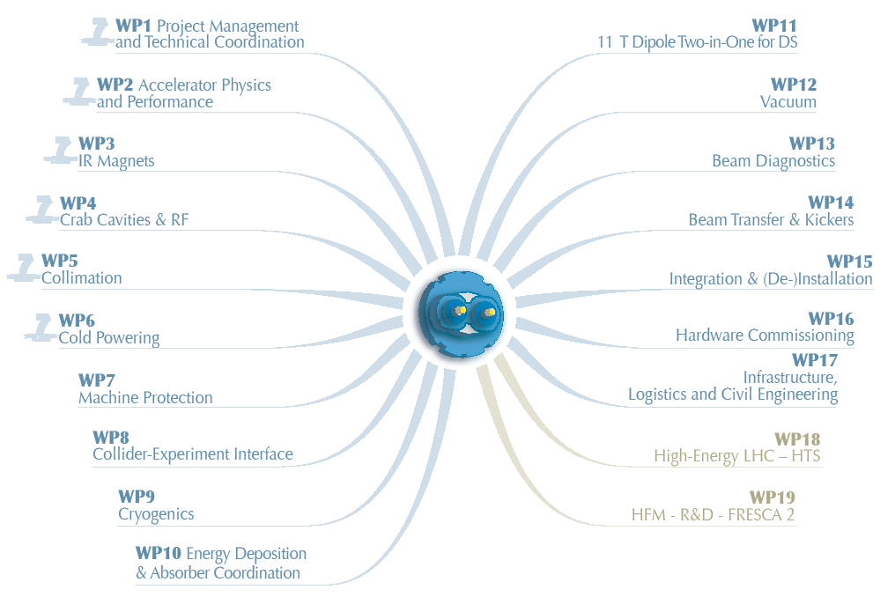
Organisation
https://espace.cern.ch/HiLumi/default.aspx
A single point of entry (VB and RK) for a TEAM work across VSC and partners

Slide 12
New Project Governance
C-MAC
CERN Directorate and
Accelerator & Technology Sector
ATSMB & EATSMB
Experiments
HL-LHC & LIU Executive Committee
HL-LHC
Collaboration Board
HL-LHC Project Office
LIU
Project
IEFC
LMC
HL-LHC Coordination Group
HL-LHC TCC
A&TS DH
GLs
➔ involvement of relevant GL
HL-LHC
Work Packages
O. Brüning

Slide 13
HL-LHC Project Office
Project Leader & Deputy
L. Rossi & O. Brüning
Project Definition & Strategy
Report to CERN Management and DHs
Report to Collaboration Board
Coordination technical WPs (2-14) & Collaborations
Safety officer
Budget Officer
Budget & its follow-up
Link to RC and to DAT
Project Office Manager
L. Tavian
Coordination among officers, secretariat, interface with host states, General Planning Coordination, Safety follow up
KT, Outreach and Communication
Technical Infrastructure Officer
L. Tavian
Civil Engineering
Impact & Environ. Studies
Electrical Distr. & CV
Access & Alarm
Logistics & link to Test Infra.
Consolidation & Operations
Configuration, Quality and Resource Officer
I. Bejar Alonso
TDR Edition & Tech. Baseline
(PBS, interfaces, Tech. Specs, Technical documentation & ECR)
Quality and Risk management
Resource & Purchase Plan
Integration and Installation Officer
P. Fessia
Integration study and layout
Lead (de-) installation
Survey
O. Brüning

Slide 14
Mandate of the HL-LHC Technical Coordination Committee
The HL-TCC is the main forum for defining, in collaboration with the work package (WP) leaders and the project management, the baseline* of the HL-LHC project and establishing and maintaining coherent sets of parameters and the associated hardware lay-out for the HL-LHC. These sets will be referred to as the HL-LHC Baseline and Options in the following. The HL-TCC will monitor and recommend changes in parameters or machine layout and the required resources and workplan based on the technical discussions at the HL-TCC meetings, interim reports from the WP leaders or any other relevant bodies of the project or of the CERN A&T sector such as group leaders and department heads. When applicable, it will also request dedicated studies to solve or mitigate any possible kind of inconsistencies and interface issue between different systems or equipment and prepare the decision making process. The HL-TCC may give also recommendation on hardware equipment, especially when the HL-LHC operation and functionality is involved, without prevailing on the responsibility of the WP leaders.
  ➔The HL-TCC reports to the HL-LHC Project Leader.
  The HL-LHC Deputy Project Leader is the HL-TCC chair ex-officio and is assisted by a deputy chair(s) and a scientific secretary(s).
*A Baseline is a set of attributes at a point in time. It serves as a basis for defining change. HL –LHC maintains Scope, Schedule and Cost Baselines
L. Rossi

Slide 15
Main HL-LHC events in 2015
Cost and Schedule Review, March 2015
Joint HiLumi-LARP meeting & 24th LARP Collaboration Meeting, May 2015
  https://indico.fnal.gov/conferenceDisplay.py?ovw=True&confId=9342
Goes to Industry, June 2015
  https://indico.cern.ch/event/387162/overview
Joint LIU / HL-LHC meeting, October 2015
  https://indico.cern.ch/event/437662/
5th Joint HiLumi LHC-LARP Annual meeting, October 2015
  https://indico.cern.ch/event/400665/overview
TDR-v0, Del-D1.10: http://hilumilhc.web.cern.ch/science/deliverables
Regular meetings such as Parameter & Lay-out Committee, Technical Coordination

Slide 16
2. WP12: Vacuum

Slide 17
WP12 Scope
Deliver a vacuum system compatible with HL-LHC beam parameters
Study, define, produce, install and commission the HL-LHC vacuum system
Including specific vacuum components and machine components (produced and installed by other WP)

Slide 18
WP12 Detailed Scope
New beams screens:
    Beam screens with shielding (Inner Triplets)
    Beam screens without shielding (other magnets)
Implementation of new vacuum layouts in Long Straight Sections, LSS:
    1 and 5
    2, 3, 7 mainly for WP 5 (collimation)
    6, 8 mainly for WP 14 (beam tranfert & kickers)
    4 mainly for WP4 (crab cavities and RF) and for WP13 (beam diagnostics)
    Insulation vacuum

Slide 19
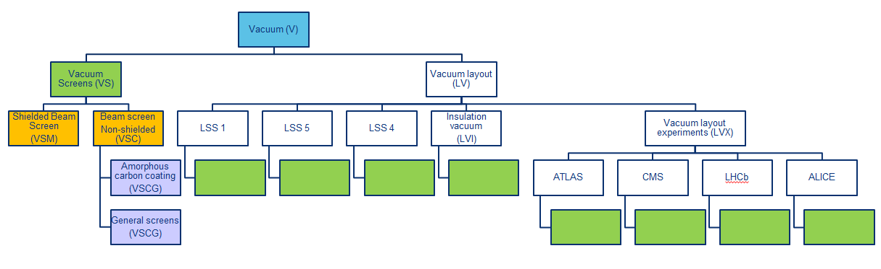
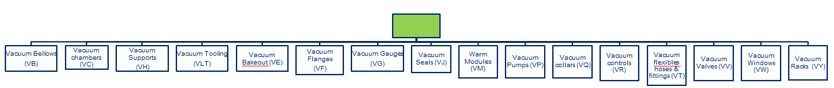
System Architecture (EDMS 14005228)
New components to produce :
  beam screen with and without shielding
  amorphous carbon coated beam screens
  vacuum layouts to implement
Where the empty green box represent a vacuum component (bellow, chamber, support etc) according to the LHC naming convention

Slide 20
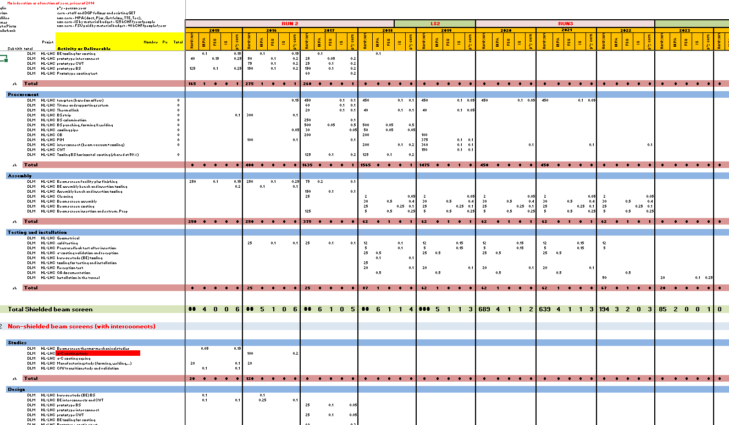
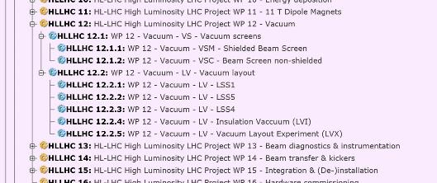
Cost and Schedule Review
Identification of resources needs with a feed back bottom-up and up-down process
Thanks to all sections for their precious inputs !
Covers 2015 till 2026
Includes studies, design, prototyping, procurement,
assembly, testing and installation for:
  Shielded beam screens
  Non-shielded beam screens
  In-situ treatment of IT2 & 8
  Room temperature vacuum system in LSS1, 5
  Room temp vacuum system in experimental areas 1 & 5 (without Exp. Beam pipes)
  Insulation vacuum
The inputs are all integrated in APT
Next C&S review: November 2016

Slide 21
Schedule
Maintained by the project office
P. Álvarez López

Slide 22
Simplified Schedule
LS2
LS3
What | Activity / deliverable | 2015 | 2016 | 2017 | 2018 | 2019 | 2020 | 2021 | 2022 | 2023 | 2024 | 2025 | 2026 | Key inputs
Beam screen with and without shielding | Procurement: beam screen, plug-in-modules |  |  |  |  |  |  |  |  |  |  |  |  | Beam screen dimension finalised in 2016
 | Procurement: tungsten, cold bore, |  |  |  |  |  |  |  |  |  |  |  |  | Cold bore dimension finalised in 2016
 | Procurement: interconnects, cold warm transition |  |  |  |  |  |  |  |  |  |  |  |  | Drawings available 2017
 | Assembly |  |  |  |  |  |  |  |  |  |  |  |  | Facility design and procurement from 2015
RT LSS1 and 5 | Design: layout, integration, prototype |  |  |  |  |  |  |  |  |  |  |  |  | Layout defined at 50 % for 2018, at 90 % for 2020 rest …
 | Procurement: instrumentation, chambers, modules |  |  |  |  |  |  |  |  |  |  |  |  | All equipment procured before installation started !
 | Component test & installation |  |  |  |  |  |  |  |  |  |  |  |  | ~ 2.5 years installation

Slide 23
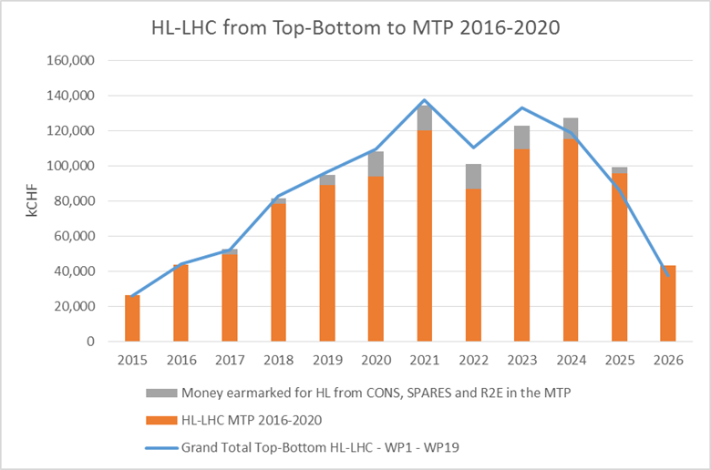
HL-LHC Cost to Completion
Following the success of C&S R: CERN management inserted the HL-LHC CtC in the MTP2016-2020 with profile till 2026 (LTP):
  ➔ MTP and strategy approved by Sept. 2015 Council.
B. Delille
CERN personnel:
1600 FTE-y
No overheads, no contingency
L. Rossi: “We have all the money we asked for, therefore we have no other possibility than succeed”

Slide 24
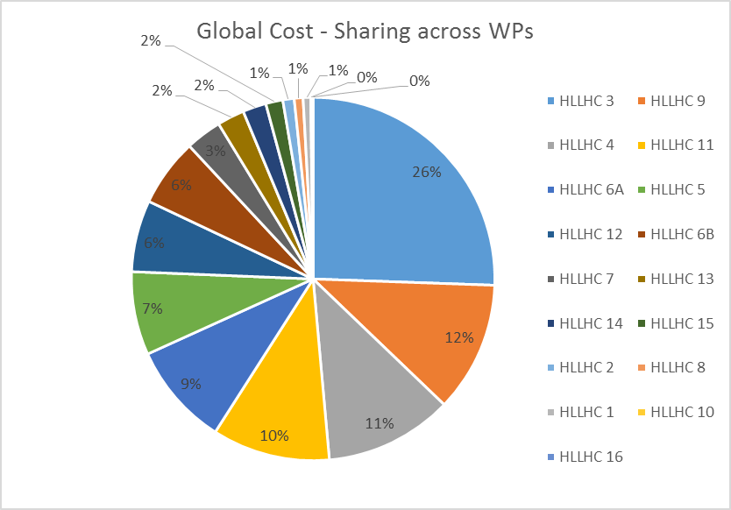
HL-LHC Cost : Distribution across WPs
WP12 : 6% ➔ ~ 54 MCHF with hardware, IS, FSU, MPA and CERN staff included
  Cost of Goods ~ 31 MCHF
IR Magnets
S = 75 %
WP12
Collimation
Cryo
Cold powering
B. Delille
11 T
CC & RF

Slide 25
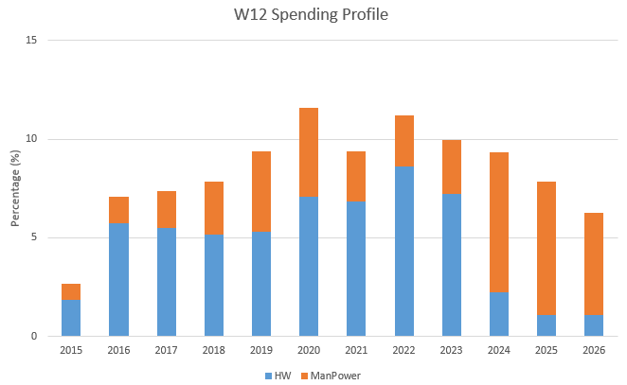
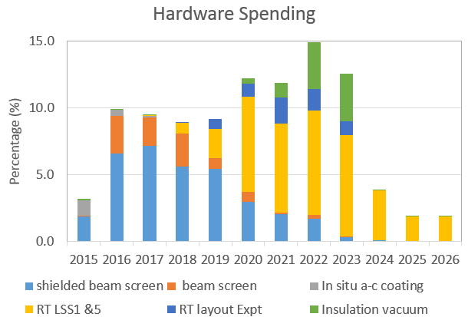
HL-LHC Cost : WP12 profiles
2015-2023:
  Mainly hardware with beam screens first then room temperature vacuum system
2024-2024:
  Mainly manpower
LS2
LS3
LS2
LS3
Need to commit large quantity of money from 2016 onwards

Slide 26
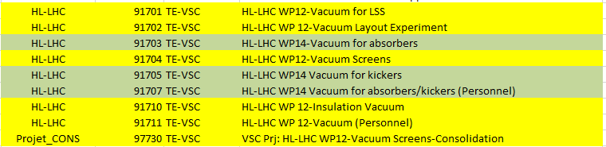
HL-LHC Budget Codes
Follows the PBS
For WP12 scope only (yellow band):
  HL-LHC money
  CONS money
For other WP scope (green band)
Please use:
91701 VSC Prj: HL-LHC WP12-Vacuum for LSS for HL-LHC activities related to the room temperature beam vacuum system.
91702 VSC Prj: HL-LHC WP 12-Vacuum Layout Experiment for HL-LHC activities related to the LHC experiments (i.e. between Q1 and Q1), machine side.
91704 VSC Prj: HL-LHC WP12-Vacuum Screens for HL-LHC activities related to the cryogenic beam vacuum system.
91710 VSC Prj: HL-LHC WP 12-Insulation Vacuum for HL-LHC activities related to the insulation vacuum system.
91711 HL-LHC WP 12-Vacuum (Personnel) for HL-LHC personnel (P and M4P).
In case of doubts, please do not hesitate to contact me,
Please respect the appropriate use of BC !

Slide 27
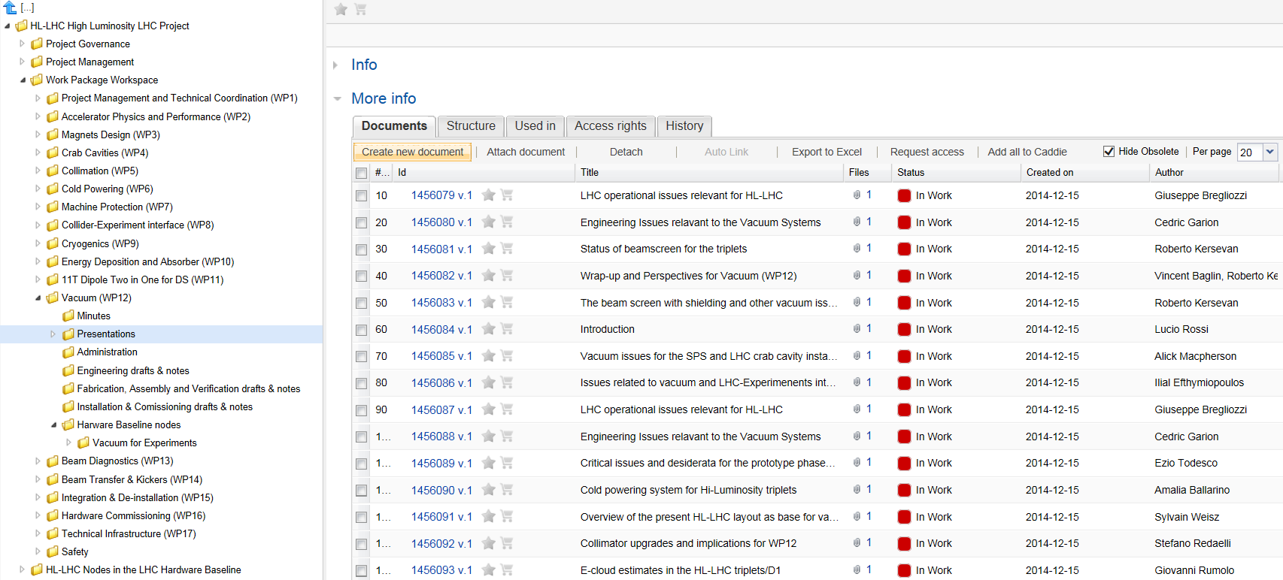
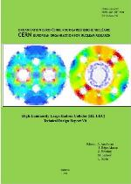
Documentation
Quality Assurance Management Plan (EDMS 1513591)
A technical design report V0 (development stage) will be issued in the coming months
WP12 as a Workspace in EDMS, please upload relevant documentations there !
I. Bejar Alonso

Slide 28
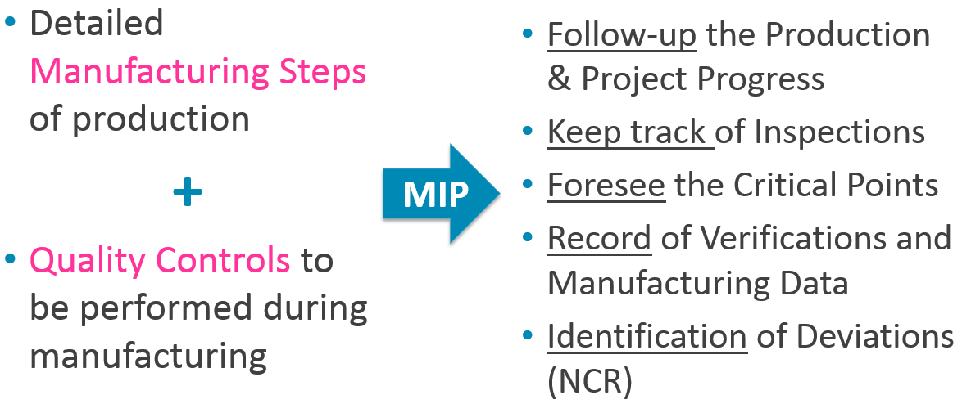
Safety and Quality Documentation
EDMS 1549066
Assess hazards and later issue the Launch Safety Agreement (LSA)
Manufacturing and Inspection Plan (MIP): contains fabrication steps and quality controls
Each point of the MIP will be classified by WP12 such as:
  N (Notification Point)
  H (Hold Point)
  R (Review)
Manufacturing and Traveller Folder (MTF) will be created from MIP for each asset and fed during production
H. Garcia Gavela
Valid for components manufactured inside and outside CERN

Slide 29
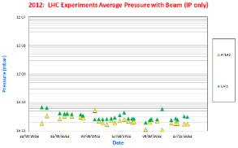

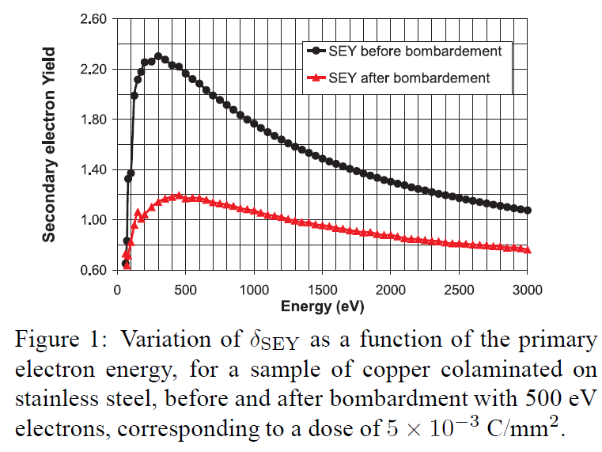
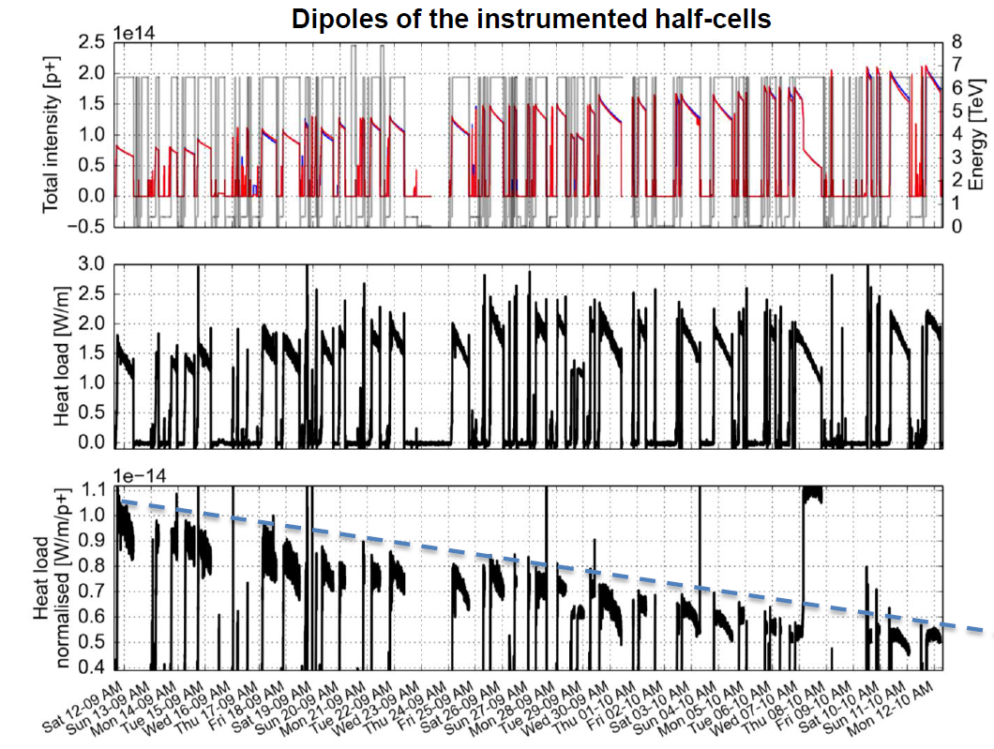
Reminder: LHC Baseline
Reduce to an acceptable level the background to the experiments:
  Room temperature vacuum system:
    Bakeable system (collimators, MKI, TDI etc.)
    Vacuum activated TiZrV getter coated system
  Cryogenic temperature vacuum system:
    Unbaked by design
    Perforated beam screens to provide pumping
    Anti-multipacting solenoids when needed
  ➔ Rely on vacuum conditioning
A. Rossi, CERN LHC PR 783, 2004.
 | H2_eq / m3 | mbar
<LSS_{1 or 5}> | ~ 5 10¹² | 10⁻¹⁰
<ATLAS> | ~ 10¹¹ | 10⁻¹¹
<CMS> | ~ 5 10¹² | 10⁻¹⁰
10⁻¹⁰ mbar
Reduce to an acceptable level the heat load on the cryogenic system:
  ➔ Rely on beam conditioning: scrubbing
δ_{max}=1.2
P. Collier
26/10/15
N. Hilleret et al.. PAC 1999

Slide 30
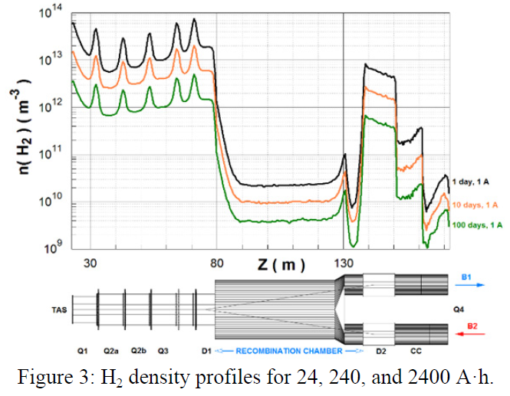
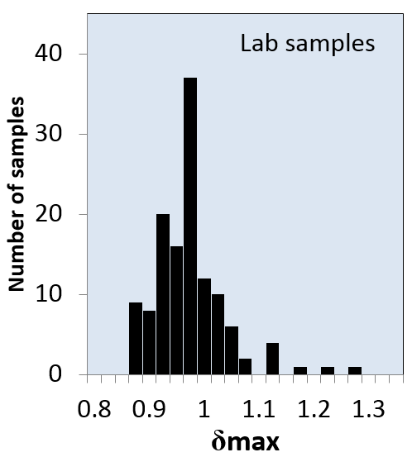
HL-LHC Baseline
Applicable to new and upgraded components: LSS1 , LSS5 and part of LSS2, 4, 8
    ➔ arcs excluded !
Room temperature vacuum system:
    ➔ same as LHC base line
Cryogenic temperature vacuum system:
  a-C coated beam screens when needed to mitigate multipacting in order to reduce:
    1) Background to the experiments
    2) Heat load on the beam screens e.g. IT in all LSSS !
  a-C performances must be validated at cryogenic temperature
10⁻¹⁰ mbar
R. Kersevan. IPAC 2015
R. Kersevan
M. Taborelli

Slide 31
3. HL-LHC Beam Screens

Slide 32
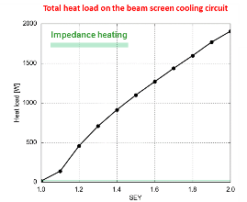
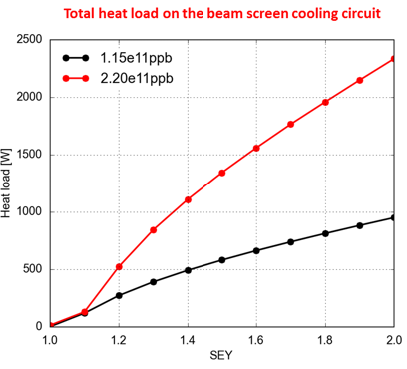
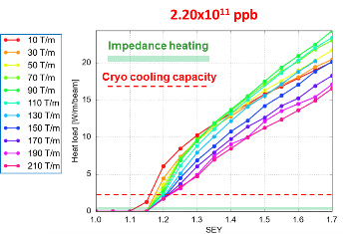
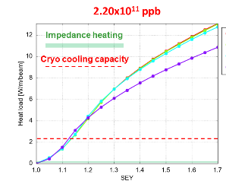
Electron Induced Heat Loads
D1 & IT LSS2/8
D1 & IT LSS1/5
G. Iadarola
Q4 LSS1/5
D2 LSS1/5
a-C coating to mitigate multipacting: 0.9< δ_{max}<1.1, thereby reducing heat load to acceptable values
All components are new, except in LSS2 & 8 ➔ In-situ a-C coating
To be confirmed by the Heat Load Working Group during 2016

Slide 33
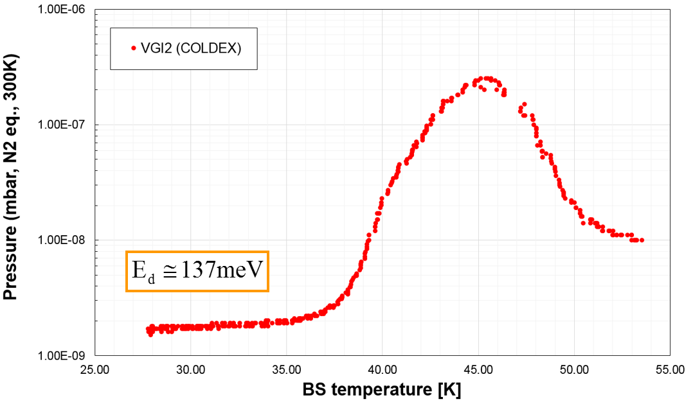
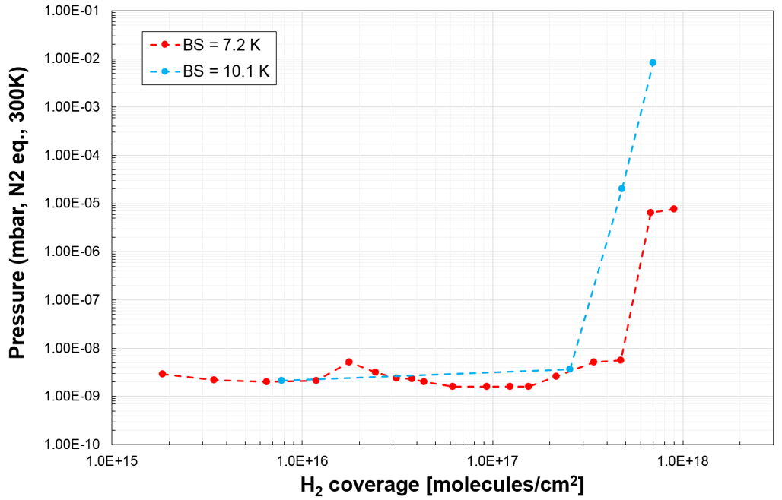
a-C coating at Cryogenic Temperature
The COLDEX program
40 K
50 K
Thermal desorption spectroscopy
Physisorbed / condensed H₂ is released from 400 nm thick a-C coating in the 40-50 K temperature range !
➔ The temperature window 40-60 K is not appropriated
➔ TBC in the coming year(s) if 50–70 K is an alternative
H₂ adsorption isotherm
a-C coating is a cryosorber !
At 10 K:
  capacity ~ 100 Cu
  but less than the LHC cryosorber
Increasing T
R. Salemme

Slide 34
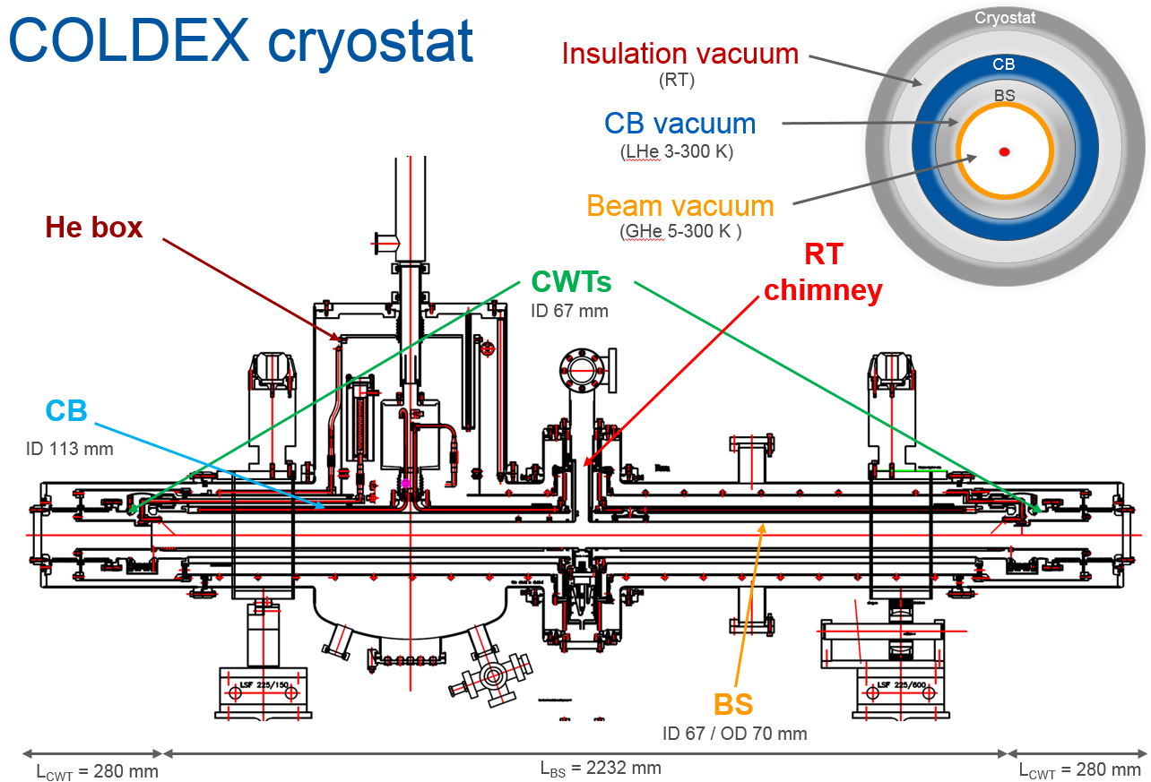
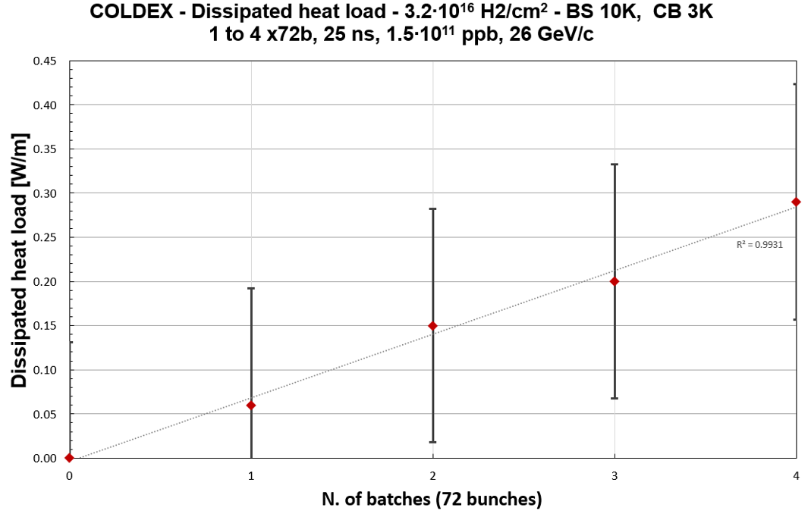
a-C coating at Cryogenic Temperature with P beams
COLDEX Studies with SPS beams:
  A 2 m long LHC type cryogenic beam vacuum system
  A beam screen temperature from 10 to 80 K and a cold bore temperature from 3 to 4.5 K
In the 10 – 80 K range:
  Pressure rise < 10⁻⁹ mbar, dominated by H₂
  Heat load < 0.4 W/m
  Electron cloud activity < 2 10⁻⁹ A/cm²
R. Salemme
Inconsistency
H₂ & CO condensation up to 2-3 10¹⁶ H₂/cm² do not strongly modify the behaviour

Slide 35
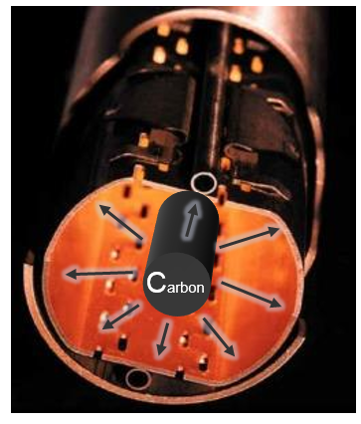
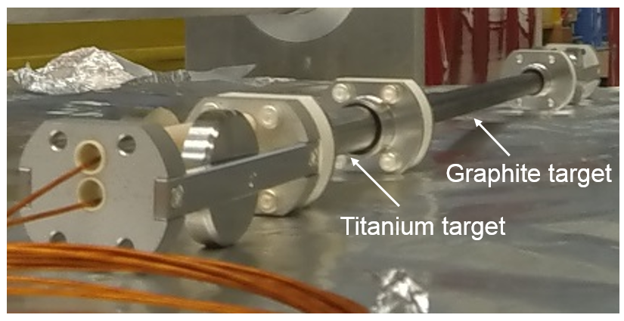
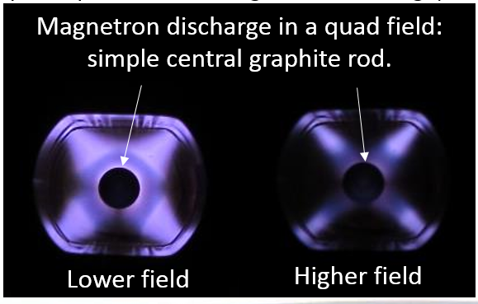
In-situ a-C coating
During LS2: in-situ a-C coating of D1+ IT in LSS2 and 8
By the end 2016, develop a “modular sputtering source” that can be inserted in a 150 mm slot and pulled by cables along D1 and the triplets
δ_{max} , unbaked | ~ 1.2
δ_{max} , after baking at 100ºC | ~ 1.15
Results achieved in a 3 m long prototype using diode sputtering
The current challenge is to decrease the SEY in the presence of outgassing and H₂ contamination from the cod bore and beam screen
Increasing the sputtering rate with Hollow cathode with quadrupole field magnetron discharge to counteract the H₂ outgassing in a 10 m long prototype
P. Costa Pinto

Slide 36
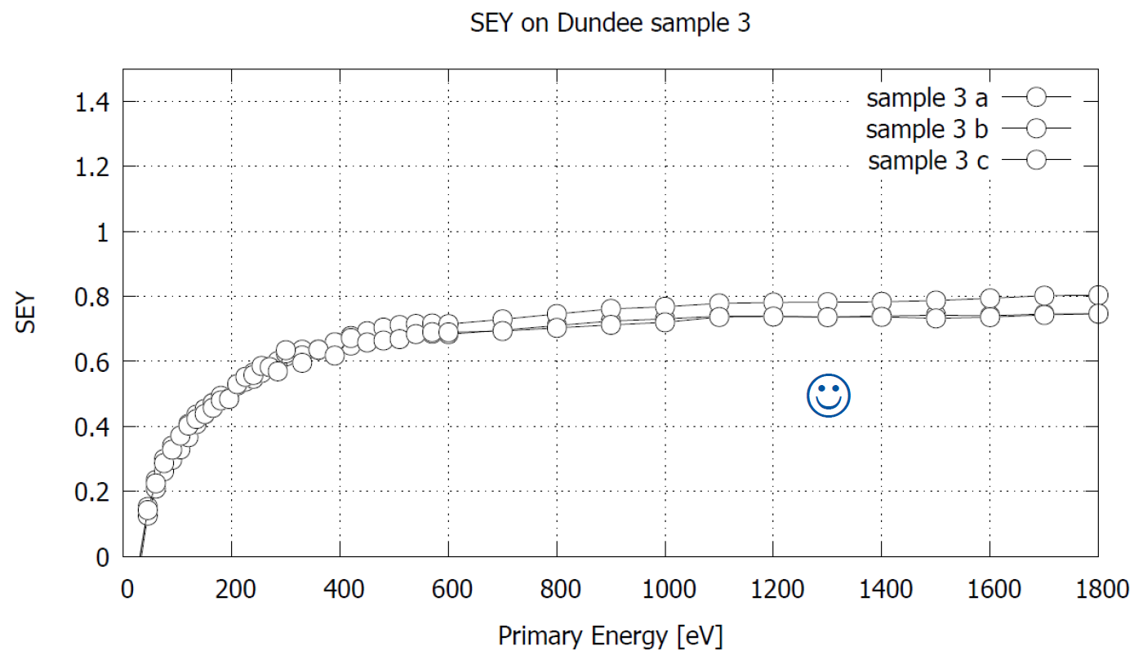
Laser Engineered Surface Structures: LESS
A studied alternative to a-C coating. Principle: laser treatment of a tube at atmospheric pressure
Collaboration with university of Dundee and ASTEC, patent deposition underway
Challenges: validate vacuum performances by mid-2017:
  Outgassing thermal and stimulated
  Produce a tube and realise implementation on the field
Test liners to be installed in SPS BA5 and later in LHC VPS and COLDEX (EYETS 2016-17)
Large H₂O outgassing
δ_{max}< 0.8 !
A. Abdolvand et al.,
Dundee University’ s samples
CERN data
CERN data
S. Calatroni

Slide 37
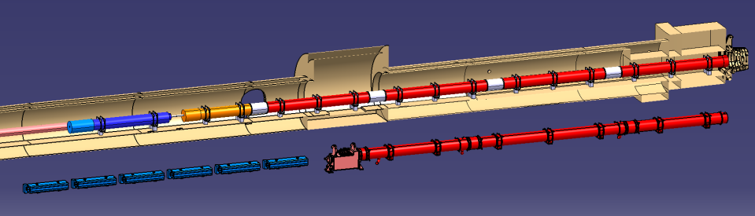





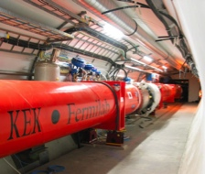
Reminder: NEW focussing quadrupole and merging dipole
Decrease beta (i.e beam size) at collision point (beta*) from 55 cm to 15 cm
IT Quads.& D1
HL-LHC
IT Quads. w/ Nb₃Sn
Q1
ATLAS
CMS
Corrector
Package
Q2b
Q2a
Q3
SC D1
Present IT
NC D1
New : Q1, Q2, Q3, CP (corrector package), D1
  All operating at 1.9 K
Magnet aperture increase in IT quads : 70 mm to 150 mm, gradient = 132.6 T/m
Superconducting D1 (aperture 150 mm, 5.6 T)
Present IT+D1 to be completely removed (radiation to personnel !!)
New beam screens, cold warm transition & interconnects to be designed and procured !

Slide 38
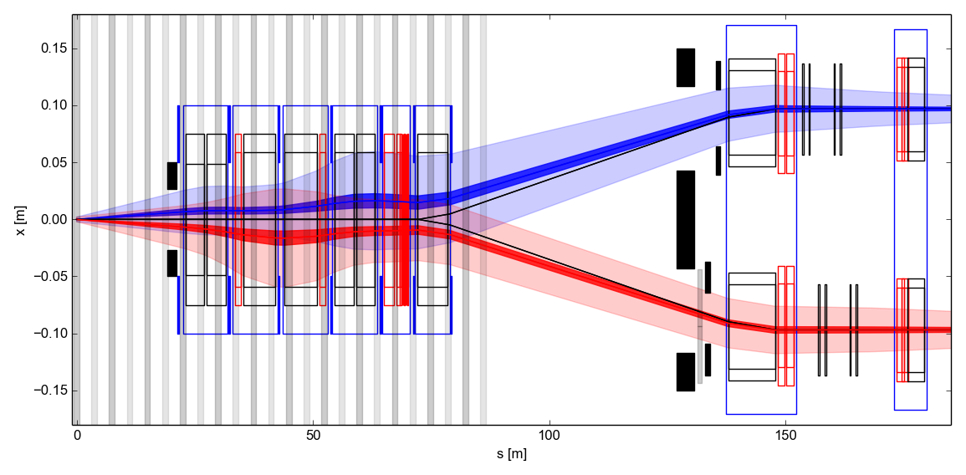
Reminder: NEW Optics HL-LHC
New optic for HL-LHC : ATS (Achromatic Telescopic Squeezing), blow-up β in the arcs to reduce β*
New Matching section
S. Fartoukh
Changes in IR1/5
  TAS aperture reduced .
  Triplet, BPM, corrector layout update.
  D1-D2 length reduction.
  TAN new aperture and separation.
  Displacement Q4 by 10m towards the arc
  3 to 4 crab cavities per side per beam.
  New MCBRD – MCBYY length and strength
  for crab cavity beam based alignment.
  Additional masks and collimators
  Q5: MQYL to MQY at 200 T/m.
Changes in IR6
  Q5: MQYL to 2x MQY.
Triplet
D1
D2 Crab Q4
Cavities
TAS
Right side of IR1/IR5
R. De Maria
Complete dismounting of LSS1 & 5
New layout

Slide 39
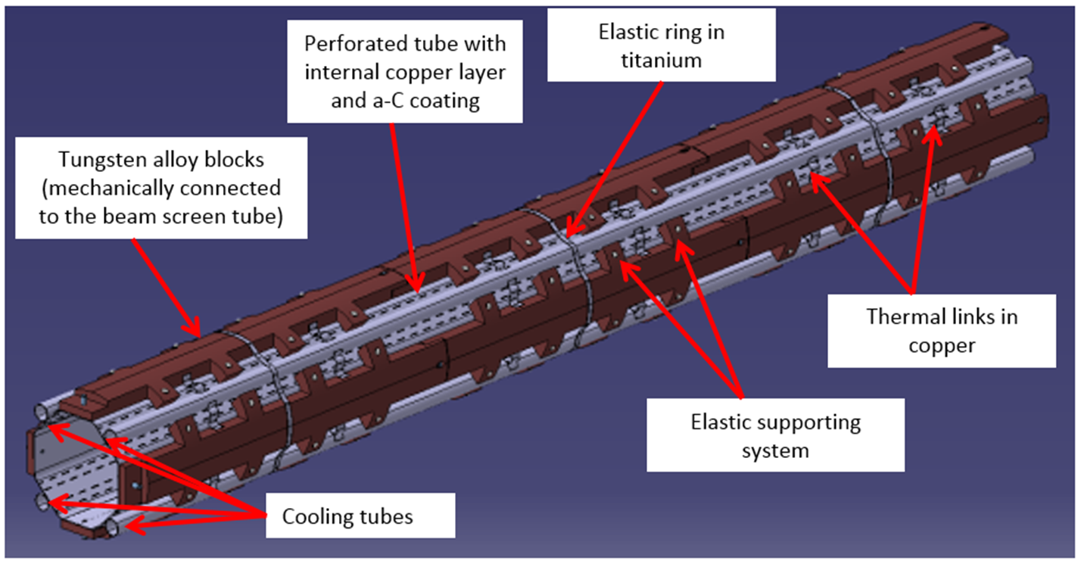
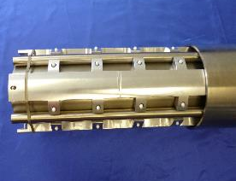
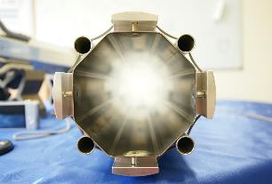
Shielded Beam Screen
Tungsten alloy (Inermet) to intercept the debris
100-200 nm thick a-C coated onto 80 μm copper co-laminated beam screen
Operating temperature : 40 – 60 K (base line under review) with the cold bore at 1.9 K
Length ~ 10 m, weight ~ 500 kg , transparency for pumping ~ 2 % (cannot be lower !)
Mechanical prototyping underway
Element | Length [m] | CB ID [mm] | Shape | W thickness [mm] | BS aperture H(V); +/- 45° [mm]
Q1 | 10.1 | 136.7 | Octagonal | 16 | 99.7; 99.7
Q2-Q3-CP | 35.7 | 136.7 | Non regular octagonal | 6 | 119.7;110.7
D1 | 7.3 | 1367. | Non regular octagonal | 6 | 119.7;110.7
DFXJ | 2.4 | tbd | tbd | tbd | tbd
C. Garion
Next steps: Validate thermal and quench models against experimental tests

Slide 40
Interconnection
Optimisation of space and shielding
Cold mass
Cryostat vacuum vessel
Cold bore
Bellows
Beam screen
IP
side
BPM
BPM
Connection beam screen/cold bore
Fixed point Cold mass/ vacuum vessel
Fixed point
Plug-In module
C. Garion
Sliding point

Slide 41
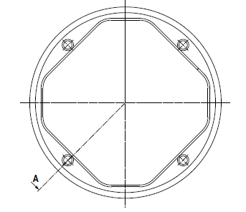
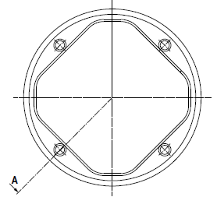
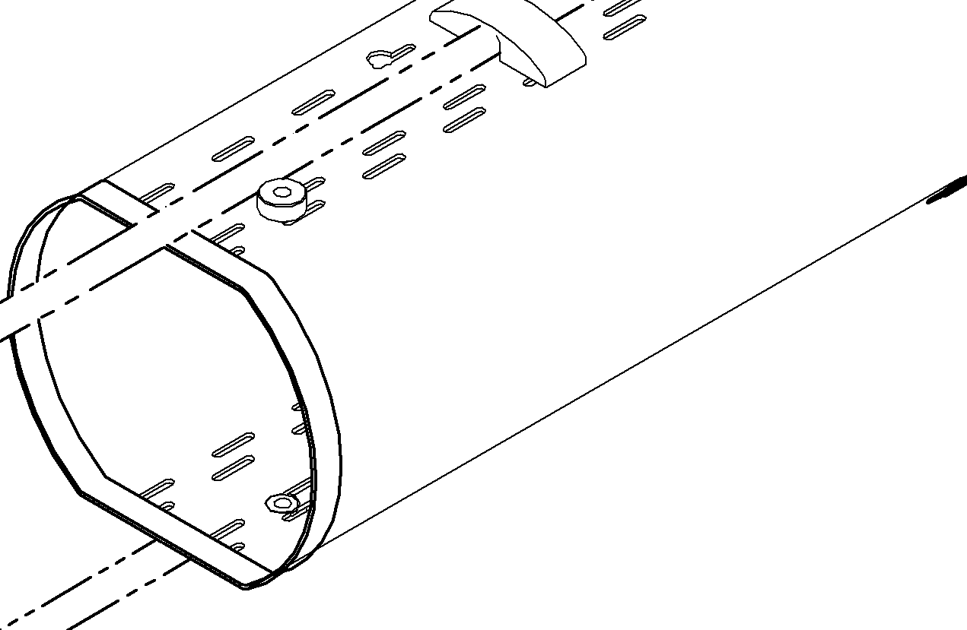
Non-shielded Beam Screens
Operating temperature : 5 – 20 K with the cold bore at 1.9 K
a-C coated Cu co-laminated beam screen except Q5 & Q6
Q5 is LHC Q4
Q6 is LHC Q6
Element | Length [m] | Shape | BS aperture H(V); +/- 45° - Radial;Between flats [mm]
D2 | 13 | Non regular octagonal | 86;77
Q4 | 9 | Non regular octagonal | 72.8;62.8
Q5 | 8 | racetrack | 57.8;48
Q6 | 6.6 | racetrack | 45.1;35.3
C. Garion
D2: octagonal shape,
CB ID: 94
Q4: octagonal shape,
CB ID: 79.8
Q5-6: racetrack shape,
CB ID: 63 -50

Slide 42

HL-LHC IT string
M. Bajko
MAIN GOAL
The HL LHC IT STRING will be a test stand to STUDY and VALIDATE the COLLECTIVE BEHAVIOUR of the different systems of the HL LHC: magnets, magnet protection, cryogenics for magnets and superconducting link, magnet powering, vacuum, and interconnections between magnets and superconducting link, alignment, interlocks.
TIMELINE: 2020-2021
The test is necessary to be performed BEFORE the series equipment will be INSTALLED in the future HL LHC machine. The HL LHC STRING test is planned for a total duration of max. 2 years while it will be operated in alternate with the HL LHC SC LINK test station using the same cryogenic installations and electrical powering systems.
VSC tests are drafted and communicated to the project

Slide 43
4. Crab cavities

Slide 44




REMINDER: Crab cavities - luminosity
Increase instantaneous luminosity by a factor 3 by “crabbing” the bunches
Requires luminosity levelling to minimise number of event per crossing
R. Calaga
B. Palmer
Crab cavities maximise luminosity and can be used for luminosity levelling:
  when luminosity is too high, CC are almost off and are slowly turned on to compensate proton burning ➔ allow to optimise integrated luminosity

Slide 45






Crab cavities
Installed on left and right side of IP1 and IP5
Q4
LARP-ODU-JLAB
D2
LARP-BNL
Installed between D2 and Q4
4 per side in IP1&5
Two designs to evaluate
Bulk Nb cavities
Staged installation:
  2 per side in IP1&5 during LS3
  the rest, after LS3
Civil engineering (to host EPCs and DFHs) during LS2

Slide 46


Crab cavities cryomodules
Operating pressure ~ 10⁻¹⁰ mbar with beams
Bulk Nb cavity operating at 2 K
Double Quarter Wave, Vertical Deflection (ATLAS)
RF Dipole,
Horizontal Deflection (CMS)
R. Calaga, O. Capatina

Slide 47

Crab cavities test in SPS BA6
Operating pressure ~ 10⁻¹⁰ mbar with beams
New SPS sectorisation in BA6 by EYETS 2016-17
Bypass design & installation by YETS 2017-18, Crab cavity module in the same time
CC
4 vacuum sectors:
  Upstream CC, NEG coated
  CC
  Downstream CC, NEG coated
  Bypass, NEG coated
Each vacuum sector has:
  Penning / Pirani gauges
  Roughing valve
NEG coated sectors have:
  Ion pumps
Layout under study

Slide 48
5. Collimation

Slide 49


Collimation baseline
TCLD in point 2
  2+1 for LS2
TCLD in point 7
  4 for LS3
TCT in LSS1 & 5
  8 + 8 for LS3
TCL in LSS1 & 5
  12 for LS3
TCSPW in LSS7
  8-10 for LS2 if ready
  12-14 for LS3
S. Redaelli

Slide 50

Collimation in DS
Detailed definition of the vacuum system and bypass
  Line 1: continuous arc beam line at cryogenic temperature
  Line 2: cold to warm transition with a sectorised room temperature vacuum sector to allow the collimator to be in-situ baked.
Prototyping for integration ongoing
Q. Deliege

Slide 51
6. Layout

Slide 52

Updated Layout
LHCLSXH__0010 and LHCLSXHT__0010
Vacuum functionalities introduced
Optimisation of BPM longitudinal position
L* fixed at 23 m
Complete redesign of
TAXD-Q1 area
Large enough to accommodate cooling tubes
Space reservation for option: BBLR compensator
Shorter TAXN and innovative solutions to accommodate TCTs + masks
Dismountable CC modules
Masks in all cells
P. Fessia
DQR and DFB, no Roman Pot
Optimisation of areas : TAXS-Q1, interconnects, TAXN-D2, crab cavities

Slide 53


New VAX area in IR1 and 5
Move the instrumentation in front of Q1 to the experiment’s cavern to reduce radiation to the personnel: robustness, remote handling and tooling are required
Installation during LS3 during TAS exchange, the impact on the experimental vacuum chamber beam pipe still needs to be defined
TAXS-Experiments & Q1-TAXS areas studies are coordinated by WP8
Unbaked a-C coated TAXS
Pumping and bellow to decouple room temperature TAS from cryogenic temperature triplet
Sectorisation to decouple experiment’s vacuum from machine vacuum
~ 520 mm
Q1
TAS
Courtesy L. Krzempek
TAS
~ 16 m
J. Perez. Espinos

Slide 54




TAXN – D2 area
Longitudinal layout defined including 5th axis for collimation
Potential issue with transverse dimensions: learn from LHC YETS 2015
LHC, LSS1L, June 2014
Bakeout jacket of TCTPV removed to allow the installation of the beam pipe
➔ loss of vacuum performances
LHC, LSS1L, June 2014

Slide 55

Layout D2-Q4
D2
LHCLSXH_0010 V0.3 under approval
Q4
B. Vasquez de Prada
5 x 4 sector valves between D2 and Q4 !
9 x 2 vacuum sectors !
Room temperature sectors (except CC modules): bakeable and NEG coated
4 sectorised CC modules: unbaked, operating at cryogenic temperature
3 types of sector valves assemblies (VAB)
Need to be reviewed following CC modification

Slide 56


Crab Cavities Modules Interconnection
Progress in the definition of the inter-module: allocated length increased to 820 mm
R. Fernandez Gomez

Slide 57
7. LHCb request

Slide 58


LHCb @ 10³⁴ Hz/cm²
Option A:
Redesign detector to cope with higher rate
Option B: This is the preferred solution !
Displace VERTEX detector towards P7 by 3.75 m to reduce the rate and add a new dipole
E. Tomas

Slide 59




Impact of LHCb @ 10³⁴ Hz/cm²
Shift of the experiment towards the left side by ~ 5 m:
I. Efthymiopoulos
“TAS” like object are needed on the left and right side :
“TAN” like object are needed on the left and right side :
Under study !

Slide 60
8. Options: not in base line but under study

Slide 61






Option: hollow e-lens
S. Redaelli
  Hollow electron beams running coaxially to the proton beam will provide an active control of beam halo population (fast failure of crab cavities) and beam loss rate. Installation LS2-LS3
  5T field
  3 m long
  RT vacuum system, bakeable
D. Perini

Slide 62


Option: cristal collimation
  A possible mean to improve collimation cleaning while reducing impedance
  A test bed already (partially) installed in LSS7 !
  More news during run 2 ….
S. Redaelli

Slide 63




Option: BBLR
  Beam-beam long range compensation (BBLR) with a flat beam optic is a plan B for HL-LHC operation without crab cavities.
S. Farthouk
  Distance from IR ~ 150 m
  Distance to beam 9.3 s
  Current ~ 125 A
HTS wire
e-lens as BBLR actuator
A prototype could be installed by LS2 !
H. Schmickler

Slide 64



Option: BI
  Fast wire-scanners
  Non invasive beam size measurement
R. Jones
  Halo diagnostic
  Beam Gas Vertex
  Coronograph

Slide 65
9. LS2

Slide 66

Installation overview for LS2
P. Álvarez López

Slide 67


HL-LHC activities during LS2 & LS3
Presented during LS2 days (P. Álvarez López, G. Bregliozzi)
  In-situ a-C coating of IT in LSS2 and 8
  Support to other WP
  LS2 days: https://indico.cern.ch/event/436424/
Detailed list of activities during LS2 and LS3 is drafted
P. Álvarez López
LS2 days
 | LHC | LS1 | HL-LHC
 | Vacuum Sectors | Vacuum Sectors | Vacuum Sectors | LS2: Length (m) | LS3: Length (m)
Cryogenic temperature | 92 | 92 | 56 | 57 | 700
Baked Room temperature | 185 | 146 | 141 | 837 | 2555
Unbaked Room temperature | 6 | 2 | 6 | 400 | 500
* HL-LHC options are excluded

Slide 68




Beam transfer and kickers
IP
  Injection protection elements to be installed in LS2
    Segmented TDIS
      TDI interferometry on the way to be installed during run II
      3 x 1.5 m long modules : 2 x low Z material (graphite) + 1 x high Z material
J. Uythoven
These upgrades must be compatible with HL-LHC

Slide 69

Beam transfer and kickers
  Injection protection elements to be installed in LS2
    Absorber in front of D1
    TCLIA and TCLIB likely not replaced for protection reasons
      However TCLIA IP2 larger opening because of ALICE ZDC?
J. Uythoven

Slide 70

Beam dumping system
  To be potentially upgrade in LS3 only
    Verification of TCDS for HL-LHC beams: will likely need to be upgraded.
    Check the already modified TCDQ : further upgrade not foreseen in the baseline.
    Check TDE heating after multiple dumps – nitrogen venting.
    Check TDE window – if this is an issue, might need to change dilution pattern. This is not part of the HL-LHC baseline.
J. Uythoven

Slide 71



LHC Experiments upgrades
G. Riddone
J. Sestak
  Work packages for LS2 (EDMS 1065775)
  Reduced ALICE Be beam pipe
  New VErtex LOcator for LHCb
  Replacement of stainless steel to Aluminum chambers for CMS
  ATLAS upgrade with a new small wheel
These upgrades must be compatible with HL-LHC
(EDMS 13601088-91) e.g. adaptation of ATLAS and CMS interface to new VAX area from LS3 onwards

Slide 72
10. Summary

Slide 73

Summary
  The design study phase is now finished (end of FP7)
  Many progress has been done in several areas of the project in the past years (studies of a-C coating, design of beam screens, interconnects, vacuum layout etc.)
  Beside the continuing studies and designs, next objectives are the TDR_V1 (Production stage: fabrication, assembly and verification) by end 2016 with a 2nd Cost & Schedule Review foreseen in Nov 2016
  There is a strong commitment of the group to the HL-LHC project which will become even stronger in the near future

Slide 74
Acknowledgments
  This presentation reflects the work of many people from the group. Particular credits should go to:
  The group management for the support and stimulation: P. Chiggiato and P. Cruikshank
G. Riddone
  BVO:
  G. Bregliozzi, J.A. Ferreira Somoza, C. Pasquino, J. Sestak
DLM:
  C. Garion, J. Perez Espinos, N. Kos, M. Sitko, A. Vidal, H. Rambeau, H. Kos, Q. Deliege, R. Fernandez Gomez, M. Morrone, L. Krzempek
  ICM:
  P. Gomes, G. Pigny
SCC:
  M. Taborelli, P. Costa-Pinto and the team in charge of surface analysis
  VSM:
  V. Baglin, R. Kersevan, S. Calatroni, I. Wevers, A-L Lamure, R. Salemme

Slide 75
Thank you for your attention

Slide 76


Slide 78
Back up slides

Slide 79



Works all around the ring… new C.E. and technical infrastructure
Cryo@P1-P5
Cryo@P4
New TAS and VCX
Beam diagnostics
BGV

Slide 80
Equipment on the Beam | Tunnel equipment | Vert. J | Surface Eq. | Dis.
Interaction Region and MS
IP 1,5
P
I
C
BIS
Magnet system
MQXFA MQXFB, MBXF, MBRD, MQYY,
Q5 1.9, Q6 1.9
MCBXFB, MCBXFA, MQSXF, MCTXF, MCTSXF, MCDXF, MCDSXF, MCOXF, MCOSXF, MCSXF,MCSSXF, MCBRD, MCBYY
CB
Cryoplant
IP 1,5
Cryo line IR+MS
Warm compressor and other surface eq.
Alignment
QPS2
TAXS, TAXN
EE
Collimation (TCTPM, TCL, TCLM, TCTP)
DF(X-M) +
SC Link DSH (X-M)
DFH(X-M) +
Power converters
Beam vacuum
Beam diagnostic
BPMSQW, BMPSQ, BPMSQT, BMLC
Rad-hard electronics for
BLM and BPM
RF system
Loads, circulators, RF power, LLRF, HVPS, central LLRR
Crab Cavity Cryomodules
CC diagnostic and protection
SC link/
Powering arc
IP 1,5
DS Collimation pp (TBC RUN II)
IP 1,5
Cryo-bypass + TCLD
H.F. dipoles
DFA+
SC Link DSHA
DFHA +
Power converters
DS Collimation for ion
IP 2
Cryo-bypass + TCLD
H.F. dipoles
HL-LHC Baseline
DS Collimation pp (TBC RUN II)
IP 7
SC link/powering
IP 7
HL-Baseline & LS2
Cryo-bypass + TCLD
Hor. SC Link
DSH + DFA
Susceptible to LS2
H.F. dipoles
AS SEEN IN SEPTEMBER 2014
Power converters

Slide 81
Equipment on the Beam | Tunnel equipment | Vert. J | Surface Eq. | Dis.
Interaction Region and MS
IP 1,5
P
I
C
BIS
Magnet system
MQXFA MQXFB, MBXF, MBRD, MQYY,
Q5 1.9, Q6 1.9
MCBXFB, MCBXFA, MQSXF, MCTXF, MCTSXF, MCDXF, MCDSXF, MCOXF, MCOSXF, MCSXF,MCSSXF, MCBRD, MCBYY
CB
Cryoplant
IP 1,5
Cryo line IR+MS
Warm compressor and other surface eq.
Alignment
QPS2
TAXS, TAXN
EE
Collimation (TCTPM, TCL, TCLM, TCTP)
DF(X-M) +
SC Link DSH (X-M)
DFH(X-M) +
Power converters
Beam vacuum
Beam diagnostic
BPMSQW, BMPSQ, BPMSQT, BMLC
Rad-hard electronics for
BLM and BPM
RF system
Loads, circulators, RF power, LLRF, HVPS, central LLRR
Crab Cavity Cryomodule
(SPS Test)
CC diagnostic and protection
SC link/
Powering arc
IP 1,5
DS Collimation pp (TBC RUN II)
IP 1,5
Cryo-bypass + TCLD
H.F. dipoles
DFA+
SC Link DSHA
DFHA +
Power converters
DS Collimation for ion
IP 2
Cryo-bypass + TCLD
H.F. dipoles
HL-LHC Baseline
DS Collimation pp (TBC RUN II)
IP 7
SC link/powering
IP 7
HL-Baseline & LS2
Cryo-bypass + TCLD
Hor. SC Link
DSH + DFA
Baseline, now postponed
No longer baseline
H.F. dipoles
AS SEEN IN SEPTEMBER 2015
Power converters

Slide 82
Equipment on the Beam | Tunnel equipment | Vert. J | Surface Eq. | Dis.
Collimation upgrade
P
I
C
BIS
Secondary TCSPM
IP 3, 7
Primary TCP TCPP
IP 3 ,7
TCSG, TCLA, TCAP
IP 3, 7
AS SEEN IN SEPTEMBER 2014
TCSP
IP 6
Injection protection
IP 2, 8
TDIS
TCLIA, TCLIB (TBC)
TCDD TCDDM (TBC)
TCLIM (TBC)
MKI (TBC)
Beam diagnostic
IP 4
Cryoplant
IP 4
Fast wire scanners BWSF
New light extraction line BSRT
Cryoline for RF
CB
Warm compressor and other surface eq.
Beam gas vertex detector BGV
Q5 at point 6
IP 6
Dump (TBC)
IP 6
TCDS (TBC)
HL-LHC Baseline
MKB, TDE (TBC)
HL-Baseline & LS2
High rad warm magnets (TBC)
IP 7
Susceptible to LS2
TAXN for LHCb
IP 8

Slide 83
Equipment on the Beam | Tunnel equipment | Vert. J | Surface Eq. | Dis.
Collimation upgrade
P
I
C
BIS
Secondary TCSPM
IP 3, 7
Primary TCP TCPP
IP 3 ,7
AS SEEN IN SEPTEMBER 2015
TCSG, TCLA, TCAP
IP 3, 7
TCSP
IP 6
Injection protection
IP 2, 8
TDIS
Upgrade of 18kW refrigerator
TCLIA, TCLIB
IP 4
New transportable refrigerator
TCDD TCDDM
Mask for D1
TCLIM
MKI prototype
Beam diagnostic
IP 4
Cryoplant
IP 4
Fast wire scanners BWSF
New light extraction line BSRT
Cryoline for RF
CB
Warm compressor and other surface eq.
Beam gas vertex detector BGV
Q5 at point 6
IP 6
Dump (TBC)
IP 6
TCDS (TBC)
HL-LHC Baseline
MKB, TDE (TBC)
HL-Baseline & LS2
High rad warm magnets
IP 7
HL-Baseline but postponed
TAXN for LHCb
IP 8
No Baseline
Mask for D1
IP 8

Slide 84

Impact of radiation to personnel around IT
1 month cooling time, dose rates at 40 cm from the cryostat
~ x16 wrt LS1
~ x4 wrt to LS3
Nominal scenario
Representing any LS after LS3
C. Adorisio

Slide 85
Impact of radiation to personnel around IT (2)
CERN Objective : 3 mSv/year maximum during LS (Rule for Cat B personnel : 6 mSv/y)
Case study : When ? any LS after LS3, nominal
 |  |  | Collective dose (man mSv)
What | Where | How ? | 1 month cooling time | 4 months cooling time
Valve exchange | TAS-Q1 | 3 teams 5 workers | 3 | 1
PIM exchange | Q1-Q2 IC | 6 teams 8 workers | 21 | 8
C. Adorisio
/2.5
Estimation of WDP (work dose plan) can also be done for LS3 and the removal of the present inner triplet magnets to optimize the work-methods
Dose maps available from TAS to D1
Optimisation of design, equipment robustness, intervention procedures (WDP) with use of remote tooling and training of people is MANDATORY

Slide 86











The magnet zoo in the IR
E. Todesco
Triplet QXF (LARP and CERN)
Orbit corrector (CIEMAT)
Separation dipole D1 (KEK)
Skew corrector (INFN)
Corrector sextupole (INFN)
Corrector octupole (INFN)
Recombination dipole D2
(INFN design)
Q4 (CEA)
Cross-sections in scale
Corrector decapole (INFN)
Corrector dodecapole (INFN)
Many beam screens with interconnects and cold warm transitions to be designed, produced & installed
C. Garion

Slide 87

Layout –D2-Q4: 2nd beam pipe
The 2nd beam pipe is held at 2 K and has cold warm transitions (CWT) !
Current material is Ti, diameter limited by space
In LHC, maximum length without beam screen is < 1 m (to be revised for HL-LHC)
Detailed studies are needed to comply with vacuum stability and pressure level (electron cloud !)
CWT
CWT
A beam screen between
2 cryogenic pipes ?
A beam pipe with
Antechamber ?

Slide 88


11 T – DS collimator
  Arc Dispersion Suppressor areas (Q7 to Q11) serve as “energy spectrometer” : a collimator is needed to reduce background to ALICE with ion operation and to reduce beam loss on the cold masses with proton beams
  Using NbSn₃ technology, the dipole field can be increased up to 11 T
  A standard LHC dipole can be replaced by two 11 T magnets and one collimator (TCLD)
F. Savary
By-pass cryostat
15660 mm
11 T dipole cold mass
Interconnect
Collimator

