Slide 1

Novel Ridge Waveguide HOM damping Scheme for High Current SRF cavity
BROOKHAVEN SCIENCE ASSOCIATES
Wencan Xu
On behalf of HOM damping team
Brookhaven National Laboratory

Slide 2
Outline
HOM damping requirement of eRHIC SRF linac
Ridge waveguide HOM damping for compact linac: HOM damping scheme, BBU, energy spread
HOM damping for “Low-risk” linac
Summary

Slide 3
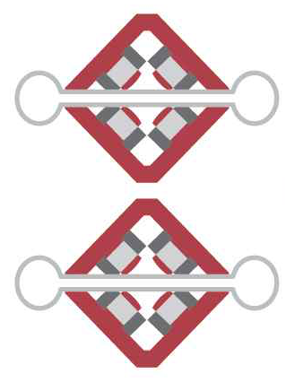
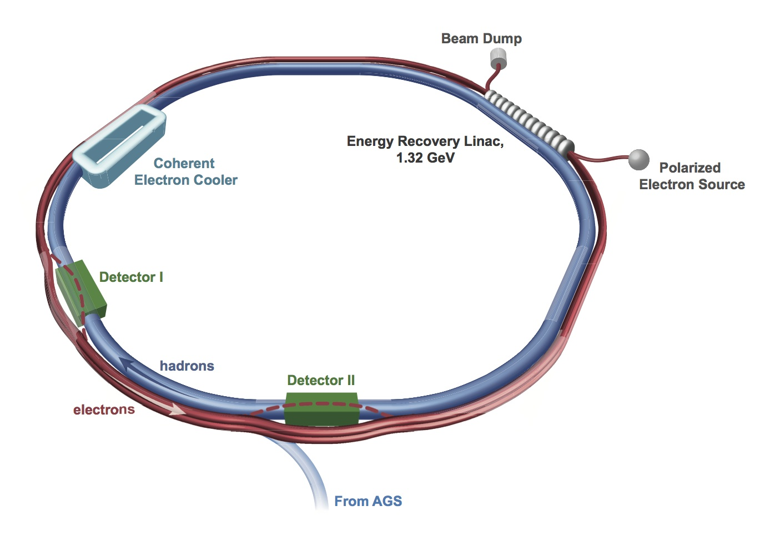

ERL SRF linac in FFAG lattice eRHIC
1.7-5.1 GeV
1.67 GeV main Energy Recovery Linac;
80 647.4 MHz 5-cell–SRF Cavity;
Available tunnel space: 200 m.
6.7-18.3 GeV
up to 20 GeV
More detail @ eRHIC Design Study: An Electron-Ion Collider at BNL, arxiv: 1409.1633

Slide 4
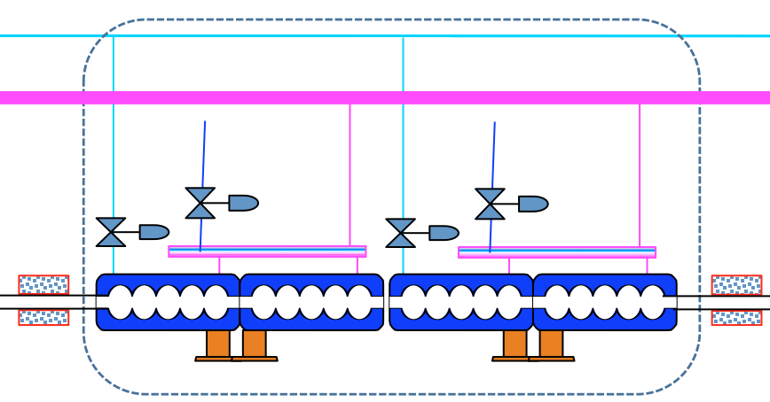
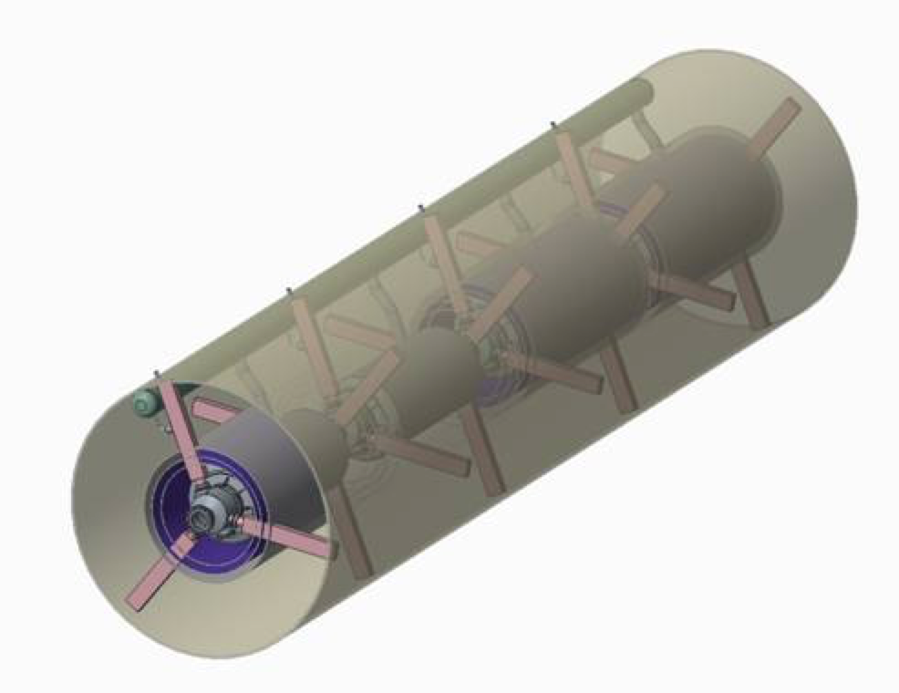
Linac Parameters for compact

Slide 5
eRHIC ERL electron beam current limits
Nominal design
Ultimate design
HOM power/cav
2.5 kW
Polar. source current
50 mA
SR power
2.5 MW
Polar. source current
26 mA
HOM power/cav
8 kW !
SR power
2.5 MW
Bunch length in eRHIC design is with sigma of 3mm, which has loss factor of 2.6 V/pC calculated by ABCI.
There are two designs with max ebeam current in linac of 340 mA for nominal design and of 500 mA for ultimate design, which, respectively, generates 2.5 kW and 8 kW HOM power calculated by single bunch loss factor.
plot@ V. Ptitsyn, Luminosity staged linac-ring design, eRHIC R&D advisory committee Review, April 7-8, 2016

Slide 6
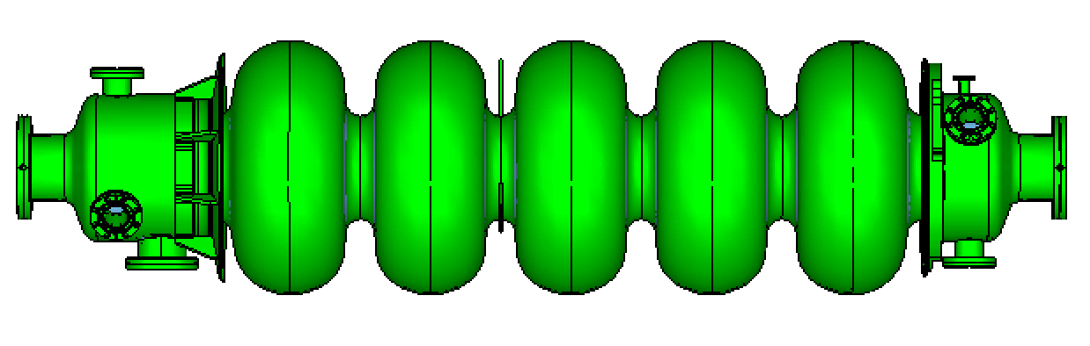
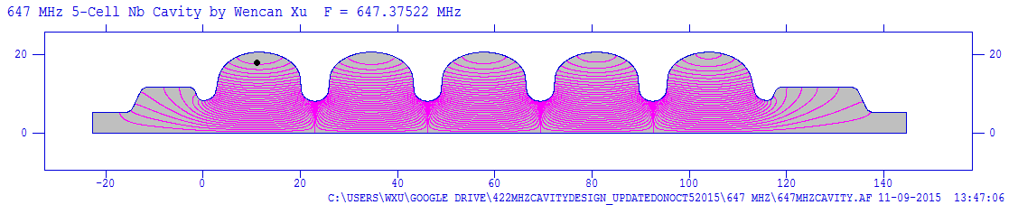
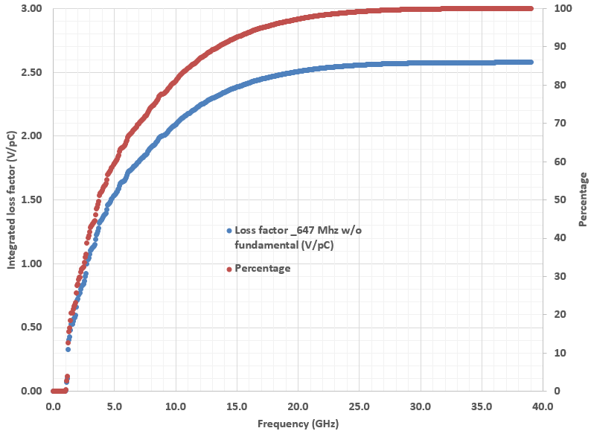
RF and mechanical design of 647 MHz cavity
Single bunch loss factor
Parameters | 647 MHz 5-cell cavity
Frequency [MHz] | 647
Number of cells | 5
Geometry factor [Ω] | 273
(R/Q)/Cavity [Ω] | 502
Epeak/Eacc | 2.27
Bpeak/Eacc [mT/MV/m] | 4.42
Coupling factor [%] | 2.8
Cavity length [m] | 1.72
The tuning range for eRHIC cavity is 173 kHz to match different Proton energy.
Tremendous mechanical analysis was carried out, and decided to have 4 mm wall thickness without Stiffness ring. This makes a reasonable tuner load, mechanical stress bellow 7000 psi.
With tabs on the middle cell of the cavity, the first mechanical mode is longitudinal mode and is 107 Hz.
The cavity will be fabricated in RI.

Slide 7
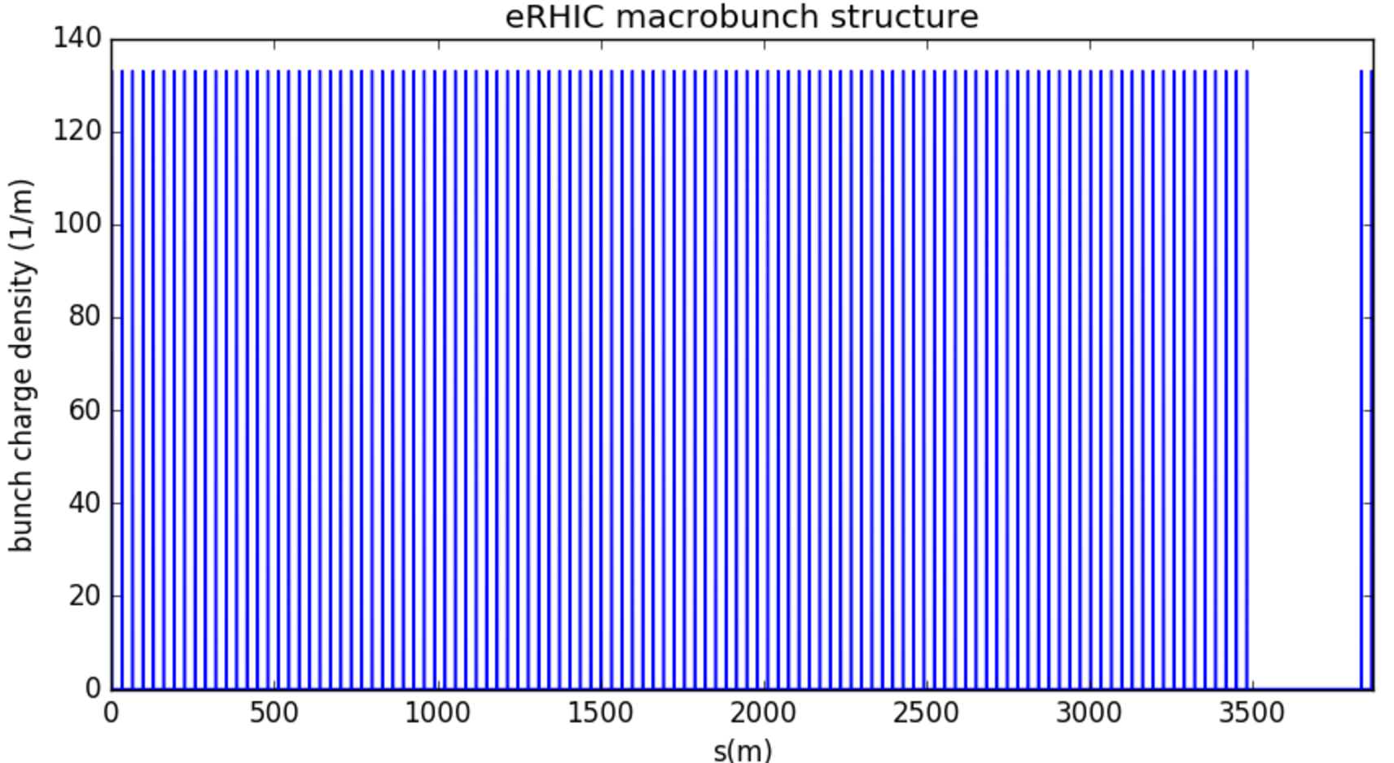
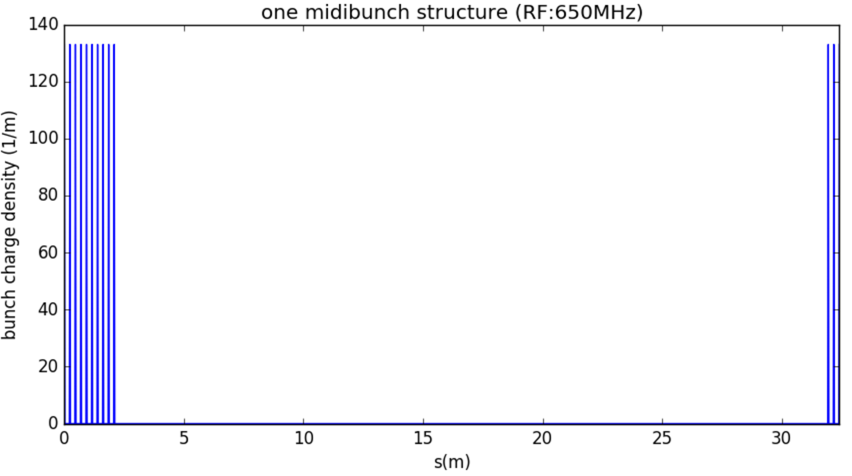
eRHIC bunch structure
gap
i(t)=A(t)xB(t) x C(t)
CW A(t): RF 647.5 MHz
Midi bunch B(t): 9.38 MHz
Macro bunch C(t): revolution frequency 78KHz (120 9.38 MHz)
Gap: 10 9.38MHz

Slide 8
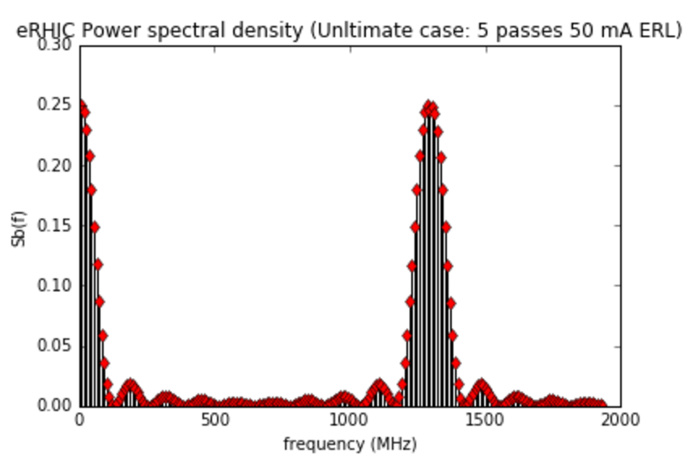
eRHIC bunch structure

Slide 9
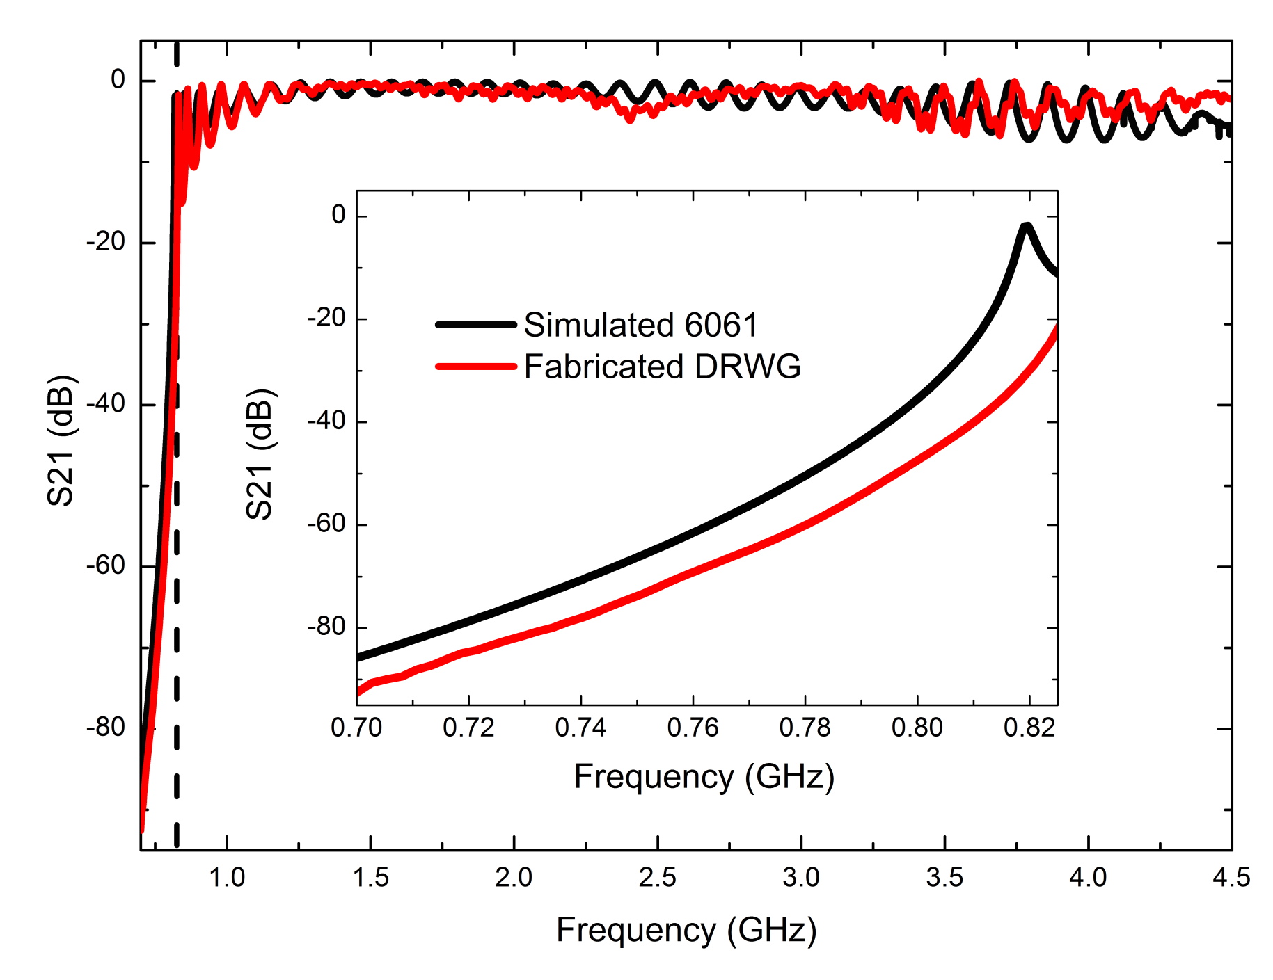
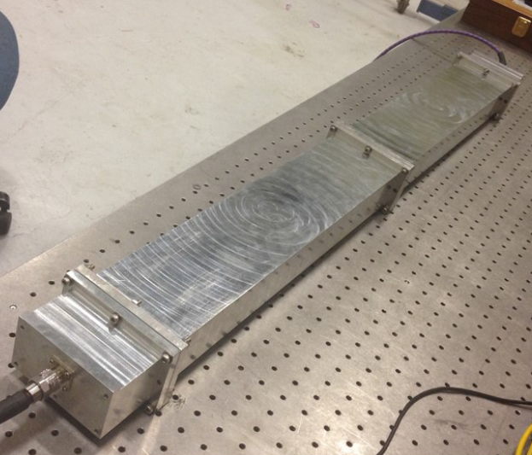
Conceptual design of Ridge waveguide damper (1)
Ridge WG is a nature high pass filter with higher bandwidth, smaller size (1/4) than regular WG.
Ridge WG has lower conduction heat load and is easier to cool.

Slide 10
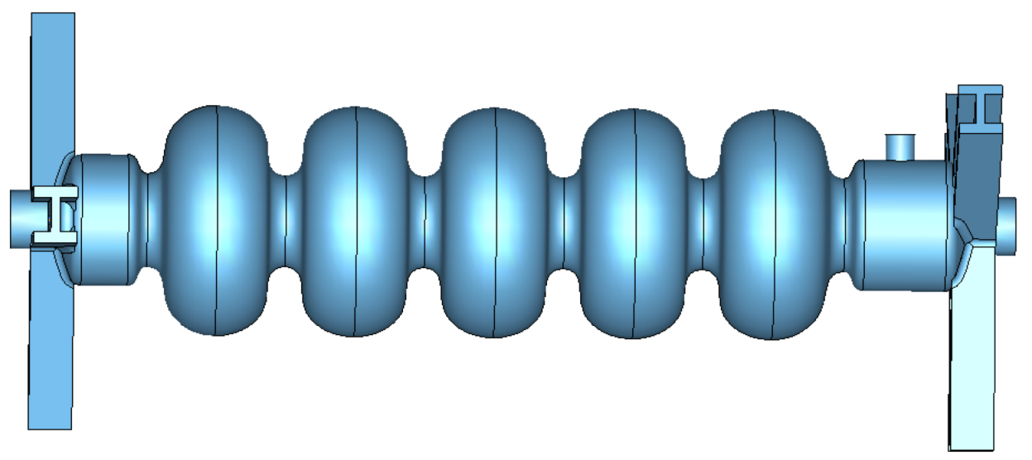
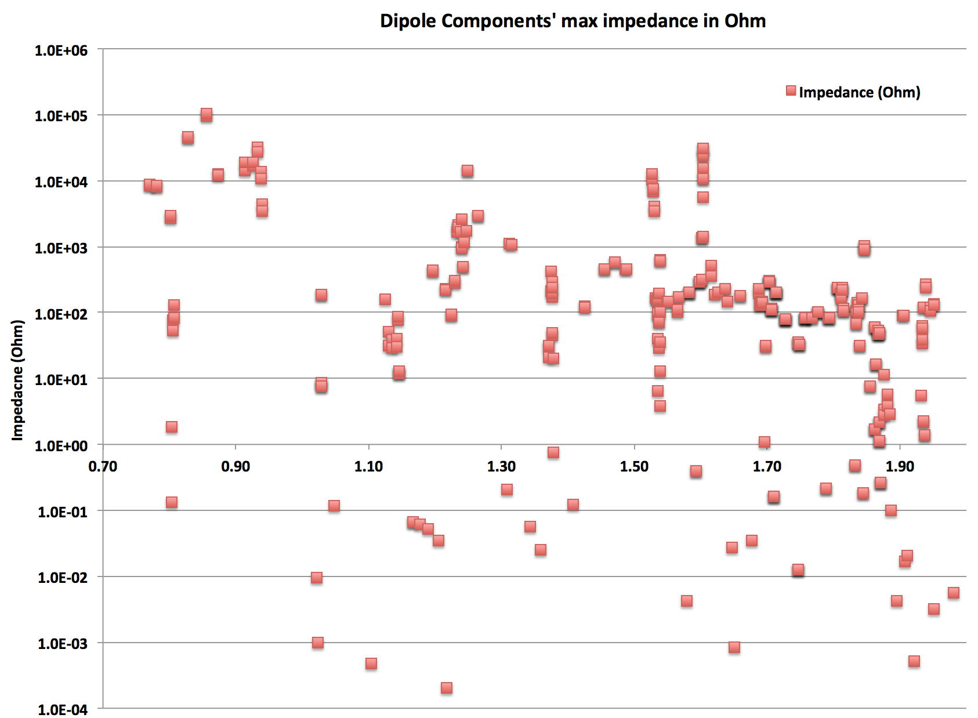
Uniform Ridge Waveguide HOM damping results

Slide 11
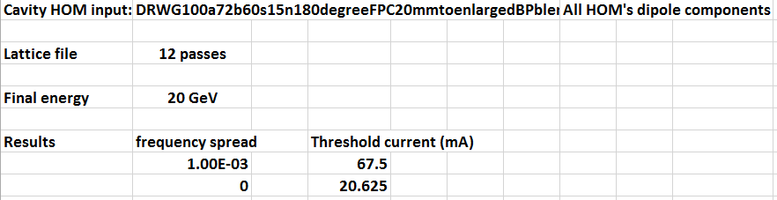
BBU Simulation results
HOM’s frequency spread (Δf/f) is important factor for BBU, the worst case is Δf/f=0. Even with this case, the threshold current is 18 mA, which is more than a factor of 3 of the requirement of 6 mA in eRHIC design.
Usually, for a cavity fabrication, the frequency deviation is a few MHz or Δf/f > 1E-3.
With Δf/f=1E-3, the threshold current is 67.5 mA > a factor of 10 of the requirement.

Slide 12
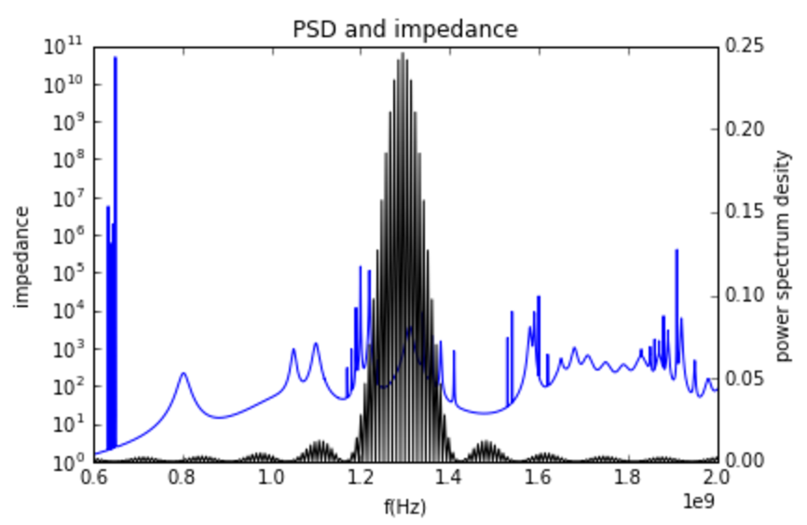
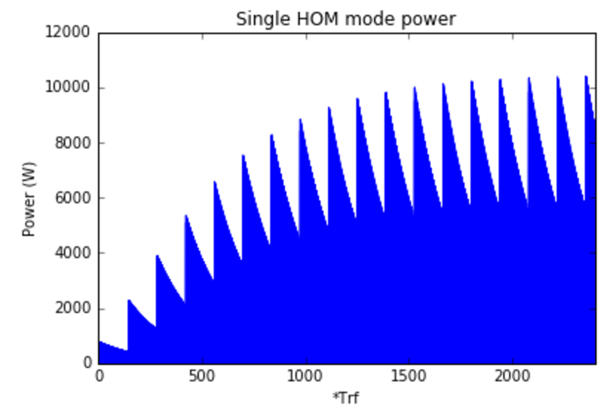
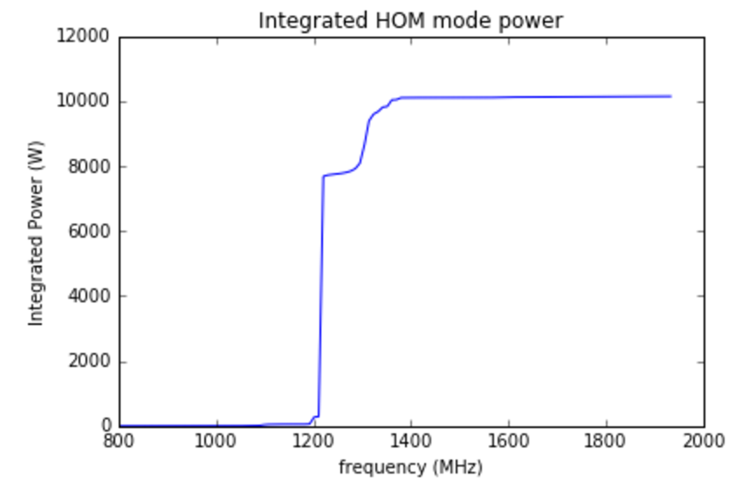
Spectral density for 5 Passes 50 mA ERL
HOM power of HOM @1.219 GHz
If some modes line up with the beam spectrum, the HOM power can be above 10 kW (depending how close is the HOM frequency and beam current spectrum).

Slide 13
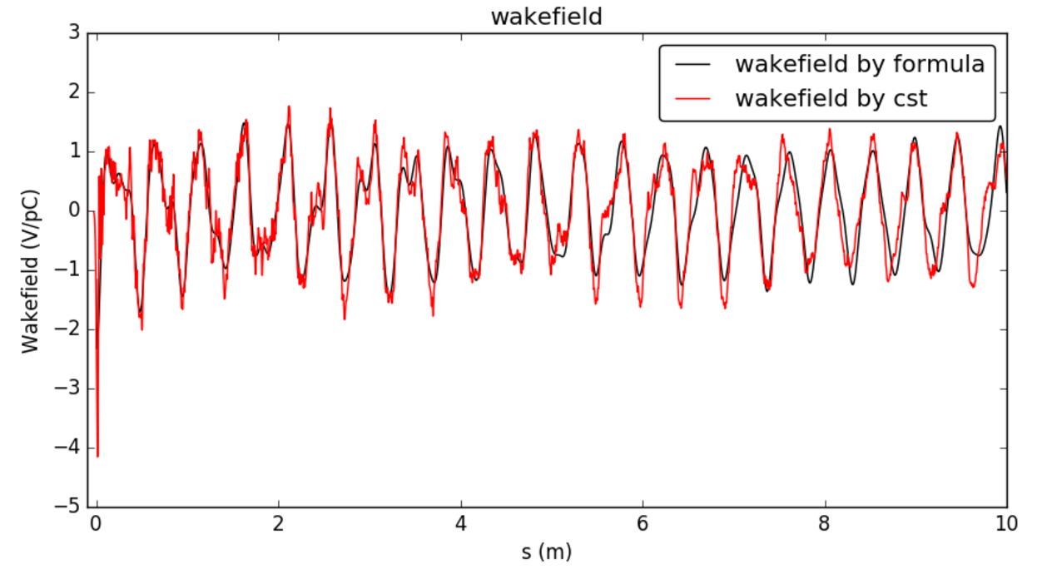
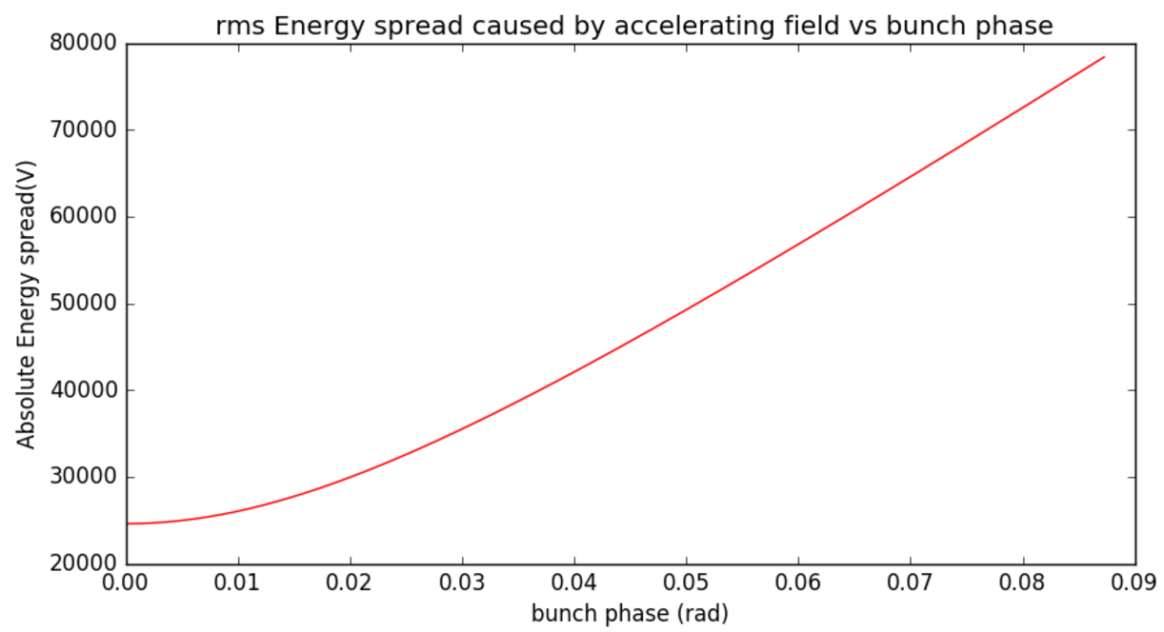
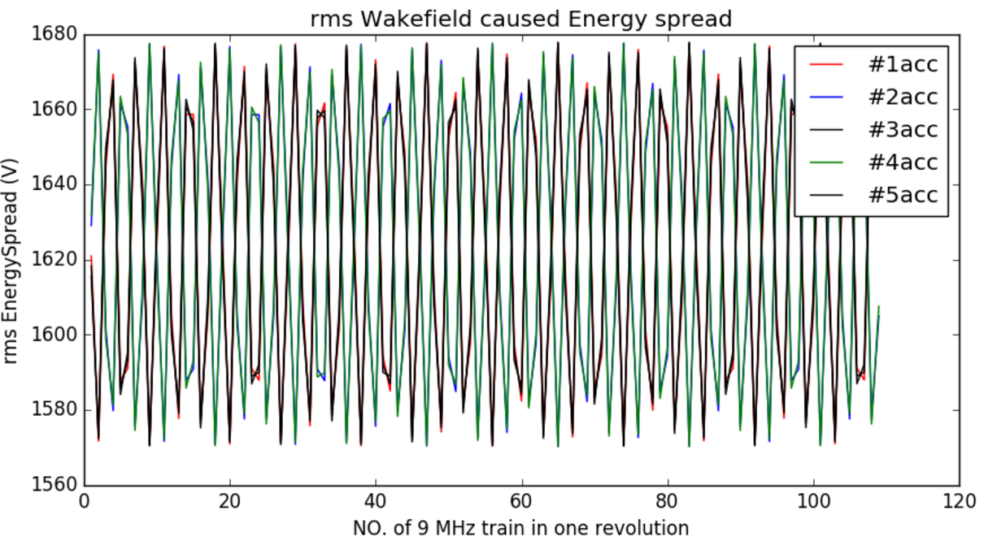
Energy spread caused by wakefield
All the calculation use rms 3mm gaussion bunch
Single bunch Wakefield: build the wakefield by formula (only up to 2 GHz) and compare with cst results.
rms Energy spread caused by wakefield (eRHIC bunch structure) is about 1700 V, < 25 kV of energy spread caused at zero RF phase (0.1% of energy gain in a cavity)

Slide 14
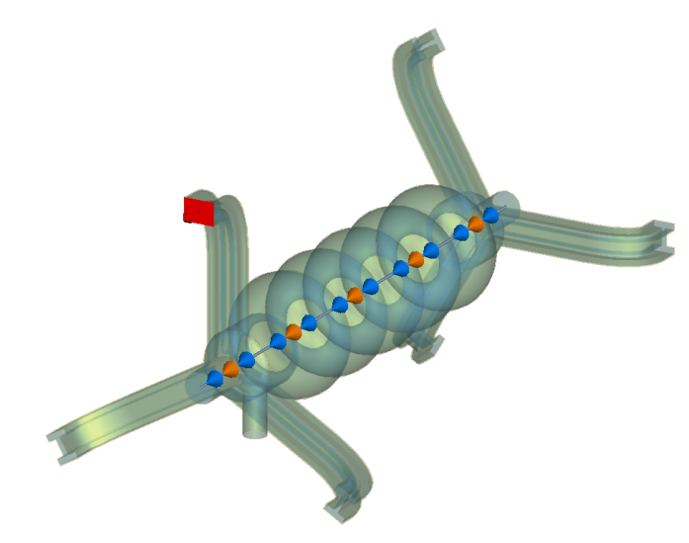
HOM power distribution (Y. Gao)
This is to simulate the HOM power at each mode of every port.

Slide 15
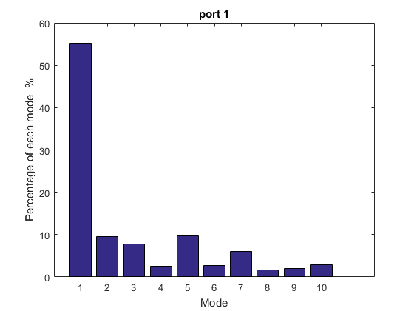
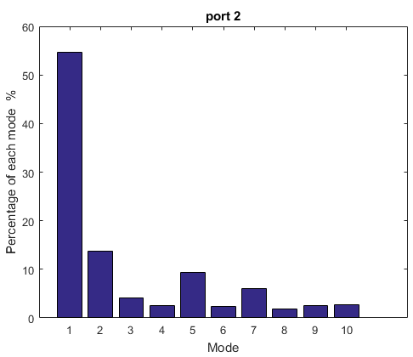
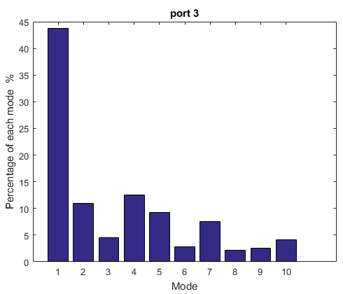
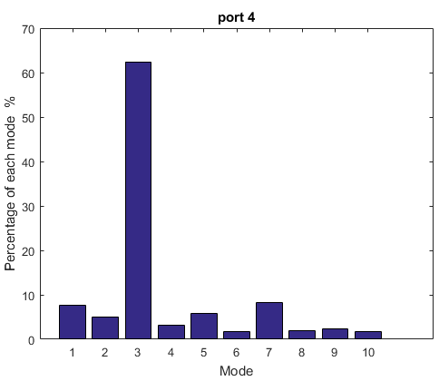
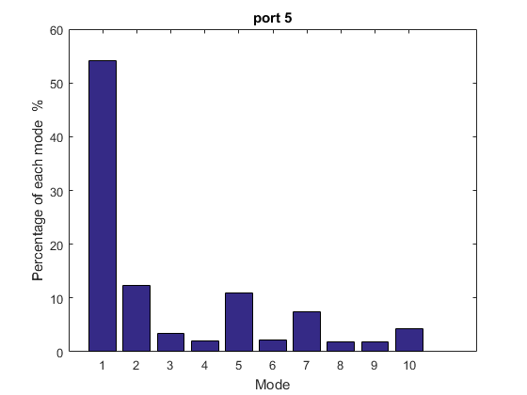
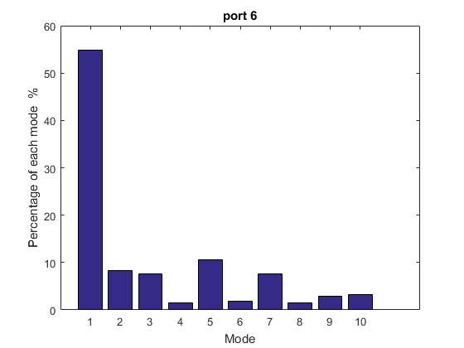
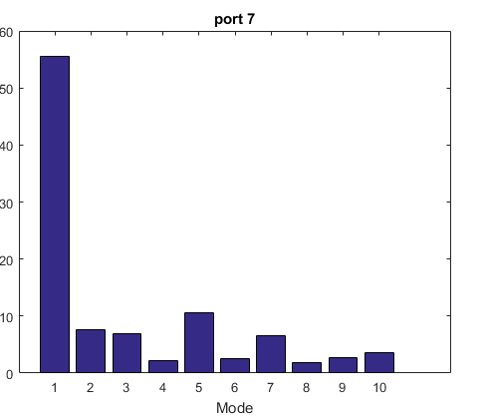
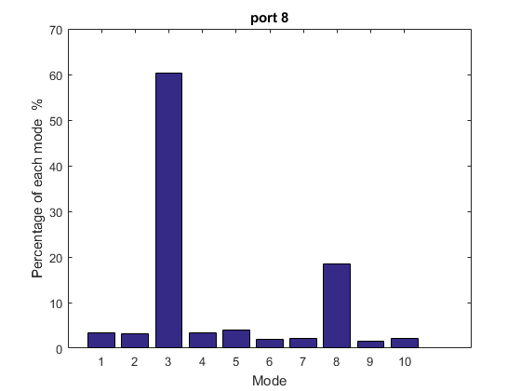
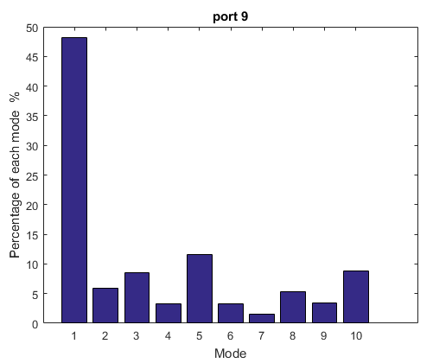
Percentage of modes for each port (Y. Gao)
BP Monopole
BP Monopole

Slide 16
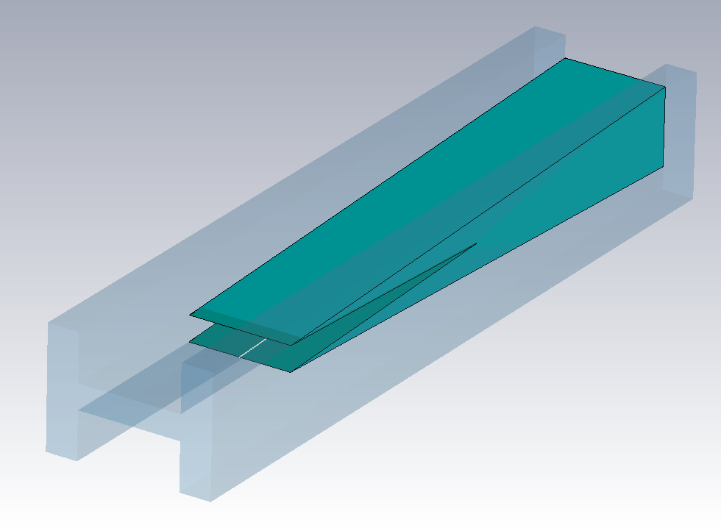
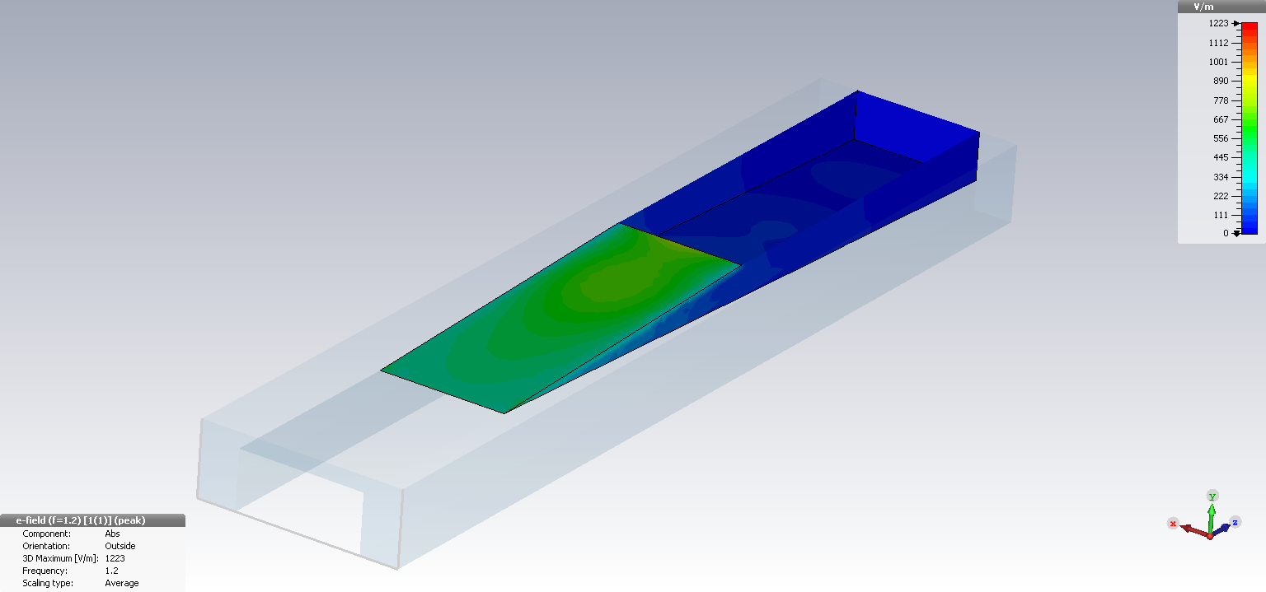
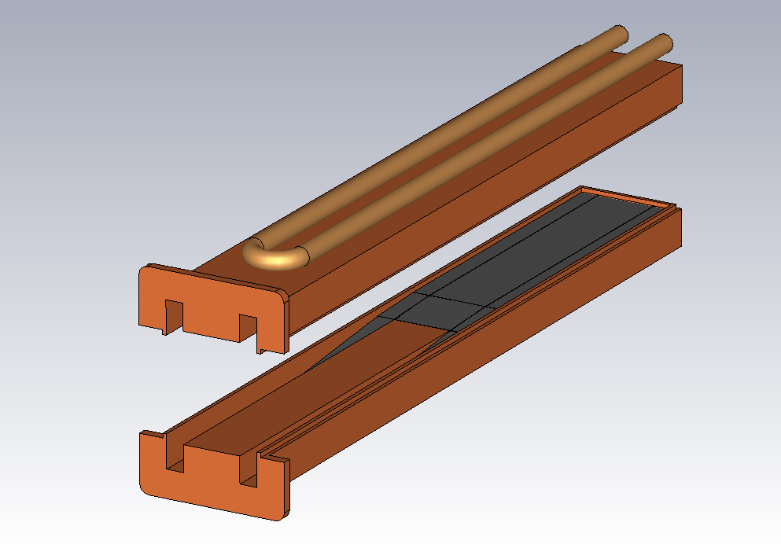
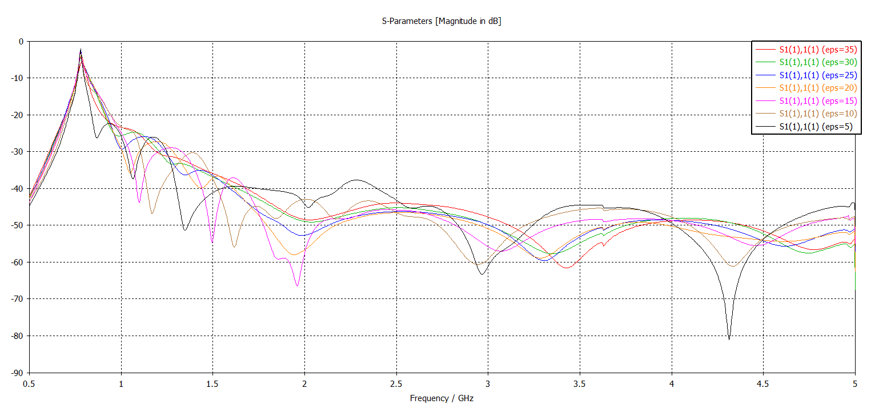
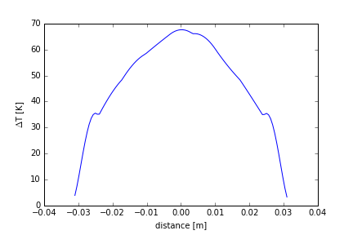
HOM absorber design (P. Kolb)
RF design
Delta T for 1 kW

Slide 17
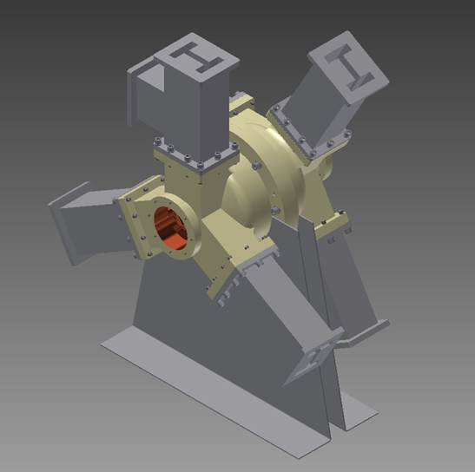
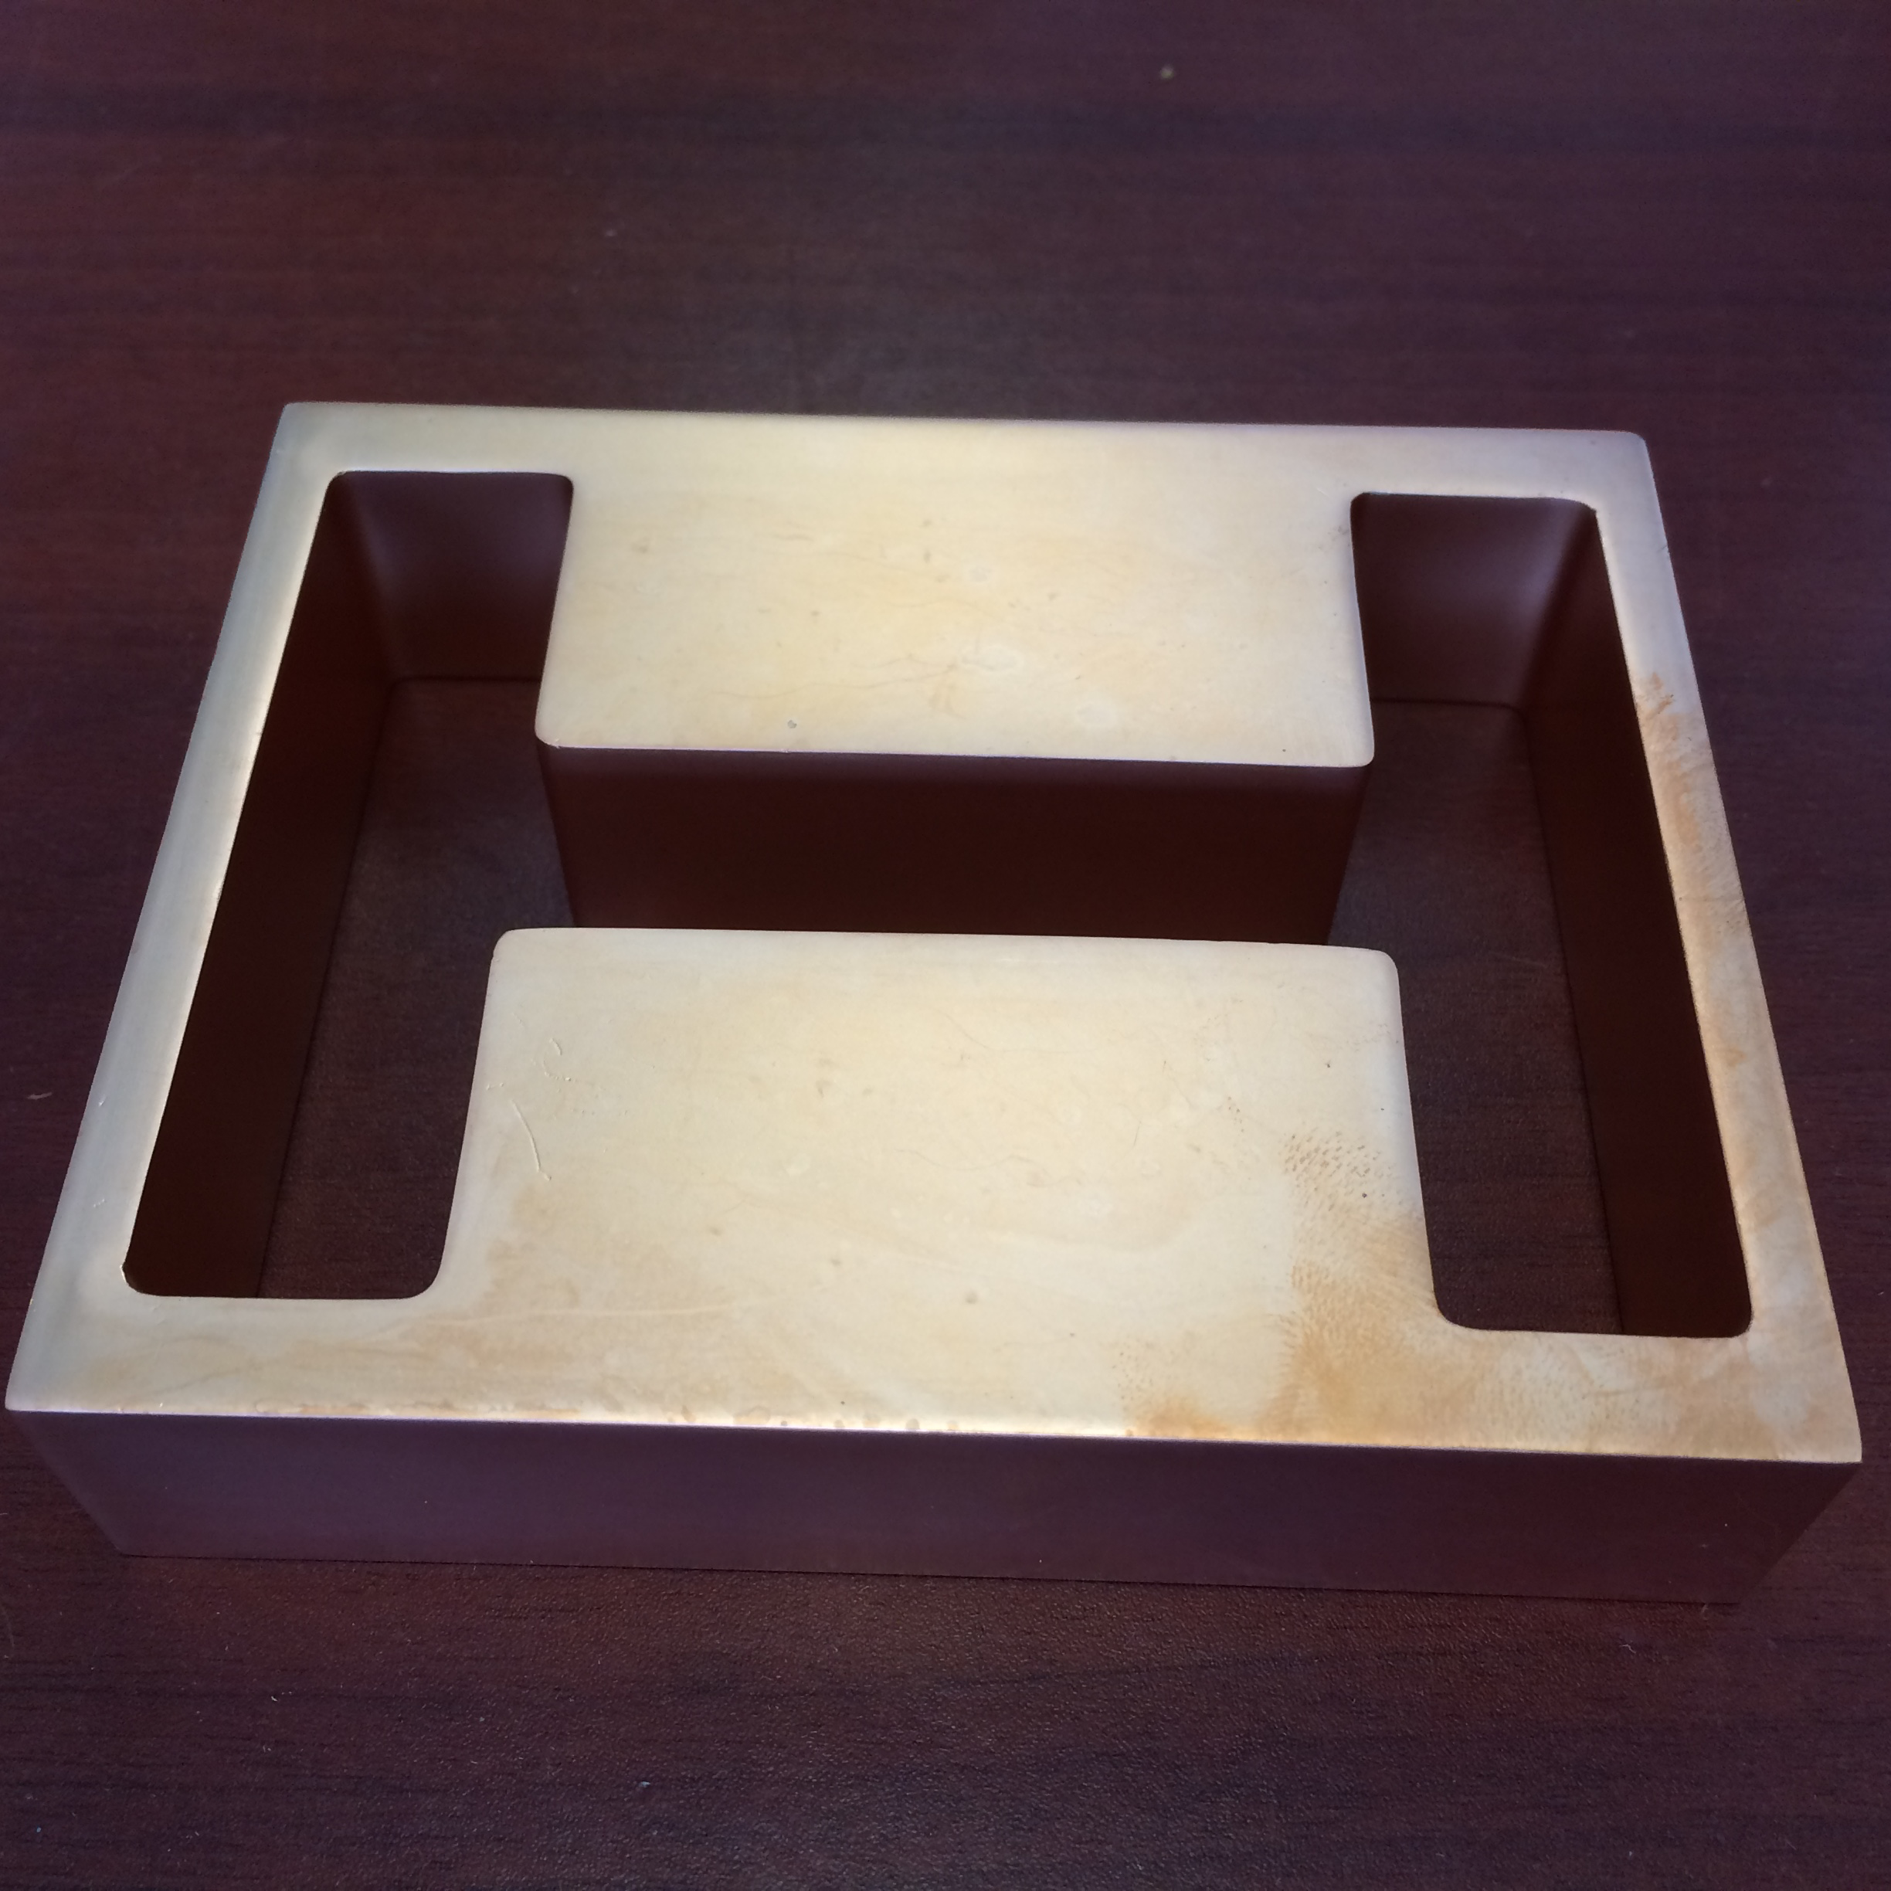
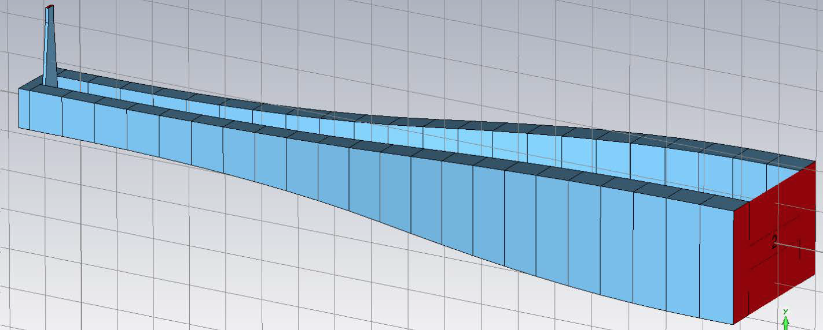
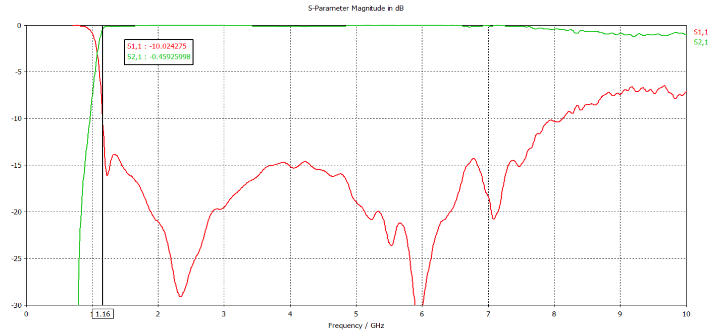
Prototyping
3-D print waveguide
Cavity inserted
Broadband adapter design

Slide 18
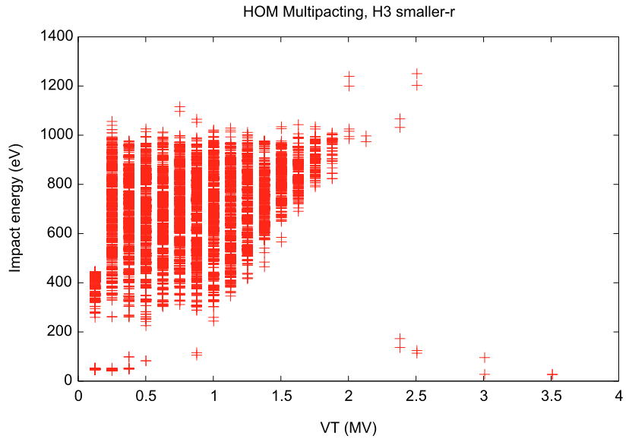
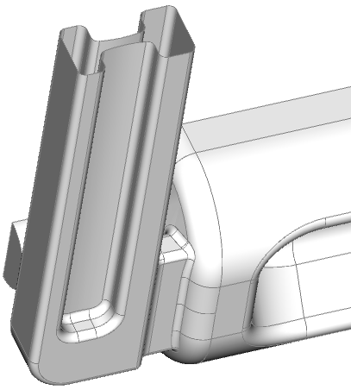
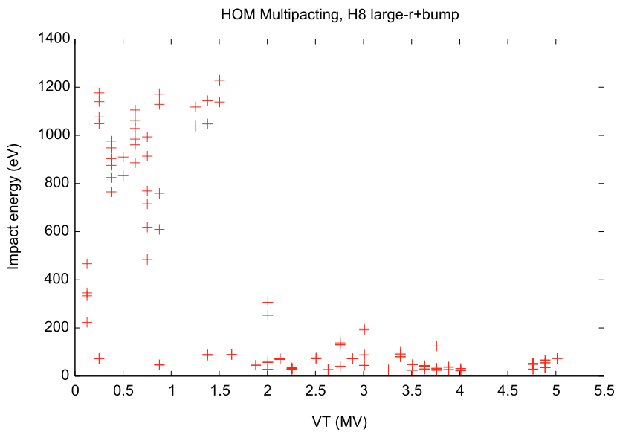
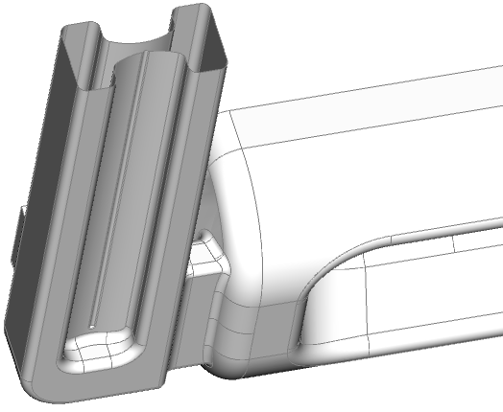
Variety of the HOM dampers: Round Ridge WG
Multipacting in the ridge waveguide by Zenghai Li, Suba De Silva and Jean Delayen. Sources of the information: Zenghai Li LARP CM20 April 8-10, 2013
A bump one side of the ridge has to be add to suppress MP.

Slide 19
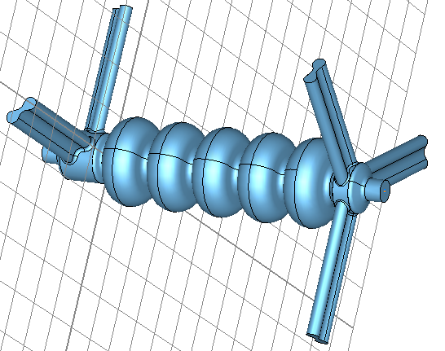
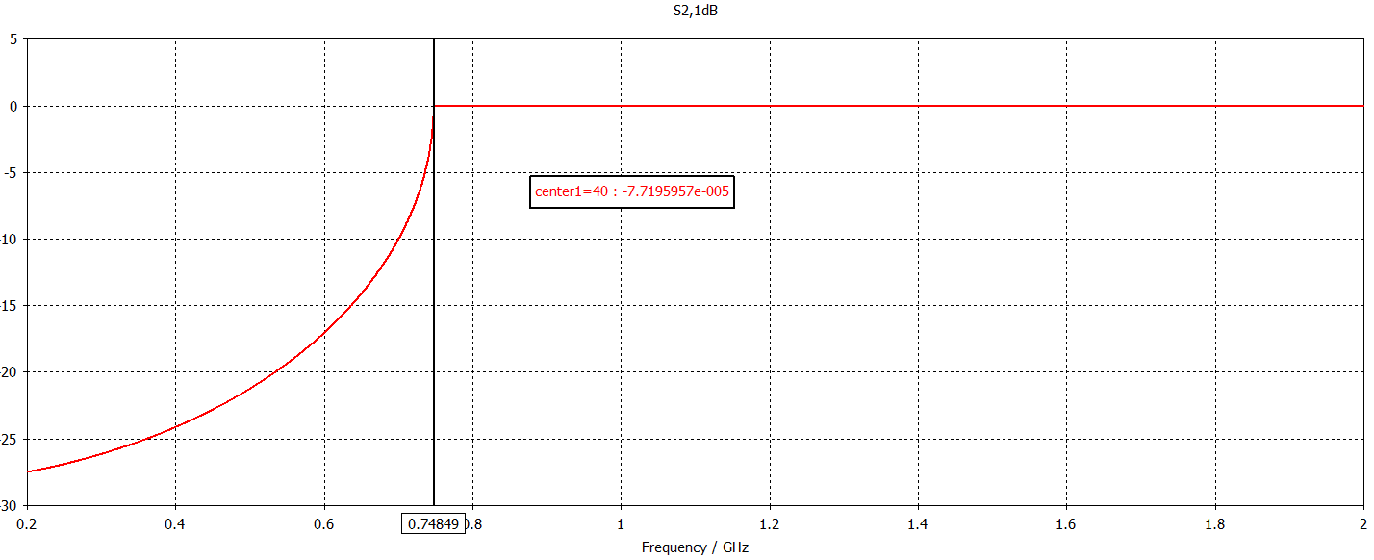
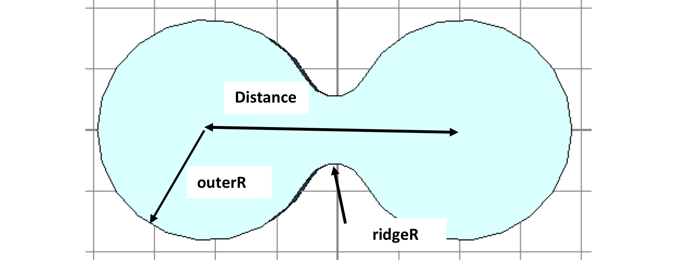
Rounded HOM damper: Parameters
Multipacting free (Will be verified by simulation after it is finalized)
Work on progress.

Slide 20
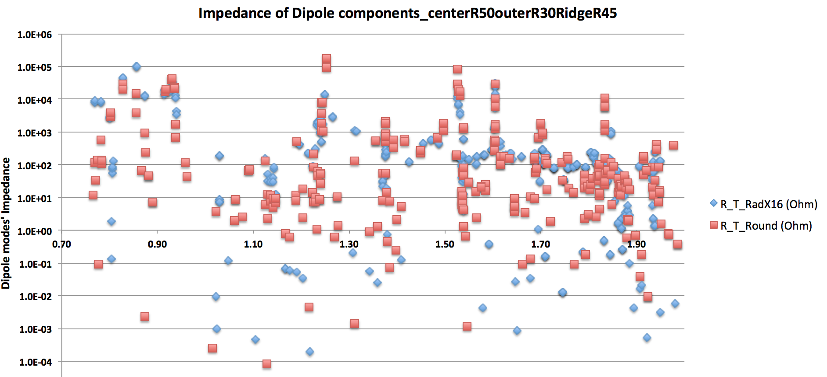
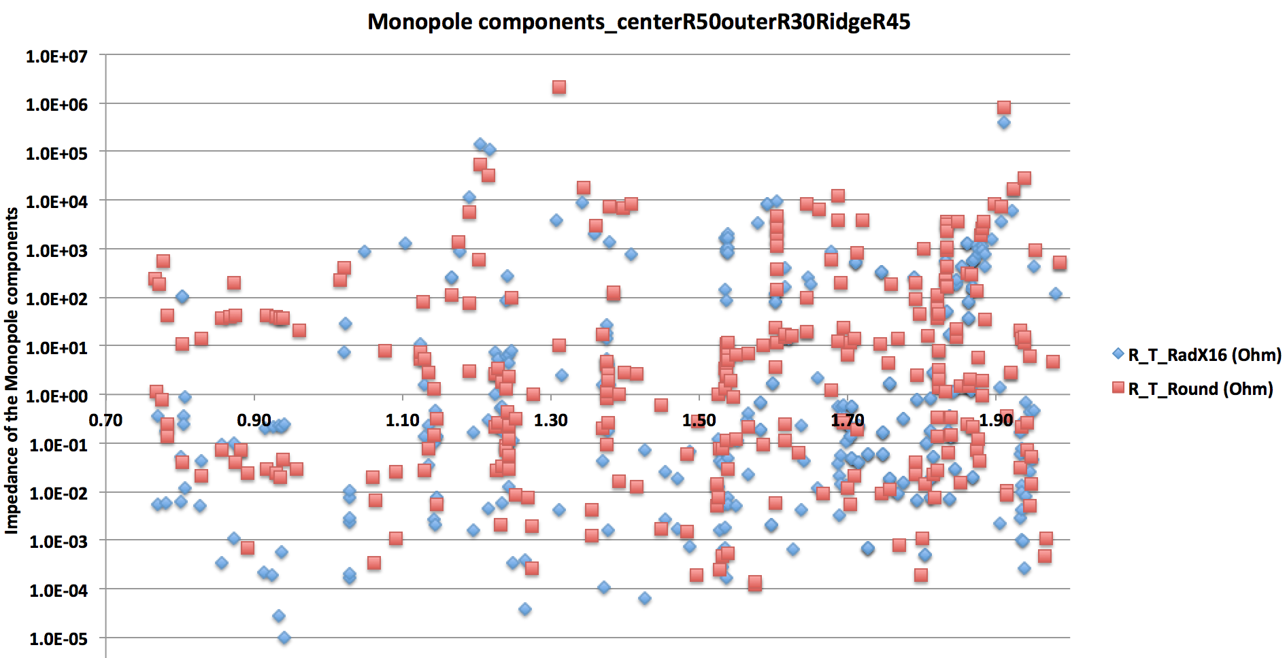
Preliminary result: Impedance
Dipole mode limit

Slide 21
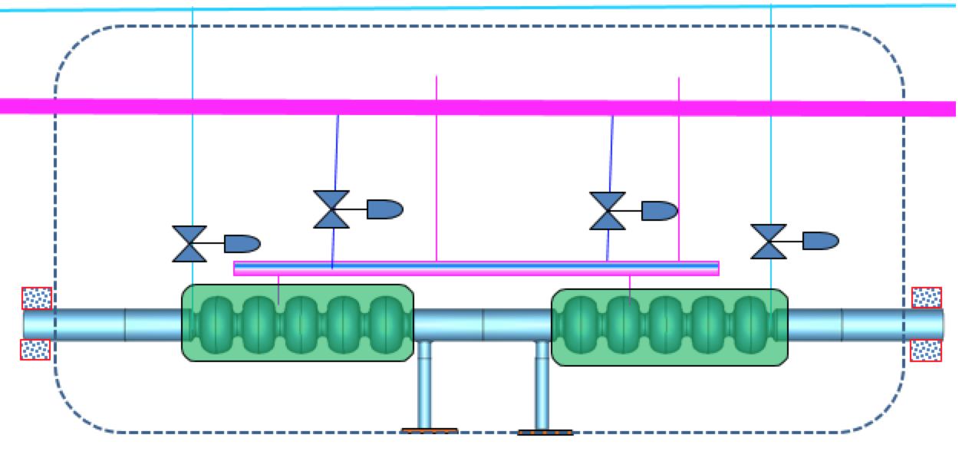

Low Risk Linac design
As there are some new modes between two cavities, a ridge WG damper in between the cavities will needed as well.
Room temperature SiC

Slide 22


HOM impedance for low-risk linac
Dipole mode limit
BBU simulation will be done as soon as the lattice design is completed.

Slide 23



HOM power up to 2.5 GHz of low-risk linac
This is HOM power is calculated with beam (5-pass ERL ) and HOM spectrum, and it is frequency is only up to 2.5 GHz.
This HOM power is much lower than the rectangular ridge waveguide mainly because of the frequency of HOM shifted.

Slide 24
Summary
eRHIC ERL SRF linac, based on 650 MHz 5-cell cavities, requires extremely good HOM damping for to reach high current, high luminosity.
650 MHz SRF cavity was designed for damping all the HOMs. A Nb and Cu cavity are under fabricating by RI. The Cu cavity will be fabricated for HOM study. The Nb cavity will be carried out performance study, and then modified by adding HOM dampers.
R&D on HOM damping scheme includes ridge waveguide for low frequency and beam piper absorber for high frequency HOM. Rectangular ridge waveguide is designed and prototyping.
While working on R&D on the compact linac scheme (with ridge waveguide and beampipe absorber), a “Low risk” linac scheme with lower HOM power and lower dipole impedance is under evaluating.

Slide 25
Acknowledgement (incomplete list)
BNL team: Philipp Kolb, Ilan BenZvi, Harald Hahn, Kevin Yongfeng Gao, Vadim Ptitsyn, Kevin Smith, Kevin Mernick, Chen Xu, Hao Yue, Alex Zaltsman, Rich Porqueddu…
Thank you for helpful and encouraged discussion from
  Jlab: Bob Rimmer, Haipeng Wang, Frank Marhauser…;
  LBNL: Derun Li, Yawei Yang, Tianhuan Lou…;
  ANL: Peter Ostroumov, Michael Kelly, Sanghoon Kim..
  Mega: Lisa Cummings, Peter Matthews..

