Slide 1
Silicon is to Physics what Carbon is to Life
Robert Klanner
Gerhard Lutz
Erik H.M. Heijne
CERN EP Department Geneva
Inst. of Experimental and Applied Physics
of the Czech Technical University in Prague
National Institute Nikhef Amsterdam

Slide 2
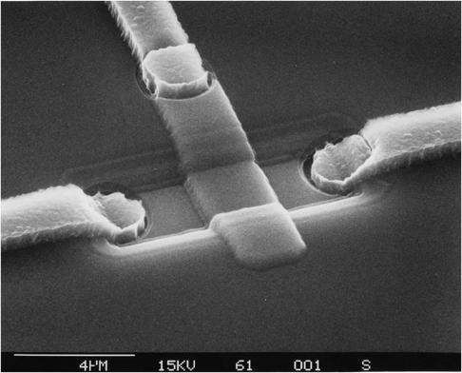
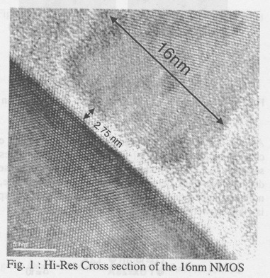
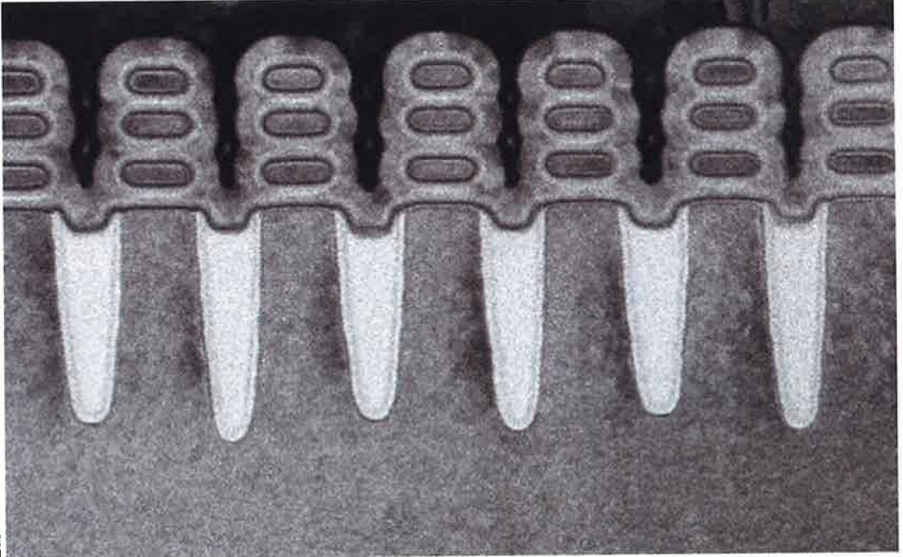
Integrated electronics is key: silicon MOS transistor
continuous scaling/miniaturization
2015
same scale
gate length .014 µm
SiO₂ gate thickness 2.75 nm
thin gate usually radhard
gate
2017 development at IBM
gate-all-around
source IBM
not same scale
2 µm TECHNOLOGY 0.005 µm
gate length .016 µm
SiO₂ gate thickness 2.75 nm
1985
2017
SiO₂ gate 2.75 nm
HEP was 2 generations behind industry
now HEP is 8 generations behind

Slide 3
Integrated electronics is key: silicon MOS transistor
continuous scaling/miniaturization
2015
same scale
gate length .016 µm
SiO₂ gate thickness 2.75 nm
thin gate usually radhard
2017 development at IBM
gate-all-around
source IBM
not same scale
2 µm TECHNOLOGY 0.005 µm
1985
2017
HEP was 2 generations behind industry
now HEP is 8 generations behind

Slide 4
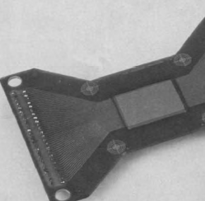
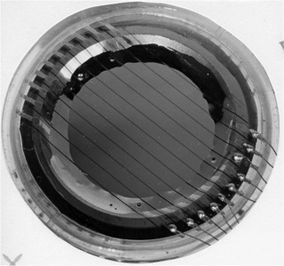
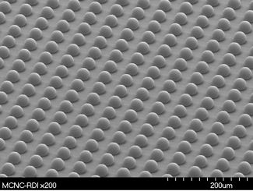
Segmented silicon detectors
Thanks to Educators, Collaborators and Supporters
1980 CERN / ENERTEC Strasbourg
100 x 4000µm x 200µm
Jarron, Burger, CSEM, Kemmer
~1965
PHILIPS-Amsterdam
100 x 1370µm x 1370µm
Ammerlaan, van Dantzig, Visschers
1989-2000
Pixel detectors developed at CERN
smallest pixel side ~50µm
Campbell, Snoeys, LAA, IMEC, ETHZ, EPFL, RD19, Omega, Medipix

Slide 5
Physics experiments should begin to use recent industrial Si technology (<20nm) and achieve:
- lower power for same functions
- ps timing
- more on-chip memory
- multilayer information processing
- economy of scale
- ....
- higher rates, better data
- new physics?

Slide 6
Future experiments will rely on newest electronics need timely R&D efforts, expertise and resources worldwide collaboration & tens of millions to do it right
Thank You

