Slide 1



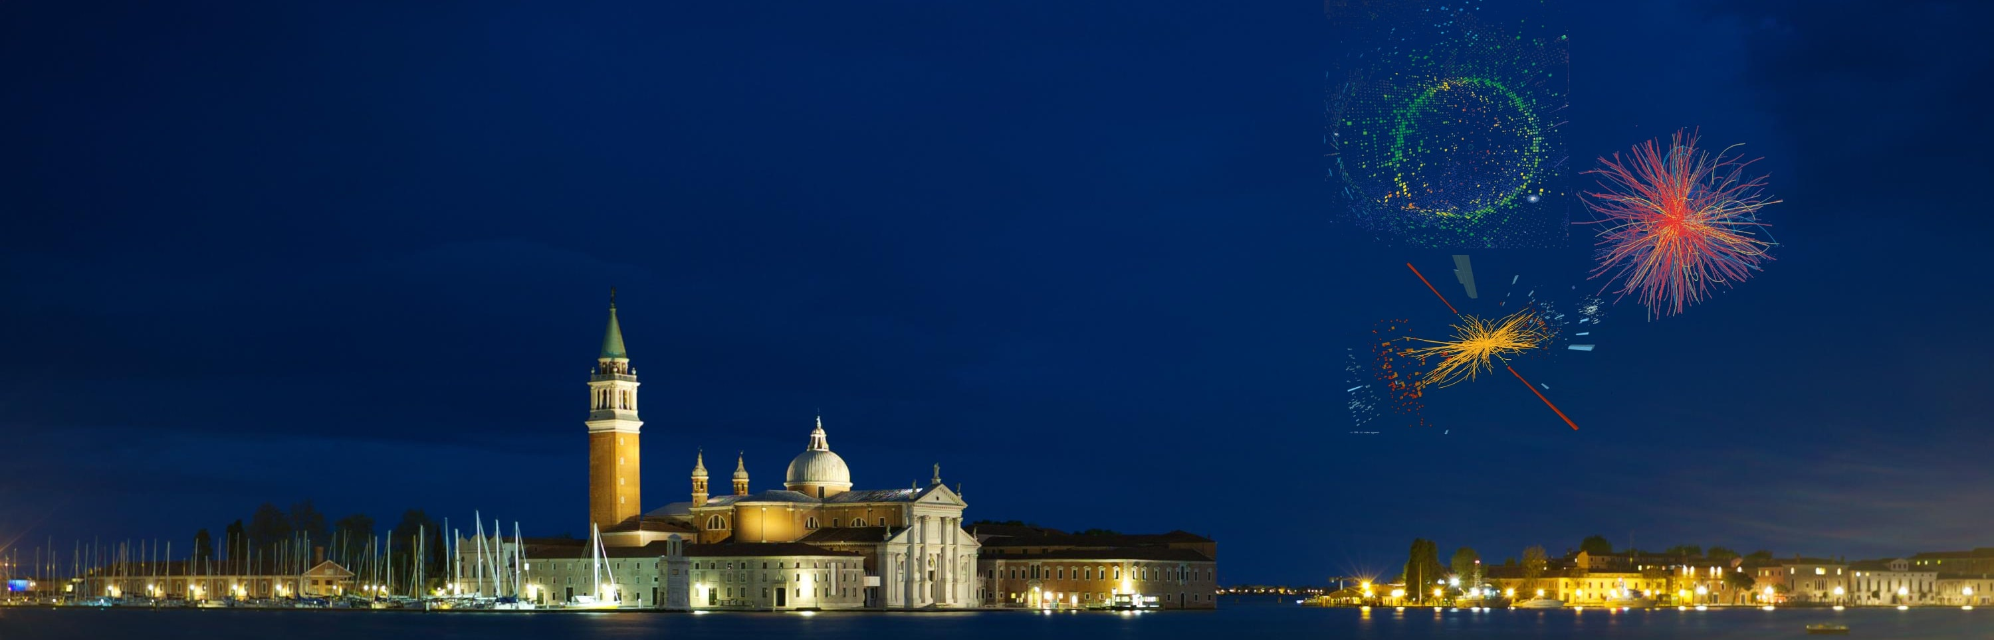
CP violation and CKM physics
Christoph Schwanda
Institute of High Energy Physics
Austrian Academy of Sciences
EPS-HEP 2017 Conference
Venice, Italy, July 5-12, 2017

Slide 2
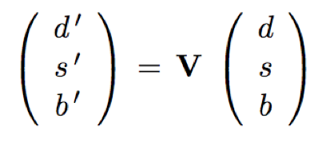
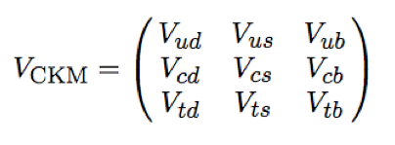

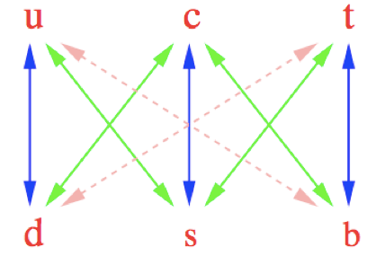

Cabibbo-Kobayashi-Maskawa quark mixing
The unitary Cabibbo-Kobayashi-Maskawa (CKM) matrix transforms the flavour eigenstates into the physical quark states
The CKM element magnitudes determine the possible quark flavour transitions in charged current processes

Slide 3
CP violation
Wolfenstein parametrization of V_{CKM}
However, V_{CKM} also contains a complex phase, responsible for all CP-violating phenomena in the SM
CPV established ( >5σ ) in 17 observables ( in K and B physics ) → extremely constrained system
New physics would typically disturb the SM pattern of CPV

Slide 4
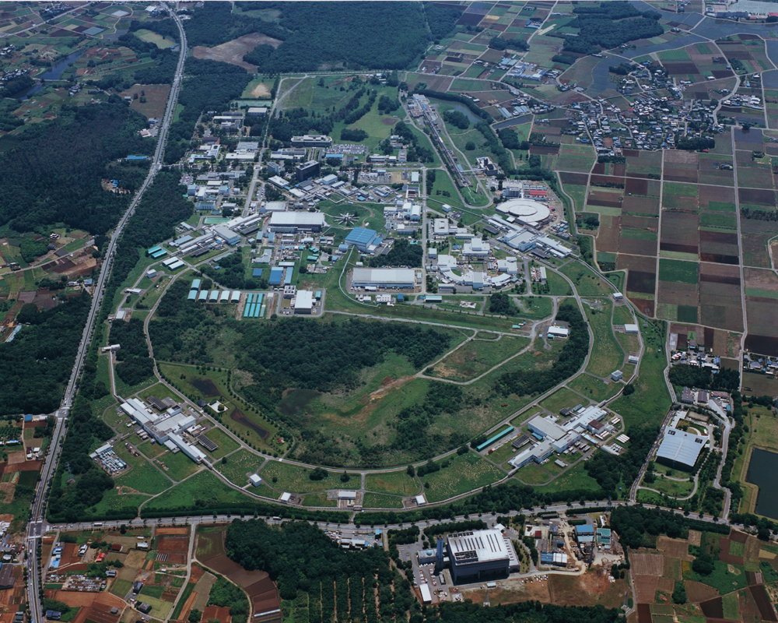
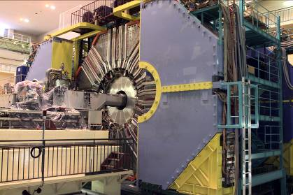
1999 – 2010: B factory at KEK (Japan)
Linac
KEKB double
ring e⁺e⁻ collider
e⁺e⁻ → Y(4S) → BB
Belle detector

Slide 5
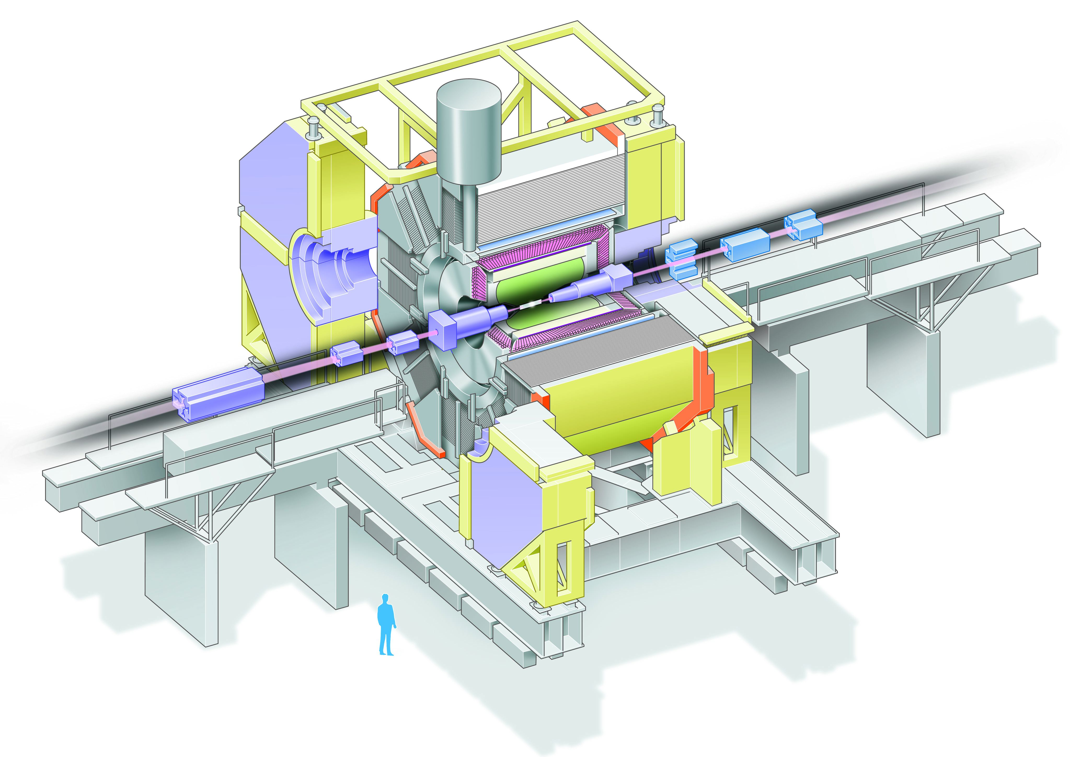
The Belle detector
Aerogel Cherenkov cnt.
n=1.015~1.030
SC solenoid
1.5T
3.5 GeV e⁺
CsI(Tl)
16X₀
TOF counter
8 GeV e⁻
Central Drift Chamber
small cell +He/C₂H₅
Si vtx. det.
3(4) lyr. DSSD
μ / K_{L} detection
14/15 lyr. RPC+Fe

Slide 6
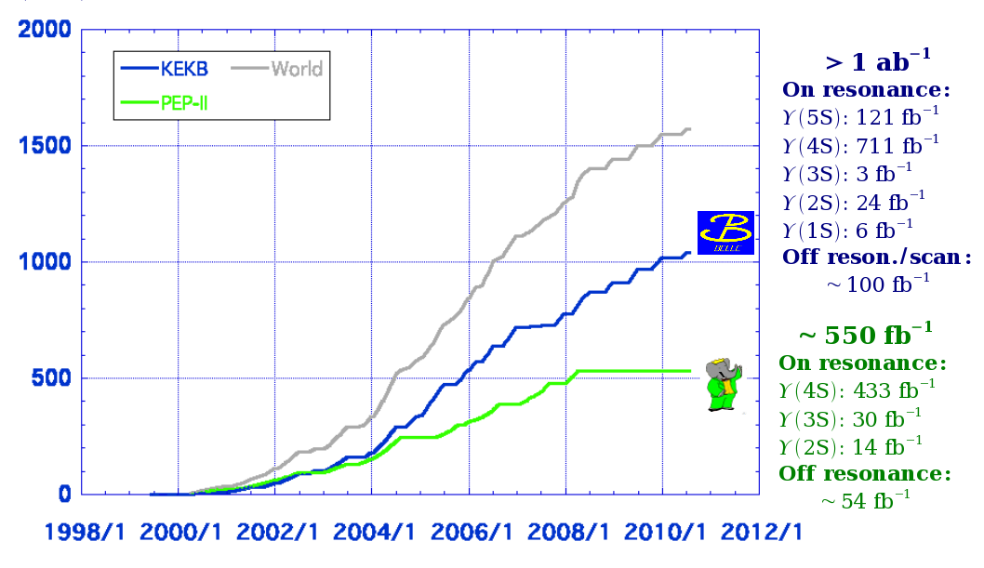
Belle and BaBar luminosity
About 771 million
e⁺e⁻ → BB events in the Belle data

Slide 7
The LHCb experiment
General purpose LHC experiment covering the forward region
Precise tracking, excellent particle identification

Slide 8
LHCb data taking

Slide 9
CKM unitarity triangle

Slide 10


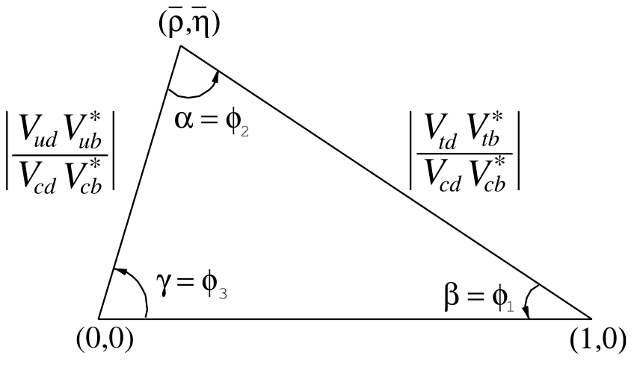
The CKM unitarity triangle
CPV in B → ππ, ρρ, ρπ
B → Xlν
CPV in B → J/ψK_{s}
B^{-/+} → D^{(*)}K^{(*)-/+}

Slide 11
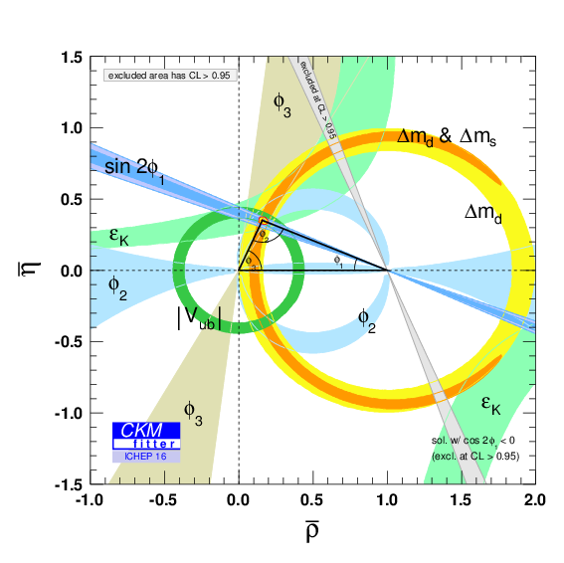
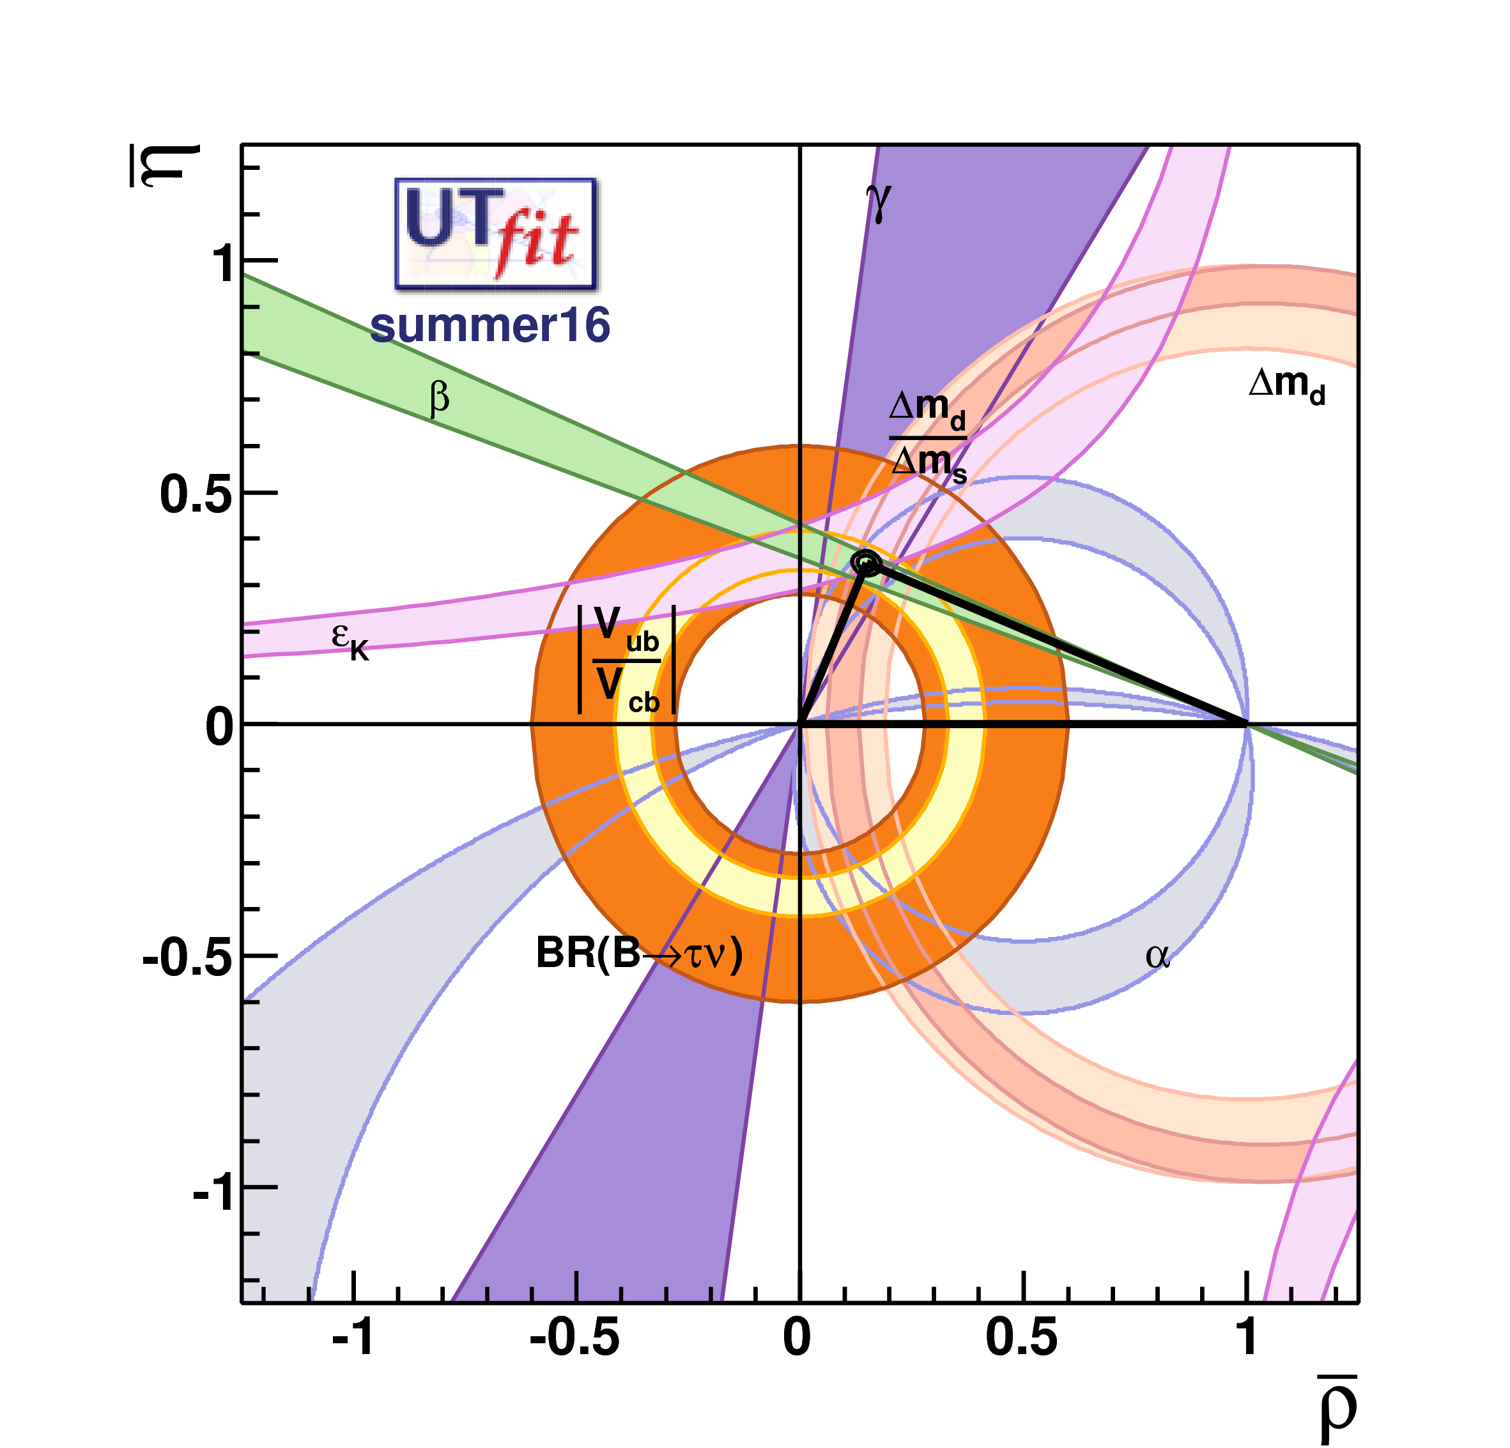
Current status (summer 2016)
http://ckmfitter.in2p3.fr/
http://www.utfit.org/
Largest pull: V_{ub} inclusive (UTfit)

Slide 12
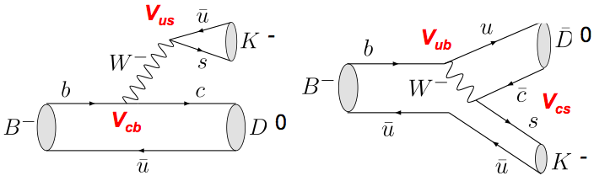
Measurement of γ/φ₃
If D⁰ and D⁰ decay to the same final state, both diagrams contribute to the observed rate
The subsequent interference allows to determine the relative phase between these diagrams δ ± γ/φ₃, γ/φ₃ = Arg(V_{ud}V*_{ub}/V_{cd}V*_{cb})
3 approaches
  Gronau-London-Wyler (GLW): uses D⁰ decays to a CP eigenstate
  Atwood-Dunietz-Soni (ADS): uses Cabibbo-favored and doubly-Cabibbo-suppressed D⁰ modes
  Dalitz plot analysis: uses three-body decays, e.g., D⁰ → K_{S} π⁺ π⁻

Slide 13
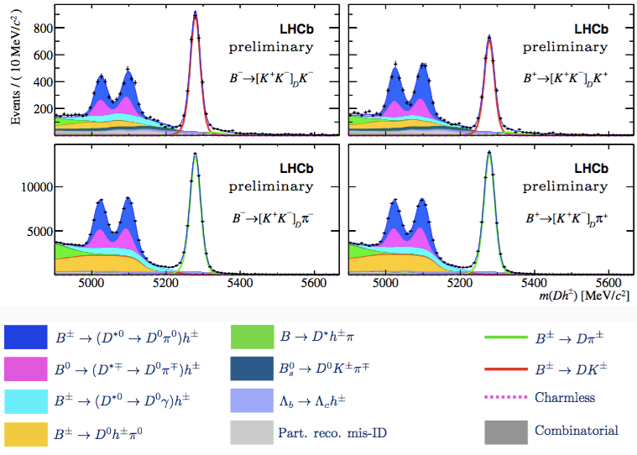
Partially reconstructed B^{+/-} → D^{*0}h^{+/-} [LHCb-PAPER-2017-21]
(in preparation)
π⁰/γ from D^{*0} decay not reconstructed
m(D⁰h) allows to distinguish these contributions
D⁰ → Kπ
And similar for D⁰ → KK, ππ

Slide 14
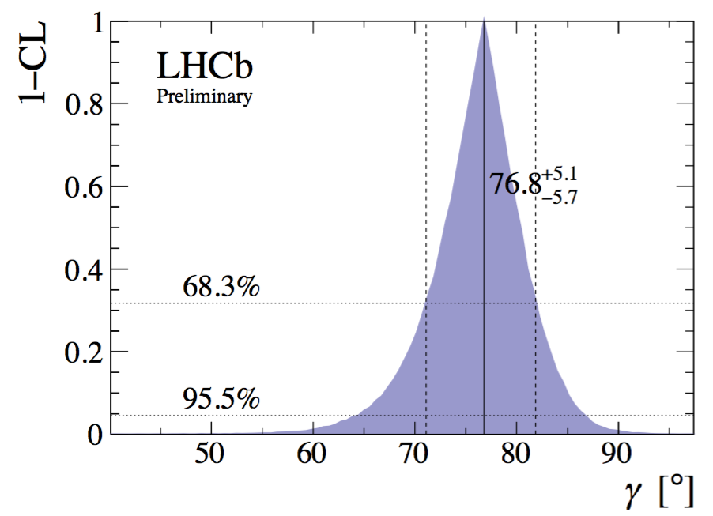
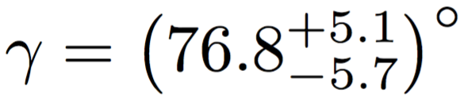
New LHCb γ/φ₃ combination [LHCb-CONF-2017-004]
(in preparation)
Includes the following updates:
  B^{+/-} → D⁰K*^{+/-} ADS/GLW [LHCb-CONF-2016-014] NEW
  B^{+/-} → D*⁰K^{+/-} GLW [LHCb-PAPER-2017-021] NEW
  B_{s}⁰ → D_{s}^{-/+}K^{+/-} TD [LHCb-CONF-2016-015] 1 → 3/fb
  B^{+/-} → D⁰K^{+/-} GLW [LHCb-PAPER-021] 3 → 5/fb
30% improvement with respect to the 2016 combination
More run 2 updates expected

Slide 15
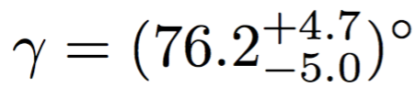
New HFLAV γ/φ₃ combination
[http://www.slac.stanford.edu/xorg/hflav/triangle/summer2017/index.shtml#gamma_comb]
The WA precision is now slightly better than 5 degrees

Slide 16
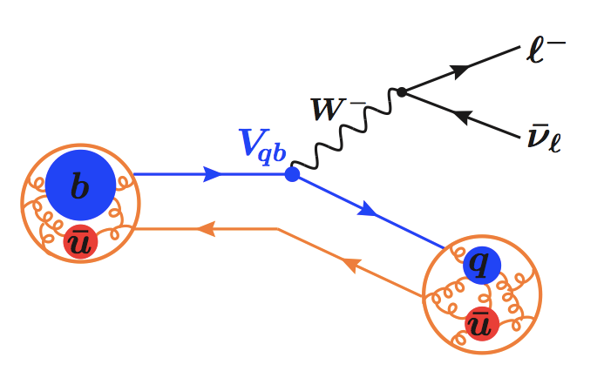

Determination of |V_{ub}| and |V_{cb}|
The CKM magnitudes |V_{ub}| and |V_{cb}| are determined from semileptonic B meson decays
 | Experiment | Theory
Exclusive |V_{cb}|, |V_{ub}| | B → Dlν, D*lν, πlν (low backgrounds) | Lattice QCD, light cone sum rules
Inclusive |V_{cb}|, |V_{ub}| | B → X_{c}lν, X_{u}lν (higher background) | Operator product expansion

Slide 17
Exclusive vs. inclusive
Consistency between exclusive and inclusive is crucial for our understanding
However,
|V_{cb}|and |V_{ub}| inclusive/exclusive are currently at odds by about 2-3σ
WA: |V_{cb}| (D*lν) = (39.05 +/- 0.47 +/- 0.58 ) x 10⁻³
|V_{cb}| (incl) = (42.19 +/- 0.78) x 10⁻³
|V_{ub}| (πlν) = (3.67 +/- 0.15 ) x 10⁻³
|V_{ub}| (incl) = (4.52 +/- 0.15 +/- 0.13) x 10⁻³

Slide 18
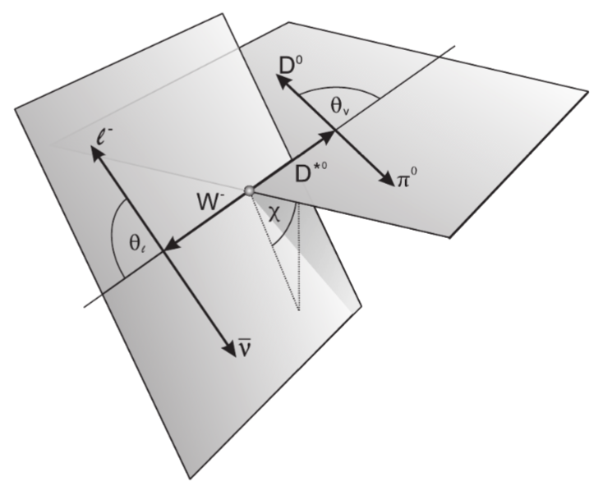
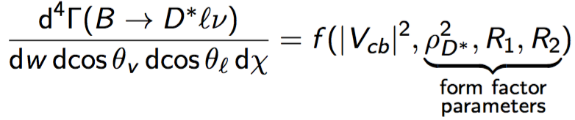

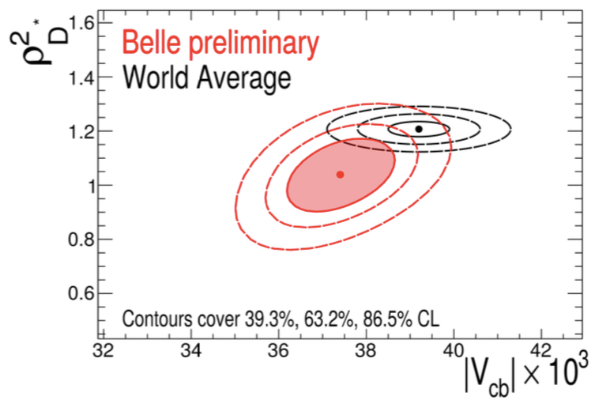
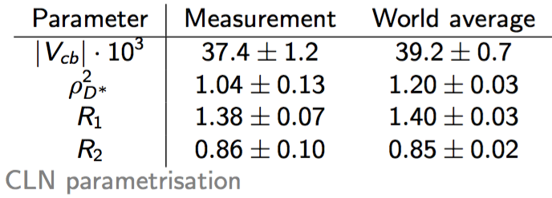
B → D*lν hadronic tag [arXiv:1702.01521]
CLN FF parameterization
[NPB 530, 153 (1998)]
Belle measured |V_{cb}| and the CLN FF
parameters in the decay B → D*lν

Slide 19
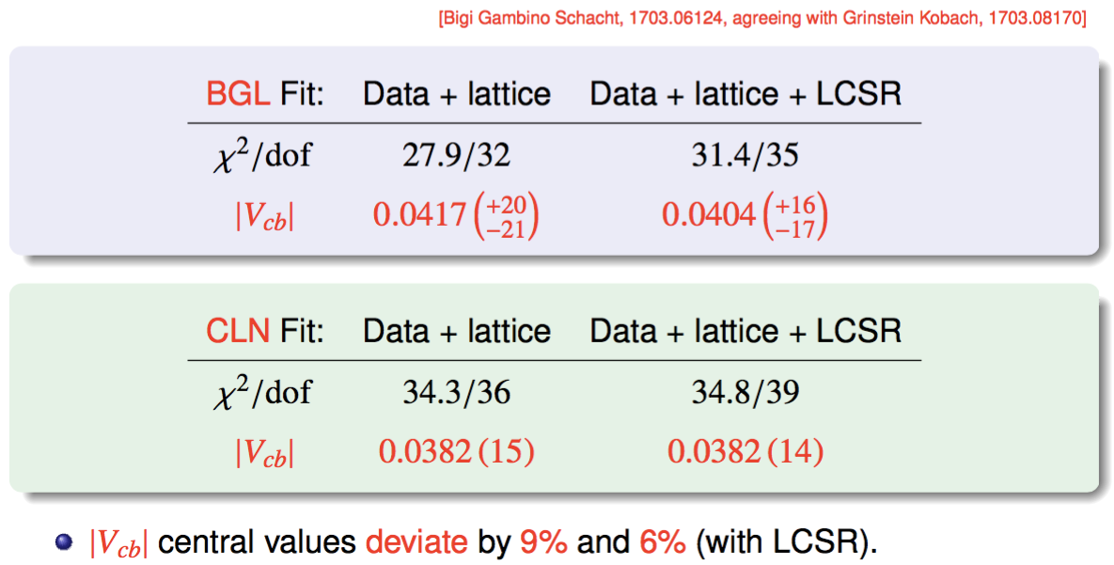
CLN vs. BGL FF parameterization
Reinterpretation of the Belle data
(parallel talk by Stefan Schacht):

Slide 20
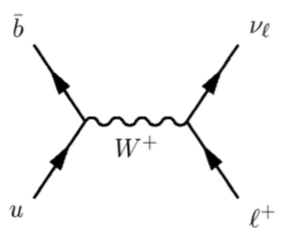
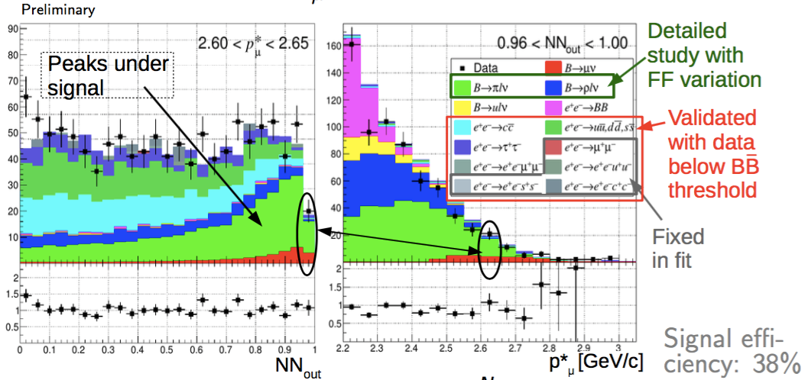

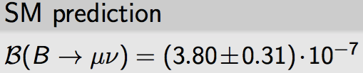
Search for B → μν [PRL in preparation]
|V_{ub}|
Extracted from a 2d fit to a neural network variable
and the muon momentum
2.4σ significance including systematics

Slide 21
The B_{s} system

Slide 22
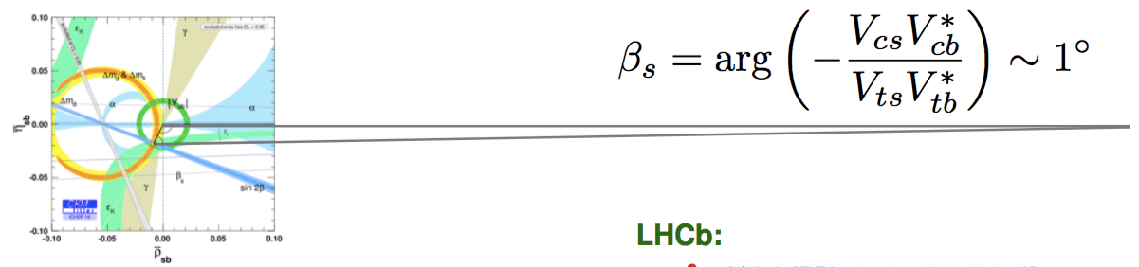

B_{s} unitarity triangle
φ_{s} phase difference between B_{s} mixing and
b → ccs amplitude
SM: φ_{s} = -2β_{s}
WA:
φ_{s} = ( -21 +/- 31 ) mrad
Still statistically dominated

Slide 23
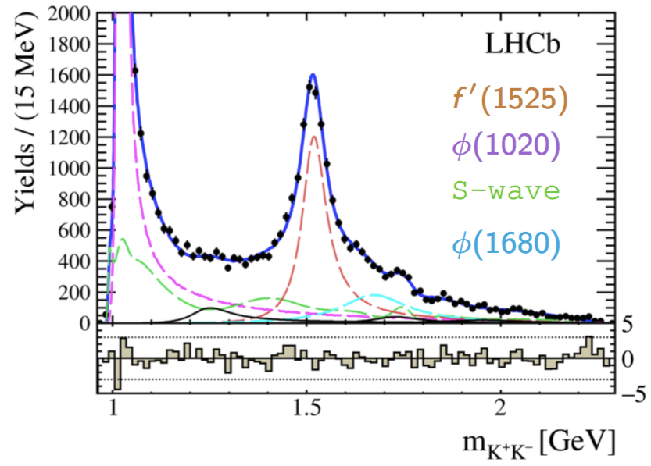
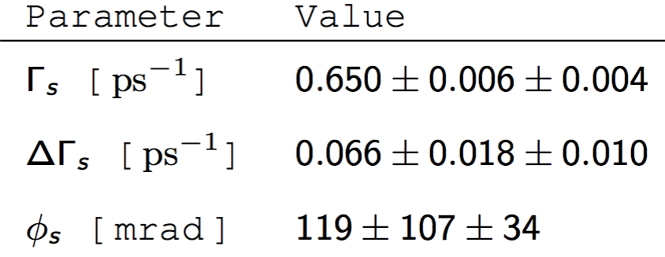
CPV in B_{s} → J/ψ K⁺ K⁻ above φ [LHCb-PAPER-2017-008]
Amplitude analysis of the K⁺K⁻ spectrum

Slide 24
Direct CPV in B/B_{s}/b-Baryon

Slide 25
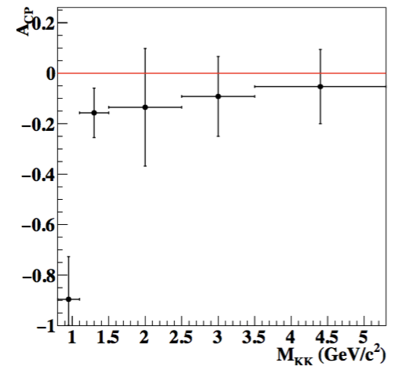
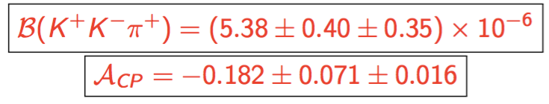
CPV in B⁺ → K⁺ K⁻ π⁺ [arXiv:1705.02640]
Large CP violation from interference between
b → u tree and b → d penguin
CP asymmetry of -0.90 +/- 0.17 +/- 0.4 (4.8σ) for
M_{KK} < 1.1 GeV
Similar excess observed by LHCb and BaBar
Overall branching ratio and A_{CP}

Slide 26
CPV in Λ⁰_{b} → pπ⁻π⁺π⁻ [Nature Physics 13 (2017) 391]
First evidence for CPV with 3.3σ

Slide 27
Summary
Unitarity triangle
  Overall the data still fits the SM well
  φ₃/γ is now known with better than 5° precision
  ~3σ discrepancy between |V_{ub}| inclusive/exclusive is still to be understood
CPV in B_{s}
  φ_{s} is consistent with SM expectation but precision is still far from the SM uncertainty (~1 mrad)
Most CPV measurements are statistically limited, so major improvements are expected from run 2 LHCb data/Belle II operation

Slide 28
More details in the parallel talks
LHCb
  Mika Anton Vesterinen “LHC results on tree-level beauty decays”
  Concezio Bozzi “Recent results from LHCb on semileptonic decays of b-hadrons”
  Donal Hill “Time-dependent measurements of the CKM angle gamma at LHCb”
  Angelo Di Canto “Charm and CP violation measurements from the LHC”
  Sevda Esen “Time-dependent CP violation in the B system at LHCb”
  Rafael Silva Coutinho “CP violation in b baryons at LHCb”
Belle
  Saskia Falke “New results on rare B decays with leptons from Belle”
  Abdul Basith Kaliyar “Recent measurements of branching fractions and CP asymmetries of charmless hadronic B meson decays at Belle”
  Minakshi Nayak “Search for CP violation and rare decays in the charm sector at Belle”

Slide 29
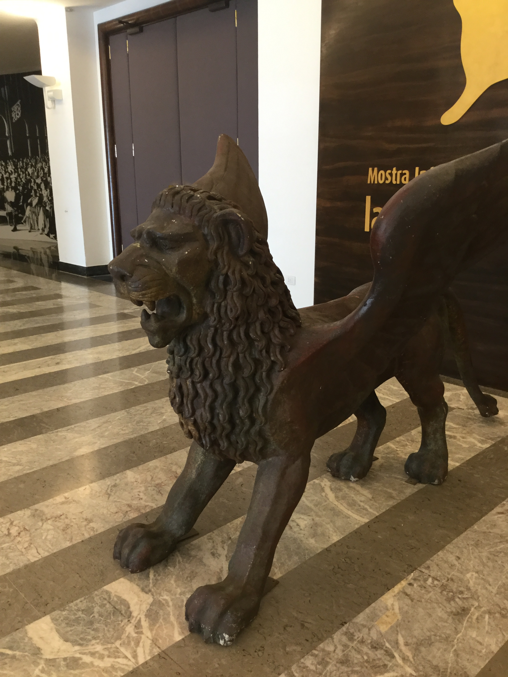
Thank you for a nice time in Venice!

Slide 30
backup

Slide 31
Zoltan Ligeti, CKM 2016

