Slide 1
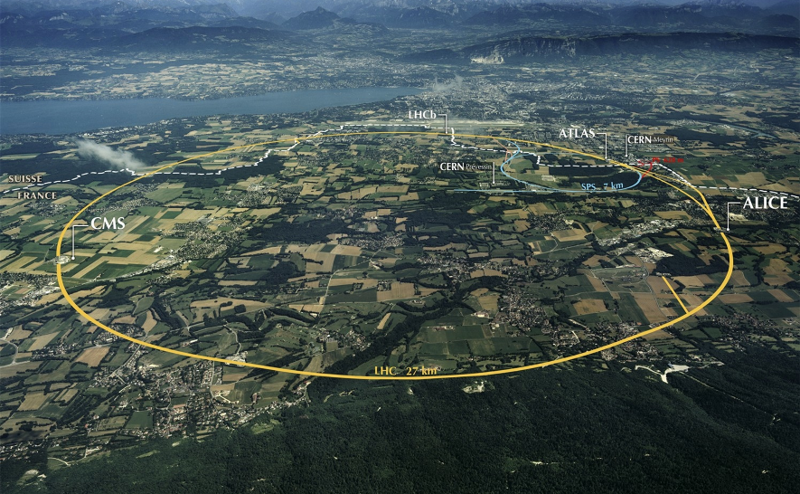

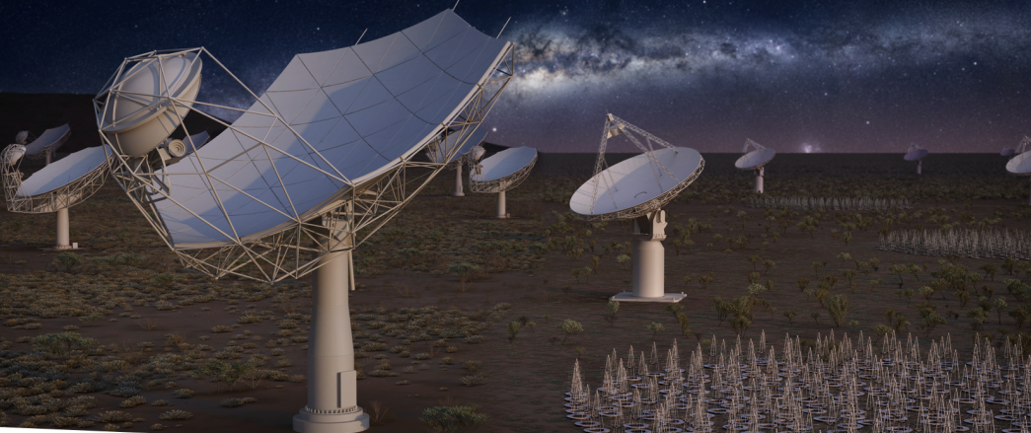
The Challenges of Big (Science) Data
Ian Bird
CERN
EPS-ECFA Meeting
Venice, 8th July 2017

Slide 2
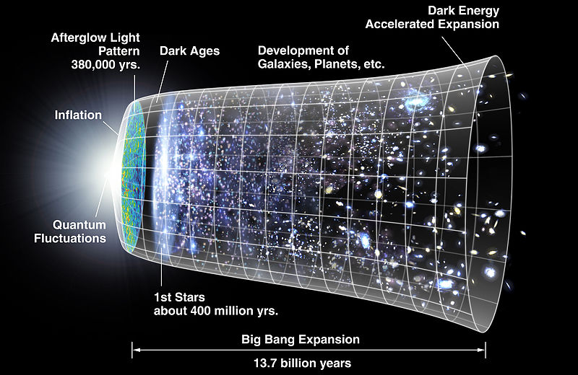
Evolution of the Universe
LHC drivers
Test the Standard
Model?
Dark Matter?
Dark Energy?
Anti-matter?
(Gravity?)

Slide 3
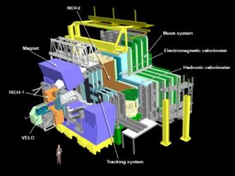
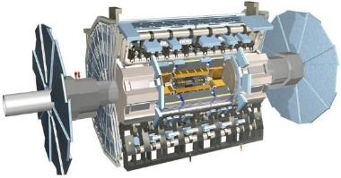
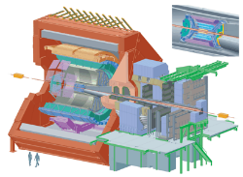
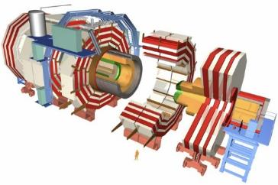
The Large Hadron Collider (LHC)
>1 GB/s
~700 MB/s
A new frontier in Energy & Data volumes:
LHC experiments generate 50 PB/year in Run 2
~10 GB/s
>1 GB/s
Notes:
Largest scientific apparatus ever build
27km around
2 general purpose detectors: Huge microscopes – to explore the very small – using a long lever arm
2 specialized detectors

Slide 4
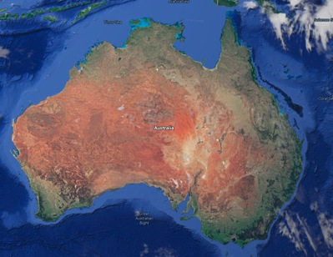


SKA - HQ in UK; telescopes in AU & SA
SKA1-LOW: 50 – 350 MHz
Phase 1: ~130,000 antennas
across 65km
SKA1-Mid: 350 MHz – 24 GHz
Phase 1: 200 15-m dishes across 150 km
Construction Phase 1: 2018 – 2024
Phase 2: mid-2020’s

Slide 5
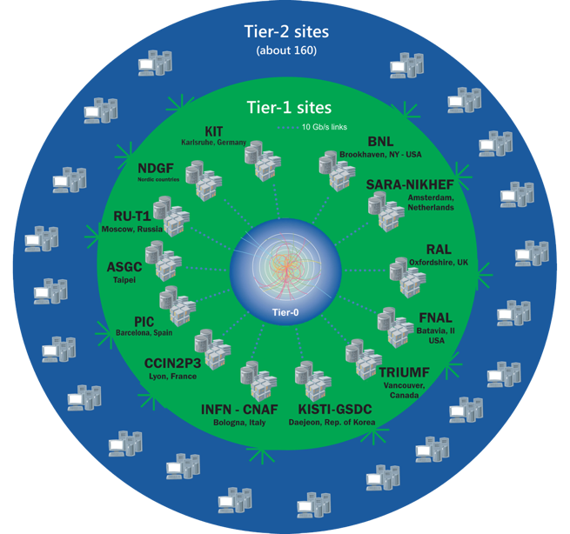
The Worldwide LHC Computing Grid
Tier-0
(CERN and Hungary):
data recording, reconstruction and distribution
~170 sites,
42 countries
~750k CPU cores
Tier-1: permanent storage, re-processing,
analysis
~1 EB of storage
> 2 million jobs/day
Tier-2: Simulation,
end-user analysis
10-100 Gb links
WLCG:
An International collaboration to distribute and analyse LHC data
Integrates computer centres worldwide that provide computing and storage resource into a single infrastructure accessible by all LHC physicists

Slide 6
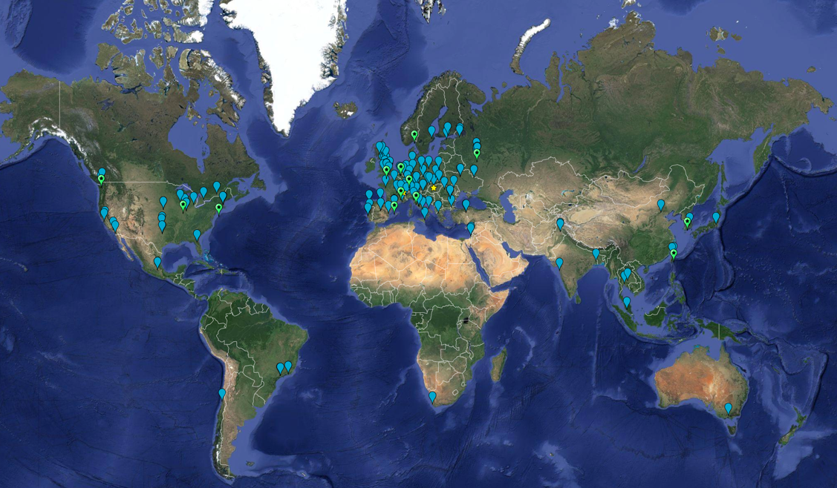
Worldwide computing
2017:
63 MoU’s
167 sites; 42 countries

Slide 7
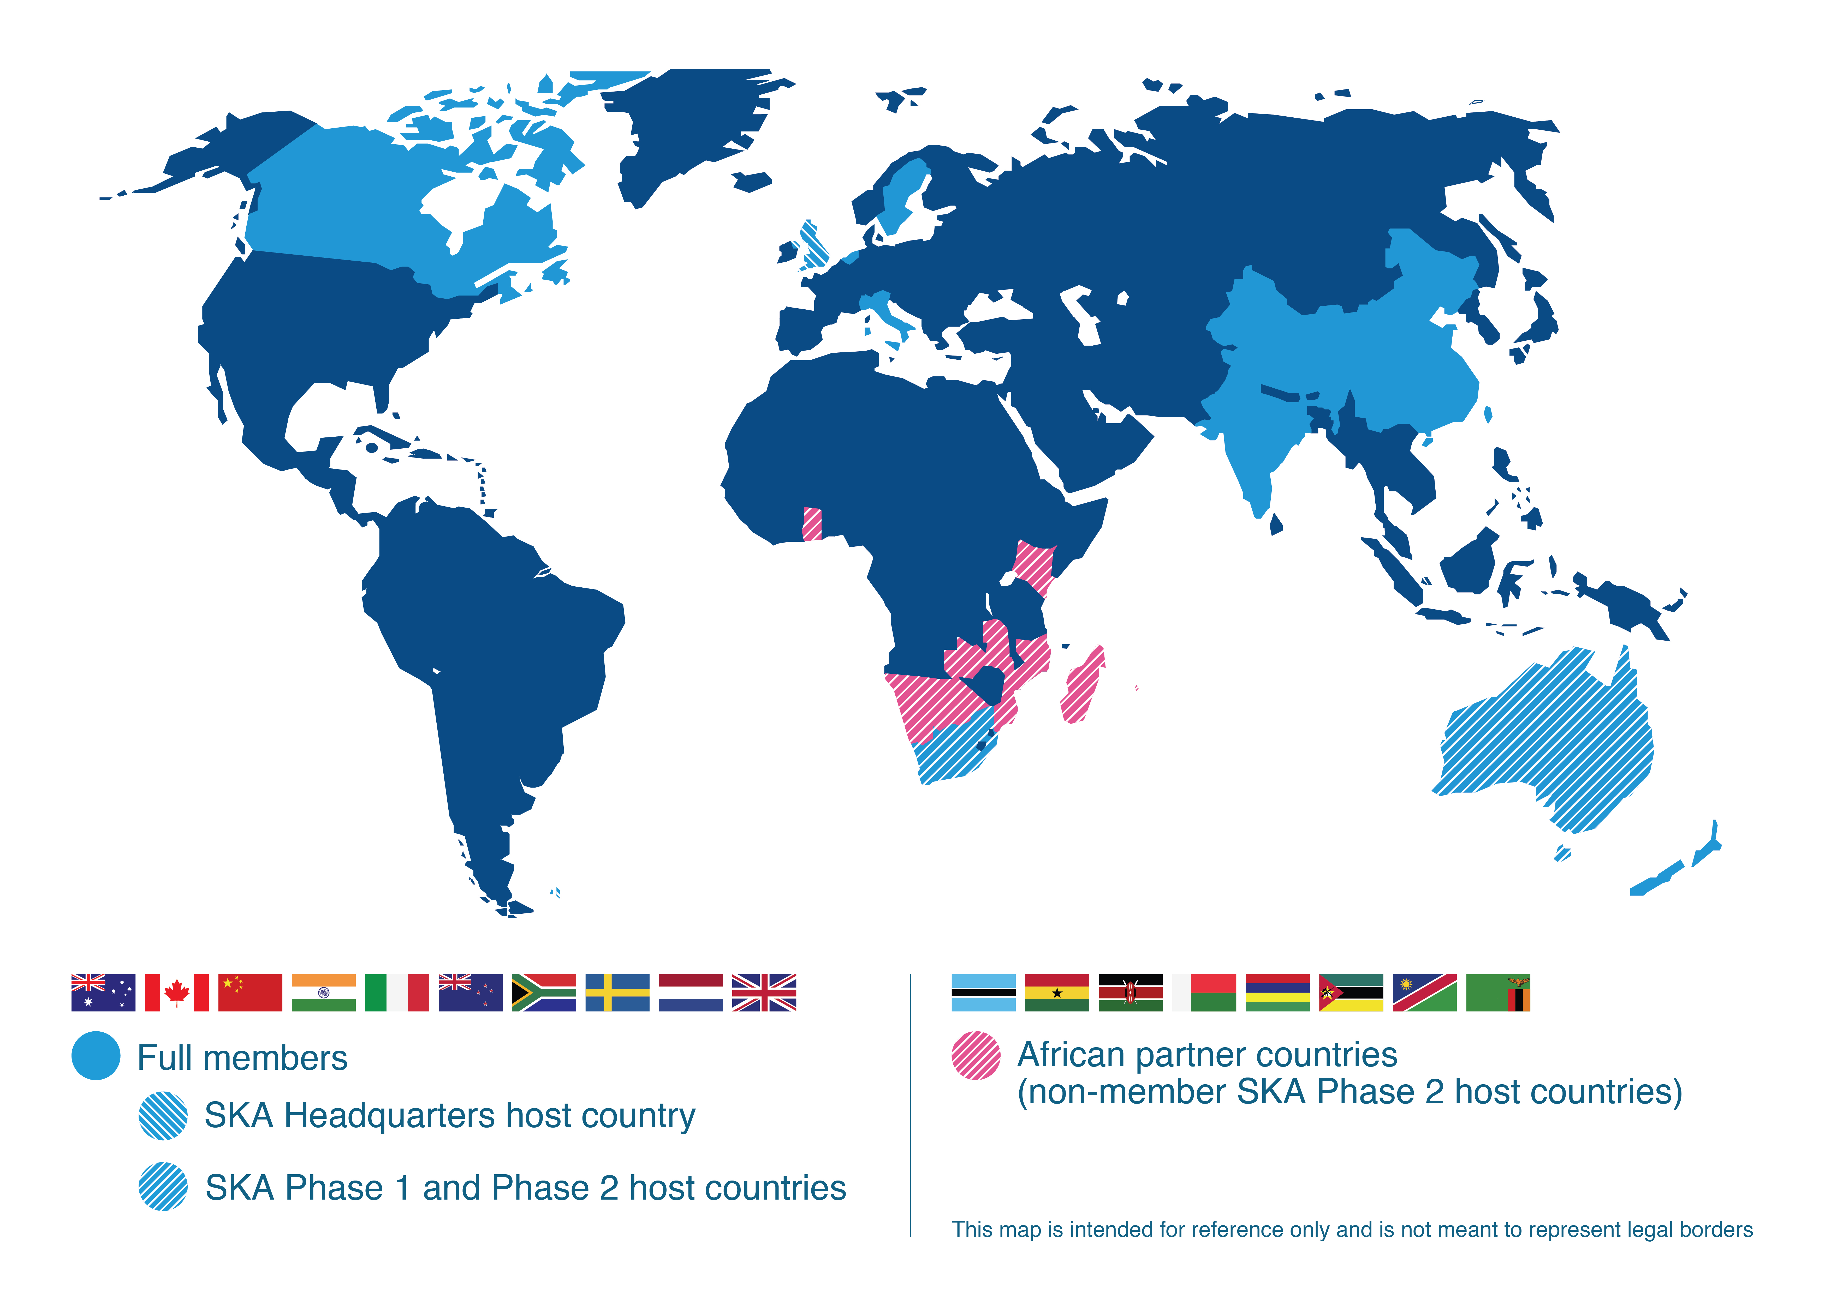
SKA Organisation: 10 countries, more to join
Interested Countries:
France
Germany
Japan
Korea
Malta
Portugal
Spain
Switzerland
USA
Contacts:
Mexico
Brazil
Ireland
Russia
Australia (DoI&S)
Canada (NRC-HIA)
China (MOST)
India (DAE)
Italy (INAF)
Netherlands (NWO)
New Zealand (MED)
South Africa (DST)
Sweden (Chalmers)
UK (STFC)

Slide 8


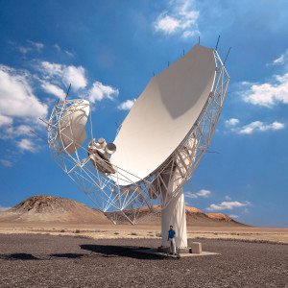



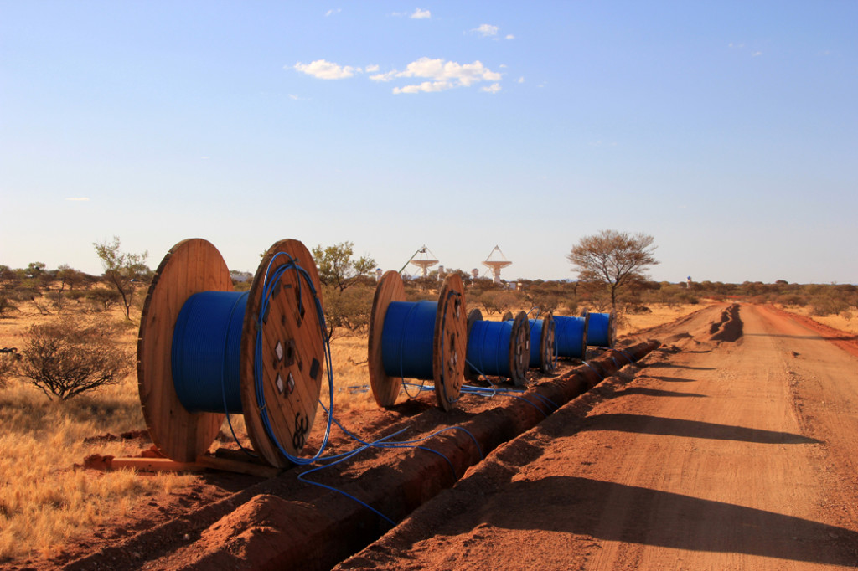
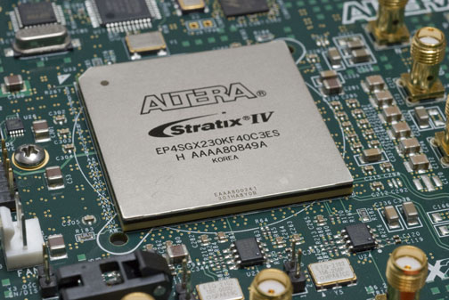
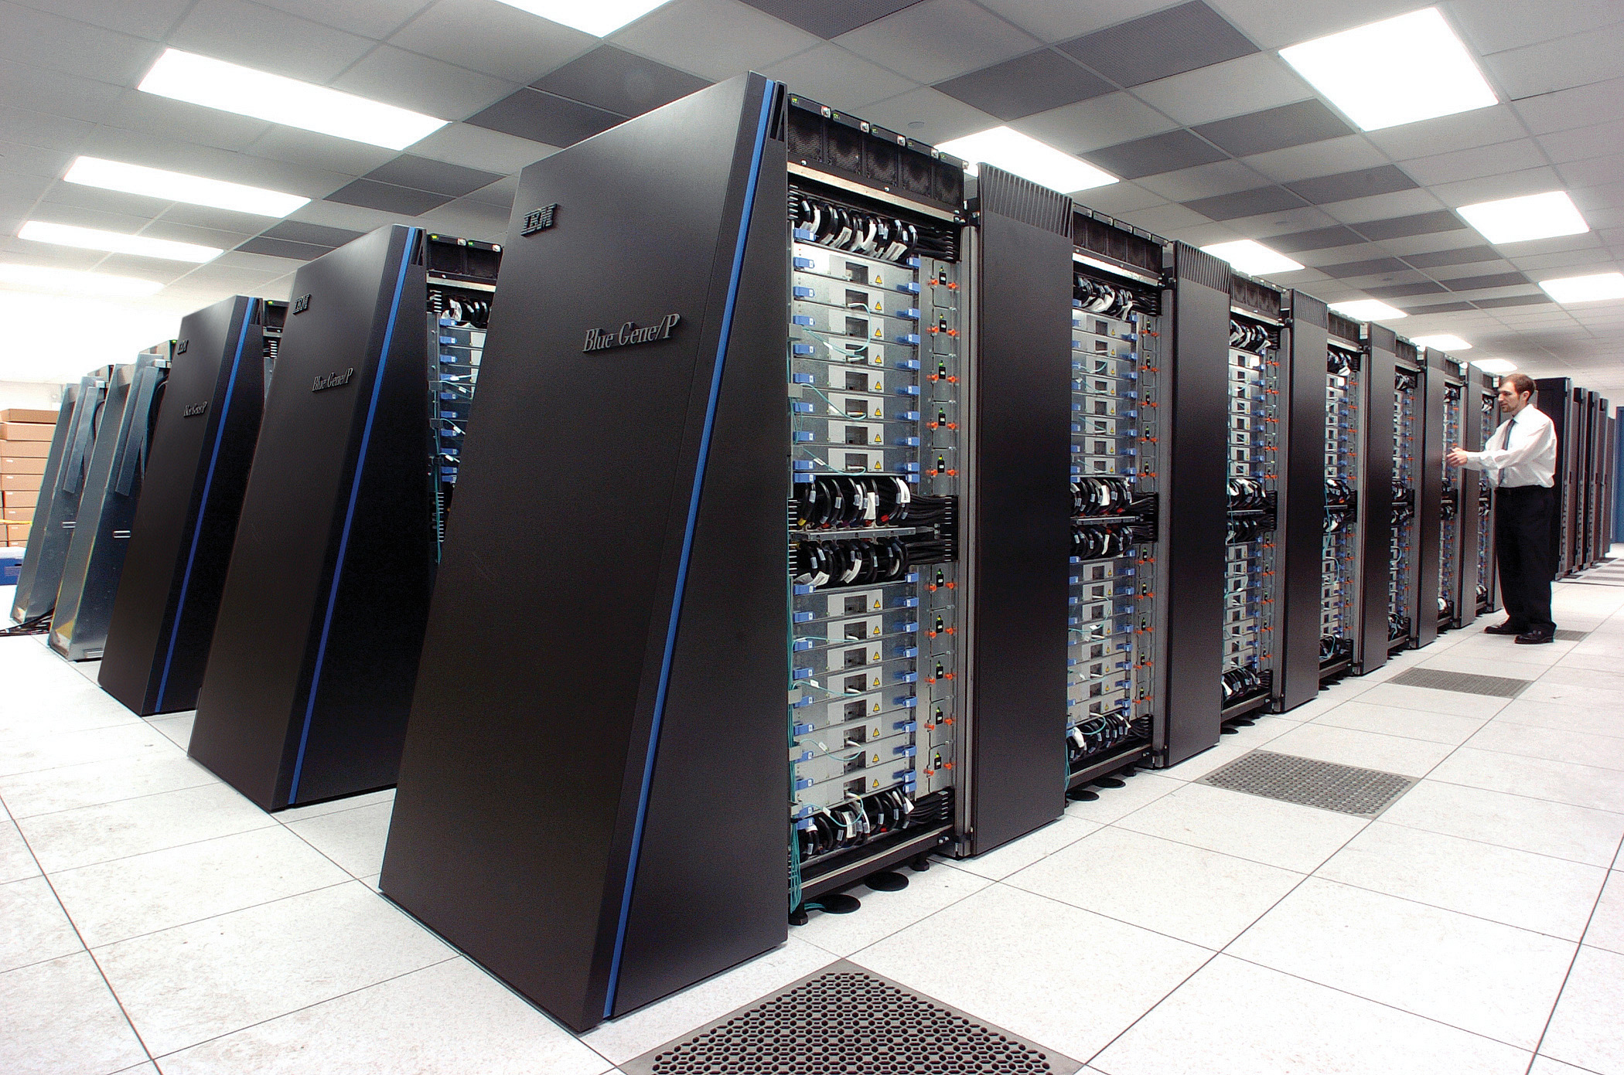

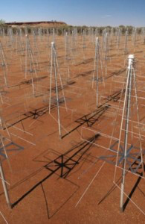
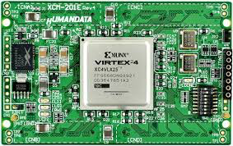
SKA Data Acquisition System Overview
8.8 Tbits/s
2x 5 Tbits/s
~50 PFlop
~250 PFlop
7.2 Tbits/s
300 PB/yr
SKA Regional Centres
2 Pbits/s

Slide 9
SKA Observatory
SKA is a software telescope
  Very flexible and potentially easy to reconfigure
  Major software and computing challenge
Computing challenges are significant
  Science Data Processor (SDP) needs 25 PetaFLOPS/sec of delivered processing
    Current estimate is that SDP needs 250 PFLOP/sec peak.
    Tianhe-2 – 50 PetaFLOPS/sec peak.
    Memory bandwidth is ~200 PetaBytes/sec
  Pulsar Search is an additional 50 PFLOP/s of
  peak processing
  Power efficiency required is ~40x better than
  Tianhe-2
Limitations
  Because of the bandwidth requirements, have
  to buy 10 x more computing than a pure
  HPC system would require.

Slide 10
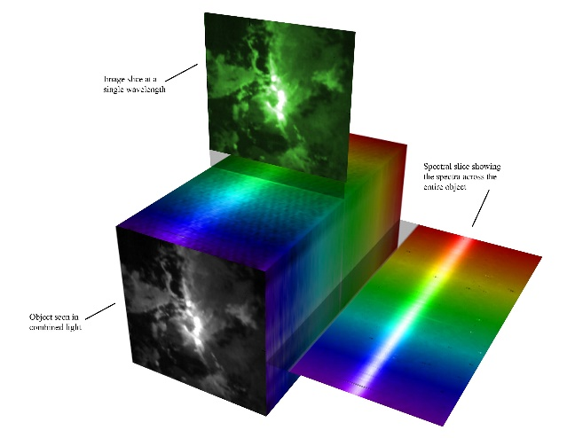
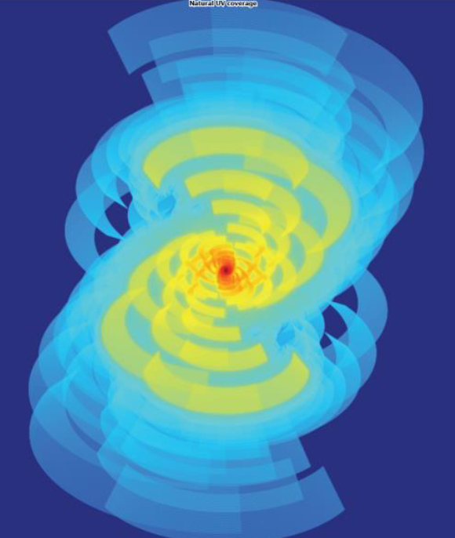
Data Products from SDP
Image cubes of sky maps (Continum) 18PB n*/year
Max ~30Gbit/s Mean ~10 Gbit/s
  SDP Fourier transform of CSP time series
  Moderate external compute and model fitting
Epoch of Re-ionisation 1.6PB/ 6 Hr ~600 Gbit/s
Only 11% duty cycle so Mean rate ~ 22 Gbit/s
  Uses calibrated aperture plane (visibility data)
  Enormous compute of power spectra
Relativity Gravitational lensing 70PB/2500Hr 60Gbit/s
  Uses further processed aperture plane data
  Considerable compute of galaxy elipsicity
Pulsars 4-5 PBytes/y ≤10Gbits
  Discovery and in depth study; timing 10 ns in 10 years
  Large physics compute
VLBI 4 beams of 4 Gbit/s (not in the 300PB)
  Data direct from the correlator, UDP all the way
PI led projects ? Some fraction of observing time
Discovery science Whatever is available
Notes:
The word used (by Rosie) was terrifying!
Lots of interest from NRENs and Academic network providers like GEANT around the world.
good collaboration between SDP and SaDT.SDP-Deliv concerning the SKA data products
Estimates of data growth based on science use cases but transfer rates even more uncertain.
SKA Data Flow Advisory Panel will advise on this area

Slide 11
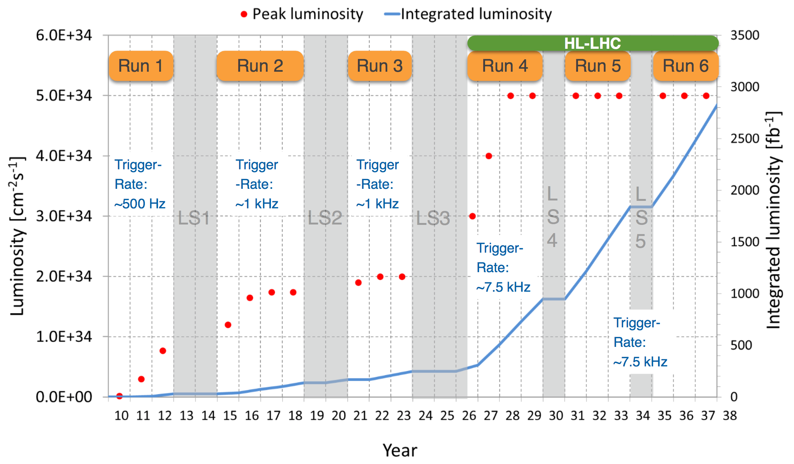
LHC Schedule
Run 3
Alice, LHCb upgrades
Run 4
ATLAS, CMS upgrades

Slide 12
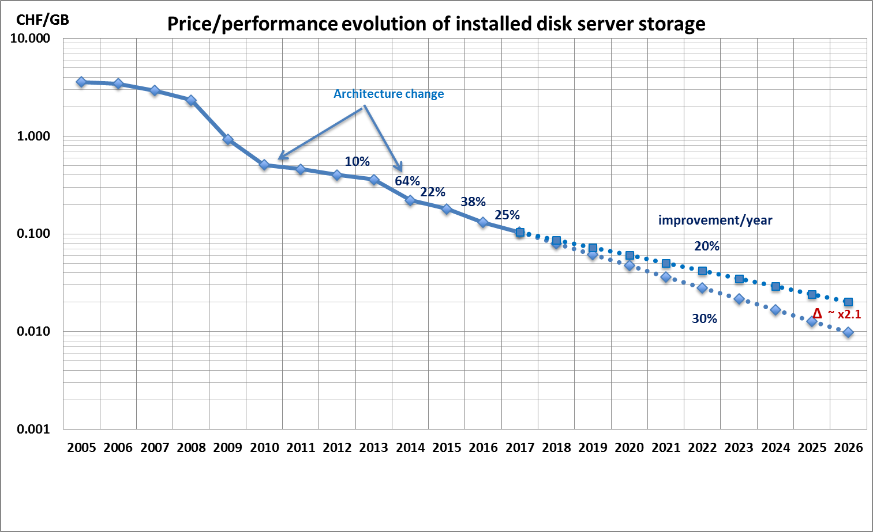
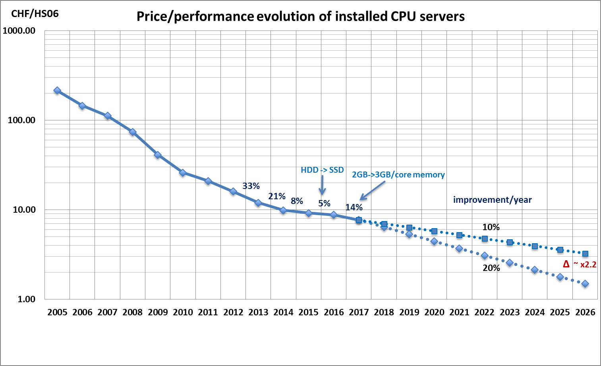
Future Challenges
2010
2011
2012
2013
2014
2015
2016
2017
2018
2019
2020
2021
2022
2023
2024
2025
…
2030?
…
First run
LS1
B
LS3
HL-LHC
Second run
LS2
Third run
FCC?
Data:
Raw 2016: 50 PB → 2027: 600 PB
Derived (1 copy): 2016: 80 PB → 2027: 900 PB
CPU:
x60 from 2016
Raw data volume for LHC increases exponentially and with it processing and analysis load
Technology at ~20%/year will bring x6-10 in 10-11 years
Estimates of resource needs at HL-LHC x10 above what is realistic to expect from technology with reasonably constant cost

Slide 13
10 Billion of these

Slide 14
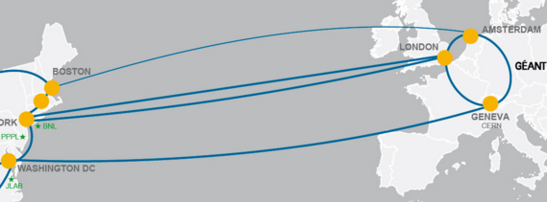
Networks
Optical Private Network
Support T0 – T1 transfers
& T1 – T1 traffic
Managed by LHC Tier 0 and Tier 1 sites
Up to 340 Gbps transatlantic

Slide 15

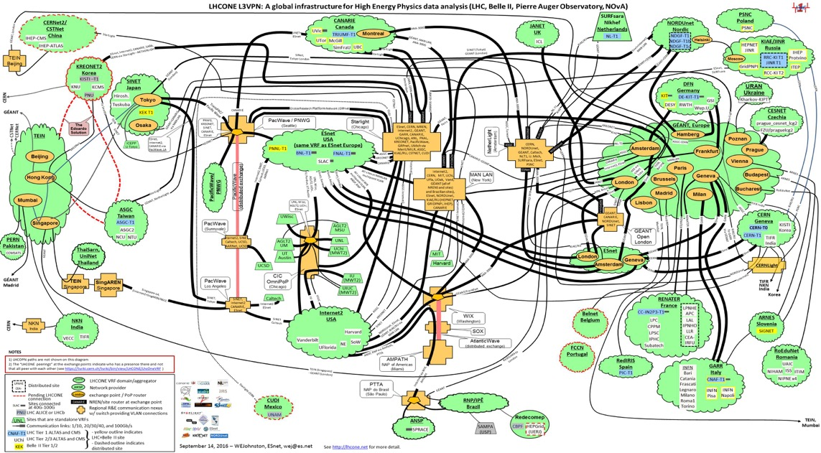

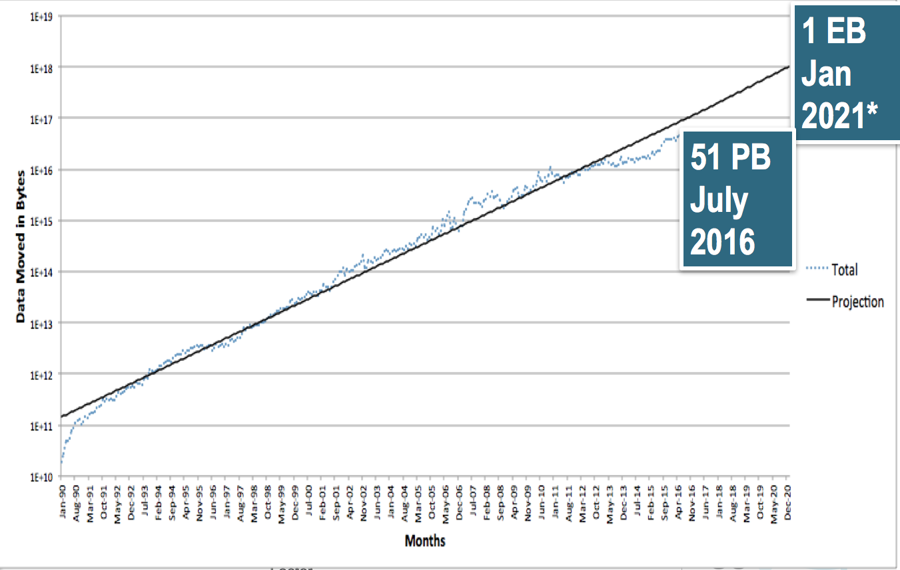
Asia
North America
Europe
South America
LHCOne: Overlay network
Allows NREN’s to manage HEP traffic on general purpose network
Managed by NREN collaboration

Slide 16





Provisioning services
Moving towards Elastic Hybrid IaaS model:
In house resources at full occupation
Elastic use of commercial & public clouds
  Assume “spot-market” style pricing
End Users
Experiment Pilot Factories
CI/CD
IT & Experiment Services
HTCondor
(LSF)
APIs
CLIs
GUIs
Volunteer Computing
Public Cloud
OpenStack Resource Provisioning
(>1 physical data centre)
Bare Metal and HPC
Containers
VMs

Slide 17
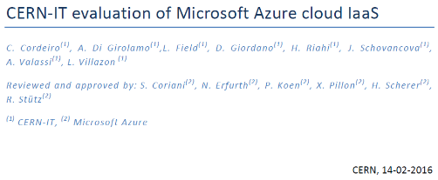
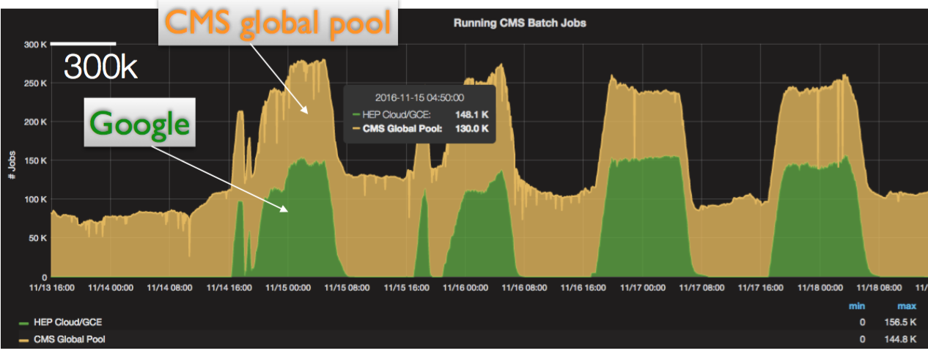
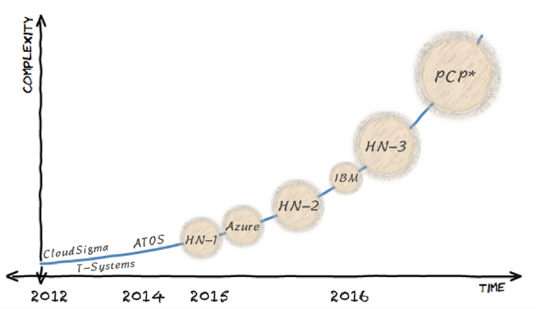
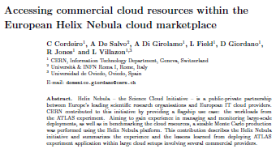





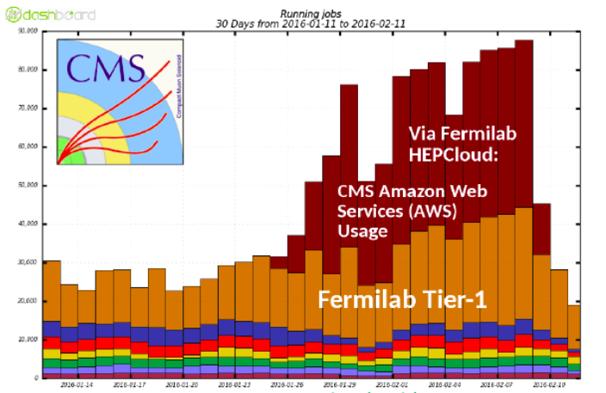
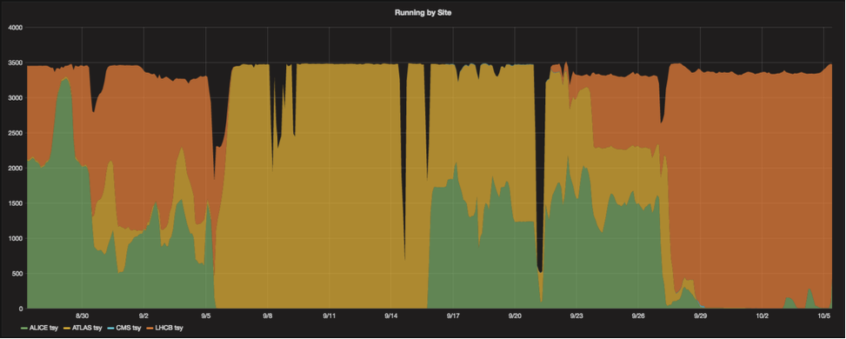
Commercial Clouds
Open Telekom Cloud
LHCb
ATLAS
ALICE

Slide 18
SKA Regional Centres
SKA envisage a network of regional centres
Modelled on the LHC Tierw
Not part of SKA, or funded by SKA, but:
  Essential to generate science
  Coordinated with assistance from SKAO and accredited with SKAO
Principle functions
  Take data products generated by SDP and turn them into science
  Support regional astronomers with their data processing.
  Act as centres for domain expertise.

Slide 19
Regional Centre Concept:
Regional Centre 1
Users
Science Processing Centre
Users
Regional Centre 2
Users
AUS
Users
Science Processing Centre
Users
Users
RSA
Regional Centre N
Users
Observatory
User Community

Slide 20
Regional Centre Network

Slide 21
10-year challenges
HL-LHC will be a multi-Exabyte challenge
  Storage and compute needs x10 above what naïve technology extrapolation will bring
  Need to drive down costs: focus on performance, efficiency, operations, etc. ➔changes in computing and infrastructure models are necessary
SKA will have similar data volumes on the same time-scale
Opportunity for synergy – in particular in large scale facilities
  SKA and LHC likely to be co-located in major facilities
But there is experience:
  ~15 years of grid development and successful operation for science
  CERN has been operating a distributed DC for ~5 years
  Large internet companies provide tools and experience that did not exist when we started WLCG
    Tools for managing interconnected DCs, cloud provisioning, etc.
  Starting to prototype federated structures for the future

Slide 22
HL-LHC computing cost parameters
Business of the experiments:
amount of Raw data, thresholds; Detector design long term computing cost implications
Business of the experiments:
reconstruction, and simulation algorithms
Core Algorithms
Software Performance
Parameters
Infrastructure
Performance/architectures/memory etc.;
Tools to support: automated build/validation
Collaboration with externals – via HSF
New grid/cloud models; optimize CPU/disk/network; economies of scale via clouds, joint procurements etc.

Slide 23
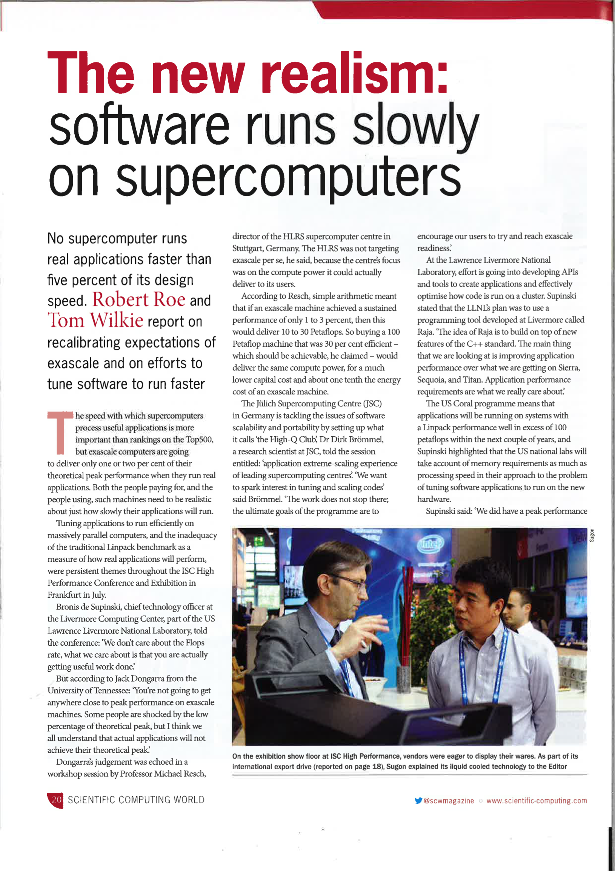
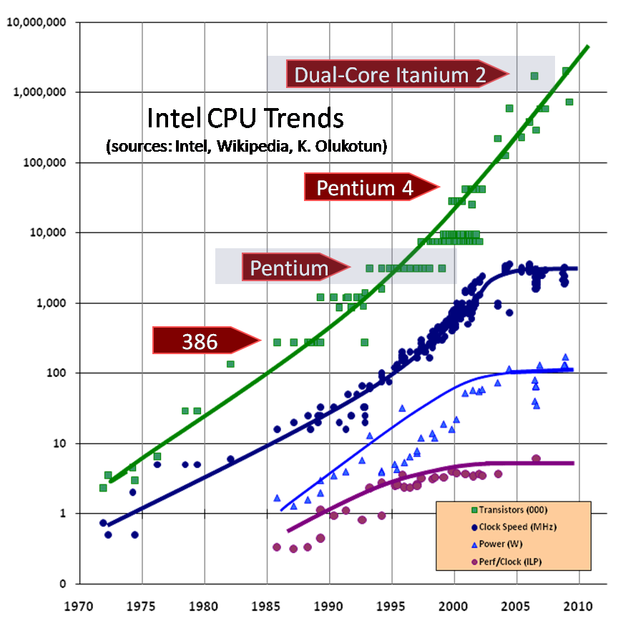
Software
Not just a HEP problem
Transistors go into many cores, co-processors, vector units, etc.
Memory access and I/O paths also become problematic
Getting performant software requires significant investment in skills
© 2009 Herb Sutter

Slide 24
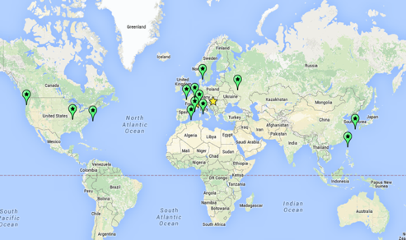
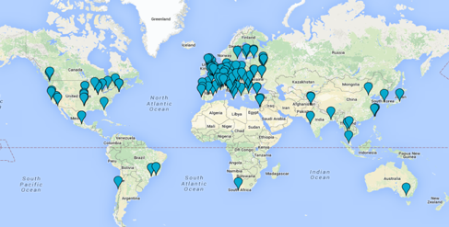
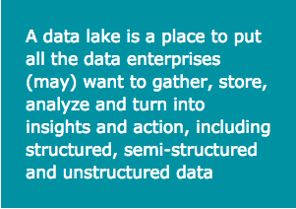
Possible Model for future HEP computing infrastructure
Cloud users:
Analysis
Simulation resources
HEP Data cloud
Storage and compute
HEP Data lake
Storage and compute

Slide 25
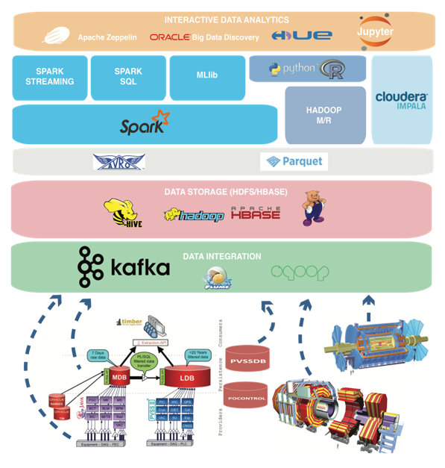
Hadoop and Analytics
Hadoop Production Service
New scalable data services
  Scalable databases
  Hadoop ecosystem
  Time Series databases
Big Data Analytics
Activities and objectives
  Develop projects and services with/for users
  Support of Hadoop Components
  Further value of Analytics solutions
  Define scalable platform evolution based on requirements

Slide 26

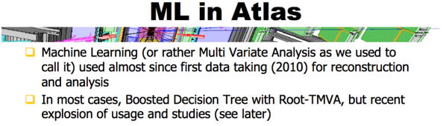
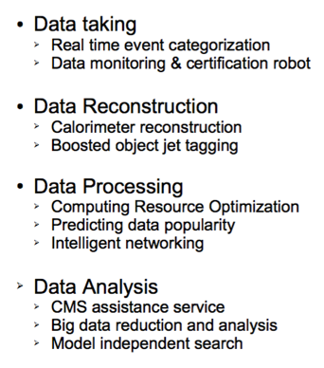
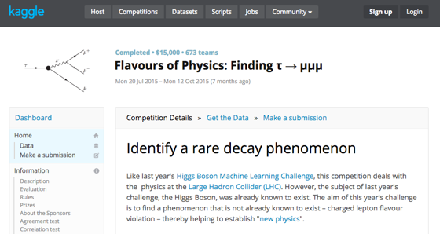
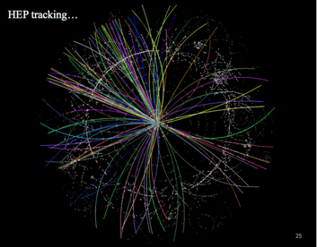
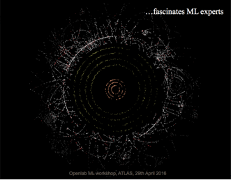
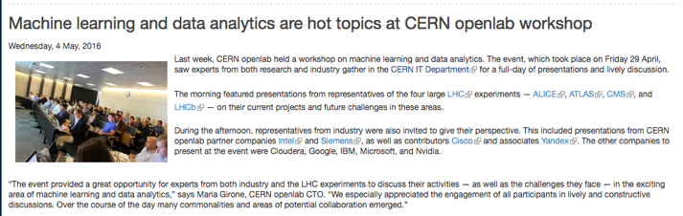
Machine Learning

Slide 27
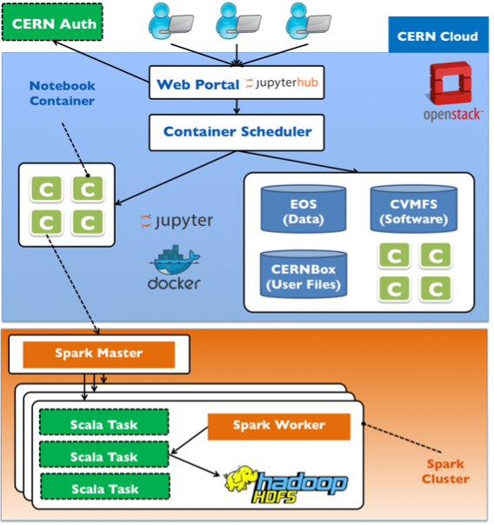
SWAN
Provides a web-based analysis facility – via notebooks
Transparent access to scalable back-end analysis infrastructure
  Clouds, Spark, Hadoop, ML, etc.
Performance is defined by the infrastructure
Provides the analysis portal in a “data cloud” or “data lake” model

Slide 28
Conclusions
In the next decade HL-LHC and SKA will be the leading Exabyte-scale scientific big data challenges
Computing & software challenges and concerns are often similar or complementary
Evolution of computing models must be very agile to be able to adapt to a rapidly evolving landscape of new technologies & funding opportunities
Many opportunities for synergy, collaboration, and leadership in scientific big data

Slide 29
Acknowledgements
Thanks to:
  Nick Rees, Rosie Bolton, Richard Hughes-Jones – SKA Organisation & Project Office, for background, discussions & material on SKA

