Slide 1
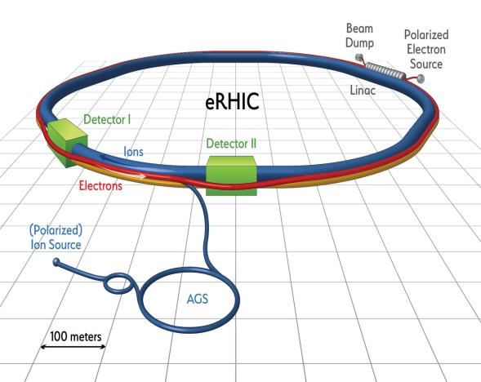

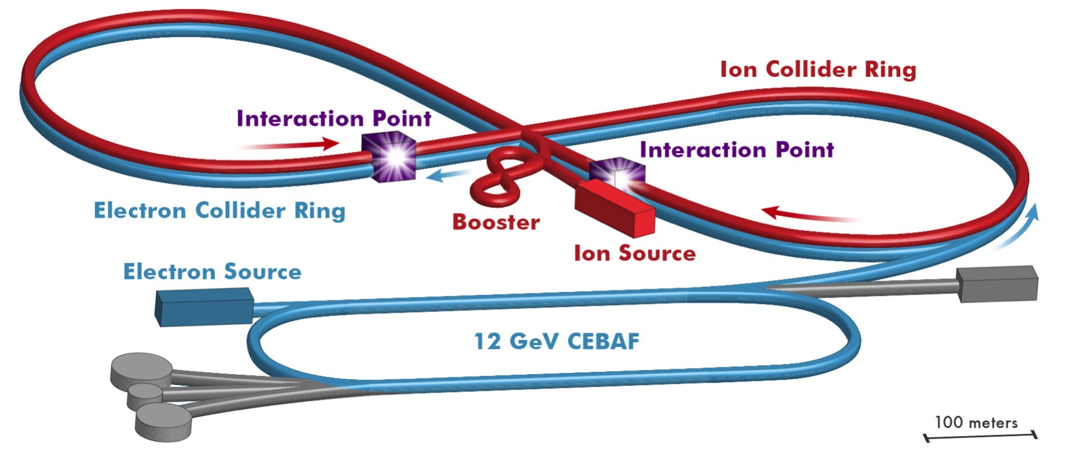
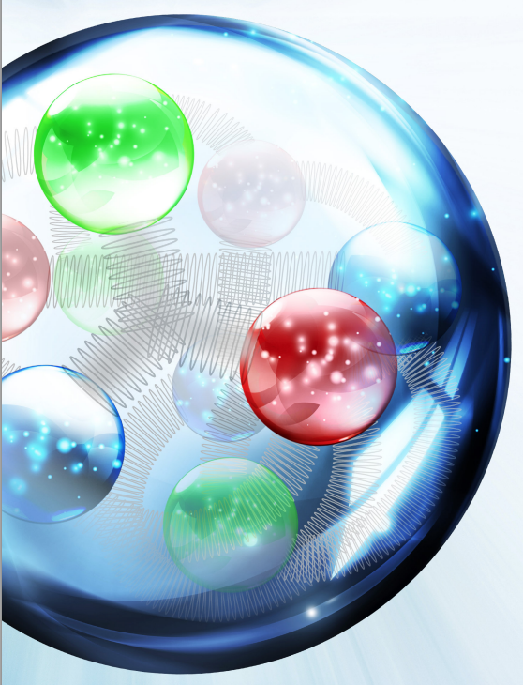
Accelerator designs and R&D for the
Electron-Ion Collider
Fulvia Pilat, JLAB
Fulvia Pilat

Slide 2
Outline
EIC: an introduction
EIC accelerator challenges and parameters
EIC concepts:
  JLEIC: figure-8 ring-ring (JLAB)
  eRHIC ring-ring (BNL)
  eRHIC ERL-ring (BNL)
EIC accelerator R&D: common and design specific
Collaborative frame, US and international
Outlook

Slide 3

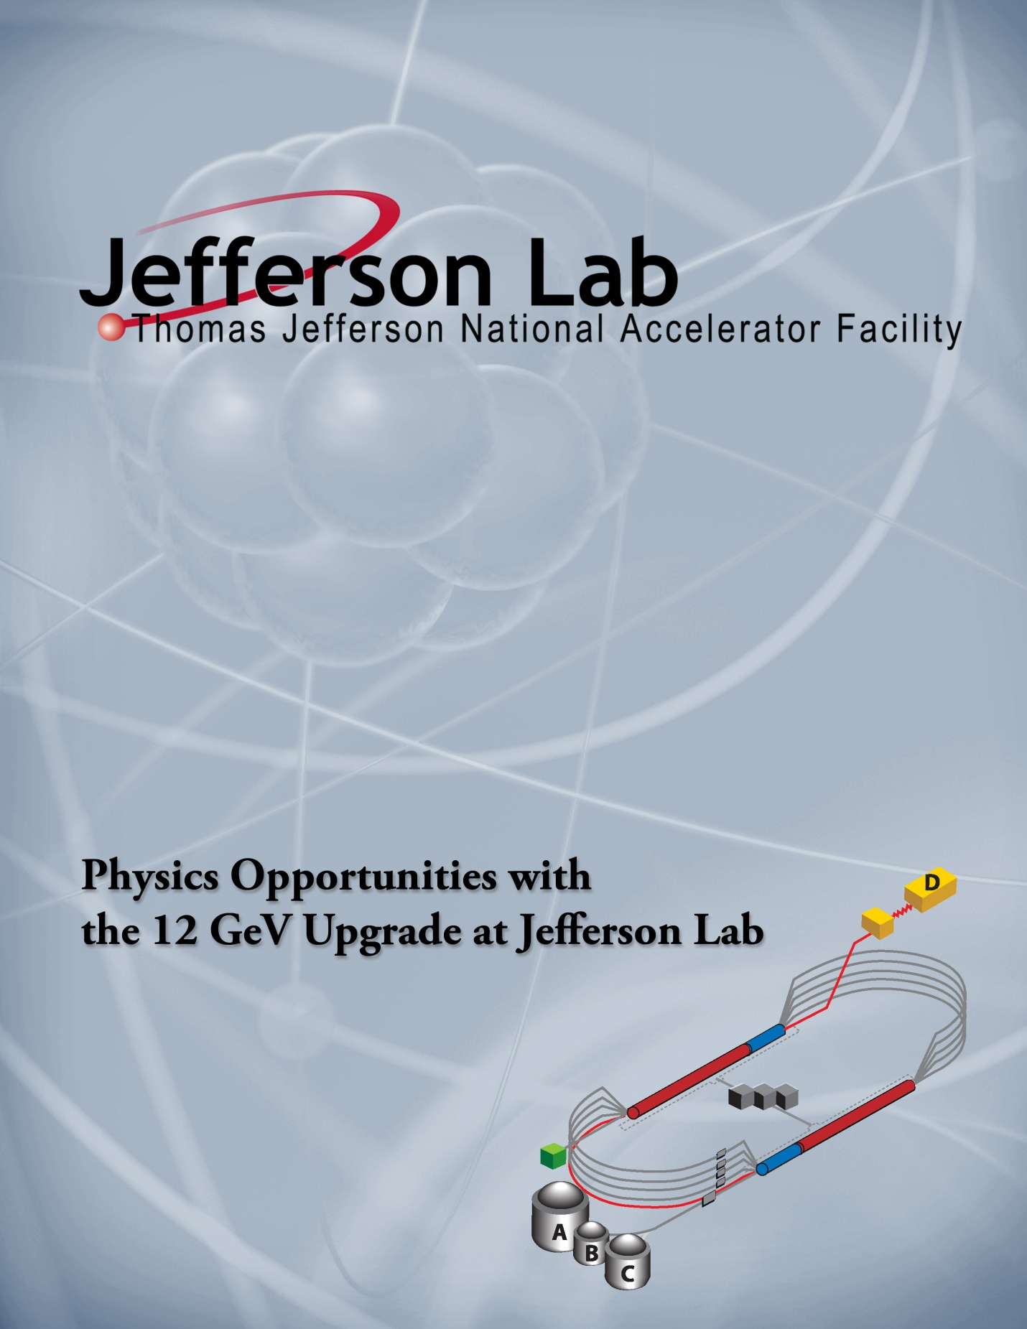
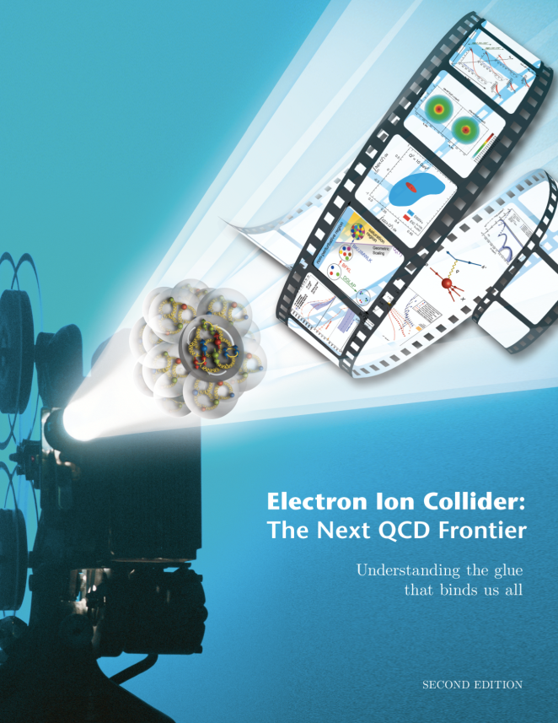
An electron-Ion collider is the highest priority for new construction in Nuclear Physics
Decade of Experiments Approved
First 12 GeV Science
Experiments Complete
Electron Ion Collider
The Next QCD Frontier
Confinement
Hadron Structure
Nuclear Structure and Astrophysics
Fundamental Symmetries
2015 NSAC Long Range Plan
Strong support for JLAB program
Role of Gluons in Nucleon and Nuclear Structure
3

Slide 4
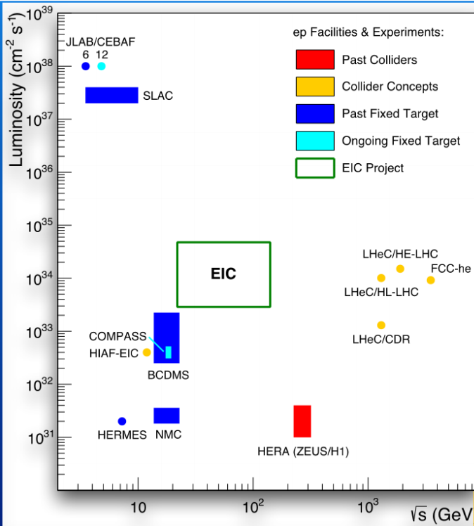
EIC unique characteristics and challenge
High luminosity (50 x Hera)
High polarization: first ever fully polarized collider
Wide range of collision energies and collision energy ratios
Many species ( polarized p, e- and light nuclei, d to heaviest nuclei)
Large detector acceptance: first ever e-p and e-A studies with ~100% reconstruction of nuclei in the final state

Slide 5
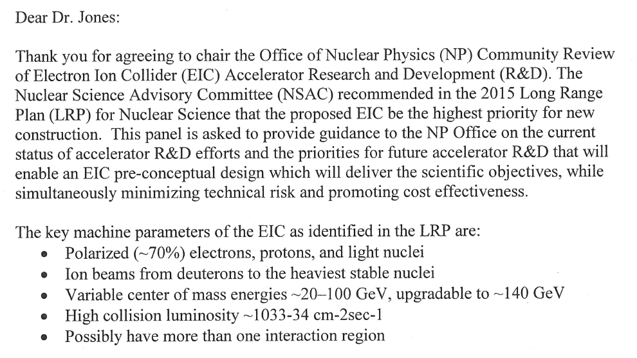
EIC parameters
From the charge letter to the NP Panel Review of EIC design and R&D, December 2016:

Slide 6
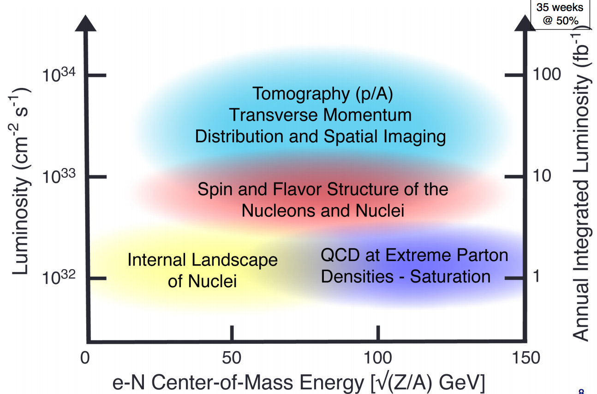
EIC Physics

Slide 7
EIC accelerator designs
New e-ring and ion complex
CEBAF full e-energy injector
High initial luminosity
Increase energy reach
New e-ring (or e-ERL)
RHIC ion complex
High initial collision energy
Increase luminosity

Slide 8
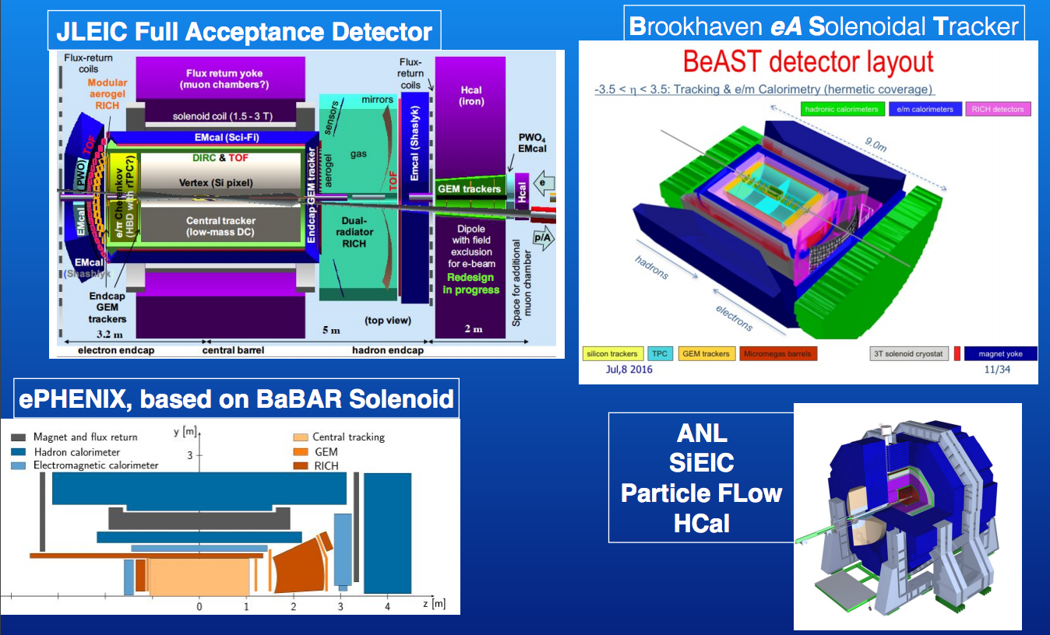
EIC detector designs

Slide 9
JLEIC design strategy
High luminosity: high collision rate of
short low-charge low-emittance bunches
  Small beam size
    Small β* ⇒ Short bunch length
    Low bunch charge, high repetition rate
    Small emittance ⇒ Cooling
  Similar to lepton colliders such as
  KEK-B with L > 2×10³⁴ cm⁻²s⁻¹
High polarization: Figure-8 rings
  Net spin precession zero
  Spin easily controlled by small
  magnetic fields for any particle
  species
Optimal integration IR and total acceptance detector (including far-forward acceptance)
Technical risk minimization
adopt established technology where possible, focus technology demonstration in few selected areas
Beam Design
High repetition rate
Low bunch charge
Short bunch length
Small emittance
Damping
Synchrotron radiation
Electron cooling
IR Design
Small β*
Crab crossing

Slide 10
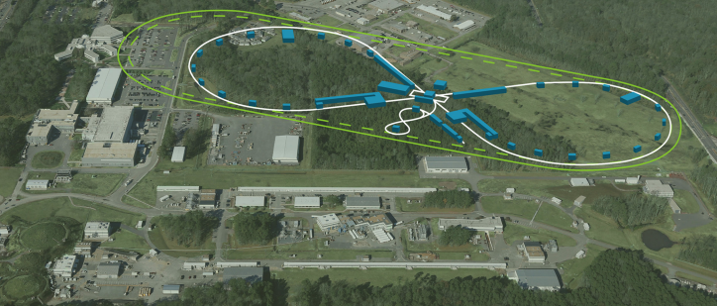
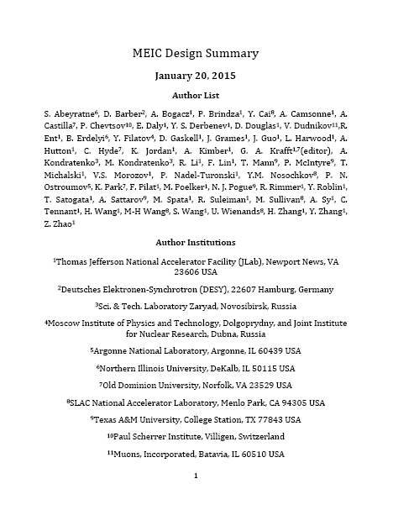
JLEIC design
energy range:
e-: 3-10 GeV
p : 20-100 GeV
√s: up to 65 GeV
Range to to √s=100 GeV and √s=140 GeV possible
8-100 GeV
3-10 GeV
8 GeV
Electron complex
  CEBAF
  Electron collider ring
Ion complex
  Ion source
  SRF linac
  Booster
  Ion collider ring
Fully integrated IR and detector
DC and bunched beam coolers
2015
arXiv:1504.07961

Slide 11
High luminosity: electron cooling
ion sources
DC cooler
BB cooler
ion linac
Booster
(0.285 to 8 GeV)
collider ring
(8 to 100 GeV)
Ring | Cooler | Function | Ion energy | Electron energy
 |  |  | GeV/u | MeV
Booster ring | DC | Injection and accumulation of positive ions | 0.11 ~ 0.19 (injection) | 0.062 ~ 0.1
 |  | Emittance reduction | 2 | 1.1
Collider ring | Bunched Beam Cooling (BBC) | Maintain emittance during stacking | 7.9 (injection) | 4.3
 |  | Maintain emittance | Up to 100 | Up to 55
DC cooling for emittance reduction
BBC cooling for emittance preservation against intra-beam scattering

Slide 12
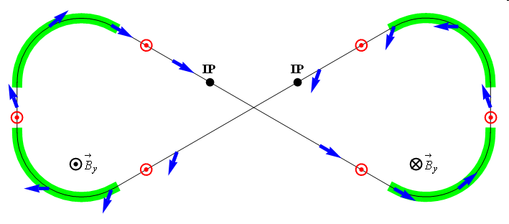
High polarization: Figure-8
Figure-8 concept: spin precession in one arc is exactly cancelled in the other
Spin stabilization by small fields: ~3 Tm vs. ~ 400 Tm for deuterons at 100 GeV
  Criterion: induced spin rotation >> spin rotation due to orbit errors
Polarized deuterons possible
3D spin rotator: combination of small rotations about different axes provides any polarization orientation at any point in the collider ring
No effect on the orbit
Adiabatic spin flips
Spin tracking in progress
Electron polarization
Spin Rotator
Magnetic field
Polarization
IP
e⁻
E- energy (GeV) | 3 | 5 | 7 | 9 | 10
Estimated Pol. Lifetime (hours) | 66 | 5.2 | 2.2 | 1.3 | 0.8
Ion polarization
ν = 0

Slide 13
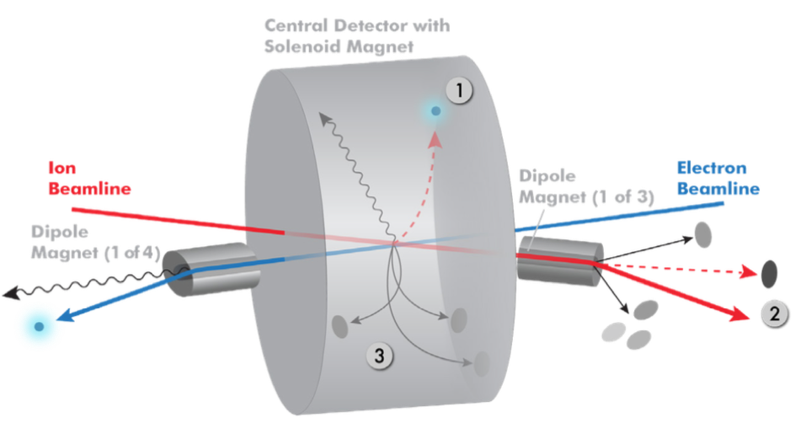
Integration IR: total acceptance detector
Possible to get ~100% acceptance for the whole event
Scattered electron
Particles associated with struck parton
Particles Associated with Initial Ion
Relatively large crossing angle (50 mr) combined with large aperture final focus magnets,
and forward dipoles are keys to this design.

Slide 14
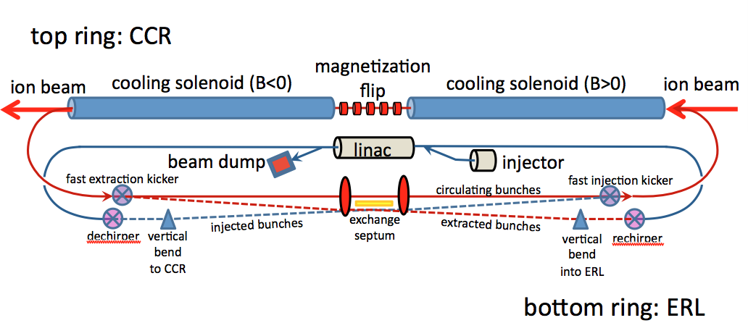
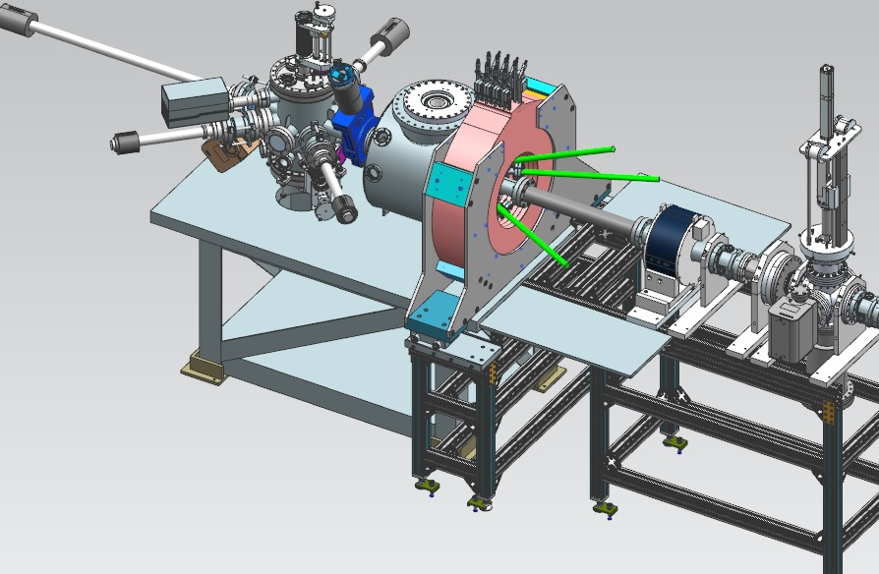
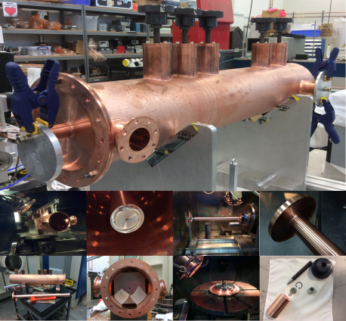
Baseline: strong cooling
ERL cooler +
Multi-turn circulator ring
Enabling technologies :
Fast kickers, risetime <1 nsec
Electron energy | MeV | up to 55
Bunch charge | nC | 3.2
Turns in circulator ring | turn | ~20
Current in CCR/ERL | A | 1.5/0.075
Bunch repetition | MHz | 476
Cooling section length | m | 60
RMS Bunch length | cm | 3
Energy spread | 10⁻⁴ | 3
Cooling solenoid field | T | 1
Cooling section length | m | 2x30
Magnetized source ~75mA

Slide 15
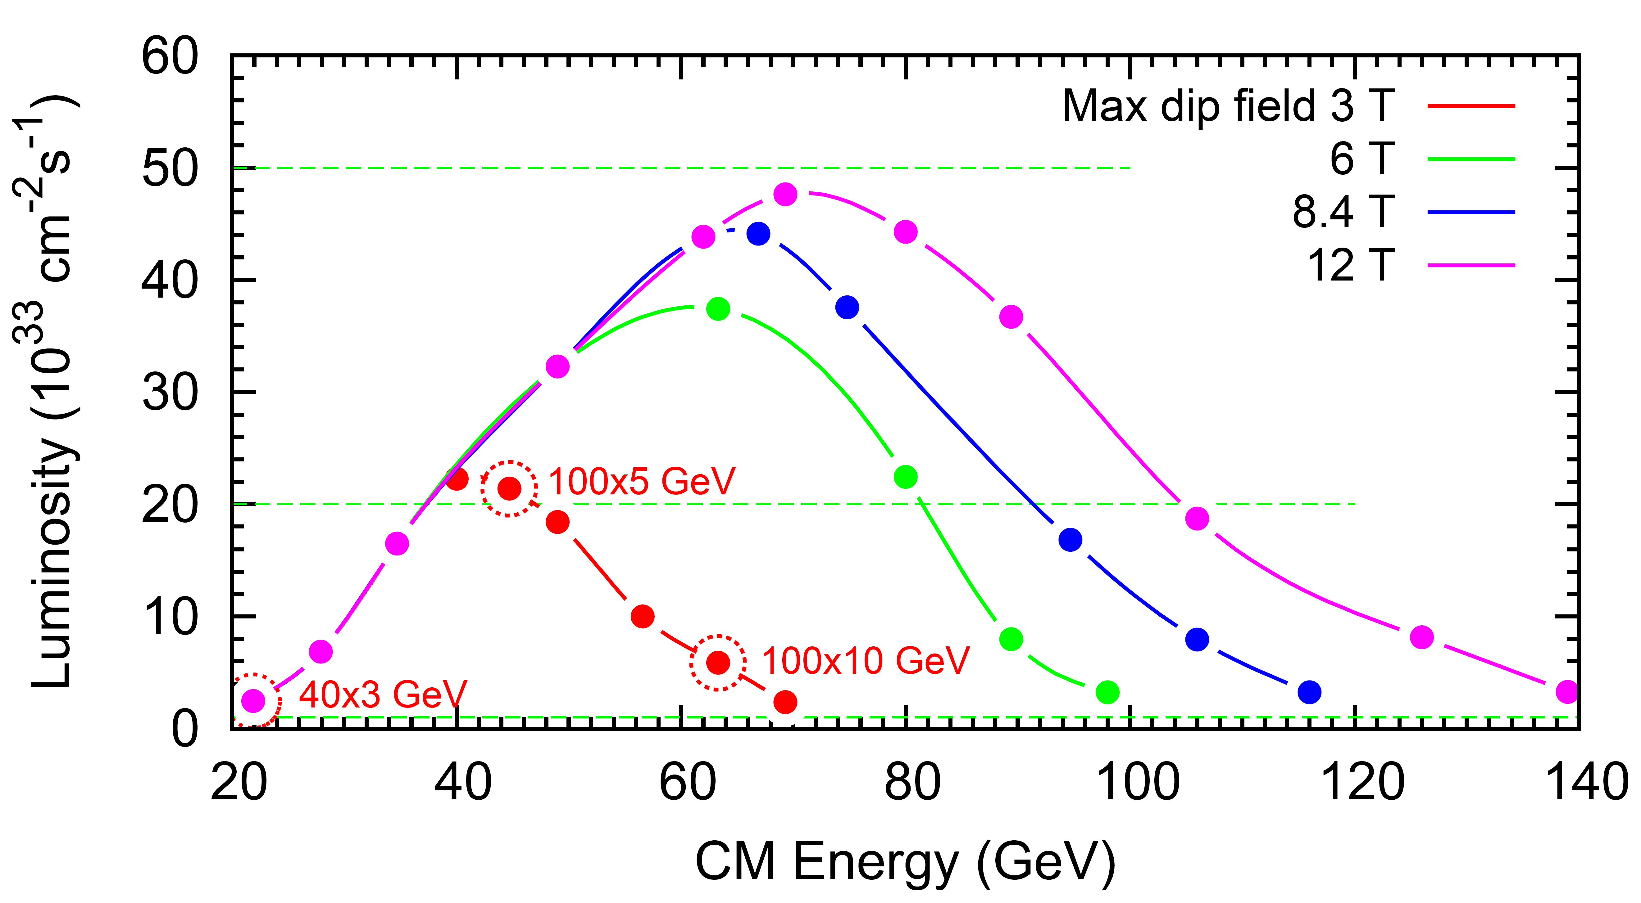
JLEIC Luminosity and Energy technical choice
LHC technology
FCC magnet R&D

Slide 16
JLEIC Parameters (3T)
CM energy | GeV | 21.9 (low) |  | 44.7 (medium) |  | 63.3 (high)
 |  | p | e | p | e | p | e
Beam energy | GeV | 40 | 3 | 100 | 5 | 100 | 10
Collision frequency | MHz | 476 |  | 476 |  | 476/4=119
Particles per bunch | 10¹⁰ | 0.98 | 3.7 | 0.98 | 3.7 | 3.9 | 3.7
Beam current | A | 0.75 | 2.8 | 0.75 | 2.8 | 0.75 | 0.71
Polarization | % | 80% | 80% | 80% | 80% | 80% | 75%
Bunch length, RMS | cm | 3 | 1 | 1 | 1 | 2.2 | 1
Norm. emittance, hor / ver | μm | 0.3/0.3 | 24/24 | 0.5/0.1 | 54/10.8 | 0.9/0.18 | 432/86.4
Horizontal & vertical β* | cm | 8/8 | 13.5/13.5 | 6/1.2 | 5.1/1.0 | 10.5/2.1 | 4/0.8
Ver. beam-beam parameter |  | 0.015 | 0.092 | 0.015 | 0.068 | 0.008 | 0.034
Laslett tune-shift |  | 0.06 | 7x10⁻⁴ | 0.055 | 6x10⁻⁴ | 0.056 | 7x10⁻⁵
Detector space, up/down | m | 3.6/7 | 3.2/3 | 3.6/7 | 3.2/3 | 3.6/7 | 3.2/3
Hourglass(HG) reduction |  | 1 |  | 0.87 |  | 0.75
Luminosity/IP, w/HG, 10³³ | cm⁻²s⁻¹ | 2.5 |  | 21.4 |  | 5.9

Slide 17
JLEIC possible timeline
Activity Name | 2010 | 2011 | 2012 | 2013 | 2014 | 2015 | 2016 | 2017 | 2018 | 2019 | 2020 | 2021 | 2022 | 2023 | 2024 | 2025
12 GeV Operations
12 GeV Upgrade
FRIB
EIC Physics Case
NSAC LRP
NAS Study
CD0
EIC Design, R&D Pre-CDR, CDR
CD1(Down-select)
CD2/CD3
EIC Construction
pre-project
on-project
Pre-CDR
CDR
CD0 = DOE “Mission Need” statement; CD1 = design choice and site selection (VA/NY)
CD2/CD3 = establish project baseline cost and schedule

Slide 18
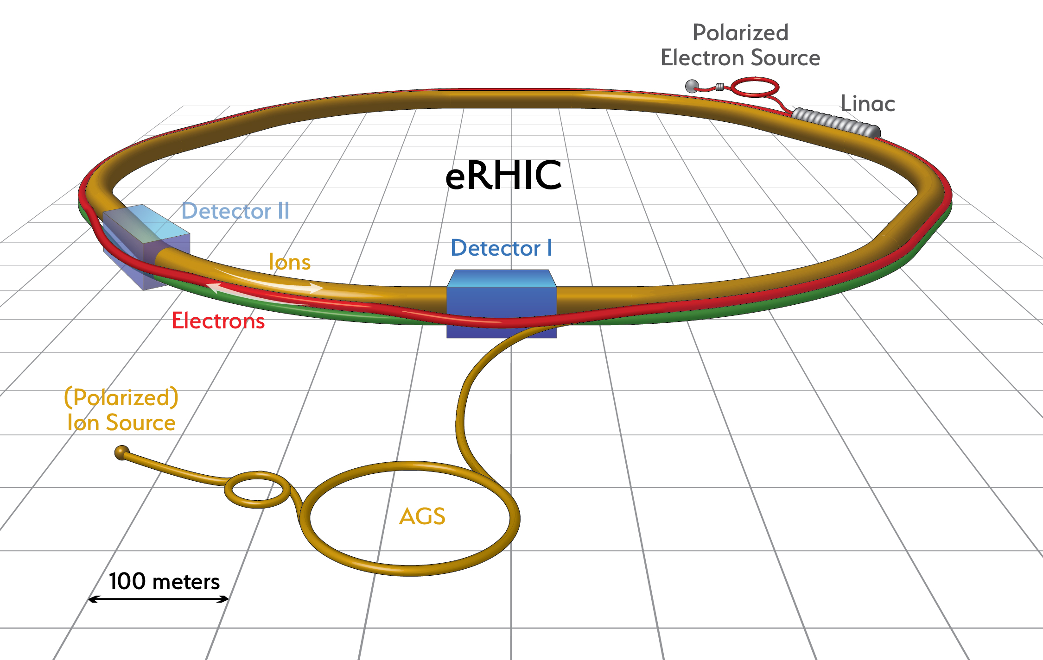
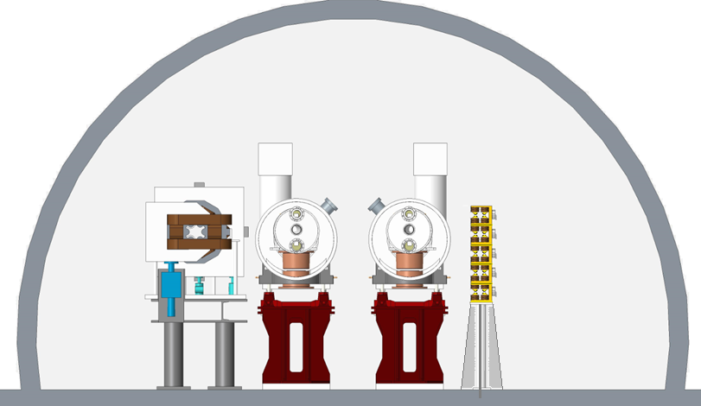
Leveraging RHIC with its
- 250 GeV protons
- large accelerator tunnel
- long straight sections
- Hadron injector complex by adding an electron accelerator of 18 GeV in the same tunnel
- high energy reach
- modest synchrotron radiation
- an electron storage ring (or a ERL)
eRHIC design
From F. Willecke, BNL

Slide 19
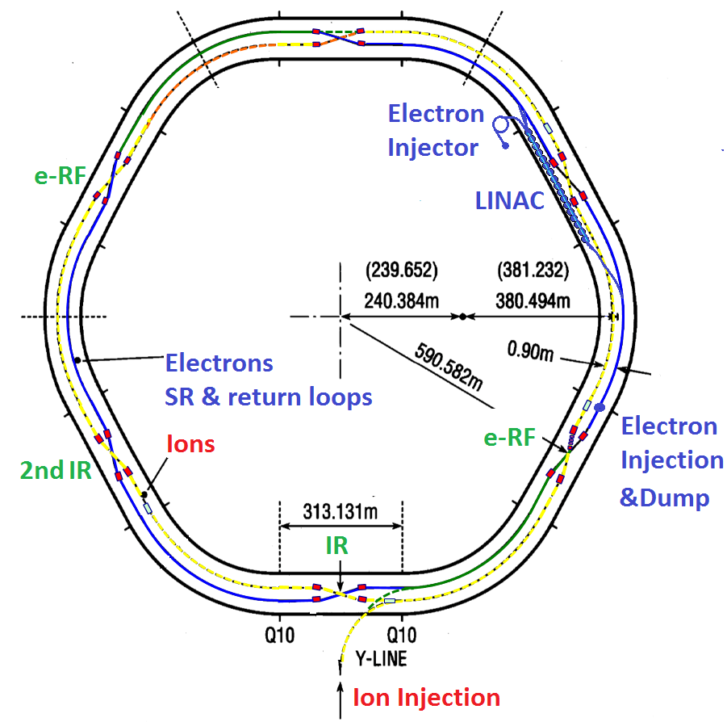
Overall Facility Layout
Issue with large E_{cm} range:
Matching hadron and e revolution times for low hadron energies:
Achieved by:
Increasing the path length for 275 GeV by a combination of going through 4 outer and 2 inner arcs
and using nominal for 50GeV
Plus modifying the entrance into straight sections for fine tuning

Slide 20
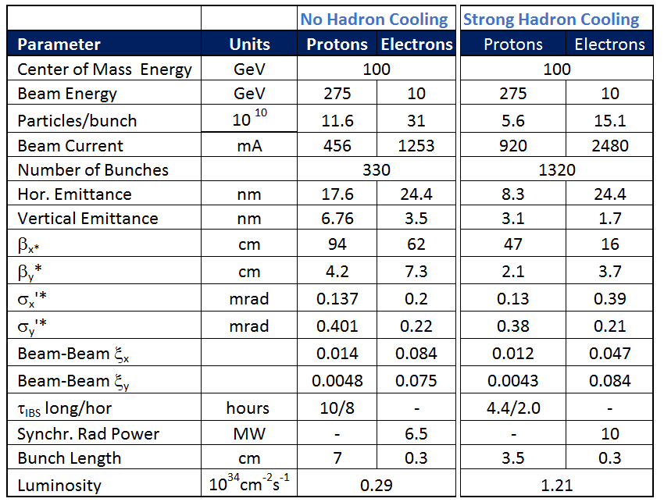
Main Parameters for Maximum Luminosity
E_{p} = 275 GeV, E_{e}= 10 GeV
20

Slide 21
Small Hadron Emittance – Strong cooling
L = 1.2∙ 10³⁴cm⁻²s⁻¹ requires vertical normalized proton emittance 3.1 μm rad, I_{bp}= 0.7 mA, bunch length 7 cm.
These hadron beam parameters are subjected to strong IBS and can be achieved and maintained only be strong active cooling of the Hadron beams with cooling times in the order of minutes.
MAJOR TECHNICAL CHALLENGE FOR ANY EIC
Cooling time < IBS growth time only 0.5 hours
This exceeds the cooling rates possible with stochastic cooling by several orders of magnitude
Coherent Electron Cooling promises to provide required cooling rates
Novel scheme, never implemented
Proof of principle tests in progress
➔ Need novel cooling schemes to meet this challenge.
E < E_{h}
E_{h}
E < E_{h}
Dispersion section
( for hadrons)
E > E_{h}
E_{h}
λ
Hadrons
Modulator
E > E_{h}
Kicker
High gain FEL (for electrons)
Electrons

Slide 22
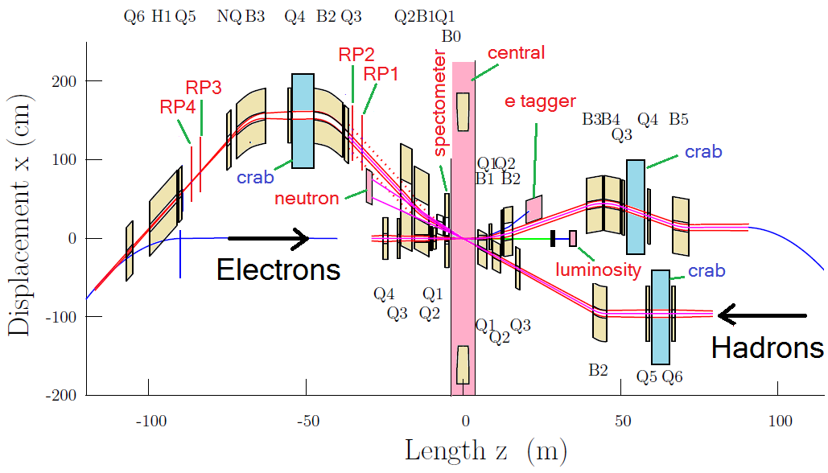
Interaction Region Layout
Interleaved arrangement of electron and hadron quadrupoles
22 mrad total crossing angle, using crab cavities
Beam size in crab cavity region independent of energy – crab cavity apertures can be rather small, thus allowing for higher frequency
Forward spectrometer (B0) and Roman Pots (R1-R4) for full acceptance

Slide 23
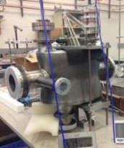
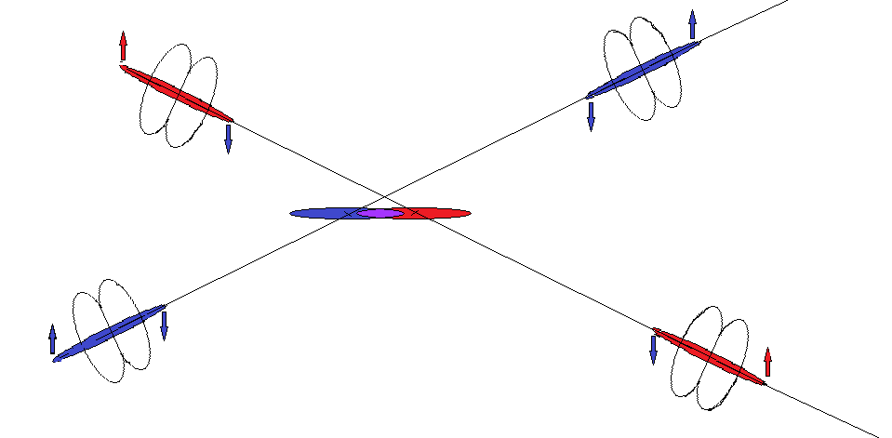
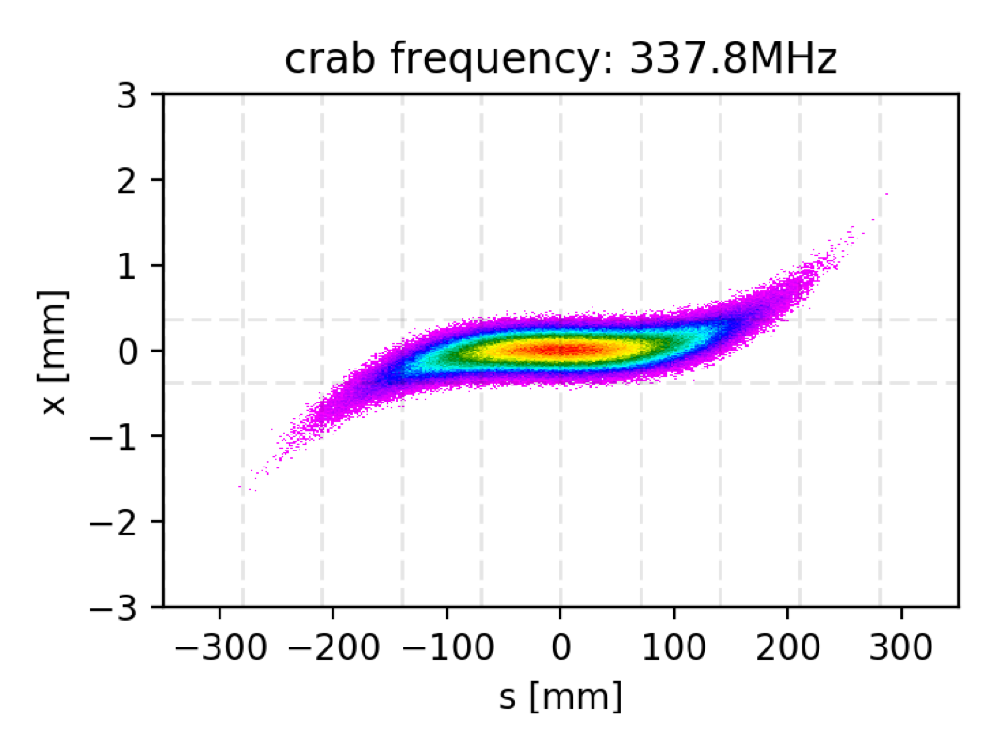
Crossing Angle Geometry and Crab Cavities
Prototype of a double quarter wave length s.c. crab cavity
(father of the prototype to be installed in SPS for the LHC crab cavity test)
Simulation of crabbing and crab cavity effects just started ➔ needs more effort
Example: Results on the quest of Higher Harmonic Crab Cavities
Simulation taking into account
linear BB,
Energy pick up in the cavity
Path length and orbit effects due to dispersion in the crab
Crab dispersion effect
Nonlinear BB with crab: in progress

Slide 24
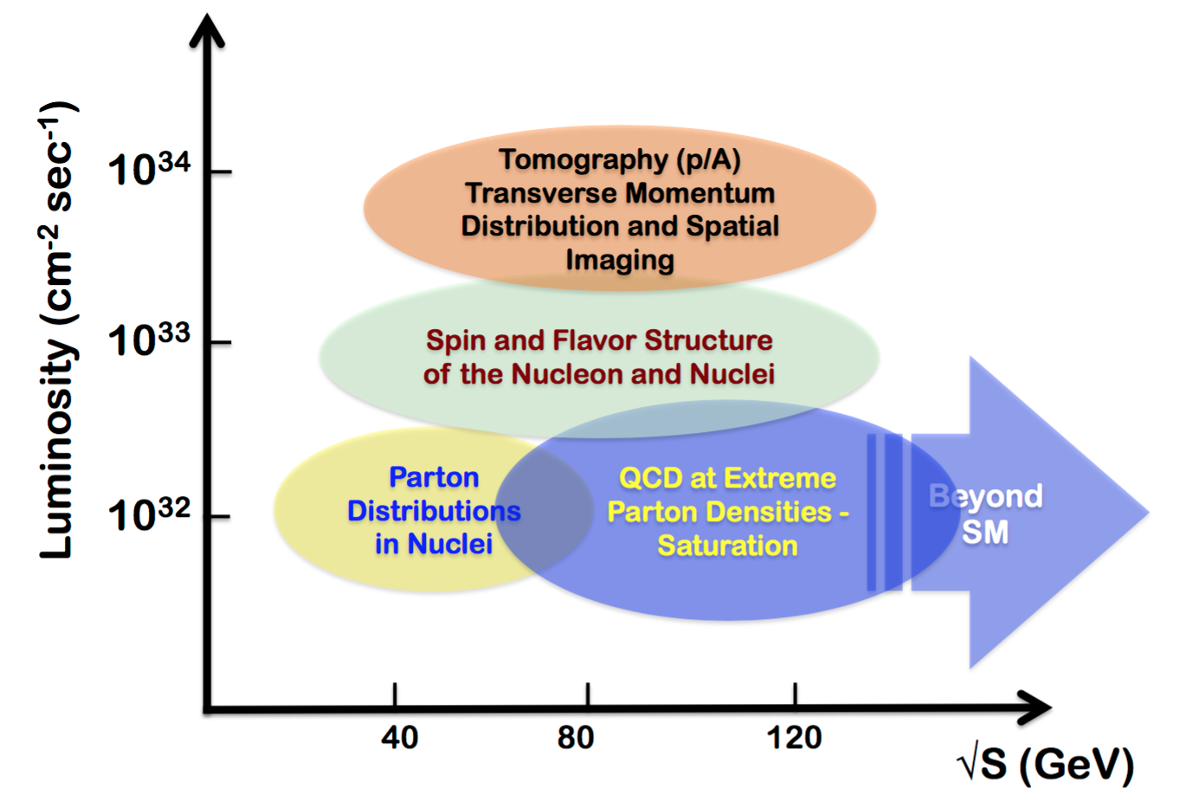
EIC luminosity summary
JLEIC upgrade
eRHIC upgrade

Slide 25
EIC accelerator R&D

Slide 26
R&D Timeline
Pre-project R&D ongoing since 10+ years
JLEIC R&D overview was presented at the NP EIC Community Review Panel (a.k.a. “Jones Panel”) in November 2017
Final Review Panel Report and R&D Priorities released in March 2017
Identified EIC JLAB-BNL Common R&D at JLEIC April Collaboration Meeting
NP EIC R&D FoA was tabled for FY’2017
NP asked for a plan for Accelerator R&D to be submitted by May 31 2017
Plans submitted by May 31 2017

Slide 27
JLEIC R&D areas
R&D activities Higher priority topical areas for EIC R&D funding | Electron Cooling ECL 8 CTE | Magnets MAG 6 CTE | SRF R&D SRF 3 CTE
Bridge design and R&D Executed on base, LDRD and selected EIC R&D funding | Injectors R&D INJ 6 CTE | Interaction Regions IRS 3 CTE | Beam dynamics and diagnostics BDD 8 CTE
Guiding principles
Adopt mature technology where applicable
Focus R&D in critical areas (i.e electron cooling)
look at a 4-5 years timeline
move technical readiness from “low” to “medium” in critical areas
properly identify high priority R&D (judgment call based on technology readiness
and impact on performance and cost)

Slide 28
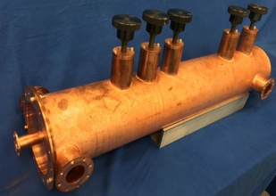
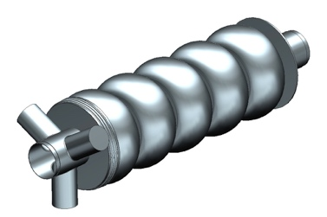
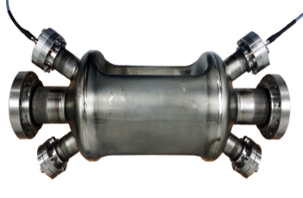
JLEIC R&D progress
e-cooling simulation, beta-cool and new code development
bunched beam electron cooling at IMP
cooler design, preliminary design single-turn cooler
magnetized source, first magnetized beam in spring 2017
fast harmonic kicker – ½ size prototype tested successfully
short SF prototype, mock up winding for 1.2m
IR magnets, initial designs started
ERL cavity, design done, prototype in progress
crab cavity, design started
spin tracking, p and e simulations validating Figure-8
beam beam, GHOST code development progressing

Slide 29
Project development and collaborations
JLAB and BNL have been developing their designs in close collaboration with other US laboratories and Universities for 10+ years
The Long Range Plan endorsement of the EIC has motivated an increased collaboration in the US and a reach to expand the collaboration internationally
An 800+ member international EIC Users Group has been established, next meeting in Trieste in July 18-22 2017
The EIC accelerator community is encouraging national and international collaboration

Slide 30
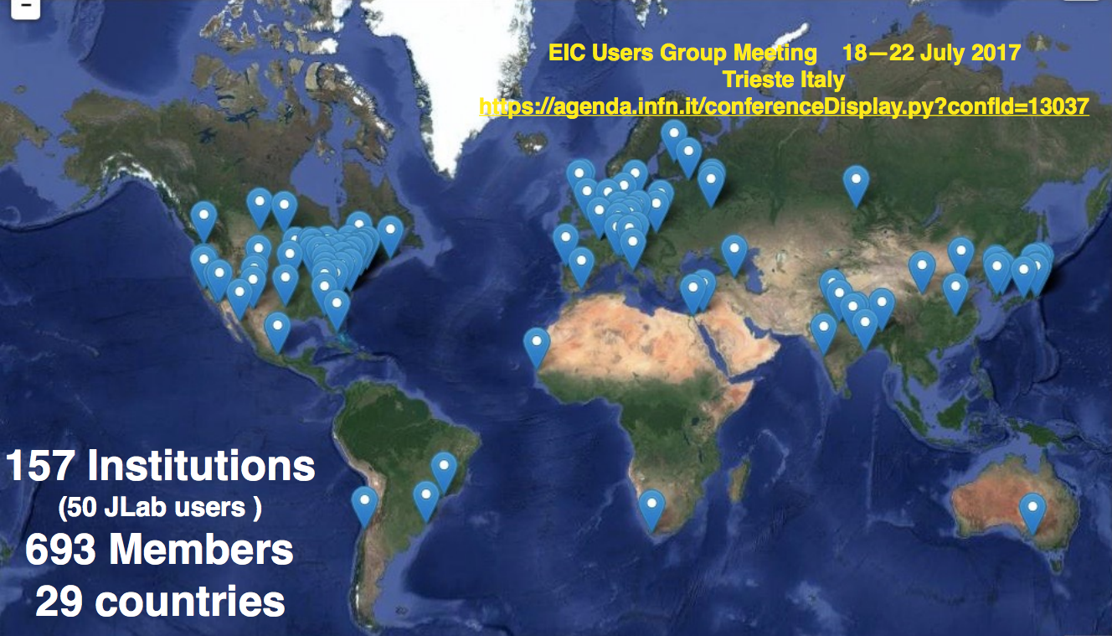
EIC Users Group

Slide 31
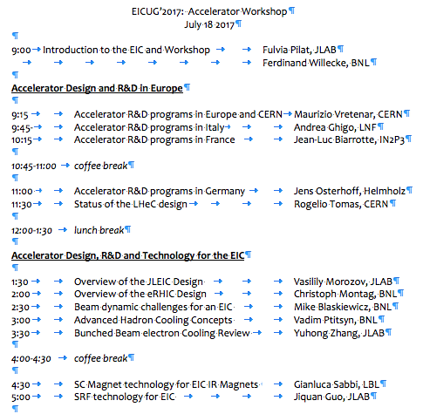
EIC Accelerator outreach
Outreach to EU institutions/funding agencies
EIC event at INFN Genova in January 2017
EIC event at LNF Frascati in March 2017
Presence at EPS high energy physics conference in July 2017
Accelerator workshop at the EICUG in Trieste
Planned outreach in Asia in 2018-19

Slide 32
Conclusions
The recognition in the US of the EIC as the highest priority for new construction in nuclear physics has set firm foundations to build this challenging accelerator
We are looking forward to engaging the national and international scientific communities
Contact info for Fulvia and Ferdinand
Fulvia Pilat, JLAB, pilat@jlab.org
Ferdinand Willecke, willecke@bnl.gov

Slide 33
Backup

Slide 34
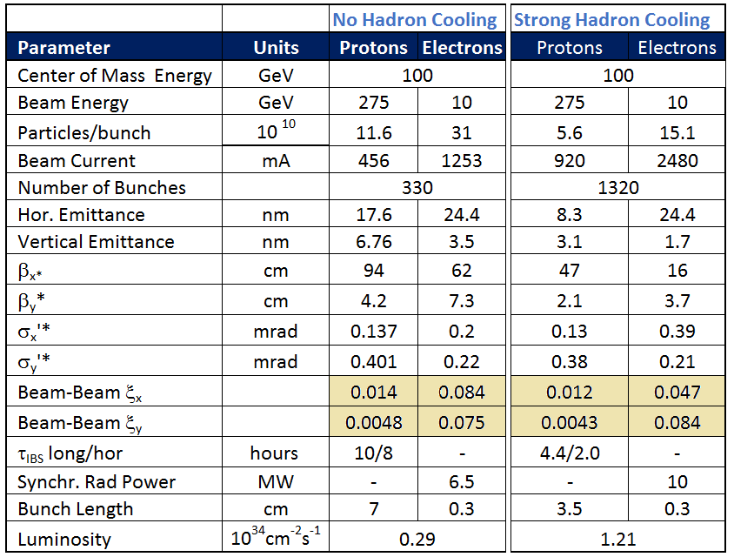
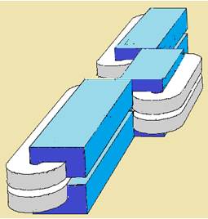
Beam-Beam Parameters Electrons
Large Beam-beam Parameters at 5GeV:
Strong electron Beam-Beam effects require strong radiation damping. Between 5 and 18 GeV τ_{x} changes by a factor 50 without further measures. (11GeV gives KEK-B damping decrement)
➔ With” super-bend” lattice achieve 11 GeV damping time at 5GeV to match KEK-B damping decrement (overcomes as well the E² scaling of beam emittance, helps with polarization)
Radiation Power:
~E²B²
cartoon

Slide 35
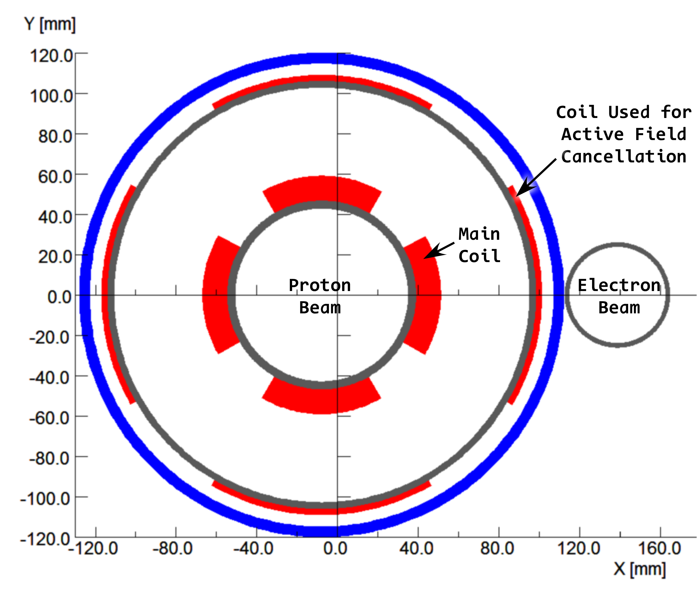
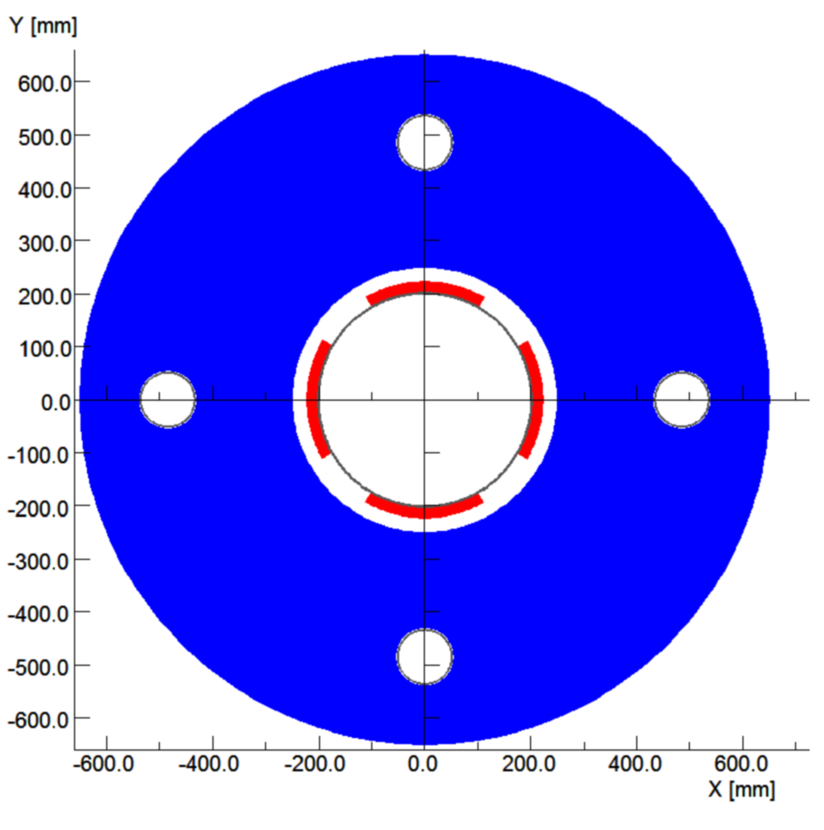
Conceptual Layout of IR Magnets with active shielding
magnets with direct-wound coil including cancelling dipole to shield electron
Hadron superconducting quadrupole with hoses in the return yoke for electrons
Prototype for actively shielded quadrupole Q1 already exists
as part of ILC work
Spectrometer magnet in the Hadron line close to detector: detection of forward scattered Hadron
Generation of dispersion downstream for increased p_{t} acceptance
Conceptual design for super-ferric dipole
With actively shielded pipe for electrons

Slide 36
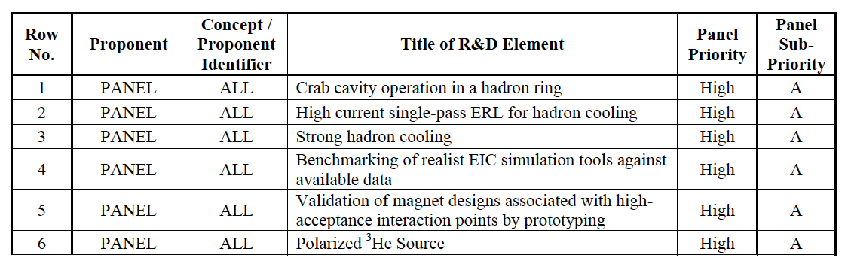
Panel priorities for R&D common to all EIC designs:
The panel reviewed all Critical Technology Elements presented by JLAB and BNL and compiled prorities for :
R&D common to all designs
Project-specific R&D

Slide 37
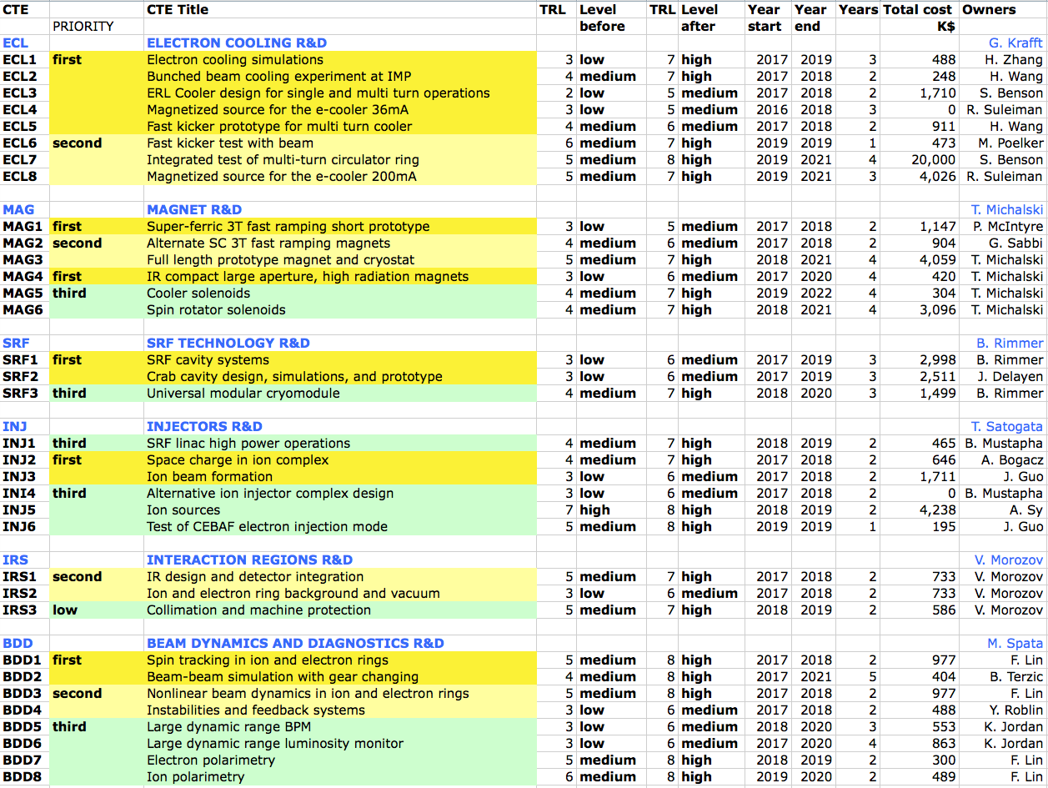
Overview of JLEIC R&D
JLAB LDRD
ANL LDRD

