Slide 1
Effects of RGE’s on fermion observables in SO(10) models
Based on 1409.3703 and 1612.07973
in collaboration with Tommy Ohlsson and Stella Riad
Davide Meloni
Dipartimento di Matematica e Fisica Roma Tre
EPS2017-Venezia

Slide 2
Main point
in GUT theories the Lagrangian is written at the very large scale, so are the Yukawas
but masses and mixing are measured at the EW scale
Extrapolation by several order of magnitude must be done
Question: what if an energy threshold in non-SUSY GUT is present between EW and 10¹⁶ GeV?

Slide 3

What we have to explain
Masses at ElectroWeak scale
Mixing at ElectroWeak scale
leptons
from MeV to GeV
quarks
from MeV to 100 GeV
$$\sum_{i=1}^{3}{m_{i}}≤1\left(ⅇV\right)$$
completely different patterns
for neutrinos:

Slide 4



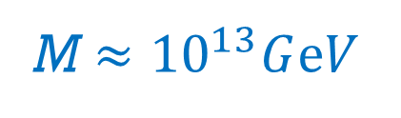


for neutrinos
Type-I see-saw (both left and right-handed helicity states)
$$m_{D}$$
order of magnitude estimate:
$$m_{ν}≈1ⅇV$$
$$m_{D}≈100 GⅇV$$
M $≈{10}^{13}GⅇV$
neutrino masses can shed light on the physics at a much higher scale!

Slide 5
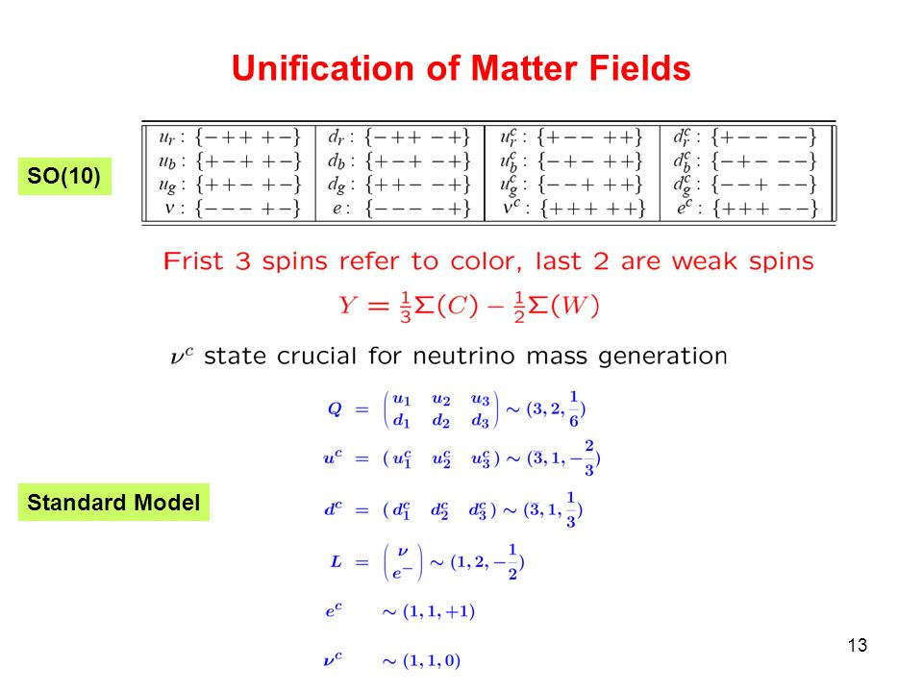

SO(10) as an example
16 :
right-handed neutrino
if masses are given by the Higgs mechanism, we need SU(2)_{L} Higgs doublets
SO(10)
colored states
not relevant here
SU(4) x SU(2)L x SU(2)R

Slide 6
SO(10) as an example
Yukawa couplings: 3x3 symmetric matrices

Slide 7










Masses in SO(10)
as usual, masses in terms of Yukawas and vevs
$$<$$
$$>$$
$$=$$
ku,d
$$<$$
$$>$$
$$=$$
vu,d
$$<$$
$$>$$
$$=$$
vR
these numbers at the GUT scale have been obtained using SM beta functions

Slide 8
Diagrams contributing to the RGE’s
Some typical diagrams
Contributions to the gauge coupling renormalization constants
Renormalization of the Yukawa couplings
corrections to the Higgs couplings
Cheng,Eichten,Li (1974)

Slide 9

Intermediate energy scales
It is well known that SM itself does not unify
Pati-Salam intermediate group:
SU(4) x SU(2)_{L} x SU(2)_{R}
Unification achieved with a large
energy threshold

Slide 10
Numerical strategy
First, the values of the Yukawas at M_{GUT} are randomly generated according to some prior distribution log priors in [10⁻¹⁵, 10⁻¹]
Multinest Feroz&Hobson2008
Then, they are evolved down to M_{Z} after solving the RGEs
Next, at M_{Z}, the observables can then be constructed and compared to experimental data
Finally, the procedure is repeated with new randomly sampled parameter values from a reduced parameter space and the result is given when convergence on the point with largest likelihood occurs

Slide 11

Result I
$$χ^{2}≈13$$
19 free parameters, 17 observables
solid: intermediate scale taken into account
dashed: SM evolution
intermediate scale
main message:
effects of M_{I} not negligible
in the 10-20% range
kinks at M_{I}
see this also in the opposite direction:
observables at the EW do not give the same results at GUT
EW scale

Slide 12
Result II
$$χ^{2}≈13$$
19 free parameters, 17 observables
difference in r is huge
(see-saw and MI coincide)
M_{I}
EW

Slide 13
One conclusion
Extrapolation of neutrino (and fermion) observables from the EW to the GUT scale and viceversa are substantially modified by intermediate energy thresholds
This effect can be as large as 20% for certain observables

Slide 14
RGE’s: dividing the problem in two energy regimes
at the GUT scale
1-
region between M_{GUT} and M_{I}
matching conditions at M_{GUT}
for neutrinos: see-saw formula

Slide 15
RGE’s: dividing the problem in two energy regimes
2-
region between M_{I} and M_{Z}
matching conditions at M_{I}
for neutrinos: effective operator
v_{a,b} are vevs of the light Higgses, k^{(a,b)} are matrices in flavor space subjected to matching conditions at M_{I}

Slide 16
RGE’s
Intermediate scale region

Slide 17
RGE’s
Intermediate scale region: masses of neutrinos

Slide 18
ν masses

Slide 19
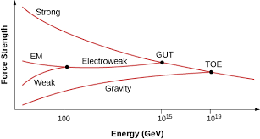
ν masses pointing to Grand Unified Theories
basic idea: at some large energy scale, particles feel a single force
idealized situation
here is where the SM is unified
theory of everything
(forget for the moment, we have problems at much smaller scales)
not far away from the see-saw estimate !

Slide 20
masses and Grand Unified Theories
difficult to fit everything but not impossible…
Altarelli, Meloni (2013)
Dueck, Rodejohann (2013)
and several interesting predictions

