Slide 1
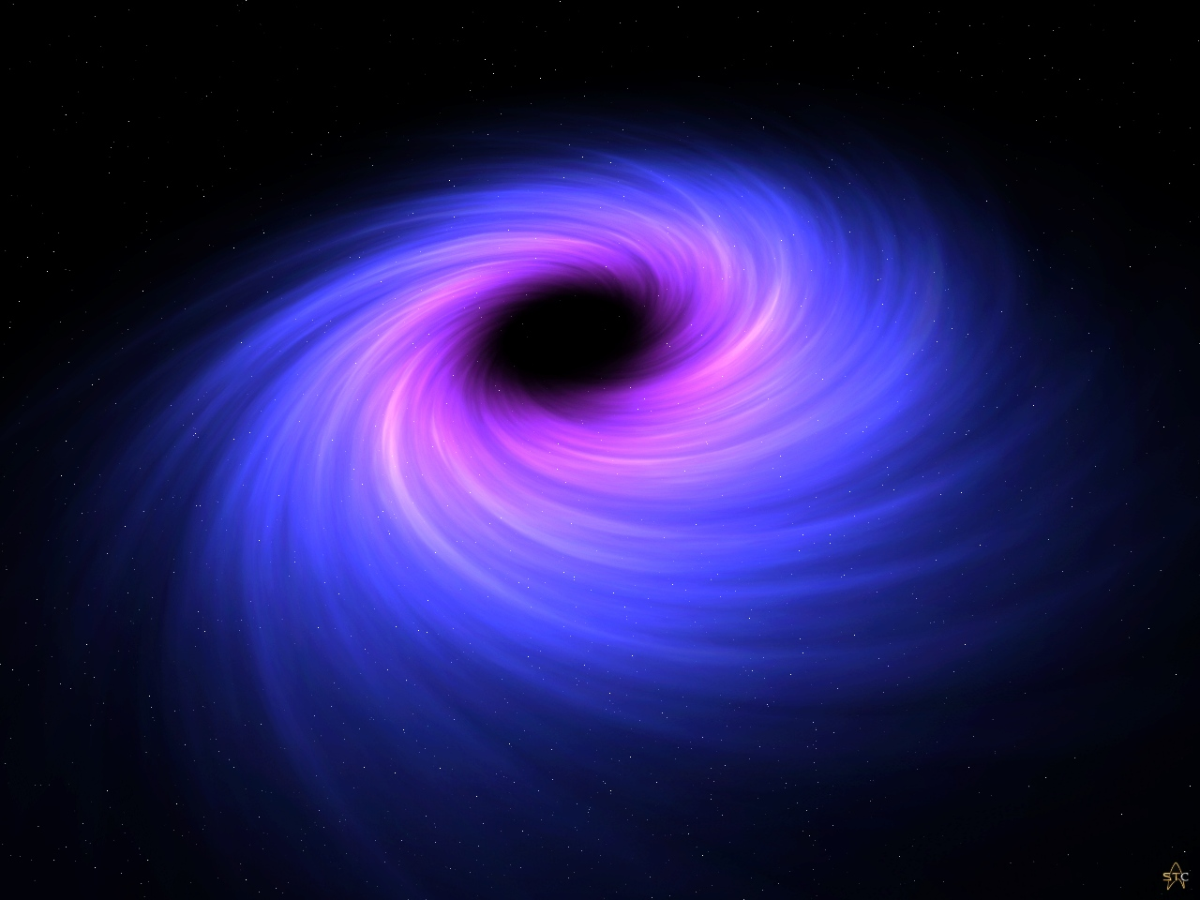
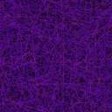




Non-Linear Invariance
of Black Hole Entropy
Alessio MARRANI
“Enrico Fermi” Center, Roma
INFN & University of Padova
EPS HEP 2017, July 8, Venezia

Slide 2
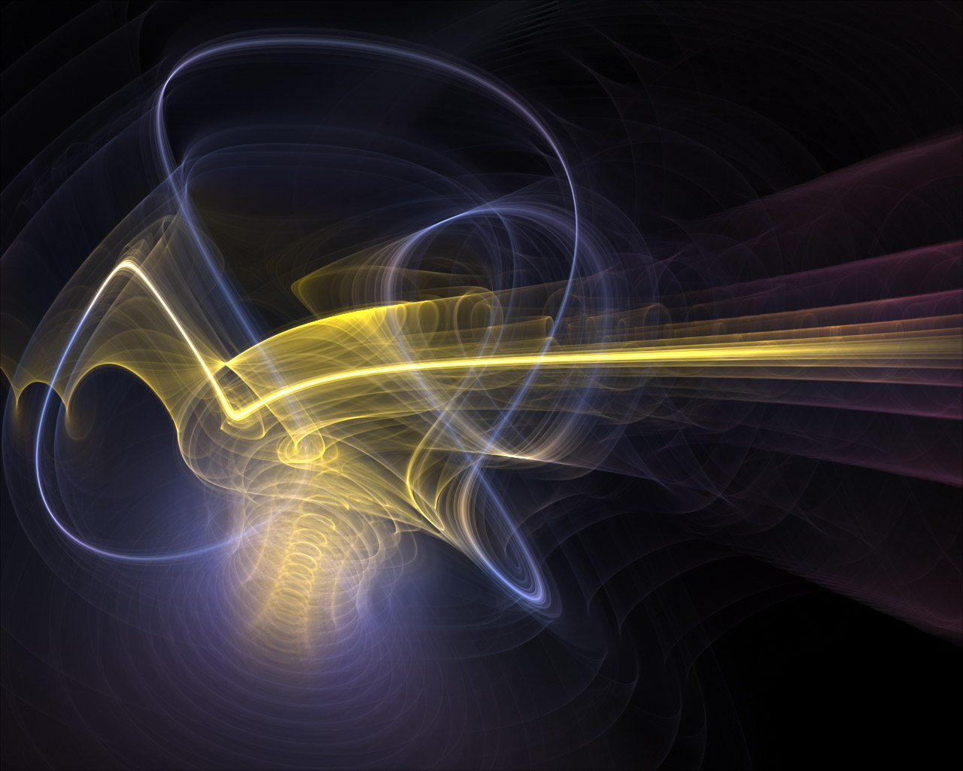
Bibliography
Borsten, Dahanayake, Duff, Rubens, Phys. Rev. D80 (2009) 026003, arXiv:0903.5517 [hep-th]
Ferrara, AM, Yeranyan, Phys. Lett. B701 (2011) 640, arXiv:1102.4857 [hep-th]
Ferrara, AM, Orazi, Trigiante, JHEP 1311 (2013) 056, arXiv:1305.2057 [hep-th]
AM, Freudenthal Duality in Gravity : from Groups of Type E7 to Pre-Homogeneous Vector Spaces,
in : ‘Group Theory, Probability, and the Structure of Spacetime’ : in honor of V. S. Varadarajan,
arXiv:1509.01031 [hep-th]
Klemm, AM, Petri, Rabbiosi, JHEP 1704 (2017) 013, arXiv:1701.08536 [hep-th]
Mandal, AM, Tripathy, IJMPA (2017, in press), arXiv:1703.08669 [hep-th]
see also (other applications)
Borsten, Duff, Ferrara, AM, Class. Quant. Grav. 30 (2013) 235003, arXiv:1212.3254 [hep-th]
Galli, Meessen, Ortin, JHEP 1305 (2013) 011, arXiv:1211.7296 [hep-th]
AM, Qiu, Shih, Tagliaferro, Zumino, JHEP 1303 (2013) 132, arXiv:1208.0013 [hep-th]
Fernandez-Melgarejo, Torrente-Lujan, JHEP 1405 (2014) 081, arXiv:1310.4182 [hep-th]

Slide 3
Summary
Maxwell-Einstein-Scalar Gravity Theories
Extremal Black Holes
Attractor Mechanism
Freudenthal Duality
Groups of type E₇
Hints for the Future…

Slide 4
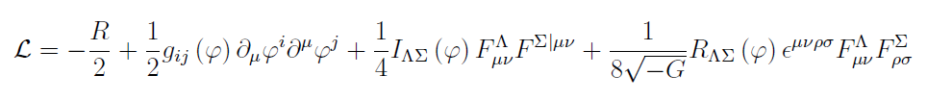
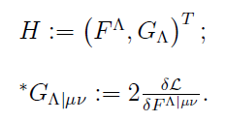

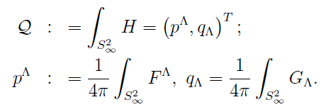
Maxwell-Einstein-Scalar Theories
D=4 Maxwell-Einstein-scalar system (with no potential)
[ may be the bosonic sector of D=4 (ungauged) sugra ]
Abelian 2-form field strengths
static, spherically symmetric, asymptotically flat, extremal Black Hole (BH)
dyonic vector of e.m. fluxes
(BH charges)

Slide 5



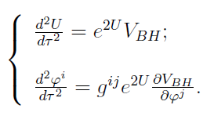



reduction D=4 →D=1 :effective 1-dimensional (radial) Lagrangian
BH effective potential
Ferrara,Gibbons,Kallosh ‘96
in N=2 ungauged sugra,
hyper mults. decouple, and we thus
disregard them : scalar fields
belong to vector mults.
eoms
Attractor Mechanism :
near the horizon, the scalar fields are stabilized purely in terms of charges
Bekenstein-Hawking entropy-area formula for extremal dyonic BH

Slide 6




Particular Class : Symmetric Scalar Manifolds
A remarkable class of Einstein-Maxwell-scalar theories is endowed with scalar
manifolds which are symmetric cosets G/H
[in presence of local SUSY :N>2 : general, N=2 : particular, N=1 : special cases ]
H = isotropy group = linearly realized; scalar fields sit in an H-repr.
G = (global) electric-magnetic duality group, on-shell symmetry
General Features in D=4
The 2-form field strengths (F,G) vector and the BH e.m.
charges sit in a G-repr. R which is symplectic :
symplectic product
in physics : Gaillard-Zumino embedding
(generally maximal, but not symmetric)
[ application of a Th. of Dynkin ]

Slide 7
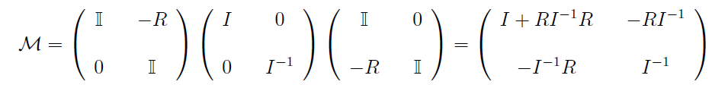



Let’s reconsider the starting Maxwell-Einstein-scalar Lagrangian density
…and introduce the following real 2n x 2n matrix :
L = element of the Sp(2n,R)-bundle over the scalar manifold
( = coset representative for homogeneous spaces G/H)

Slide 8





By virtue of this matrix, one can introduce a (scalar-dependent) anti-involution
in any Maxwell-Einstein-scalar gravity theory in D=4:
Ferrara,AM,Yeranyan; Borsten,Duff,Ferrara,AM
In turn, this allows to define an anti-involution on the dyonic charge vector Q,
which has been named (scalar-dependent) Freudenthal duality (F-duality)
By recalling
F-duality is the symplectic gradient of the effective BH potential :

Slide 9



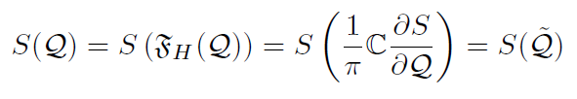
All this enjoys a nice physical interpretation when evaluated at the BH horizon :
Attractor Mechanism
Bekenstein-Hawking
entropy
By evaluating the matrix M at the horizon :
one can define the horizon F-duality as:
It is a non-linear (scalar-independent) anti-involutive map on Q (hom of degree 1)
Bek.-Haw. entropy is invariant under its own non-linear symplectic gradient (i.e., F-duality) :
This can be extended to include at least all quantum corrections
with homogeneity 2 or 0 in the BH charges Q
Ferrara, AM, Yeranyan (and late Raymond Stora)

Slide 10





Lie groups of type E₇ : (G,R)
Brown (1967);
Garibaldi; Krutelevich;
Borsten,Duff et al.
Ferrara,Kallosh,AM;
AM,Orazi,Riccioni
the (ir)repr. R is symplectic :
symplectic product
the (ir)repr. admits a completely symmetric invariant rank-4 tensor
(K-tensor)
G-invariant quartic polynomial
defining a triple map in R as
it holds
this third property makes a group of type E₇ amenable to a description
as automorphism group of a Freudenthal triple system (FTS)

Slide 11

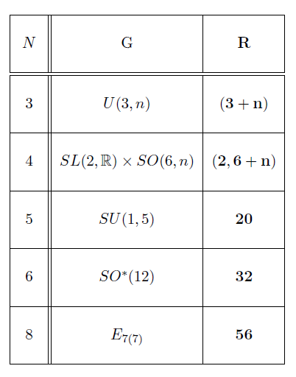
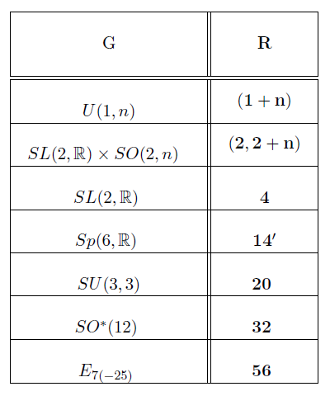


Evidence : all electric-magnetic duality groups of D=4 ME(S)GT’s with
symmetric scalar manifolds (and at least 8 supersymmetries) are of type E₇
(E₇, 912 – embedding tensor N=8/N=2 exc, D=4)
satisfies the first two Brown’s axioms,
but not the third one!
“degenerate” groups of type E₇

Slide 12



In D=4 sugras with the previous electric-magnetic duality group of type E₇,
the G-invariant K-tensor determining the
extremal BH Bekenstein-Hawking entropy
can generally be expressed as adjoint-trace of the product of G-generators
(dim R = 2n, and dim Adj = d)
The horizon F-duality can be expressed in terms of the K-tensor
Borsten,Dahanayake,Duff,Rubens
and the invariance of the BH entropy under horizon F-duality can be recast as

Slide 13
Hints for the Future…
extension to “small” [intrinsically quantum] Black Holes :
how to define F-duality ?
extension to multi-centered (extremal) BH solutions:
Yeranyan; Ferrara,AM,Shcherbakov,Yeranyan
into the quantum regime of gravity [e.m. duality over discrete fields]:
F-duality for integer, quantized charges ?
Borsten, Duff et al.
application in flux compactifications : U-duality inv. expression of the
cosmological constant [Cassani, Ferrara, AM, Morales, Samtleben]
interpretation in string theory / M-theory ? Still mysterious…
Work in progress….

Slide 14
Thank You!

