Slide 1
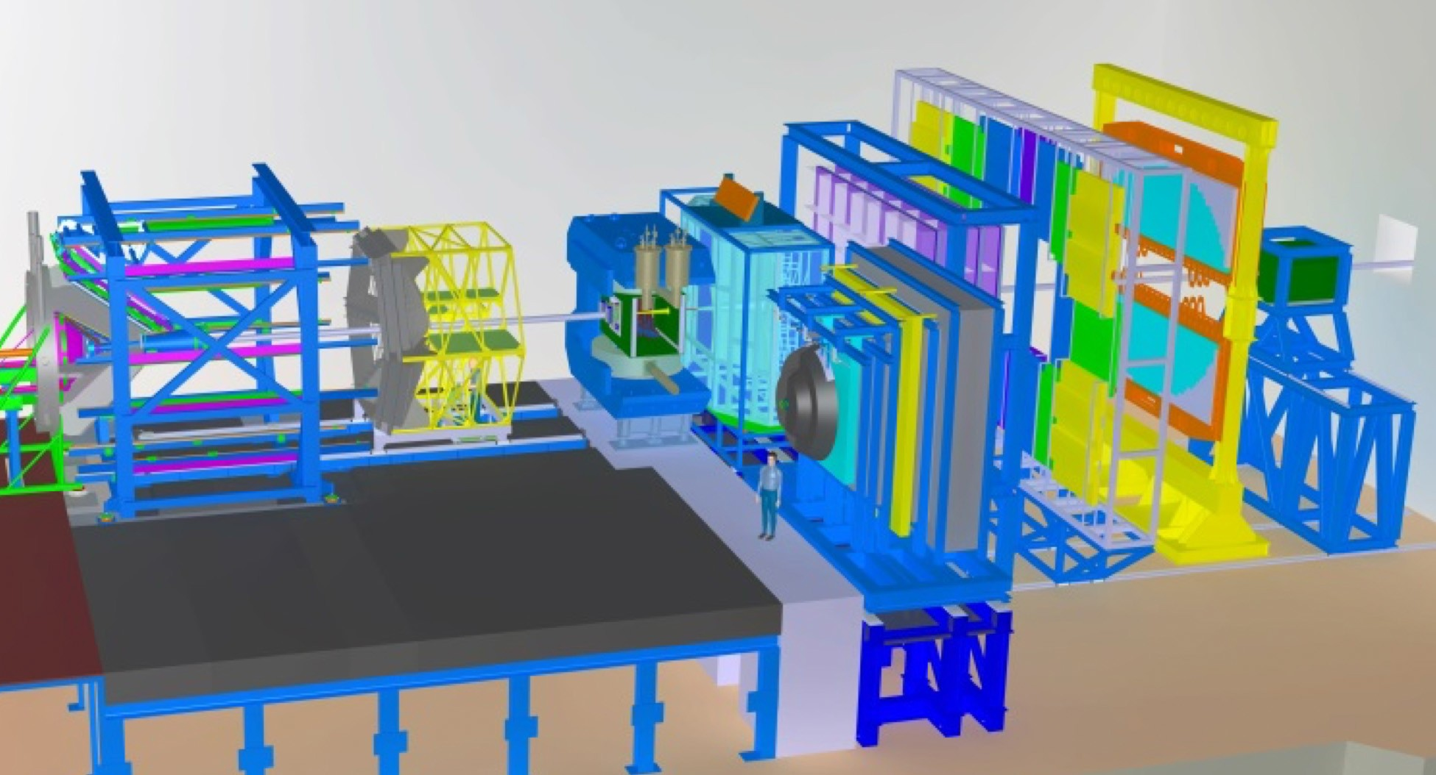
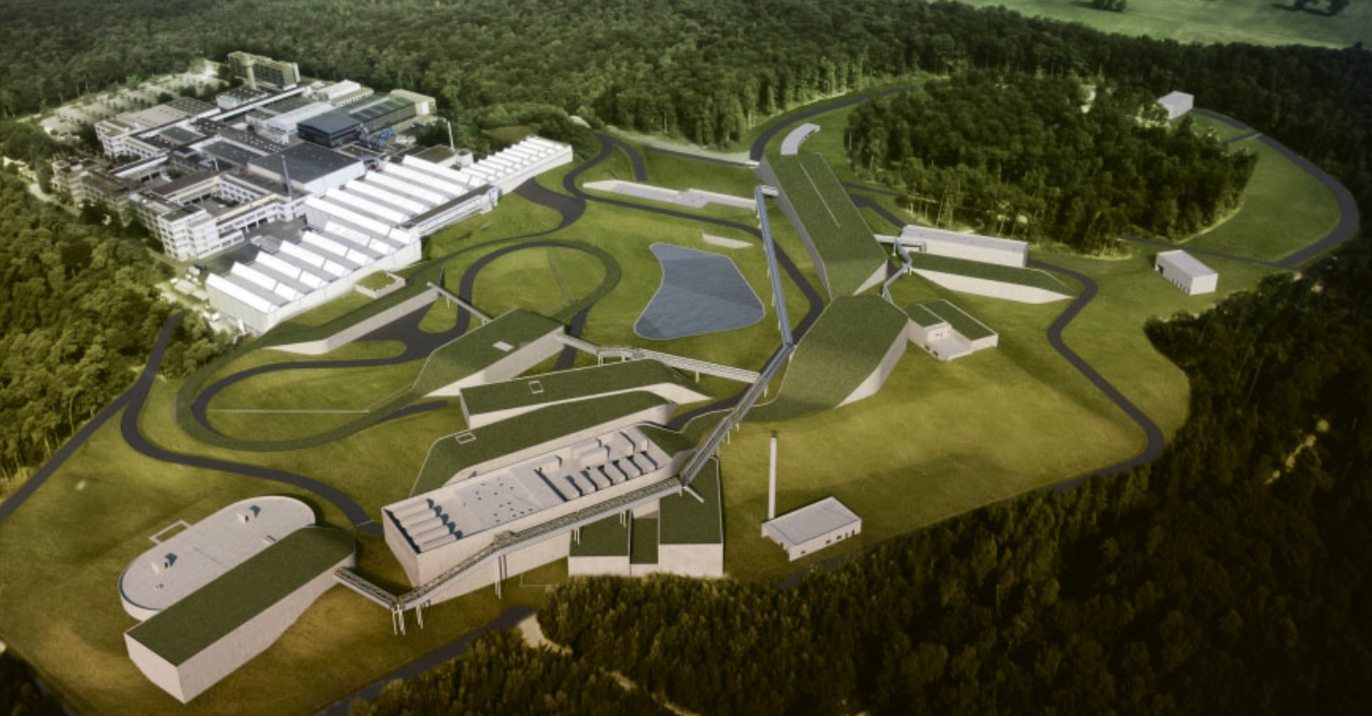
Status of the
Compressed Baryonic Matter Experiment at FAIR
Hans Rudolf Schmidt
University of Tübingen & GSI Darmstadt
EPS Conference on High Energy Physics
Venice, Italy 5-12 July 2017

Slide 2
Outline
Physics: Exploration of Dense Matter with new, rare probes
  Focus^{(*)} on strange matter
    (sub)threshold production of
    multi-strange hyperons
    (double)-hyper-nuclei
Status of CBM
  CBM-FAIR Phase 0 program
  ^{(*)} Not covered (because of time constraints)
    bulk observables
      fluctuations, correlations, ….
    Hadrons in Dense Matter
      low mass vector mesons
      charm & open charm
    Dileptons
unique feature of CBM

Slide 3
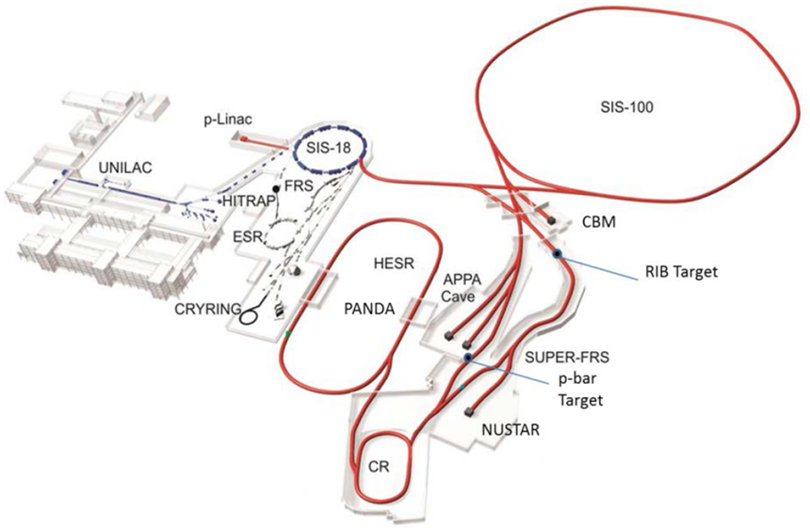
FAIR Accelerator Complex
SIS100 beams:
AuAu: 11 AGeV
pA: 30 GeV
CBM
100 m
FAIR:
fully operational 2015
GSI

Slide 4
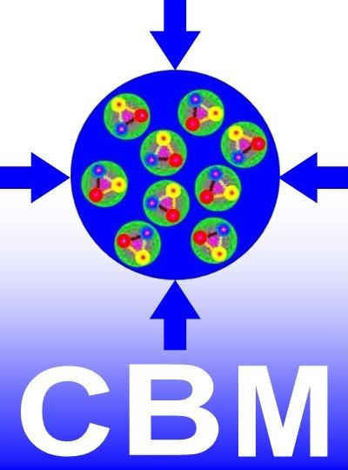
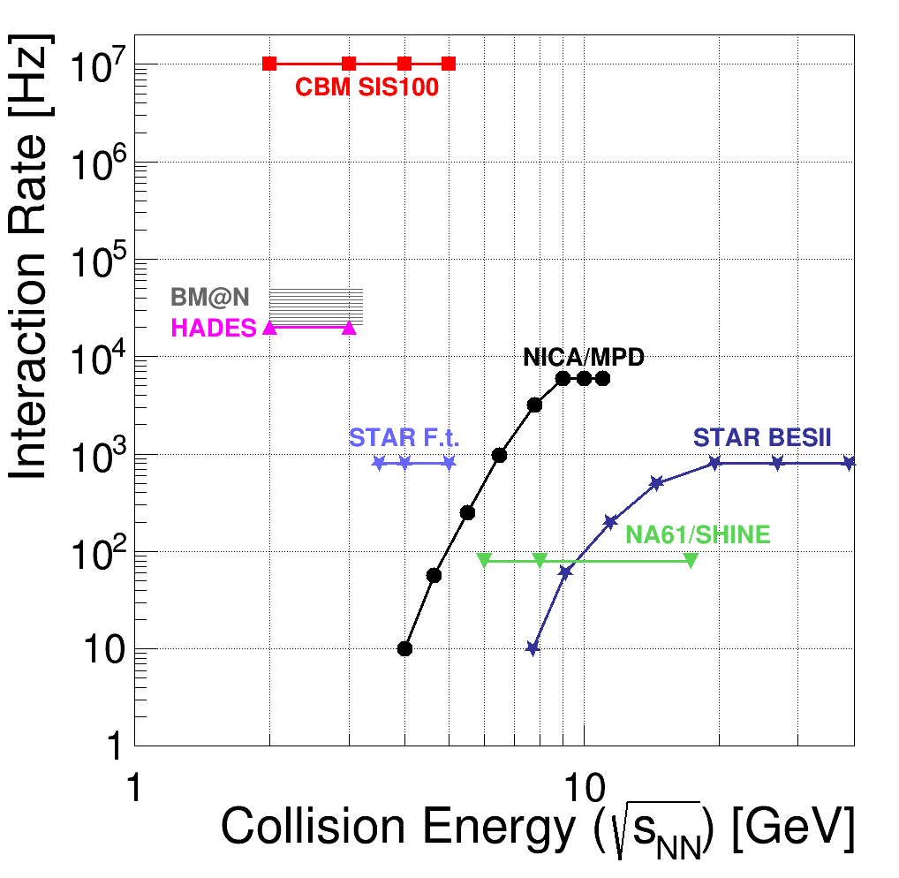
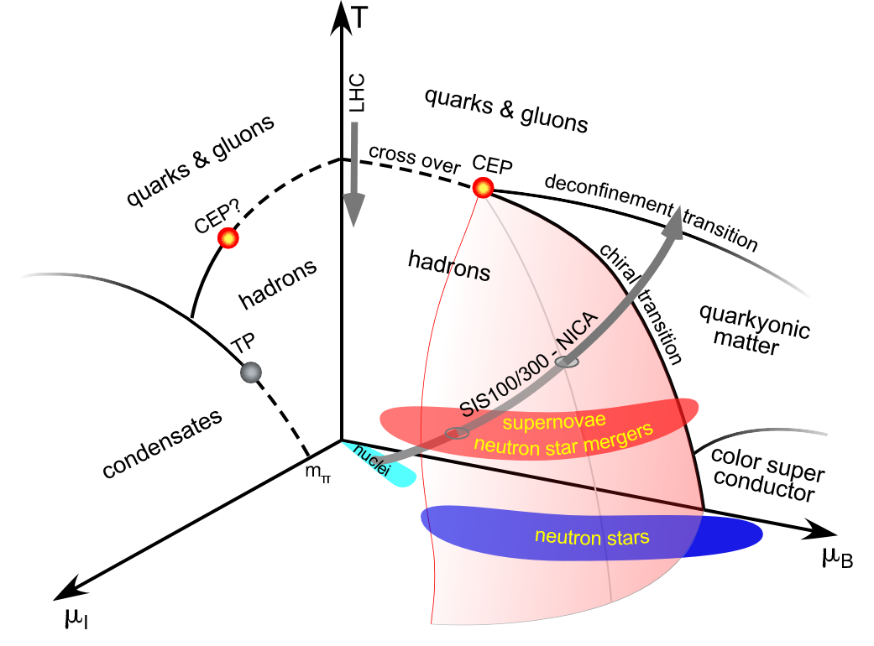
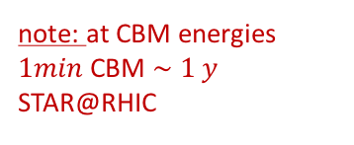
Probing the QCD 3D-Phasedigramm
equation of state (EOS) at neutrons star densities
search for the limits of hadronic existence at moderate temperature and high density
QCD critical end point
highest
net-baryon densities
note: at CBM energies $1min$CBM $\sim 1 y$ STAR@RHIC

Slide 5
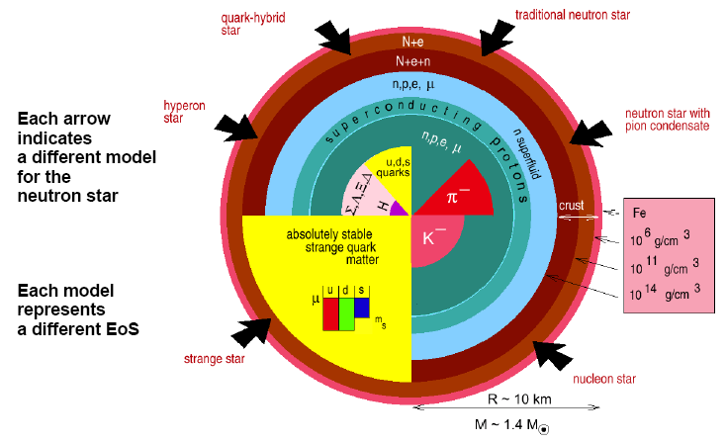
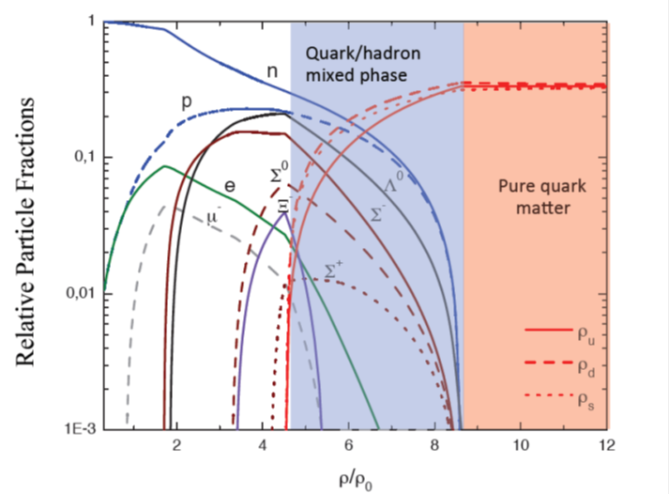
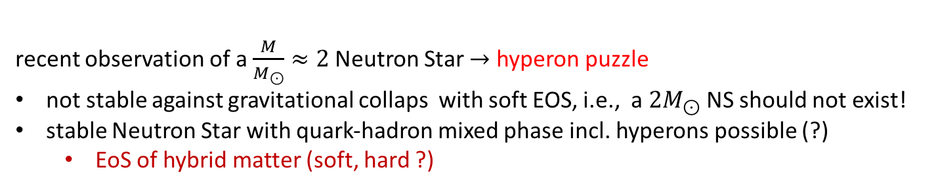
CBM Physics
QCD matter at finite baryon densities is not understood, neither experimentally not theoretically!
Example:
M. Orsaria, H. Rodrigues, F. Weber, G.A. Contrera
Phys. Rev. D 87, 023001 (2013)
recent observation of a $\frac{M}{M_{⊙}}≈2$Neutron Star $→$ hyperon puzzle
not stable against gravitational collaps with soft EOS, i.e., a ${2M}_{⊙}$ NS should not exist!
stable Neutron Star with quark-hadron mixed phase incl. hyperons possible (?)
  EoS of hybrid matter (soft, hard ?)

Slide 6
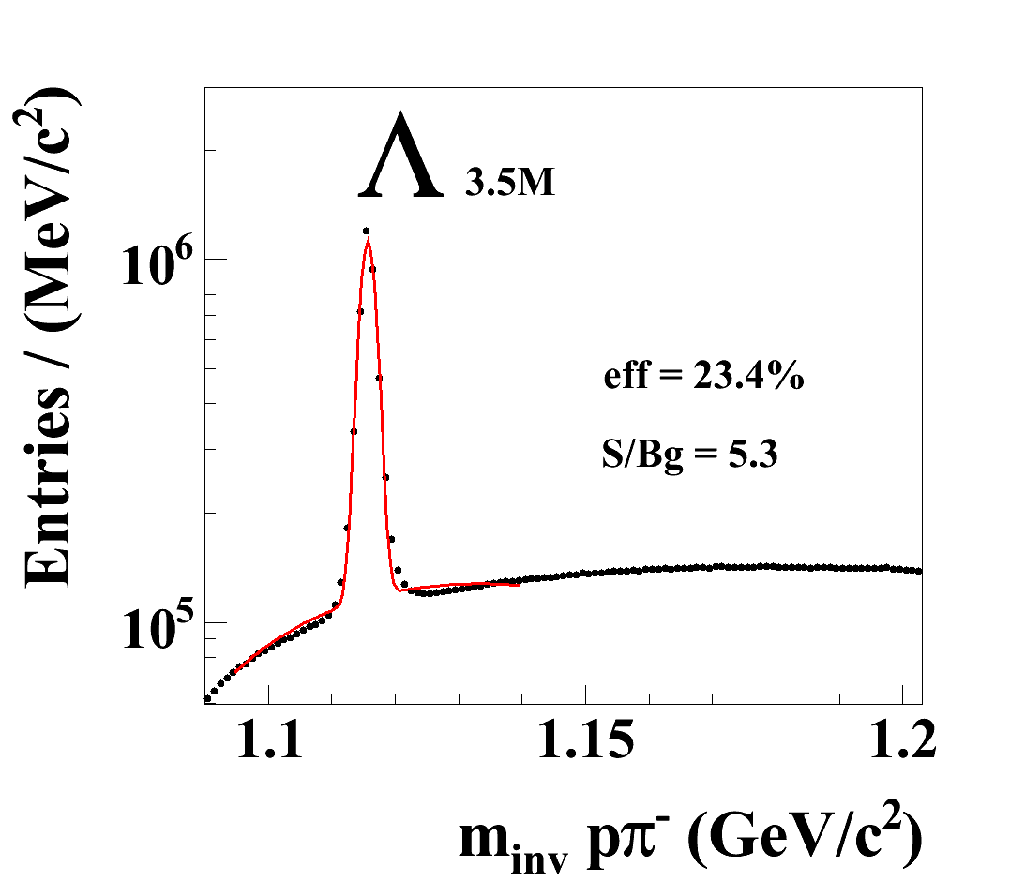
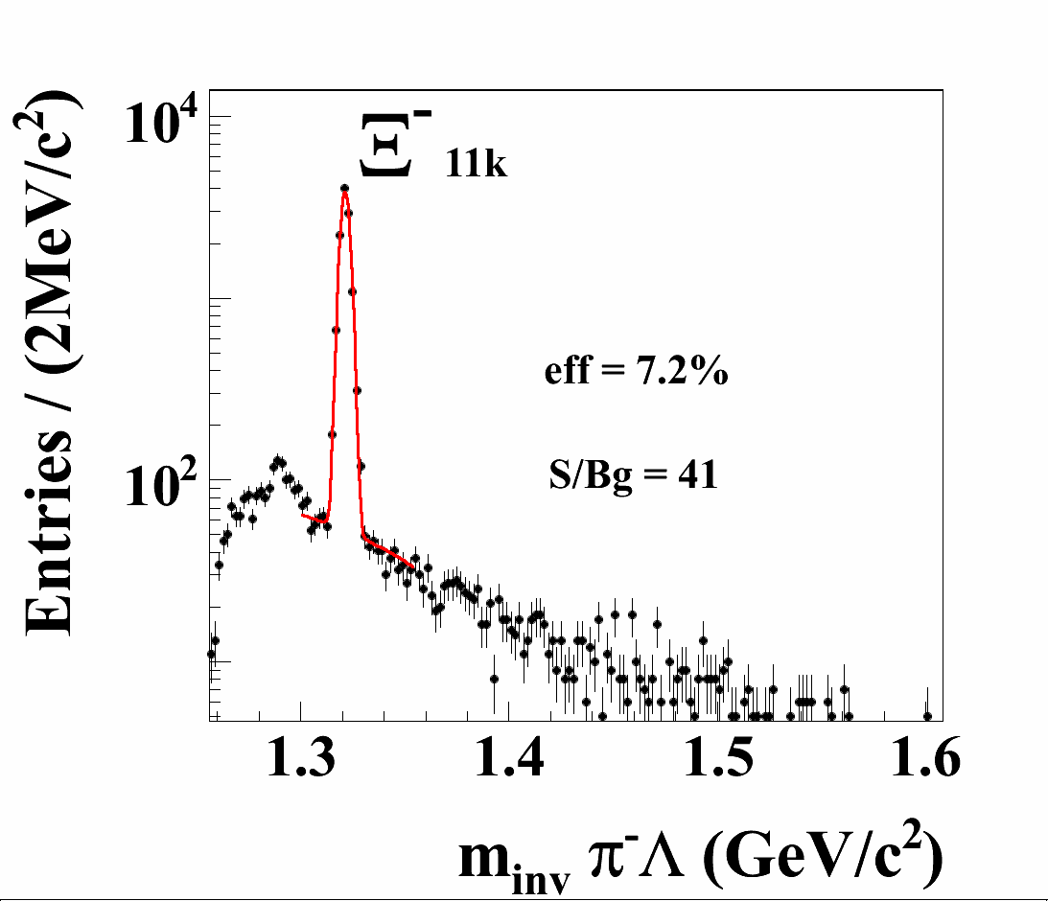
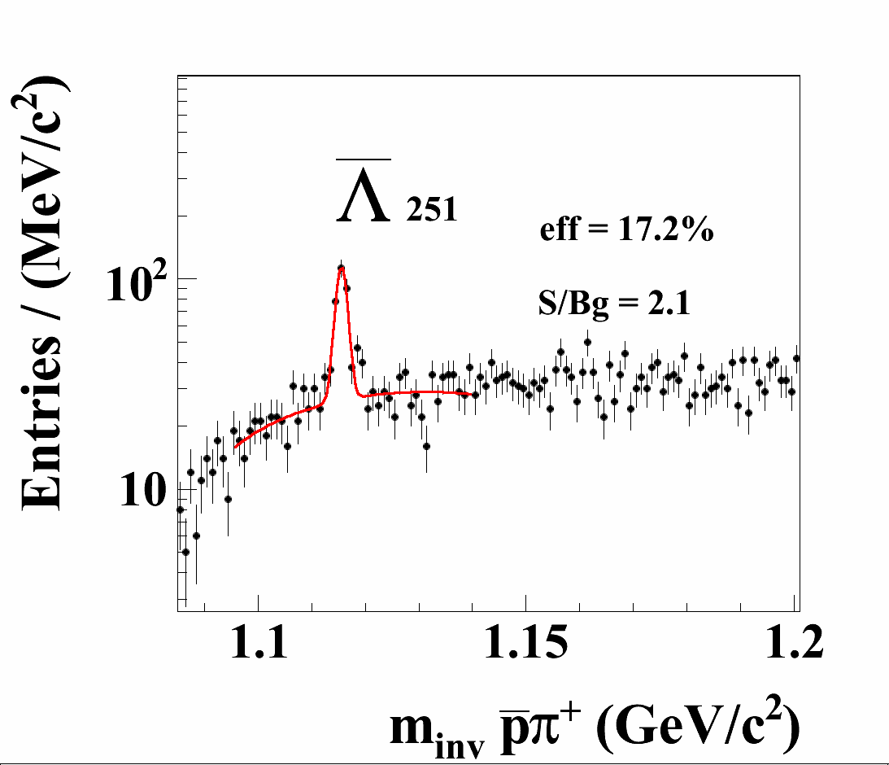
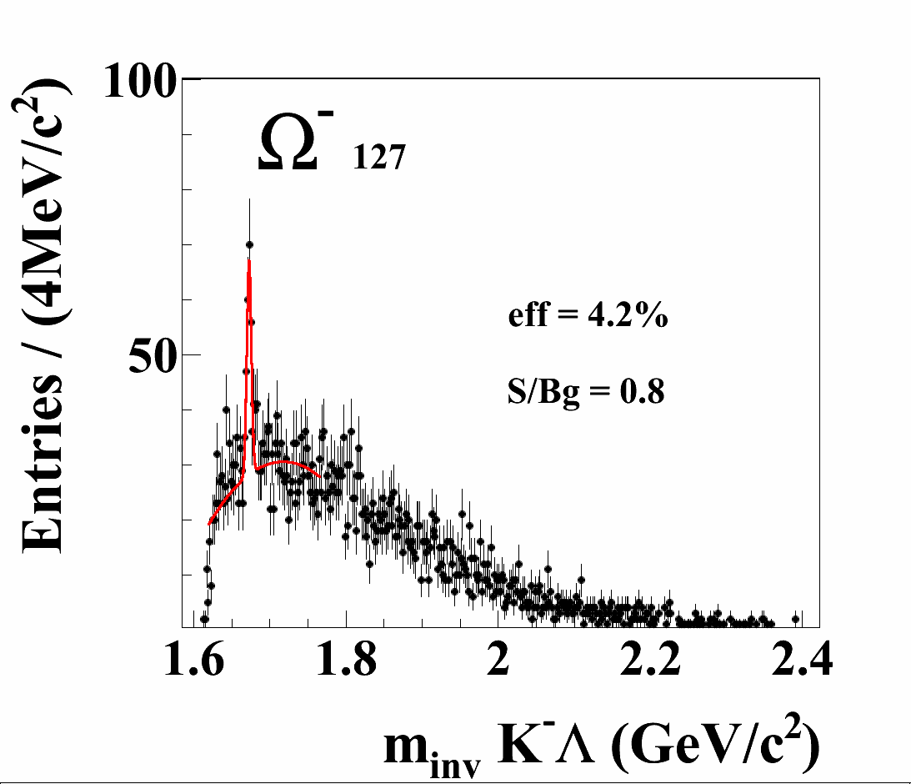
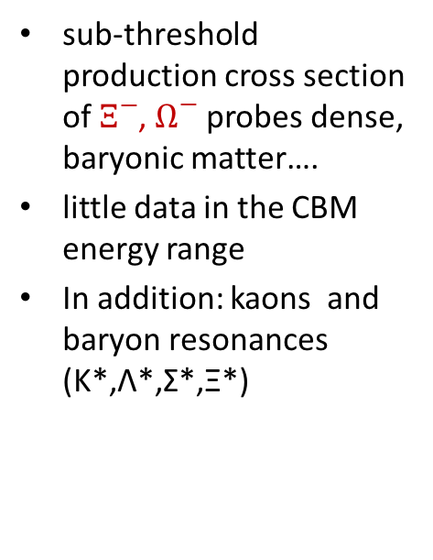
CBM as a „Hyperon Factory“
Simulations: Au+Au at 8 A GeV, 10⁶ central collisions
promise and challenge of CBM: data taking of a few seconds at 10⁷ Hz
sub-threshold production cross section of $Ξ^{−}$, $Ω^{−}$ probes dense, baryonic matter….
little data in the CBM energy range
In addition: kaons and baryon resonances (K*,Λ*,Σ*,Ξ*)

Slide 7
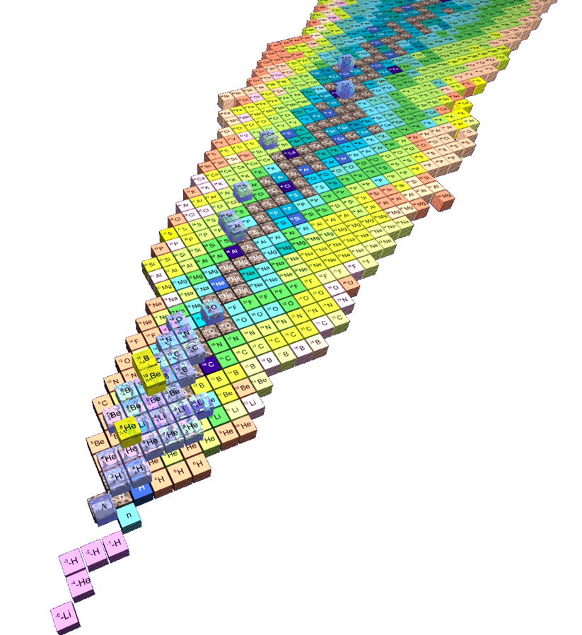
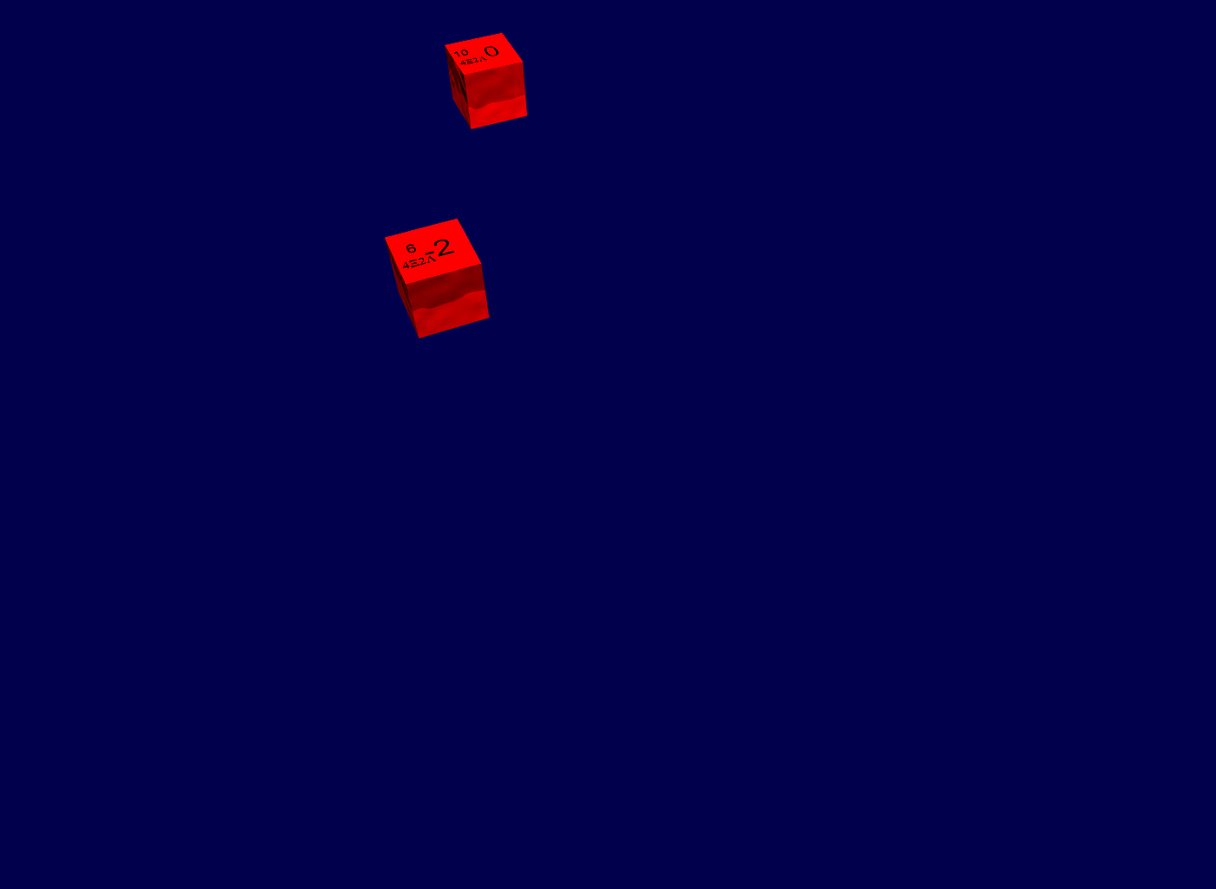
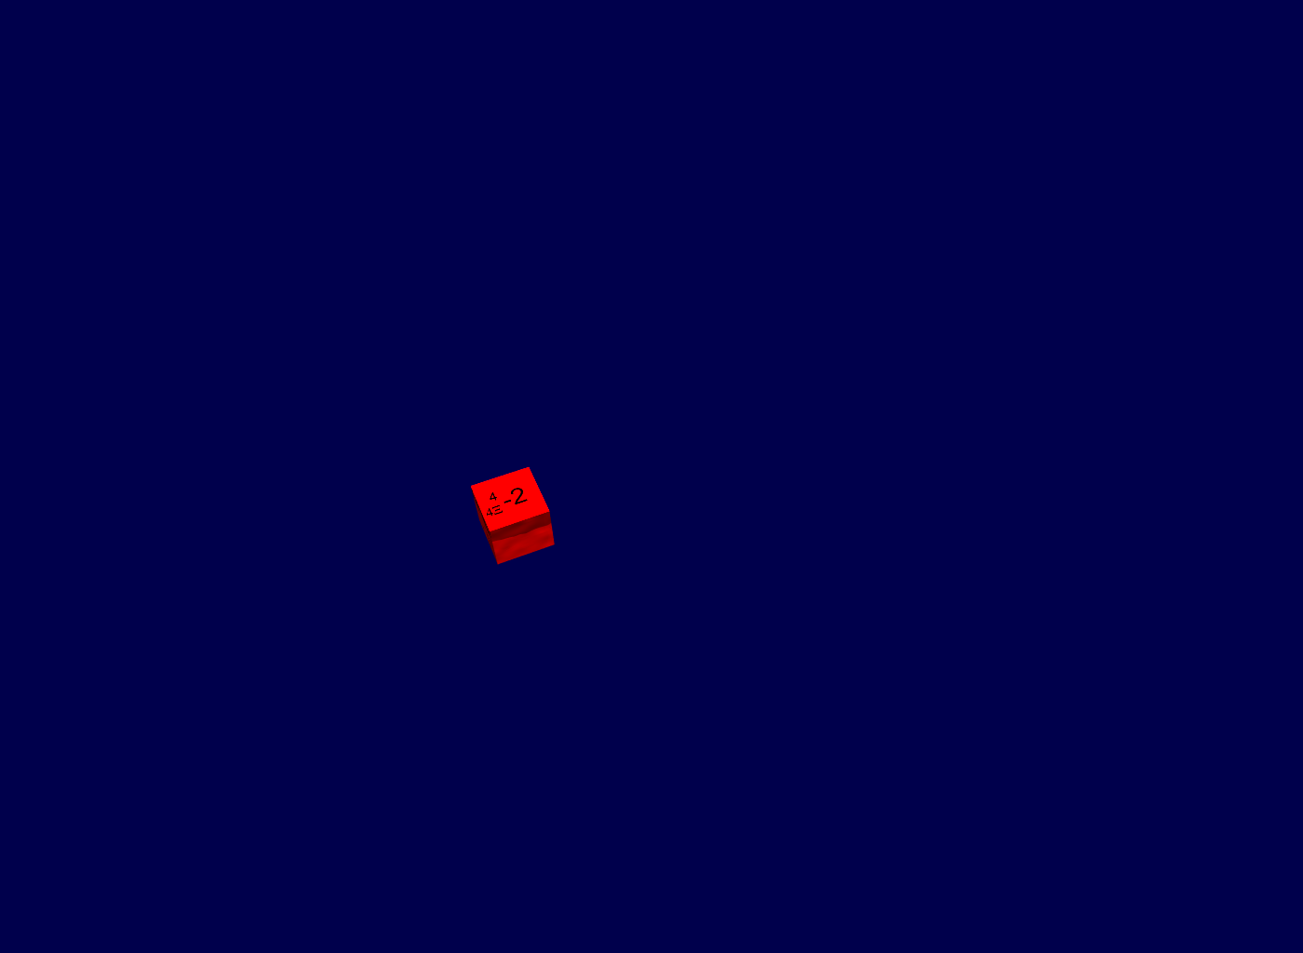
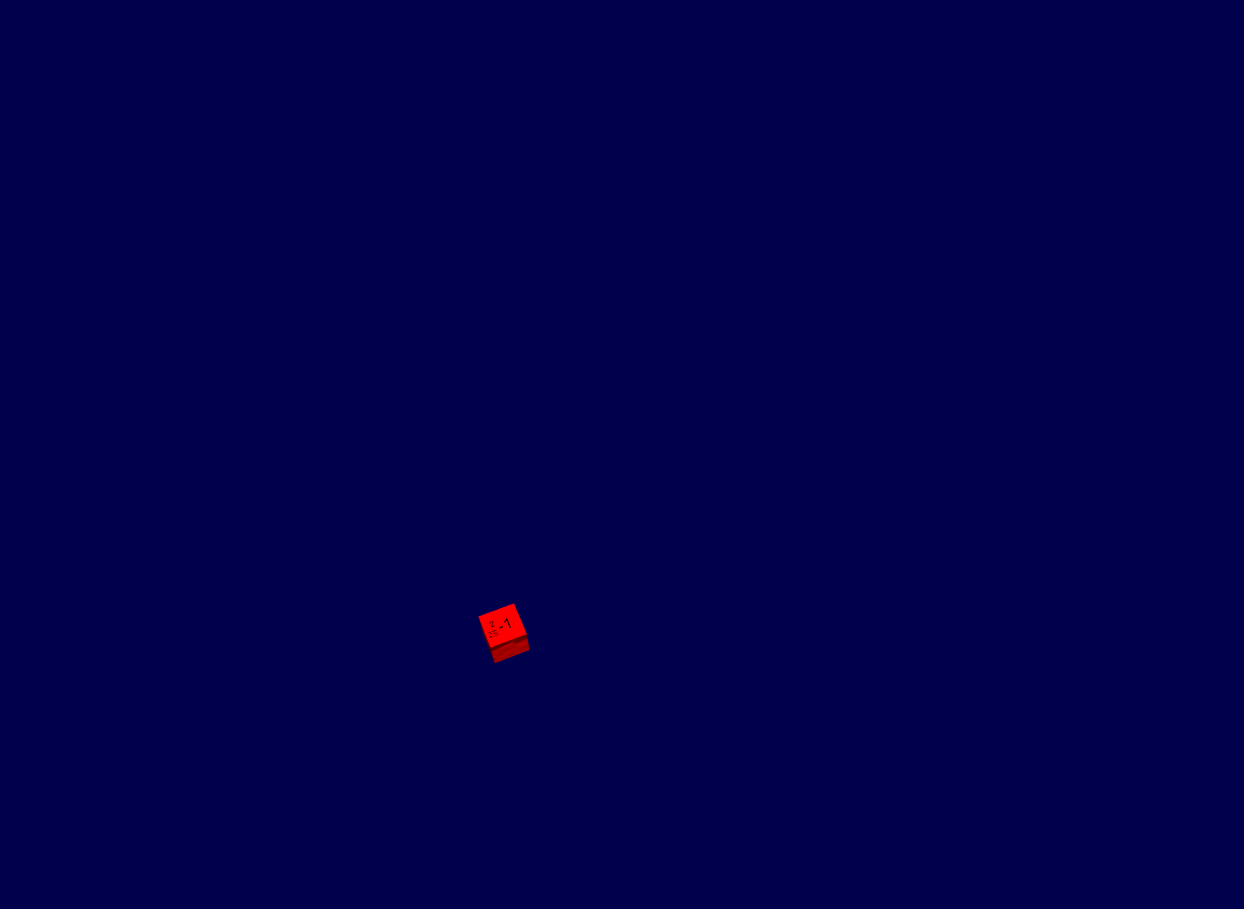
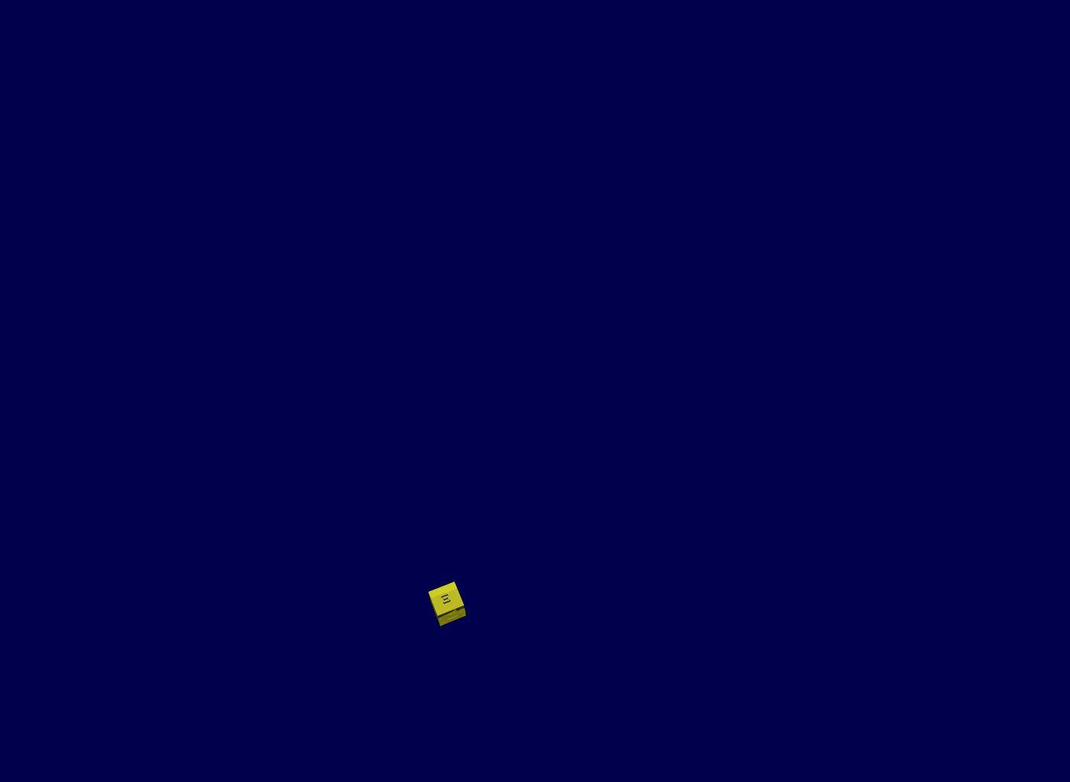
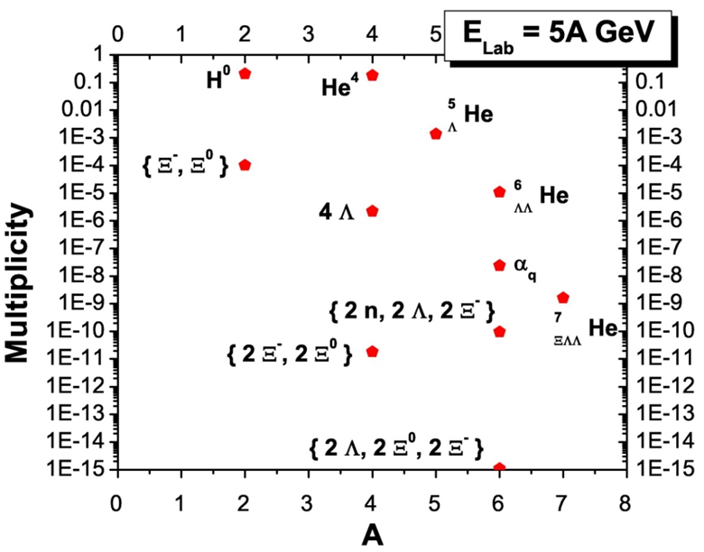
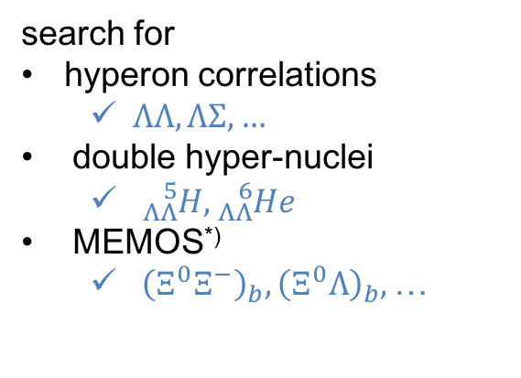
Multi-Strangeness
search for
hyperon correlations
  $ΛΛ,ΛΣ, …$
double hyper-nuclei
  ${}_{ΛΛ}^{5}{H, {}_{ΛΛ}^{6}He}$
MEMOS^{*)}
  ${{\left(Ξ^{0}Ξ^{−}\right)}_{b}, \left(Ξ^{0}Λ\right)}_{b},$…
^{*)} Metastable Exotic Multihypernuclear Objects
H. Stöcker et al., Nucl. Phys. A 827 (2009) 624c

Slide 8
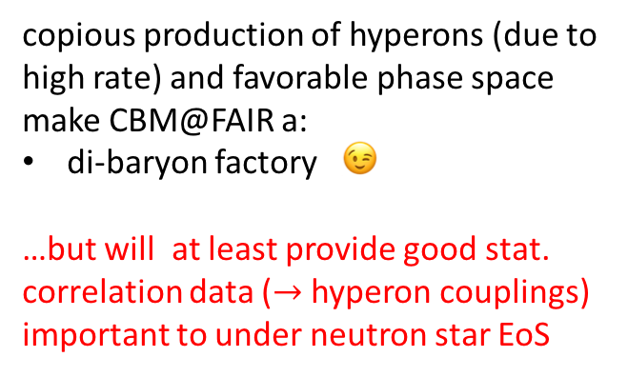
Di-Baryons and Hyperons Correlations at FAIR/CBM?
yield/event
copious production of hyperons (due to high rate) and favorable phase space make CBM@FAIR a:
di-baryon factory 😉
…but will at least provide good stat. correlation data ($→$ hyperon couplings)
important to under neutron star EoS
lines: UrQMD + thermal hydrodynamics
symbols: DCM + coalescence
J. Steinheimer, K. Gudima, A. Botvinab, I. Mishustin, M. Bleicher, H. Stöcker, Phys. Lett B714 (2012) 85

Slide 9
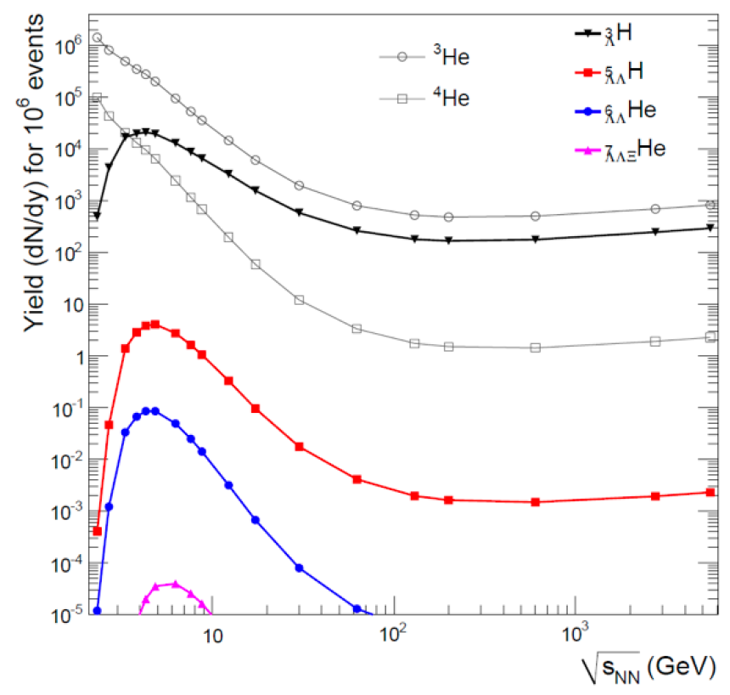
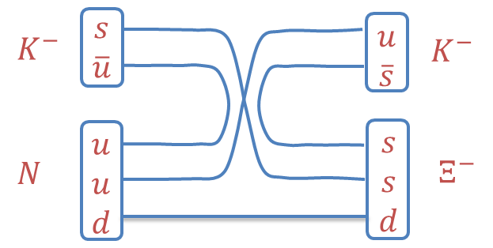

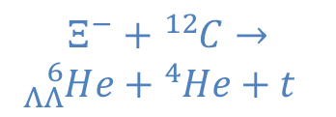
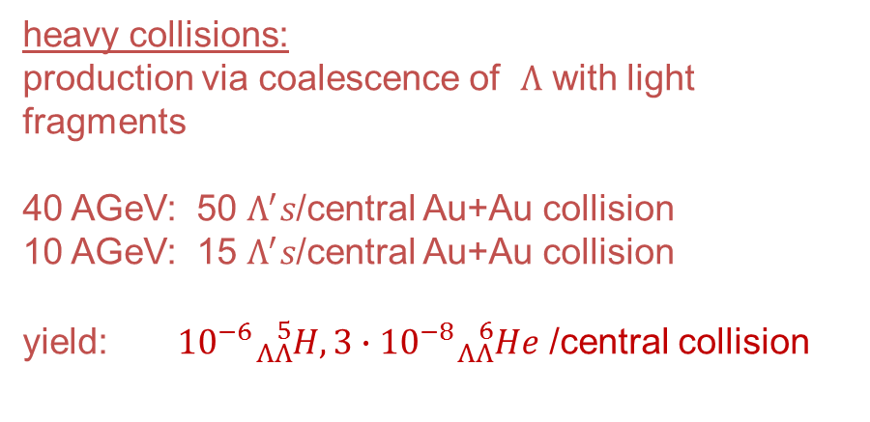
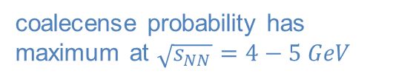
Search for Double Hypernuclei
conventional production mechanism^{*)}:
A. Andronic, P. Braun-Munzinger, J. Stachel, H. Stöcker ,
PL B697 (2011) 204
+
$$Ξ^{−}+{}_{}^{12}C→$$
$${}_{ΛΛ}^{6}He+{}_{}^{4}{He+t}$$
heavy collisions:
production via coalescence of $Λ$ with light fragments
40 AGeV: 50 $Λ^{′}s$/central Au+Au collision
10 AGeV: 15 $Λ^{′}s$/central Au+Au collision
yield: ${10}^{−6}{}_{ΛΛ}^{5}{H, {3∙10}^{−8}{}_{ΛΛ}^{6}He}$ /central collision
coalecense probability has maximum at $\sqrt{s_{NN}}=4−5 GeV$
120/week
3.6/week
^{*)} Takahashi et al, PRL 87 (2001)

Slide 10
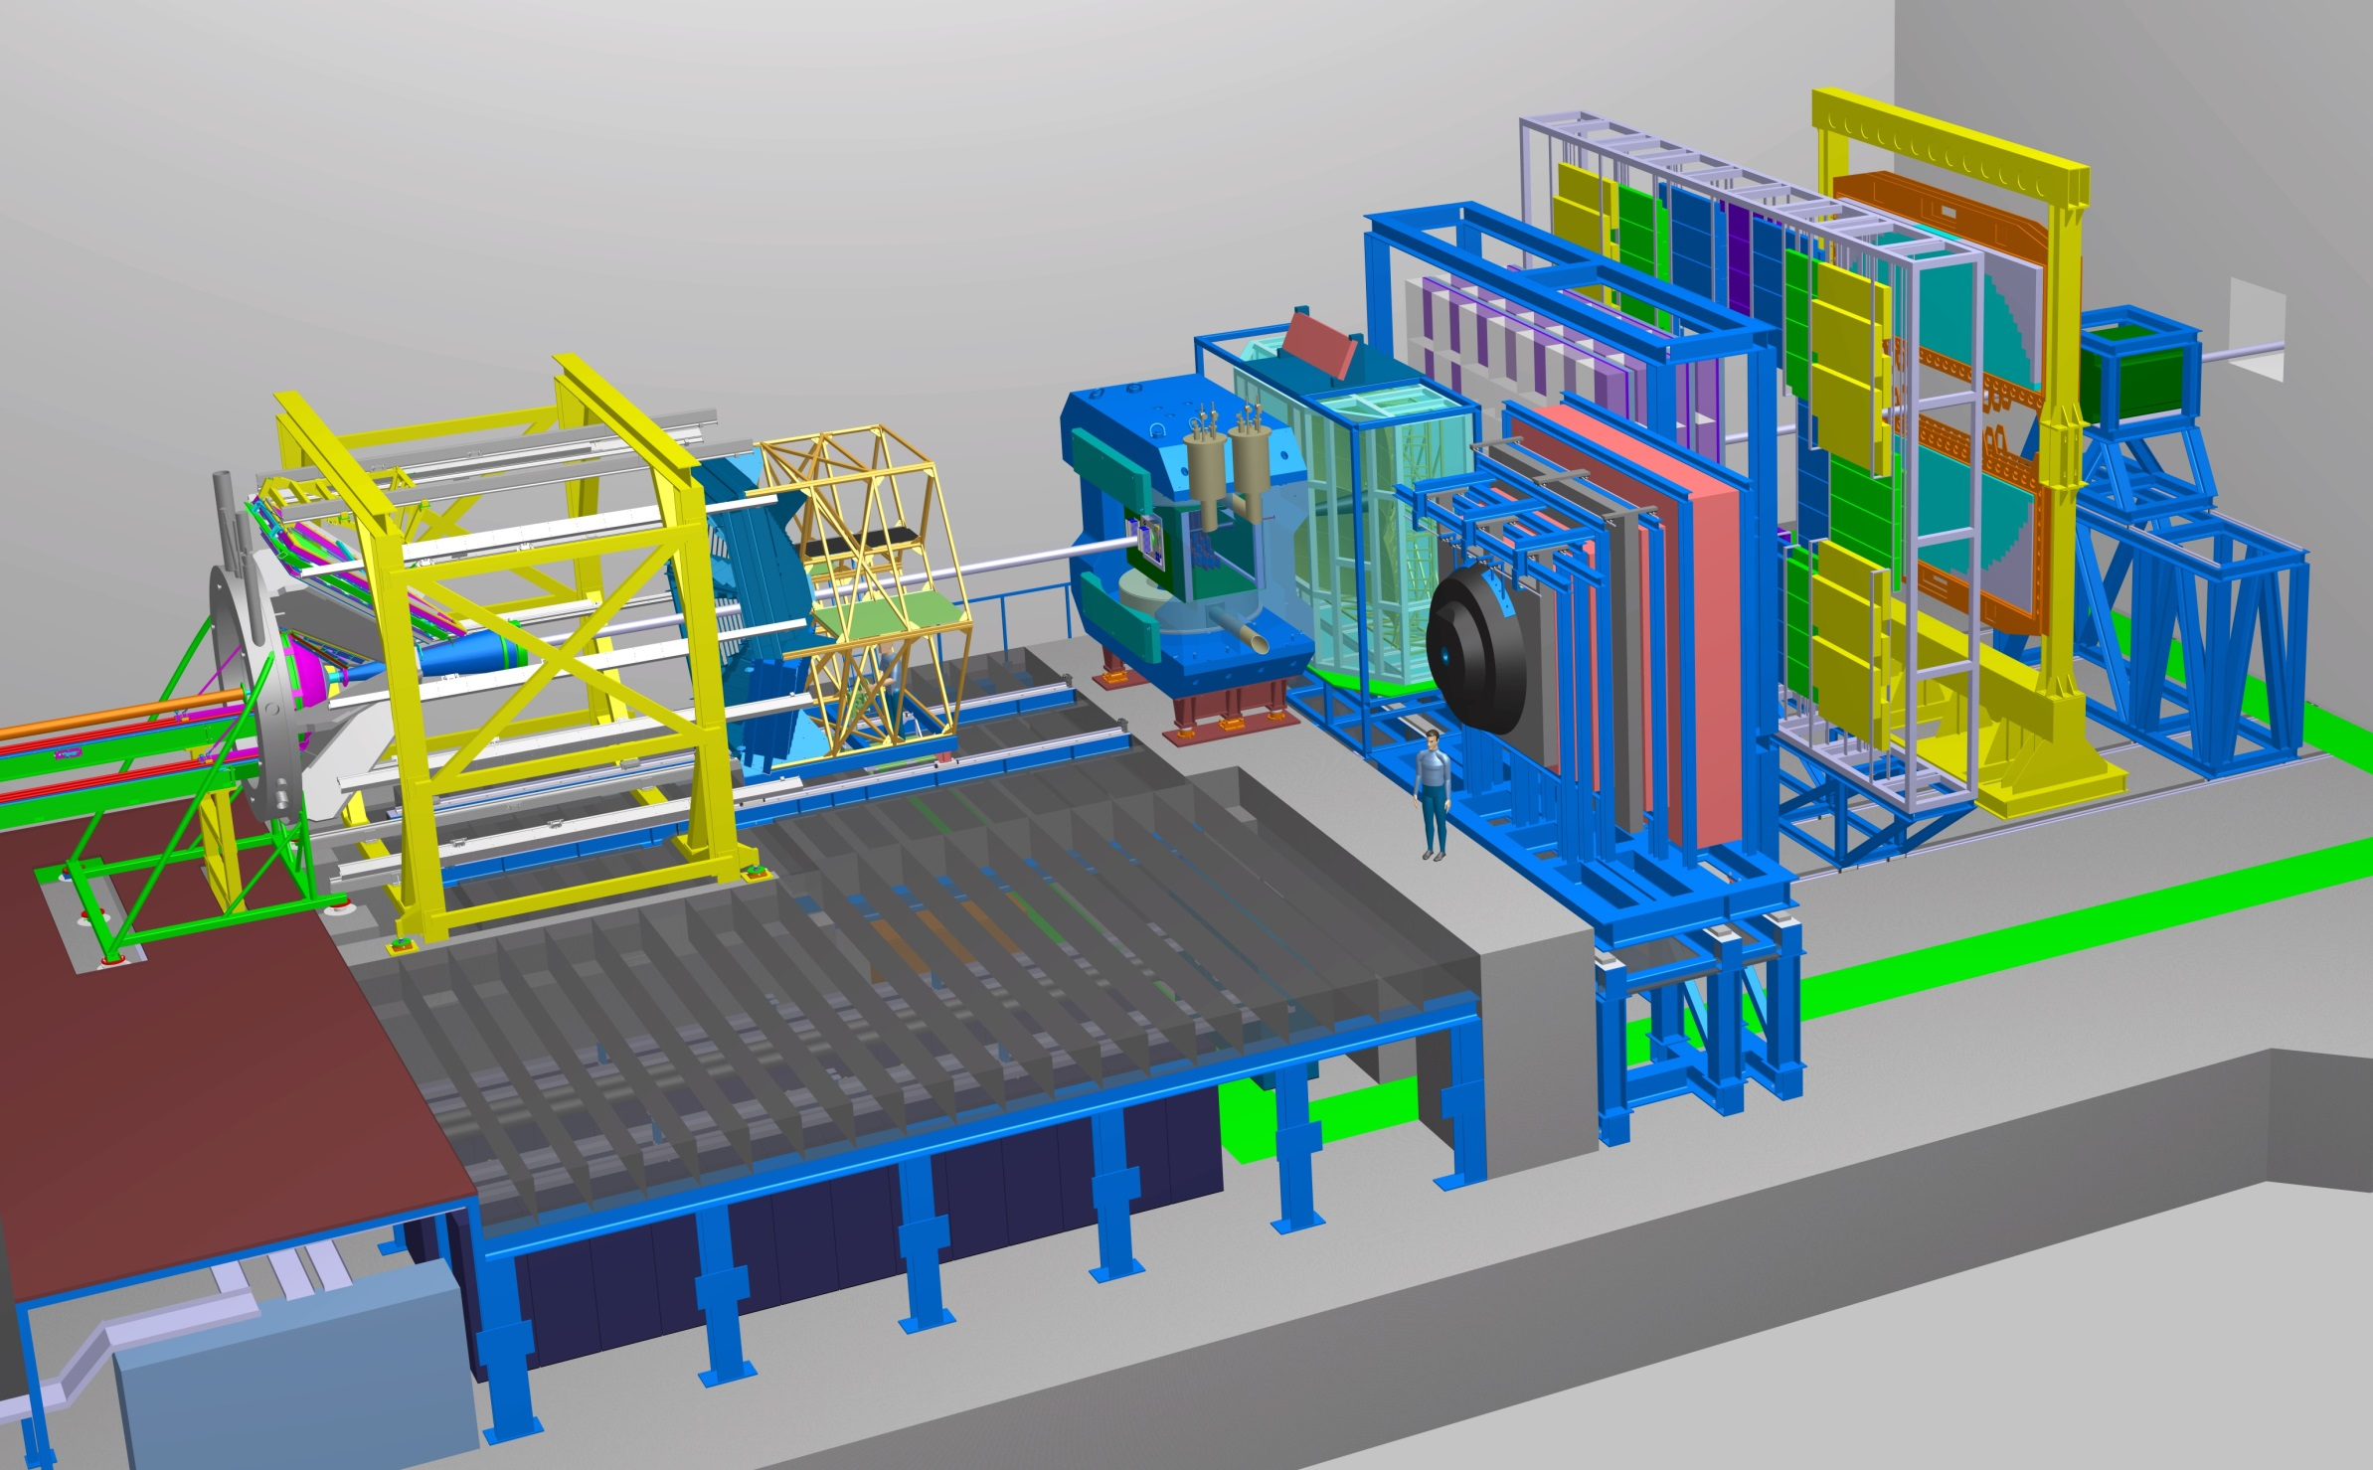
The CBM Detector System
Micro
Vertex
Detector
Silicon
Tracking
System
Dipol
Magnet
Ring
Imaging
Cherenkov
DAQ/FLES HPC cluster
HADES
p+p, p+A
A+A (low mult.)
Time of Flight
Detector
Transition
Radiation
Detector
EM calori-meter
Projectile
Spectator
Detector
Muon
Detector

Slide 11
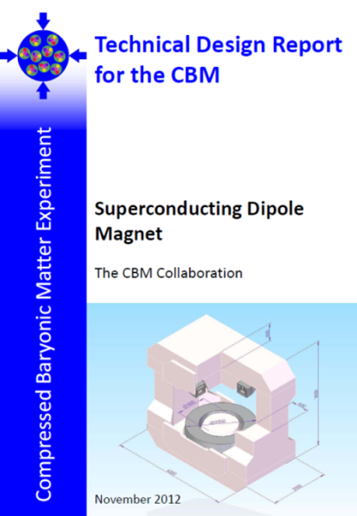
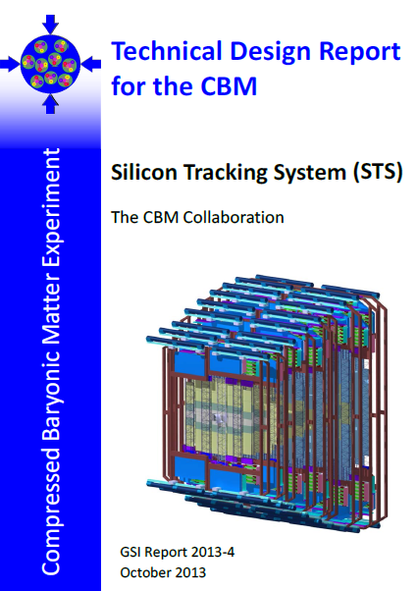
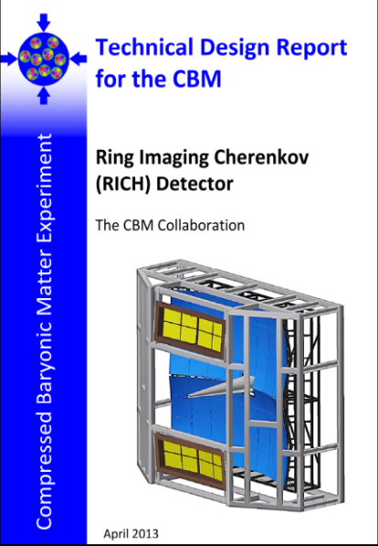
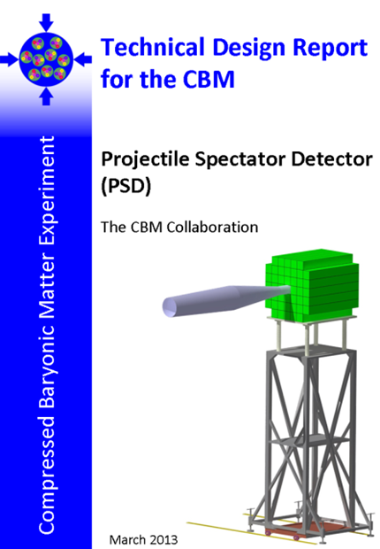
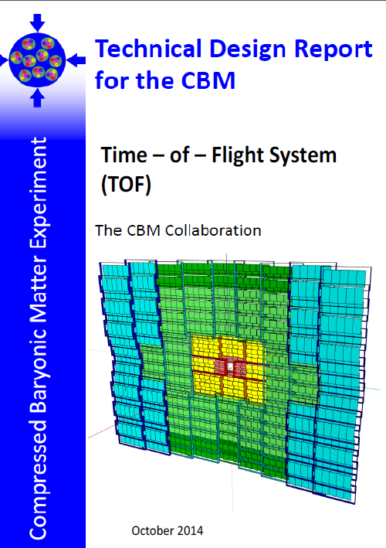
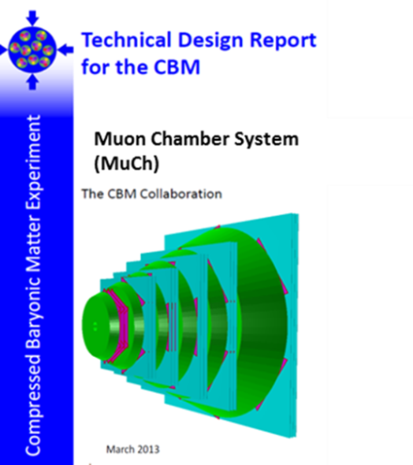
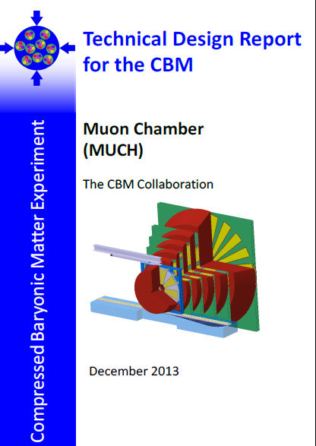
Technical Design Reports
# | Project | TDR Status
1 | Magnet | approved
2 | STS | approved
3 | RICH | approved
4 | TOF | approved
5 | MuCh | approved
6 | HADES ECAL | approved
7 | PSD | approved
8 | MVD | submission 2017
9 | DAQ/FLES | submission 2017
10 | TRD | submission 2017
11 | ECAL | submission 2017
⇒ CBM start version is ready to be build

Slide 12
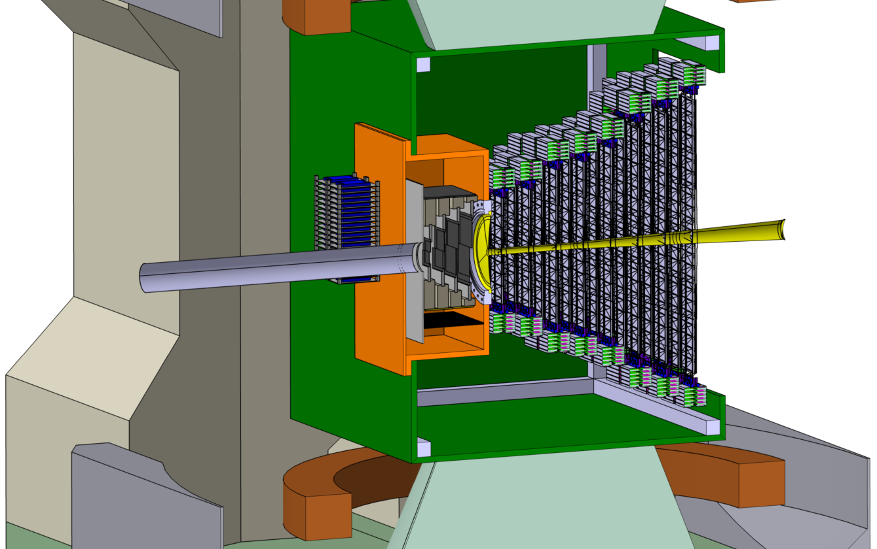
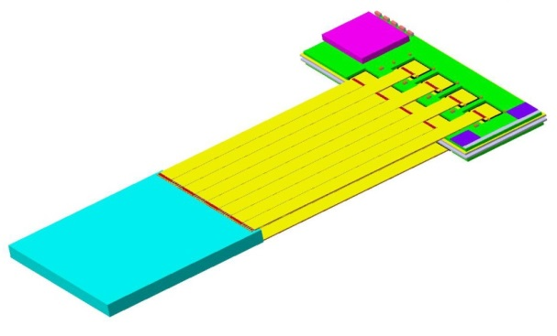
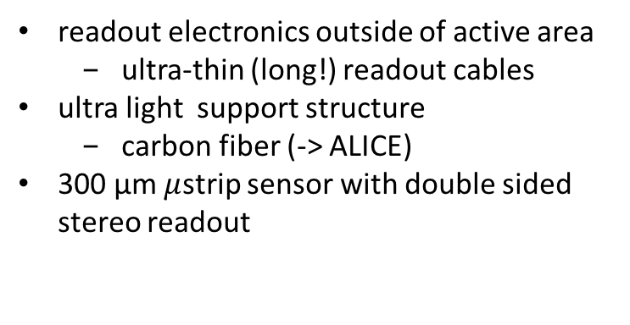
The Central Detection System: a Silicon Tracker
At SIS-energies (and design spatial resolution < 25 µm) the momentum resolution is dominated by multiple scattering, i.e., for good momentum resolution the active area has to be practically massless….
readout electronics outside of active area
  ultra-thin (long!) readout cables
ultra light support structure
  carbon fiber (-> ALICE)
300 µm $μ$strip sensor with double sided stereo readout
STS
beam
2.5°
25°
FEE
cables
sensors
target

Slide 13
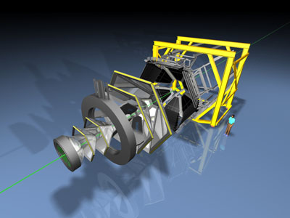
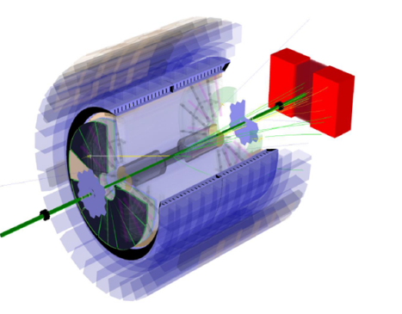
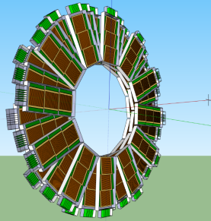
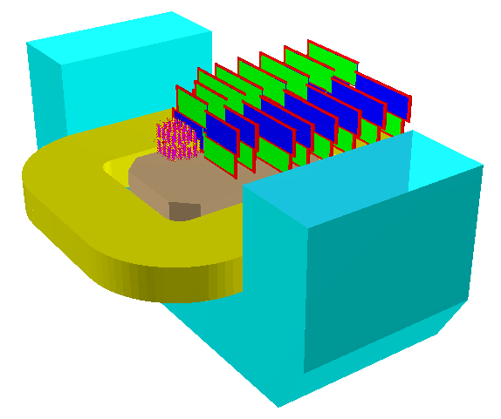
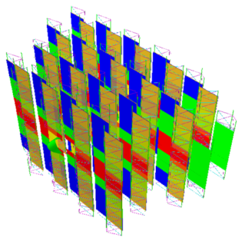
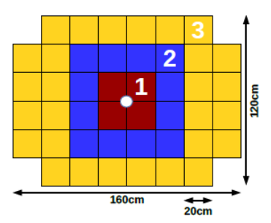
CBM-FAIR Phase 0 (>2018)
Hades physics programm@SIS18 (p+p, p+A, Ag+Ag 1.65 AGeV)
  Multi-strange baryons
  ϕ production study via K⁺K– and e⁺e–
  Dileptons around and beyond vector meson mass region
10% of the CBM TOF modules including read-out chain at STAR/RHIC (BES II 2019/2020)
Silicon Tracking Stations in the BM@N experiment at the Nuclotron in JINR/Dubna (Au-beams up to 4.5 A GeV in 2018/19)
CBM Project Spectator Detector at the BM@N experiment

Slide 14
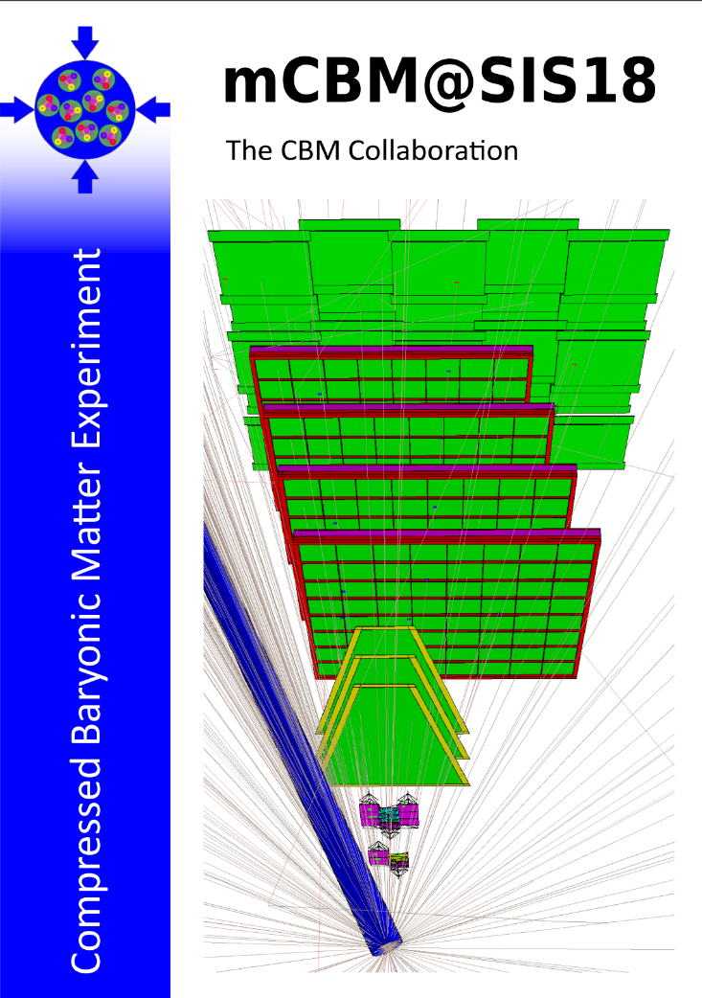
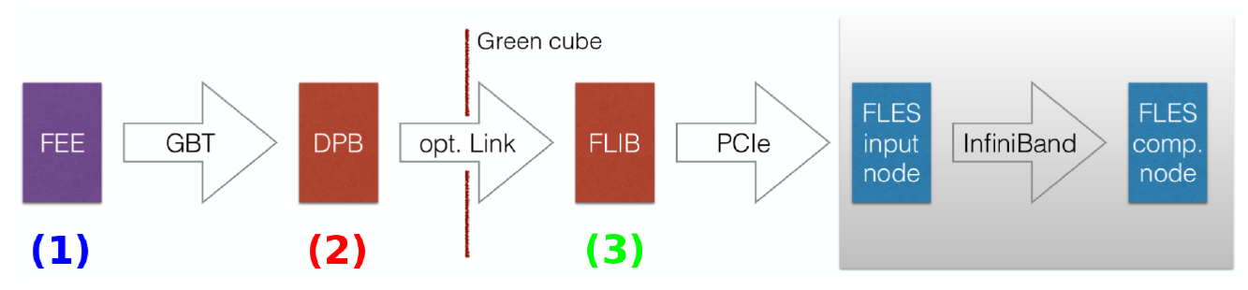
mCBM@SIS18 (>2018)
Demonstrator for full
CBM data taking and analysis chain
Test facility
for high interaction rate operation (10MHz)
free streaming readout
online data compression
All CBM subsystems participating!

Slide 15
Summary
CBM will measure rare probes at unprecedented interaction rates
CBM (FAIR Phase-0) program starts 2018
CBM (day-1 @ SIS100) starts 2025

