Slide 1
Exhibition
"The beginning of everything. About galaxies, quarks and collisions"
Jochen Schieck & Brigitte De Monte
EPS-HEP 2017
7th July 2017

Slide 2
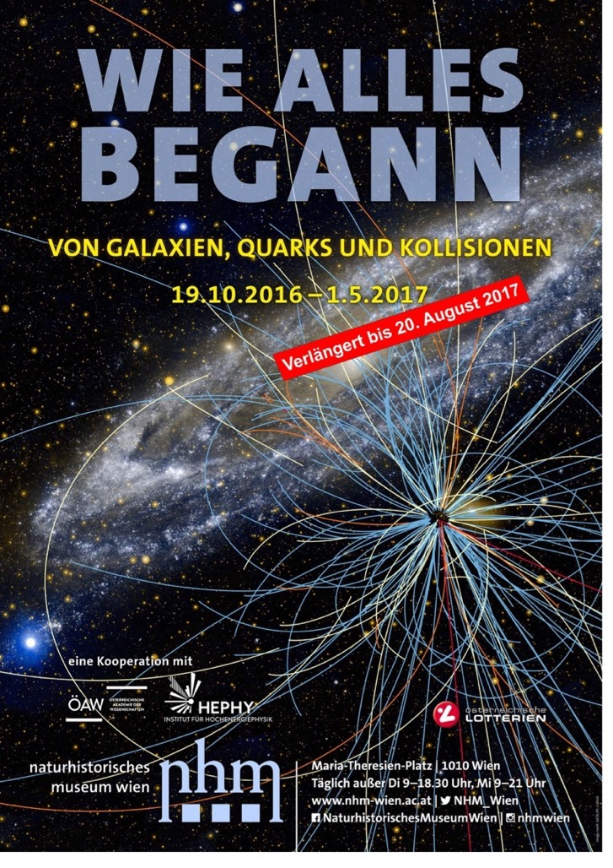

Natural History Museum Vienna (NHM Vienna)
19th October 2016 - 20th August 2017
Cooperation between the NHM Vienna and
the Institute of High Energy Physics (HEPHY)
of the Austrian Academy of Sciences
Exhibition space: about 550 m²
~ 530 000 visitors (from 19th October 2016 - 30th June 2017)
HEPHY celebrated 50th anniversary in 2016
7th July 2017 Jochen Schieck & Brigitte De Monte 2

Slide 3
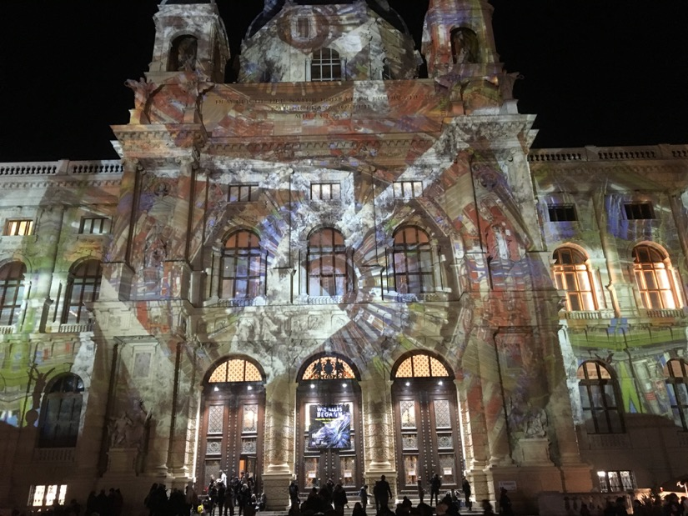
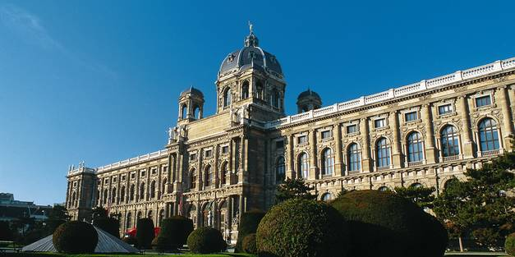
Natural History Museum Vienna
In an international ranking the Natural History Museum Vienna war rated one of the ten most important museums in the world. Its earliest collection are more than 250 years old. Today around 30 million objekts are kept there.
- Famous, irreplaceable exhibits – e.g. the 25,000-year-old Venus of Willendorf
- World‘s largest and oldest meteorite exhibit
© WienTourismus/Karl Thomas
7th July 2017 Jochen Schieck & Brigitte De Monte 3

Slide 4
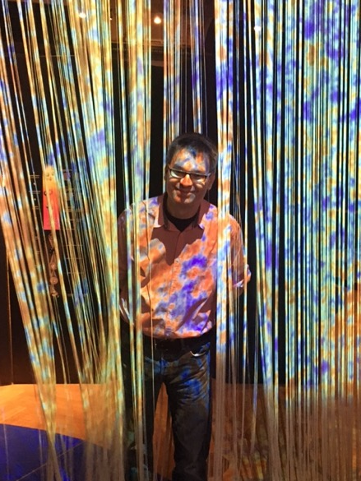
Concept of the Exhibition
Basic idea: What is particle physics and
how can we put it in a general context?
  What is particle physics: key findings of particle
  physics and tools/experiment used in research
  General context: place key findings in timeline of the evolution of the universe – extend scope of the exhibition towards astronomy
    Exhibition subdivided in three main parts – reflected in the title:
    “The beginning of everything. About galaxies, quarks and collisions”
we start 13.8 Gy and take the visitor back to the Big Bang
→ blue time line with major time steps printed on a blue “carpet”
Curtain representing the border
between the visible and invisible universe
7th July 2017 Jochen Schieck & Brigitte De Monte 4

Slide 5
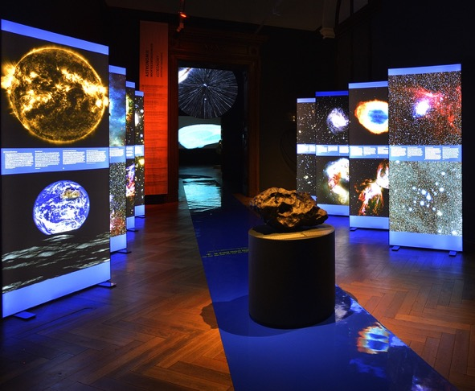
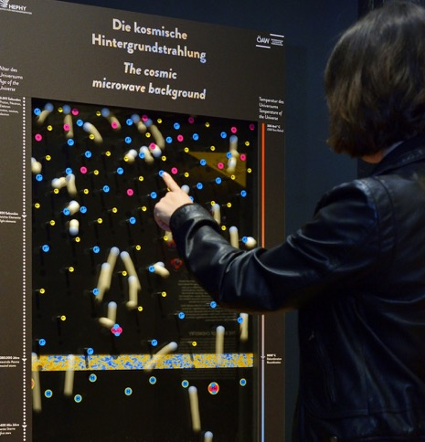
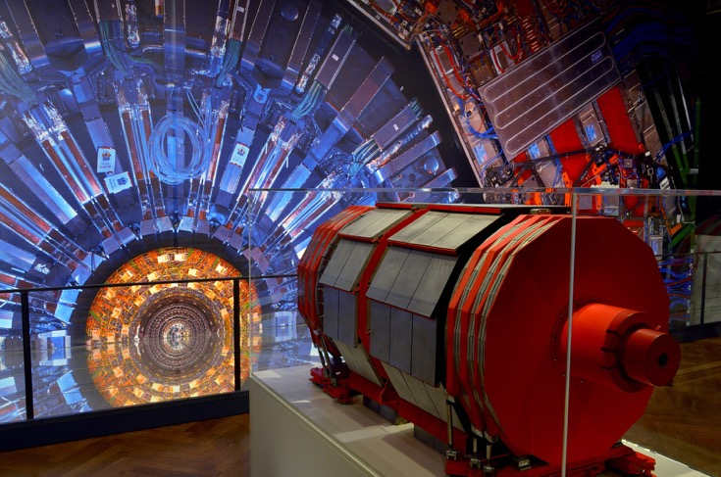
Story of „The beginning of everything“
The exhibition "The beginning of everything" taking visitors on a journey more than 13 billion years back into the past, to the start of the universe, and communicate the most recent scientific knowledge of particle physics and cosmology in a readily comprehensible manner.
7th July 2017 Jochen Schieck & Brigitte De Monte 5

Slide 6
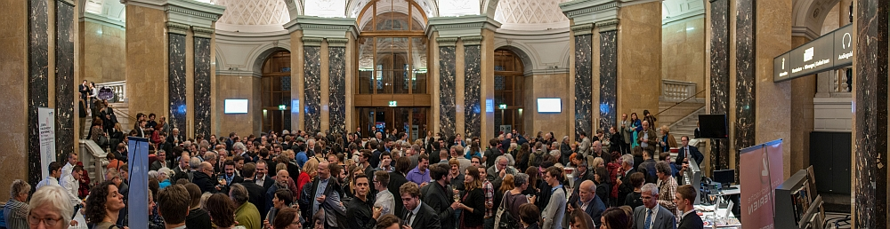
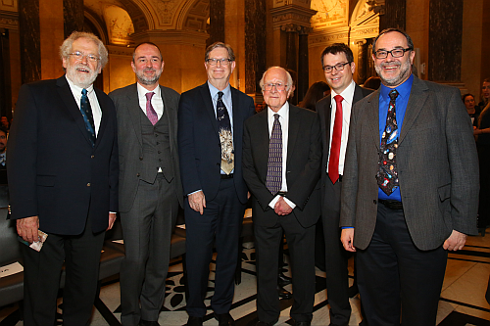
Grand Opening
Guest of honour:
  Peter W. Higgs
  George F. Smoot
  Federal Minister Thomas Drozda
  Video greetings by Fabiola Gianotti
  ~ 700 guests
7th July 2017 Jochen Schieck & Brigitte De Monte 6

Slide 7
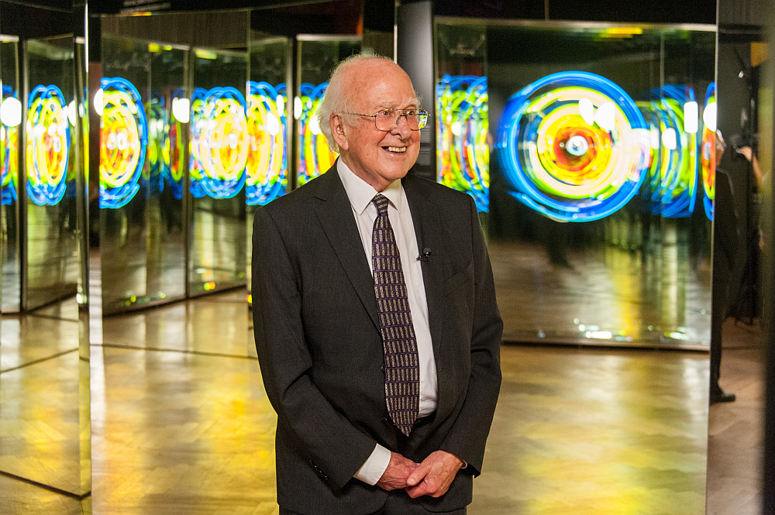
Peter Higgs in front of the art work of Brigitte Kowanz: „Dateline zero for space and time“
www.labiennale2017.at
7th July 2017 Jochen Schieck & Brigitte De Monte 7

Slide 8
Visual, optical, and acustic angles and perspectives from artists
Austrian artists:
Barbara Imhof/Damjan Minovski/Eva Schlegel: „Cosmic Mist“
Manfred Wakolbinger: „Galaxies“
Brigitte Kowanz: „Dateline zero for space and time“
Hofstetter Kurt: „Susys Fingerprint“
Rudolf Wakolbinger: „Expansion of the Universe“ (from 25th May)
Art@CMS:
Michael Hoch: „The GodParticleHuntingMaschine“
Chris Henschke: „Nature of the Apparatus“
7th July 2017 Jochen Schieck & Brigitte De Monte 8

Slide 9
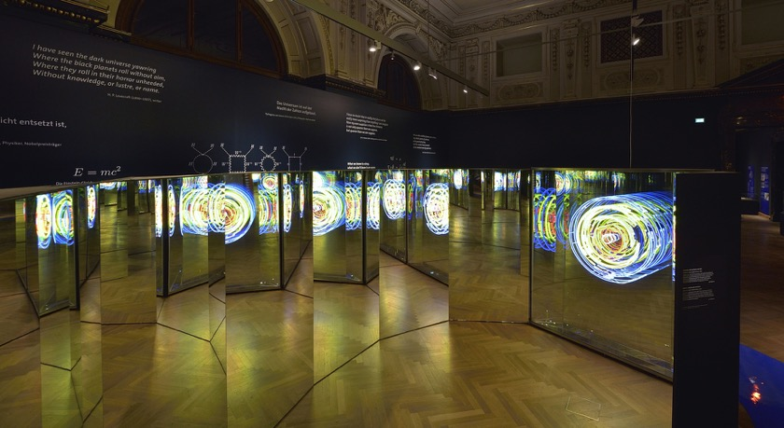
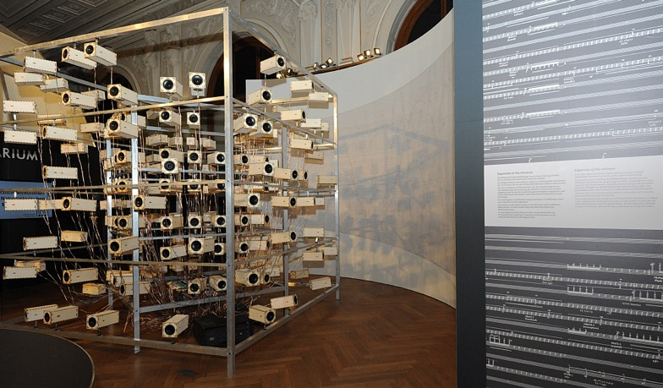
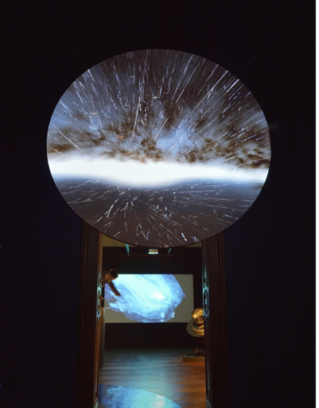
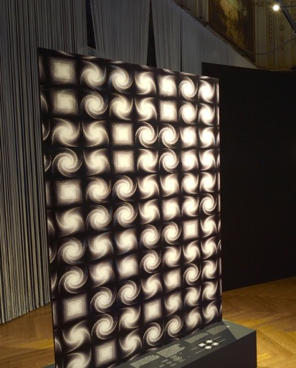
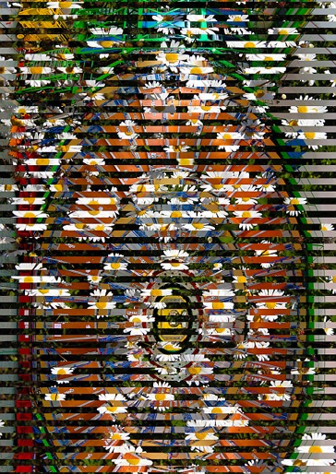
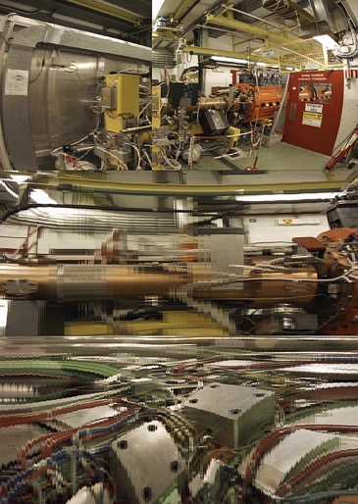
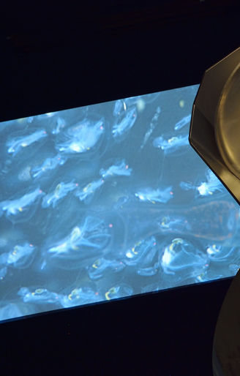
7th July 2017 Jochen Schieck & Brigitte De Monte 9

Slide 10
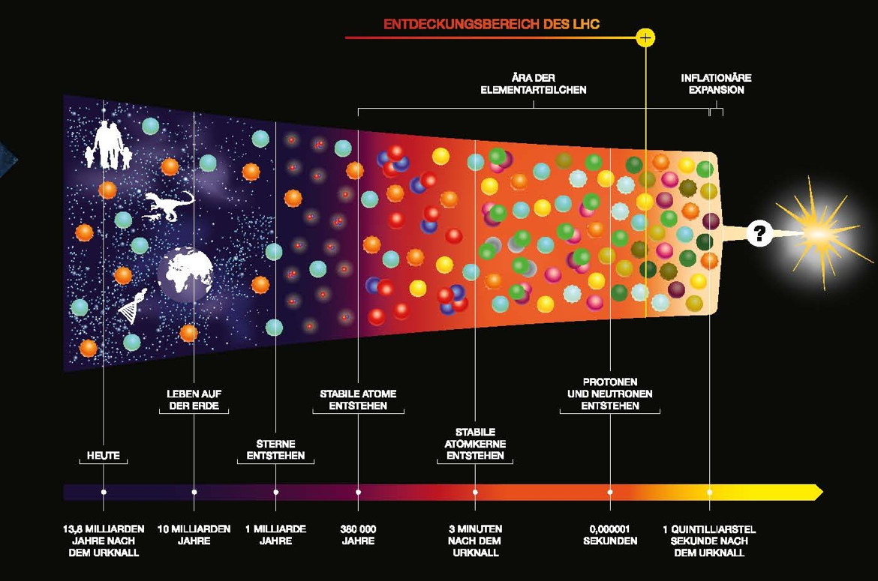
From the idea to concept
October 2014: first contact with DG of the Natural History Museum Vienna, Christian Köberl
January 2015: initial concept/story
7th July 2017 Jochen Schieck & Brigitte De Monte 10

Slide 11
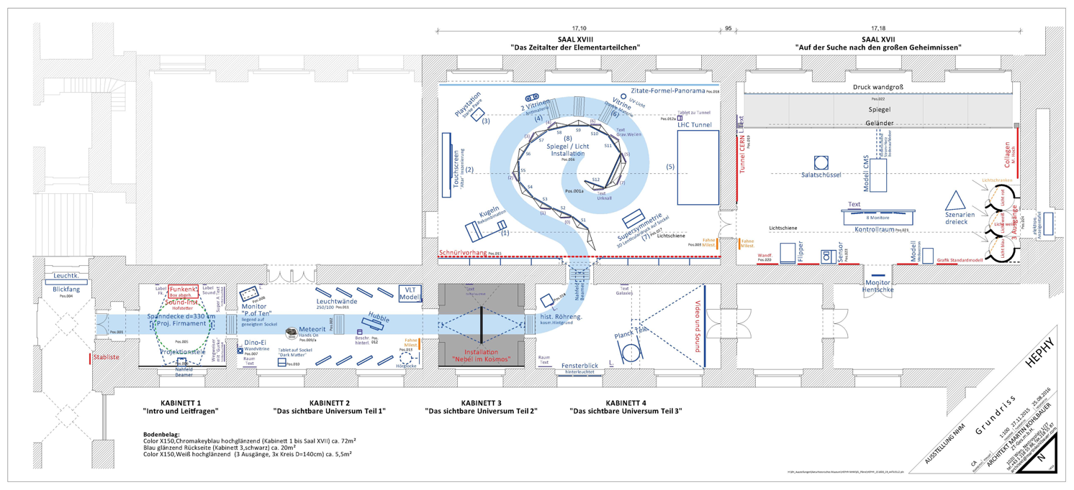
Creative process
January – April 2015: finding Austrian artists by an art curator
Mai – August 2015: creation of the scientific and art exhibition concept
    jointly developed by the exhibition and education team of the NHM Vienna, HEPHY Vienna, Institute of Astronomy /University of Vienna, exhibition architect, and the artists.
7th July 2017 Jochen Schieck & Brigitte De Monte 11

Slide 12
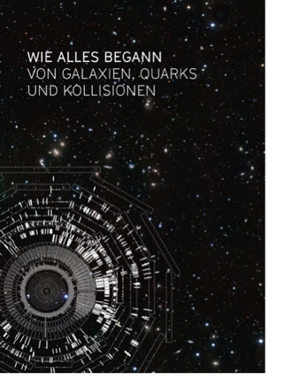
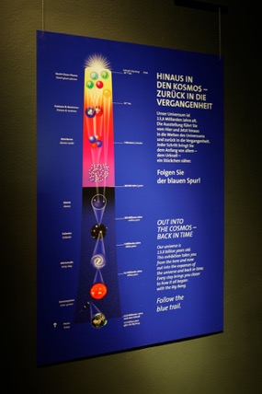
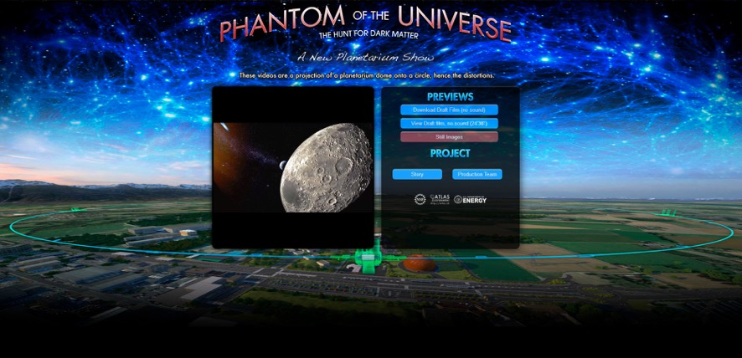
Planning and realization
September 2015 – September 2016:
  detailed planning / scenography
  realization of exhibits, interactive features, videos, and artwork
  text development and graphic design
  loan contracts for exhibits; licenses
  Dubbing in German language of the full dome movie „Phantom of the Universe“
  invitation of the guests of honor
  preparing of the exhibition brochure
  creating of a new website
  etc.
7th July 2017 Jochen Schieck & Brigitte De Monte 12

Slide 13
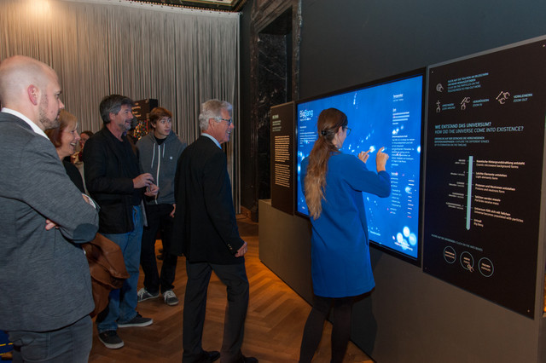
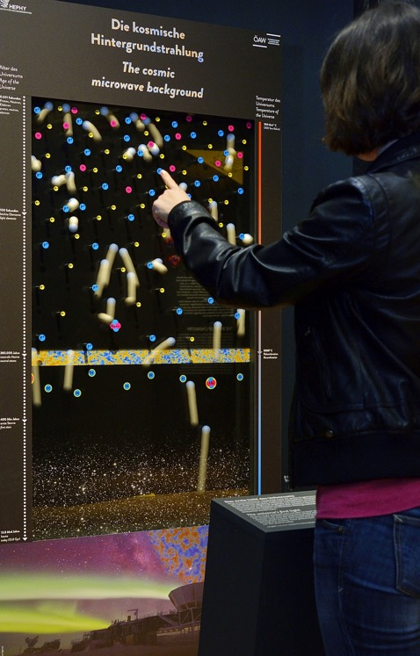
New exhibits (e.g.)
Interactive journey back to the „Big Bang“
Discover the early stage of the Universe and navigate through the era of elementary particles.
Idea and concept: J. Pradler and H. Eberl (HEPHY)
„Cosmic microwave background machine“
Idea and concept: J. Pradler and H. Eberl (HEPHY)
Development and construction: J. Pirker (HEPHY)
7th July 2017 Jochen Schieck & Brigitte De Monte 13

Slide 14
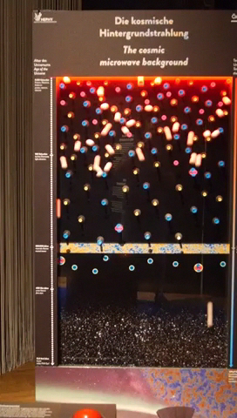
14

Slide 15
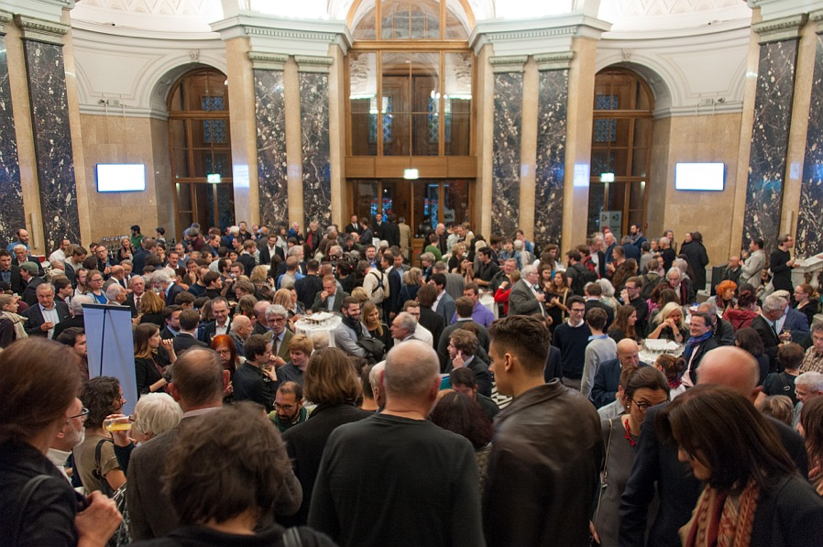
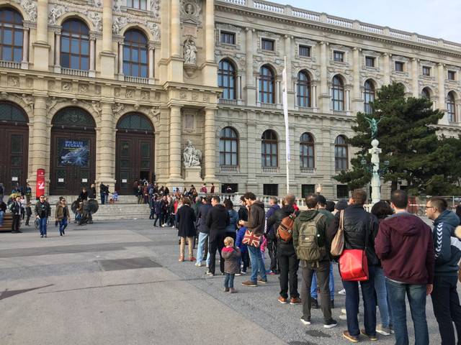
Setup and opening
Mid September – 14th October 2016: setup
18. October 2016: press conference and grand opening
Grand opening
Queue in front of the NHM entrance end of October
7th July 2017 Jochen Schieck & Brigitte De Monte 15

Slide 16
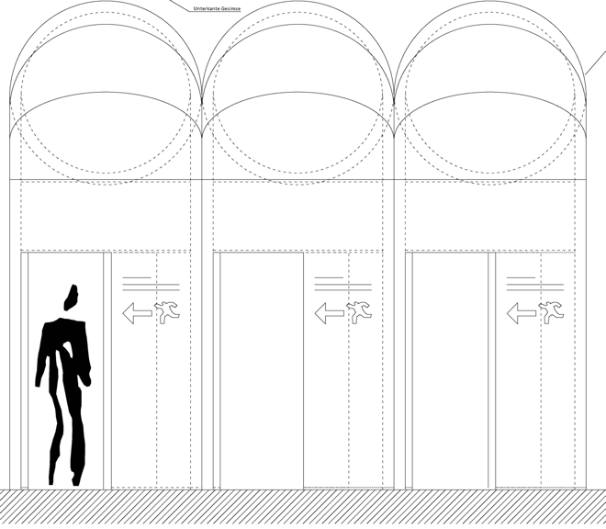
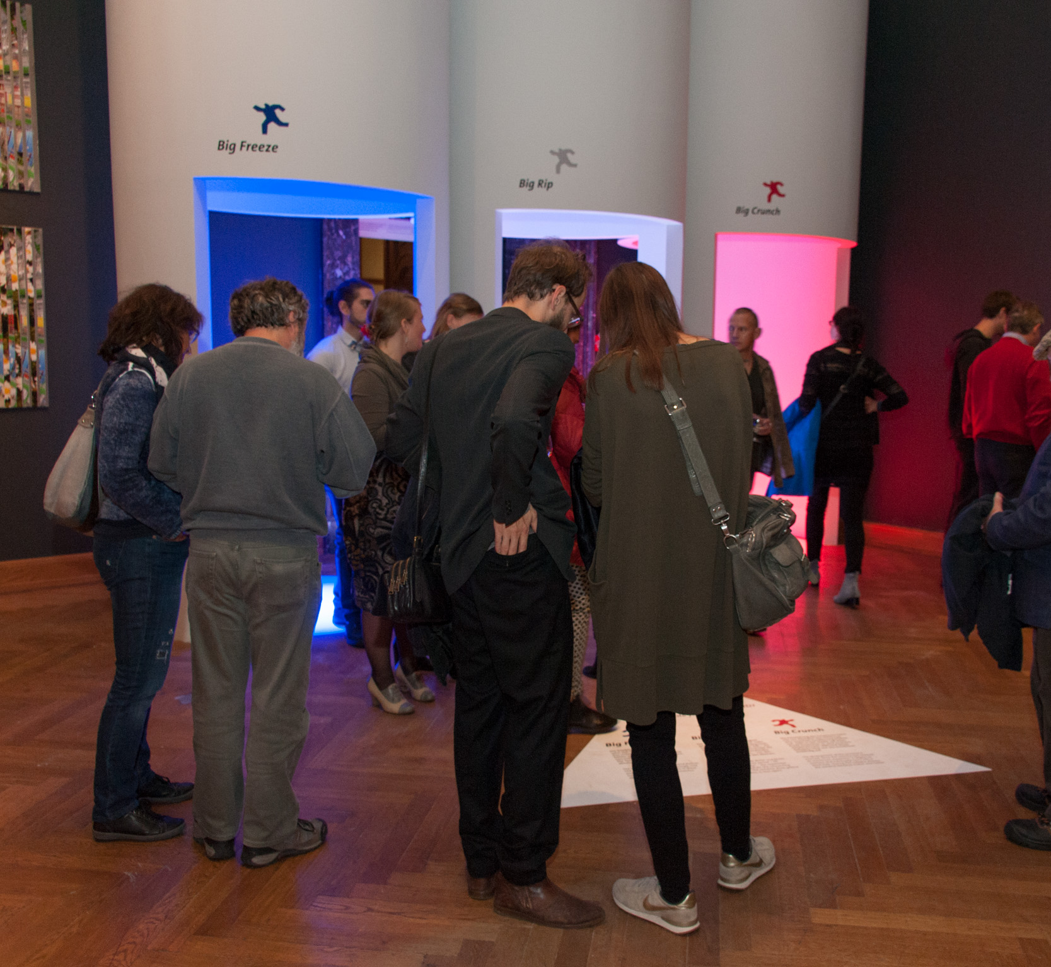
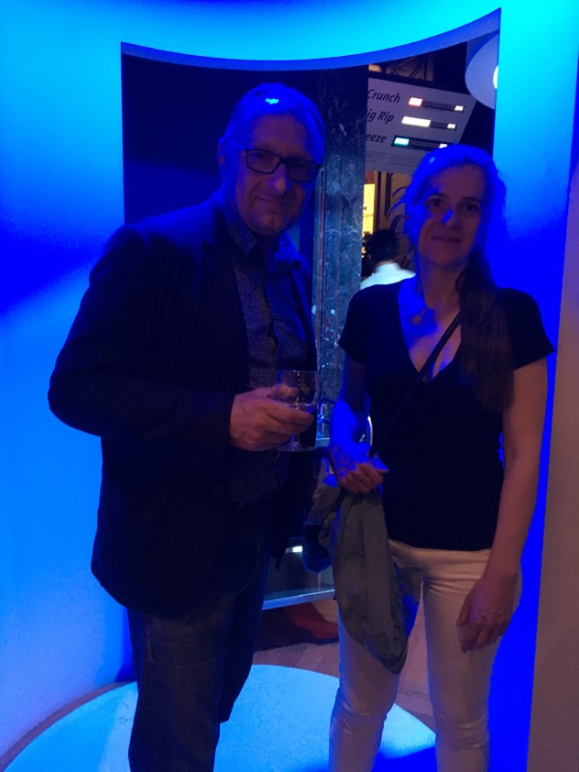
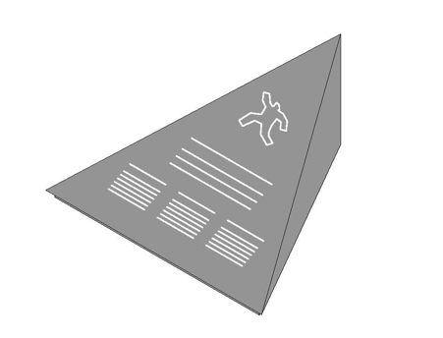
The end
Visitors have the chance to create their favorite possible scenario for the end of the Universe. They can choose between:
Big Crunch
Big Rip
Big Freeze
Big Crunch / Big Rip / Big Freeze
7th July 2017 Jochen Schieck & Brigitte De Monte 16

Slide 17
Team
NHM Vienna:
Head: Christian Köberl
Concept/scenography/production: Reinhard Golebiowski
Text/education: Agnes Mair
Graphic design: Krimhild Repp
Technique: Walter Hamp
HEPHY Vienna:
Head: Jochen Schieck
Project management/editing: Brigitte De Monte
Curator and scientific concept particle physics:
Marko Dragicevic
Helmut Eberl
Wolfgang Lucha
Josef Pradler
Curator astronomy: Franz Kerschbaum (Institute of Astronomy / University of Vienna)
Curator art: Sárolta Schredl
Exhibition architect: Martin Kohlbauer and Carl Auböck
Coordination: Bertram Schütz
7th July 2017 Jochen Schieck & Brigitte De Monte 17

Slide 18
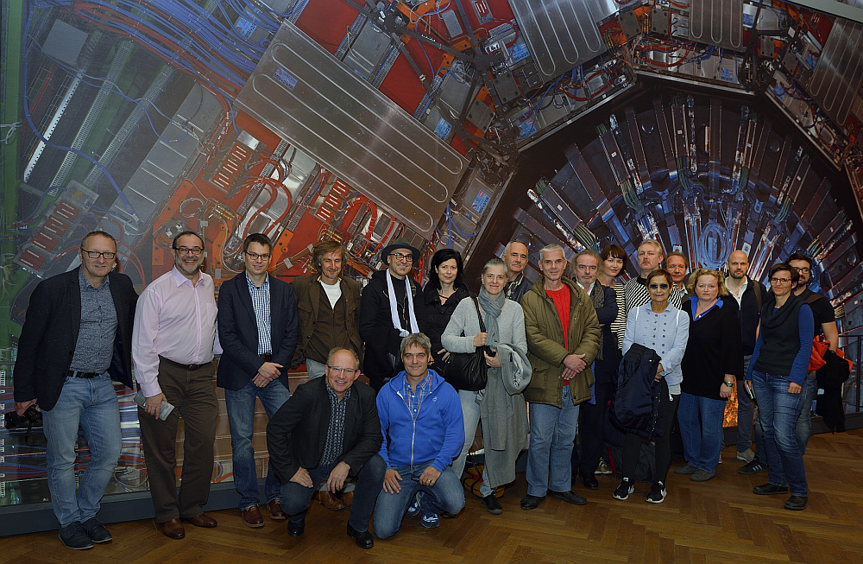
Real size picture of the CMS detector
Exhibition team
7th July 2017 Jochen Schieck & Brigitte De Monte 18

Slide 19
Accomanying program
The full dome movie „Phantom of the Universe“
Girls Day 2017
    (with Fabiola Gianotti and the federal minister Reinhold Mitterlehner)
Guided tours by experts
Matinees with artists and physicists
Readings by renowned writers
Concerts and visuales
Book presentation „CMS – the Art of Science“ (Michael Hoch)
7th July 2017 Jochen Schieck & Brigitte De Monte 19

Slide 20
Accomanying program
Virtual CMS visit
International Masterclass
TEDXCERN
Workshop „Sciences&Art@School“
Opening of the sound installation „Expansion of the Universe“
    (with Cardinal Schönborn and the director of the Vatican Observatory, Dr. Consolmagno)
Workshops for students and kids
Public lectures (Austrian and international physicists)
      (e.g. Marc Kamionkowski/John Hopkins University and Sijbrand de Jong/Pierre Auger Observatory)
7th July 2017 Jochen Schieck & Brigitte De Monte 20

Slide 21
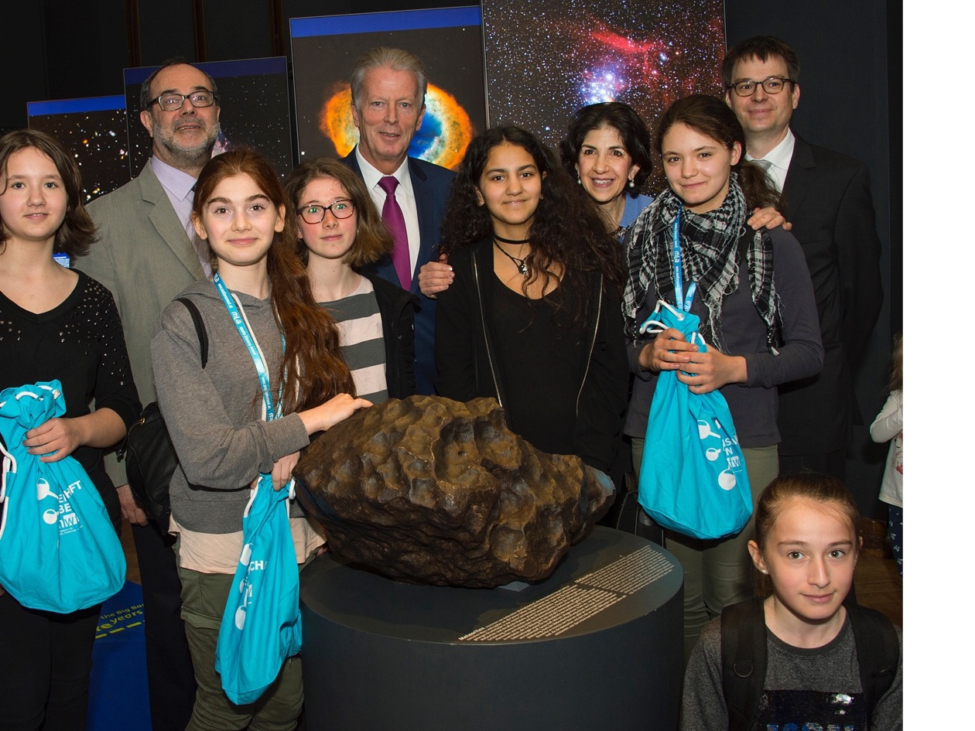
Girls Day 2017
7th July 2017 Jochen Schieck & Brigitte De Monte 21

Slide 22
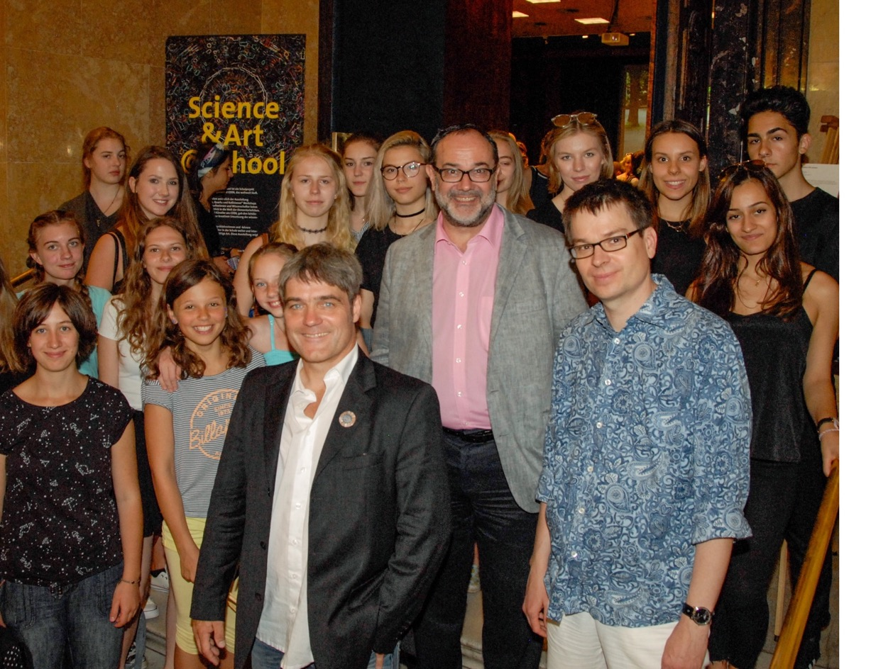
Science&Art@School
7th July 2017 Jochen Schieck & Brigitte De Monte 22

Slide 23
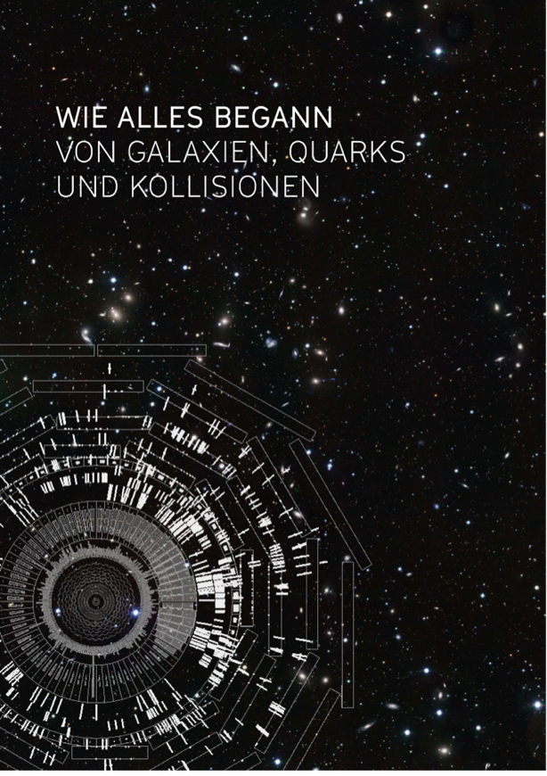
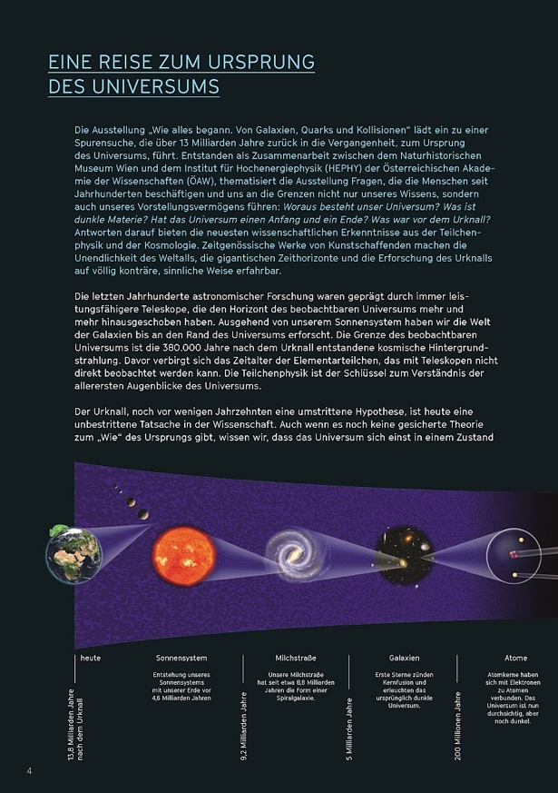
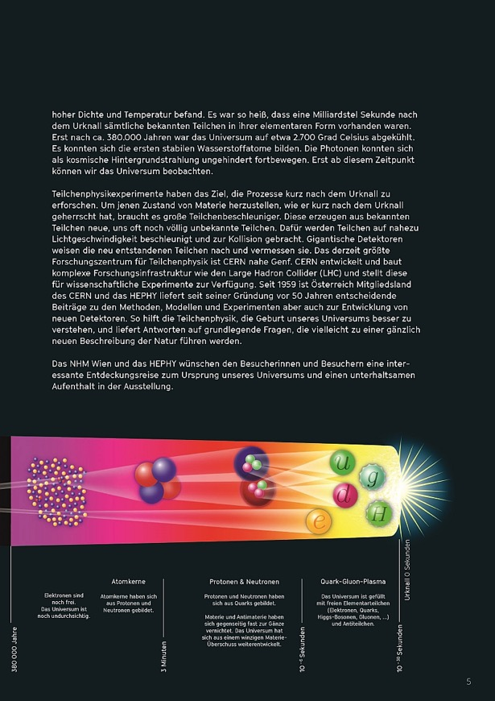
Exhibition brochure
36-page brochure; publisher NHM Vienna and HEPHY
http://www.teilchenphysik.at/fileadmin/user_upload/Booklet_WieAllesBegann_online.pdf
7th July 2017 Jochen Schieck & Brigitte De Monte 23

Slide 24
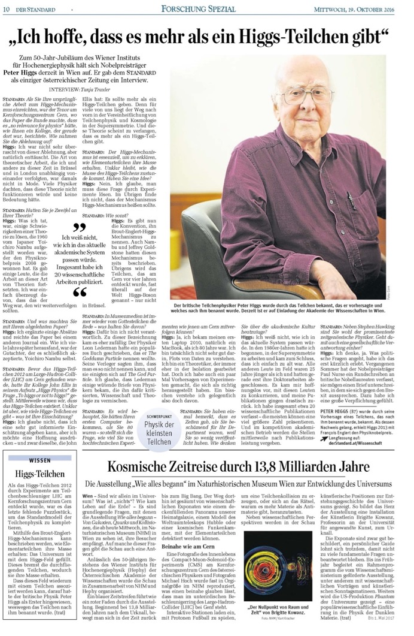
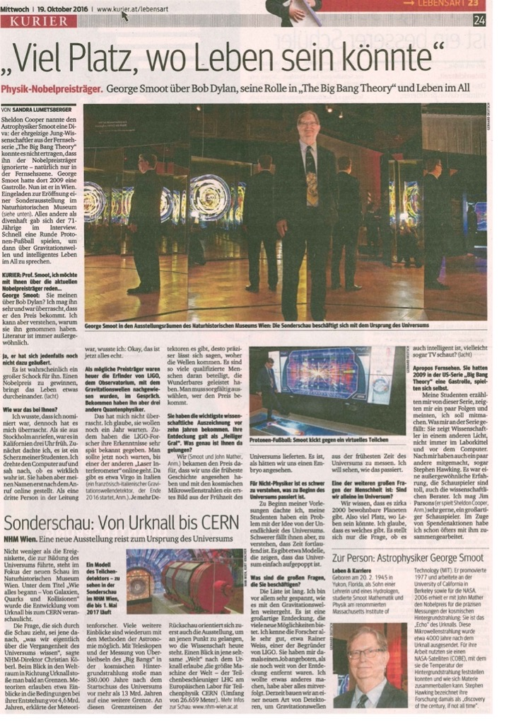
Press review
https://www.youtube.com/watch?v=dDw8A4IzpzU
7th July 2017 Jochen Schieck & Brigitte De Monte 24

