Slide 1
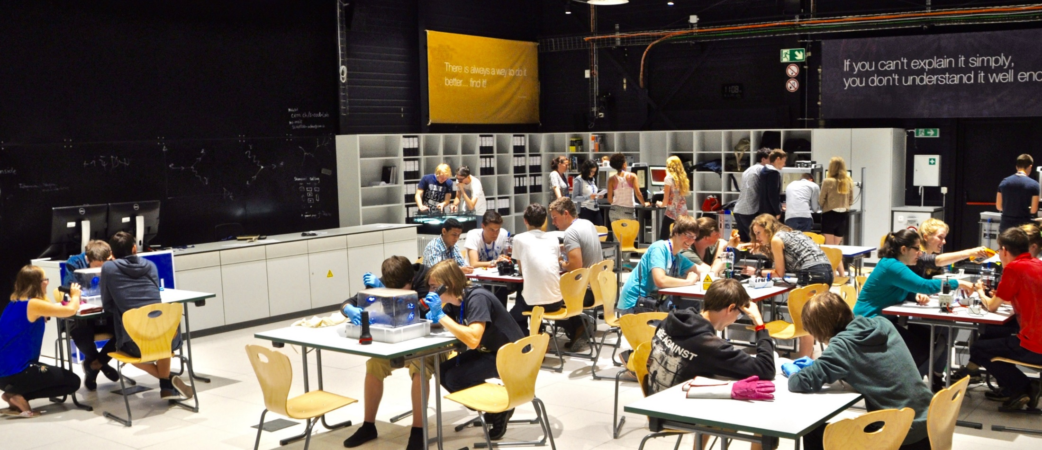

3D-Printable Experiments in CERN’s S’Cool LAB
Julia Woithe, Alex Brown, Alexandra Feistmantl, Oliver Keller, Sascha Schmeling

Slide 2
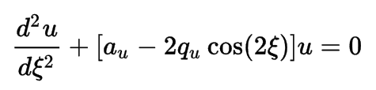
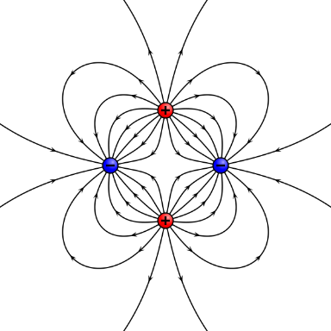
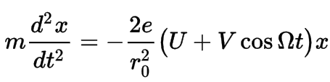
vs.

Slide 3
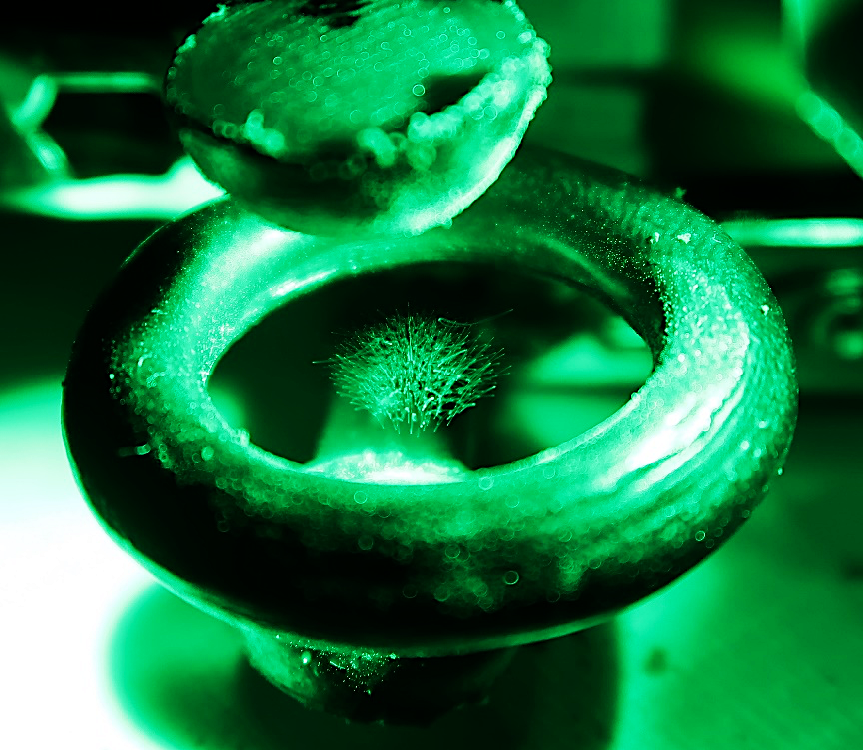
vs.

Slide 4
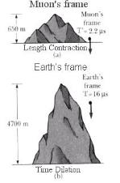


vs.
Notes:
http://scool.web.cern.ch/cloud-chamber-stream

Slide 5
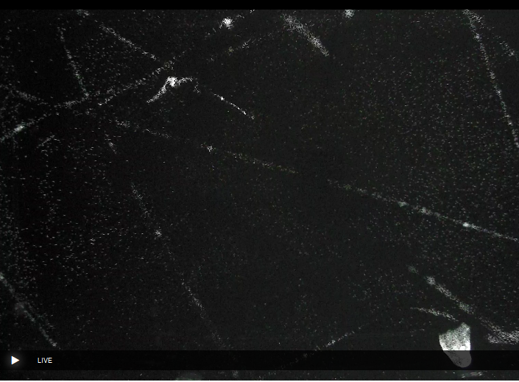
vs.
Notes:
http://scool.web.cern.ch/cloud-chamber-stream

Slide 6
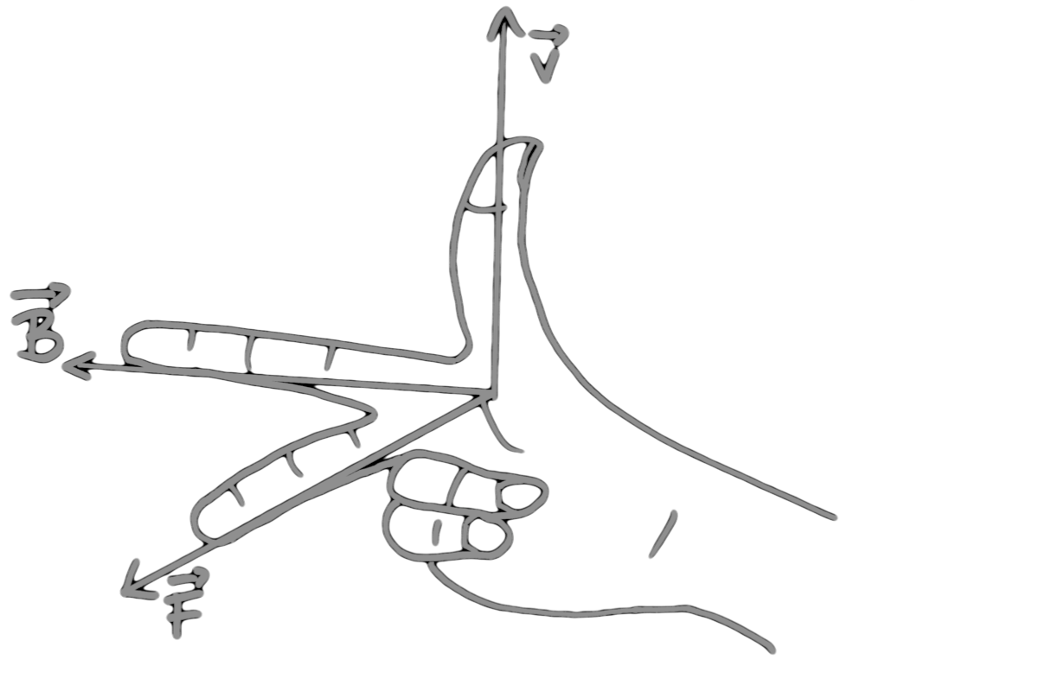

vs.

Slide 7
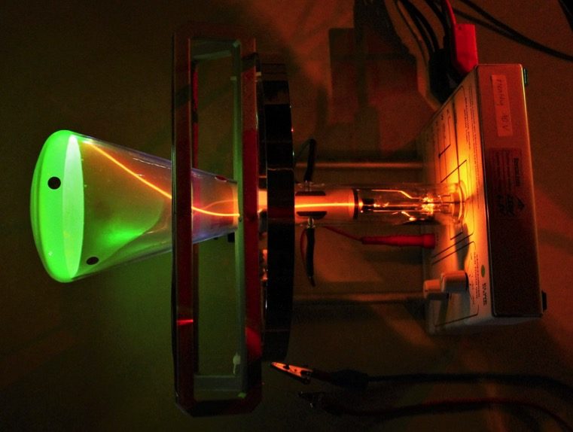
vs.

Slide 8
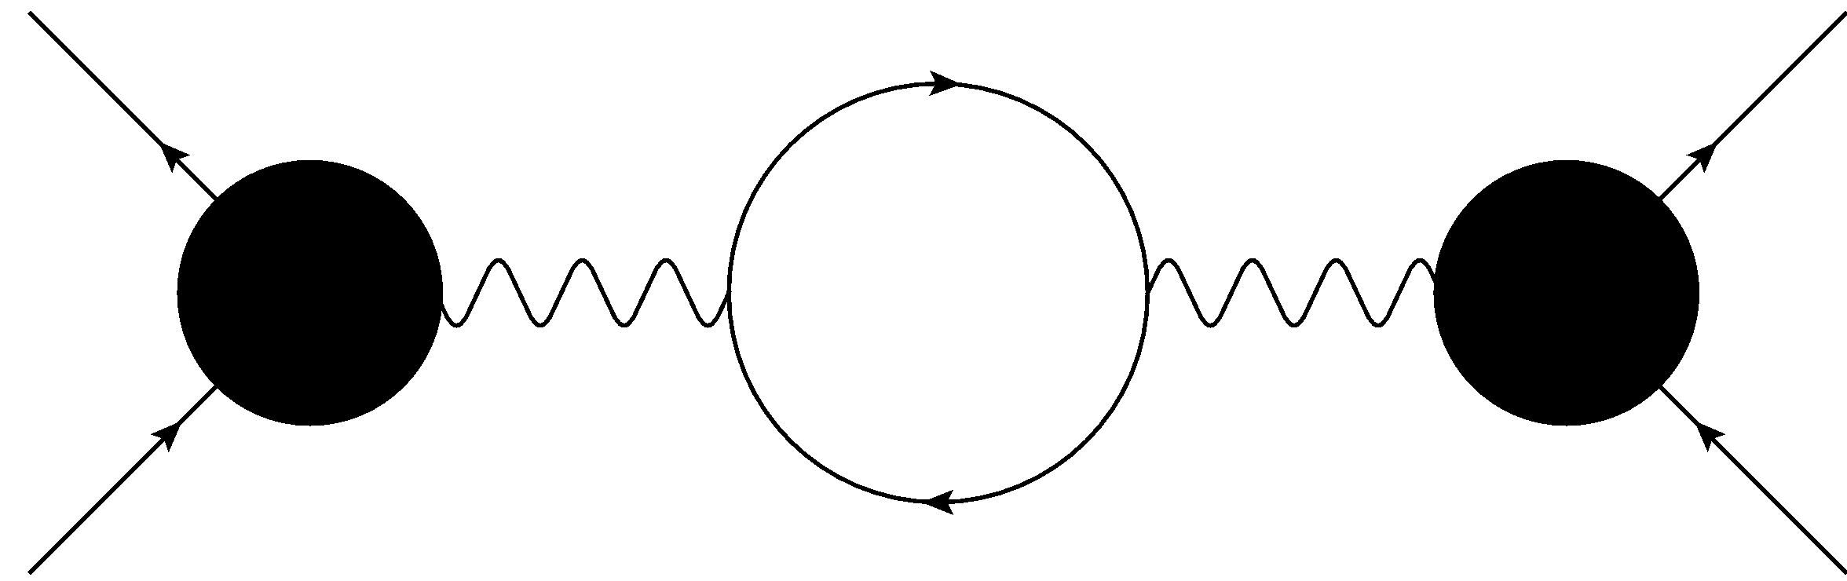
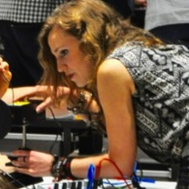
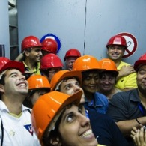
CERN S‘Cool LAB a hands-on particle physics learning laboratory
particle physics experiments
► hands-on & minds-on
Physics Education Research
high school students
high school teachers

Slide 9
CERN S‘Cool LAB a hands-on particle physics learning laboratory
particle physics experiments
► hands-on & minds-on
Physics Education Research
high school students
high school teachers

Slide 10
CERN S‘Cool LAB a hands-on particle physics learning laboratory
particle physics experiments
► hands-on & minds-on
Physics Education Research
high school students
high school teachers

Slide 11
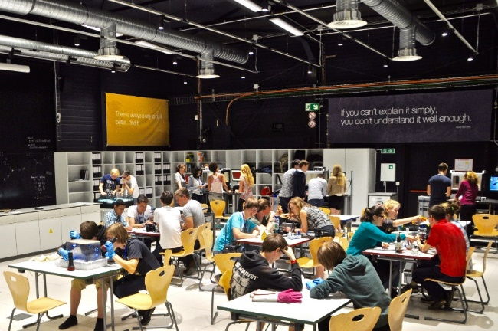
Current opportunities
S’Cool LAB Days
A full-day programme of hands-on particle physics experiments & CERN tours for groups of high school students aged 16-19.
1000 participants in 2016

Slide 12
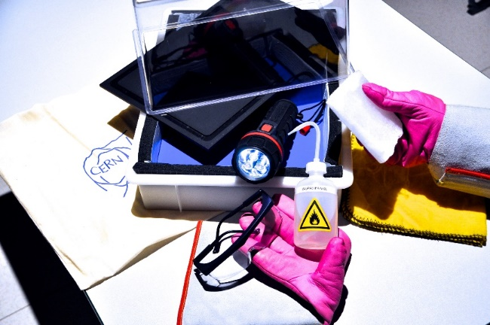
Current opportunities
S’Cool LAB Days
Cloud Chamber WS
A full-day programme of hands-on particle physics experiments & CERN tours for groups of high school students aged 16-19.
1000 participants in 2016
A 90-minute hands-on particle physics workshop for high school students (aged 14 and above)
and teachers.
4400 participants in 2016
(3400 students & 1000 teachers)

Slide 13
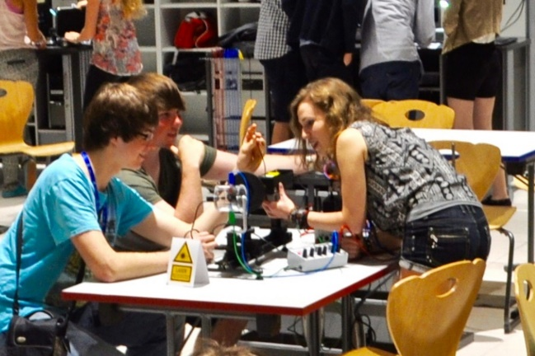
Current opportunities
S’Cool LAB Days
Summer CAMP
Cloud Chamber WS
A full-day programme of hands-on particle physics experiments & CERN tours for groups of high school students aged 16-19.
1000 participants in 2016
A two-week residential particle physics summer camp for 24 high school students aged 16-19 from all around the world.
first camp in 2017
(23/07 – 05/08)
A 90-minute hands-on particle physics workshop for high school students (aged 14 and above)
and teachers.
4400 participants in 2016
(3400 students & 1000 teachers)

Slide 14
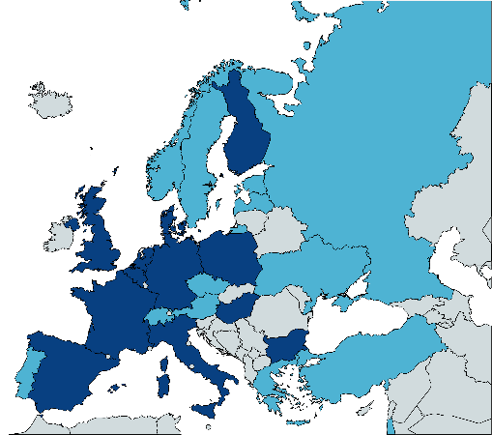

Origin of high-school students
visiting S’Cool LAB
101-550 students in 2016
10-100 students in 2016
& Us, Sg, Hk, Au, Jp

Slide 15
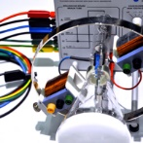
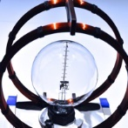
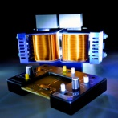
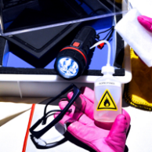
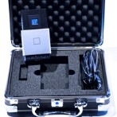
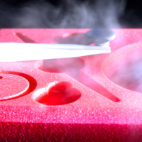
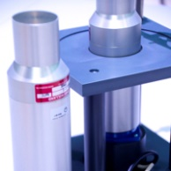
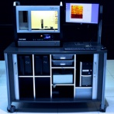

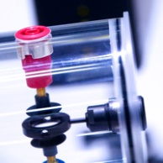
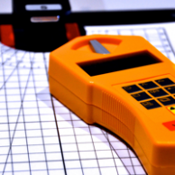
Equipment of S‘Cool LAB
Particle Acceleration
Basics & Applications
Particle Detection
electrons & electric fields
HALL effect
FRANCK-HERTZ experiment
cloud chambers
supercon-ductivity
electrons & magnetic fields
PET
scintillation detectors
pixel detectors
particle traps
RUTHER-FORD experiment
PLANCK’s constant
X-ray
machines
ionisation chambers
… and many more to come

Slide 16
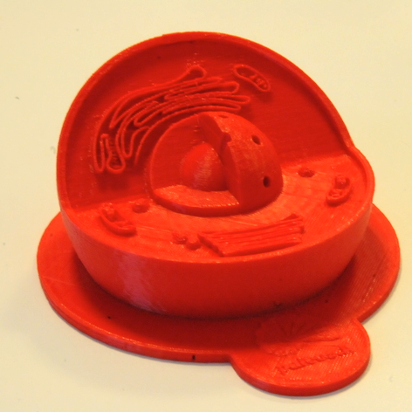
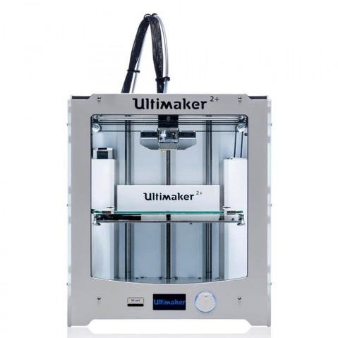
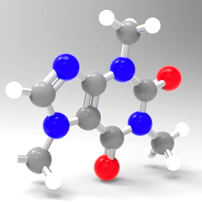
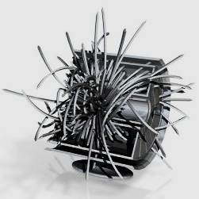
3D printable things & education
model of an animal cell www.thingiverse.com/
thing:689381
model of a caffeine molecule www.thingiverse.com/
thing:876224
More and more 3D printers &
3D printable things available
e.g. www.thingiverse.com/education
model of ALICE detector http://cern.ch/alicematters/
?q=ALICE_3D_models

Slide 17
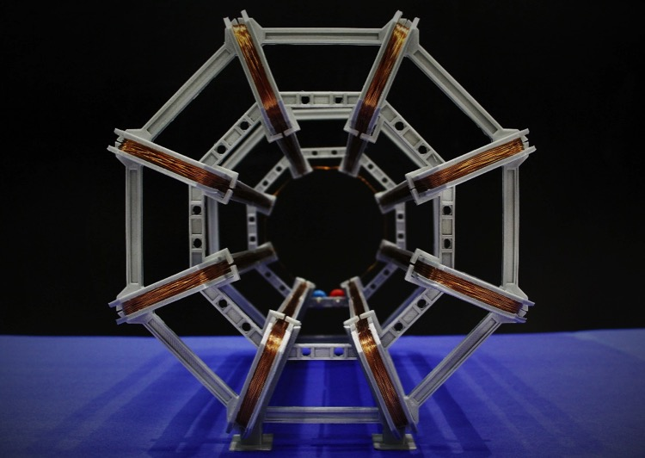
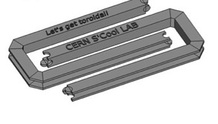
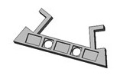
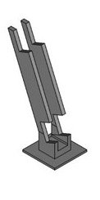
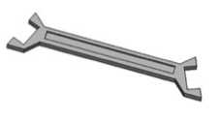
Designing a 3D printable model
FreeCAD 0.16
scaled 1:100
8x
4x
16x
16x
+500 m copper wire
(Image: CERN)
S’Cool LAB www.thingiverse.com/thing:1722230

Slide 18
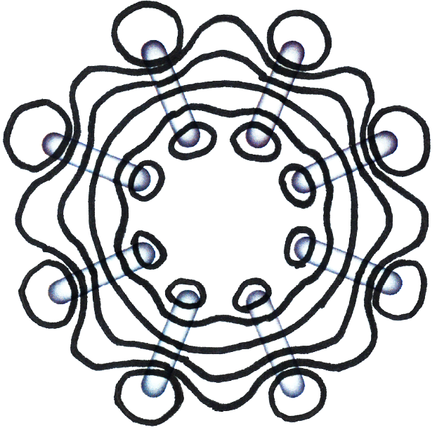
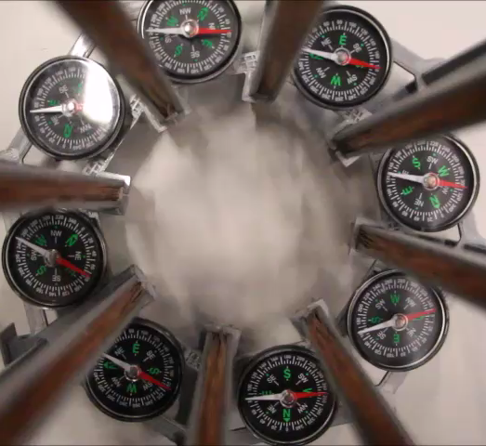
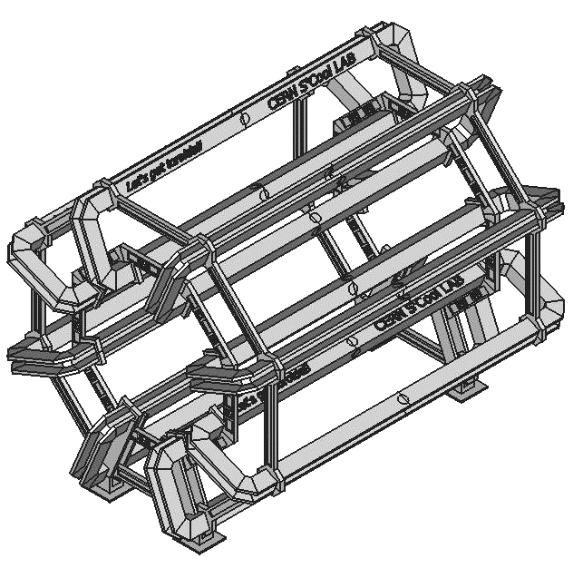
The final model

Slide 19
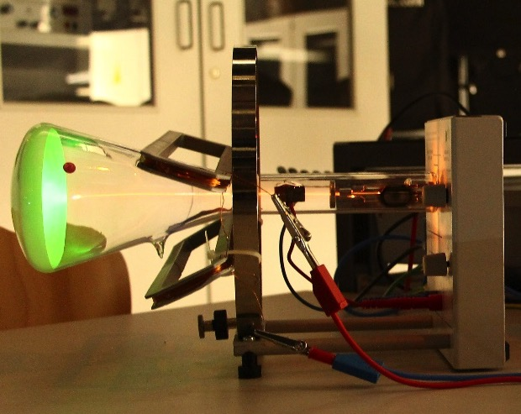
250 eV electron beam & model coils

Slide 20
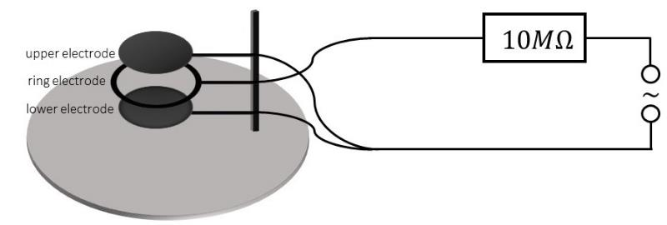
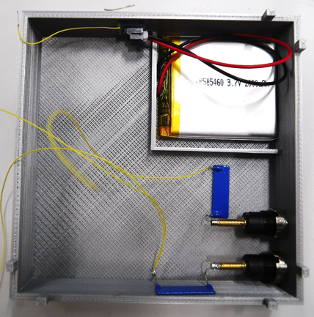
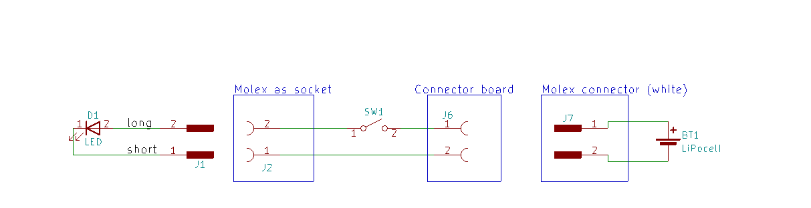
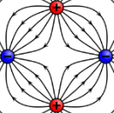

A 3D printable particle trap
2 - 4 kV
http://newtonianlabs.com

Slide 21
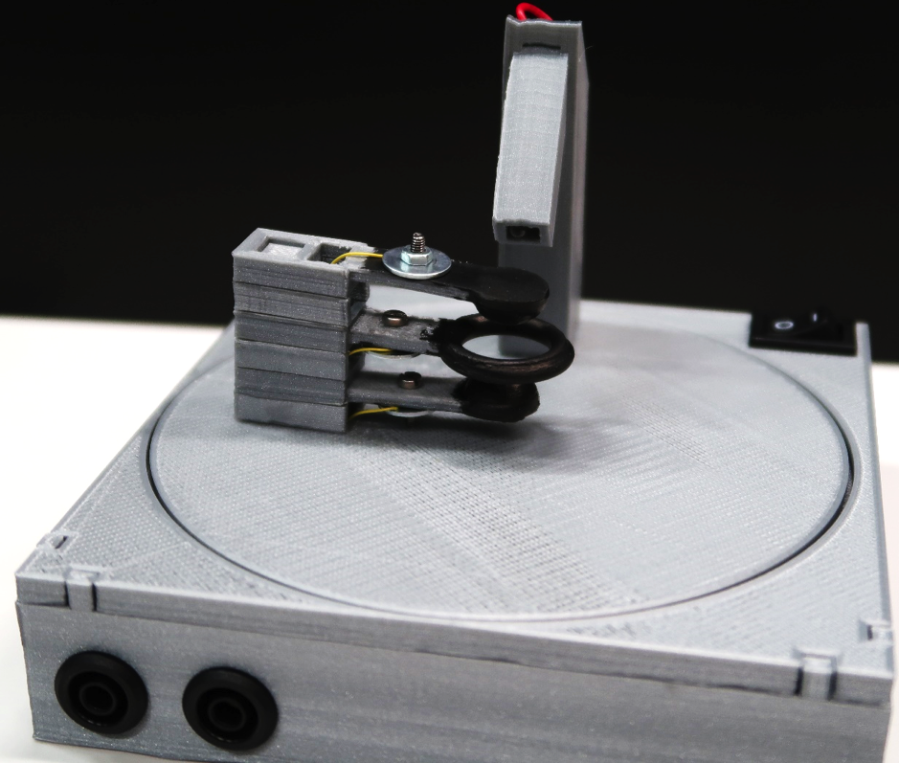
A 3D printable particle trap

Slide 22
More info: cern.ch/s-cool-lab

Slide 23
Back-up

Slide 24
Comparison between the ATLAS barrel toroid and the functional 3D-printed model
 | Feature | ATLAS toroid¹ | Modell toroid
Dimensions | Inner diameter | 9.4 m | 9.3 cm
 | Outer diameter | 20.1 m | 20.1 cm
 | Length | 25.3 m | 24.7 cm
 | Mass | 830 t | 860 g
Coils | Number of coils | 8 | 8
 | Material | Niobium-Titanium | Enamelled copper wire
 | Operating temperature | 4.5 K | Room temperature
 | Turns per coil | 120 | 80
 | Total length of conductor | 56 km | 500 m
 | Voltage | 16 V | 12 V
 | Nominal current | 20.5 kA | 0.4 A
 | Resistance | 0.16 mΩ | 31 Ω
 | Average magnetic field | 0.5 T | 0.8 mT
¹ The ATLAS Collaboration (2008). The ATLAS Experiment at the CERN Large Hadron Collider. Journal of Instrumentation, 3, S08003 http://cdsweb.cern.ch/record/1129811

Slide 25
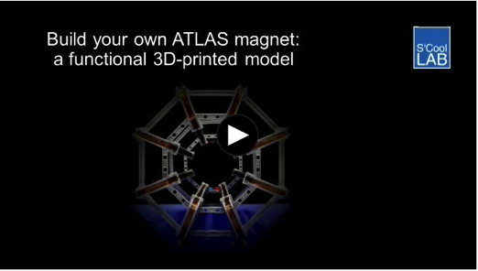
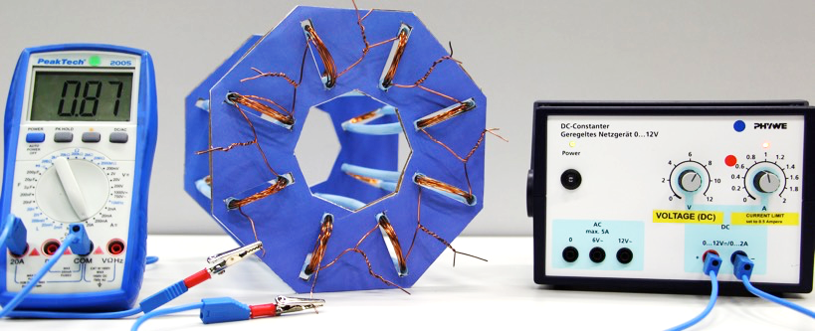
More about the ATLAS magnet model
http://cern.ch/s-cool-lab/classroom-activities/atlas-model
Video
https://cds.cern.ch/
record/2255117
Model with straws: Feistmantl, A., Woithe, J. (2017). Elektromagneten der Teilchenphysik
hands-on – das ATLAS-Magnetsystem. Praxis der Naturwissenschaften - Physik in der Schule, 66(1), 21-28 https://cds.cern.ch/record/2244917

