Slide 1

Network Security Self-Service Platform in IHEP
- for Hosts & Services Vulnerability Assessment
Fazhi Qi, Tian Yan, Zhihui Sun, Chichi Weng
Computing Center, IHEP
HEPiX Spring 2016

Slide 2
Outline
Motivation & background
Design and architecture
Development and deployment
Running status at IHEP
Summary

Slide 3
Background & Motivation
Facing network security problems/issues
  99% of the network security problems are caused by the vulnerabilities
Lack of tools for our users to evaluate the security situation of their hosts and services easily
  Some tools/softwares are focusing on dedicated services
  What we need is a software that composed of all the evaluate tools for all the services based on users’ requirements
  User interface is not friendly…

Slide 4

Background & motivation(Con.)
Security As a Service, Users can using the service at any time for any hosts or services with the proper privilege
  Normal users can use the service to know his/her services/hosts status and get some suggestions for security
  Administrator of servers can use the services to ensure the system and applications safety
  Network security team use the services to assess the vulnerabilities for the hosts and to launch the related security policies
  Services for the testers to find the system Vulnerability during the software testing
https://security.web.cern.ch/security/home/en/about.shtml

Slide 5
Design and architecture

Slide 6
Design Principles
Easy to use
  since end users/physicists are not security specialist
Scalability
  easy to add new functional module
  Multi Scanners/Engines should be supported (open source/ commercial security scanners) easily
High availability & high concurrency support
  Online services
  For the network security team to do the assessable, thousand hosts will be scan at the same time
Least privilege & separation of duties
  Normal users can only use it to scan his/her own hosts
  Security administrators can scan all the needed hosts

Slide 7
Architecture
Service layer
User interface
Permission control
User authentication
Admission control
Middle layer
Message middleware
Data access
Data storage
Schedule layer
Task reciever
Buffer
Module Manager
Module executor
Result Synchronizing
Module layer
Form vulnerability detection
Application vulnerability detection
Port vulnerability detection
Password vulnerability detection
Deep vulnerability detection

Slide 8
Module Layer
Each module is a detector/scanner for a kind of vulnerabilities
Current modules:
  Form vulnerability detector for weak password in HTML pages.
  Web application vulnerability is detected by the response of a constructed request to that application.
  Port vulnerability is found by Nmap and analysis of the response of a customized request sending to the opened port.
  Weak password detection is carried out by verification of user password against a weak password list collected from internet.
  OpenVAS is called in client/server scheme for deep vulnerability detection, through OpenVAS Management Protocol (OMP).
It’s easy to add more functional modules in this layer.

Slide 9
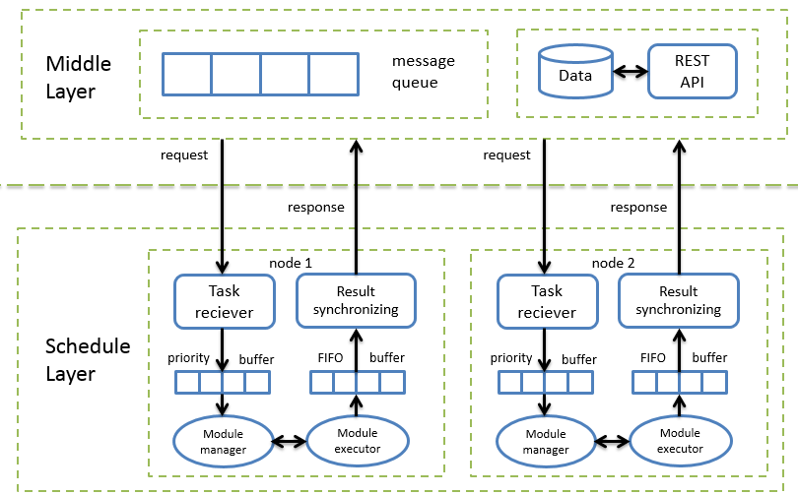
Schedule Layer
The schedule layer contains several independent, scalable nodes.
Modules in this layer communicates with each other through buffer.
  Task reciever fetch jobs from the message queue and put them to the priority queue. It stops fetching jobs when reached max concurrently tasks.
  Module manager create and destroy scanning task threads, according to the priority queue.
  Module manager create and destroy scanning task threads, according to the priority queue.
  Module executor detects the vulnerabilities by interact with target host. Each executor is designed as a plugin.
  The result synchronizing module get data from FIFO buffer and put them to database. Redundant result will be ignored.

Slide 10
Middle Layer
In message middleware, the active MQ and P2P model is used. Failover mechanism is also realized by multiple JMS broker.
A general data format is designed to store the vulnerability information detected.
The data is stored at MySQL database.
RESTfull API is developed to encapsulate data, it provides general interface for data access
Producer
Consumer 1
push
JMS Provider
Consumer 2
pull
Consumer n
Message queue
Client

Slide 11
Service Layer
User interface
  A user friendly web interface is provided for user self-service
  It’s easy to use and present straightforward result for non-expert user
Authentication and authorization
  Role based access control
  Dynamic authorization
  Integrated with IHEP unified authentication system /Oauth2.0
  Host admission/access control based on assessment result, Integrated with IHEP firewall system

Slide 12
Development and deployment

Slide 13
Development Environment
Programing Langurage:
  Python 2.7
Operation system:
  CentOS 6 and Windows 7
Database:
  MySQL 5.6
Web framework:
  Django, uwsgi, Nginx

Slide 14
System Deployment
Assessment Server
Host security evaluation service
Permission control
detection task
push
pull
message queue server
DB server
Data access module
detection task
pull
detection result
push
Detector node 1
Detector node 2
Detector node 3
Detector node n
……

Slide 15
User Workflow
Evaluation workflow for normal user:
  login to the network security self-service evaluation system
  create assessment task
  choose evaluation module
  choose online or offline evaluation
  waiting when system perform evaluation
  check result
  enhance host security according to the suggestions
All these operations can be performed at web client
Start
Access http://safe.ihep.ac.cn
Login with the SSO
Create a job/task for host assessment
If the user has the privilege for the host?
no
no
Approved by the Administrator/Security manager ?
yes
Start the job/task
yes
Result: Assessment report and enhance suggestions

Slide 16
Running Status at ihep

Slide 17
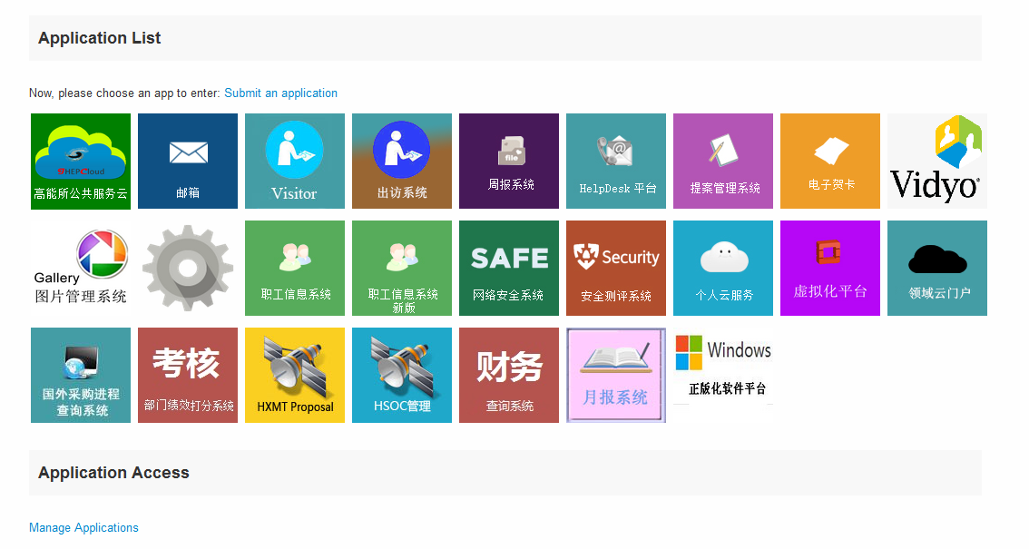
Deployment and Operation at IHEP
This NSSP was deployed at IHEP and started to run at 2014.
Users can access to this system through the application list in IHEP unified authentication homepage.

Slide 18
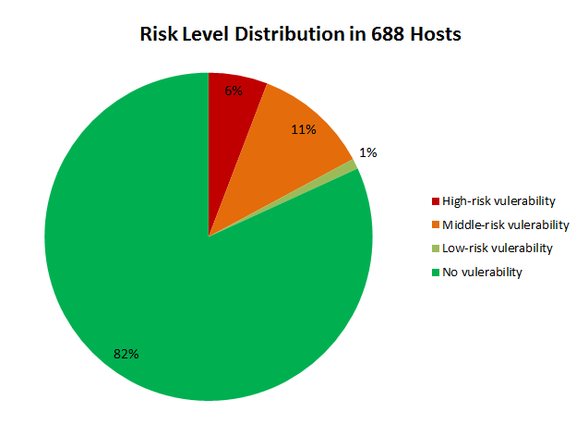
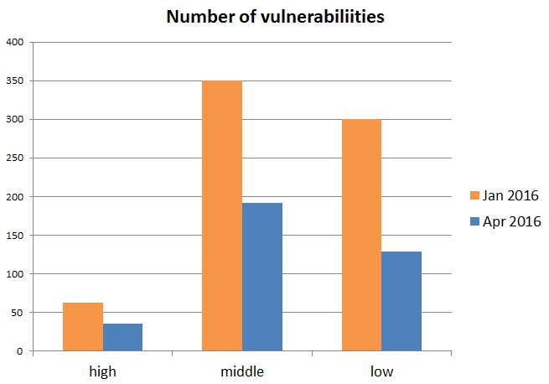
Running Status at IHEP
Online for about 1 year
  1458 distinct hosts have been evaluated in NSSP.
  About half of the high-risk vulnerabilities have been fixed
  For example, at Jan. 2016, 63 high-risk vulnerabilities have been detected on 40 hosts (6% of 688 hosts)

Slide 19
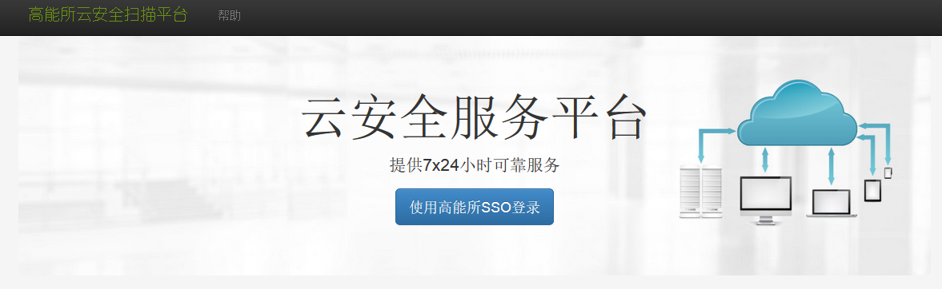
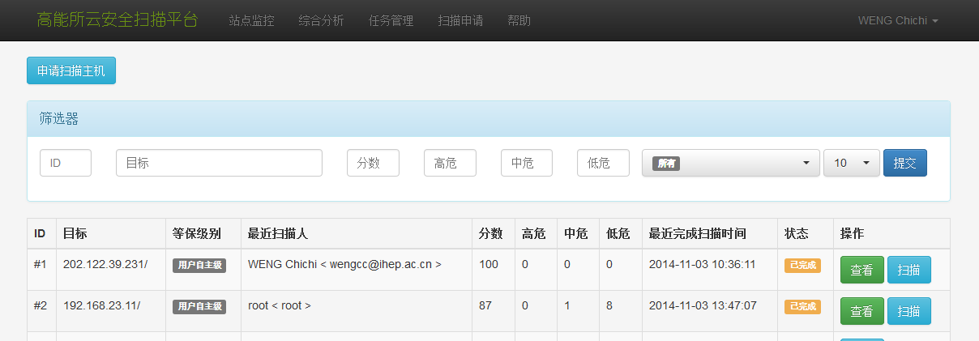
Web Interface

Slide 20
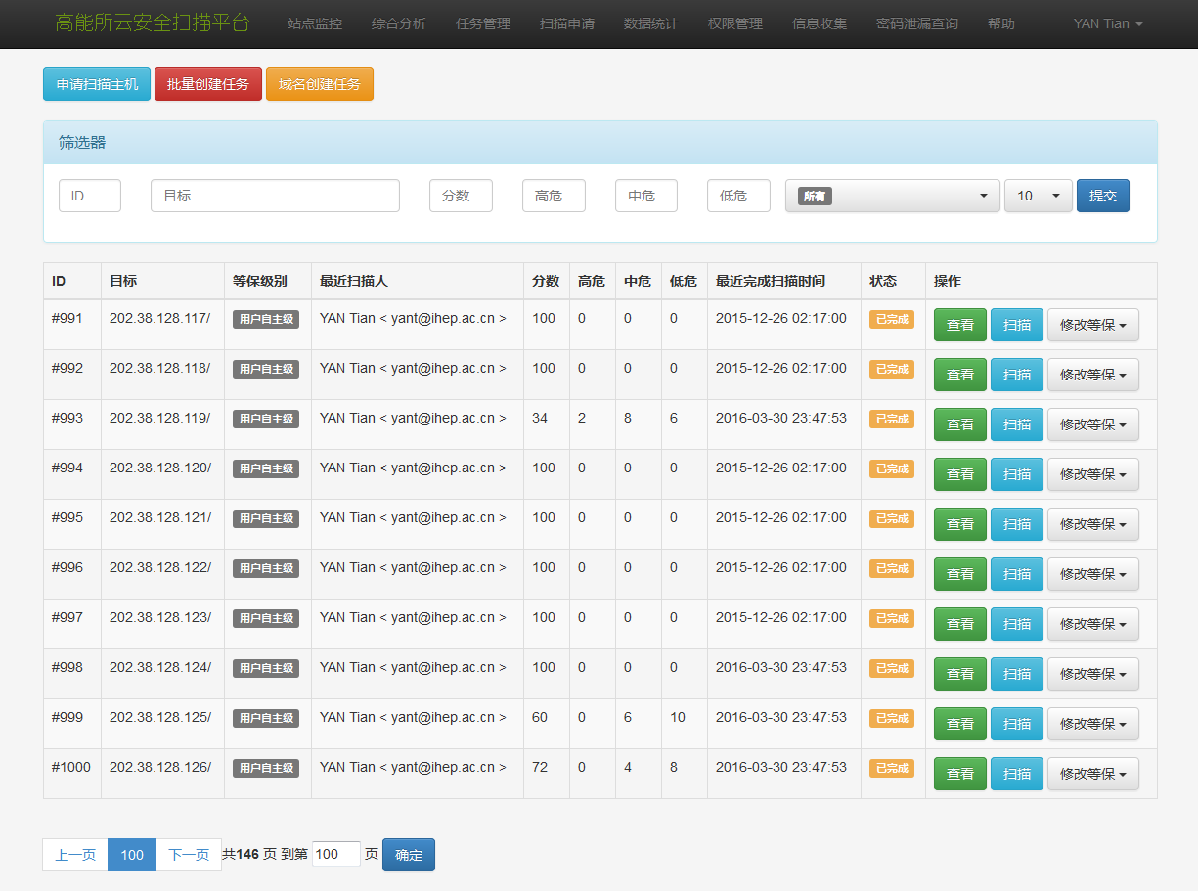
Example of Evaluation Result

Slide 21
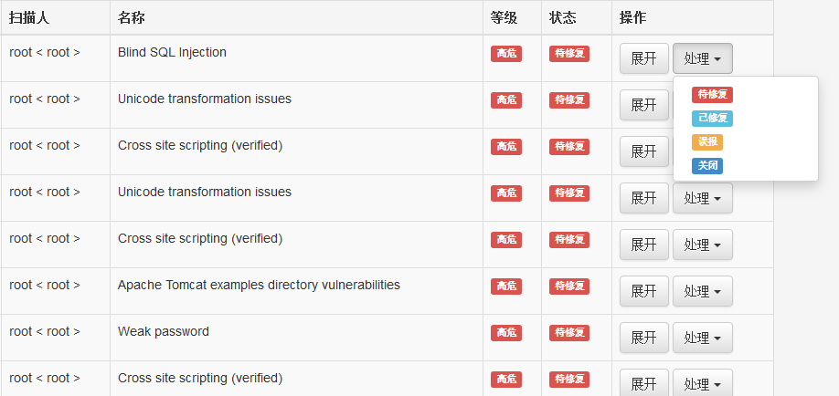
Example of Evaluation Result

Slide 22
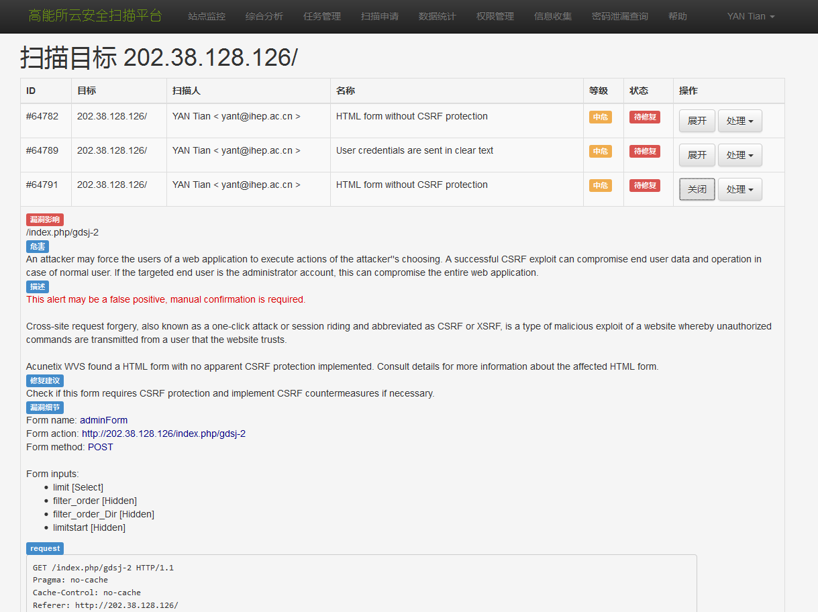
Example of Evaluation Result

Slide 23
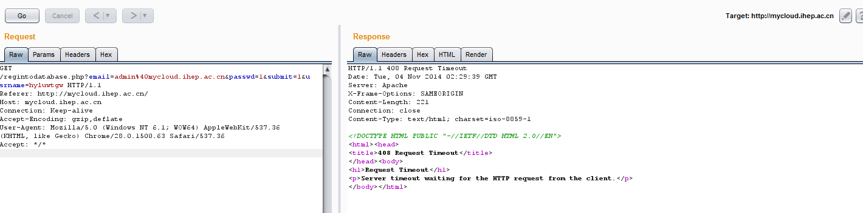
Example of Evaluation Result

Slide 24
Summary
Motivated by the requirements of a easy-to-use network security assessment tools set for users, we developed and deployed such a system at IHEP.
This platform has been online at IHEP for one year, becoming an important tools for users and the network security team. working very well….
More scanners will be added according to the needs in the future

Slide 25
Thank you

