Slide 1
A virtual private network based on software defined network architecture for high energy physics data exchange
Zhihui Sun, Fazhi Qi, Tao Cui
Hepix Spring 2016
Computing Center, Institute of High Energy Physics, CAS

Slide 2
outline
Background
Key Technologies
Current Status
Future work

Slide 3
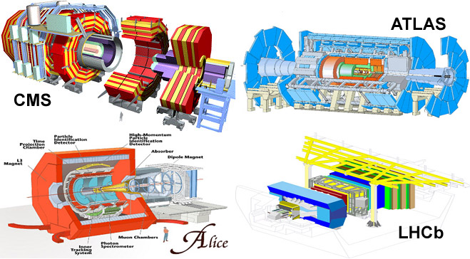

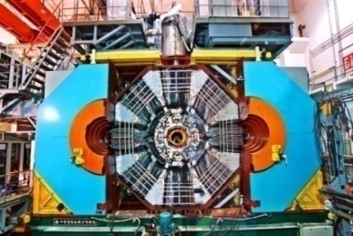
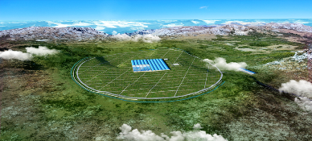

Background
Data Exchange Challenges
  HEP Experiments are data intensive science
  IHEP is hosting and participating in several HEP Experiments
  BESIII、DayaBay、Atlas、CMS、CSNS、JUNO、LHASSO …

Slide 4
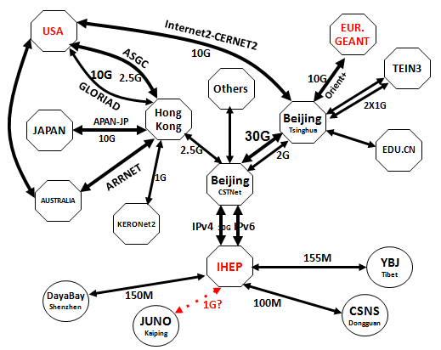
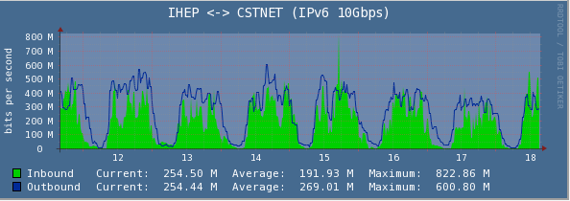
IHEP Current Network Status
IPv4
  Good connection for international cooperation
  Poor bandwidth for the domestic communication
    Universities…
IPv6
  Available bandwidth is good
  Always too busy in daytime,
  only good at night

Slide 5
What shall we do?
Build a simple, flexible, robust, high performance and central－controlled network environment for HEP cooperation members in China
SDN is one of the Choices…

Slide 6
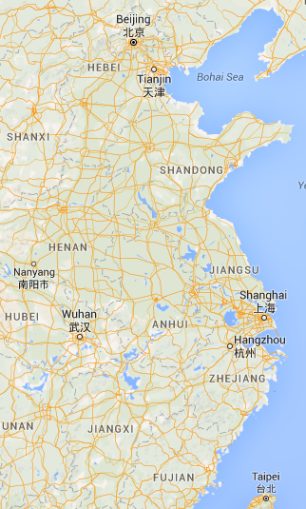
The Key Technologies
IHEP
SDU
SJTU
CCNU
Network topology
  SJTU (Shanghai Jiao Tong University), SDU (Shandong University), CCNU (Central China Normal University), IHEP
  IPv4 & IPv6

Slide 7

The Key Technologies
Overlay
  IPv4OverIPv6
  VPN：GRE tunnel,
  Efficiency: >95%
SDN Controller
  Based on OpenDaylight
  North-API: RESTAPI
  South-API: OpenFlow, SNMP
SDN Boundary Switch
  OpenFlow 1.3
  VPN function
  Link performance probing

Slide 8
The Key Technologies
Link Quality Detection
  Packet loss
  Latency
  Available bandwidth: Active measurement
  (by iperf)
path | Packet loss | latency | Available bandwidth
Site A->site B(ipv4)
Site A->site B(ipv6)
Site A->site C->site B (ipv4)
Site A->site C->site B (ipv6)
Site A->(ipv4)site C-> (ipv6)site B
Site A->(ipv6)site C-> (ipv4)site B
Ipv4 GRE tunnel
Ipv6 GRE tunnel
Site
A
wan
Site
B
Site
C

Slide 9
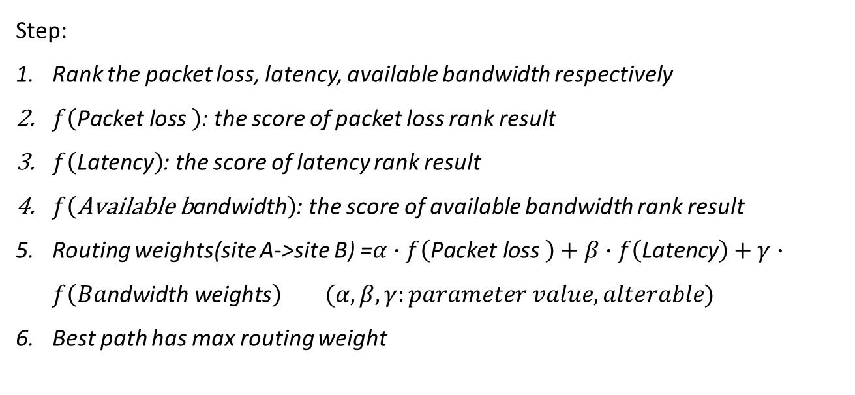
The Key Technologies
Routing Switching algorithm
Step:
  Rank the packet loss, latency, available bandwidth respectively
  $f\left(\text{Packet} \text{loss} \right)$: the score of packet loss rank result
  $f\left(\text{Latency}\right)$: the score of latency rank result
  $f\left(\text{Available} \text{b}\text{andwidth}\right)$: the score of available bandwidth rank result
  Routing weights(site A->site B) =$α∙f\left(\text{Packet} \text{loss} \right)+β∙f\left(\text{Latency}\right)+γ∙f\left(Ba\text{ndwidth} \text{weights}\right) (α,β,γ:parameter value,alterable)$
  Best path has max routing weight

Slide 10
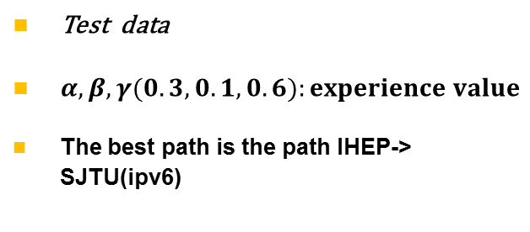
The Key Technologies
Ipv4 GRE tunnel
path | Packet loss | Latency (ms) | Available bandwidth (Mbps)
IHEP->SJTU (ipv4) | 0 | 179.3 | 49.6
IHEP->SJTU (ipv6) | 0.2% | 66.75 | 337
IHEP->SDU->SJTU(ipv4) | 0.5% | 30.1 | 4.6
IHEP->SDU->SJTU(ipv6) | 3% | 110.6 | 1.05
IHEP->(ipv4)SDU-> (ipv6)SJTU | 1% | 32.13 | 4.57
IHEP->(ipv6)SDU-> (ipv4)SJTU | 4% | 116.132 | 1.43
Ipv6 GRE tunnel
IHEP
wan
SJTU
SDU
path | Packet loss (score) | Latency (score) | Available Bandwidth (score) | Routing weights (score)
IHEP->SJTU (ipv4) | 6 | 1 | 5 | 4.9
IHEP->SJTU (ipv6) | 5 | 4 | 6 | 5.5
IHEP->SDU->SJTU(ipv4) | 4 | 6 | 4 | 4.2
IHEP->SDU->SJTU(ipv6) | 2 | 3 | 2 | 2.1
IHEP->(ipv4)SDU-> (ipv6)SJTU | 3 | 5 | 3 | 3.2
IHEP->(ipv6)SDU-> (ipv4)SJTU | 1 | 2 | 1 | 1.1
Test data
$α,β,γ(0.3,0.1,0.6):experience value$
The best path is the path IHEP-> SJTU(ipv6)

Slide 11
Scenarios
✗
Host A
Site
A
Site
B
Site
C
Host B
Host C

Slide 12
Routing Switching
Host A
Site
A
Site
B
Site
C
Host B
Host C

Slide 13
Routing Switching
Host A
Site
A
Site
B
Site
C
Host B
Host C

Slide 14
Test Result
Transfer performance test
latency test
Path | Traditional method （Mbps） | SDN method （Mbps） | Best path | Traditional method （Mbps） | SDN method （Mbps）
IHEP->SJTU | 29.7 | 337 | IHEP->(IPv6)SJTU | 179.3 | 66.75
SJTU->IHEP | 23.1 | 43.5 | SJTU->(IPv6)IHEP | 180.1 | 66.79
IHEP->SDU | 4.76 | 28.8 | IHEP->(IPv6)SJTU->(IPv6)SDU | 9.14 | 87.33
SDU->IHEP | 4.46 | 27.3 | SDU->(IPv6)SJTU->(IPv6) IHEP | 10.3 | 87.29
SDU->SJTU | 4.84 | 28.40 | SDU->(IPv6)SJTU | 21.3 | 20.54
SJTU->SDU | 4.89 | 29.23 | SJTU->(IPv6)SDU | 20.5 | 20.53
Transfer performance has been improved a lot
Latency varies uncertainly, but it has little effect

Slide 15
Current Progress
Phase I
  Aug. 2014
  SJTU,SDU,IHEP
  Only IPv6 link
  Manual path selection
  Problems
    VPN efficiency：70%
    IPv6 link performance was unstable
Phase II
  Oct.2015
  SJTU,SDU,IHEP,CCNU
  IPv6 & IPv4
  Automatic path selection
  Performance improvement
    testing

Slide 16
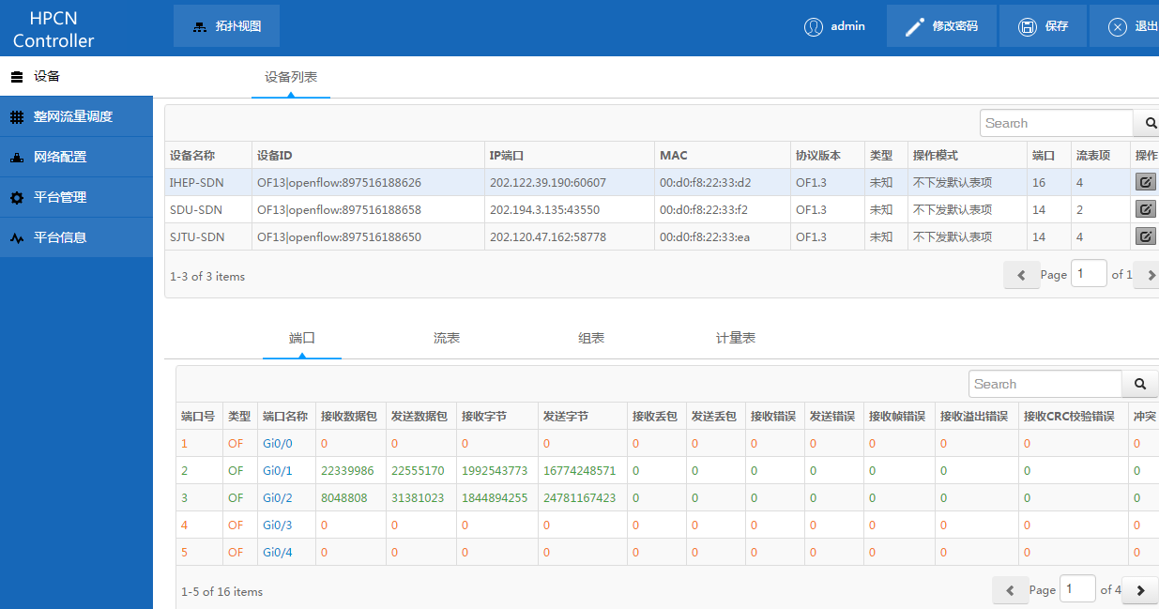
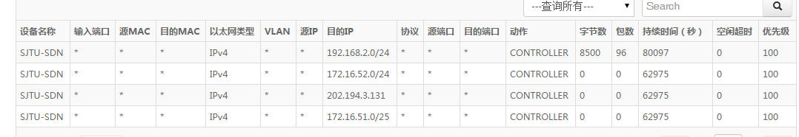
Controller dashboard
SDN Switch
info
Flow table
info

Slide 17
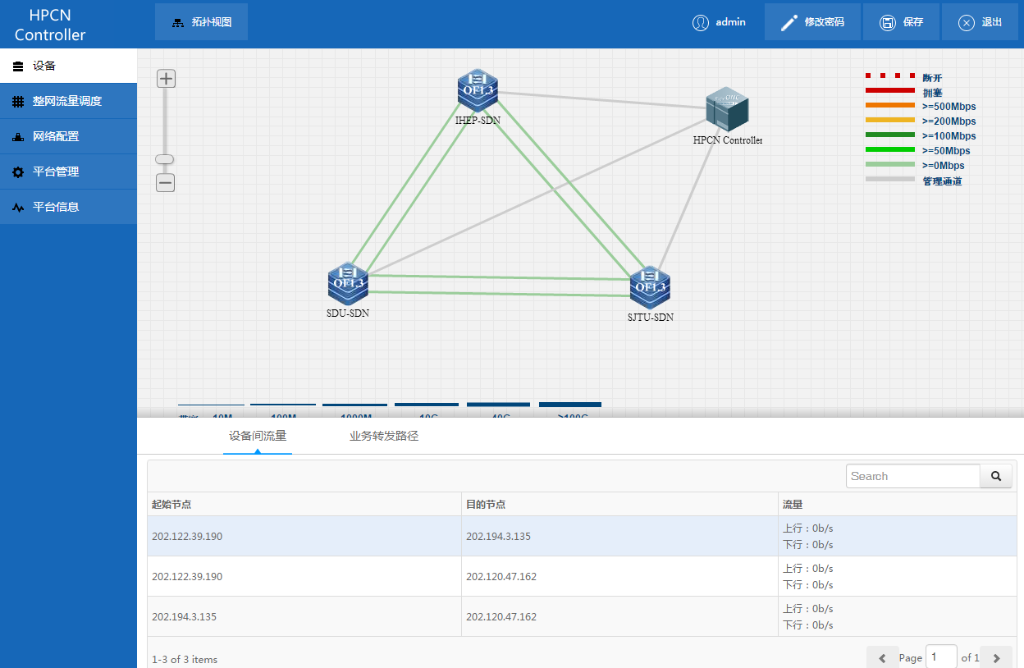
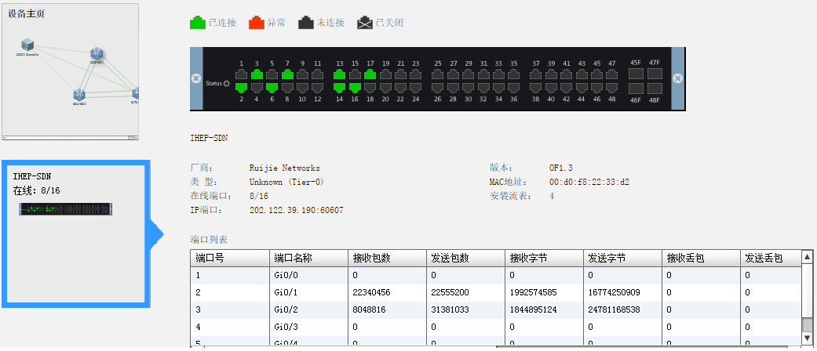
Controller dashboard – network & devices status
Control link
Ipv4 link
Ipv6 link

Slide 18
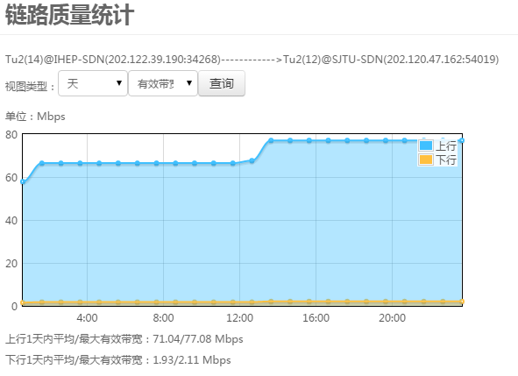
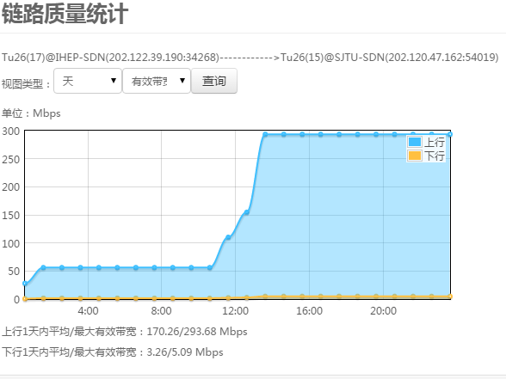
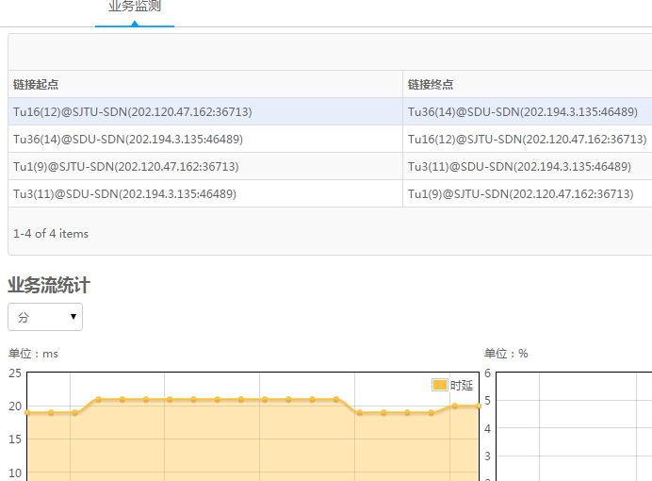
Controller dashboard – link performance statistics
Available
bandwidth
(ipv4)
Available
bandwidth
(ipv6)
latency
(ipv6)

Slide 19
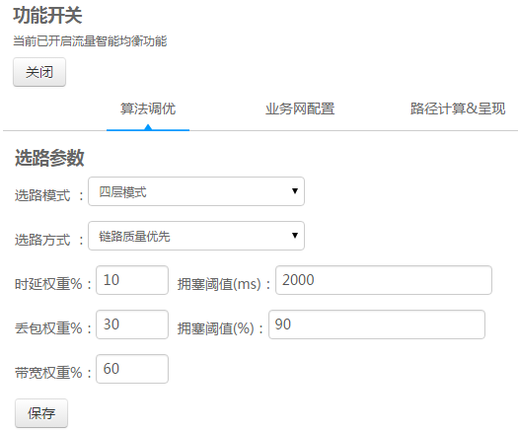
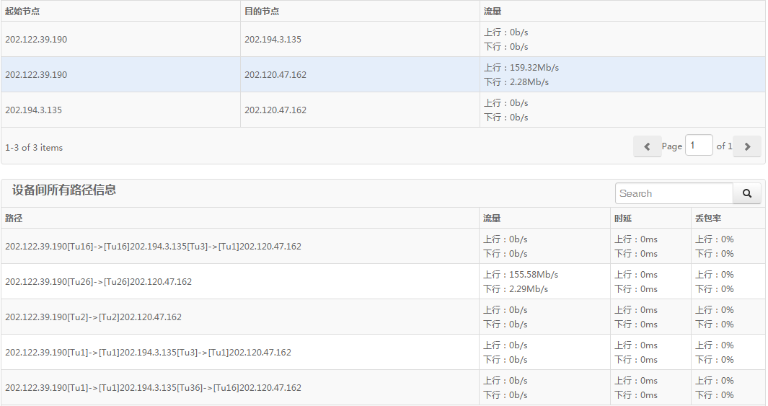
Controller dashboard- Path selection
parameter
setting
path
Selection
result

Slide 20
Future work
Optimization
  Available bandwidth probing
  Path selection algorithm
Add more HEP experiment sites
Couple with data transfer application

Slide 21
Thanks for your attention !
Any questions？

