Slide 1

KEK site report
The next generation system of KEKCC
Tomoaki Nakamura
on behalf of KEKCC team
KEK (HIGH ENERGY ACCELERATOR RESEARCH ORGANIZATION)

Slide 2
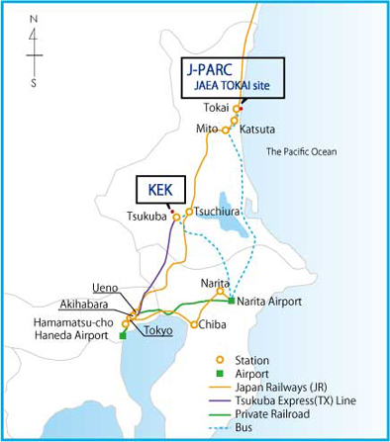
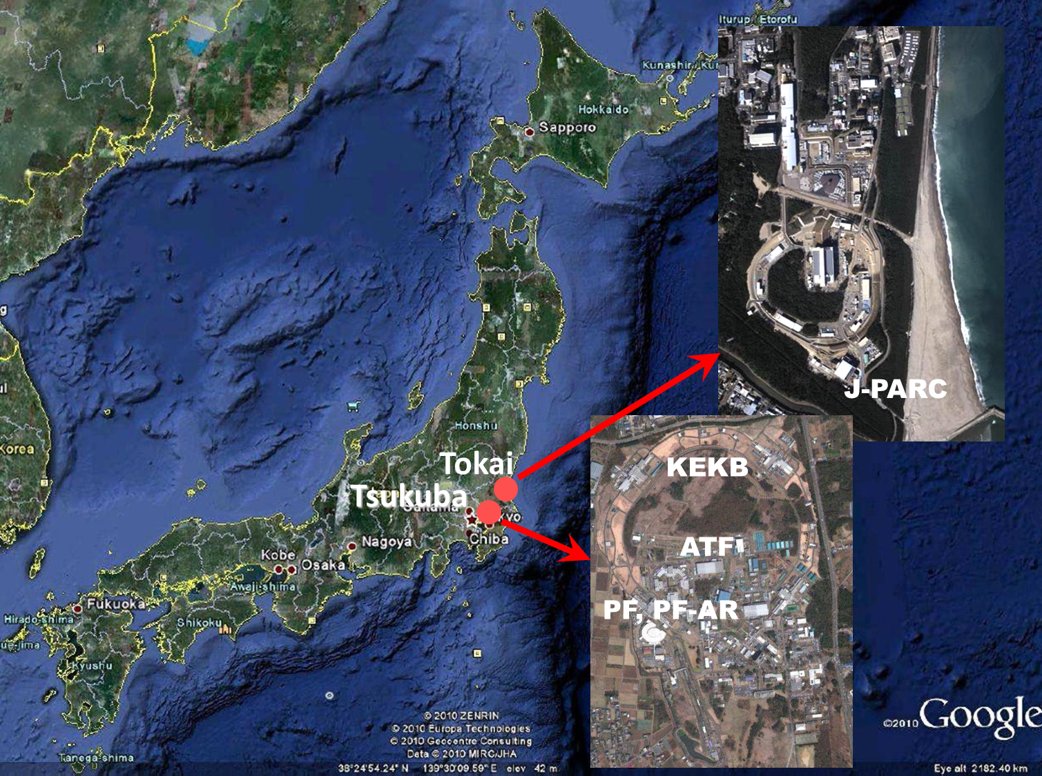
KEK facilities
Proton machine
~60km
~60km
Electron machine

Slide 3
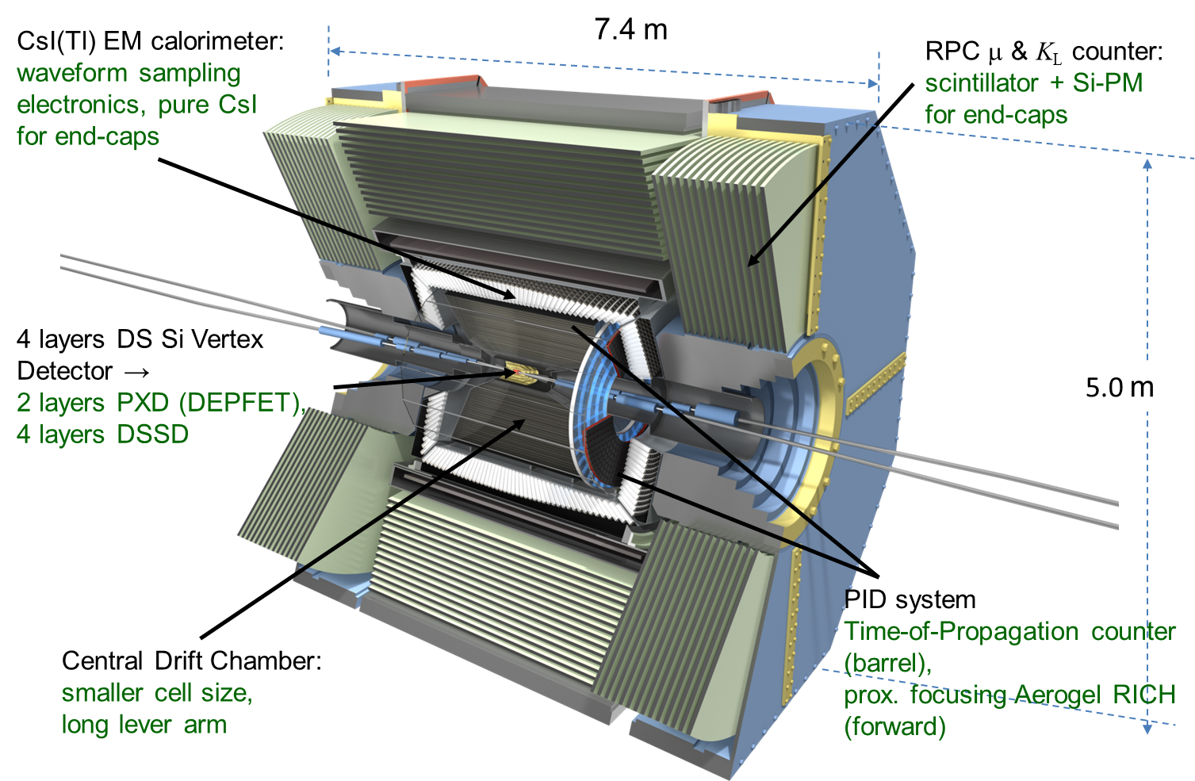
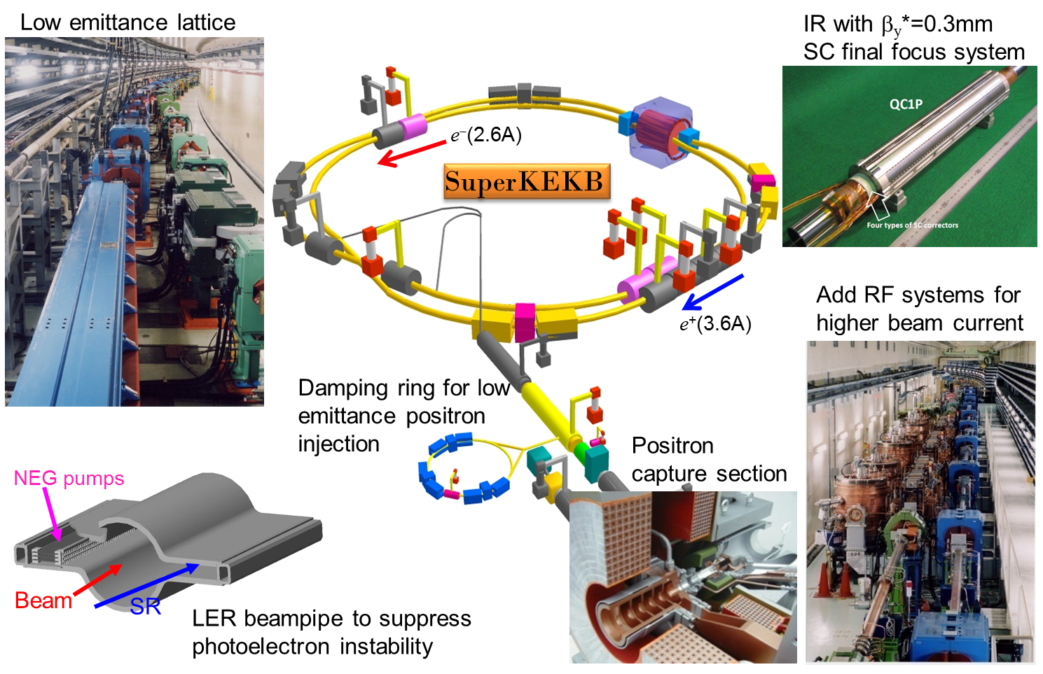
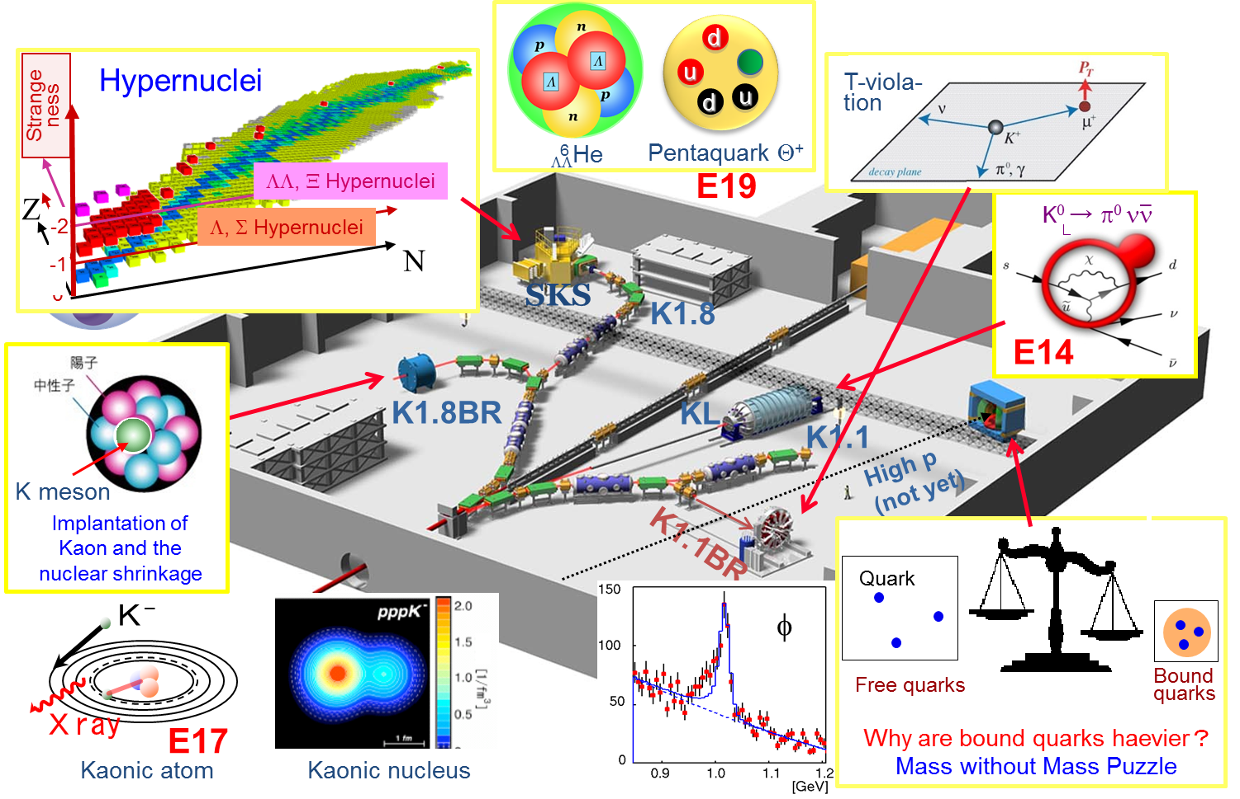
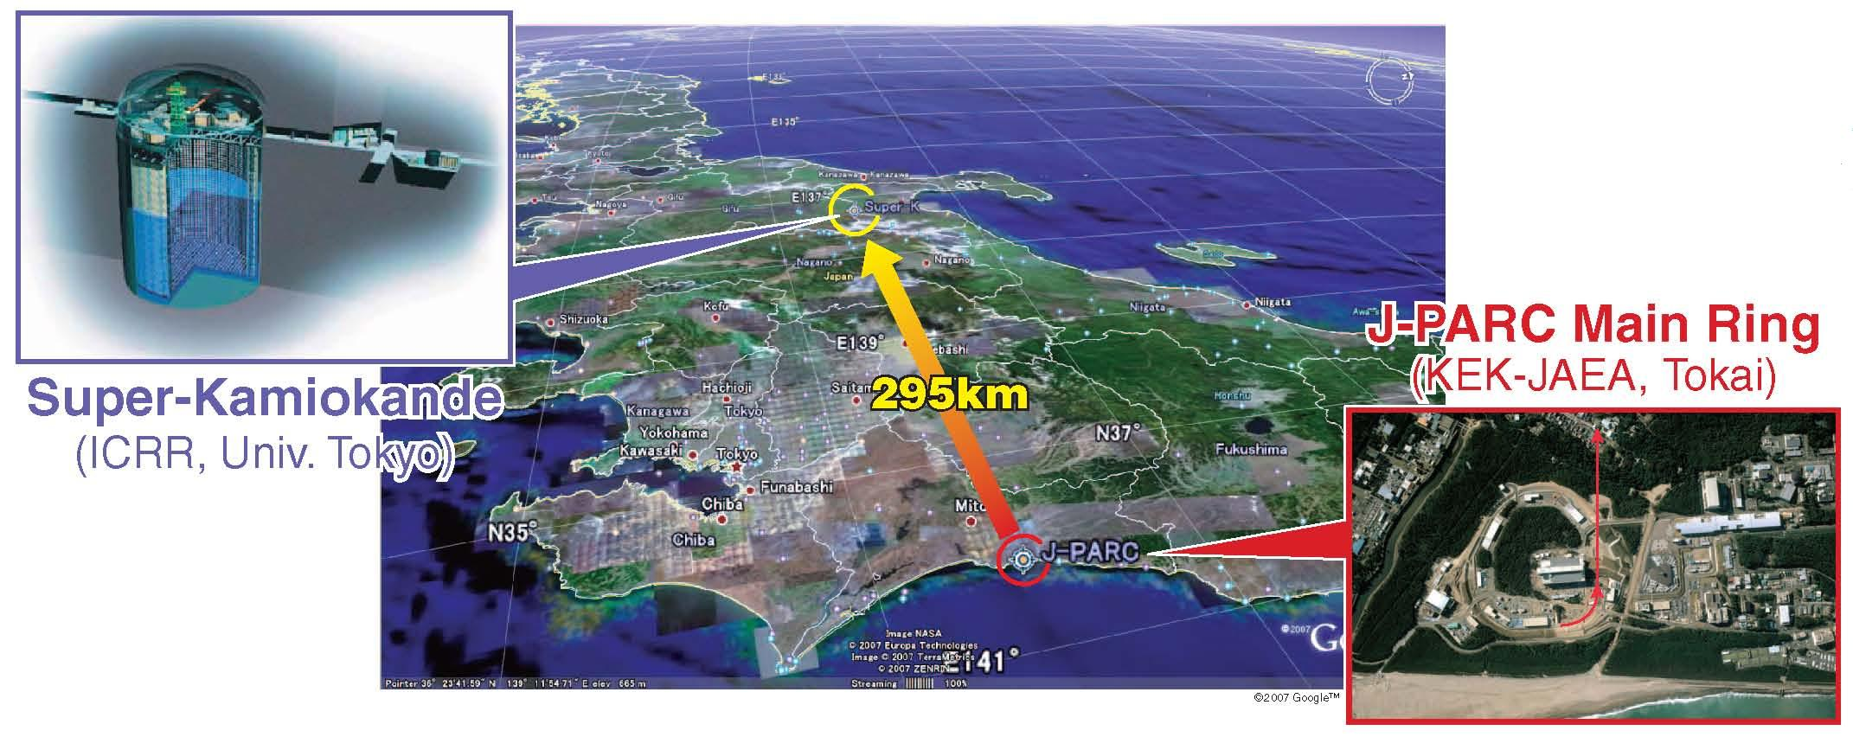
On going projects in KEK
SuperKEK B-Factory
Belle II
T2K (Tokai to Kamiokande)
Nuclear/Hadron experiments
J-PARC

Slide 4
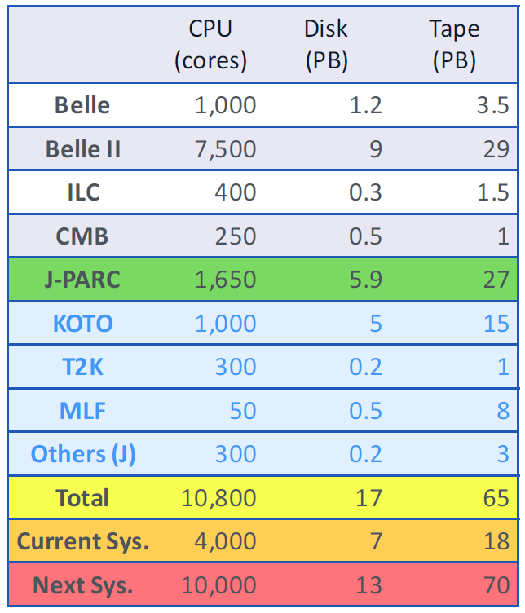
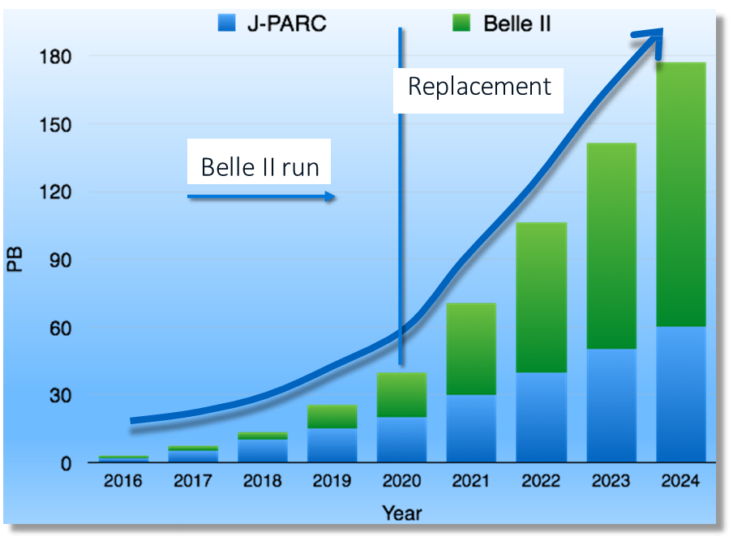
Computing requirement for KEKCC
Demand for computing resource is increasing
Not only from High Energy Physics
  precise measurement produce huge data
K. Murakami (KEK)

Slide 5
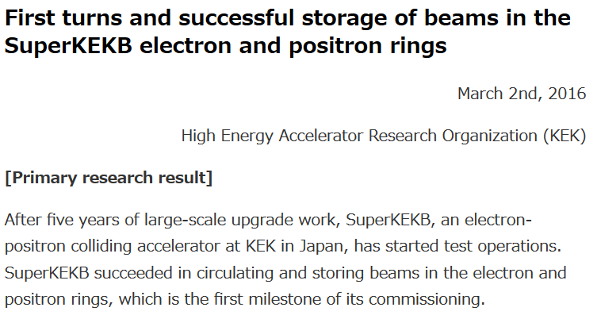
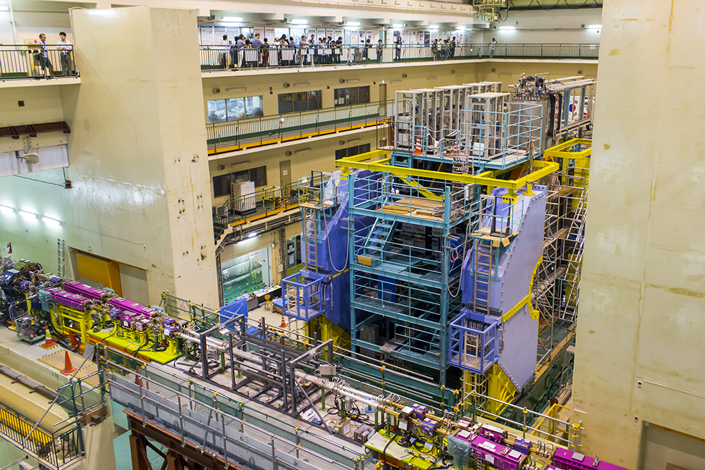
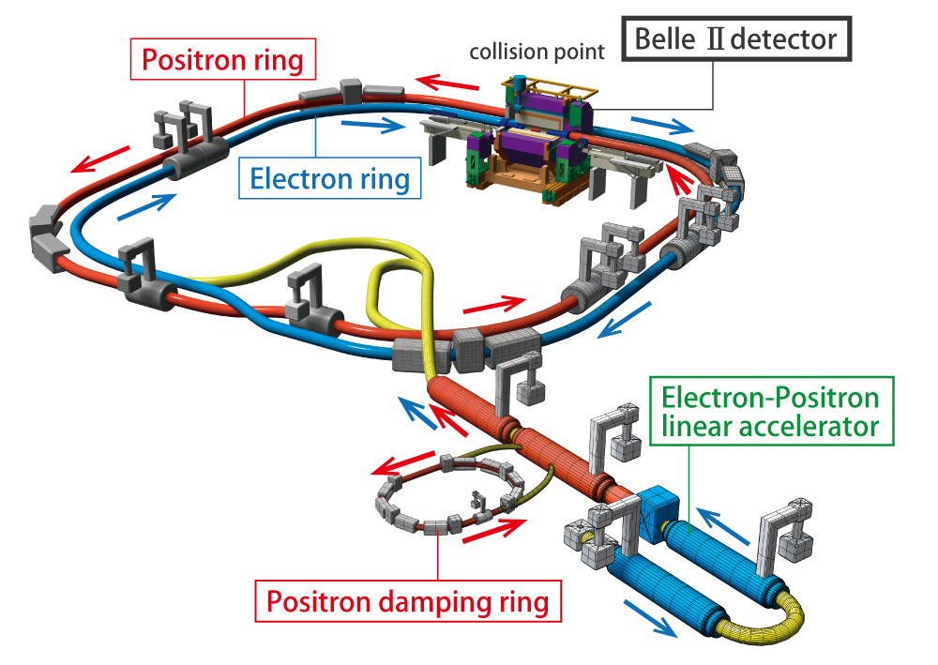
https://www.kek.jp/en/NewsRoom/Release/20160302163000/

Slide 6
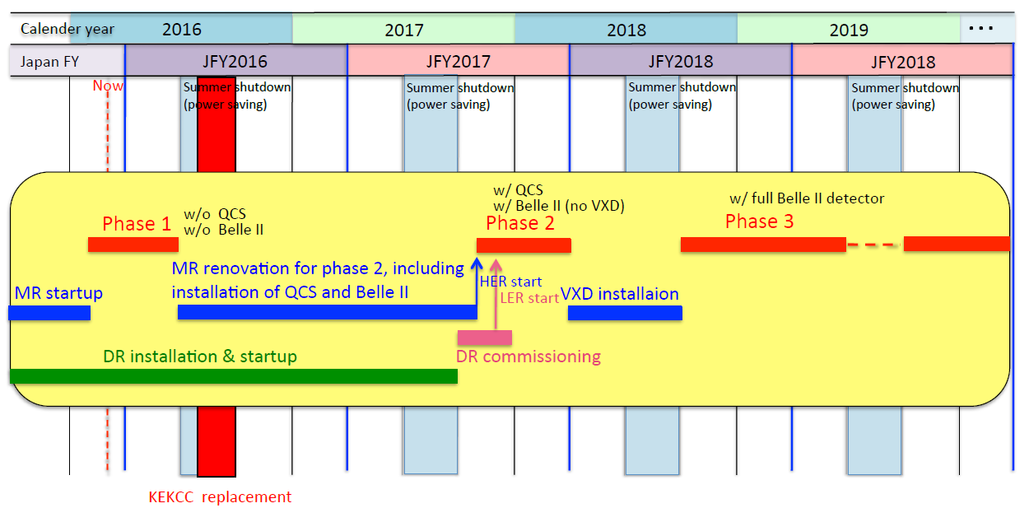
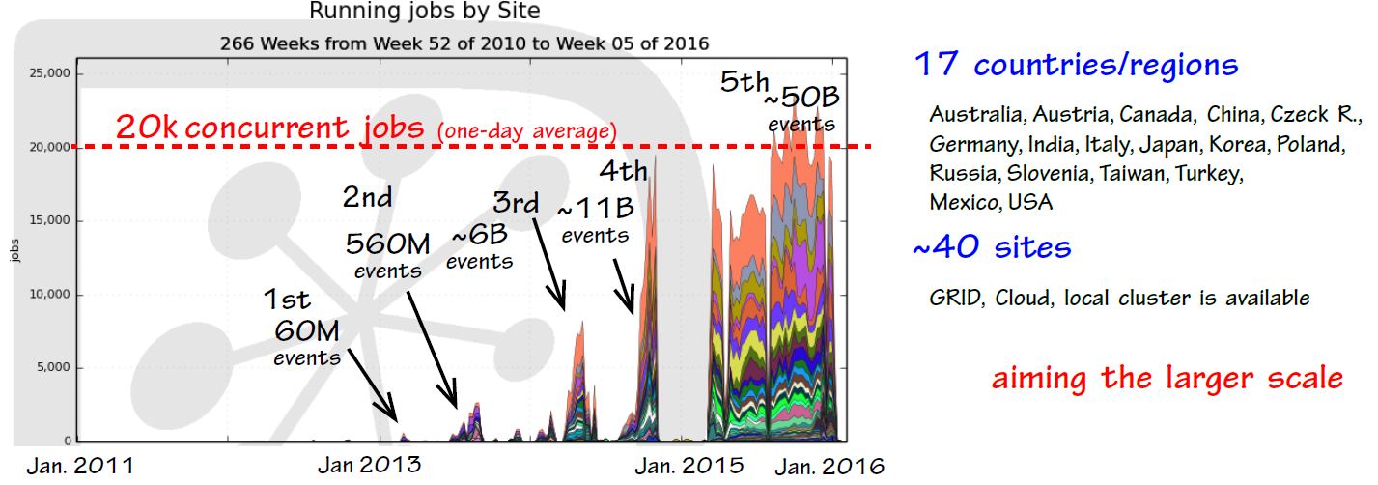
Schedule of SuperKEKB and Belle II
T. Hara (KEK)

Slide 7
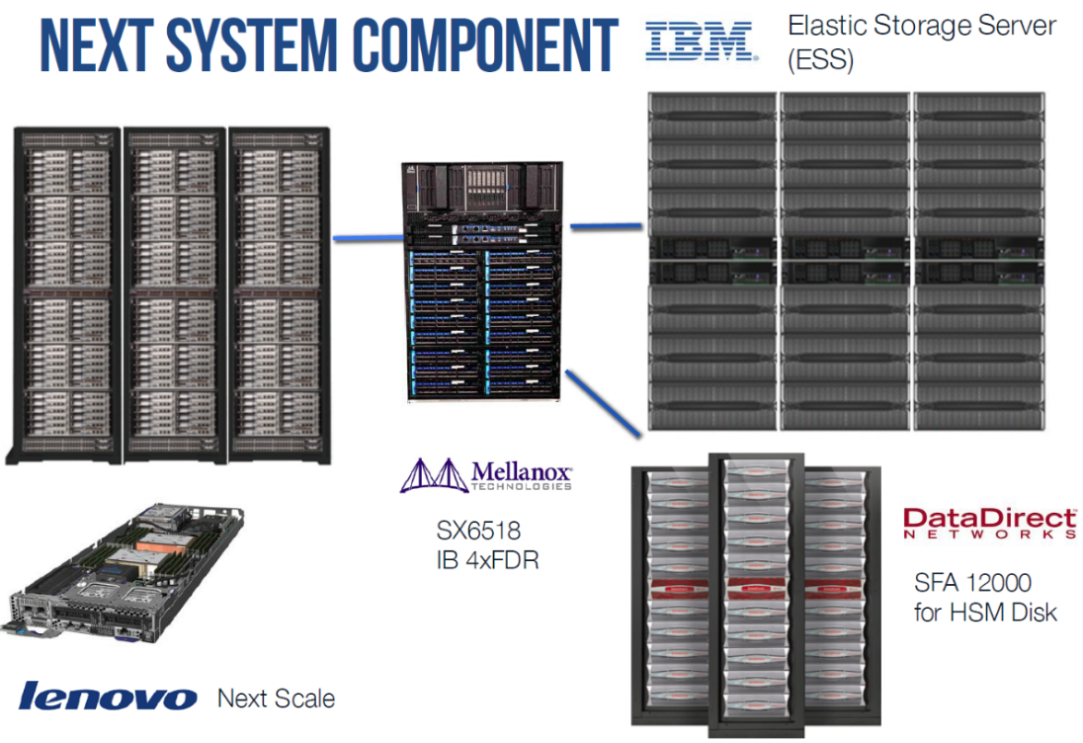
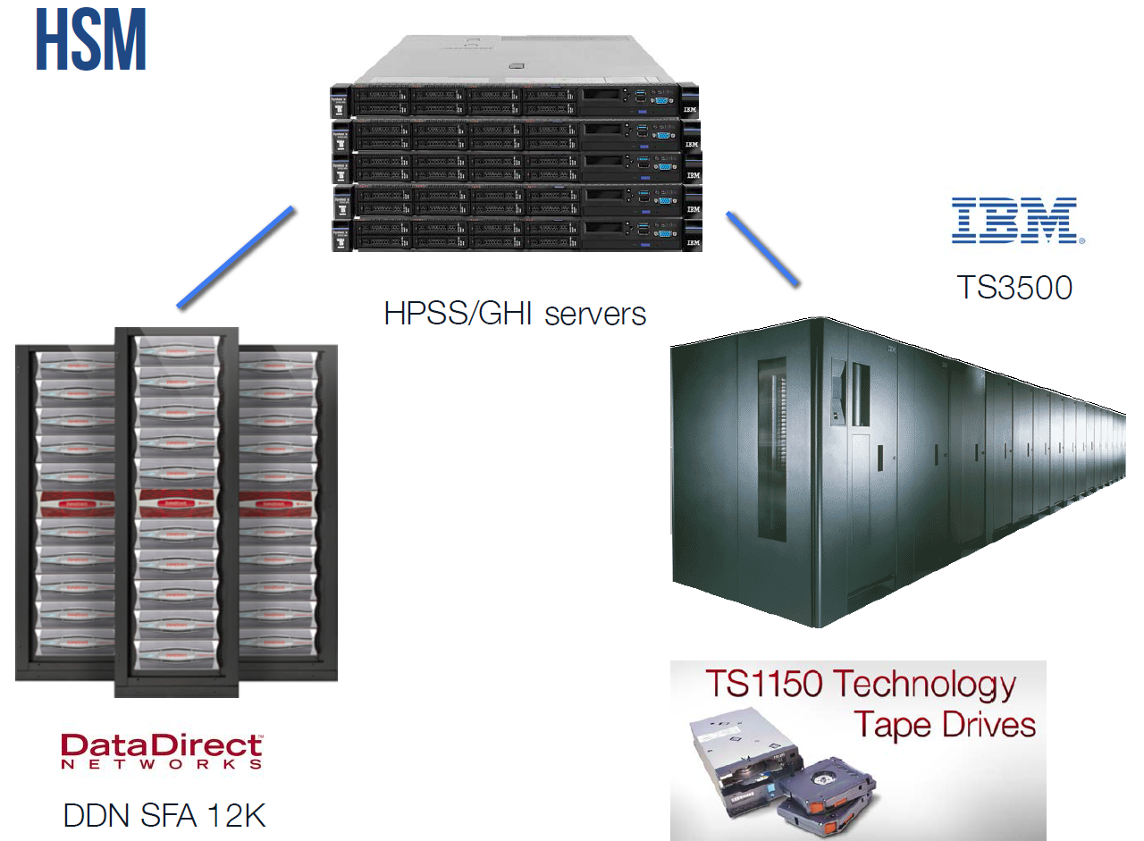
Upgrade of KEK Central Computer (KEKCC)
New KEKCC will start operation from Sep. 2016
Just in construction phase
Very high Integration
  10K CPU cores in 6 racks
  All comp. node have SSD
High speed interconnect with storage
  InfiniBand 4xFDR (56Gbps)
Can use tape as disk transparently
  GPSS-HPSS integration technology

Slide 8
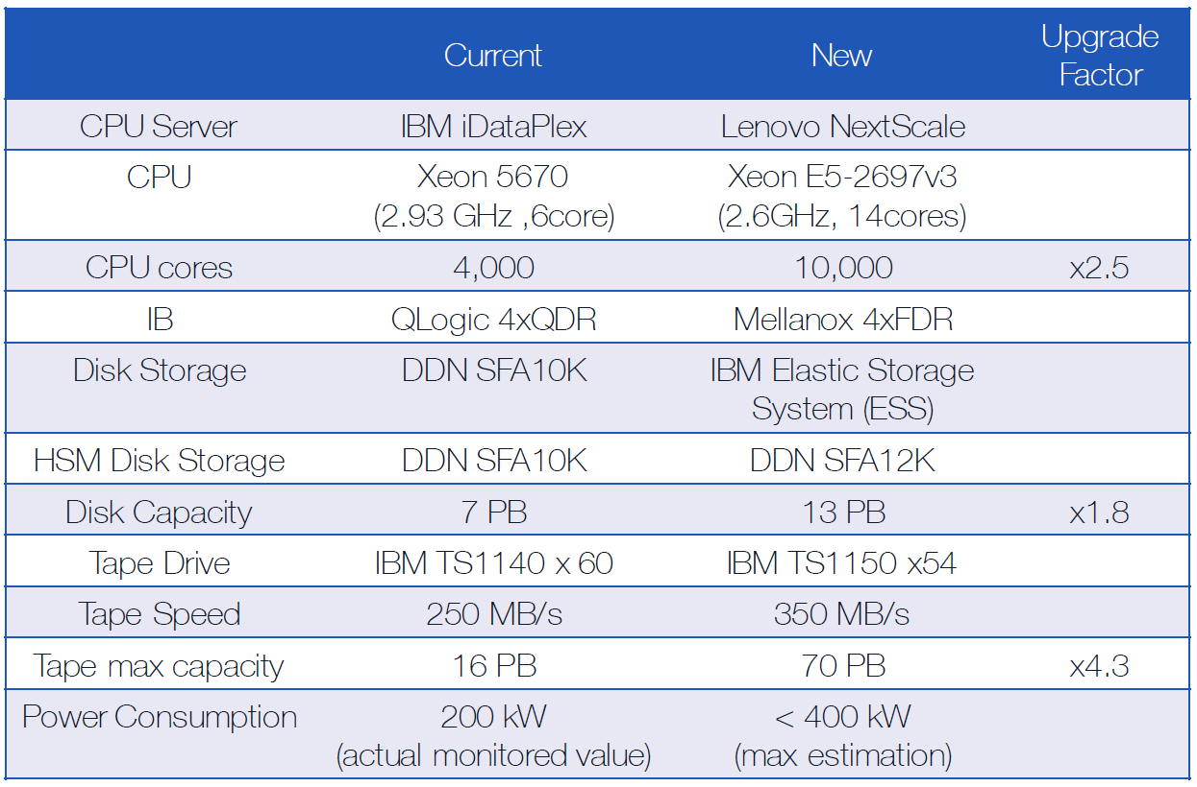
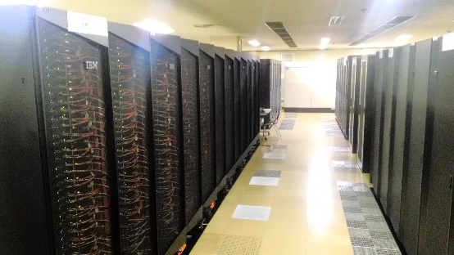
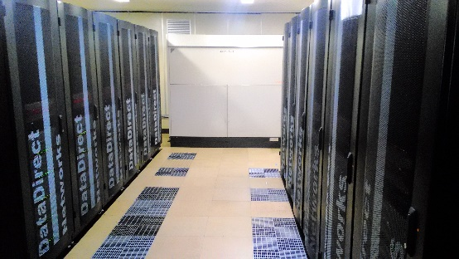
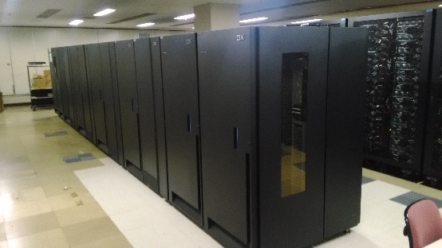
Spec of the new system and migration schedule
Procurement
Dec. 2015 (18 months)
HW installation
Jan. - Mar. 2016
System setup
Apr. - May. 2016
Testing
Jun. 2016
Data migration
Jul. - Aug. 2016
Deployment
Sep. 1st, 2016

Slide 9
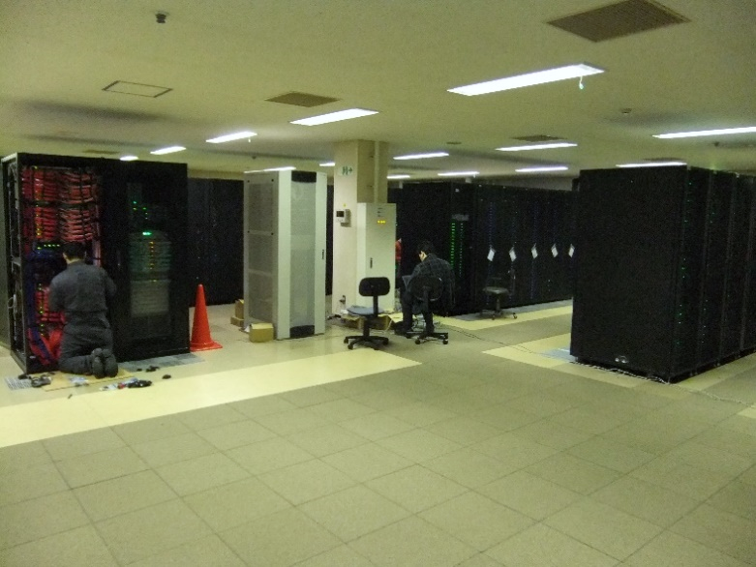
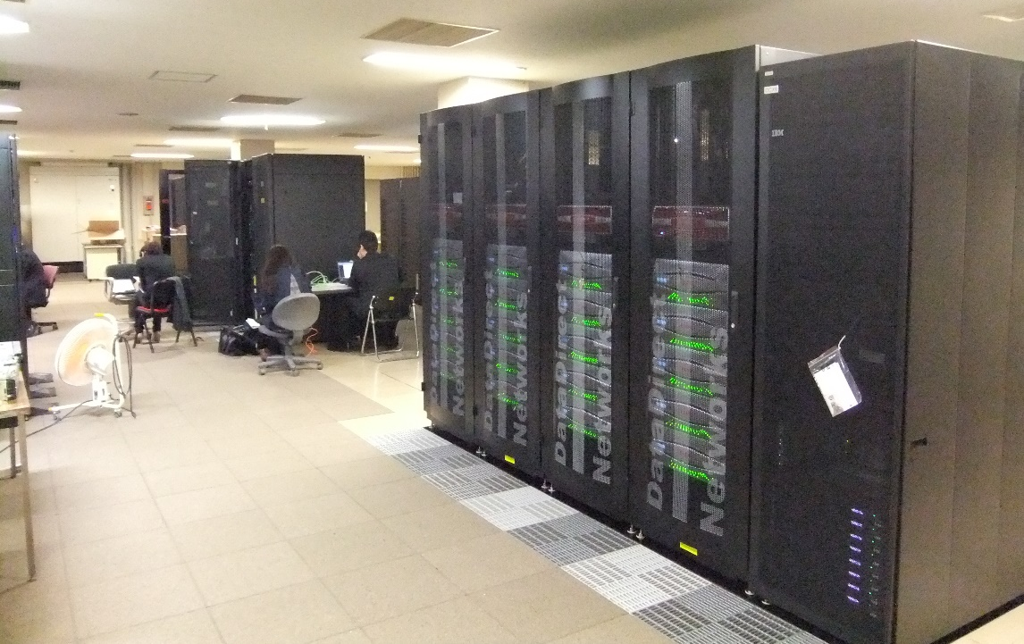
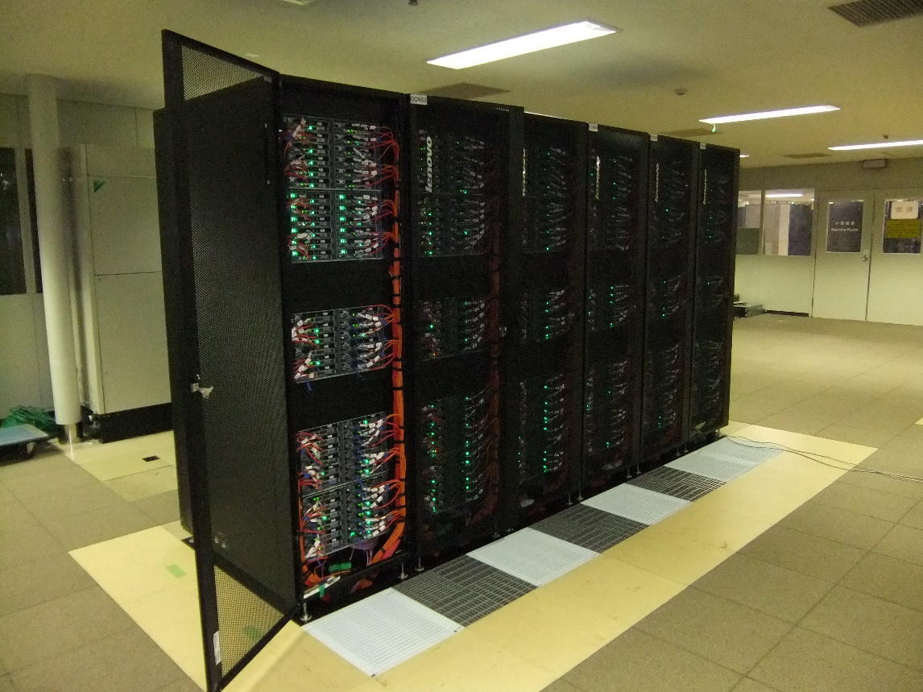
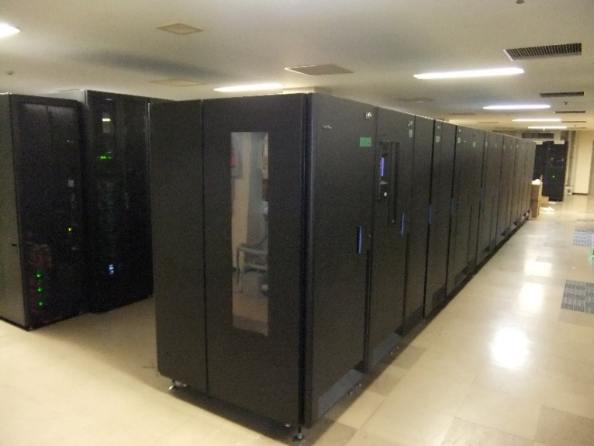
Just in construction
Internal network
Disk
10K CPU cores in 6 racks
Computing node
Tape

Slide 10
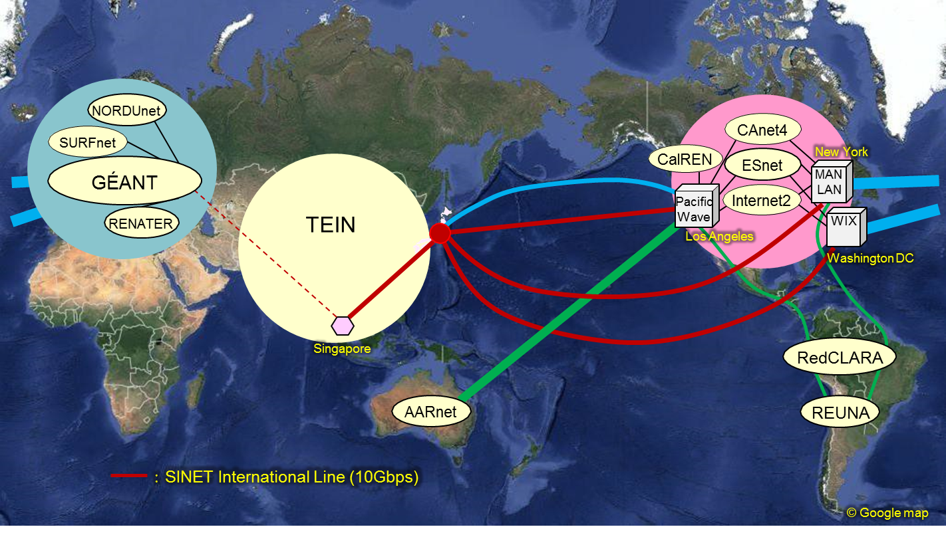
SINET4 until JFY2015 (Mar. 2016)
Tokyo
Tokyo
Osaka
Y. Kubota (NII)

Slide 11
LHCONE implementation
LHCONE VRF at MANLAN
dedicated for ICEPP
to GEANT (backup)
LHCONE VRF at Pacific Wave
dedicated for KEK
to ESnet and CAnet4
Tokyo
Tokyo
LHCONE VRF at WIX
dedicated for ICEPP
to GEANT
Osaka
Y. Kubota (NII)

Slide 12
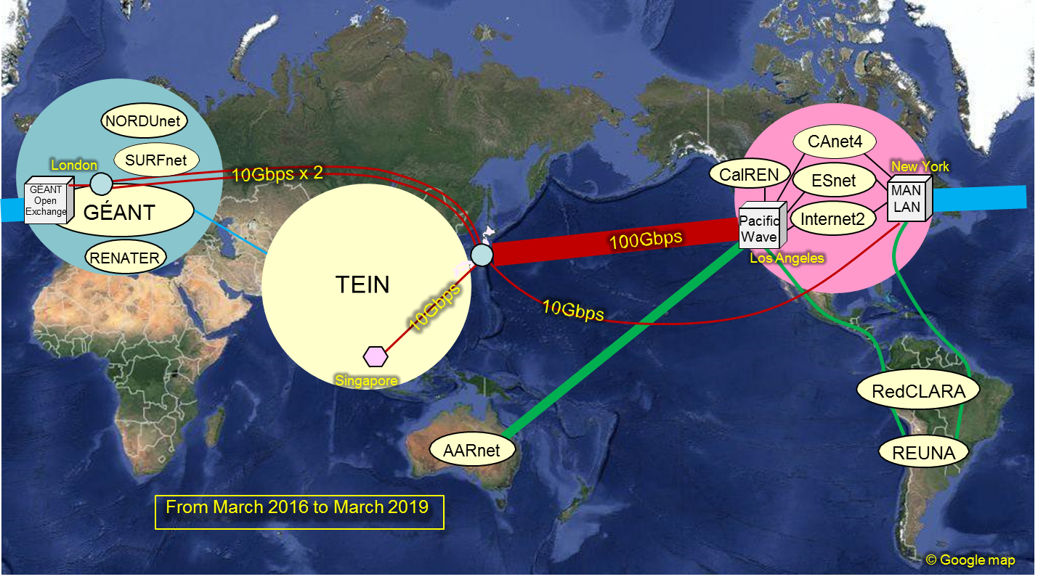

Migration to SINET5 (Apr. 2016)
VRF
Tokyo
Tokyo
Osaka
Migration of Singapore line (10G): Feb. 12
Termination of WDC line (10G): Feb. 26
Switching of NY line (10G): Mar. 8 (via Osaka)
Upgrade of LA line (100G): Mar. 15
Connection from KEK (100G): Mar. 16
New London Line (20G): Mar. 18
Y. Kubota (NII)

Slide 13
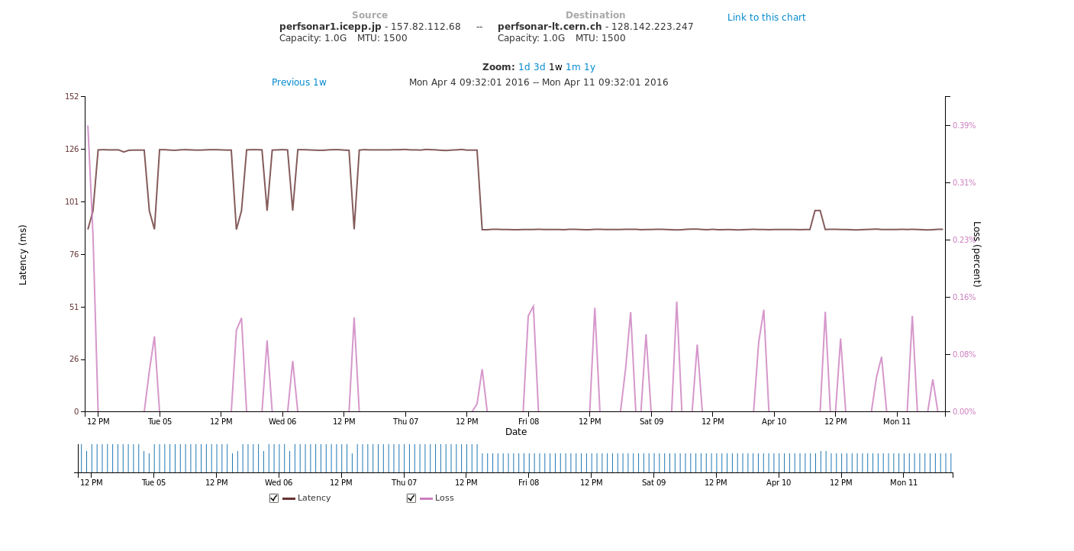
Improvement of connectivity
Latency between Tokyo and CERN on LHCONE
25 - 30 % reduction
Apr. 7th, 2016
Tokyo-Osaka-NY-CERN (LHCONE backup)
Oneway: ~126ms
RTT: ~252ms
Tokyo-London-CERN (LHCONE primary)
Oneway: ~88ms
RTT: ~176ms

Slide 14
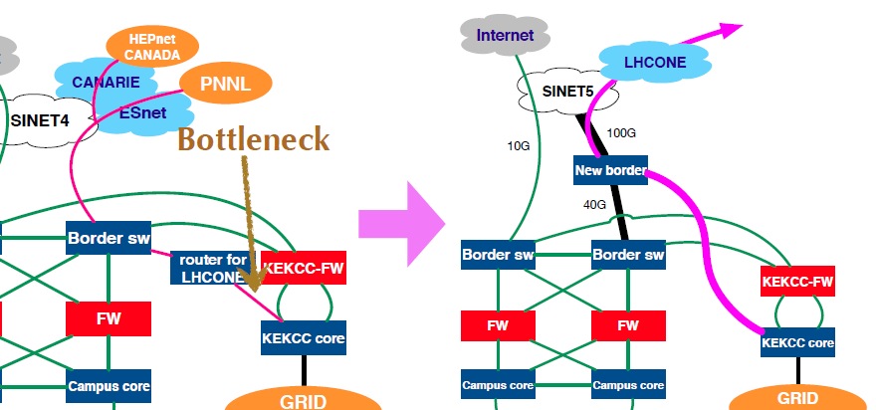
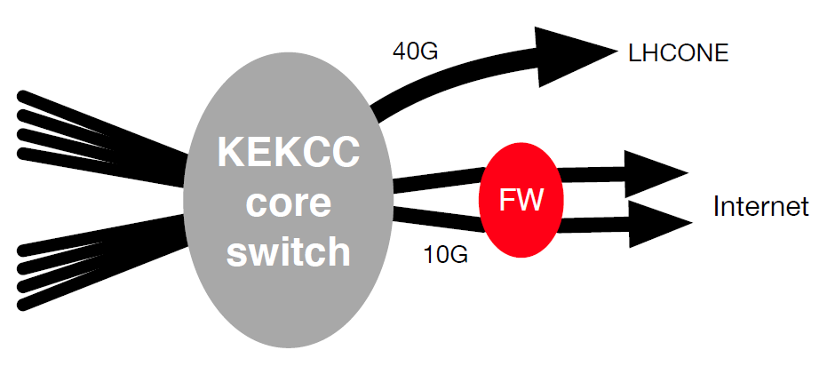
Network configuration at the new system
Network configuration
New border switch is available
100G connection with SINET5
Capability of policy routing
No LHCONE dedicated router
Data transfer
5 GridFTP servers
2 servers for Belle II raw data transfer to the other sites
Prepared 40 Gbps for LHCONE
S. Suzuki (KEK)
Belle II raw data transfer: 40G x 2 servers
Belle II analysis: 20G x 1 server
Other VO: 20G x 2 servers

Slide 15
Summary
A lot of experiments/projects are on going at KEK, SuperKEKB and J-PARC. Demand for computing is further increasing.
Procurement of the new computer system was completed. We are just in construction phase. The next generation KEKCC (KEK Central Computer) will start operation from September 2016.
There are various activities at KEK Computing Research Center and details on each activates will be presented at this HEPiX meeting as;
  Grid system and detailed specification by Go Iwai
    New services: CVMFS Stratum0/1, FTS3, AMGA etc.
  Private Cloud platform by Wataru Takase
    R&D for authorization mechanism utilizing Elasticsearch + Kibana
  Security infrastructure by Tadashi Murakami
    KEK CSIRT, Security situation in Japan

