Slide 1
WLCG Network and Transfer Metrics
Shawn McKee, Marian Babik for the Working Group
HEPiX Spring Meeting / Zeuthen
19 April 2016

Slide 2
Working Group
Started in Fall 2014, it brings together network & transfer experts
  Follows up on the WLCG perfSONAR Task Force goals
Mandate
  Ensure all relevant network and transfer metrics are identified, collected and published
  Ensure sites and experiments can better understand and fix networking issues
  Enable use of network-aware tools to improve transfer efficiency and optimize experiment workflows
Membership
  WLCG perSONAR support unit (regional experts), WLCG experiments, FTS, Panda, PhEDEx, FAX, Network experts (ESNet, LHCOPN, LHCONE)
https://twiki.cern.ch/twiki/bin/view/LCG/NetworkTransferMetrics

Slide 3
Importance of Measuring Our Networks
End-to-end network issues are difficult to spot and localize
  Network problems are multi-domain, complicating the process
  Standardizing on specific tools and methods allows groups to focus resources more effectively and better self-support
  Performance issues involving the network are complicated by the number of components involved end-to-end.
perfSONAR provides a number of standard metrics we can use
Latency measurements provide one-way delays and packet loss metrics
  Packet loss is almost always very bad for performance
Bandwidth tests measure achievable throughput and track TCP retries (using Iperf3)
  Provides a baseline to watch for changes; identify bottlenecks
Traceroute/Tracepath track network topology
  All measurements are only useful when we know the exact path they are taking through the network.
  Tracepath additionally measures MTU but is frequently blocked
Notes:
Introduction to what and why we measure
- there has been focus on latencies/packet loss recently – explained on the next slide

Slide 4

Latency and packet loss matters
Performance is poor when RTT exceeds ~10 ms
Performance is good when RTT is < ~10 ms
Source
Campus
R&E
Backbone
Destination
Campus
S
D
  0.0046% loss (1 out of 22k packets) on 10G link
  with 1ms RTT: 7.3 Gbps
  with 51ms RTT: 122Mbps
  with 88ms RTT: 60 Mbps (factor 80)
Switch with small buffers
Regional
Regional
© 2015, http://www.perfsonar.net
April 19, 2016
4
Notes:
2 messages here:
latency determines the throughput you can achieve and is at the core of why it’s so difficult to find the “soft” network failures – if you have packet loss (switch with small buffer dropping packets) – you won’t see this locally unless you have special equipment since network will be fast to recover from any loss
for higher latencies, however performance will be poor (even with 0.0046% packet loss – you’re down to factor 80 of throughput on 10G link with RTT (round-trip time) 88ms, which is quite a usual latency you get for ATLAS T2s)
perfSONAR can measure one-way latency and packet loss at 10Hz so we’re getting a very precise measurements on this already

Slide 5
Packet ordering and jitter
Source
Campus
R&E
Backbone
Network introducing delays and out of order packets
Destination
Campus
S
D
  At 70ms RTT on 10G link, 60 seconds test
  with 1% re-ordering, 0.2 ms jitter: 8.45 Gbps
  with 1% re-ordering, 1ms jitter: 1.1 Gbps
Regional
Regional
© 2015, http://www.perfsonar.net
April 19, 2016
5
Notes:
2 messages here:
latency determines the throughput you can achieve and is at the core of why it’s so difficult to find the “soft” network failures – if you have packet loss (switch with small buffer dropping packets) – you won’t see this locally unless you have special equipment since network will be fast to recover from any loss
for higher latencies, however performance will be poor (even with 0.0046% packet loss – you’re down to factor 80 of throughput on 10G link with RTT (round-trip time) 88ms, which is quite a usual latency you get for ATLAS T2s)
perfSONAR can measure one-way latency and packet loss at 10Hz so we’re getting a very precise measurements on this already

Slide 6
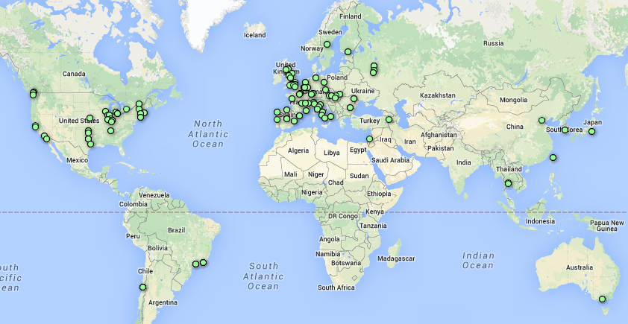
Current perfSONAR Deployment
http://grid-monitoring.cern.ch/perfsonar_report.txt for stats
246 Active perfSONAR instances
202 Running latest version (3.5+)
- 95 sonars in latency mesh
  8930 links measured at 10Hz
  packet-loss, one-way latency, jitter, ttl, packet-reordering
- 115 sonars in traceroutes mesh
  - 13110 links
  - hourly traceroutes, path-mtu
- 102 sonars in bandwidth mesh
  - 10920 links (iperf3)
https://www.google.com/fusiontables/DataSource?docid=1QT4r17HEufkvnqhJu24nIptZ66XauYEIBWWh5Kpa#map:id=3
Initial deployment coordinated by WLCG perfSONAR TF
Commissioning of the network followed by WLCG Network and Transfer Metrics WG
Notes:
Overview of our current deployment and commissioning, our major achievement is that we’re now able to take measurement with high efficiency and run a stable network – which given it’s size and frequency of measured metrics is one of the biggest (if not the biggest) network perf. monitoring network based on open-source

Slide 7
Coordinating Network Issue Response
The working group has created a support unit to coordinate responses to potential network issues
  Tickets opened in the support group can be triaged to the right destination
  Many issues are potentially resolvable within the working group
  Real network issues can be identified and directed to the appropriate network support centers
Documented at https://twiki.cern.ch/twiki/bin/view/LCG/NetworkTransferMetrics#Network_Performance_Incidents
Recent case CA<->EU GGUS-118730
  resolved within hours of being reported
  mainly due to our ability to narrow down using perfSONAR
Notes:
https://twiki.cern.ch/twiki/bin/view/LCG/NetworkTransferMetrics#Network_Performance_Incidents

Slide 8
Overview of perfSONAR Pipeline
The diagram on the right provides a high-level view of how WLCG/OSG is managing perfSONAR deployments, gathering metrics and making them available for use.
Notes:
Some Plans:
OSG monitoring (psomd) – will be moved to a standardized SAM/Nagios monitoring (it will still be hosted at OSG)
Configuration interface has been major success – there is open source project now in the works that will be part of perfSONAR 3.6

Slide 9
ATLAS Network Analytics
Ilija Vukotic/U Chicago has been leading an effort to get network metrics into an analytics platform
This analytics service indexes historical network related data while providing predictive capabilities for near term network throughput performance.
Primary functions:
  Aggregate, and index, network related data associated with WLCG “links”
  Serve derived network analytics to ATLAS production, DDM & analysis clients
  Provide a generalized network analytics platform for other communities in the OSG
Part of ATLAS Analytics platform
  https://cds.cern.ch/record/2056257/files/ATL-SOFT-SLIDE-2015-752.pdf

Slide 10
Throughput predictions
Throughput measurements are expensive so done at low frequency. Delays and packet loss rate are cheap.
Idea is to use delays and packet loss rate to predict maximum possible throughput.
Mathis formula is used to model impact of packet loss and latency on throughput
  Rate < (MSS/RTT)*(1 / sqrt(p))
    MSS – segment size
    RTT – round trip time
    p – packet loss
Packet (re)ordering and jitter to be added as well

Slide 11
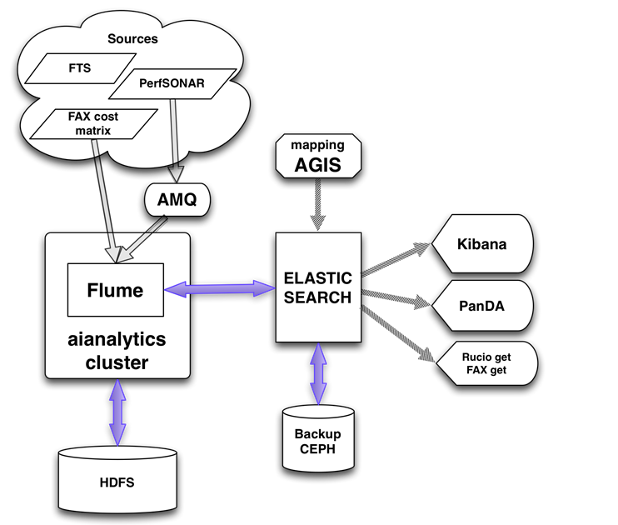
ATLAS Network Analytics
Diagram shows the flow
End-to-end+perfSONAR
data both available to
jointly analyze
Kibana can be used to get
customized views
http://cl-analytics.mwt2.org:5601
More details at: http://tinyurl.com/gt92zwb
Notes:
This is from Ilija/Mario – feeding ElasticSearch/Kibana –

Slide 12
Playing with SDN in ATLAS
A group of people in the US from AGLT2, MWT2, SWT2 and NET2 are planning to explore SDN in ATLAS
  Working with the LHCONE point-to-point effort as well
The plan is to deploy Open vSwitch on ATLAS production systems at these sites (http://openvswitch.org/ )
  IP addresses will be move to virtual interfaces
  No other changes; verify no performance impact
  Traffic can be shaped accurately with little CPU cost
The advantage is the our data sources/sinks become visible and controllable by OpenFlow controllers like OpenDaylight
Follow tests can be initiated to provide experience with controlling networks in the context of ATLAS operations.
For more details talk to Rob Gardner or Shawn McKee
Notes:
There is also some initial work on establishing SDNs in ATLAS – initially just to see if there would be any impact to usual operations

Slide 13
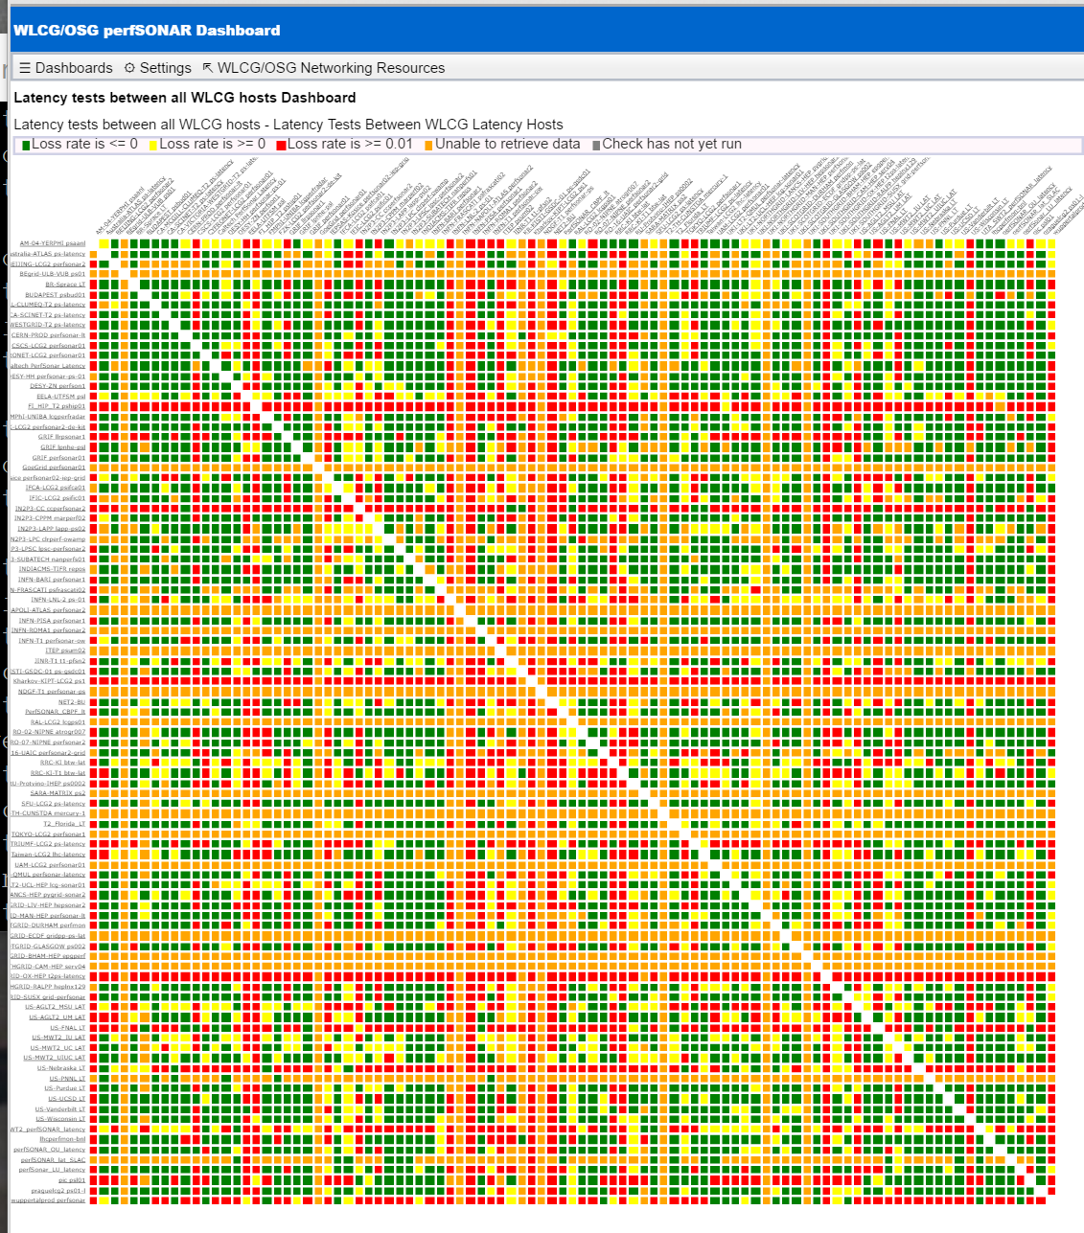
Quick View of Latency Mesh

Slide 14
Current Efforts
A near-term focus is on reorganizing our bandwidth meshes
  Currently one big mesh with 4 day cadence
    Unable to finish tests due to nightly service restarts
  New target: 2 (or more meshes) 20 hour cadence
    Challenge: who goes to which mesh?
We are also working on alerting when “obvious” problems are found
  Challenge: getting appropriate contacts setup in check_mk
  Intend to use rule-based notifications
  Working with ETF to enable this (see http://etf.cern.ch/docs/latest/user/overview.html#service )

Slide 15
Future Directions
The WLCG efforts at CERN are being reorganized and this is an opportunity to chart future directions for the working group
We have a number of areas (projects; see next slide) we are considering and we need to understand where these efforts should be housed (Stay in WG, move to GDB, to LHCONE)
There is a review of the working group scheduled for April 28th during the WLCG Operations Coordination meeting.

Slide 16
Possible Future Project Areas
Title: LHCONE Traffic engineering
Areas: LHCONE, routing, debugging, network orchestration
Title: LHCONE L3VPN Looking Glass
Areas: LHCONE, monitoring, debugging
Title: Integration of network and transfer metrics to optimize experiments workflows
Areas: FAX/Phedex, Rucio, perfSONAR, DIRAC
Title: Advanced notifications/alerting for network incidents
Areas: WAN, Advanced Notifications/Alerting, perfSONAR, Hadoop/Spark
Title: Network performance of the commercial clouds
Areas: Clouds, WAN connectivity, WAN performance (perfSONAR), establishing and testing network equipment at the cloud provider (VPN)
Title: Software Defined Network Production Testbed
Areas: WAN, SDN, LHCONE/LHCOPN, Storage/Data nodes

Slide 17
Summary
We have a working infrastructure in place to monitor and measure our networks
perfSONAR provides lots of capabilities to understand and debug our networks
Work on new applications is underway
  Notifications/alerting
  Predictive capabilities
  Current utilization and capacity planning
  Evaluating network performance of commercial clouds
We (OSG and WLCG) welcome feedback on how to further improve
Questions or Comments?

Slide 18
References
Network Documentation https://www.opensciencegrid.org/bin/view/Documentation/NetworkingInOSG
Deployment documentation for OSG and WLCG hosted in OSG
  https://twiki.opensciencegrid.org/bin/view/Documentation/DeployperfSONAR
Measurement Archive (MA) guide http://software.es.net/esmond/perfsonar_client_rest.html
Modular Dashboard and OMD Prototypes
  http://maddash.aglt2.org/maddash-webui https://maddash.aglt2.org/WLCGperfSONAR/check_mk
OSG Production instances for OMD, MaDDash and Datastore
  http://psmad.grid.iu.edu/maddash-webui/
  https://psomd.grid.iu.edu/WLCGperfSONAR/check_mk/
  http://psds.grid.iu.edu/esmond/perfsonar/archive/?format=json
Mesh-config in OSG https://oim.grid.iu.edu/oim/meshconfig
  Being updated to a new standalone mesh-config application (ready for v3.6?)
Use-cases document for experiments and middleware https://docs.google.com/document/d/1ceiNlTUJCwSuOuvbEHZnZp0XkWkwdkPQTQic0VbH1mc/edit

