Slide 1

Grid Computing System in the KEK Central Computer System (KEKCC)
Go Iwai
High Energy Accelerator Research Organization (KEK)
Computing Research Center (CRC)

Slide 2
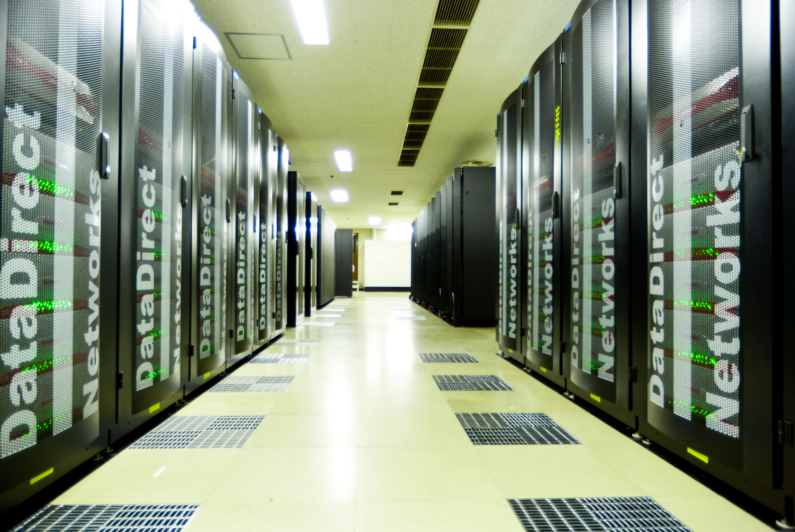
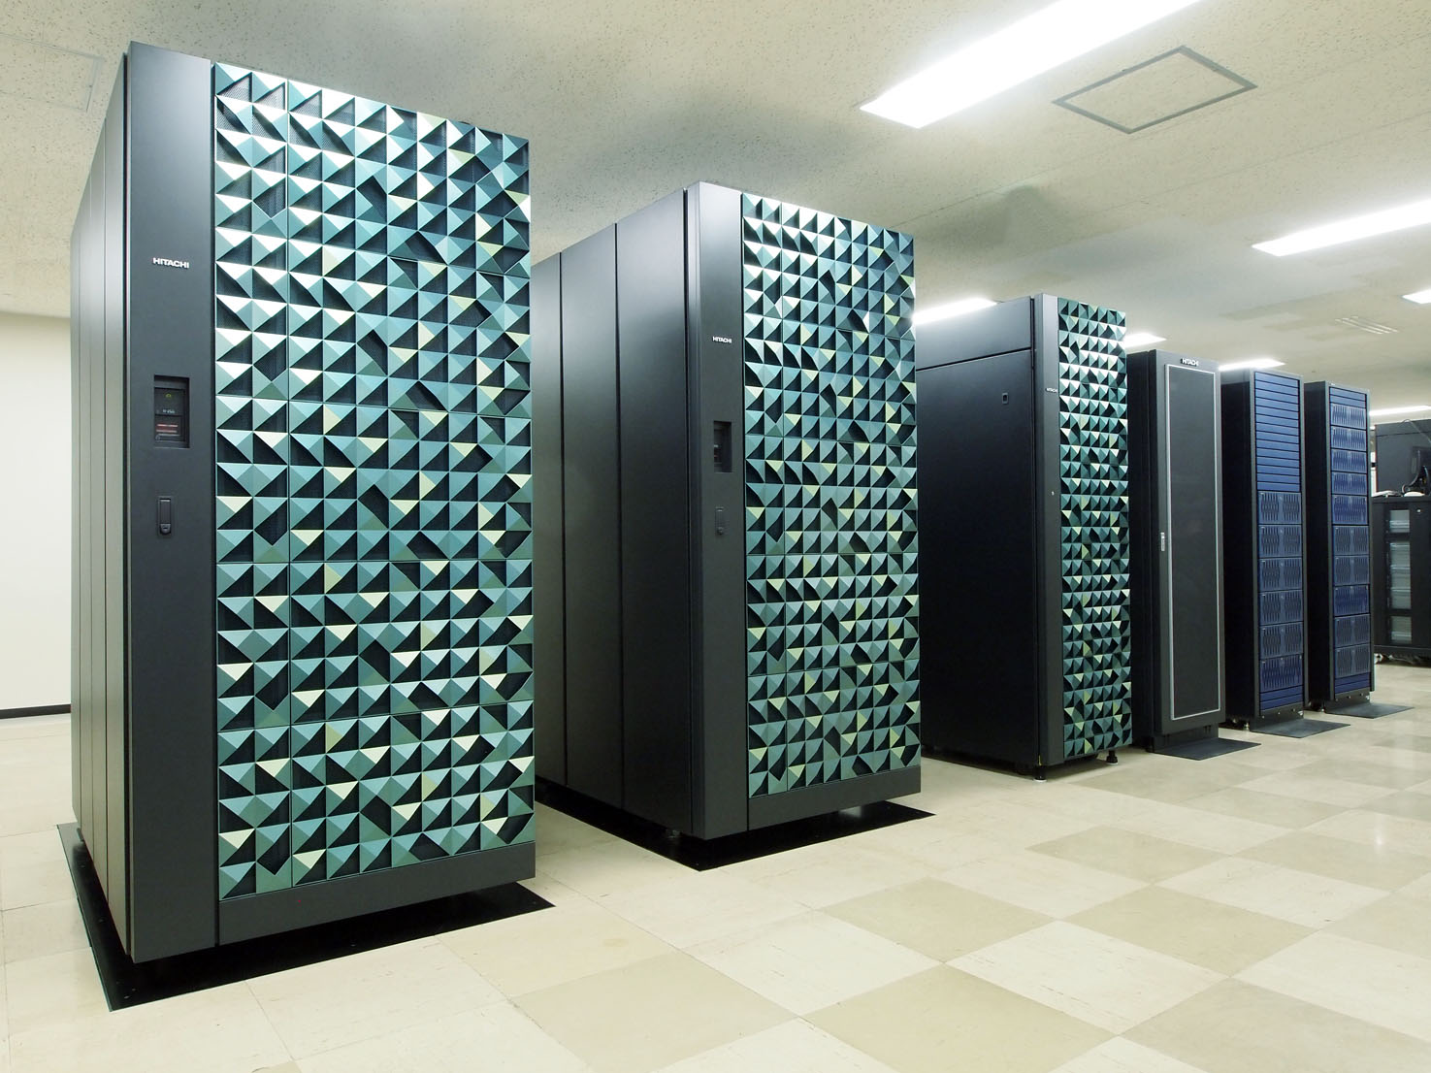
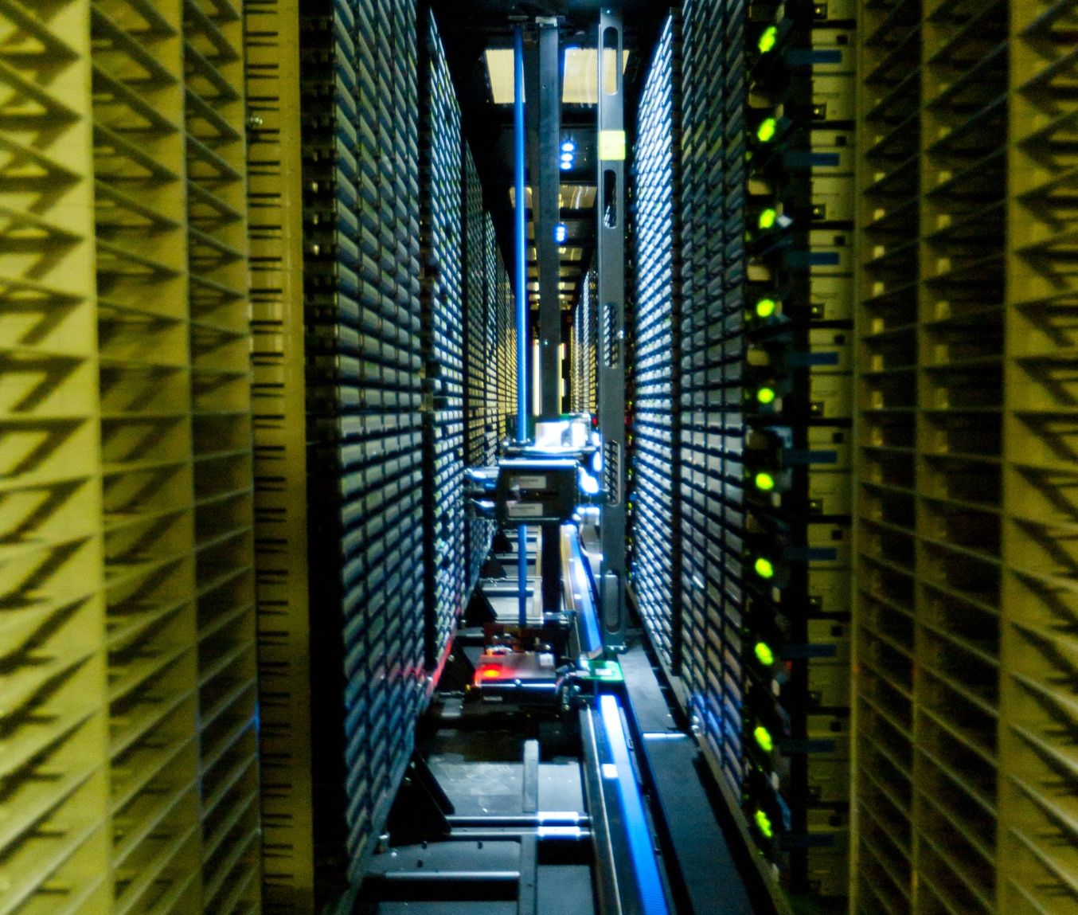
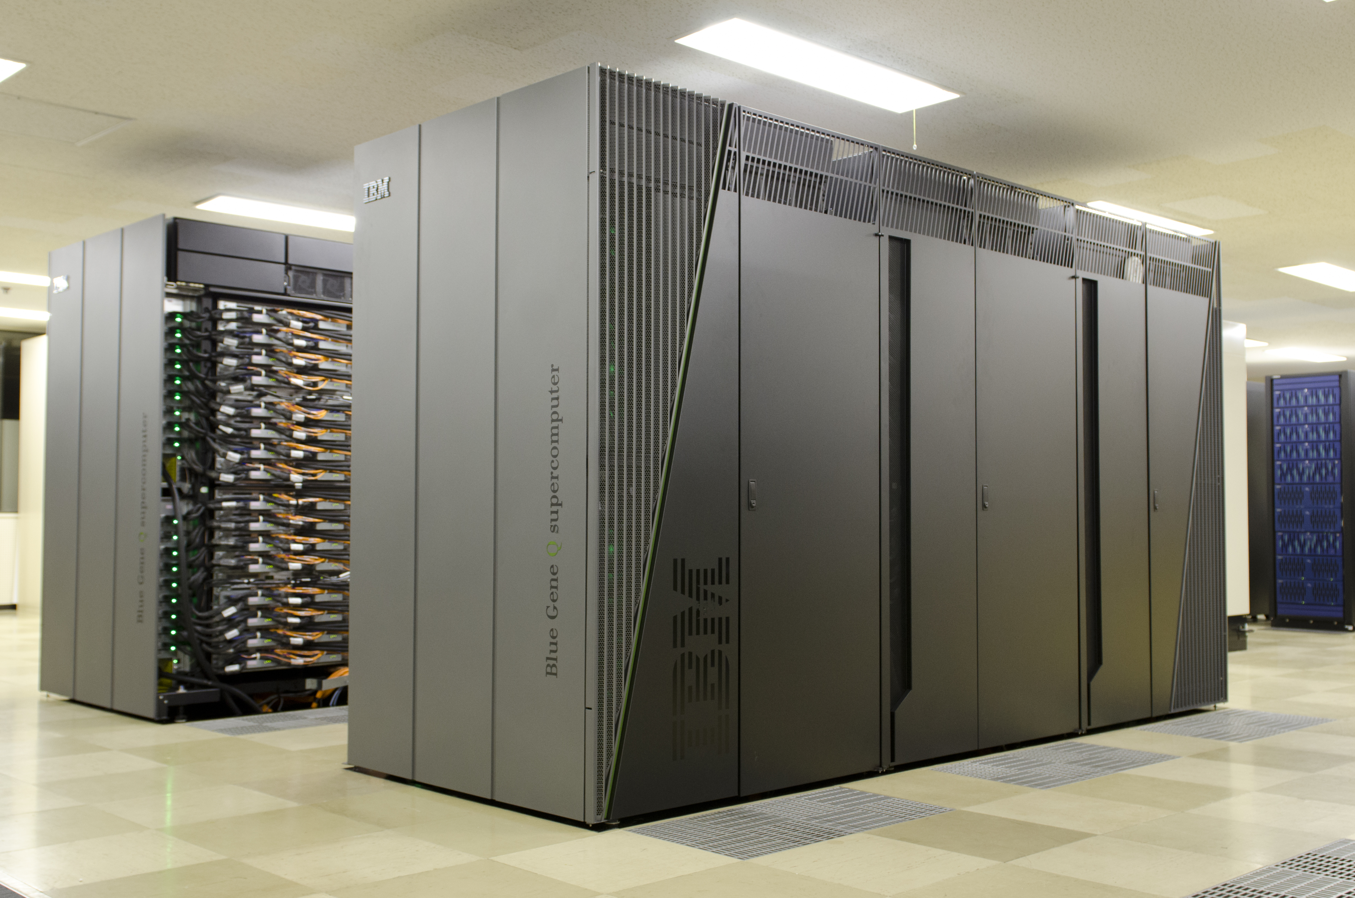
Two Large-scale Computer Systems in KEK
Central Computer System (KEKCC)
Supercomputer System
System-A Hitachi SR16000 model M1
Total peak performance: 54.9 TFplops
Linux Cluster + GPFS/HPSS
4,000 cores (Xeon 5670)
7 PB disk storage and tape library (up to 16 PB)
System-B IBM Blue Gene/Q
Total peak performance: 1.26 PFlops
Grid instance is running in the KEKCC

Slide 3
KEKCC Overview
Supporting a lot of KEK projects, e.g. Belle/Belle2, ILC, J-PARC, and so on.
  KEKCC is totally replaced every 4-5 years.
  Current KEKCC has started in April 2012 and will be ended in August 2016.
Data Analysis System
  Login servers, batch servers
    IBM iDataPlex, Intel Xeon X5670, 4,080 cores (12cores x 340nodes)
    Linux Cluster (SL5) + LSF (job scheduler)
  Storage System
    DDN SFA10K 1.1 PB x 6 sets
    IBM TS3500 tape library (16 PB max.)
    TS1140 x60 drives
    GPFS (4PB)+ HPSS/GHI (3PB for HSM)
    Storage interconnect : IB 4xQDR (Qlogic)
    Grid (EGI) SE, iRODS access to GHI
    Total throughput : > 50 GB/s
Grid Computing System: EMI and iRODS
General-purpose IT Systems: mail, web (Indico, wiki, ...), CA as well.

Slide 4
Resource History
60 kHS06 of CPU
7 PB of disk
Max 16 PB of tape capacity
x6.6
7PB
in USE
x9.8
Current System

Slide 5
Who Works on KEKCC
Experiments |  |  | Start Year | How work on KEKCC
Ongoing or Completed | Belle |  | 1999 | Mainly work on local batch servers
 | J-PARC | T2K | 2009 | Mainly work on local batch servers Partly using Grid for data delivery
 |  | Hadron Exp. | 2010 | Mainly work on local batch servers
 |  | MLF (Material&Life Science) | 2010 | Mainly work on local batch servers Partly using Grid (iRODS) for data transfer
Future | Belle2 |  | 2017 | Actively work on Grid
 | Kagra |  | 2018 | Just started preparation work for sharing data over the Grid
 | ILC |  | 202X | Working on Grid, and local batch servers

Slide 6
Courtesy of Takanori Hara, et al.
A Global Collaboration
as wide as an LHC

Slide 7
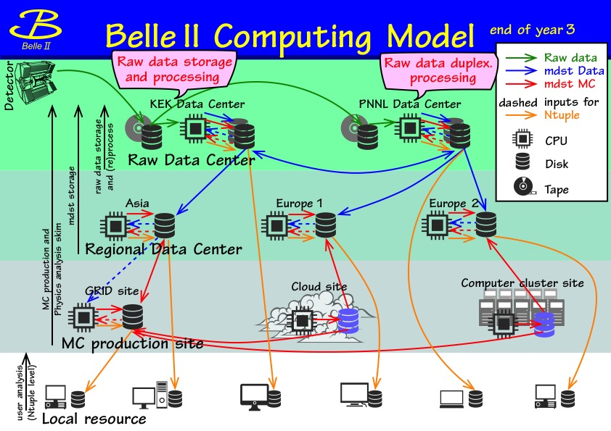
Courtesy of Takanori Hara, et al.

Slide 8
Grid is Now Using Nearly Half of KEKCC
Local batch jobs
Belle2 jobs are dominant.
4 Years Stats

Slide 9
Yearly 1PB of Read/Write to SRM
(Not Including Internal Data Transfer)
Belle2 MC Campaign
Belle2 Data Challenge
4 PB of readout and 5 PB of writing to the SRM has been achieved

Slide 10
Courtesy of Takanori Hara, et al.
Big contribution from DESY

Slide 11
4 Gbps of transfer performance from KEK to PNNL is sufficient until 2018
Should be improved because of SINET upgrade in March
3-4 Gbps of throughput has been achieved between DESY and KEK at this test.
Courtesy of Takanori Hara, et al.

Slide 12
System Procurement
KEKCC is totally replaced every 4-5 years, according to Japanese government procurement rule for computer system.
  International bidding according to GPA (Agreement on Government Procurement by WTO)
  Bidding is processed for 1.5 year.
Purchase and operation model
  Completely different purchase/operation model from US/EU sites
  NOT in-house scale-out model, BUT rental system
  Much less human resource in computer center
    25 staffs (KEK/CRC) vs 270 staffs (CERN-IT)
KEK purchases a Service:
Hardware by lease
+
Implementation and operation staffs

Slide 13
System Replacement Cycle
Jan
Feb
Bidding process:
  Committee was launched in Feb/2015.
  RFx (Request for Information/Proposal/Quotation)
  RFC (Request for comments)
  Bidding
    Score for price + benchmark
    Bid-opening was done on the end of Dec/2015.
System implementation (Jan – Aug / 2016)
  Facility updates (power supply, cooling)
  Hardware installation
  System design / implementation / testing
Mar
Apr
May
Jun
Jul
Aug
Sep
Oct
Nov
Dec
Service-in of the new system is scheduled on Sep/2016.

Slide 14
Current VS Next
 | Current | New | Upgrade Factor
CPU Server | IBM iDataPlex | Lenovo NextScale
CPU | Xeon 5670 (2.93 GHz, 6 cores/chip) | Xeon E5-2697v3 (2.60 GHz, 14 cores/chip)
CPU cores | 4,000 | 10,000 | x2.5
HEPSPEC (kHS06) | 60 | 250 | x4.1
IB | QLogic 4xQDR | Mellanox 4xFDR
Disk Storage | DDN SFA10K | IBM Elastic Storage System (ESS)
HSM Disk Storage | DDN SFA10K | DDN SFA12K
Disk Capacity | 7 PB | 13 PB | x1.8
Tape Drive | IBM TS1140 x60 | IBM TS1150 x54
Tape Speed | 250 MB/s | 350 MB/s
Tape max capacity | 16 PB | 70 PB | x4.3
Power Consumption | 200 kW (actual monitored value) | < 400 kW (max estimation)
Notes:
Go Iwai has shown “Mellanox 4xQDR” in the cell of IB for New KEKCC. It was an unintentional mistake, and corrected to “Mellanox 4xFDR” after his talk.

Slide 15
Expected
Resource in KEKCC’16
250 kHS06 of CPU
13 PB of disk
Max 70 PB of tape capacity
NOT benchmarked score
x4.2
x6.6
x9.8
Current system
by summer
Expected
in summer

Slide 16

Belle2 Dedicated Services
The big change on Grid in the next KEKCC is many Belle2-critical services, e.g. LFC, SRM, AMGA, and FTS3, are isolated to the other VOs for more stable operation with NO downtime.
Example 1
LFC
RW
LFC
RW
LFC
RO
LFC
RO
LFC
HA
With NO GSI auth.
For other VOs

Slide 17
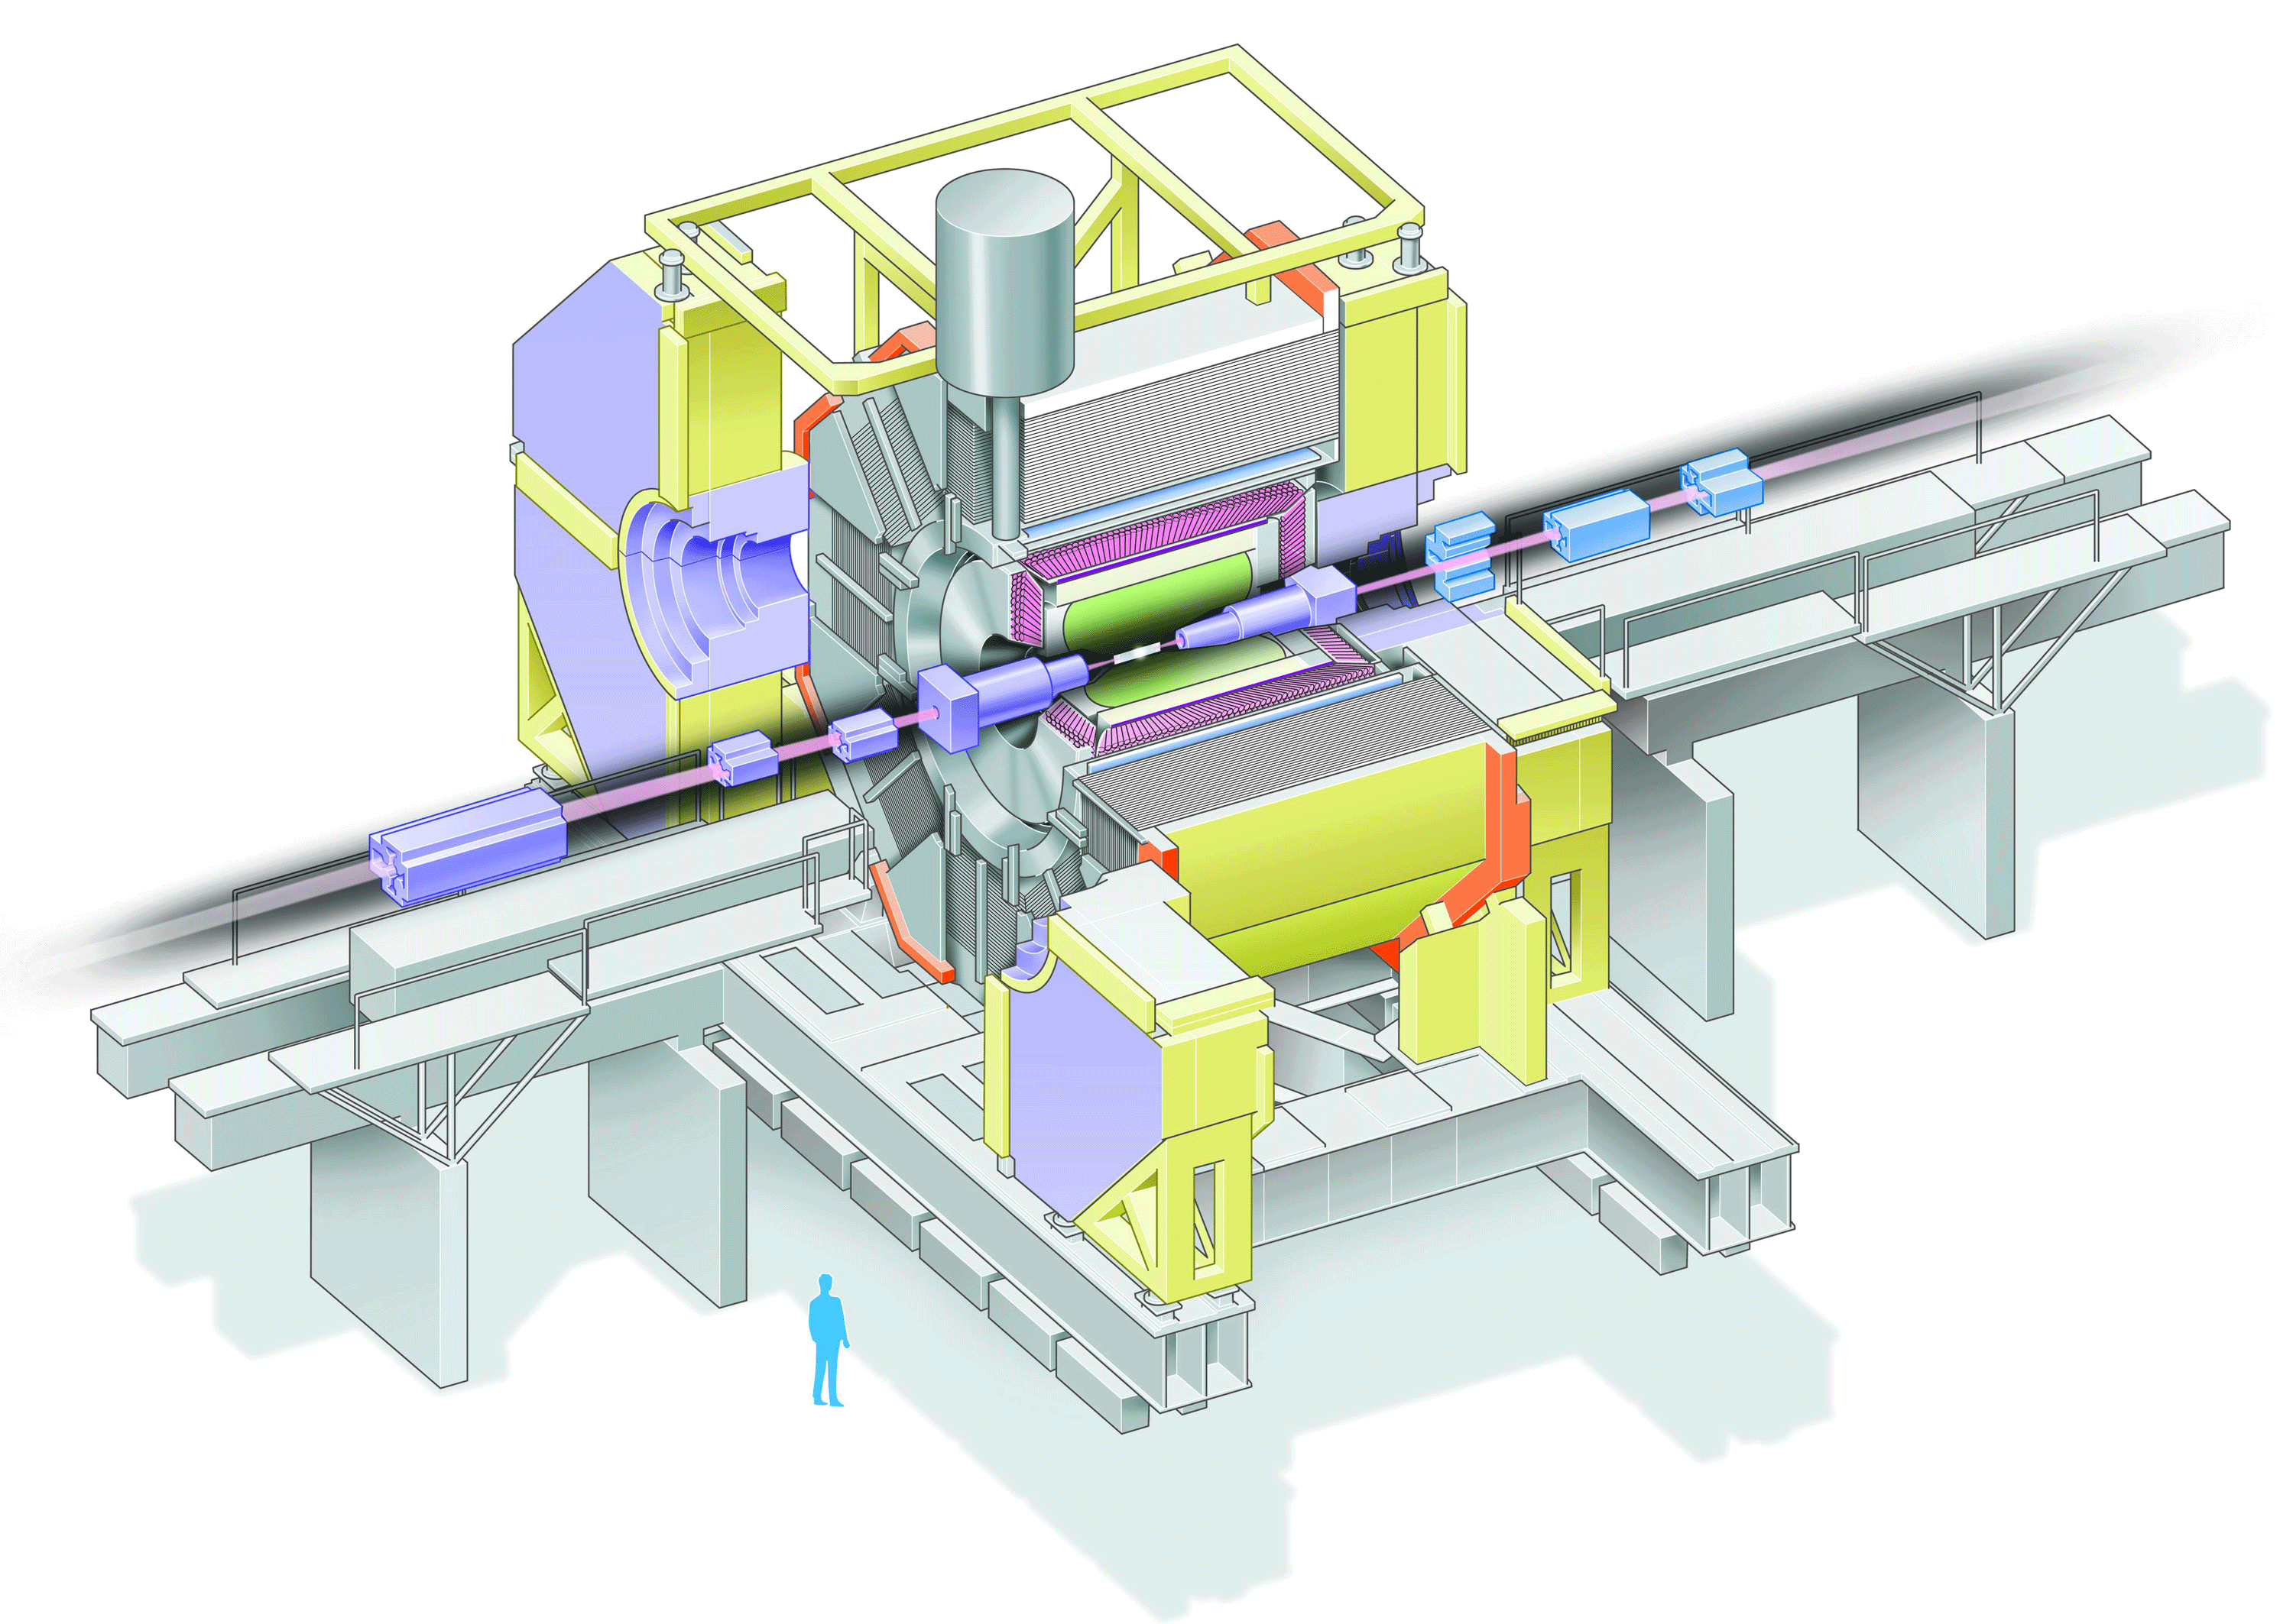
RAW data transfer
to PNNL in US
with NO firewall
Example 2
2x 10 Gbps
2x 10 Gbps
2x 10 Gbps
4x 10 Gbps
4x 10 Gbps
GridFTP
GridFTP
GridFTP
GridFTP
GridFTP
2 GB/s
2x 10 Gbps
HSM
Disk
HSM
IBM
ESS
HSM
HSM
4xFDR
Analysis – for any activities other than raw data transfer
For other VOs
2x 56 Gbps
(IPoIB)
4 GB/s

Slide 18
Upcoming Service Instances
CVMFS stratum-1 has been launched in September 2015 and had almost production service quality
  Mainly for Japanese institutes and Asian sites
  Not mirroring all repositories
CVMFS stratum-0 (kek.jp) is now under preparation work
CVMFS
S1
cern.ch:
belle.cern.ch
grid.cern.ch
geant4.cern.ch
egi.eu:
dirac.egi.eu
t2k.egi.eu
desy.de:
ilc.desy.de
CVMFS
S0
kek.jp:
belle.kek.jp

Slide 19

Dropbox-like cloud storage service based on ownCloud
Deal with a lot of user’s demands
Just started policy making work:
  How much space
  Service to whom
  How authorize

Slide 20
Conclusion
Grid job (Belle2) is being the biggest consumer in the KEKCC.
  30-50% of CPU time
  Maybe near or more use is expected in the next system
    Belle2 will start in 2017
Next KEKCC will start in September 2016.
  CPU : 10K cores (x2.5), 250 kHS06 (x4.1), Disk : 13PB (x1.8), Tape : 70PB (x4.3)
  Some Grid components (LFC, StoRM, etc) will be deployed as Belle2-dedicated services on Belle2-dedicated servers with HA.
  CVMFS stratum-0 (kek.jp) and -1 will start.
  Due to the data migration work, downtime is planed in August 2016.

Slide 21
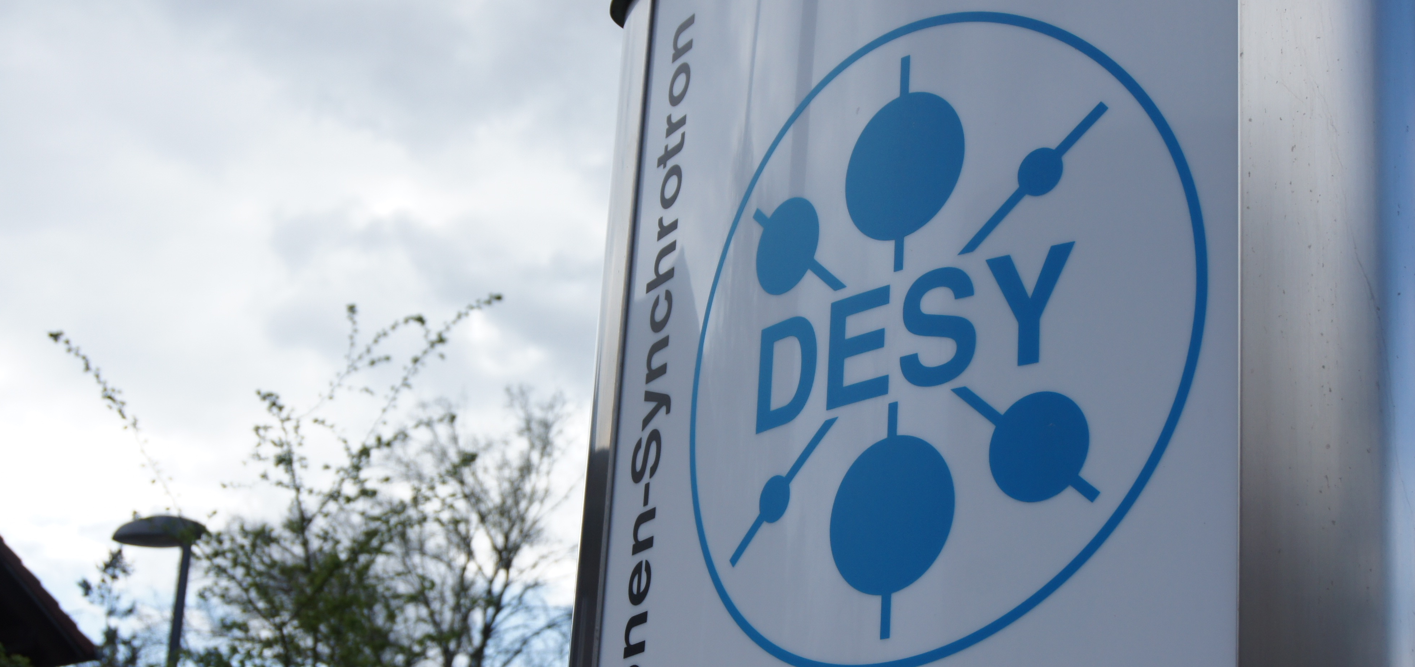
Many Thanks for Your Attention

