Slide 1
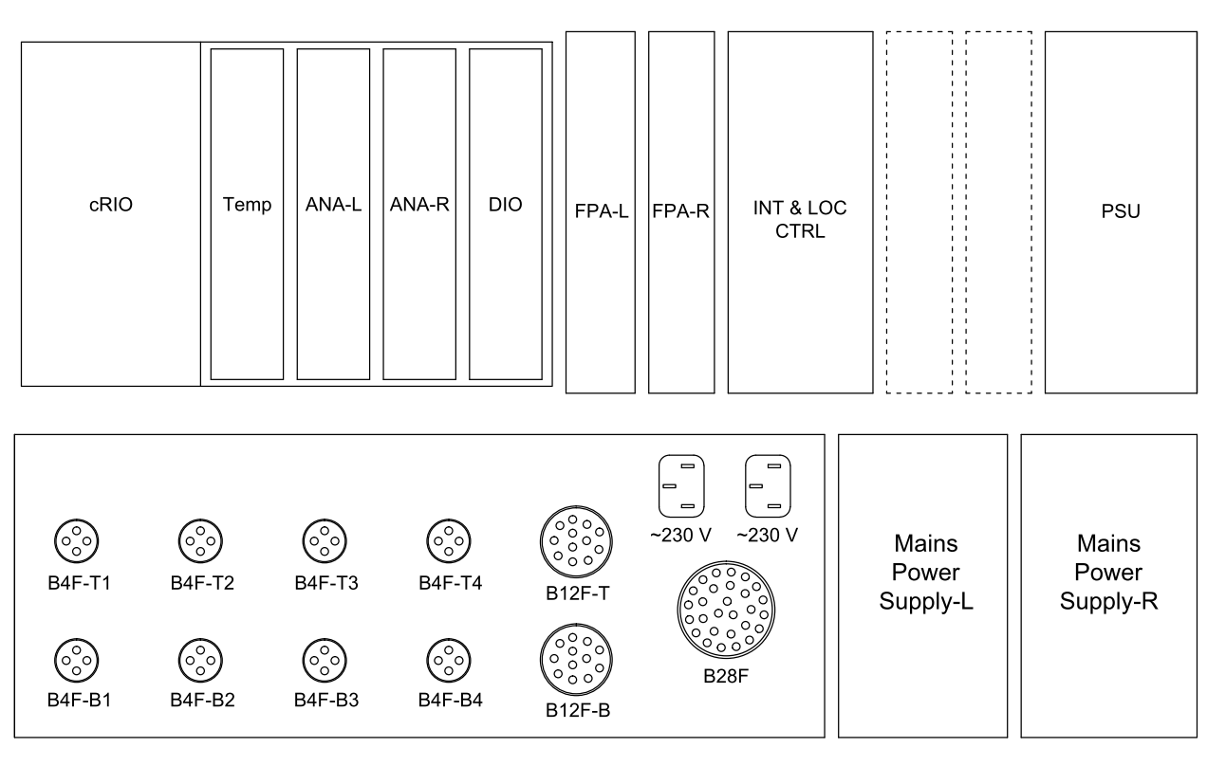
Controls Crate

Slide 2
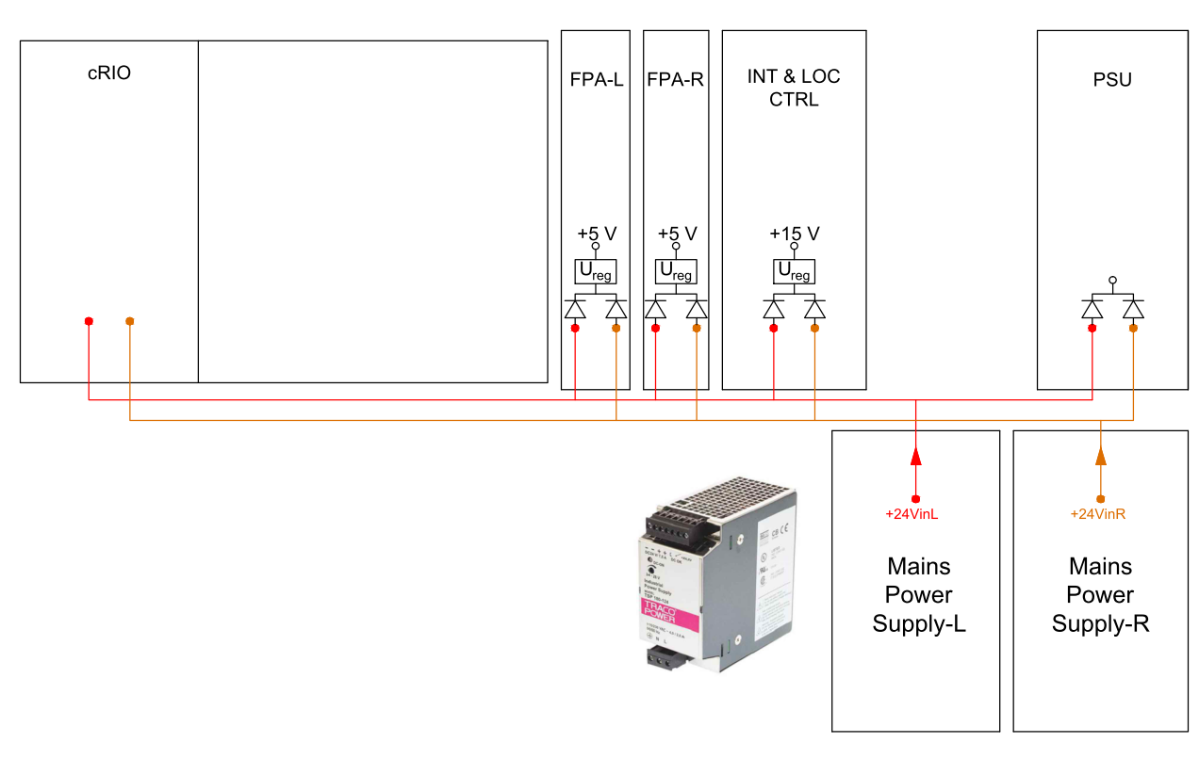
Mains Power Supply (x2)
The 24 VDC generated by this module supplies all the power needed for the controls electronics.
Two of those modules are used for redundancy (L&R).
24 V – 7.5 A

Slide 3
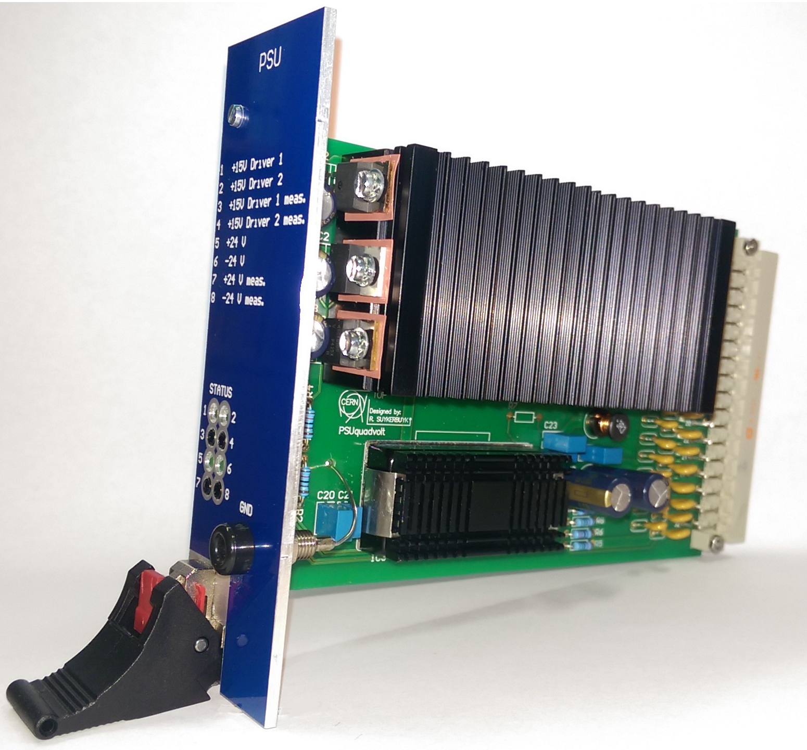
PSU board
Inputs: +24VinL
+24VinR
Outputs: PSUdriver1+15V (2 A_{max})
PSUdriver2+15V (2 A_{max})
PSUelec+24V 1→8 (0.4 A_{max})
PSUelec-24V 1→8 (0.2 A_{max})
The function of this board is creating 2x 15 VDC linear regulated supplies for the IGBT driver boards.
A 40 W DC/DC converter generates the
-24 VDC which is together with +24 VDC supplied, via 8 individually fused outputs, to the 8 signal conditioning boxes.

Slide 4
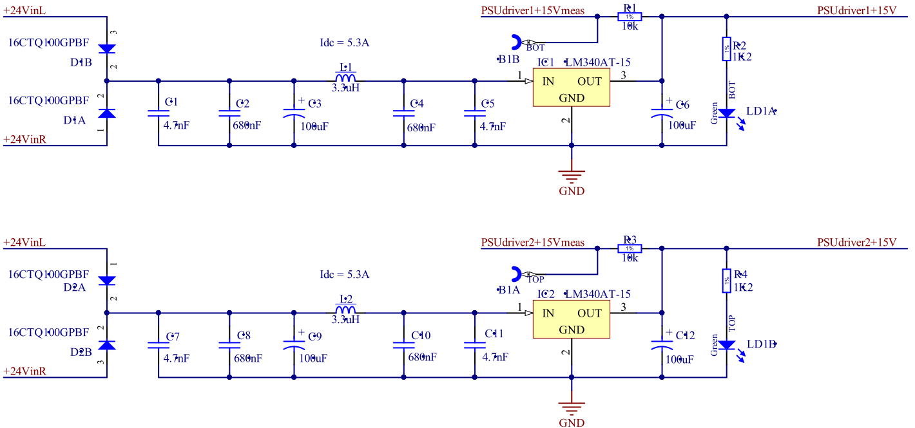
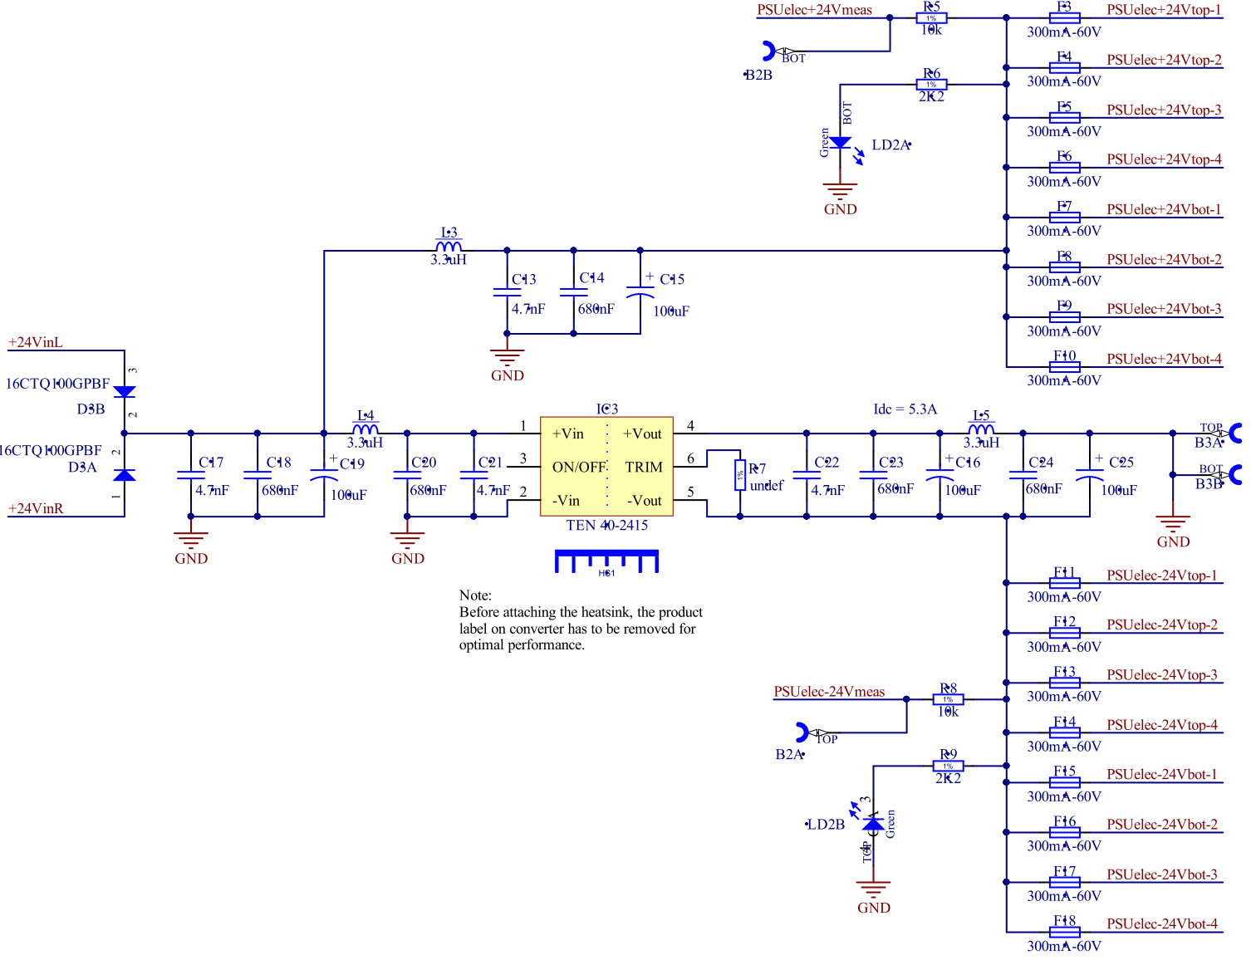
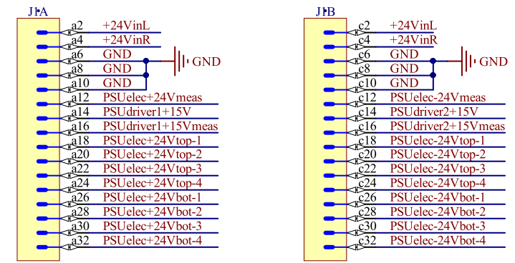
PSU board - schematic

Slide 5
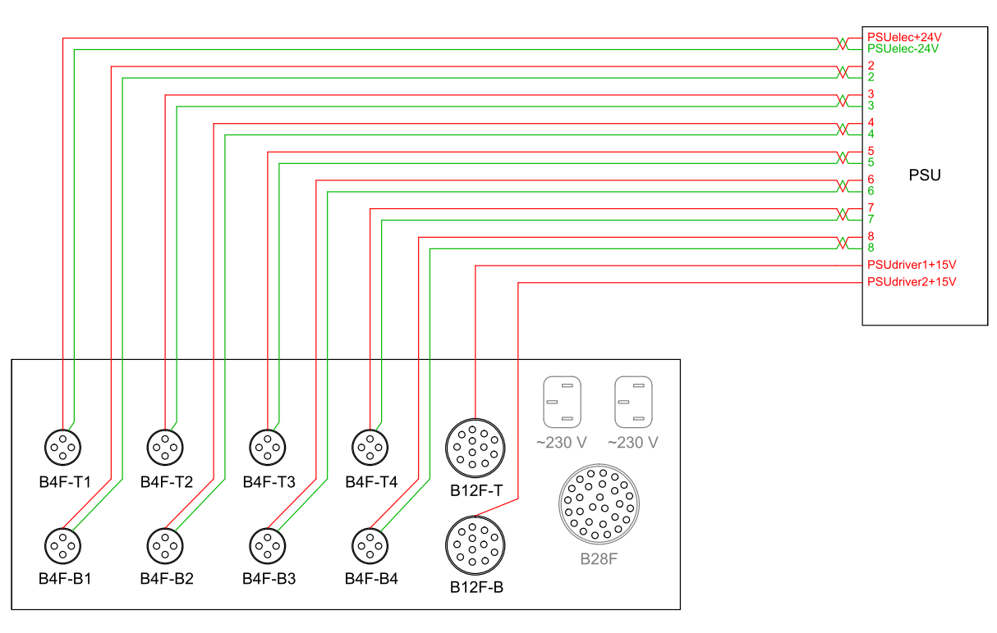
Distribution ±24 VDC and +15 VDC – Part 1

Slide 6
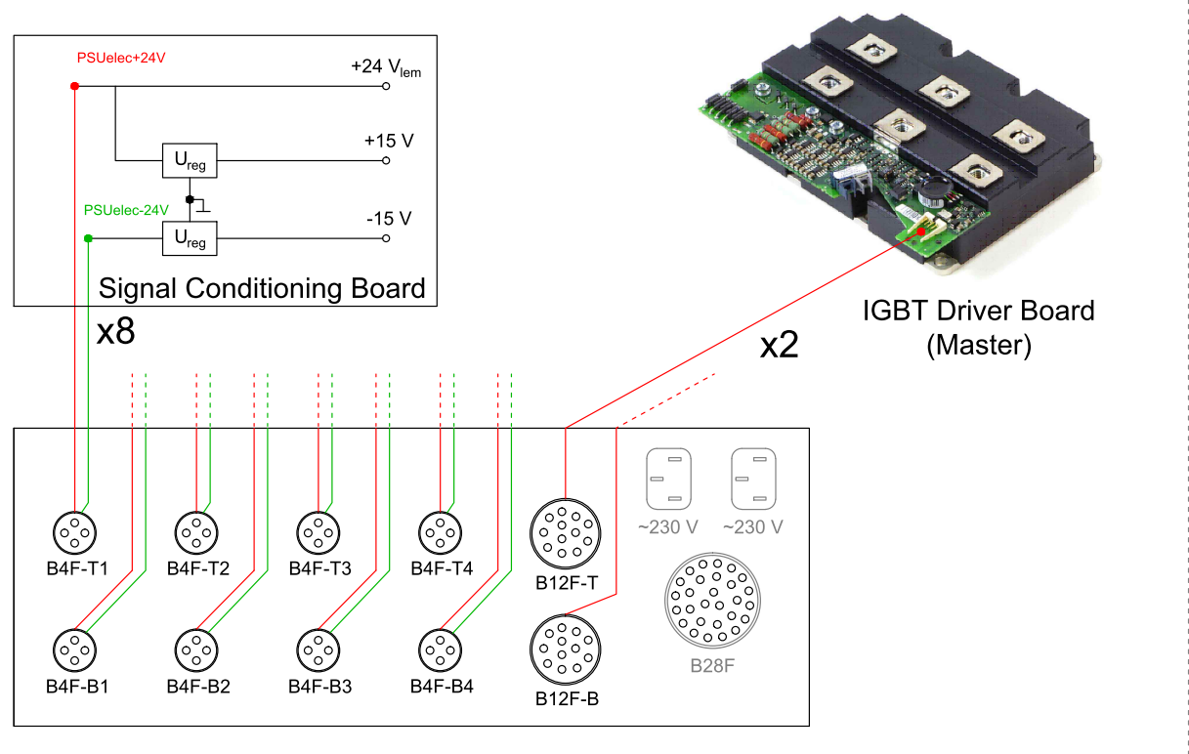
Distribution +24 VDC and +15 VDC – Part 2

Slide 7
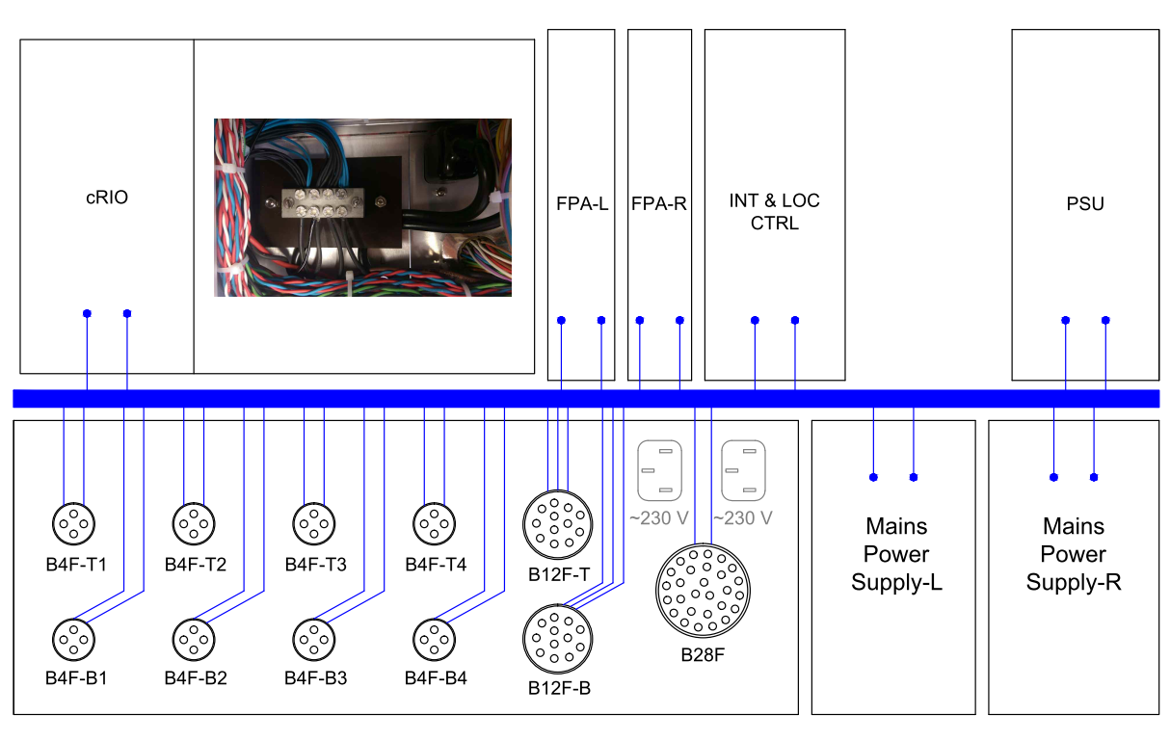
Electronics Ground (Powering Returns & Shielding) – Part 1

Slide 8
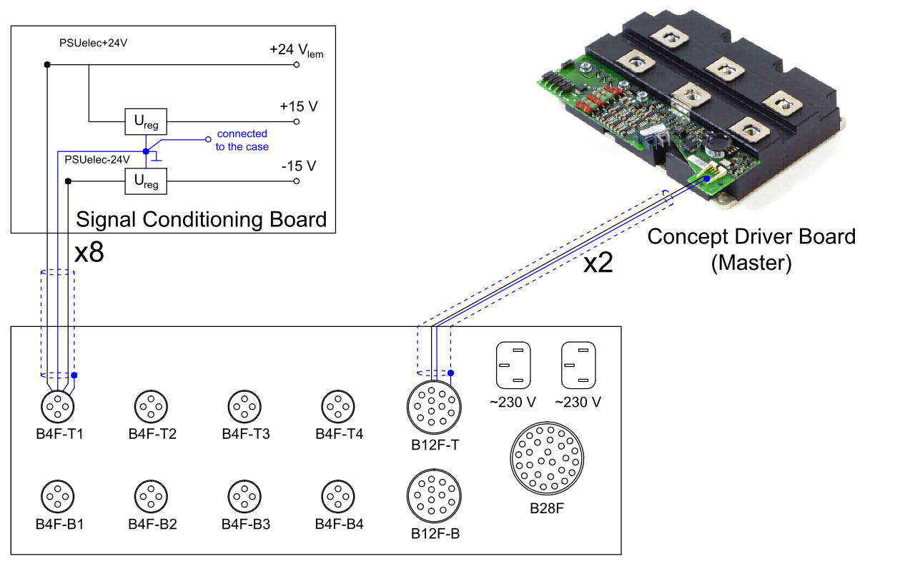
Electronics Ground (Powering Returns & Shielding) – Part 2

Slide 9
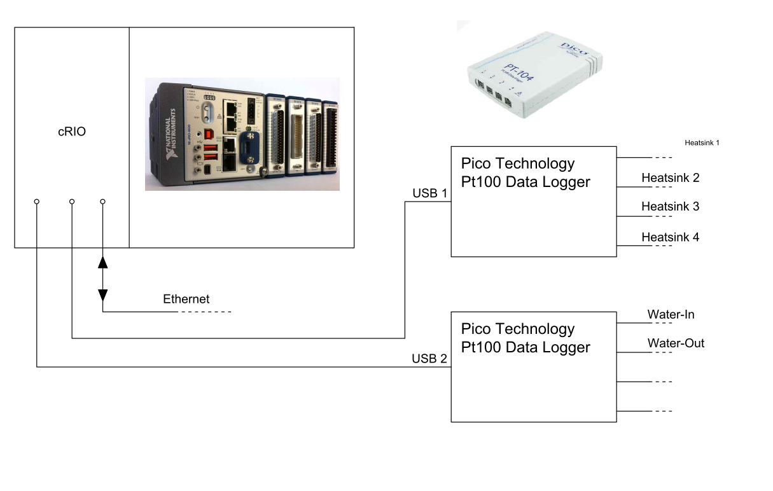
cRIO – connections CPU

Slide 10
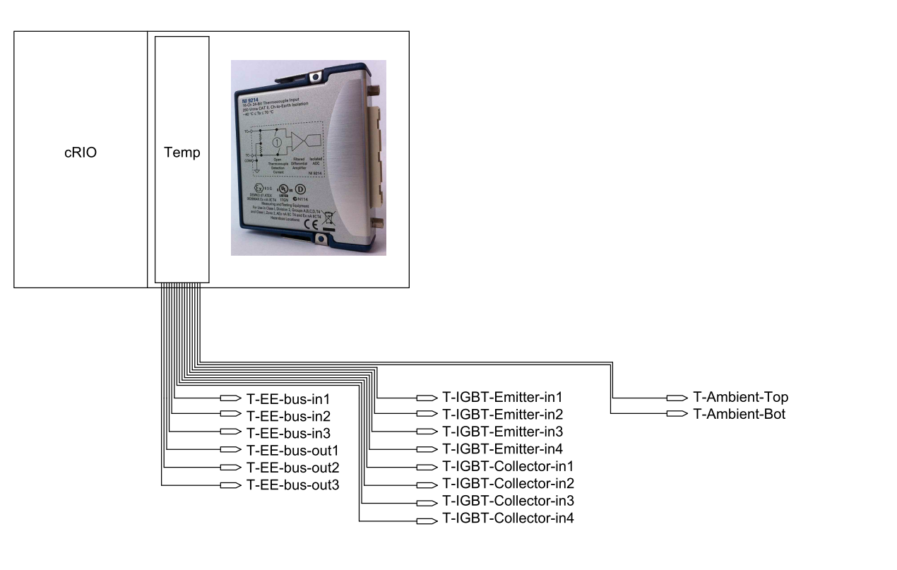
cRIO – connections TEMP module
Thermocouples

Slide 11
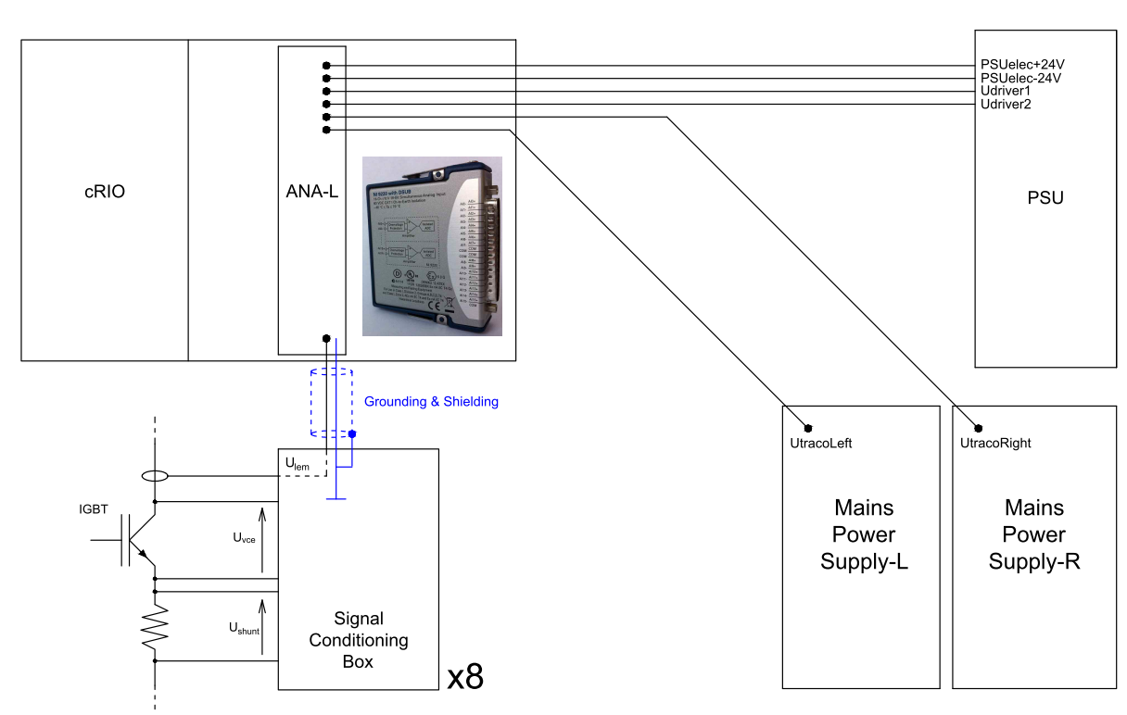
cRIO – connections ANALOG module Left

Slide 12
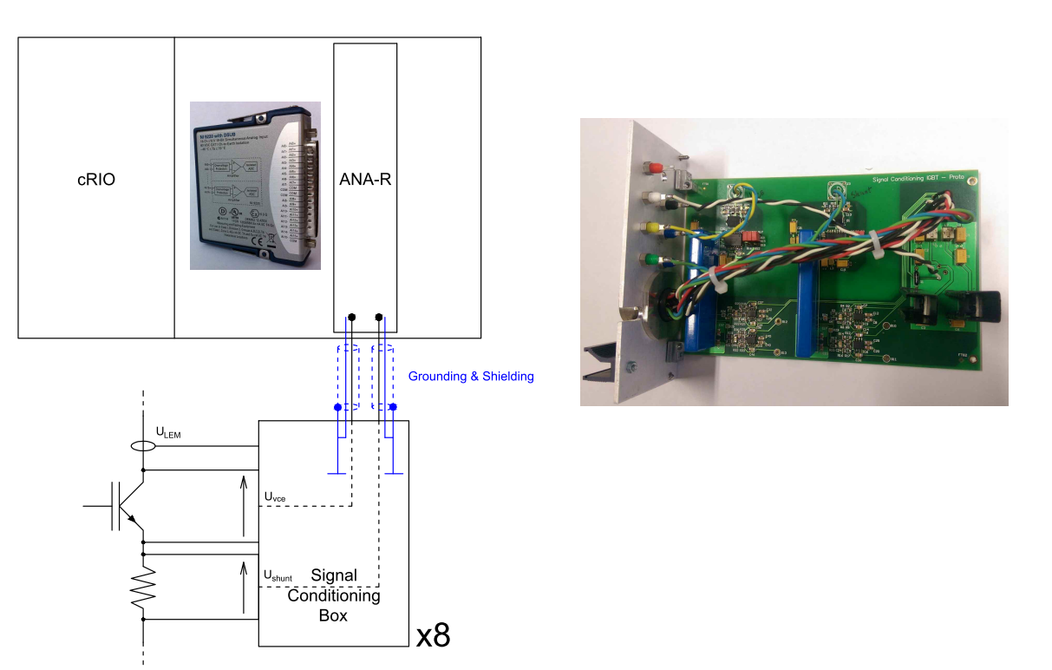
cRIO – connections ANALOG module Right
The function of these boxes is to provide galvanic separation for the V_{CE} and Shunt measurements (up to 2.5 kV).

Slide 13
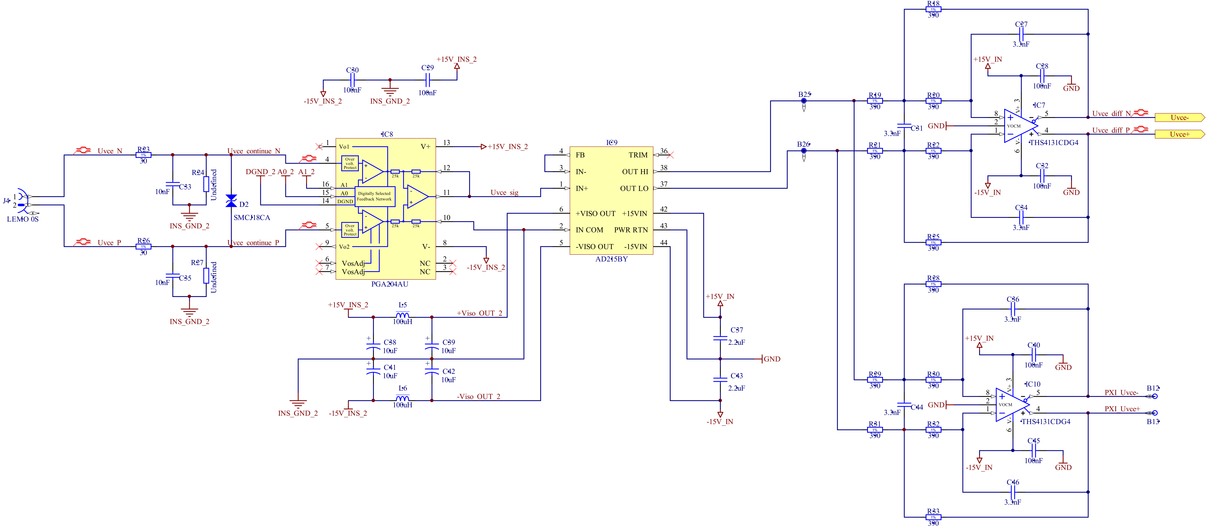
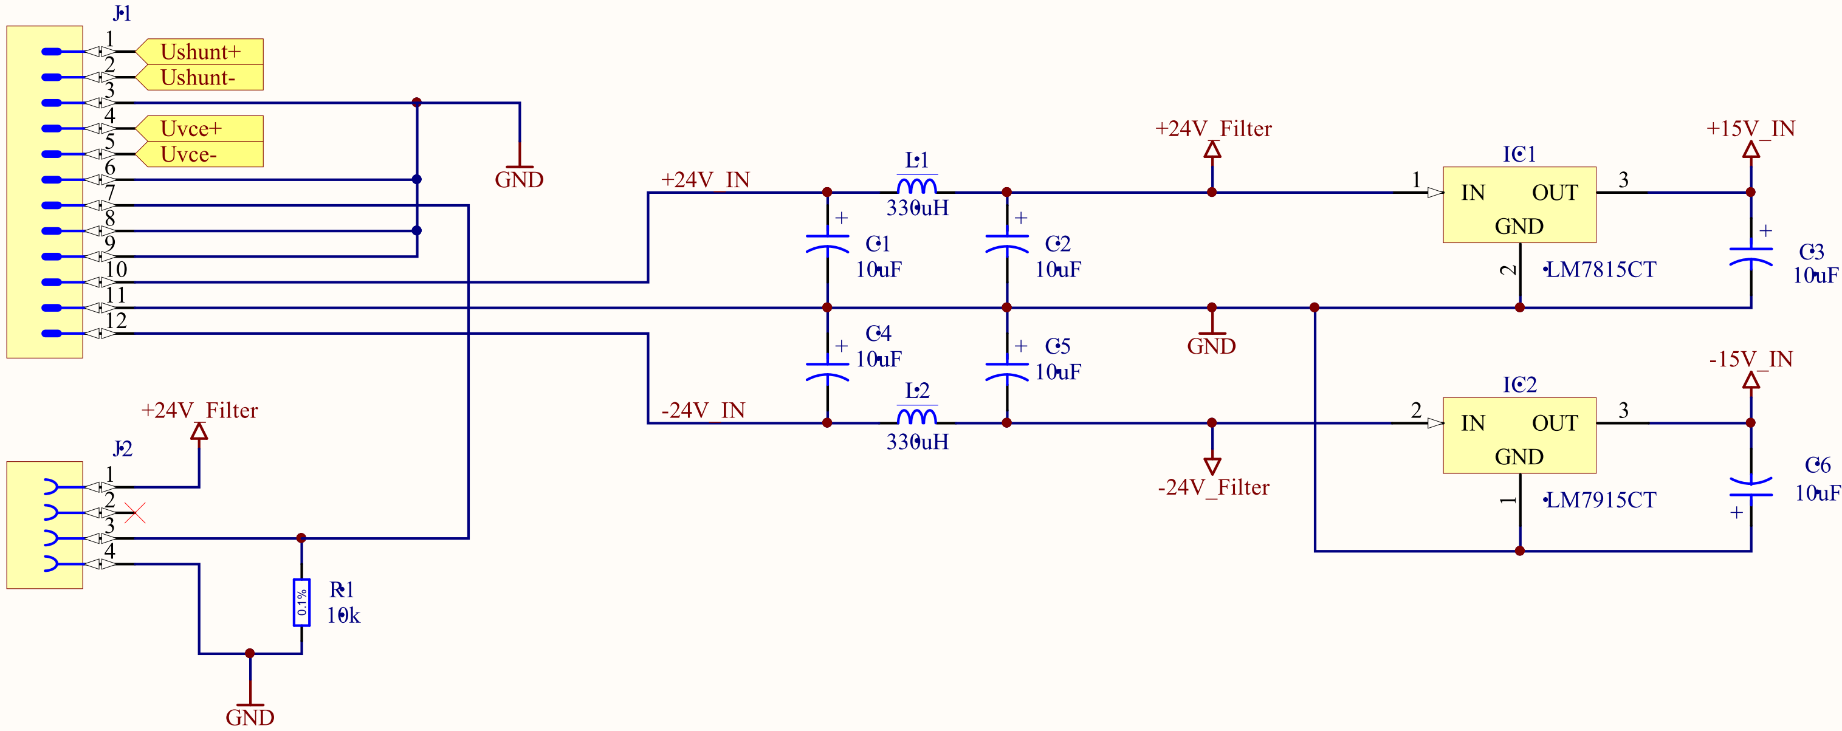
Signal Conditioning Box - schematics
x2

Slide 14
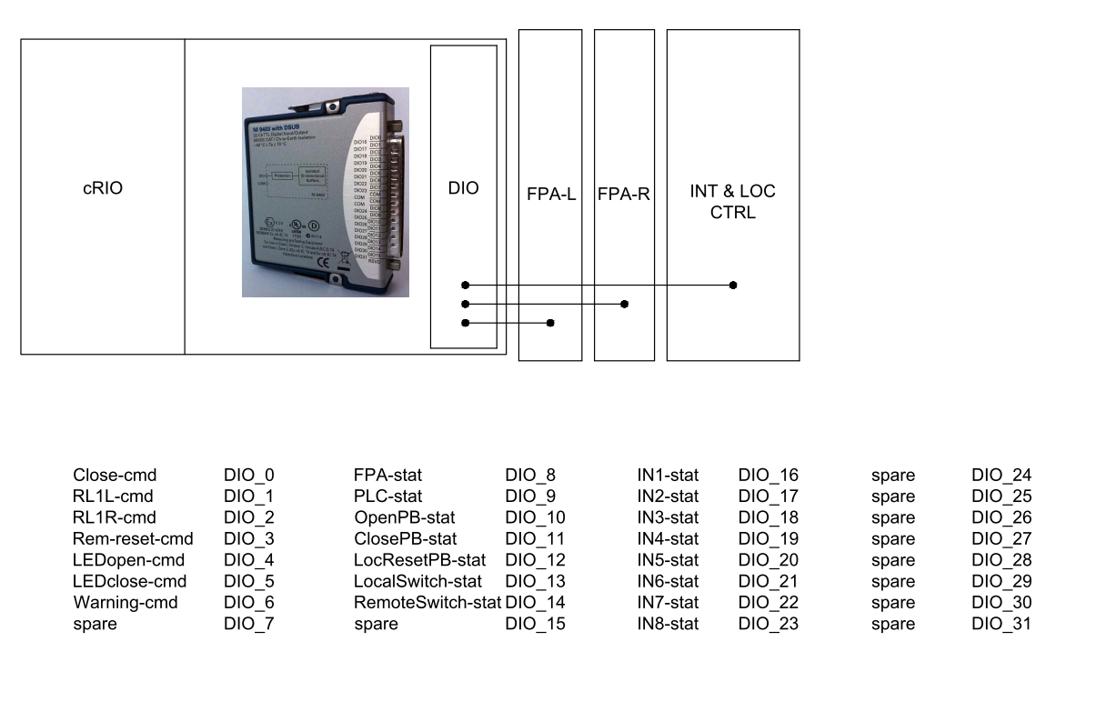
cRIO – connections DIO module

Slide 15
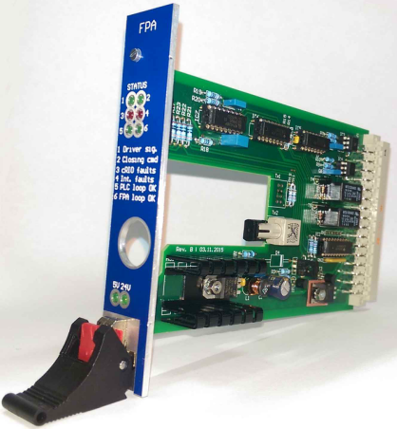
FPA board (x2)
Inputs: FPA loop
PLC loop
Close-cmd
RL1/2-cmd
SumFault14/58-stat
Outputs: FPA-stat
PLC-stat
Optical Fiber for IGBT drivers (x2/board)
The function of these boards is to control the conducting of the IGBT's when:
- FPA loop o.k.
- PLC loop o.k.
- no faults from cRIO
- the command has been given to close the switch
and the inverse!
Remark:
Two of these boards operate
together to create redundancy

Slide 16
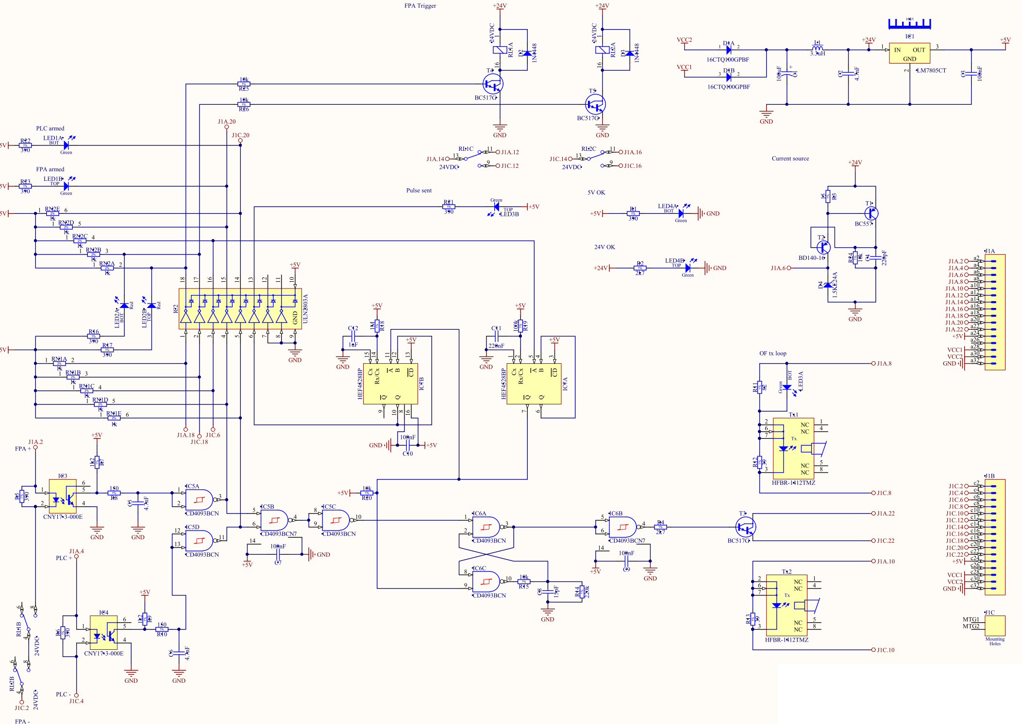
FPA board - schematic

Slide 17
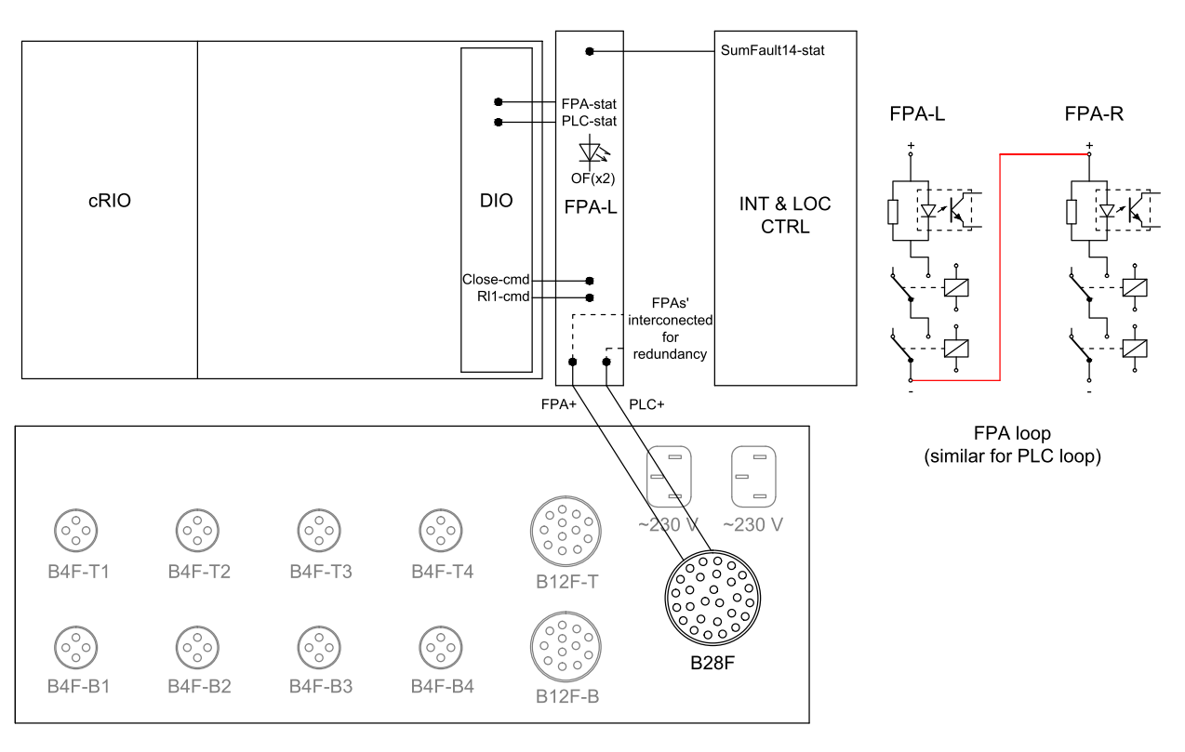
FPA board (L) - connections

Slide 18
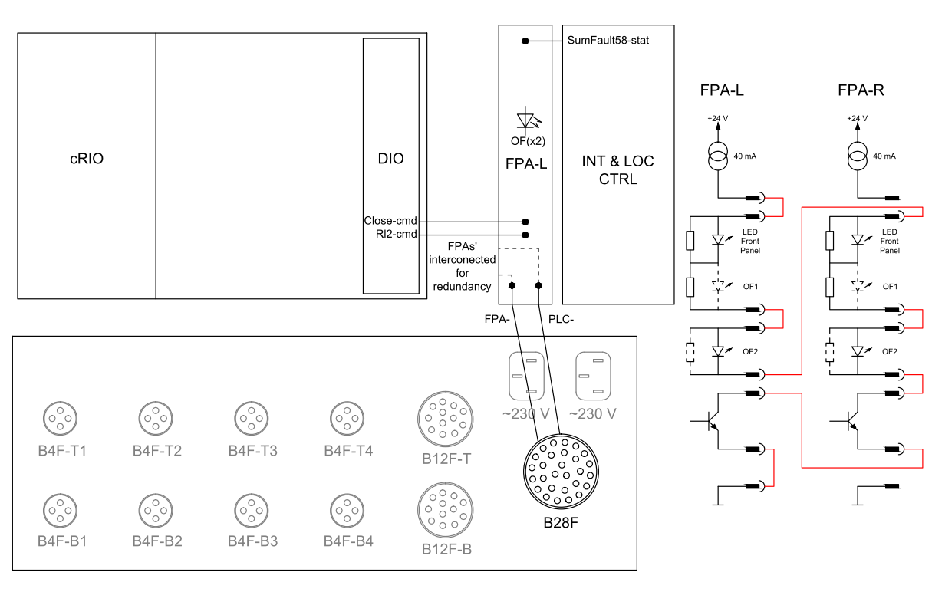
FPA board (R) - connections

Slide 19
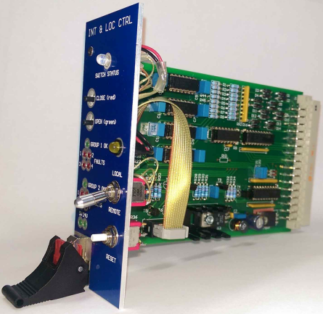
INT & LOC CTRL board
Inputs: IN1 to IN8 External Faults
LEDopen-cmd
LEDclose-cmd
Outputs: IN1 to IN8 Status of External Faults
SumFault14-stat
SumFault58-stat
OpenPB-stat
ClosePB-stat
LocResetPB-stat
LocalSwitch-stat
RemoteSwitch-stat
The function of this boards is to provide local open/close operation, displaying the Status of the Switch and have the possibility of External Interlocks to act directly, without intervention of the cRIO, on the opening of the switch as a last resort when all other safety devices have failed.

Slide 20
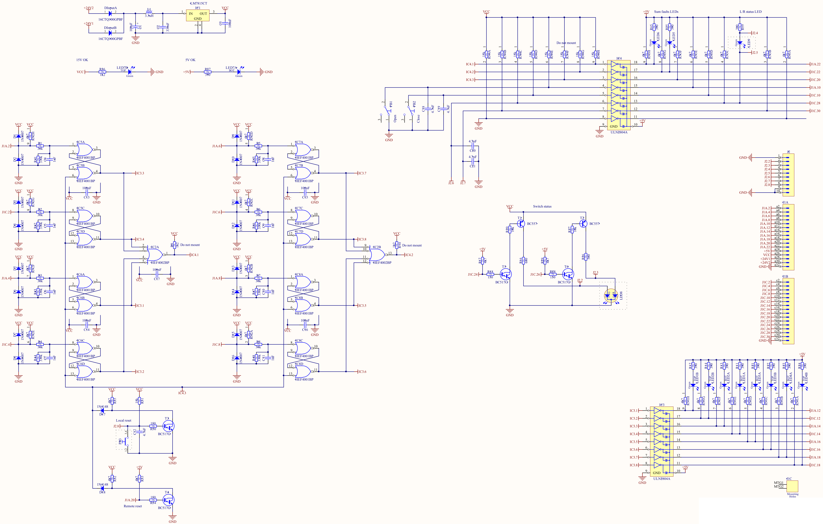
INT & LOC CTRL board
- schematics

Slide 21
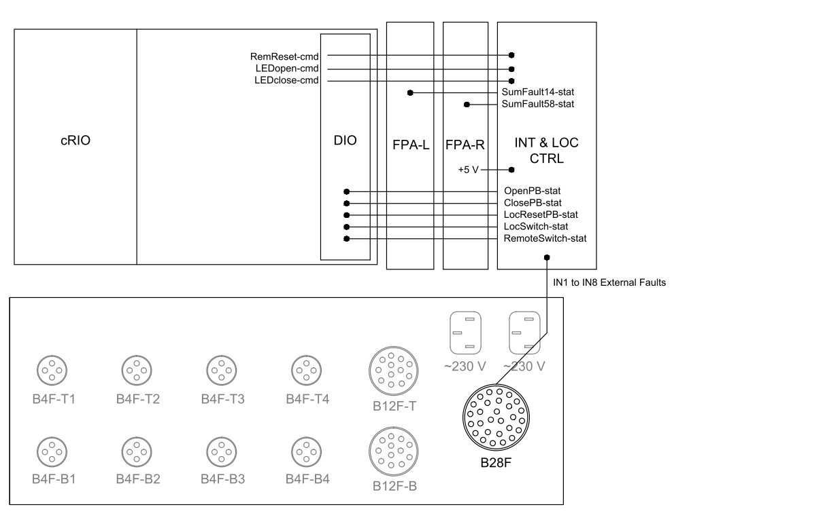
INT & LOC CTRL Board - connections

Slide 22
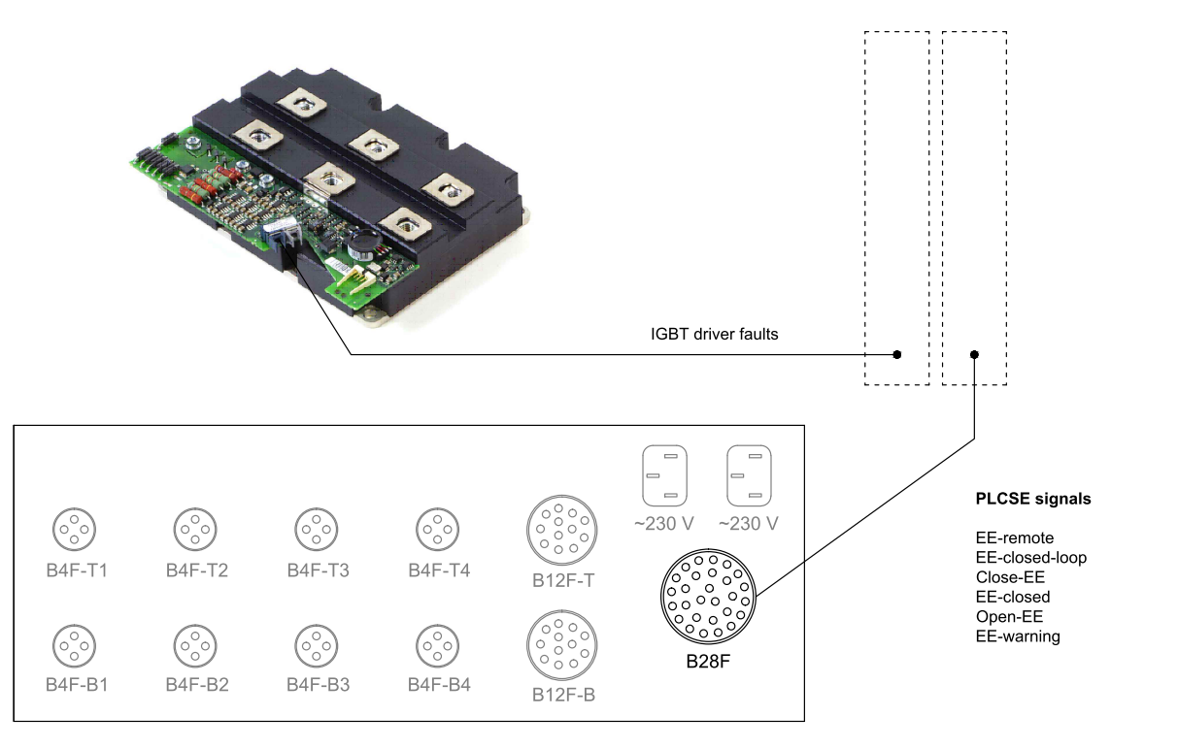
Not taken in account yet
Slow Power Abort

