Slide 1
30kA Energy Extraction
Semi-Conductor Switch
SM18 - CLUSTER D
Recall
Gert Jan Coelingh on behalf of all team members
TE-MPE-EE

Slide 2
OUTLINE
Project team
SM18
Requirements / Functional Specification
Schematics / Design Criteria
Topology
Simulations
Status
To do
Conclusion

Slide 3
Project team
Core team members: Gert Jan, Alexandr, Arend, Mateusz
Supporting teams electronics: Bozhidar, Pål, Szymon, (Ron)
Supporting team 1 electro-mechanics: Mathieu, Samuel
Supporting team 2 electro-mechanics: Stephen, Grzegorz, Krzysztof
Others involved: Knud, Future TS,
Solomon (ext): 2D-, 3D- & production drawings
Mathieu: production drawings

Slide 4
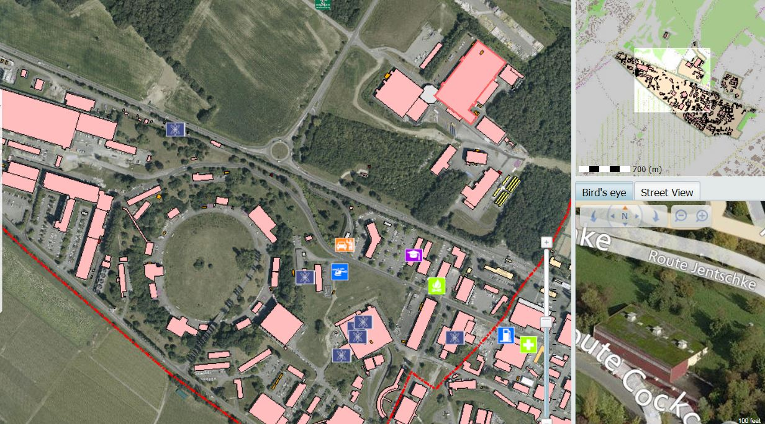
Building 2173 aka SM18 - Cluster D
Courtesy PERRET Ph.

Slide 5
Requirements EE Cluster D
Demand coming from MSC group (SM18) for Energy Extraction Systems:
    Fast opening time (< 2 ms)
    High Current 30 kADC
    Medium Energy (10 MJ)
    Maximum extraction voltage: 1000V
Fast opening time means; can’t be achieved with Electro-Mechanical Breakers
Alternative: Semi-Conductors
Chosen type: Integrated Gate Bipolar Transistor (IGBT)

Slide 6
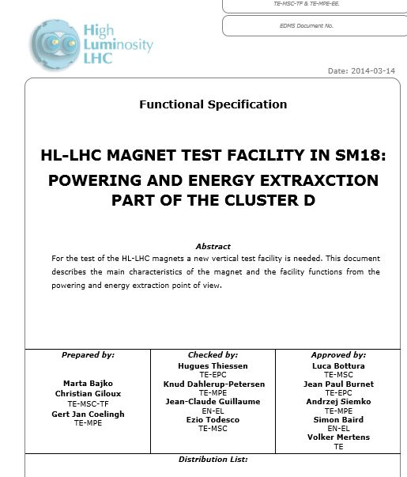
Requirements F.S.
TYPICAL MAGNET PARAMETERS
•Maximum stored energy : 10 MJ
•Short Sample current : 21.5 kA
•Magnet inductance ( ex. Of HL LHC QXF type) : 8. 27 mH/m
•Magnet length : 1 – 4.2 m max.
•Nominal Ramp Rate: 11 – 20 A/s
•Maximum Ramp Rate: 200 A/s

Slide 7
Requirements F.S.
3.1.4 ENERGY EXTRACTION OF CLUSTER D
The energy extraction will be made with and external dump resistor. The dump resistor value will be adjusted case by case and in function of the necessity but always set such that with the maximum expected quench current the voltage stays below the last successfully qualified test value, typically obtained during a test performed while the whole magnet is in LHe and ready for the test. The max. value is 1000 V. To extract the maximum energy and stay within a given voltage , lower than the designed value, there is a strong interest to place the ground of the converter in the middle of the dump resistor.
The extraction will be triggered by the quench detectors with or without delays and trough a dedicated switch the power converter will be switched off and the current will go trough a free wheel. The reaction time of the switch was set up in function of the maximum allowed temperature in the most critical magnets after a quench and is set in the range below 1 ms leading to the choice of IGBT based technology.
4.1.2 EXTRACTION SWITCH OF CLUSTER D
The switch will be composed by a transistor based semi-conductors of type IGBT. Two identical switches of 15 kA will each consist of 8 elements in parallel and both racks will be located in the Cluster D area under the platform. Each rack is again split up in two modules, rated for 7.5 kA. One IGBT will carry a maximum of 1.875 A depending on number of elements in parallel. The current sharing is expected to be better than 5% difference between the individual IGBTs, leading to temporary maximum currents of 1970 A for short durations (minutes). The maximum forward voltage of each switch will be 3 V. Therefore no redundancy in the system will be possible so this switch will be directly acting on the circuit. The command chain will be doubled as far as possible to guaranty the opening of the switch. It will be mono polar and the reaction time (time from FPA to 0 current in the switch) will be less than 1 ms. To be remarked that the max. of 1000 V will be also seen by the switch in blocking mode. The maximum forward losses, roughly 30 kA x 3 V will be 90 kW and water-cooling is needed. At the time of writing this document a flow rate is estimated at 200 l/min. This may decrease since the forward losses are linear with the circuit current and a higher delta T of the water in vs out may be accepted at occasions where 30 kA is needed.
The estimated floor space needed for each of the two switches will be maximum 2 x 1 meters with a maximum height of 2.20 meters. There will be free space of 1 m around each of the switches allowing access to it.
Each 15 kA switch will be connected, by means of a 2x2x200mm2 ultra-low-inductance cable to a separate dump resistor capable of absorbing 5 MJ each grounded via their midpoint.
4.1.3 THE DUMP RESISTOR OF THE CLUSTER D
The resistor racks will be located at the first floor as close as possible above the switches. The total modular resistor can be changed roughly between 3.6 and 120 mΩ.
The number of steps in between these values is still to be decided as well as absorbed energy for each resistor value. For each 15 kA switch, a proposal of
6 elements of 40 mΩ and 1 MJ each seems to be a realistic option. Each element will have a mid-point grounding tab. This allows 4 configurations with full energy dump.

Slide 8
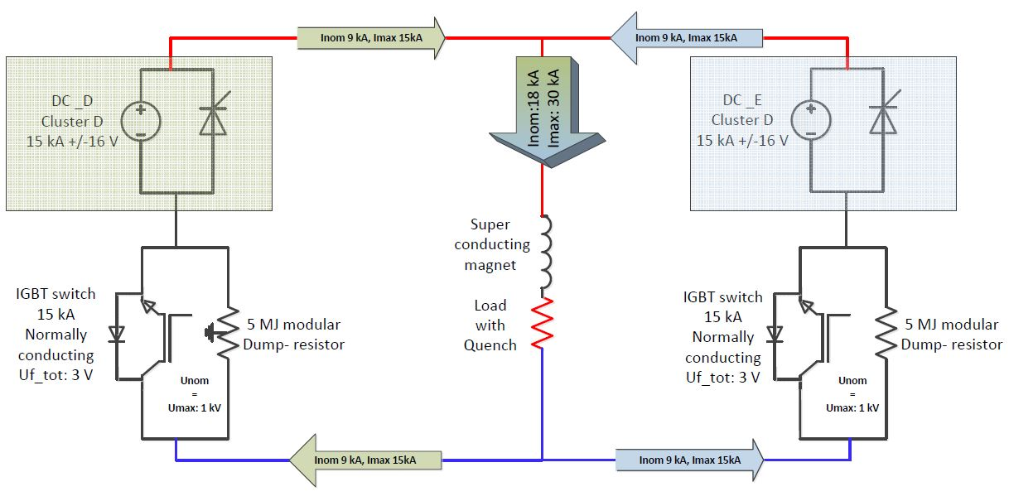
Simplified 30 kA schematic

Slide 9
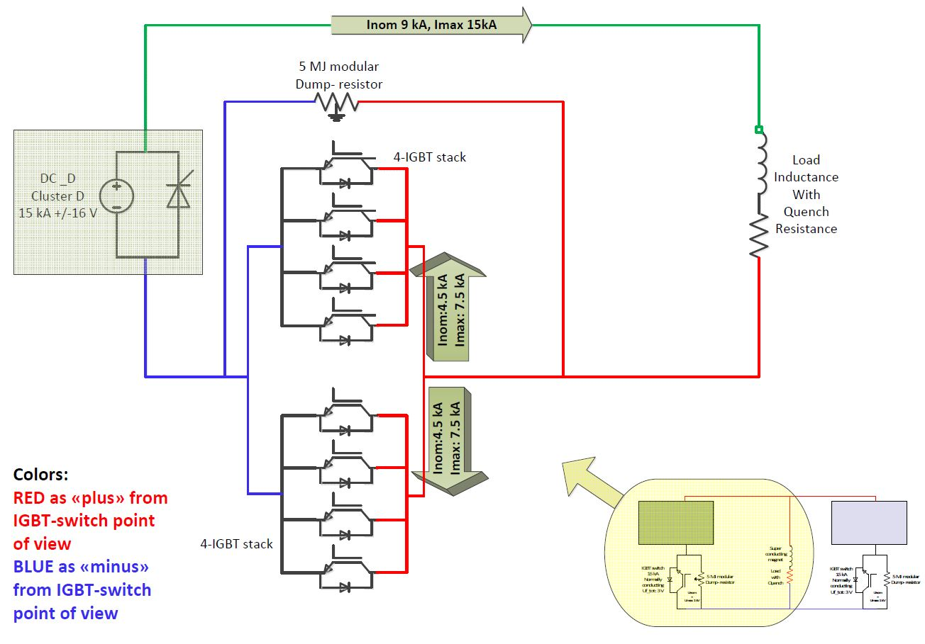
Simplified 15 kA schematic

Slide 10
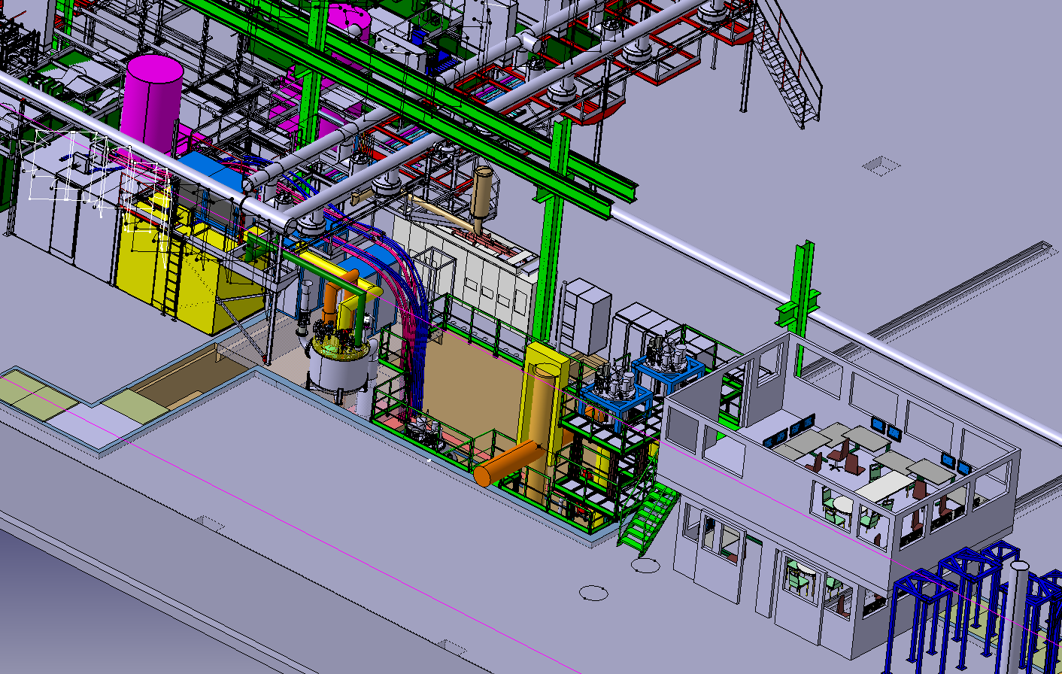
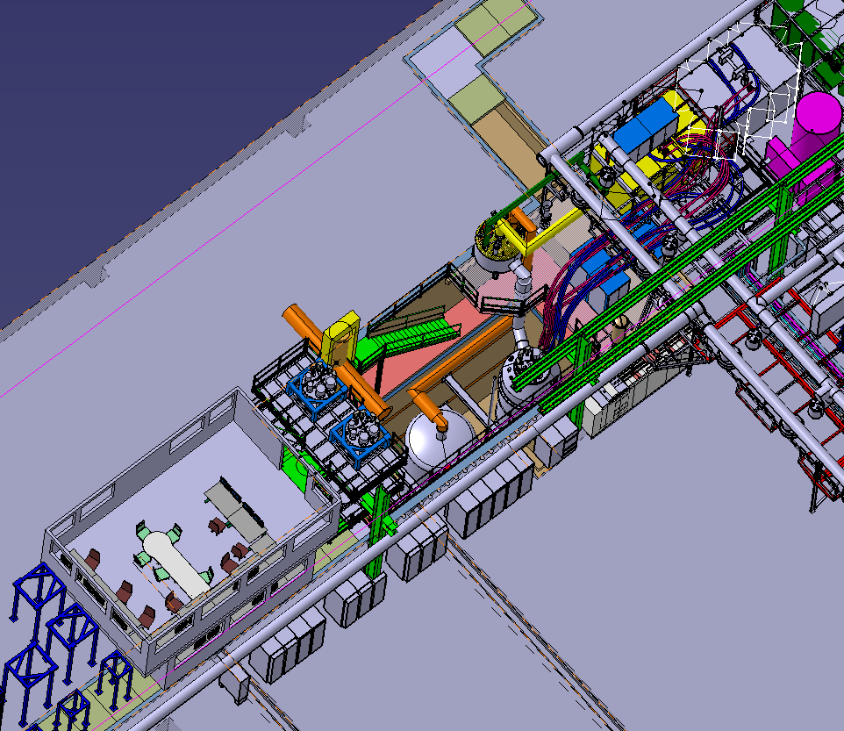
SM18 Cluster D
Courtesy PERRET Ph.

Slide 11
Design criteria 1
Reliability of the Semi Conductor
  Major failure causes due to
    Thermal design (DC application)
    Over-voltages due to stray inductances
    Over-current
Forward losses reduced because of over-rating
Commercial Availability
Notes:
Overcurrent due to bad current sharing

Slide 12
Design criteria 2
Lifetime Reliability
  Due to thermal cycling the lifetime decreases drastically
    Keep Delta T of junction < 80 °
      Tj < 110°C
    See plot lifetime cycles

Slide 13
Design criteria 3
Transient processes lead to high voltage spikes and potential over-currents through single IGBT
  Stray inductance to be kept as low as possible
    non compensated stray inductance will lead to high voltage spikes
  Need for fully symmetrical design
    Trade-off: efficient cooling, current distribution & stray inductance
  Fully compensated design
  Need for multi-level snubber compensation
  Simultaneous switching of all 16 IGBTs (sub µs range)

Slide 14
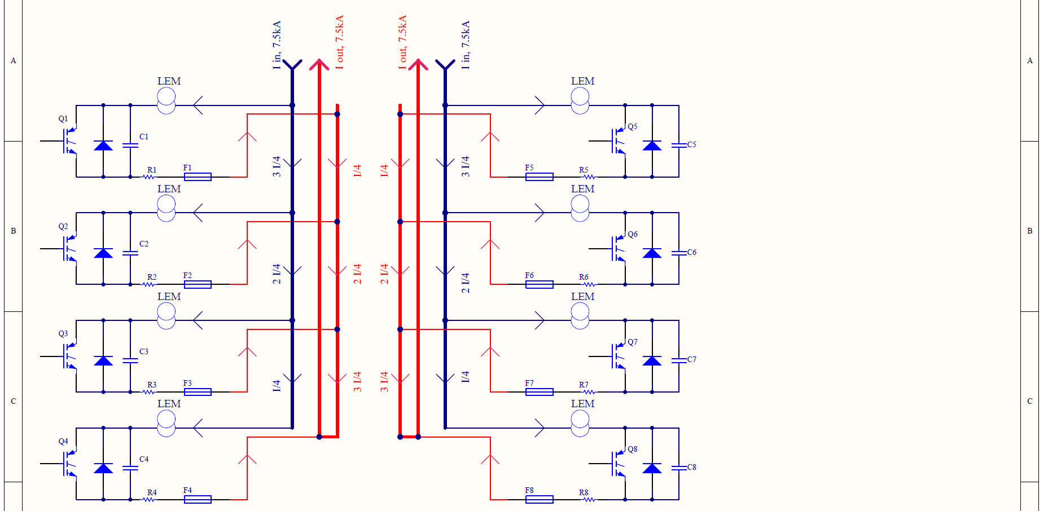
15kA Switch topology
TRIPLET MAIN BUS-BARS
to minimise stray fields

Slide 15
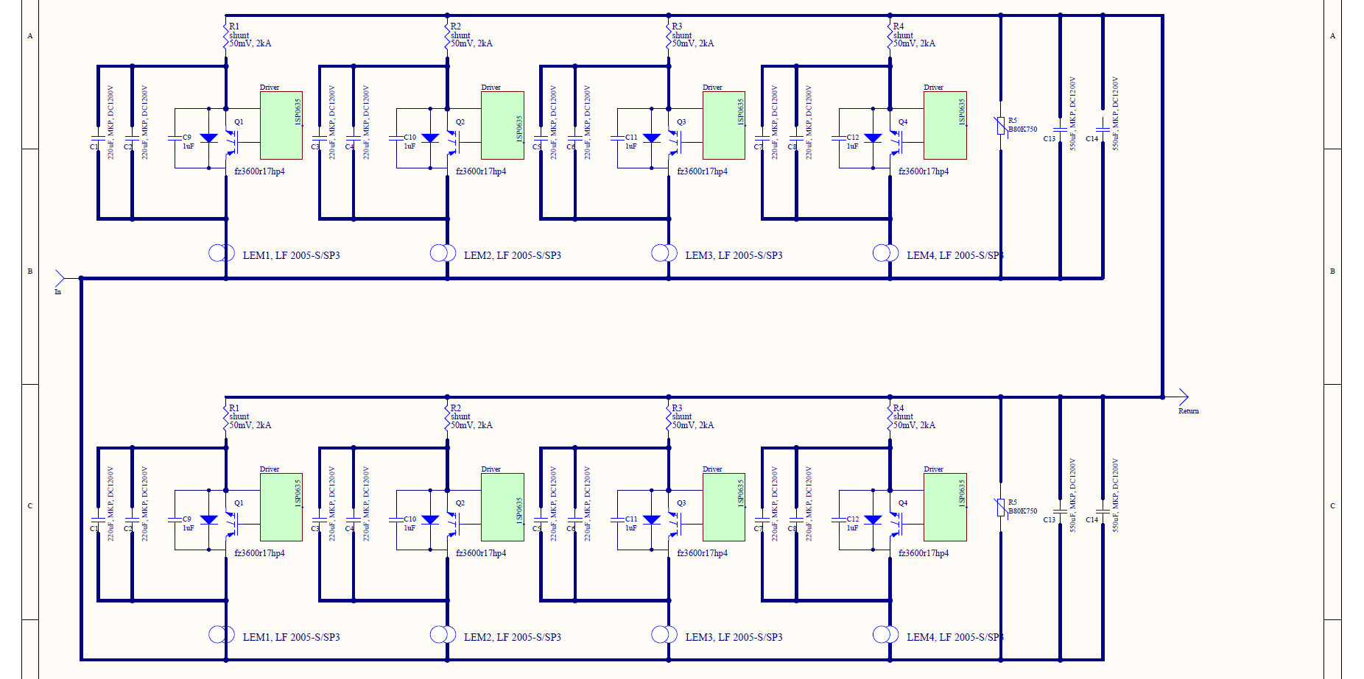
15kA Switch schematic

Slide 16
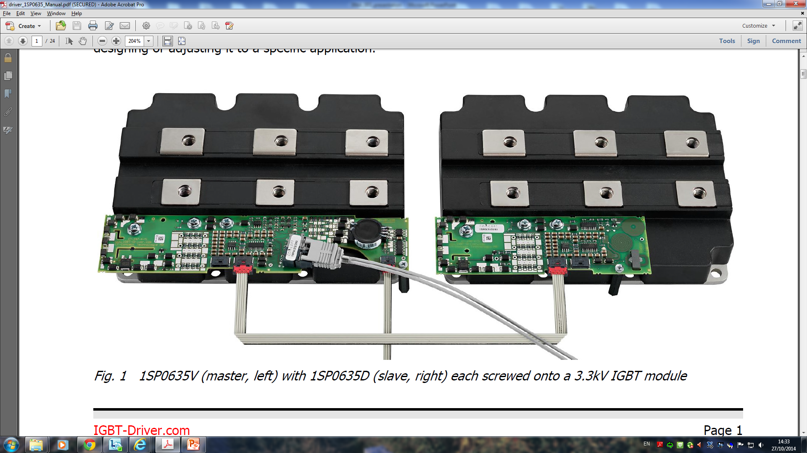
Main components
IGBT:
Infineon FZ3600R17HP4_B2 – the best available on the market
Vce_max = 1700V, Inom = 3600A
With I = 1875A (max possible current):
Vces =1.6V => Junction heat dissipation ~3000W per module
Junction temperature ~ 100-105°C
300 W dissipation for the terminals
_B2 version comes with AlSiC base plate adjusted to thermal expension of silicon and ceramics leading to longer lifetime due to thermal cycles

Slide 17
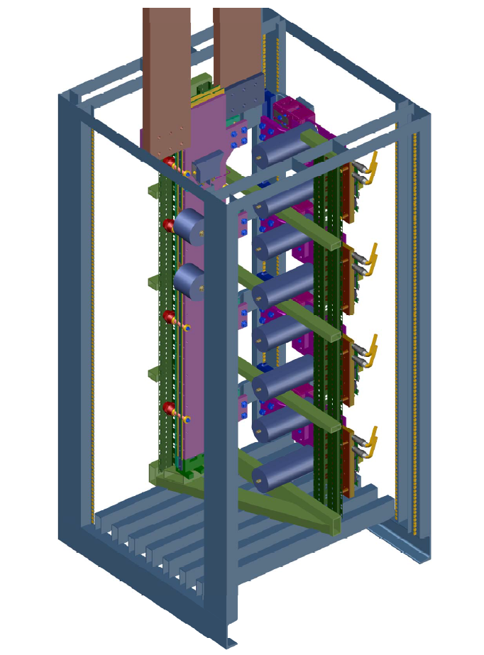
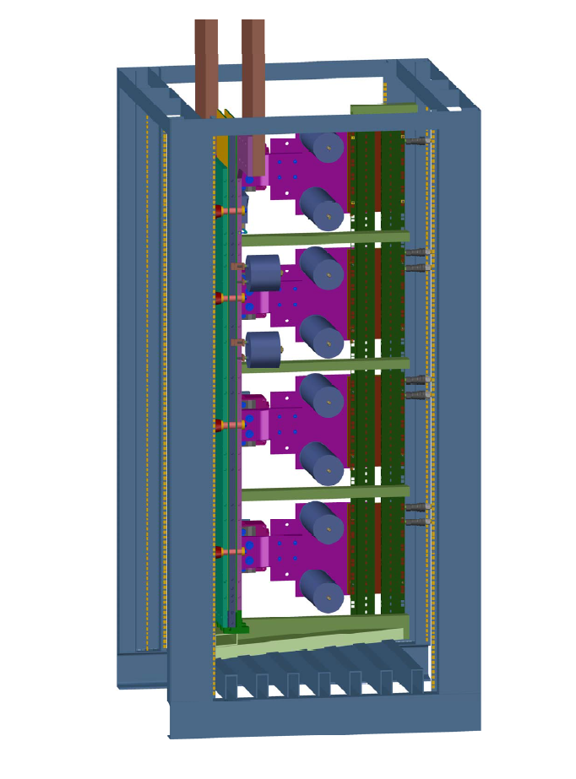
Design topology

Slide 18
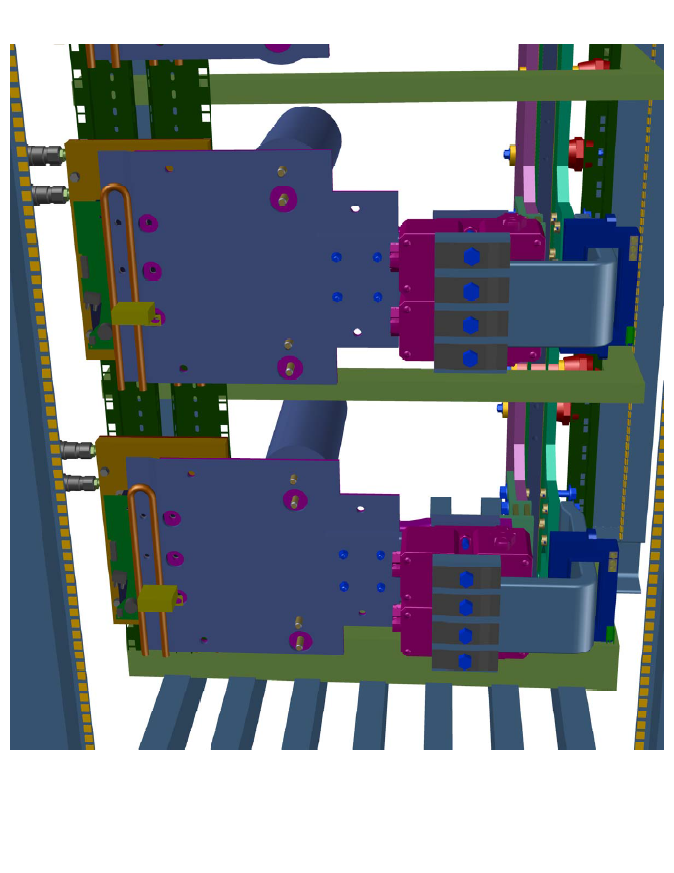
Design topology
distribution
busbars
Driver
LEM
Emitter / Collector
water cooled
laminated busbars
flexibles
Fuse

Slide 19
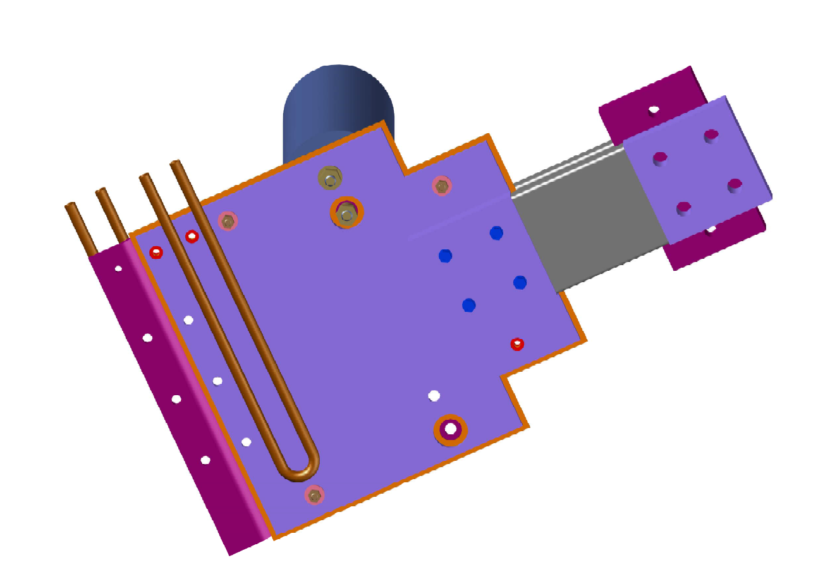
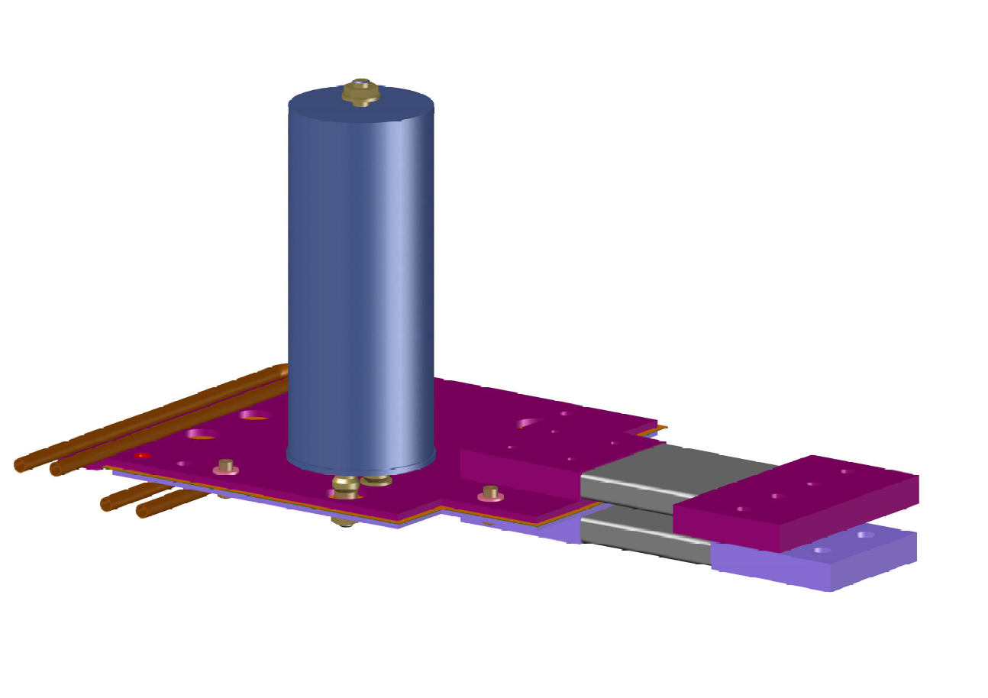
Design topology
Laminated busbars with flexibles and
Water cooling of the IGBT terminals

Slide 20
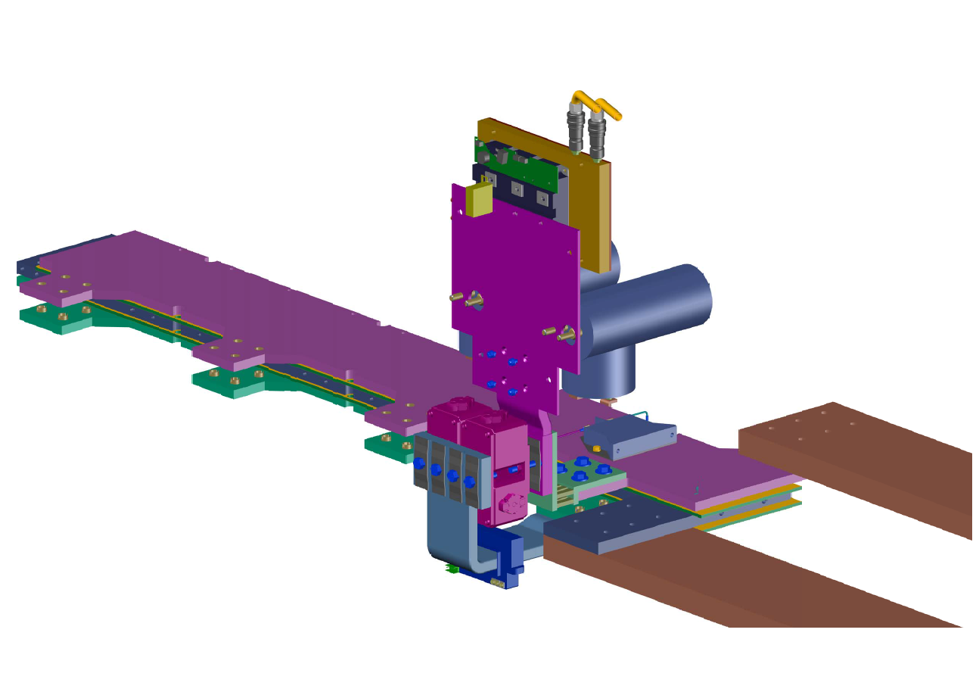
Design topology
Triplet main busbars equipped with
one branch, including fuse, LEM and shunt resistor

Slide 21
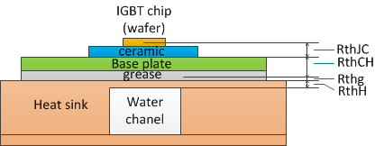
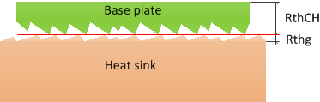
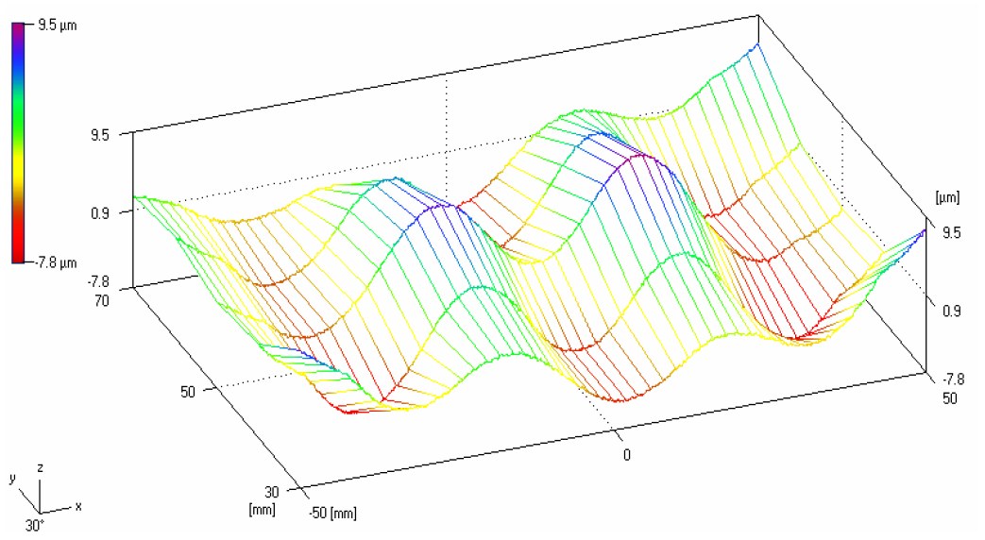
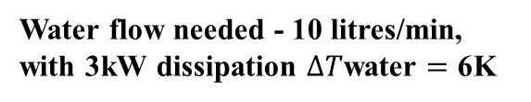

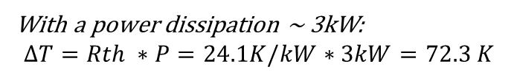



IGBT cooling plates
Thermal calculations
$$RthJC=7.1 K/kW$$
$$RthCH=9.7 K/kW$$
$$Rthg=4 K/kW$$
$$RthH=3.3 K/kW$$
With a power dissipation ~ 3kW:
$$ΔT=Rth ∗P=24.1K/kW∗3kW=72.3 K$$
Water flow needed - 10 litres/min,
with 3kW dissipation $ΔT$water $=$ 6K
Therefore $ΔT$total $\sim$ 80K, with the inlet water 20°C $=$ > IGBT chip temperature Tjunction $=$ 100°C

Slide 22
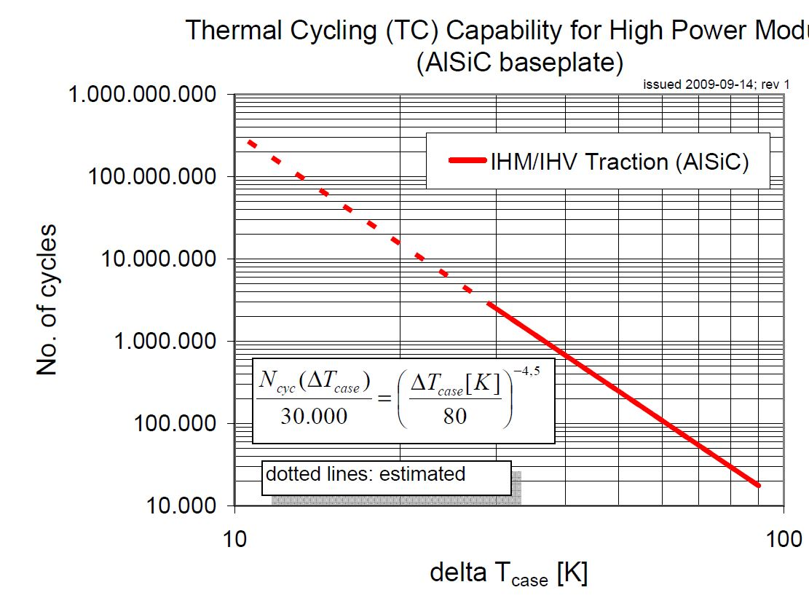
IGBT cooling plates

Slide 23
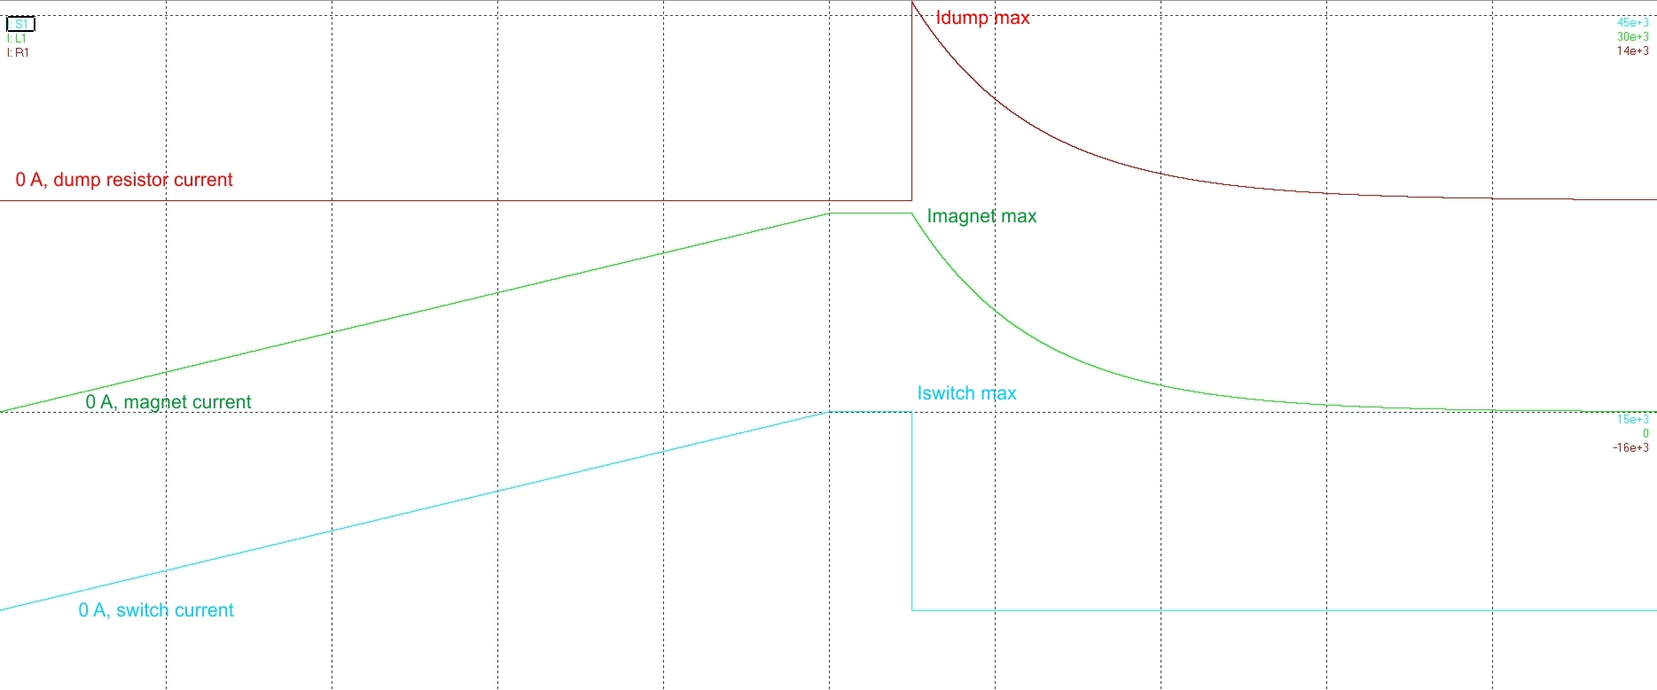
Power simulation
Complete power cycle (charge, discharge)

Slide 24
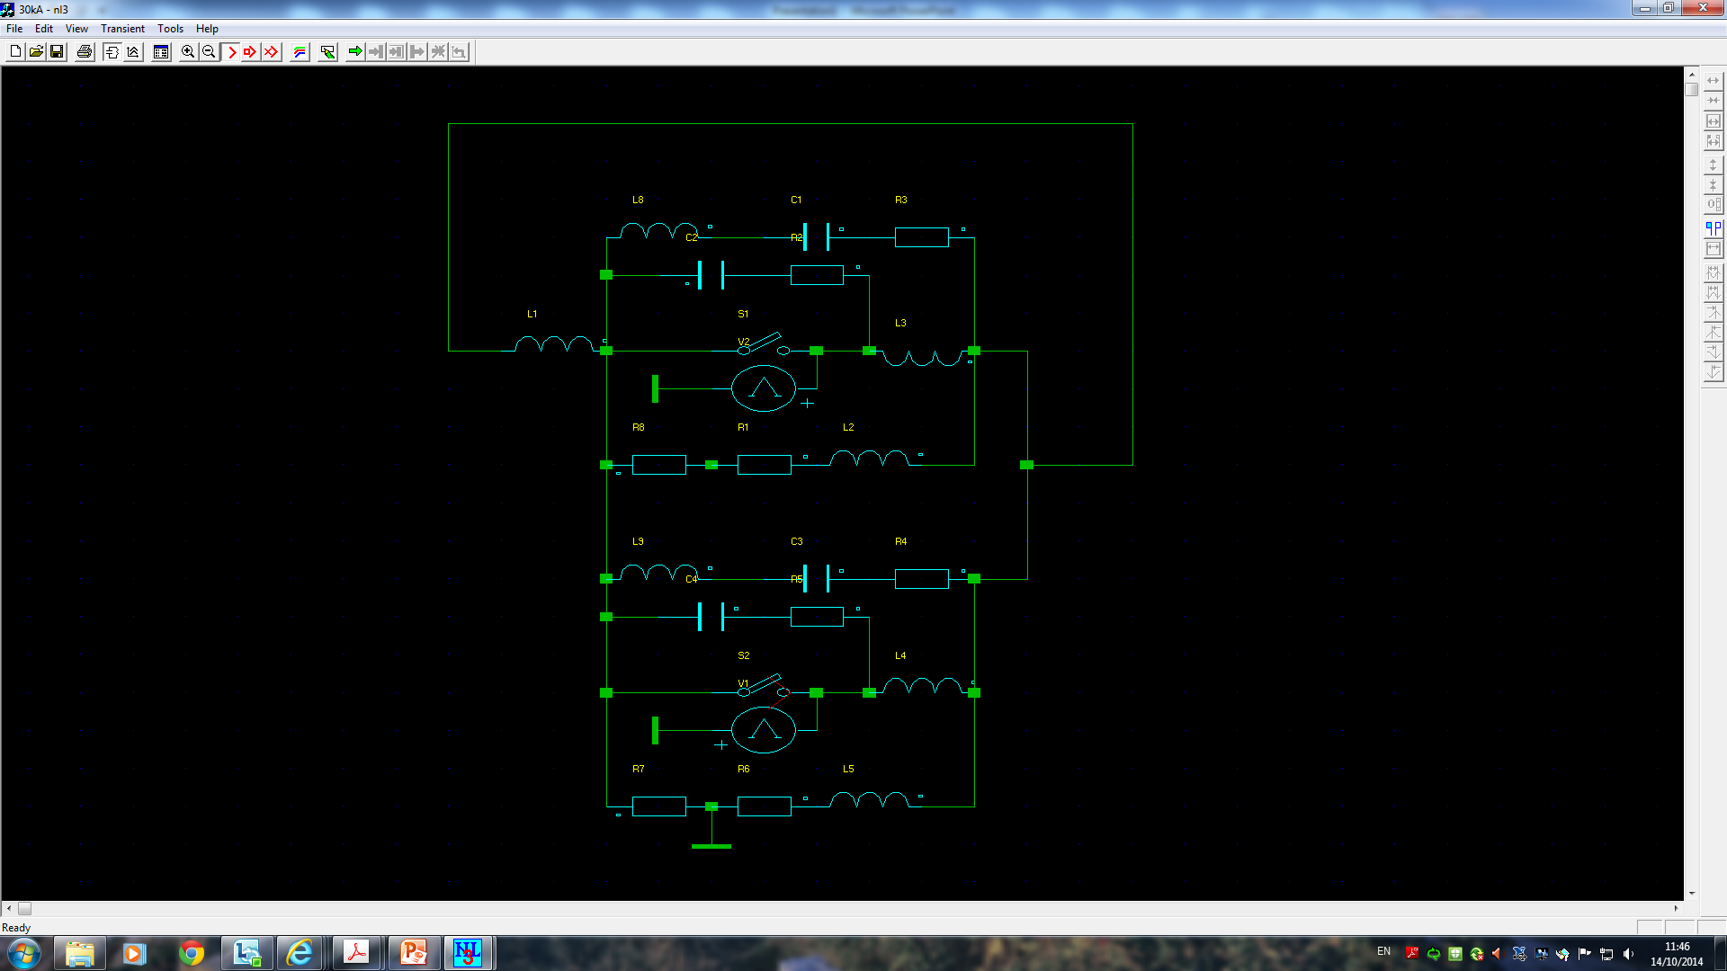
Power simulation
Two 15kA systems - opening details with the different synchronisation conditions

Slide 25
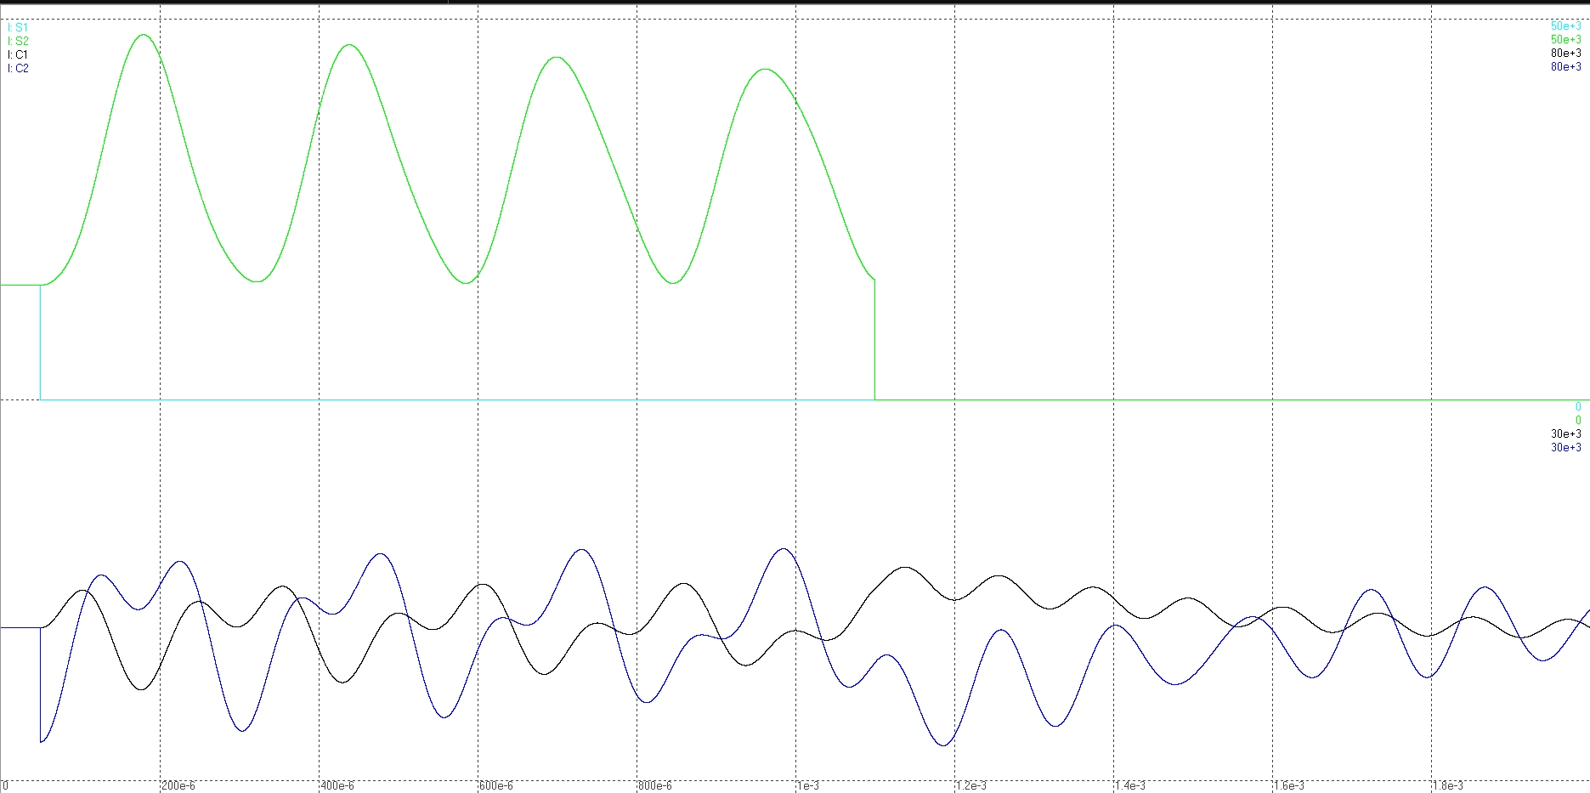
Power simulation
Delay: 1ms
Green – switch #2 current (that one which delayed to open)
Cyan – switch #1 current (that one which opened)
Blue and black – currents through the snubber capacitors
15k A
0, A
0, A
15k A
200us/div

Slide 26
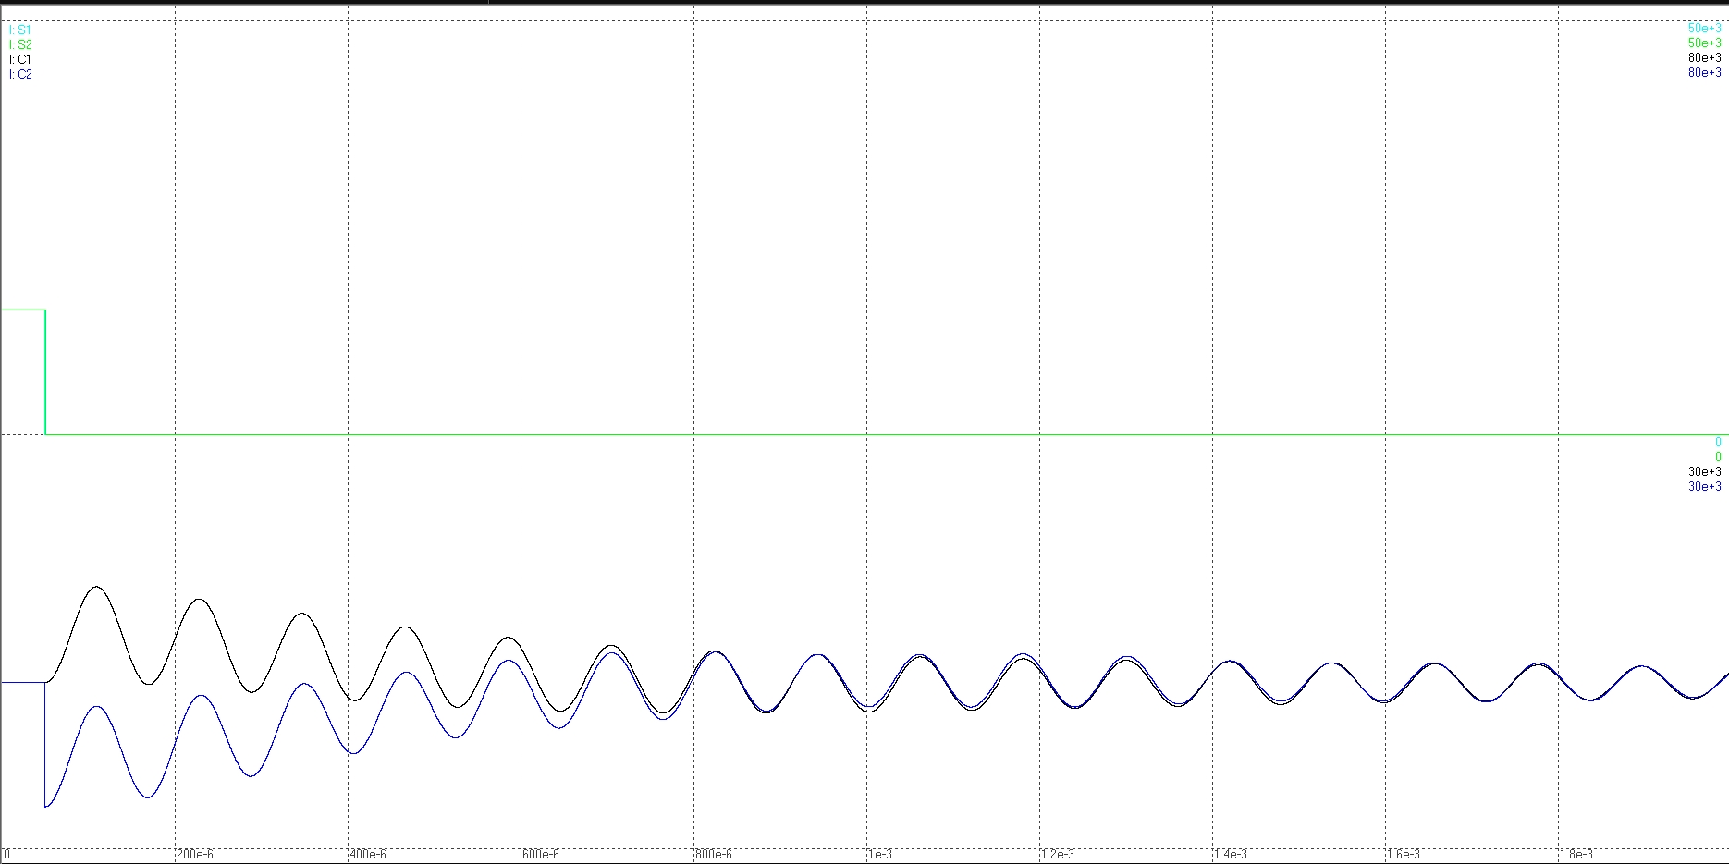
Power simulation
Delay < 1µs
Green – switch #2 current (that one which delayed to open)
Cyan – switch #1 current (that one which opened)
Blue and black – currents through the snubber capacitors
15k A
0, A
0, A
15k A
200µs/div

Slide 27
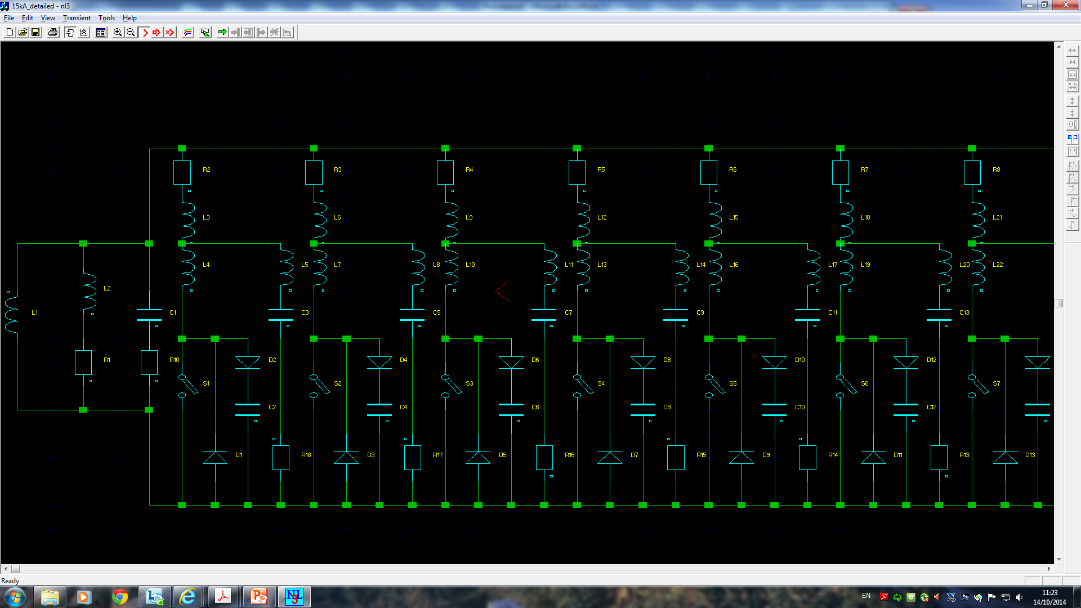
Power simulation
One 15kA system - opening details with all parasitical and protection elements taken into account

Slide 28
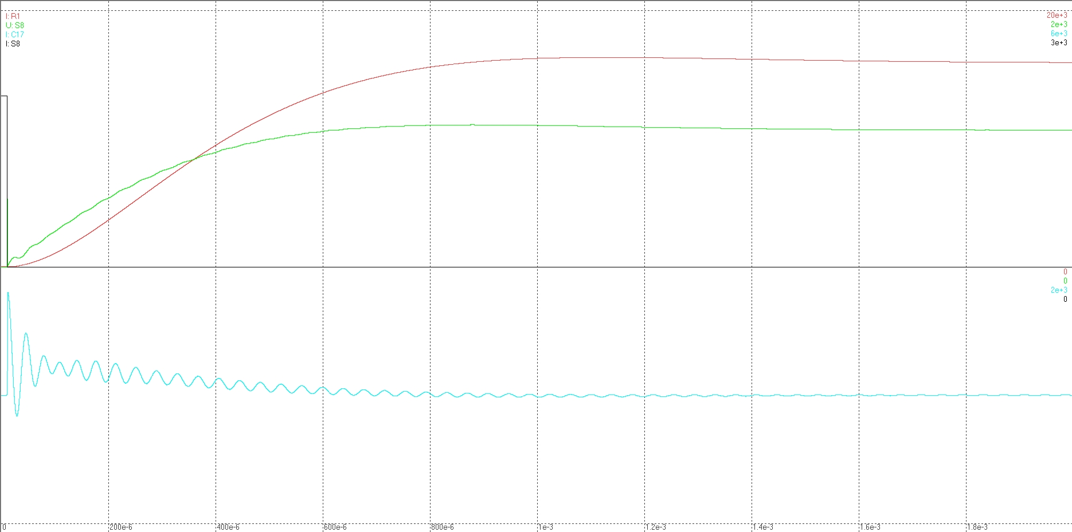
Power simulation
15k A
1875 A
1040 V
Black – current trough the one IGBT
Green – Voltage over one single IGBT
Cyan – snubber capacitor current
Red – dump resistor current
0 A, 0 V
1875 A
0 A
200µs/div

Slide 29
The Project Today

Slide 30
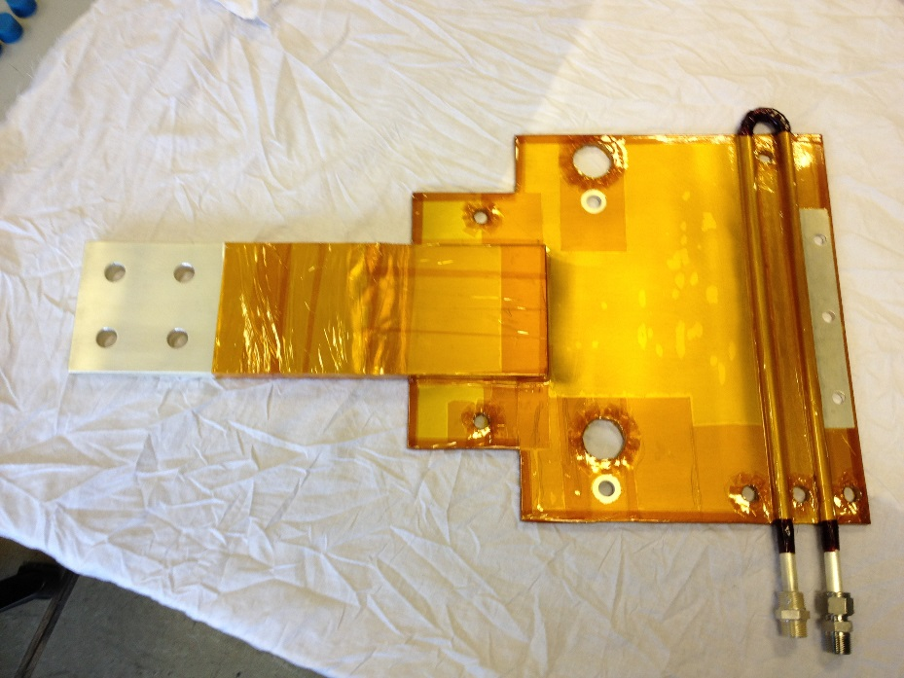
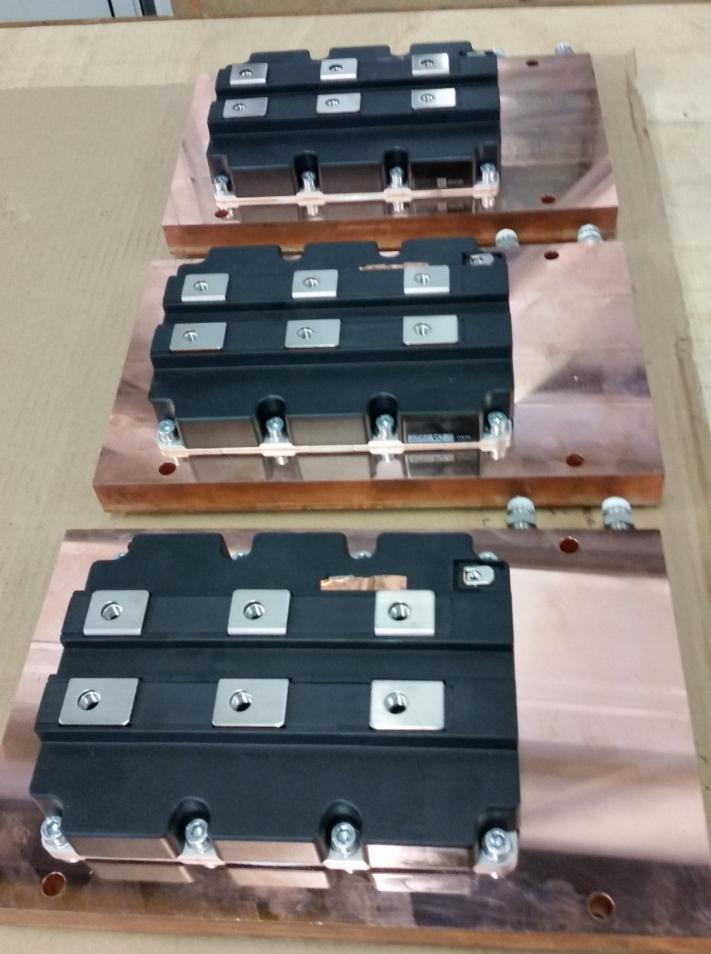
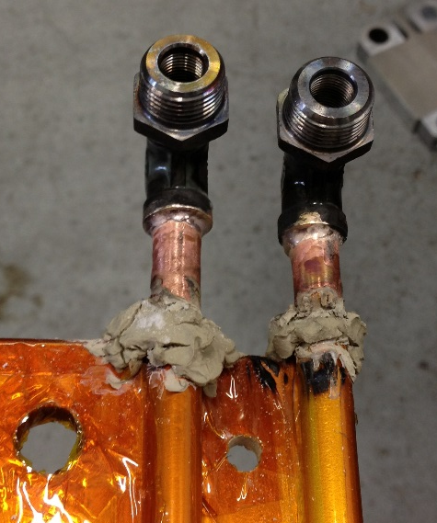
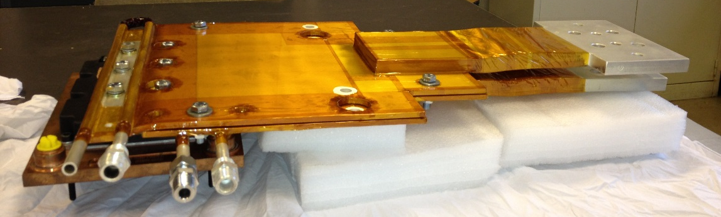
Progress for 7.5 kA Prototype
IGBTs on the heatsinks
Laminated busbar (emmiter)
Laminated busbars (collector + emmiter) with the IGBT

Slide 31
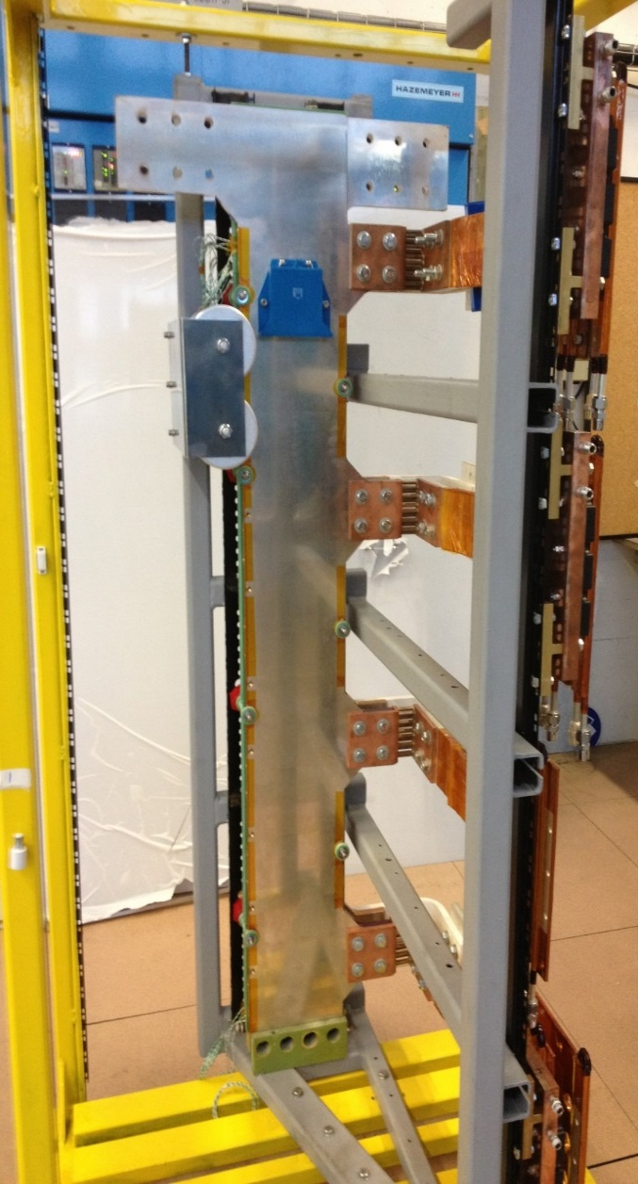
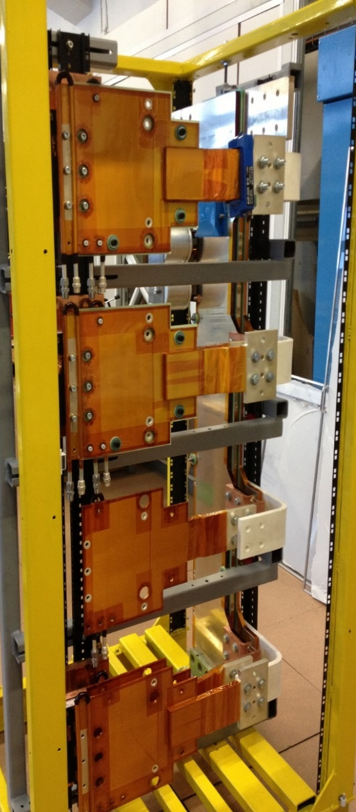
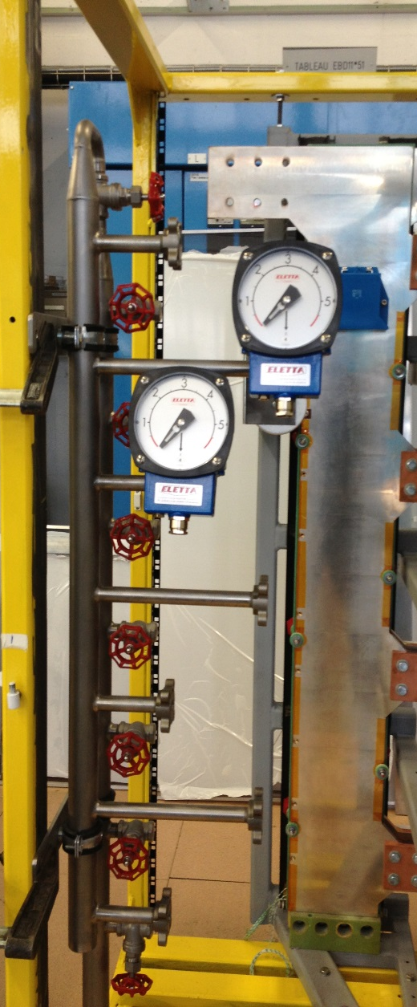
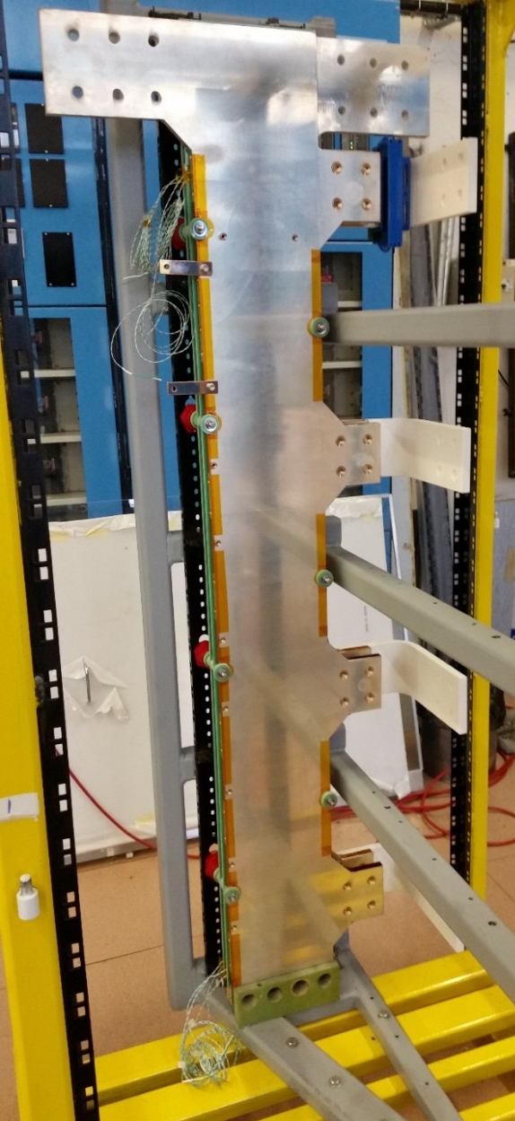
Progress for 7.5 kA Prototype
Rack assembling
DC IN
DC OUT

Slide 32
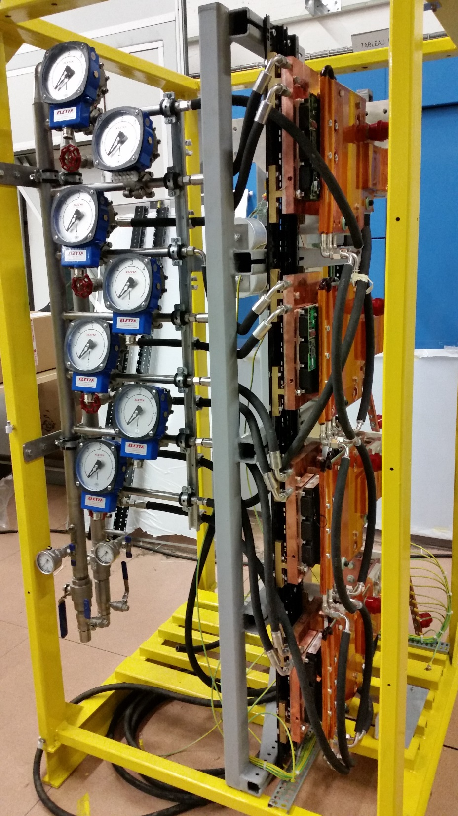
Advancement for 7.5 kA
Prototype mounted
First type tests on-going
  Water pressure test – 25 bars – 45 minutes – completed and ok
  Insulation test – 2.5 kV vs gnd – completed and ok
  More while we speak

Slide 33
Progress for 7.5 kA Prototype
Thermal studies
Printing the grease trough the stencil
Grease pattern on the IGBT after printing
Stencils with the thickness from 60um till 120um were tried, after the pattern analysis the 80um was chosen

Slide 34
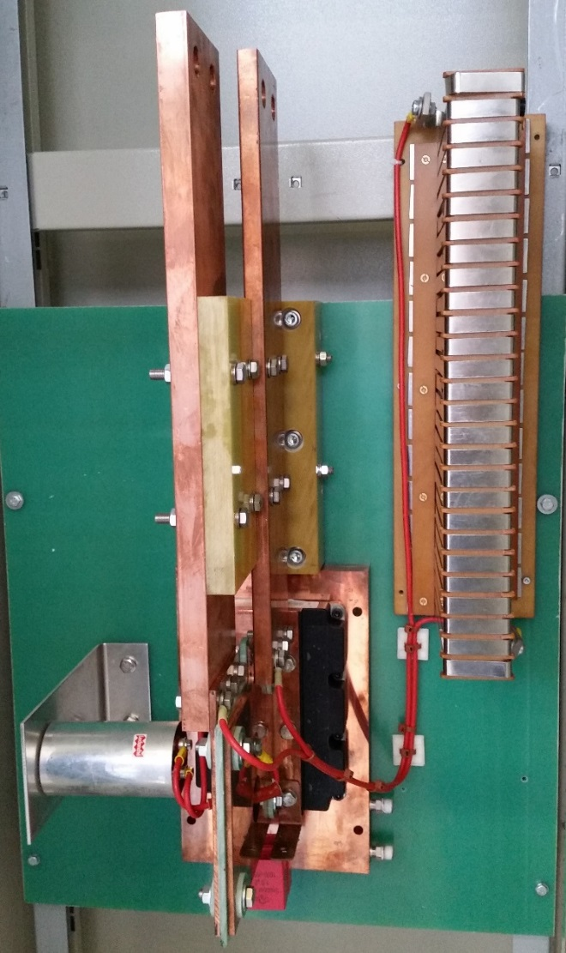
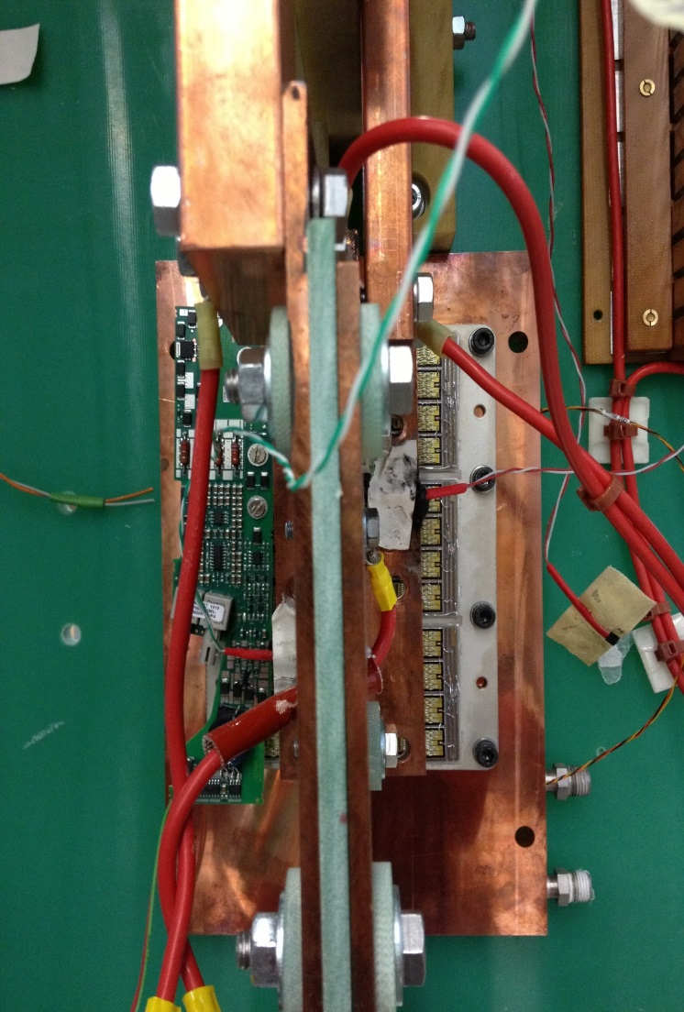
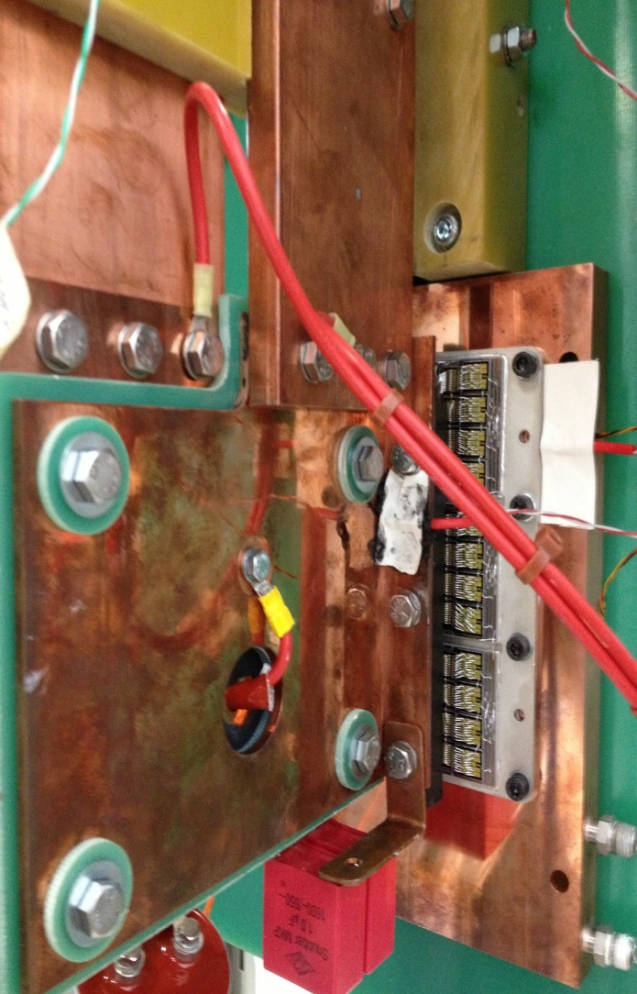
Progress for 7.5 kA Prototype
Test stand for the thermal studies
With the “normal” IGBT
With the “open” IGBT

Slide 35
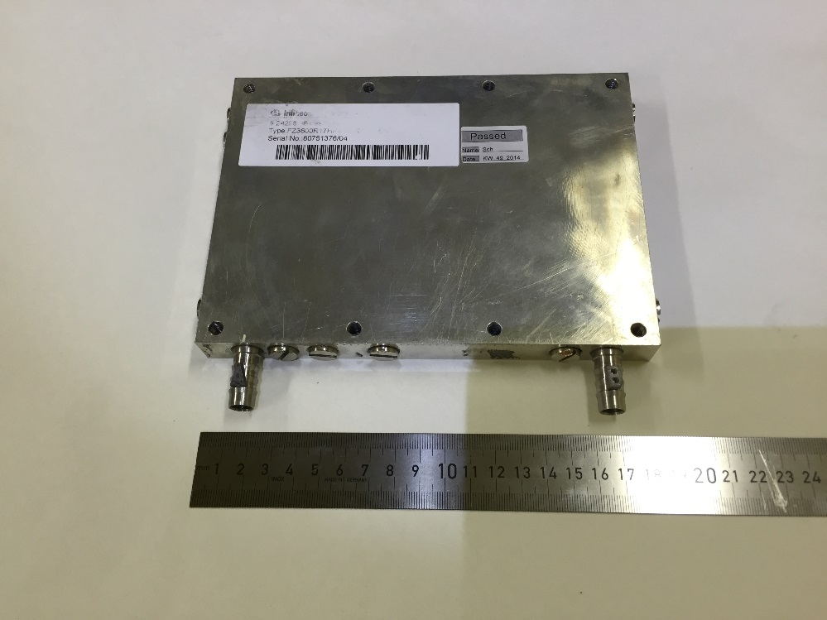
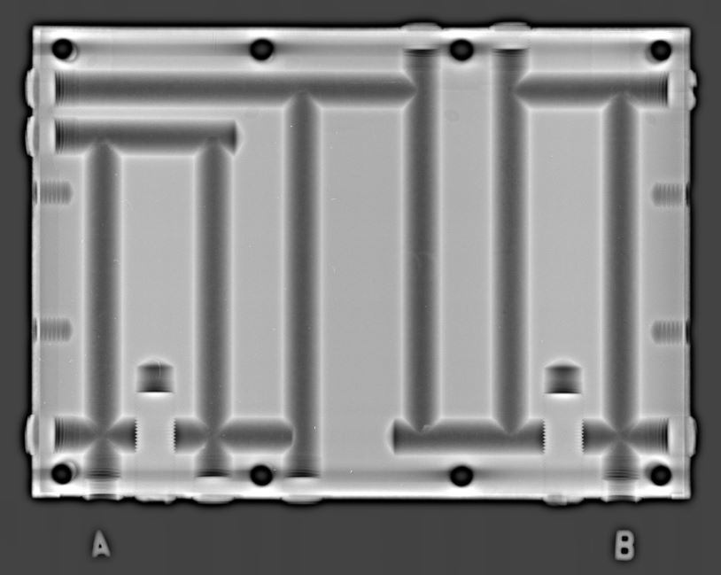
Progress for 7.5 kA Prototype
Thermal studies, heatsinks (cooling plates)
Homemade
heatsink
Mersen
heatsink
Infineon KW51
heatsink

Slide 36
Progress for 7.5 kA Prototype
Thermal studies conducted by Alexandr and Bozhidar:
Report almost available for distribution: Conclusions
Three different heatsinks were tested
All three heatsinks have the similar efficiency (difference < 1 %).
“Home-made” heatsink: Pro: compatible to the existing topology which is however complex
Pro: likely to be cheaper (50%)
Pro: could be improved but is not needed
Con: need specialist and time for IGBT mounting
“Mersen” heatsink: Con: not mechanically compatible
Con: guaranteed by manufacturer to 10 bars
Con: need specialists for IGBT mounting
“Infineon” heatsink: Con: needs water-connection adaption
Pro: could be delivered with IGBT mounted
BUT – chosen topology is correct, grease interface is correct, results in the all cases are excellent, theoretical calculations are confirmed by the measurements!

Slide 37
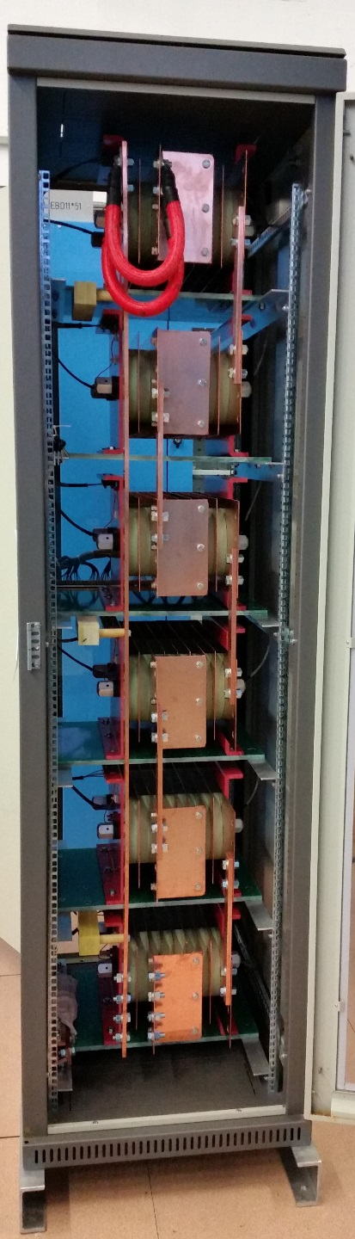
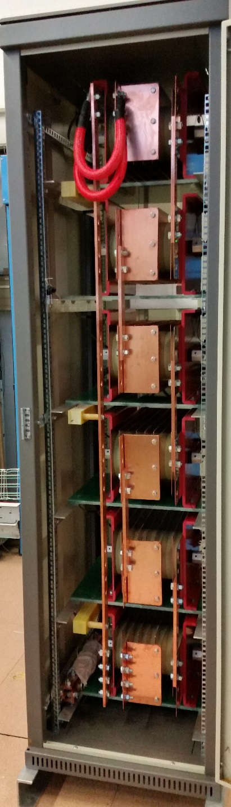
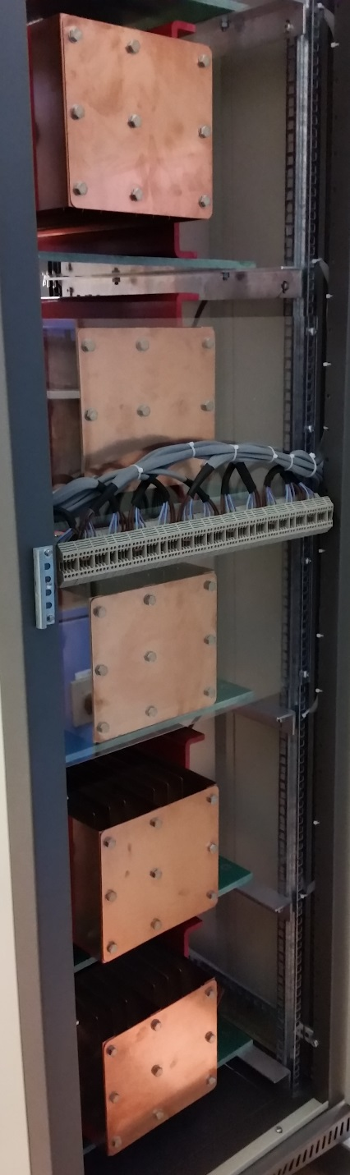
Progress for Dump-Resistor

Slide 38
Switch-Protection
The EE system protects the s.c. magnet
Maximum allowed forward voltage: 1700V (including spikes)
Maximum circuit current: 30 kA
Modular Extraction Resistance from 3.5 – 120 mΩ
  Possible extraction voltage maximum: 3600V (+/- 1800 to ground without ground fault)
Extraction Resistor measurement with preventive/corrective action
  Limit power converter current (preventive)
    External source needed to measure total resistance value and values to ground
Details to be decided.
  Study conducted by Szymon

Slide 39
To do
Priority 1, 2 and 3: Prototyping..
Still to be solved:
  Many details… see next presentations
      Electronics
      Software
      External communication
      QA
      Documentation

Slide 40
Conclusion
Many technical details need to be addressed and solved
Probability to succeed within proposed planning is extremely small
  LHC operation has absolute priority
  Availability of 2 of the core members is not enough
  PJAS core member (with 15 years of IGBT experience) will leave 06-2016

