Slide 1
Quality assurance and tests
Quality assurance should include:
Before arriving to CERN - Factory Acceptance Tests on the manufacturer’s premises are the obligatoire!
Input control of the components. Travellers, responsibilities
Input test of the delivered parts (quality test, electrical tests, pressure tests). Travellers, responsibilities
Approved test program
Complete test documentation, responsibilities
Maintenance programme
List of the spare parts

Slide 2
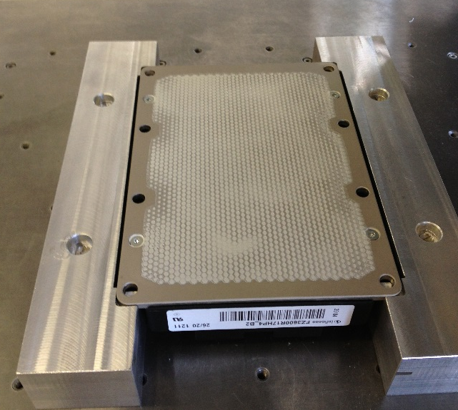
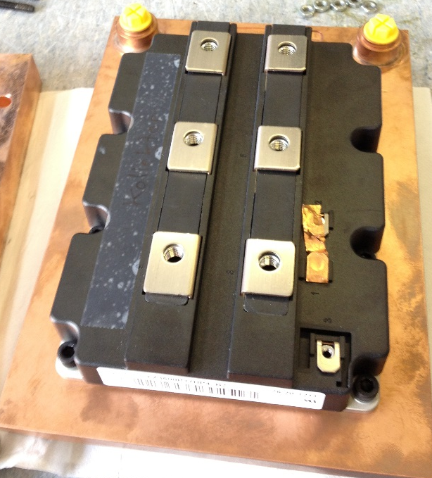
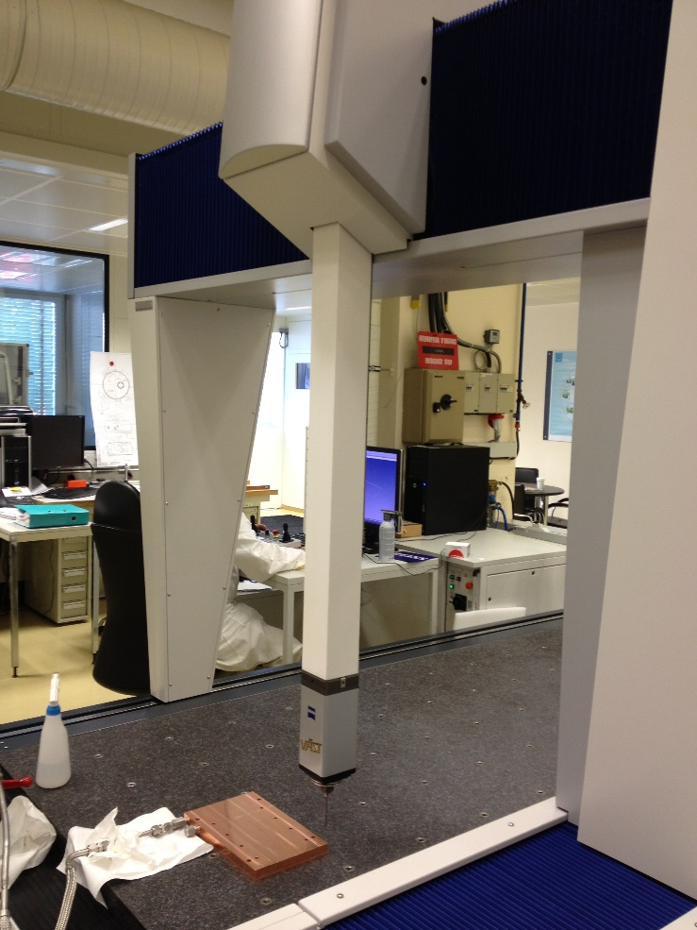
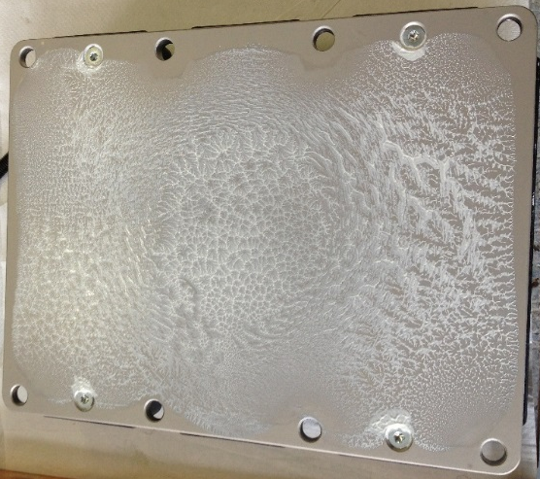
Parts input control
Correct printing of the grease
Input control for the parts
Heatsinks:
Surface test under 25 bars
Mounting
Check “pattern” after dismounting

Slide 3
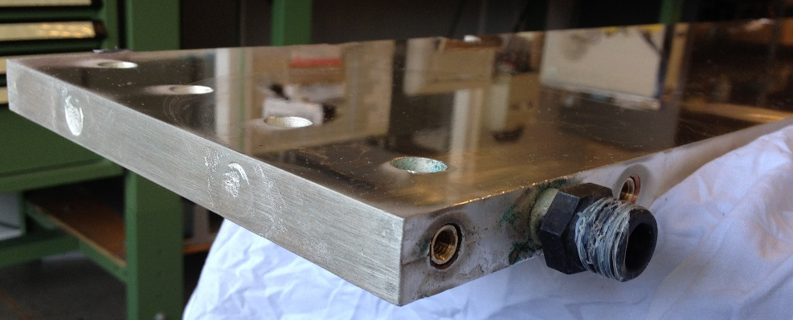
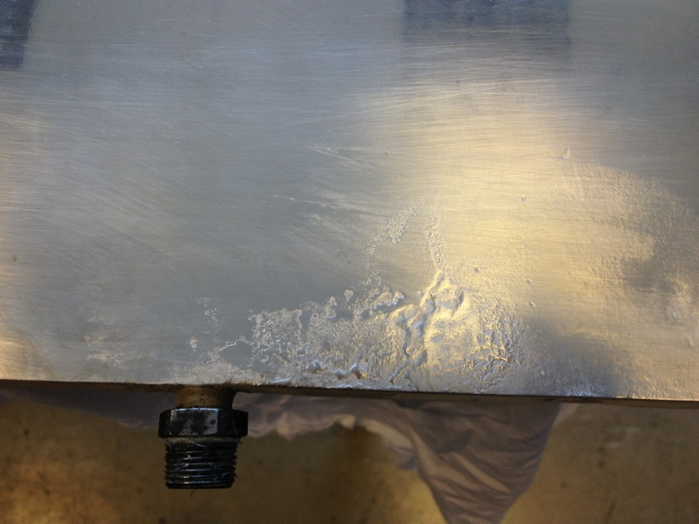
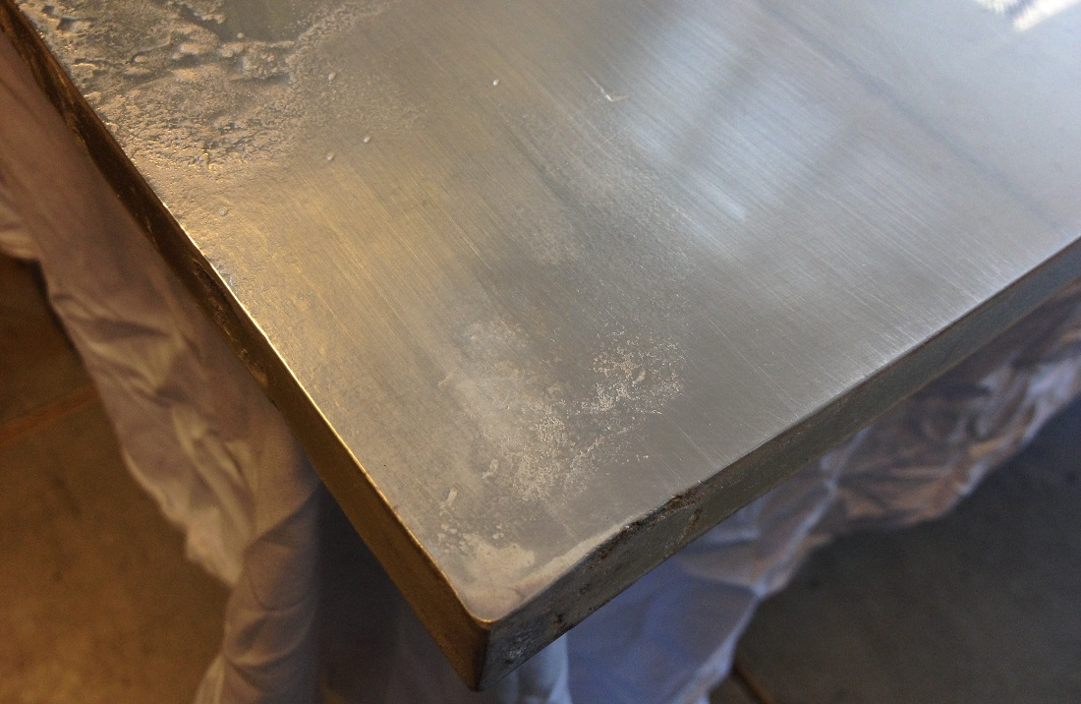
Parts input control
What should not be accepted

Slide 4
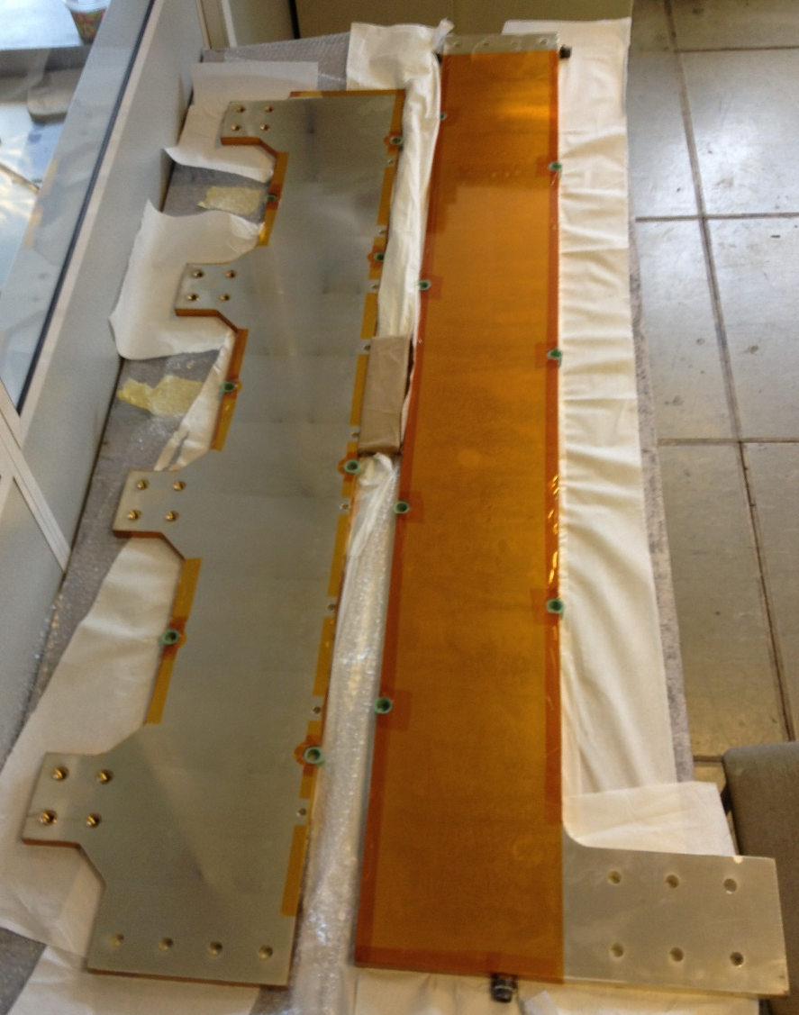
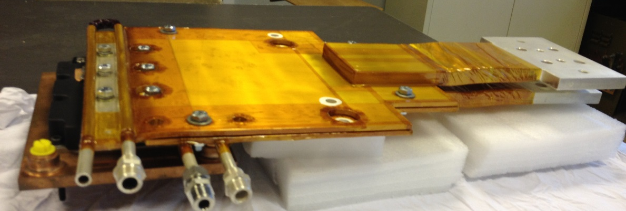
Parts input control
Busbars:
Surface check (especially for the connection flags)
Pressure tests with 25 bars
Correct lamination and hi-pot test

Slide 5
Test programme
Visual control
Insulation test – 2.5kV. Dry conditions
Complete system pressure test – 25 bars
Insulation test – 2.5kV. With the water running
Interlock tests
Functional tests without current
Functional tests for each IGBT separately
Functional test for the groups of GBTs
Faults simulation – reaction control
Complete system functional tests
Heat run

Slide 6
Test programme
Functional tests without current
Auxiliary voltages control
IGBTs commutation cycles ON – Off
Oscilloscope measurements for the gate side
Interlock tests
Analogue channels: noise, offsets, calibrations

Slide 7
Test programme
Functional tests with current
Introducing IGBTs one by one.
Master – Slave configuration
Tests of 1 IGBT: DC 0 – full current,
opening, transients, overvoltages…
3rd level snubber calculations and
implementation for all IGBTs

Slide 8
Test programme
Functional tests with current
Complete system:
Introducing delays for the switching Off for different IGBTs
reaction control:
oscillations
overcurrents
safe triggering
Switching Off in normal conditions: oscilloscope shots for the
transients
DC test: Current sharing, analogue measurements,
thermos scans

Slide 9
Test programme
Heat run
Complete system:
Ultimate current heat run for 1-2 hours
Ultimate current heat run for 8 hours
All temperatures should be monitored:
Input and output water
Heatsinks
Laminated busbars
Distribution busbars
Ambient temperature
Vce monitoring versus current and temperature
Thermo scans every 30 minutes.

Slide 10

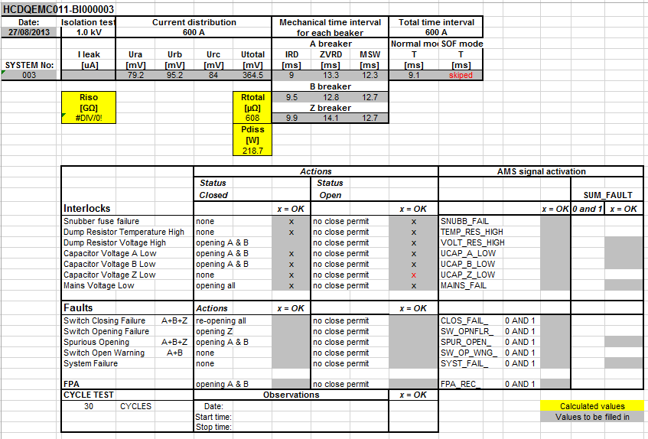
Test documentation
EDMS document – complete test programme
All results to be saved in MTF

Slide 11
Maintenance, spares
Regular maintenance programme – regularity, volume, procedure…
Regular check programme – regularity, points to checked, procedure…
Spares – XX%, availability…
Still to be determined!

Slide 12
Thanks for your attention!

