Slide 1
Software development
Control system of the new IGBT EE switch

Slide 2
Tasks of the controller
Monitoring of 32 analog channels @ 100 kS/s and triggering appropriate actions
Monitoring of 16-24 DIO and triggering appropriate actions
Controlling 8-16 DIO to achieve required actions
In case of a trigger (internal or external) recording of a PM with all AIN, DIO, internal variables
Monitoring a slow evolution of each signal with a high precision and sending to the logging DB
Not yet fully decided if one controller should be associated with one 7.5 kA branch or one 15 kA branch
→ Prototype tests will tell

Slide 3
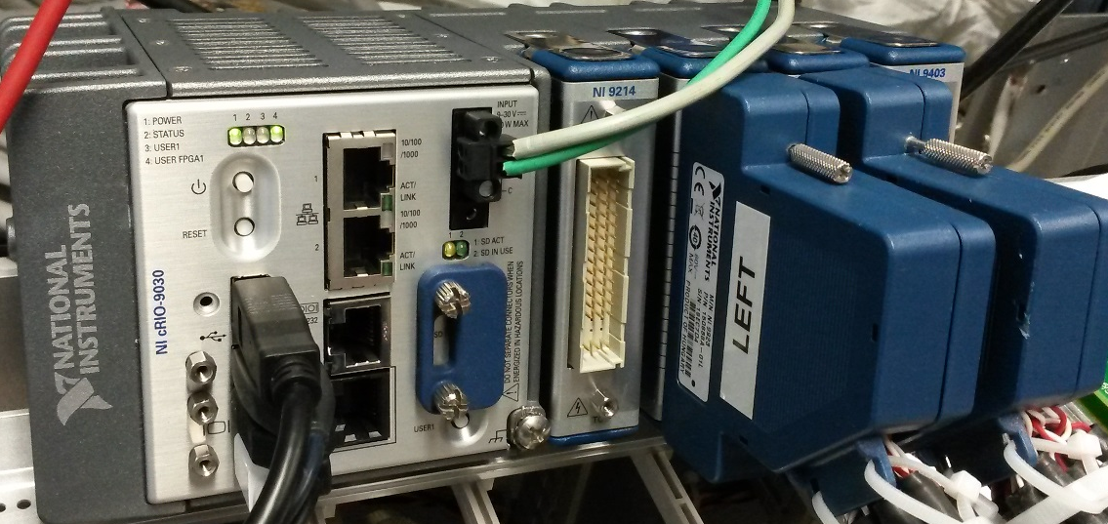
Controller
The controller is based on NI cRIO-9030
  1 GB RAM (we are very close to the limit)
  2 cores Intel Atom @1.33 GHz
  4 slots
    NI-9403 - 32 x Digital IO @ 140 kHz
    2 x NI-9220 – 2 x 16 x 16 bit analog IN @ 100 kS/s
    NI-9214 – 16 x thermocouple @68 S/s
  Powered from two redundant 24 V power supplies

Slide 4



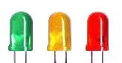

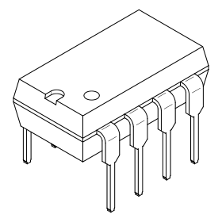

Simplified
overview
Local display
PM
Logging
cRIO
FPGA
Real Time system
PM
Expert application
Configuration settings
Analog
Digital
Technical network
Arend
SM18 PLC:
PC, QPS etc.
Power electronics
analog signal conditioning &
low level control electronics

Slide 5
FPGA and RT target roles
FPGA:
Data acquisition
Data pre-processing
Sending data to the RT target
Simple and fast fault detection
Simple data interpretation
RT target:
Reception of pre-processed data from the FPGA
Floating point maths
Complicated fault detection
Data interpretation
Communication with the external world
  Status
  Sending logging data
  Sending PM data
  Reception of software requests
Configuration storage

Slide 6
Classes of faults and events
FPA faults
PM recording
FPA Interlock loop opens (switch opens)
Can’t reclose the FPA loop
Logging stops (?)
Controller reset required
SPA faults
PM recording?
Logging stops (?)
Controller reset required
Power permit faults
No PM recording
No action at the level of the switch when it is closed
Controller reset required
External FPA request
PM recording
Not a fault (Normal operation from EE point of view)
Logging stops (?)
Controller reset required
Undefined exact
behaviour!
Undefined exact
behaviour!
Undefined fault
Conditions!
Undefined fault
Conditions!
Undefined fault
Conditions!

Slide 7
Fault detection
On FPGA – simple threshold and discrimination time evaluation
Is more complicated maths needed?
  Example:
    “if water cooling is cut off and the current is more than 50 % of nominal and temperature of heatsinks is higher than 60ºC then this is an FPA fault”
  What is the generic formula?
  How should it be defined in a config file?
  Is floating point maths needed?
Floating point calculations are done on RT and results are fed back to the FPGA for sum faults (thermocouples)
  Significant time lag in contrast with a solution implemented directly on the FPGA

Slide 8
PM data
Displayed locally if the screen is present
Displayed in the expert application available in the technical network
Stored in the binary file locally (better on an SD card?)
  There is an option not to store the file locally (flash memory with a limited number of cycles)
  Recallable using an expert application in the technical network
To be implemented: Sent to the PM central storage
Prototype tests
SM18
operation
Technical details:
Full bandwidth is stored
+-10 V range of the ADC -> resolution 305 uV
Analog and temperature signals: 500 ms pretrigger and 500 ms posttrigger
Digital signals: 1500 ms pretrigger and 500 ms posttrigger
Names can be easily assigned via a config file

Slide 9
Logging data
Status, not time critical
Displayed locally if screen is connected
Displayed in the expert application available on the technical network
  Possibility to store the data for long term trend analysis
To be implemented: Sent to the central logging database
Prototype tests
SM18
operation
Technical details:
Full bandwidth is used for analog input signals
  Averaging of 40 kS
  One point every 400 ms (refresh rate of the status loop)
  Increased accuracy vs raw signals
  On +-10 V range usable resolution is at the level of 20-50 uV
Names can be easily assigned via a config file

Slide 10

FPGA operation simplified
AIN:
Acquisition
Fault detection
Transfer to RT
Average
∑ SPA faults
Set IO bits
DIO:
Acquisition
Fault detection
Transfer to RT
∑ FPA faults
FPGA
???
Record PM and STOP
INIT
start
External FPA request
Sync
TT:
Acquisition
Transfer to RT
∑ Warnings
Delay = 100 ms
Transfer status to RT
RT:
Floating point calculations
INIT
Send PM
and STOP
RT

Slide 11
RT simplified
FPGA
IF FAULT
Data acquisition &
Scan for faults
Record PM and STOP
INIT
start
Sync
DMA data receive:
Maintain PM buffers
  AIN
  DIO
  TT
  Local variables
Floating point calculations
Complicated conditions
evaluation
INIT
start
RT
Generate PM
Send PM
STOP
UI:
Gather the status data from the FPGA
Maintain a circular buffer and display the data
Publish the data for the expert app
Collect requests and send to the FPGA
Logging:
Send data to the logging DB

Slide 12
Init procedure
TO BE TESTED!
RT reads config files
FPGA and RT get synced
  RT sends config to the FPGA and checks that it was correctly populated
FPGA resets the low-level electronics of the EE switch
FPGA starts the acquisition and fault analysis
Fault summing loop starts 100 ms later
  If there are no faults the FPA loop will be closed
  During the first ~1 ms it disregards the state of the FPA loop(s)
  The loop has sufficient time to close
  If after ~1 ms the loop is still open, it means there are external reasons
At any time later breaking FPA loop(s) or occurrence of FPA faults causes the PM to be generated
  The controller gets suspended and does not allow any operations until it is restarted

Slide 13
Configuration files
Configuration files are stored locally on RT target
At the start-up they are read out and transmitted to the FPGA
Content:
  Basic time intervals
  PM recording settings
  Names and units of measured signals
  Calibration factors: offsets and gains
  Fault detection thresholds
Format:
  .csv file for analog signals
  .csv file for digital signals
  .ini text file for other values

Slide 14
Interface with SM18
Very important to fix common signals and the exact meaning within the team and with SM18!
Need to define the behaviour of the controller in various scenarios
  Time budget
  SPA, FPA etc.
  Local/remote

Slide 15
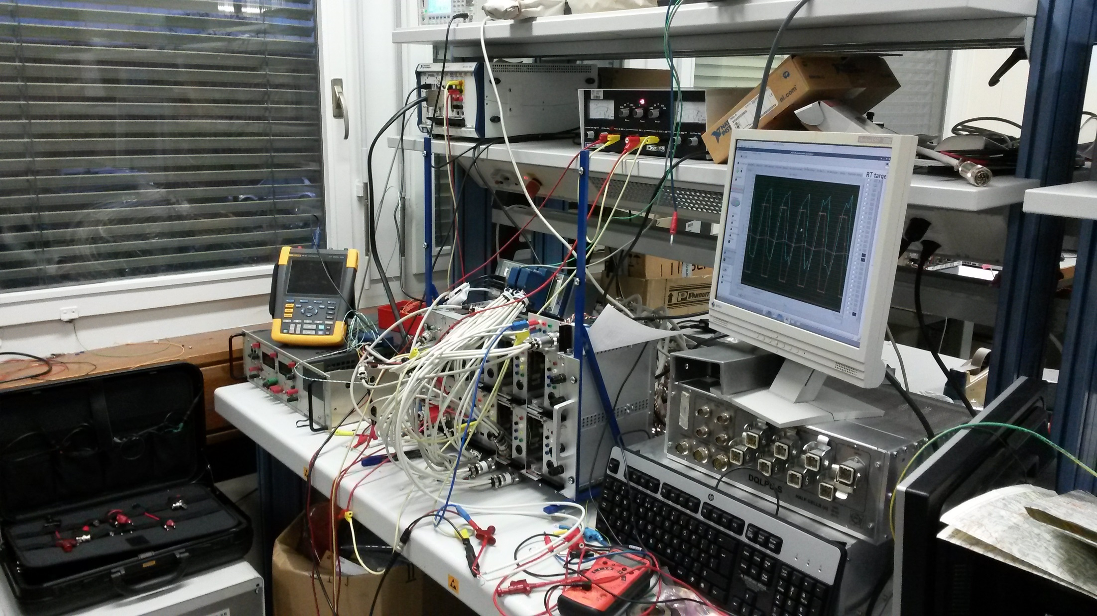
System overview

Slide 16
Conclusion
The software is almost ready
Remains
  TESTING
  Understanding the physics of the installation
  Definition of necessary features
  Definition of detailed behaviour in case of faults
  Definition of fault criteria
  Fine tuning
  Adding features needed for SM18 operation
Further development highly depends on prototype hardware progress

