Slide 2
HTCondor at CERN
Ben Jones
Barcelona 2016

Slide 3
Batch Service at CERN
Service used for both grid and local submissions, HPC on the way
Local public queue open to all CERN users
Wider range of requirements than grid submissions
Migration to HTCondor underway, majority still LSF
  Some Grid migrated to HTCondor (see Iain’s talk)

Slide 4
LSF likes/dislikes
Pros | Cons
Defined queues based on job length | Slow reconfigure to add/remove machines
Ability to backfill whilst draining | Limit of 6500 nodes
Ability to encourage shorter jobs | Slow query / submission

Slide 5
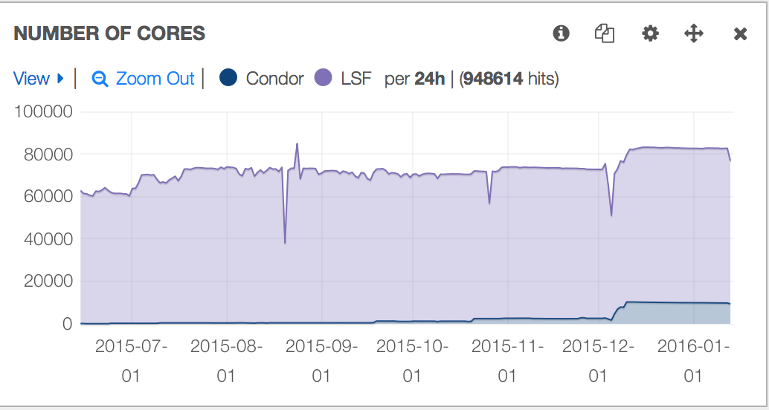
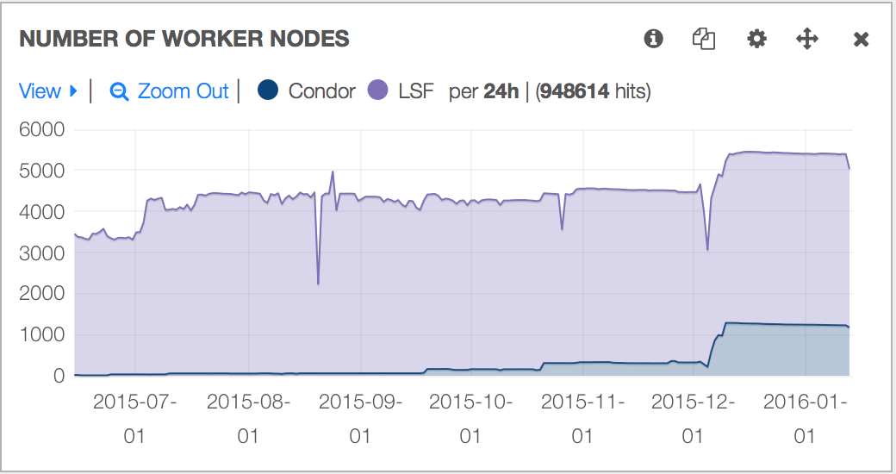
Current Capacity
~80K cores vs ~10K cores
~5.4K nodes vs ~1.4K nodes
HTCondor nodes 8 core, vs most LSF are 16 core

Slide 6
Some background
400-600K job submissions per day
~60K running jobs, ~110K pending
“local” submissions range between 40-60% of total
Primarily Vanilla Universe

Slide 7
Some background
400-600K job submissions per day
~60K running jobs, ~110K pending
  Implies around 10-15 schedds
“local” submissions range between 40-60% of total
  Local submissions less predictable
Primarily Vanilla Universe
  Planning on Docker universe
  Parallel universe to be evaluated

Slide 8
Schedds
Need to map users to schedds (currently)
Want to make it easy & cheap to query, so needs to be static assignment
Currently using zookeeper as the k/v store
  Previous experience with zk, we like the availability, has kerberos support
znode contains schedd
  /htcondor/users/$username/{current,old}
Old kept for scenarios where we migrate

Slide 9
Schedds
LOCAL_CONFIG_FILE with piped script to contact zk on submit/query for schedd
Remapping of users to schedds for failures, also to rebalance heavy users
Specific schedds for DAG
Trying to decouple use of $HOME for local batch users
  Starting to migrate away from AFS homedirs
  File stage in/out necessary for cloud resources
  May provide our own stage in/out from CEPH S3 and/or EOS

Slide 10
Kerberos
Local batch users use/expect kerberos
  Submission, authentication with other services (yes, including AFS)
Existing CERN service to renew kerberos tickets for job lifetime
Testing HTCondor integration via Credential Monitor
  Touchpoints with condor_submit, condor_credd to maintain, condor_starter to copy to sandbox

Slide 11
Accounting Group management
Preferred workflow: resource coordinator sets overall shares, experiments manage lower down
Using Group Quota tool from BNL (github.com/fubarwrangler/group-quota)
Extending to provide REST service to add/remove group membership
SUBMIT_REQUIREMENT checks if user authorized for a group

Slide 12
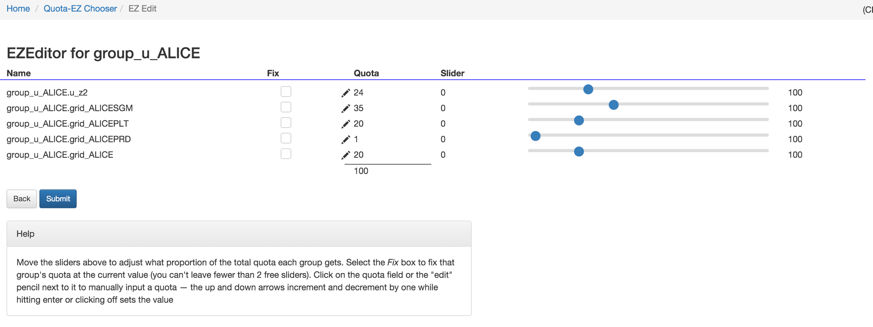
EZEditor of group

Slide 13
Jobflavours
Current LSF service has defined queues for local
  Defined as “normalised” minutes/hours/weeks
  Slot limits for individual queues (ie limit long queues)
Use SYSTEM_PERIODIC_REMOVE & Classads to achieve similar with HTCondor
Try to keep it reasonably simple for users, and easy for admins to manage

Slide 14
JobFlavours
Instead of 8nm, 1nh, 8nh, 1nw, 2nw… espresso, lunchbreak, mañana, nextweek
Either way “normalised” time is hard for users to understand (“why was my job killed?)
Job Classad for JobFeature, SYSTEM_PERIODIC_REMOVE to kill jobs over threshold
Machine Classad for which JobFlavours to accept

Slide 15
Espresso JobFlavour eg
## Espresso Definitions
# Remove espresso jobs after 600 seconds wallclock
Remove_Espresso_WallClock = ((JobFlavour =?= "espresso") && (RemoteWallClockTime >= 600))
# Remove espresso jobs after 500MB Resident Set Size used
Remove_Espresso_RSS = ((JobFlavour =?= "espresso") && (ResidentSetSize >= 488281))
# Combine Expressions
Remove_Espresso_Constraints = $(Remove_Espresso_WallClock) || $(Remove_Espresso_RSS)
SYSTEM_PERIODIC_REMOVE = $(Remove_Espresso_Constraints)

Slide 16
Draining with backfill
Necessary when deleting / rebooting worker nodes
Whilst waiting for long jobs to finish, backfill with shorter jobs
BackfillDraining = False
UnixShutdownTime = 0
STARTD_ATTRS = $(STARTD_ATTRS), BackfillDraining, UnixShutdownTime
STARTD.SETTABLE_ATTRS_ADMINISTRATOR = $(STARTD.SETTABLE_ATTRS_ADMINISTRATOR), BackfillDraining, UnixShutdownTime
ENABLE_PERSISTENT_CONFIG = TRUE
PERSISTENT_CONFIG_DIR = /etc/condor/persistent
START = $(START) && ((BackfillDraining =?= False) || (BackfillDraining =?= True && (time() + ExpectedJobTime) <= UnixShutdownTime))

Slide 17

Docker
Some user enquiries already
Nascent CERN registry
  docker.cern.ch
Plan to use docker universe when some CentOS 7 worker nodes
Possible extra tool for heterogeneous worker pools (alongside compat)

