Slide 1
GRIF: site report
CREAM-CE/HTCondor site

Slide 2
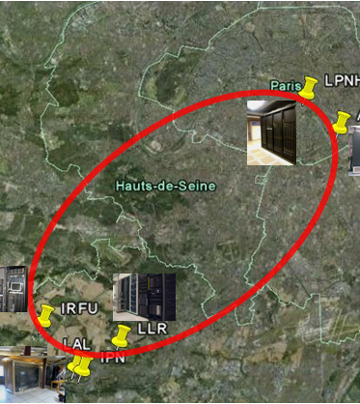
What’s GRIF ?
A distributed grid site mainly for LHC experiences (started 2005)
  6 labs around Paris
  ~ 7PB
  ~ 15k logical core
Goal
  Be seen and used as a unique site
  Create 1 tech. Team distributed on labs

Slide 3
HTCondor @GRIF
3 sub-sites leads the migration to HTCondor
  Due to scalability issue on some site
  Better multicore support
  Leak of support on some historical component (maui)
Migration started on July 2014
  One ARC-CE/HTCondor for multicore support
  2 other sub-site chose to keep CREAM-CE and HTCondor as batch system (January 2015)

Slide 4
Why CREAM-CE ?
We support a lot of differents VO
  Not want to do some validation stuff for VO frontend
We know the CREAM-CE so easiest for us to understand where the problem is
We were happy with CREAM-CE

Slide 5
CREAM-CE/HTCondor
Stuff are implemented on CREAM-CE since a long time
  95% of the job was done
  But since now no sites were use it
    Some stuff were broken
    Some stuff missed
  But a shell script can be put by site between CREAM-CE and HTCondor schedd
    /usr/libexec/condor_local_submit_attributes.sh

Slide 6
Queue vs ClassAd
CREAM-CE is based on Queue
  But it use queue only as a endpoint
    No need to linked it with anything behind
What we want to do with queue
  Mainly apply some policy to a queue (multicore / long-time job/ short-time job / …)
    Put a ClassAd to specify which queue was used

Slide 7
Scheduling policy
Main idea of our grid site is
  You have a priority to access to X% of our cluster
  But you can have more if available
  And we ensure your job will run up to 72H
This is what you can do with
  Dynamic quota (based on accounting_group)
  Accept_surplus & autoregroup
  Preempting should not be enabled

Slide 8
Hierarchic Fair Share
A VO request since a long time
  Could you have 50% of my fair share dedicated to analysis
  And 50% to production
On CREAM-CE side we create one queue per activities
  And put the right accounting_group information on submit config

Slide 9
Group assignment
Key point of scheduling policy
  No way provide by CREAM-CE out-of-the-box
But shell script have access to user proxy
  So we can compute vo name and role
  Associate it to a group and or subgroup
Shell script also have access to CREAM queue name
  So we can use it for subgroup instead of role

Slide 10
Multicore support
Some VO want to use multicore job
  Based on the agreement that 1 multicore job will take 8 cores
We just put all our slot as partitionable
  But hardest to monitor the effective usage of our cluster as HTCondor provide a job based view

Slide 11
Single / Multicore
For fair share we create a new subgroup ‘multicore’
  With it s own quota
To avoid infinite idle job we active DEFRAG
  Based on the idea that drain stop when 8 core is available (thx Andrew from RAL)
  But no dynamic configuration modification (DrainBoss)

Slide 12
Partitionable slot and BDII
A BDII is a information system database
  Regroup all information about your site
  Based on a script that run on your CREAM-CE
But as CREAM-CE/HTCondor BDII plugin not supported partitionable slot
  We re-write it in python with HTCondor python bindings

Slide 13
Accounting in HTCondor
Based on work done @RAL
We convert HTCondor history to PBS accounting log
  And push it on national accounting as a classic CREAM-CE / Torque cluster

Slide 14
1 year production
No big issue
No regrets
But…

Slide 15
Job HELD
Some job go HELD
  CREAM-CE submit the job but user proxy is not available on CREAM sandbox
  It was a pure CREAM-CE issue
  Was very easy to debug
    HELD message was clear (file missing)

Slide 16
Accountantnew.log corruption
Just trigged last week
When CREAM-CE is overloaded, shell script raise « Java out of memory .. » exception
  Lot of space on error message
  But not catch by our script that pass the message as a group name
  On restart Negiciator complains that accountantnew.log is corrupt

Slide 17
Future plans
HTCondor CE
  CREAM-CE is now our bottleneck
  1 middleware
Create 1 GRIF HTCondor pool
  1 CE (submitter) per site
  H.A Central Manager
  Each worker node available for every CE
    Probably add some ClassAd (WorkerLocation) to allow Ranking

