Slide 1
Piquet & Best effort
Christmas break 2015 / 2016

Slide 2
Systems monitored by TI
Cooling, electricity, safety systems, access system, IT network.
We are happy to help out monitoring other systems!
Notes:
We will be present 24/7 during the christmas break. It makes more sense to say what systems we do monitor.

Slide 3
Systems not monitored by TI
Vacuum | Piquet but no alarms to TI
RF | No piquet, and no alarms in TI
Power converters | Best effort, no alarms in TI
QPS | Magnets off
Collimation, injection, beam dumps, beam instrumentation | No piquet, no monitoring
Controls for accelerators | Best effort

Slide 4
Machines status
LHC All circuits OFF
SPS OFF
PS OFF
Booster OFF
Isolde Water & Power OFF
AD OFF
CTF3 OFF

Slide 5
CRYO – With helium in magnets 3K
Automatic calls, backed up by TI
Rounds several days per week
Piquet & best effort CRYO – No shift
Depend on services: IT, VACUUM, EN-EL, EN-ICE, EN-CV, BE-CO (Word fip)

Slide 6
EN-CV
Interventions planned during closure
Maintenance works on surface CPS, SPS and LHC
Operation works (for example: emptying cooling towers of point 18 )
Pipework modifications for the upgrade of SM18
Piquet
6 persons in standby duty level 1 + one person in level 2
For old control system: best effort
For UNICOS new control system : piquet ICE
SIG standby services will remain (leaks on pipework, pumping station, ..)

Slide 7
EN-EL
Piquet EL-OP Operating network
Piquet EL-CO Controls system
Best effort for experts
Piquet Schneider, APC, diesels, etc.

Slide 8
Others
TE-VSC Piquet + best effort
EN-ICE Piquet + best effort
GS-ASE Piquet (Access, safety, TIM)
GS-SE Piquet
BE-CO Best effort + Piquet Worldfip
IT
RP Piquet
EN-HE Piquet snow, lifts, transport + Best effort
BE-OP Group leaders and machine representatives available if needed

Slide 9
Access during Christmas break
Access given by TI operator
PS Access possible, RP needed
LHC Access possible, RP if required
SPS Access possible, RP if required

Slide 10
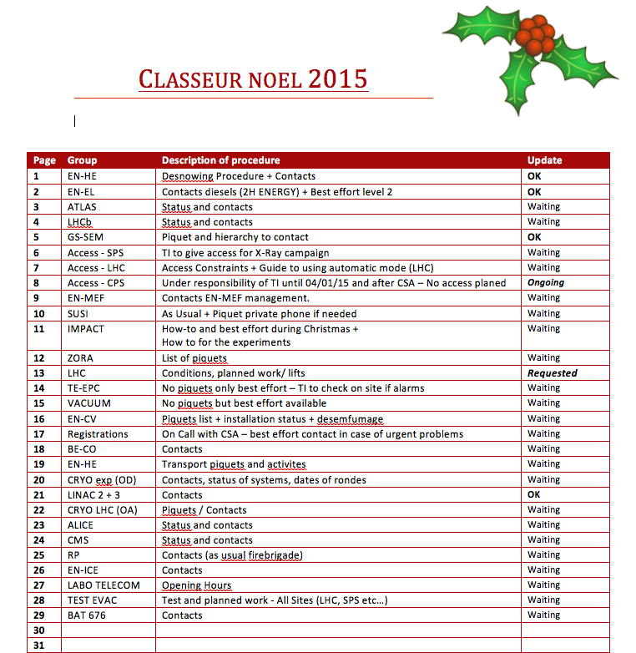
Any other special procedures?
Please send them to
tiop@cern.ch

