Slide 1
Shunt-LDO Regulator in C65nm
simulation results, status & plans
Michael Karagounis
RD53 Serial Powering Meeting
10th Dec 2015

Slide 2
Status
All regulator components ready in schematic and layout (amplifier, shunt circuitry, biasing)
  high voltage tolerant bandgap reference missing
Top Level Layout finished in schematic and layout
  Simulation of full extracted netlist ongoing
Submission has been canceled
Time for modifications
  Implement distributed input/output pad structure (distributed pass/shunt transistors)
  Adapt existing bandgap reference to have high voltage tolerance
  Configurable shunt current → configurable resistance value R3

Slide 3
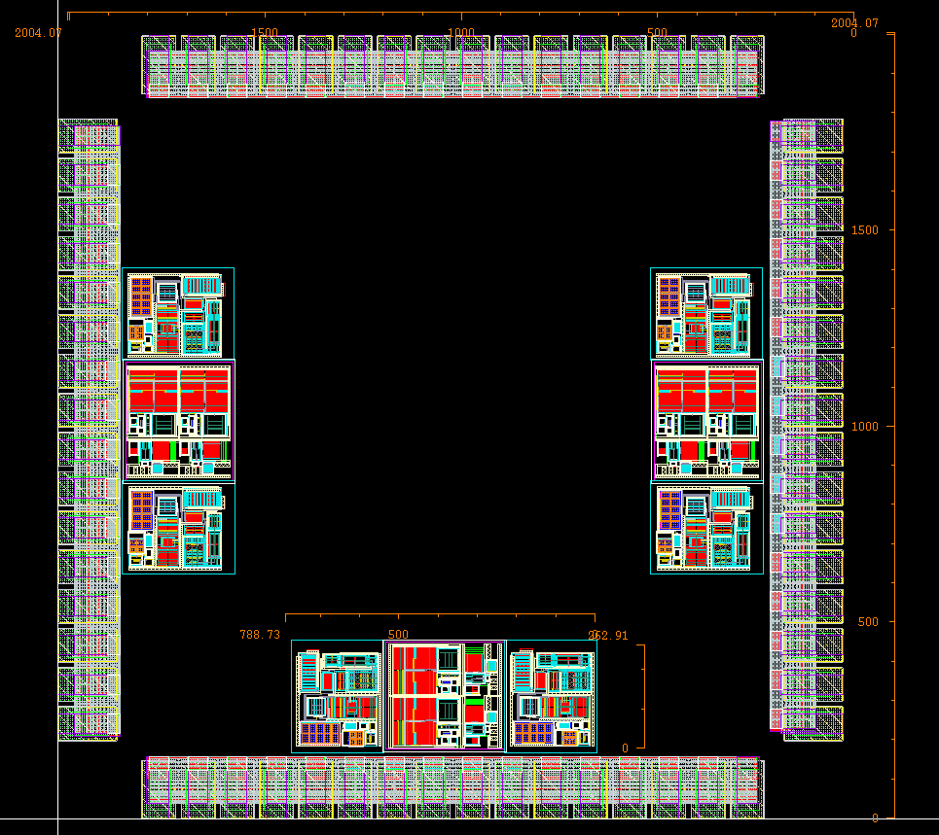
Chip Layout (shown without top level wiring)
Testchip – Size
2 mm x 2 mm
Testchip - Content
3 regulator incl. biasing
Pad – Count
4 x 16 with 100 µm pitch
Area per Regulator:
800 µm x 400 µm
Pads per Regulator:
5 x input current
5 x shunt current
5 x output voltage
1 x reference voltage
1 x biaising voltage
1 x internal resistor con.
1 x external resistor con.
1 x shunt-circuitry supply

