Slide 1


Glasgow multi-module
update
10/12/15

Slide 2
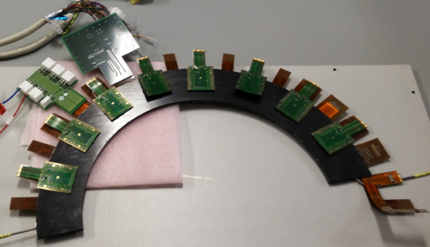
Goals
Readout of a pixel ring with electrical modules
Prototype testing for ring loading
Test bed
  noise studies
  grounding and shielding
  Serial powering
  Multiplexing
  Thermal loading
  DCS and DAQ developments
Implement single framework to run as much software as possible (SCTDAQ)

Slide 3
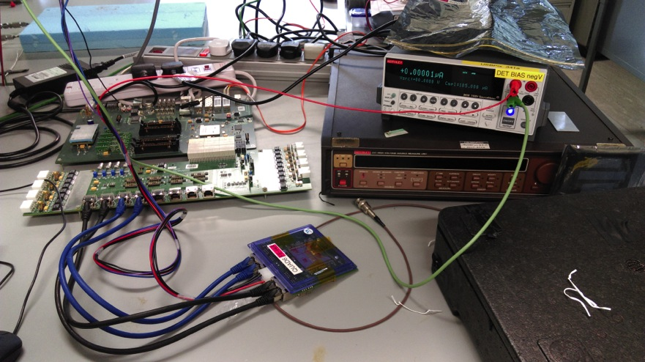
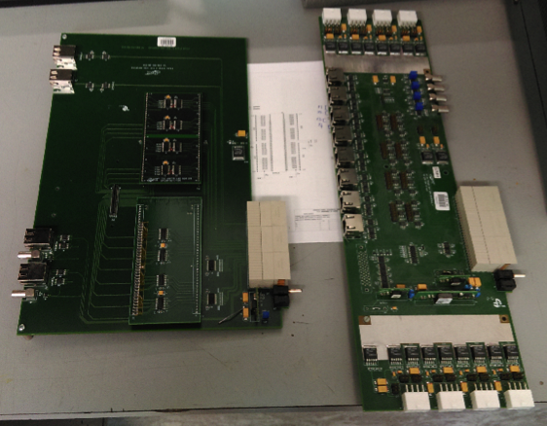
Previous DAQ
Version 1 RCE board (2 shelf ATCA crate with switch): 2 RCEs
HSIO board
Cosmic board for module lab tests and tuning:
  8 RJ45 ports available

Slide 4
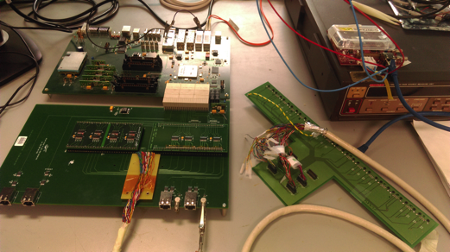
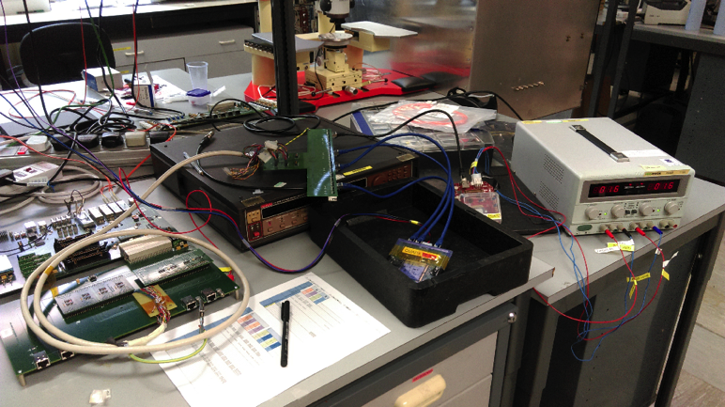
Serialising steps
Increase capacity for modules
Modules adapted for AC
clk & cmd AC signals
ME firmware
Serial powering for
multiple chips
GLIB for (de-)MUXing

Slide 5
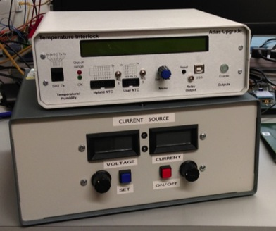
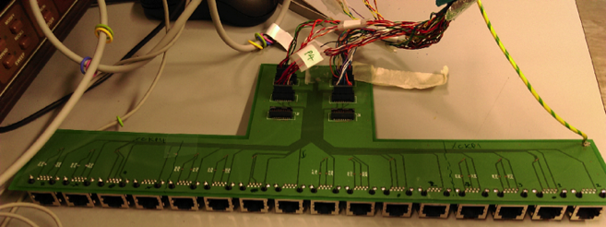
Current Multi-module kit
Serial PS: controllable by SCTDAQ
code
Cambridge interlock board: interlock
& NTC
V1 RCE board (2 shelf ATCA crate & switch): 2 RCEs
IBL interface board: 16 chips (4quads) possible
HSIO firmware update: ME encoding
Installing second set → 8 quads capacity
Breakout board: 16 modules
via RJ45s

Slide 6
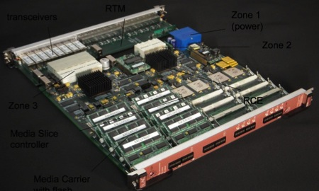
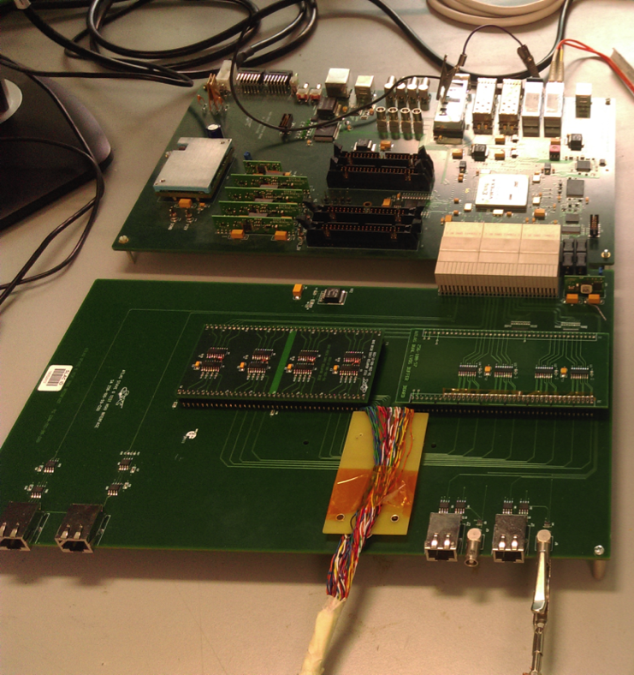

V1 RCE board (2 shelf ATCA crate & switch): 2 RCEs
HSIO Power
Optical connection to RCE
Connection to IBL
clk&cmd mezzanine
Two clks & cmds per IC
Data mezzanine
Four data per IC
100 pin Samtec connector
16 RJ45 breakout board

Slide 7
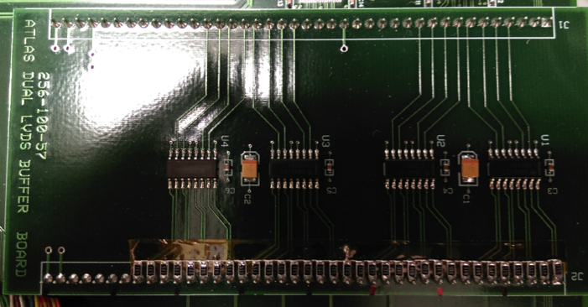
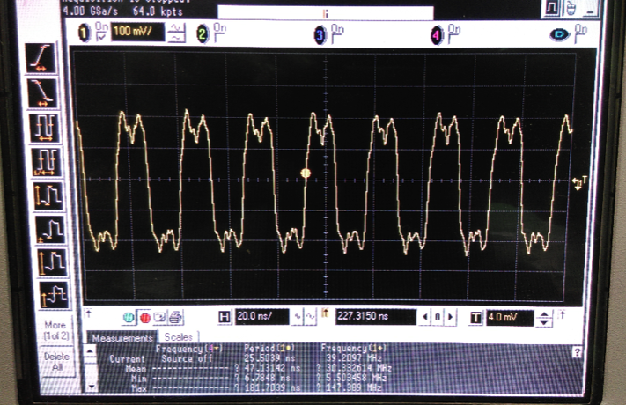
Signal
Previous firmware version (HsioStave0_00000003_el.mcs) could see signal across mezzanine
Trigger with signal peaks
“Manchester encoded” firmware (HsioStave0_00000008_nonrot_me.mcs)
Need to review ME signal
  Software alteration for probe
See LV current vary with signal

Slide 8
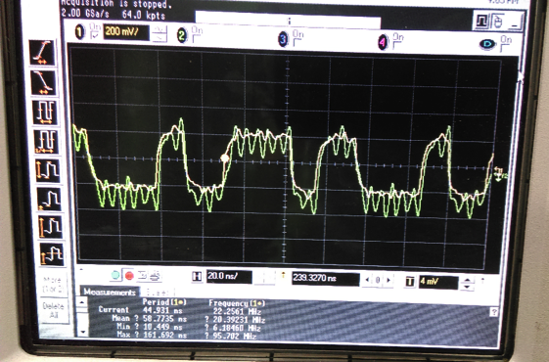
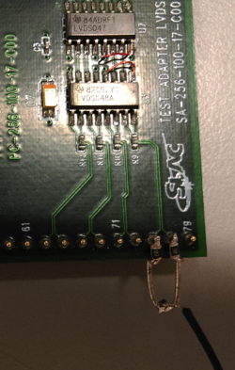
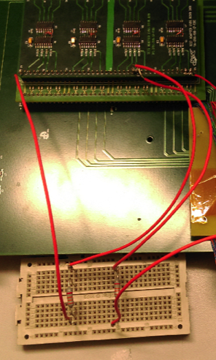
AC Data
Additional mezzanine with transmitter/receiver capacitors added
See data cross capacitors (green transmitter, yellow receiver)
Extra grounding required on receiver side before IC accept data
Simple: connect each differential pin to ground via 10kΩ
Failsafe: connect one pin to 3.3V via 33kΩ, and other to ground, via 33kΩ
Scans complete for both schemes!
failsafe
simple

Slide 9
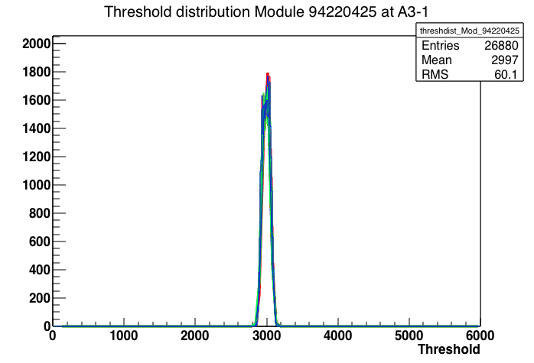
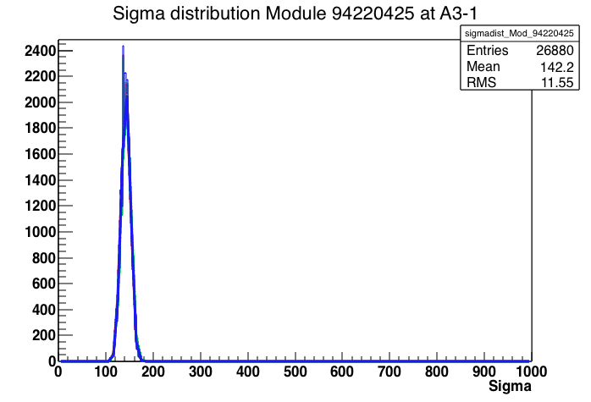
Data check
Compare previous firmware THL scan (blue) with simple grounding (red) and failsafe grounding (green)
Single FEI4b chip with 100V bias
Grounding schemes are equivalent and agree with previous firmware
Have functioning ME cmd, AC coupled data multi-module set-up
3000THL
8Tot@20ke

Slide 10
Powering & Cooling
Using shunt LDO powering of FEI4 test chips
Only digital LV used to power chip
Added capacitors to clk&cmd on chip for serial supply
Successful digital and analog test scans using sLDO powering with constant current supply
Beginning to bring together system infrastructure
ring, CO2 cooling & cold box

Slide 11
Summary & next
Have capacity for ≥8quads: current capacity is 4 quads
Functioning ME cmd, AC coupled data multi-module set-up
Basic DAQ chain works
Read out adapted sensors with constant current supply
Next
Build up module power supply chain
Implement DCS
(further) Expand system to 32 chip capacity

