Slide 2
WLCG Data Management Coordination Proposal
Oliver Keeble

Slide 3
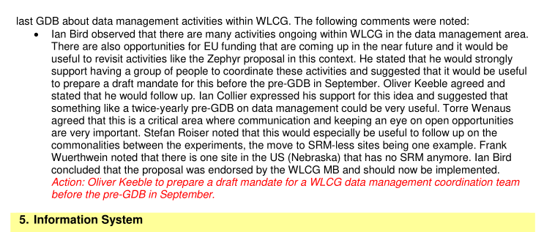
From the July WLCG MB

Slide 4
Proposal
A proposal was discussed at the data pre-GDB last Tuesday (Sep 13th)
  https://indico.cern.ch/event/394833/
Then presented at the subsequent GDB

Slide 5
Proposal
A data steering group is created
  One person per experiment, storage provider, 2 or 3 for infrastructure (plus backups)
  The representatives understand they are undertaking a WLCG responsibility
  Would probably need a chair, or two co-chairs.
  No limit on group lifetime
This steering group
  Defines long term WLCG strategy for data management
  Tracks relevant technical themes
  Meets regularly to define priorities
And on that basis oversees
  A pre-GDB slot every N months, which should be confirmed 2 months before. Focussing on medium term developments.
  Triggering of task forces if necessary
  WLCG data discussions in other forums, e.g. the WLCG Workshop data session
  Creation of an open wlcg-data-management@cern.ch list
  Reporting to WLCG ops meeting where requested.
  Escalation and reporting to MB
  Representation of WLCG interests beyond the community
The steering group is not itself a decision-making body

