Slide 1

WLCG and support for
IPv6-only CPU – update
David Kelsey (STFC-RAL)
WLCG MB, CERN
20 Sep 2016

Slide 2
Outline
Reminder - plans presented to June 2016 GDB and July 2016 Management Board
News since July
  LHCOPN/LHCONE
  Dual-stack perfSONAR
  Tier 1 Summary (ATLAS)
Plans clarified
  Presented and discussed at GDB 14 Sep 2016
  Today seeking approval for the plan
    to keep up momentum

Slide 6
WLCG MB – 19 July 2016
Some concerns about the aggressiveness of the plan
  E.g. implications on CERN Tier 0 storage operations
the real target is to have a reasonable fraction of services on IPv6 by LS2
  but we need a fairly aggressive schedule to get there
Action on the Tier0 and the Tier1 sites to analyse the implications of the document, to be ready for discussion at the next MB

Slide 7
News since July 2016

Slide 8
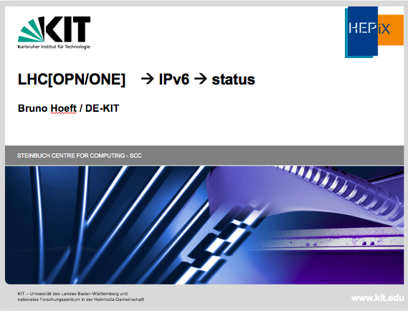
Some slides shown at LHCOPN meeting (Helsinki) 19 Sep 2016

Slide 9
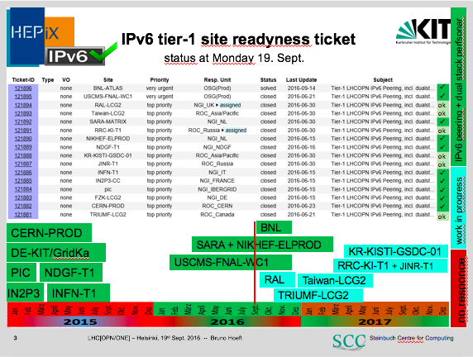

Slide 10
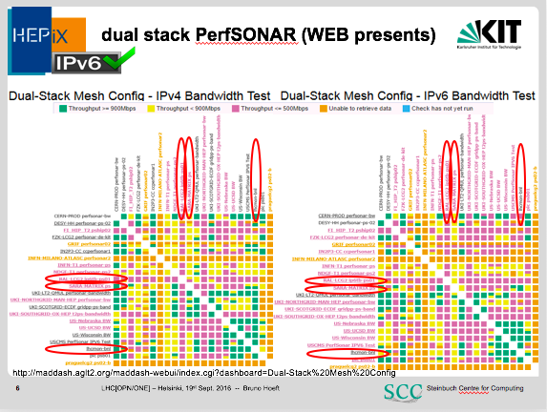

Slide 11
HEPiX IPv6 WG F2F
HEPiX IPv6 Working Group F2F meeting
At CERN on 6/7 September 2016
  http://indico.cern.ch/event/561262/
Feedback from Tier 0/1 since MB in July
    No complaints
    Reporting good progress in some cases
    CERN, CNAF and RAL now more engaged with the working group

Slide 12
Tier 1 summary (ATLAS)
NDGF-T1: Happy with the IPv6 only CPU proposal and have already met dual stack requirements. The dCache storage and some of the computing resources are already dual stack.
PIC: Happy with the IPv6 only CPU proposal and have already met dual stack requirements. Their dCache storage has been dual stack since April 2016. Performance is at the same level or better than via IPv4.
IN2P3: In good shape to be able to provide the dual stack storage services according to the proposed time line.
RAL: Happy with the IPv6 only CPU proposal. The IPv6 testbed should meet be requirements of the April 1st 2017 deadline. RAL are working on providing production quality endpoints significantly before the April 2018 deadline.
Triumf: Deployed IPv6 in September 2016. Currently running just perfSonar dual stack box. Currently working on an IPv6 deployment timeline, so unable to comment on if they will meet deadlines.
SARA-MATRIX: In process of preparing for data centre move in October 2016. They will look into it after this.
FZK: No official feedback. GGUS ticket is marked as in progress. Bruno Heft is active member of HEPiX IPv6 working group.
Taiwan-LCG2: No official feedback. GGUS ticket is marked as in progress.
RRC-KI-T1: No official feedback. GGUS ticket is marked as in progress.
NFN-T1: No official feedback. No response to GGUS ticket.
NIKHEF-ELPROD: No official feedback. No response to GGUS ticket.
BNL: No official feedback. No response to GGUS ticket.

Slide 13
Other news
BNL now peering IPv6 over LHCOPN
FNAL reports (to CMS) progress to dual-stack storage
Dual-stack perfSONAR – new sites
  BNL
  RAL
  TRIUMF

Slide 14
Clarification of IPv6-only paper
Comments on Executive Summary
  Tier 1s “required” to provide dual-stack storage
  Not necessarily all storage and can be via testbed and/or dual-stack gateway (with reduced performance/reliability) for 1st year
  Discussions with Tier 0 and CERN storage
  Reminder – any site using pledged IPV6-only resources needs to discuss/agree with working group and VO to check workflow proposed (e.g. not ALICE)
To achieve a significant IPv6-capability by LS2 we need to keep up the momentum
  We must encourage the Tier 2s more
  We still ask for MB approval of the April 2017 date!

Slide 15
Questions?

