Slide 1
LIU Beam Parameter Working Group
Meeting #1: Ion parameter table
    Outline:
    Where we are standing
    What we need to do (still in 2015)

Slide 2
Ions: parameter tables
Three main sources at the present stage:
  EDMS document 1533832, not yet released but circulated for some time as LIU counterpart of J. Jowett’s document with the HL-LHC specifications (J. Jowett et al., HL-LHC heavy-ion beam parameters at LHC injection, EDMS 1525065). This only gives the beam parameters at the SPS extraction and not throughout the chain
  Table in the draft ion TDR
  Table from M. Bodendorfer (EDMS 1420286, 2014), in which he tried to collect all the numbers from the different machines and compare “Achieved” values with “LIU achievable” values
Notes:
Main problems: numbers are not always consistent between different sources and assumptions are not specified anywhere

Slide 3
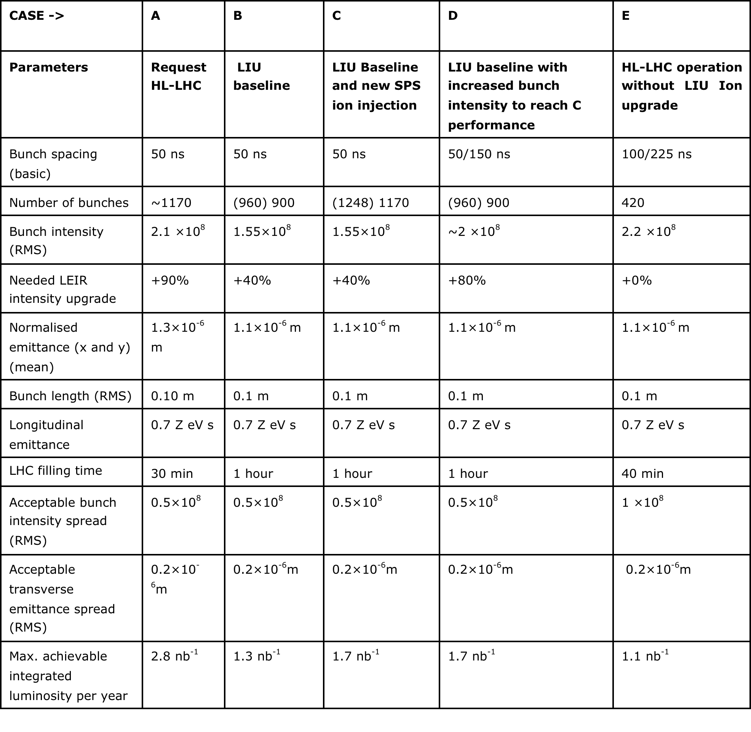
Ions: parameter tables
EDMS document 1533832, under discussion
Notes:
Assumption of 300 ns between trains in the SPS (250 ns would already give 1008 bunches in LHC)
+40% in LEIR is just an assumption ….
Achieved parameters are not consistent with those quoted elsewhere (usually 1.4e8 ions/bunch within 1.2 um). Even if these are the max values (inconsistent with row label), still incosistent with plots from Michaela and John in TDR

Slide 4
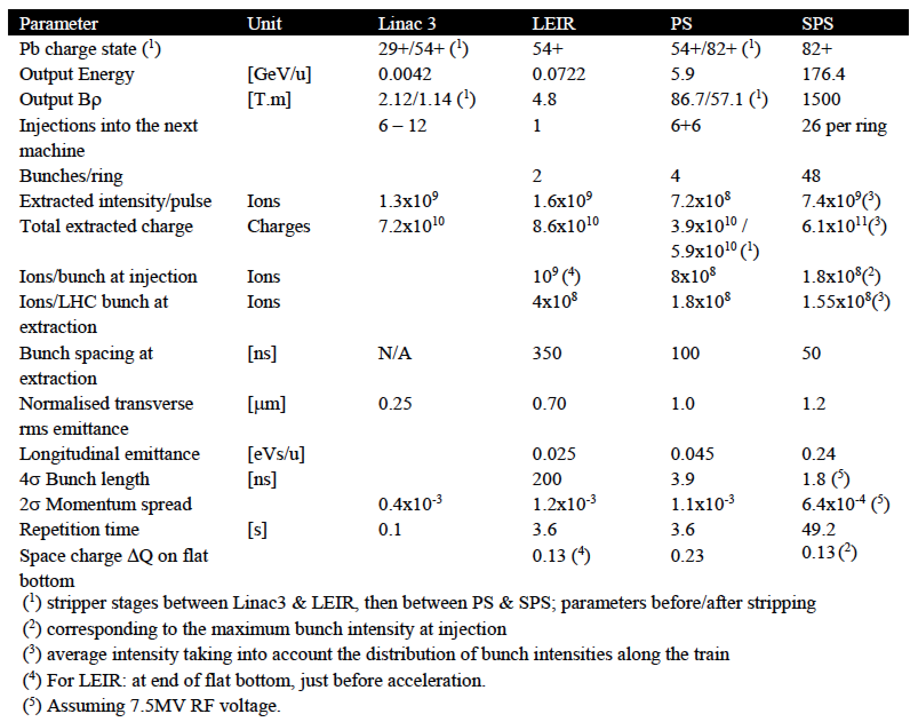
Ions: parameter tables
Draft TDR, under check
How much is lost in the PS??
Notes:
>50% losses in the PS ???

Slide 5
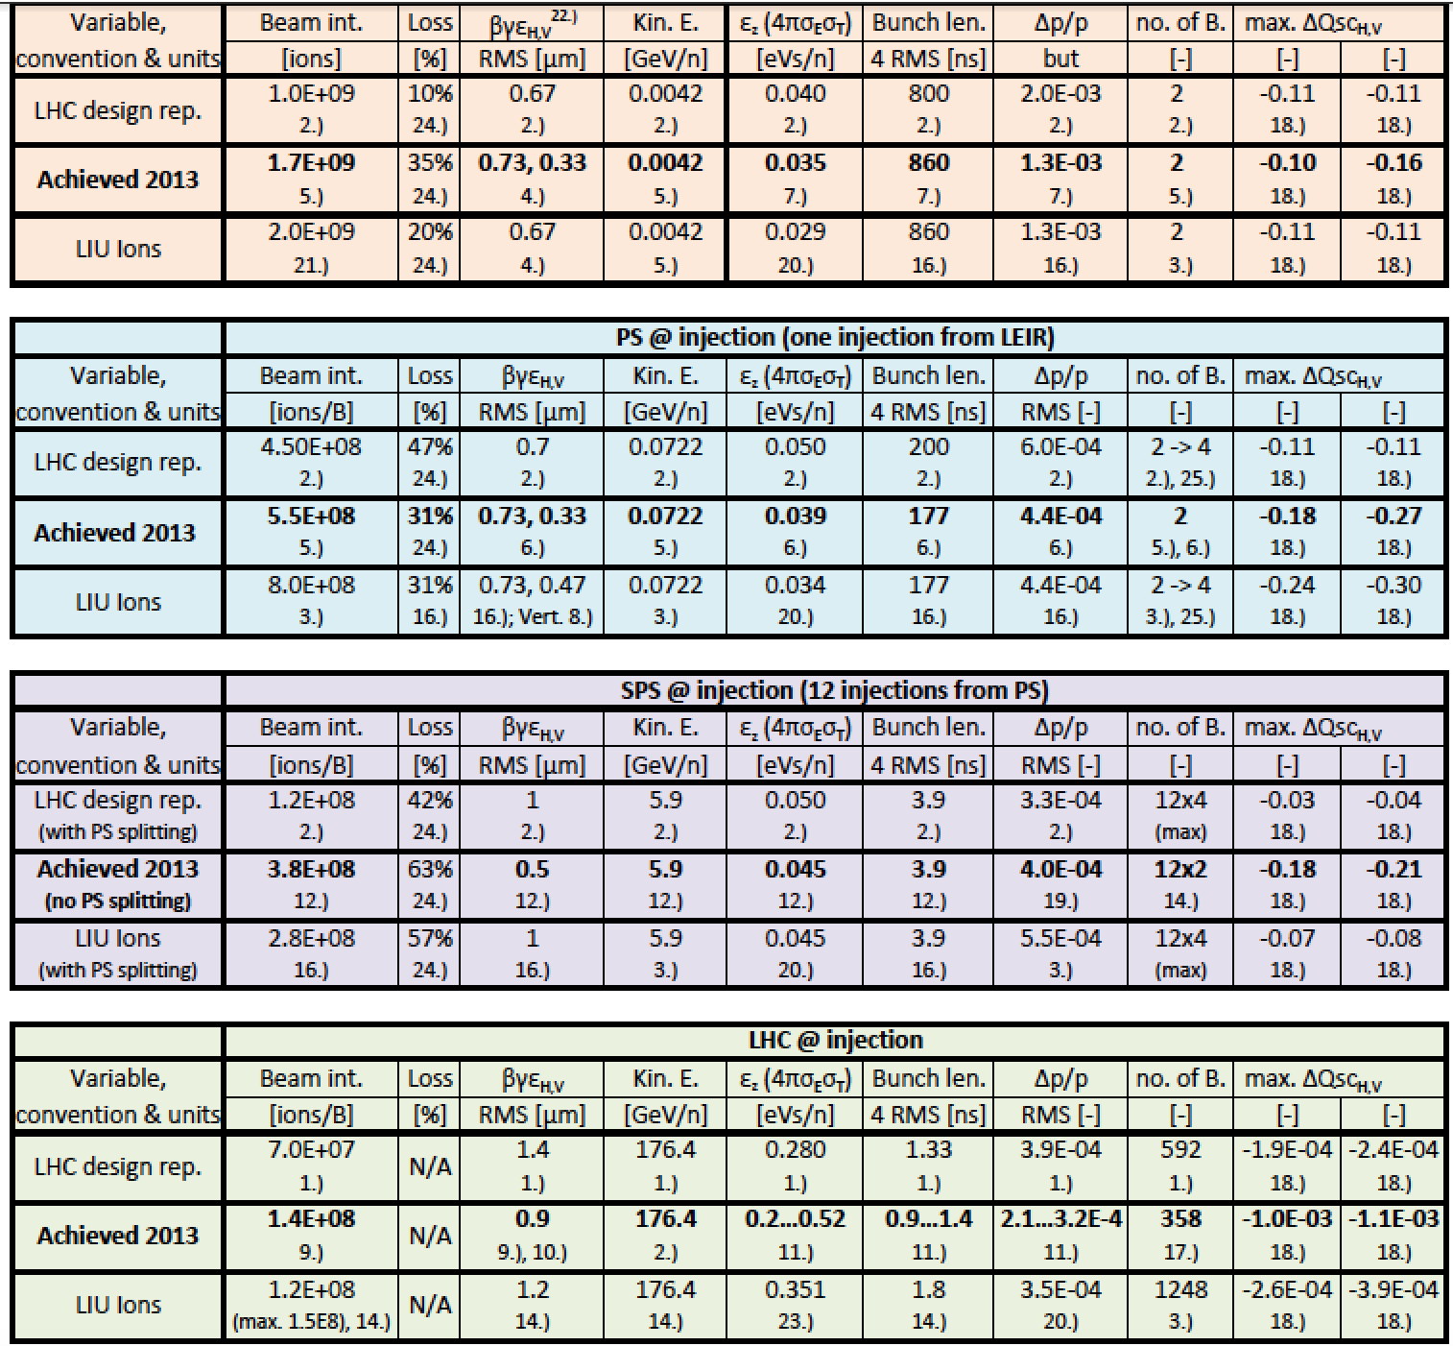
Ions: parameter tables
M. Bodendorfer, 2014
EDMS 1420286
How much is lost in the PS??
Notes:
Achieved numbers are considered here as “best performance” but there is no logical propagation of the parameters through the table
Again assumptions on improvement with respect to “achieved” and loss/emittance growth budgets quite unclear

Slide 6
Ions: parameter tables
What we need to do:
  Build a consistent “Achieved” table based on 2015 measurements throughout the chain (with present loss and emittance growth –where measurable)
  Build the baseline LIU scenario by fixing the assumptions (again based on 2015 experience for loss/emittance growth budgets, but also for the projected performances of LEIR/PS/SPS) to propagate parameters through accelerators
  Iterate with John for the assumptions he uses in his model related to the injectors (ex. shape of the trains from SPS, emittance spread, number of bunches per PS-SPS and SPS-LHC transfer)
Notes:
Main problems: numbers are not always consistent between different sources and assumptions are not specified anywhere

