Slide 1
GridPix: integrated Timepix chips with a Micromegas mesh
P. Colas
The digital TPC:
the ultimate resolution

Slide 2
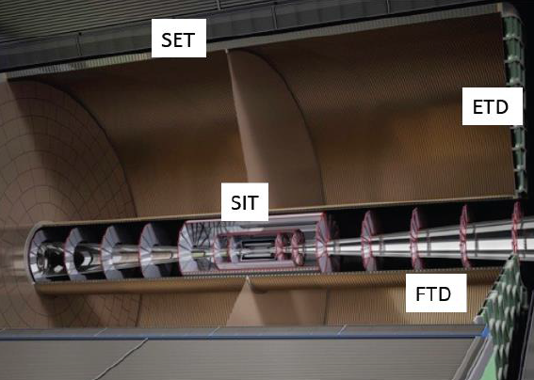
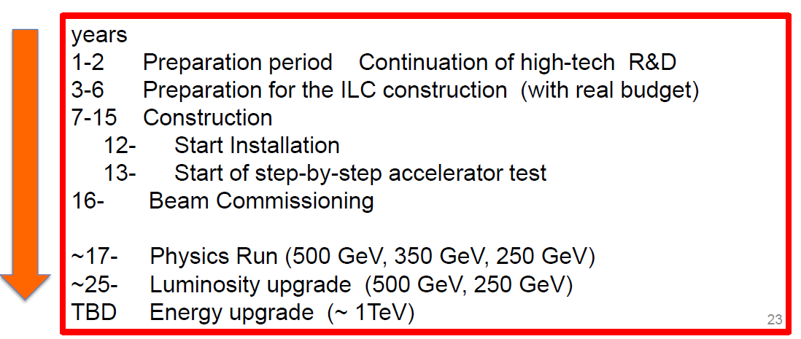
ILD Tracking:
Vertex detector
TPC
Silicon →
Magnet
We now have a realistic (though unofficial) estimate of the ILC schedule (S. Komamiya, Lepton-photon 2015) :
Start
2016? 2018?
2033 ?

Slide 3
t0 = Ground Breaking
2033?
After Y. Sugimoto
The yoke and the solenoid have to be assembled on surface site very early (start Y3)
The remaining of the tracker is for end of Y8

Slide 4
Detectors using TimePix chip
Solid-state detector
Gaseous detector
Drift grid
x, y, z(t), E(x,y) → 3D
x, y, F(x, y) → 2D
X-ray source
Ionizing
particle
Gas volume
+
-
Semiconductor
sensor
Flip-chip
bump bonding
connections
Single pixel
readout cell
+
Amplification System (MPGD)
+
-
-
Medipix2/TimePix chip
TimePix chip

Slide 5
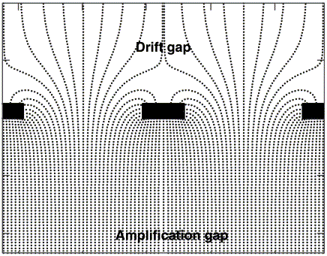
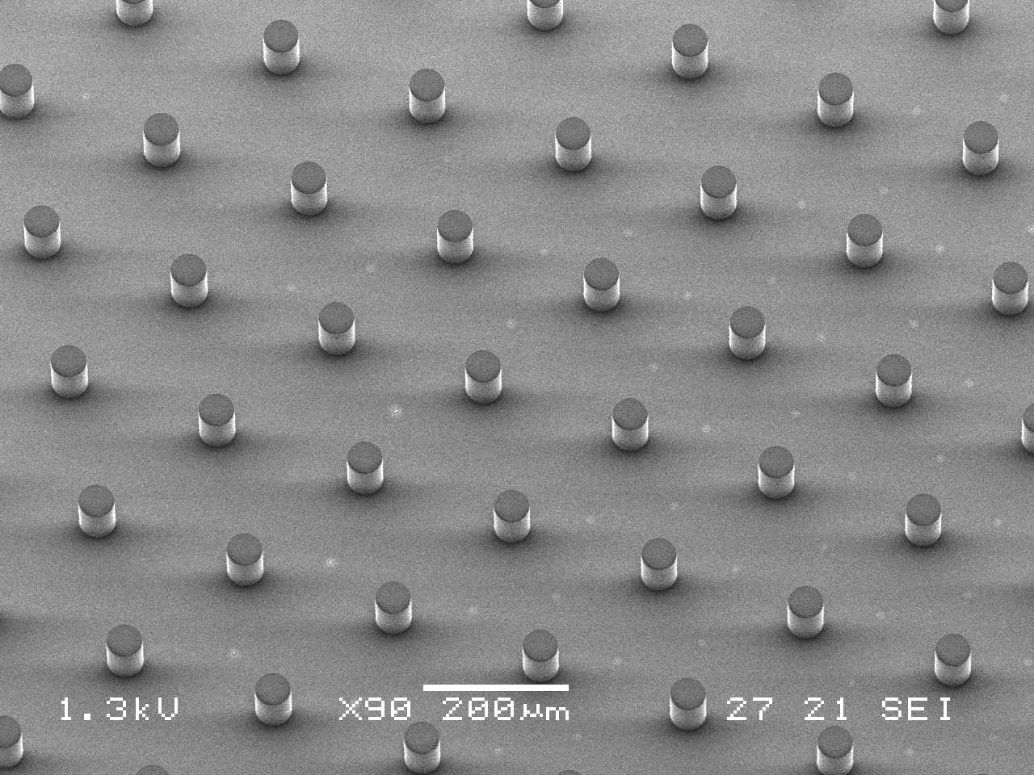
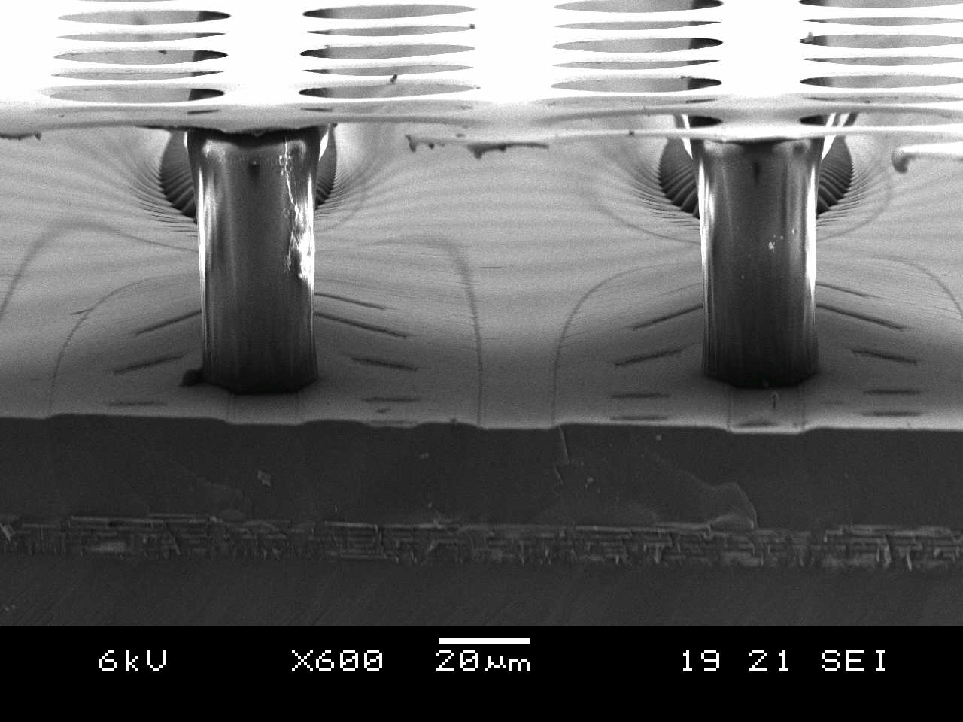
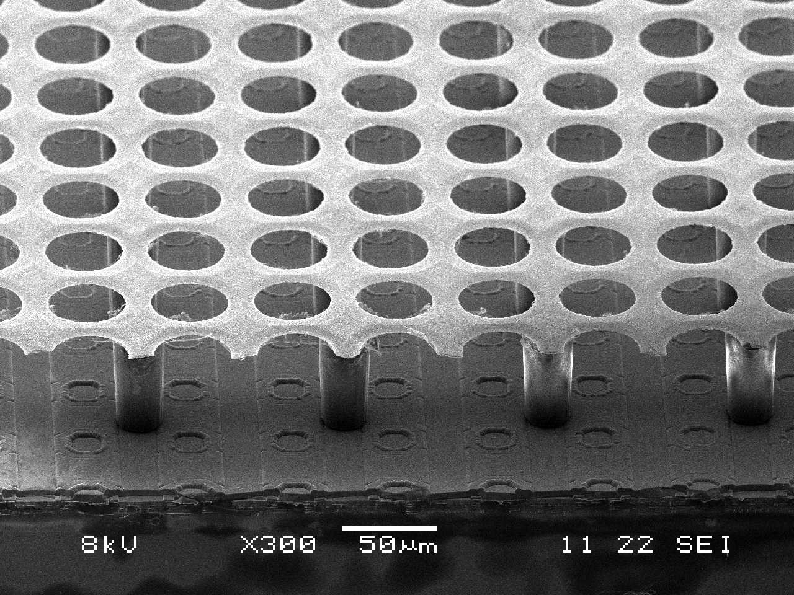
InGrid: Integrated Micromegas Grid
Micromegas is a Micro Pattern Gas Detector formed by
a metallic micromesh
sustained by 50μm pillars above the anode
Multiplication between anode and mesh
avalanche
~ 80 kV/cm
Integrate Micromegas detector directly on a CMOS chip by post-processing
Resistive layer for protection
IMT Neuchatel
NIKHEF
(MESA+,
Univ. Twente)

Slide 6
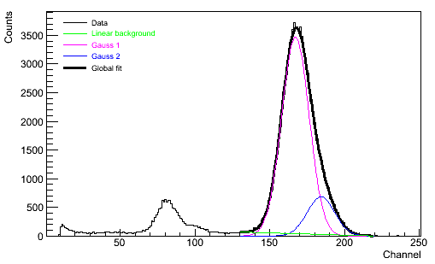
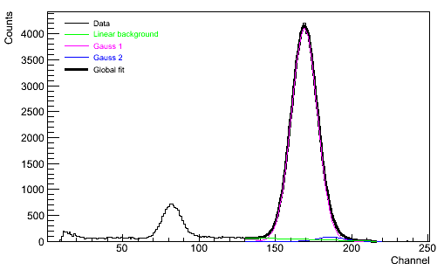
InGrid: energy resolution
Energy resolution depends on the
grid geometry
Grids can be very flat
  best resolution:
  13.6 % FWHM with ⁵⁵Fe source in P10
  removal of K_{β} 6.5 keV line:
  11.7 % @ 5.9 keV in P10
Hole pitch down to 14 μm
with various diameters
Different gaps (35-75 μm)
Until now: grid is 1 μm of thin Al
but can also be increased to 5 μm by electrolysis to be more robust
Escape peak K_{α}
13.6 % FWHM
Escape peak K_{β}
Gap: 50 μm; Hole picth: 32 μm,Ø: 14 μm
11.7% FWHM
Kβ-filtered spectrum with Cr foil

Slide 7
The TimePix chip
Starting from the Medipix2 chip, modify to replace photon counting by time counting (clock on each pixel)
(PC, H. van der Graaf, J Timmermans, J. Vischers)
Technology : IBM 0.25 µm
Charactéristics:
  surface : 1.4 x 1.6 cm²
  256 x 256 pixel maxtrix
  Pixels : 55 x 55 µm²
Each pixel features:
  Preamplifier + shaper
  Threshold discriminator
  Configuration register
  synchronization logic (TSL)
  counter 14-bit
  Threshold ~ 700 e-
  (M. Campbell, X. Llopart)
pixel
Logique de
synchronisation
55 μm
Interface
Registre de configuration
55 μm
Préamplificateur
Discriminateur
Compteur

Slide 8
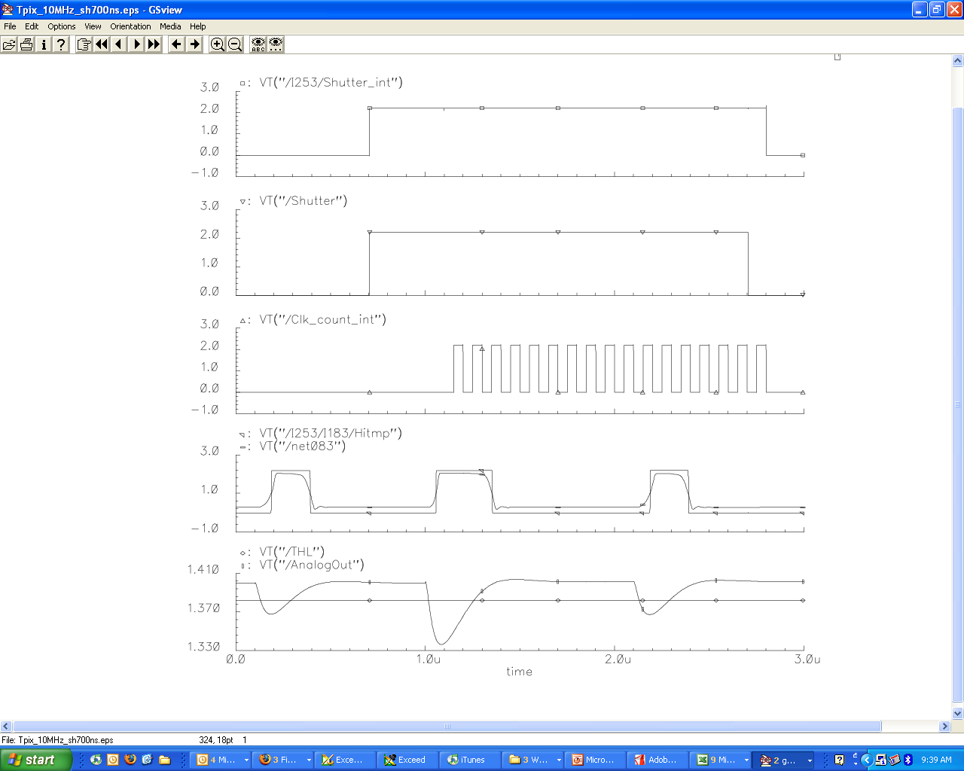
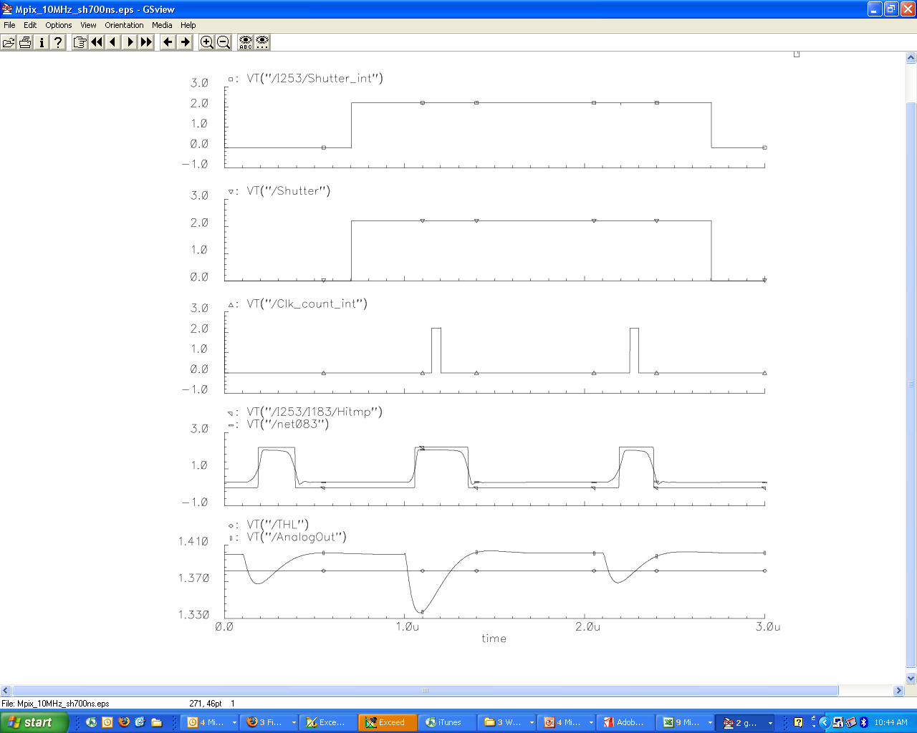
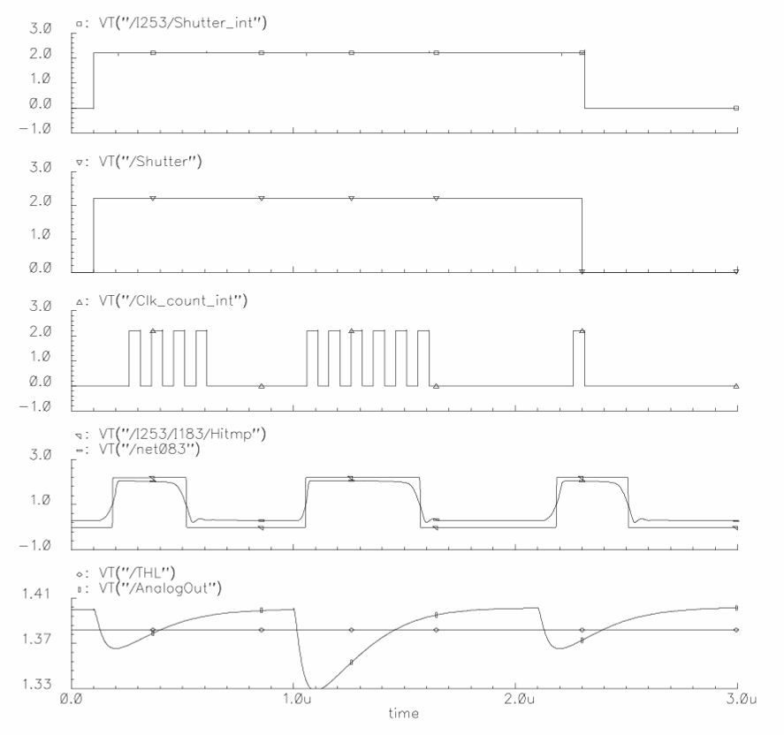
TimePix Synchronization Logic Control
Each pixel can be configured independently in 5 different modes
Internal clock up to 100 MHz
Timepix Mode
Medipix Mode
TOT Mode
100 MHz
Internal Shutter
DACs values
Mask | P1 | P0 | Mode
0 | 0 | 0 | Masked
0 | 0 | 1 | Masked
0 | 1 | 0 | Masked
0 | 1 | 1 | Masked
1 | 0 | 0 | Medipix
1 | 0 | 1 | TOT
1 | 1 | 0 | Timepix-1hit
1 | 1 | 1 | Timepix
Shutter
Internal Clock
10 ns
Digital Signal
Analog Signal
not detected
detected
Summed charge

Slide 9
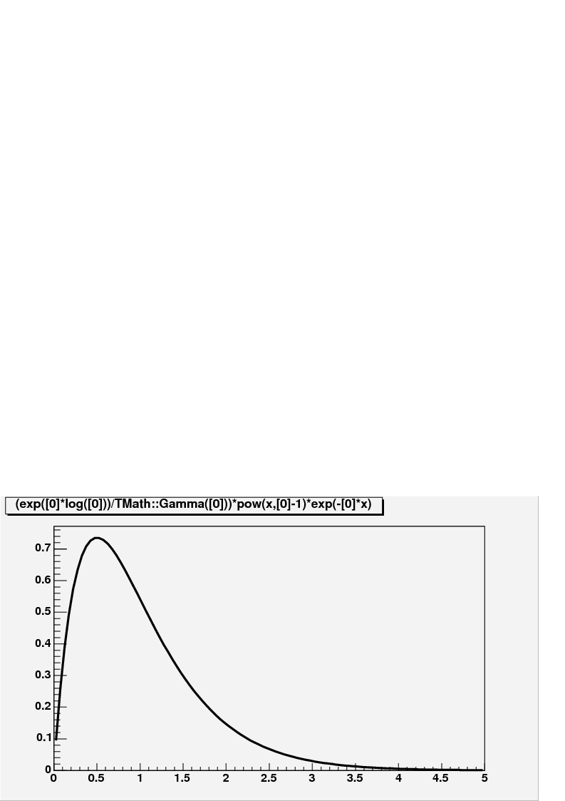
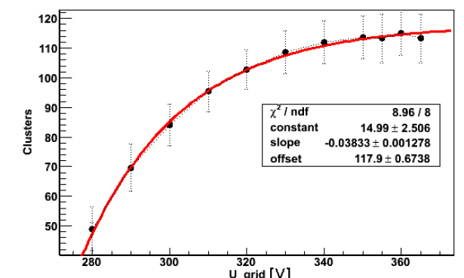
Single electron efficiency
Single electron efficiency is limited by gain fluctuations
Close to 100% efficiencies are obtained.
(M. Lupberger’s diploma thesis, 2010)
threshold
G/<G>

Slide 10
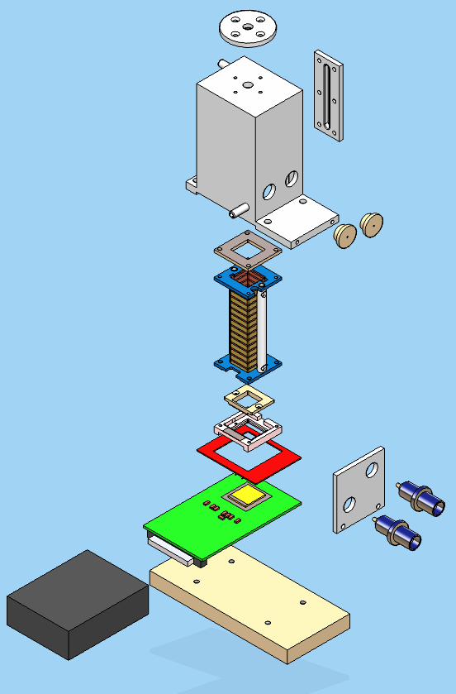
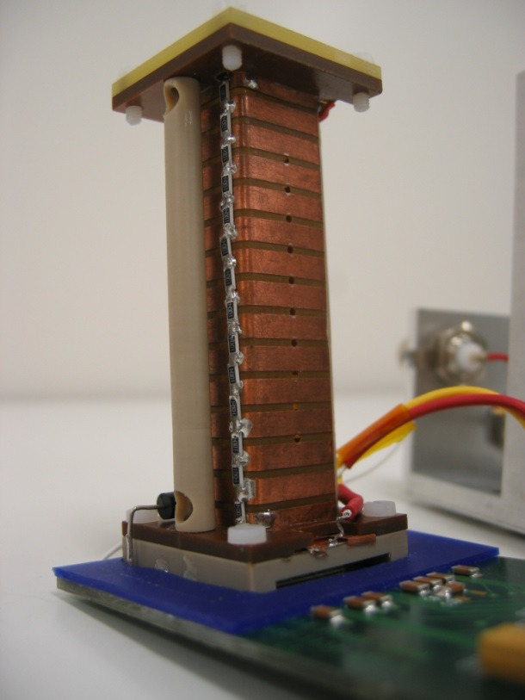
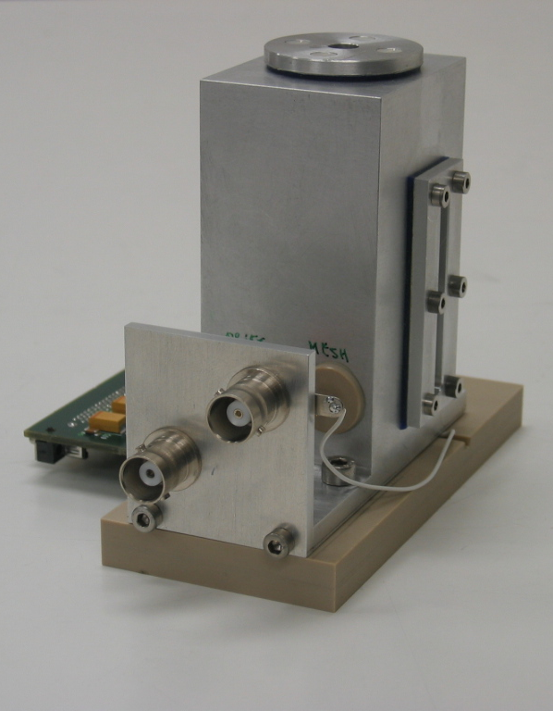
Micro-TPC using TimePix/Micromegas
Micro-TPC with a 6 cm heigh field cage
Size : 4 cm × 5 cm × 8 cm
Windows for
X-ray sources
Cover
Windows for
β sources
6 cm
Field cage
Micromegas
mesh
Gas mixture at atmospheric pressure
TimePix chip

Slide 11
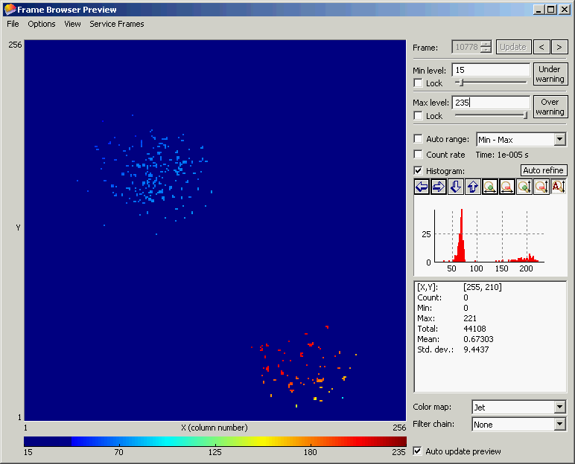
Micro-TPC TimePix/Micromegas
TimePix chip
+ SiProt 20 μm
+ Micromegas
⁵⁵Fe source
Ar/Iso (95:5)
Time mode
z = 25 mm
V_{mesh} = -340 V
t_{shutter} = 283 μs

Slide 12
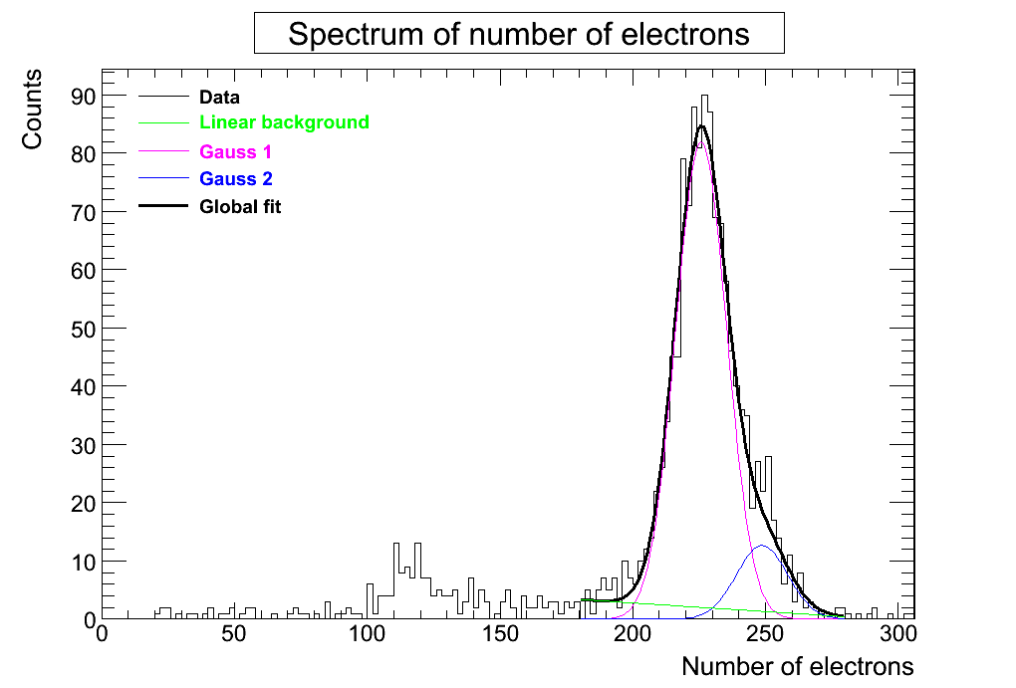
Measurements of primary statistics in gases
Diffusion σ_{t} should be big enough to separate electrons: cluster size per e- ~ 1
Study of primary electrons and Fano factor F using RMS
Spectrum of number of electrons for 2000 events:
    F: Fano factor
    √b: single e- gain distribution rms (%)
    ε: detection efficiency
    N: number of primary e-
Sensitive to K_{α} & K_{β} lines
FWHM = 9,5 %
5.9 keV line at ~ 226 e-
TimePix+Ingrid+ 15 μm SiProt
Argon + 5% Isobutane

Slide 13
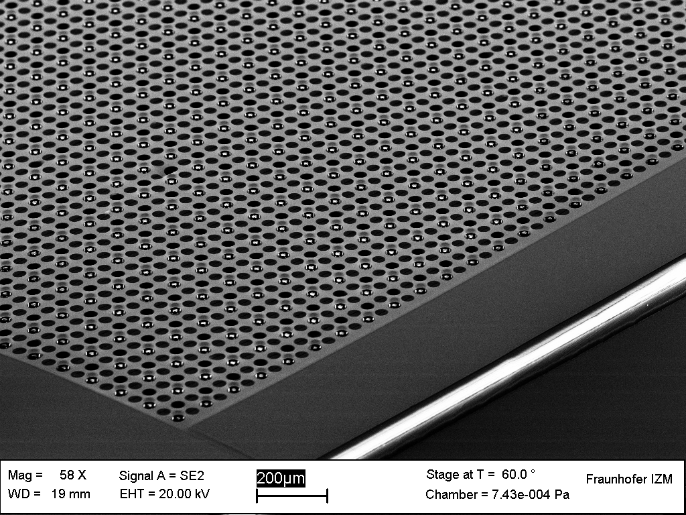
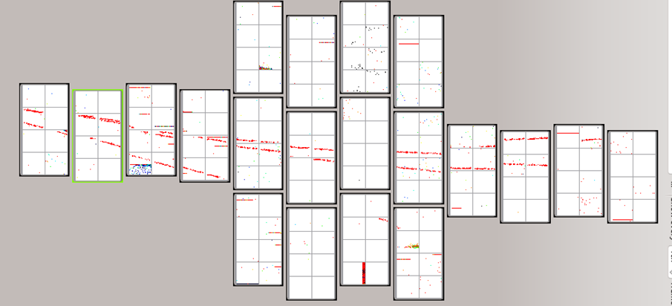
GridPix progress
Wafer-based post-processing to add a protection layer and a mesh on pillars on top of the chips (107 chips at a time)
March 2015, there was a successful test with 3 modules (96 chip each) partially equipped : 160 chips!
This shows that this technique is applicable to large areas
This opens the way for ultimate dE/dx resolution

Slide 14
Applications
e+e- collider TPC (with time)
basic studies of gases (avalanche fluctuation, ionization mechanisms, gas electron properties
Solar axion search (with a X-ray telescope)
Double beta decay
Dark matter directional search
Future work: INNOPIX EU project and LAAS RTB

