Slide 1
CERN Xboxes
x
Xbox
N. Catalan Lasheras
X-band FEL meeting. 10.12.2015

Slide 2
Outline
Xboxes 1,2 & 3 presentation
  Location and layout, Differences, Capabilities
Associated systems
  LLRF, signal acquisition, Cooling, Controls
Operation
Diagnostics
Schedules
  Construction schedule
  Testing schedule

Slide 3
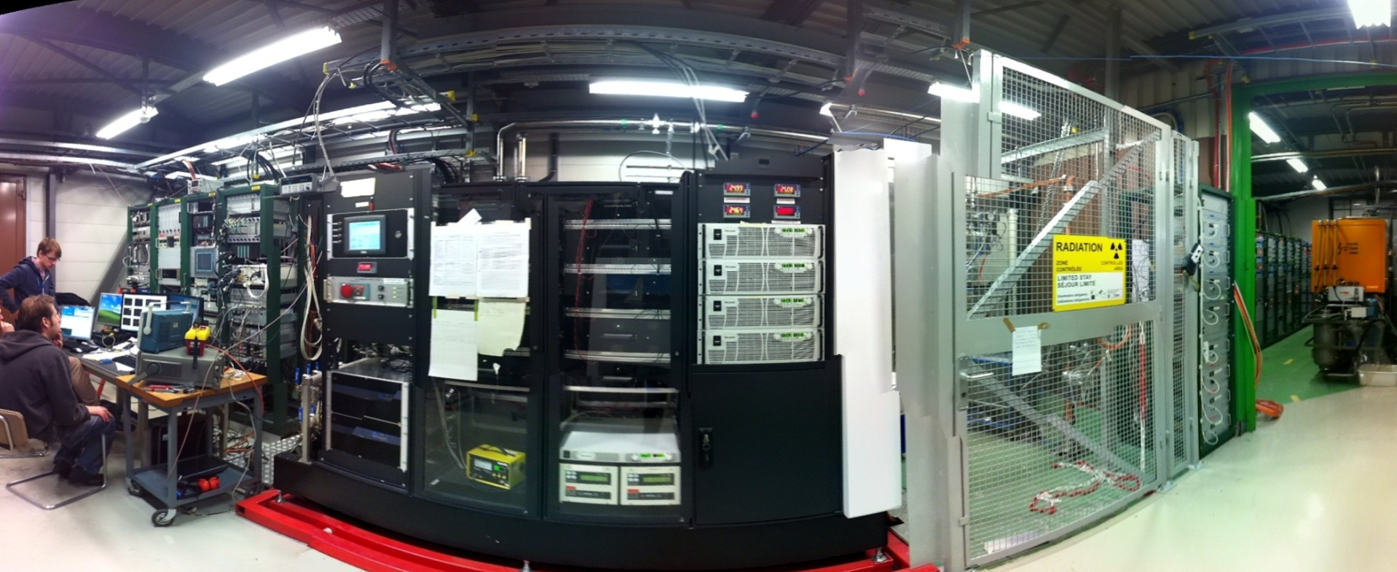
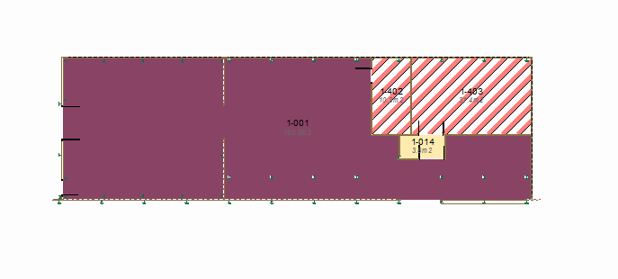
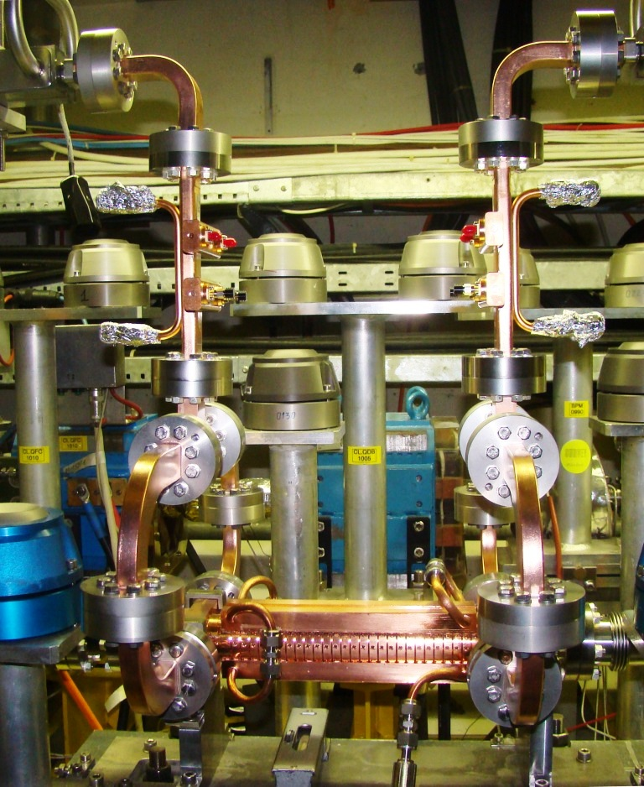
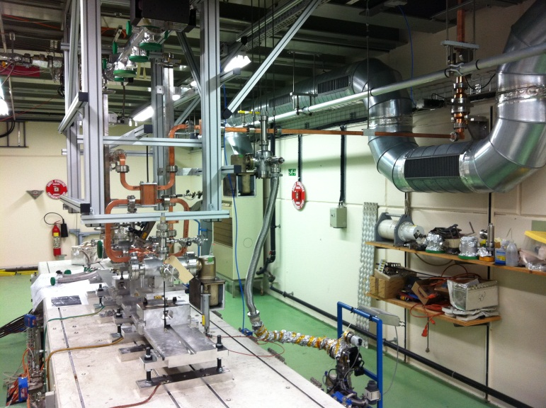
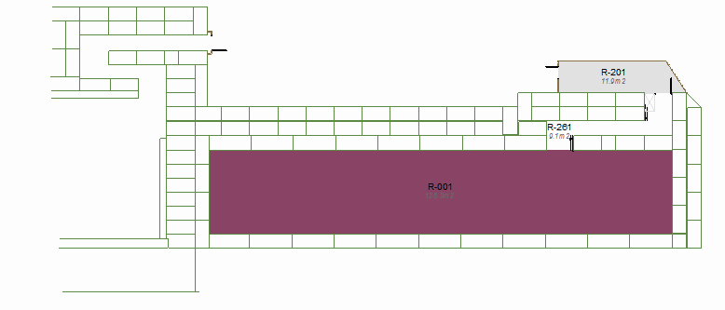
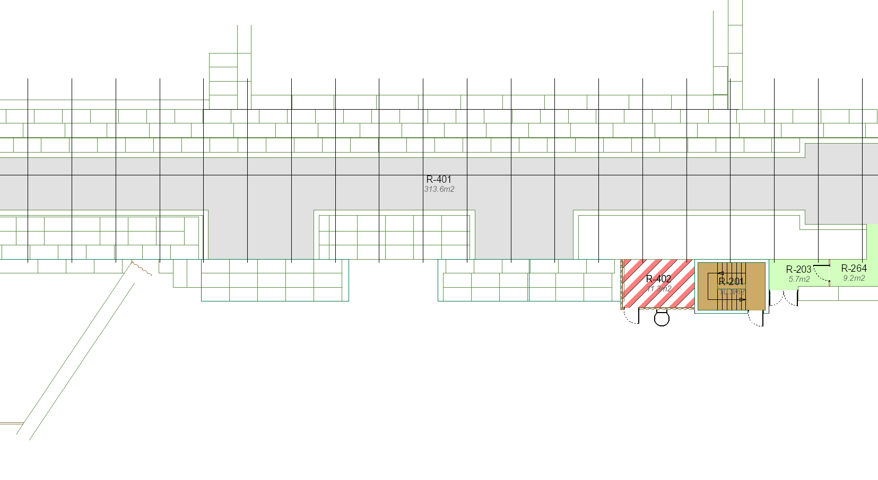
Xbox1 operating since 2012
50 MW klystron
RF pulse compressor
LLRF
CTF3 klystron gallery
430 kV modulator
CTF2
Dog-Leg (beam loading) working since 2014

Slide 4
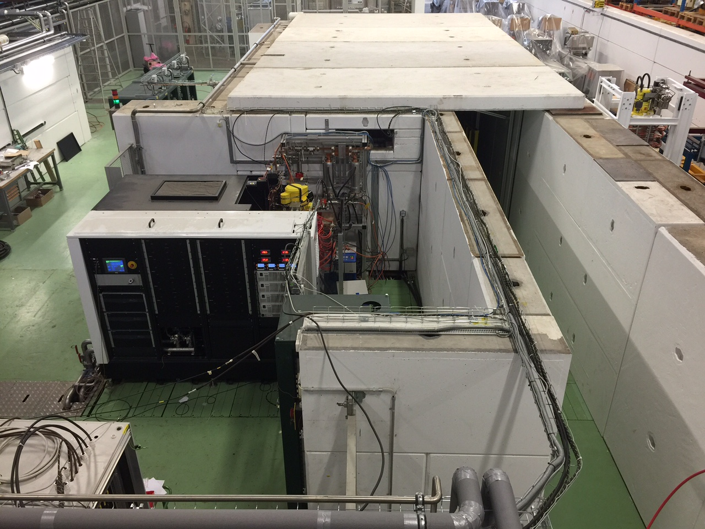
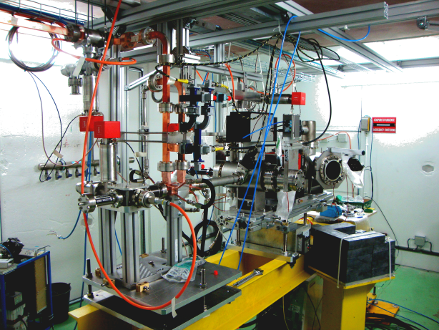
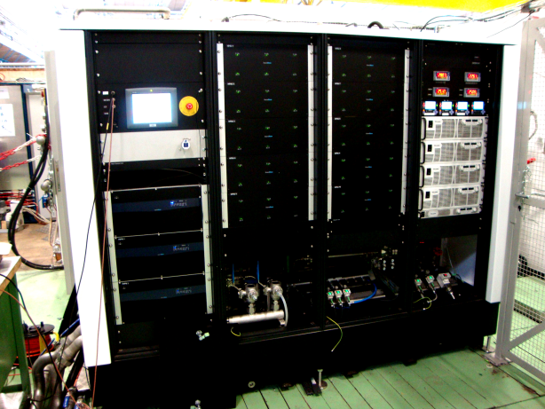
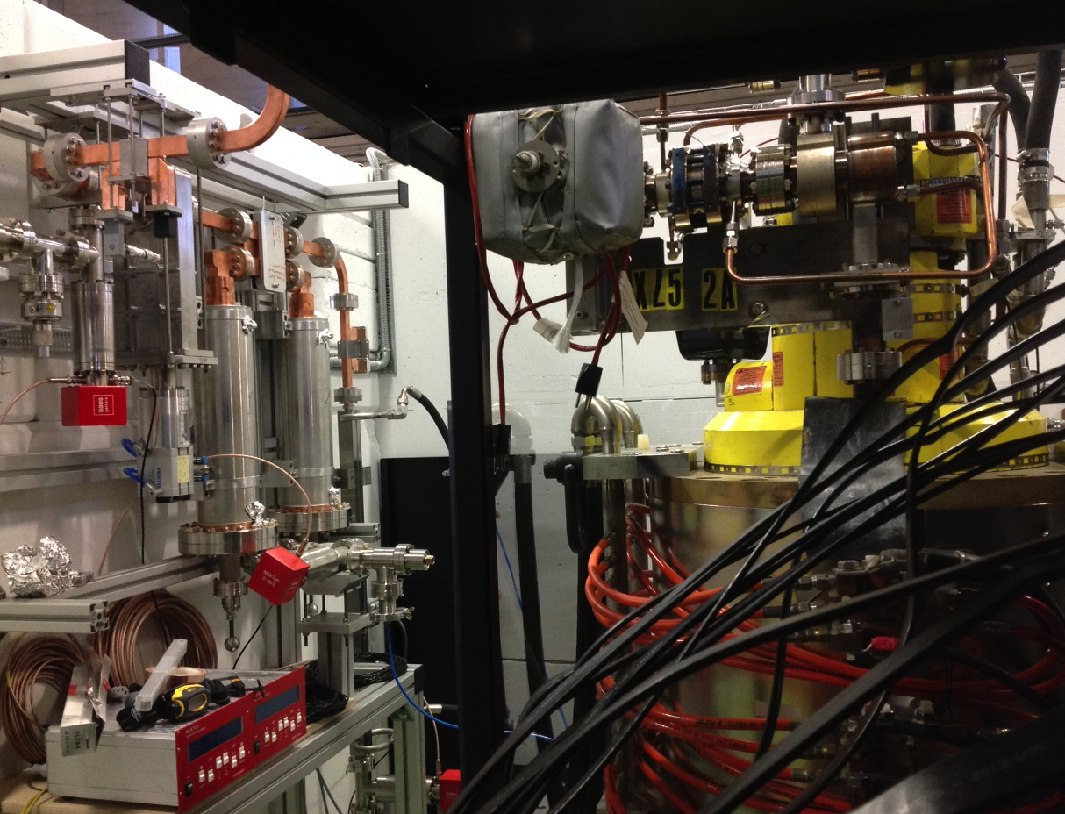
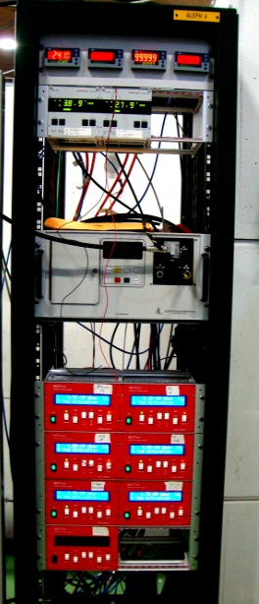
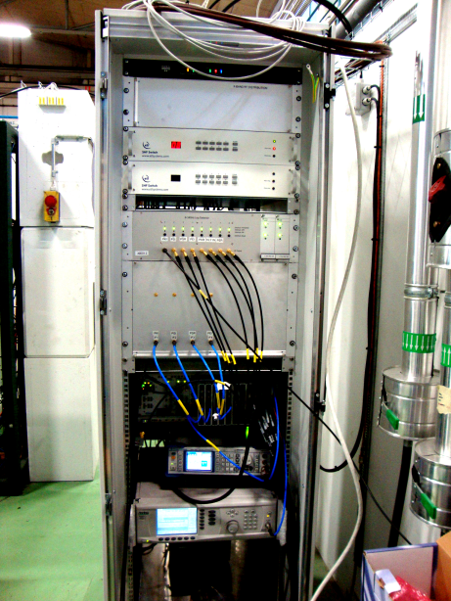
Xbox2 in operation since 2014
50 MW Klystron
Vacuum controllers
RF Pulse compressor
430 kV modulator
LLRF

Slide 5
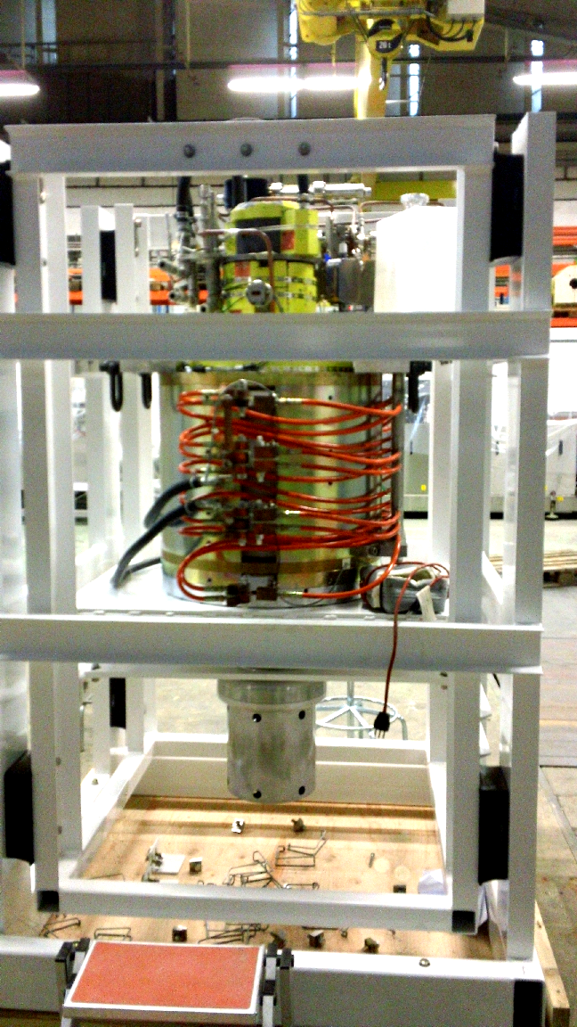
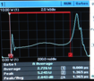
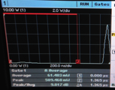
CPI2-2 Klystron in Xbox2
First diode tests (no RF) of CPI#2 tube showed that 0.7 GHz gun oscillations starts at about 240 kV and even generate RF power from the input cavity:
12 GHz pulse from the input cavity
Fortunately, going higher in voltage, the instability zone moves towards the rise/fall time, so the plat top can be used now.
Example of the pulse with ~ 5 MW RF peak power expected:

Slide 6
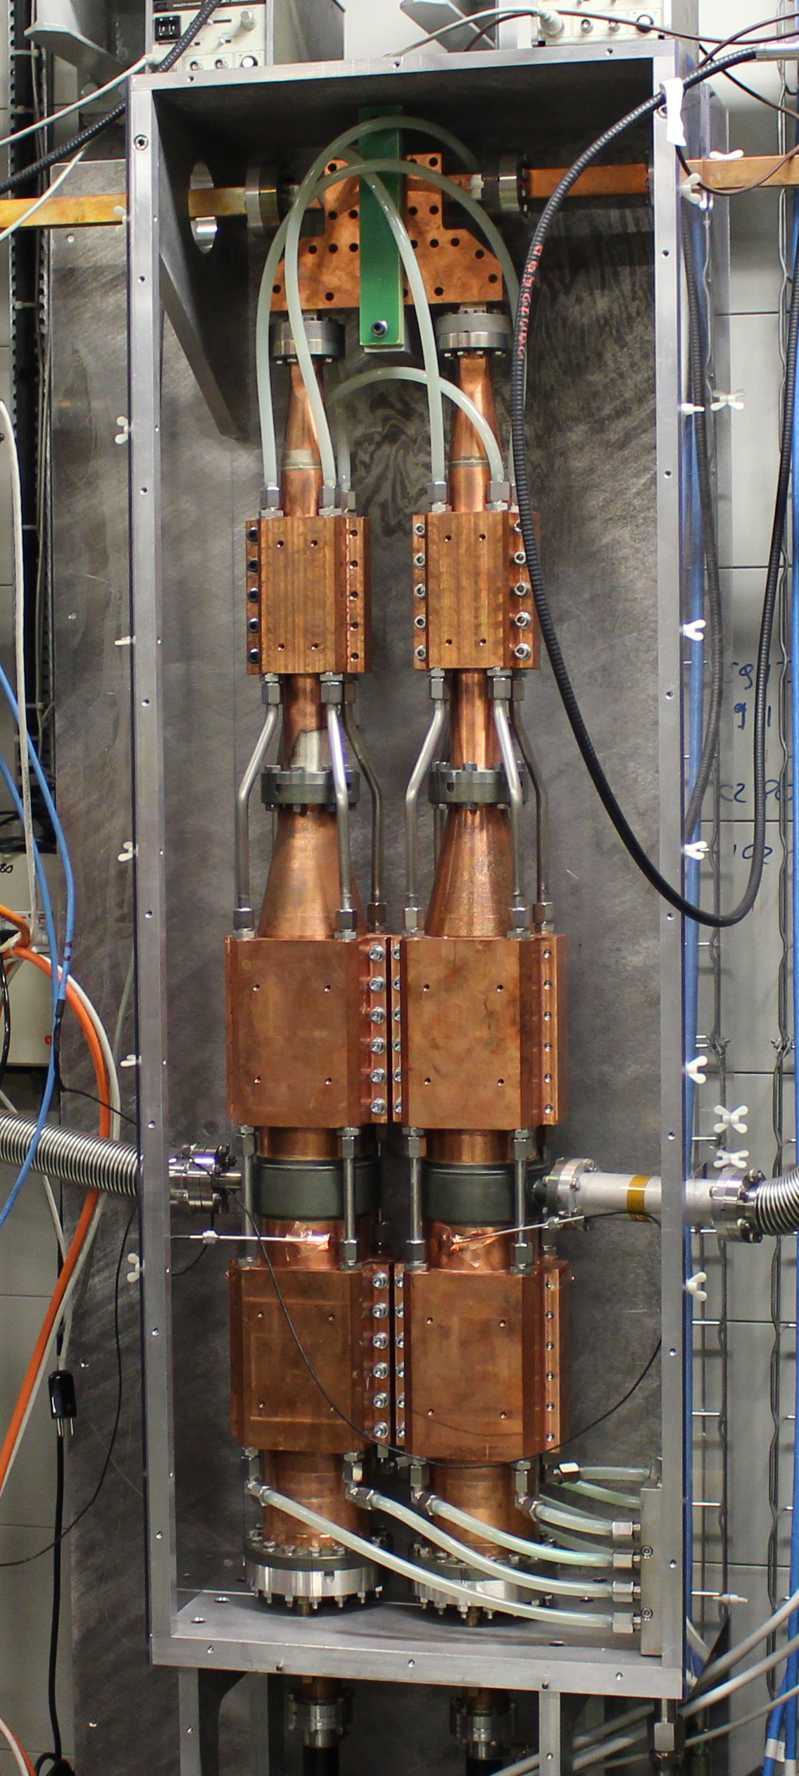
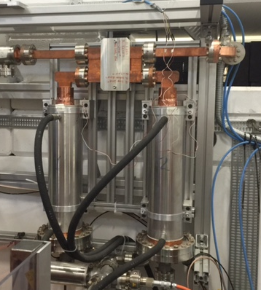
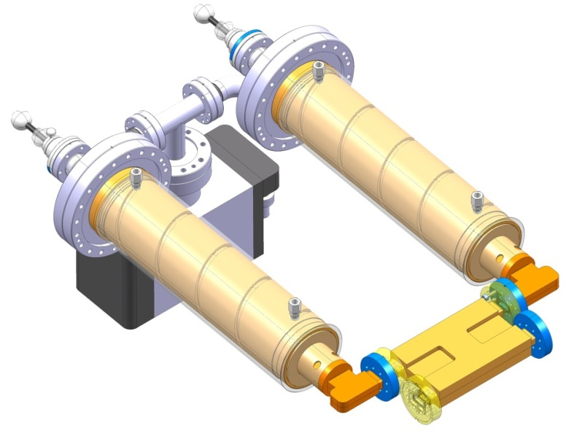
What is different?
Similar multiplication factor (~2.7)
Xbox1 actively tuned,
  large impact of temperature variations
Xbox2/3 tuned once after assembly
  Can be tuned with temperature
  Very stable
Notes:
**

Slide 7
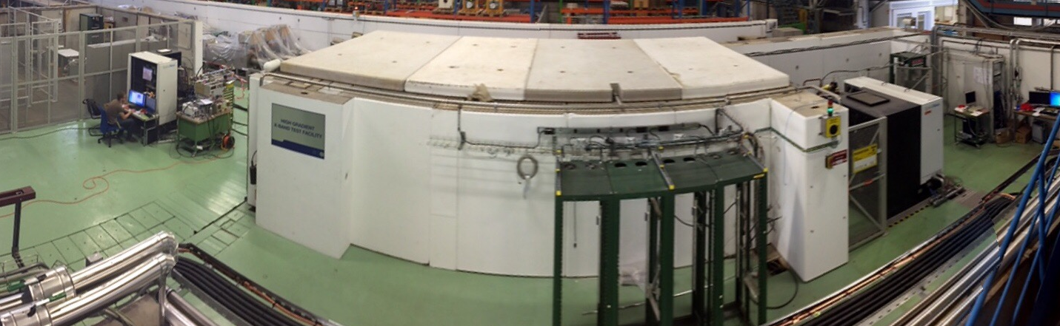
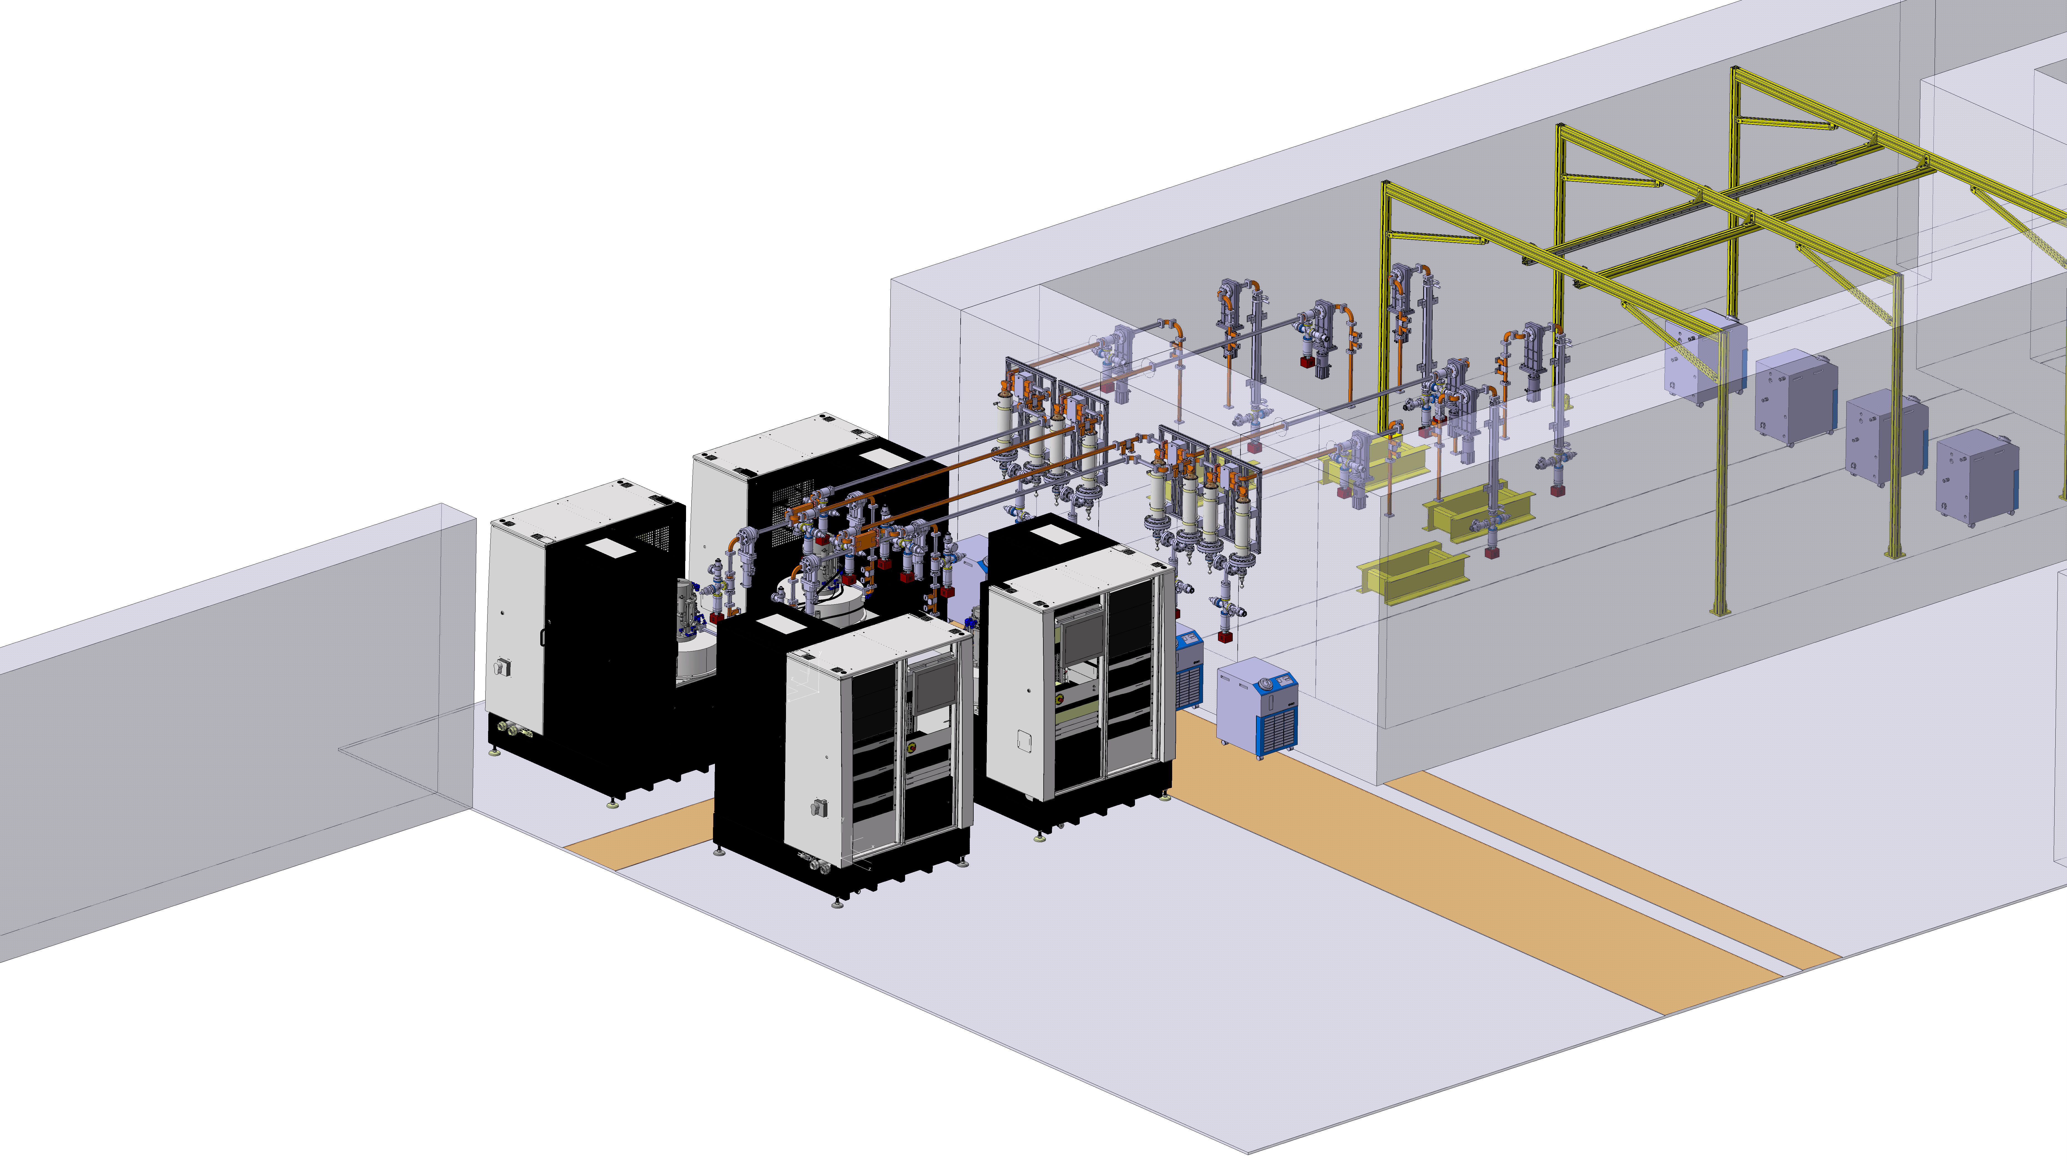
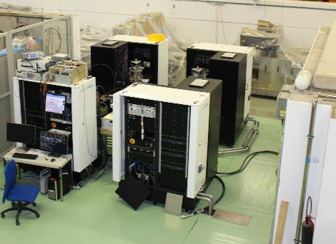
Xbox3 being installed

Slide 8
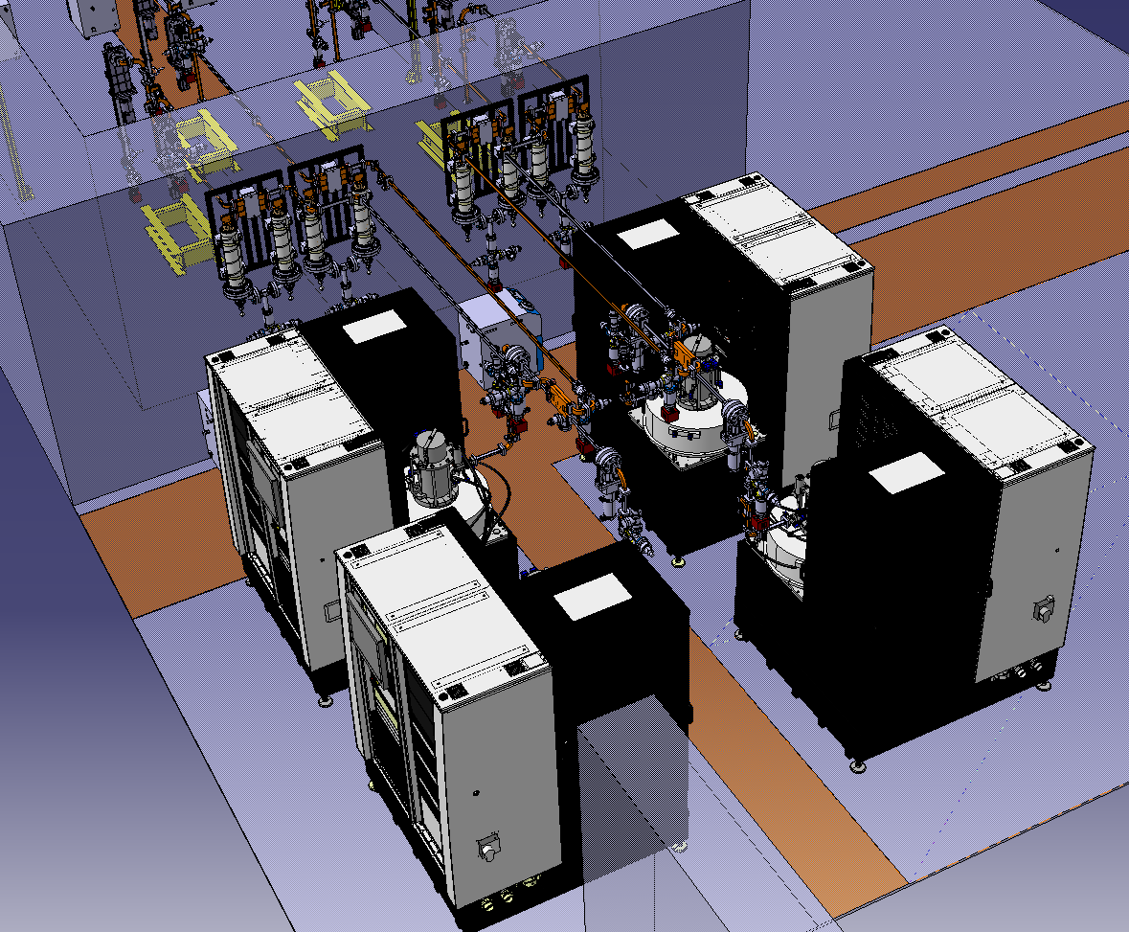
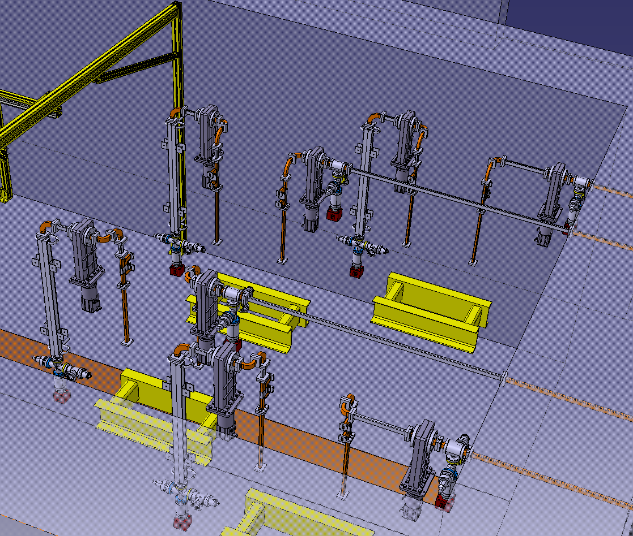
Xbox3 integration drawings
Power generation 2+2
Testing area inside bunker x4

Slide 9

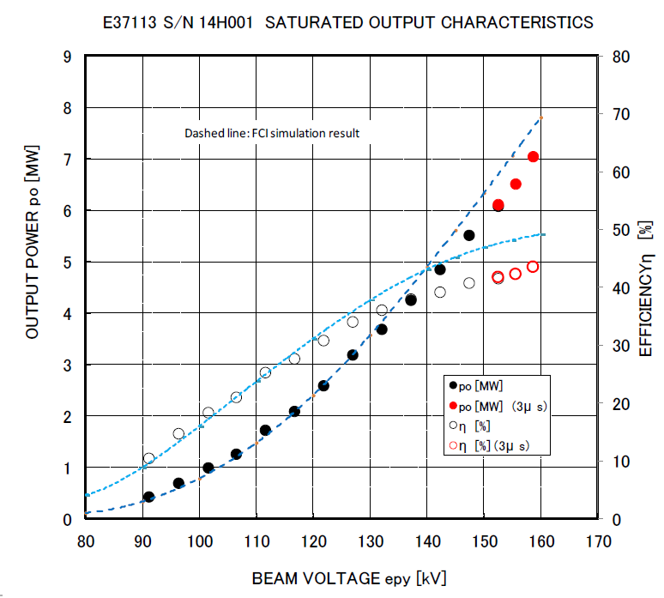
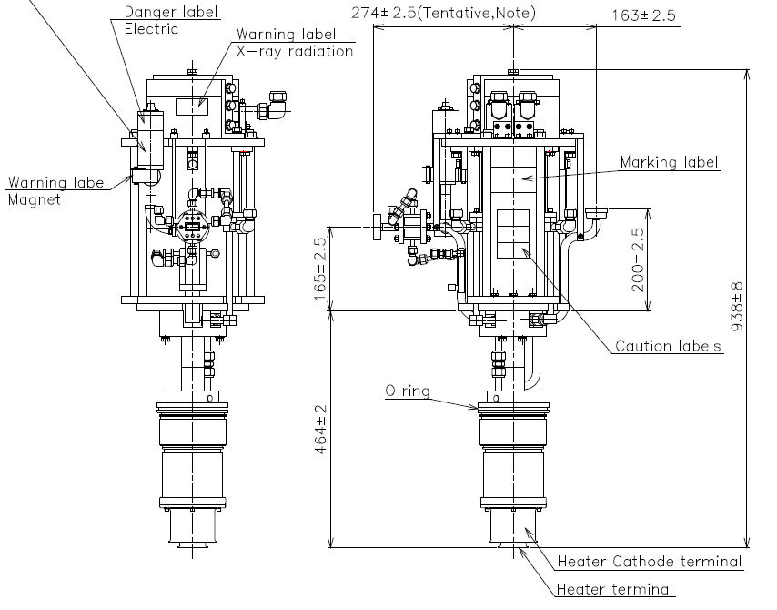
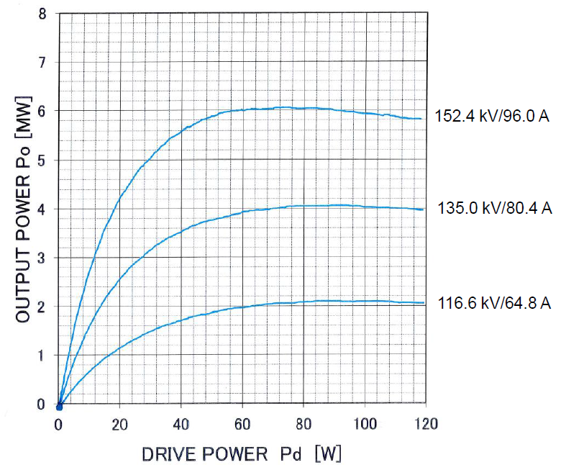
Toshiba E37113
Design:
Peak power: 6 MW
Beam Voltage: 150 kV
Beam current: 90 A
Average power: 12.4 kW
Efficiency: 47.5%
Factory tests results
The full delivery of 4 units will be completed before July 2015.

Slide 10
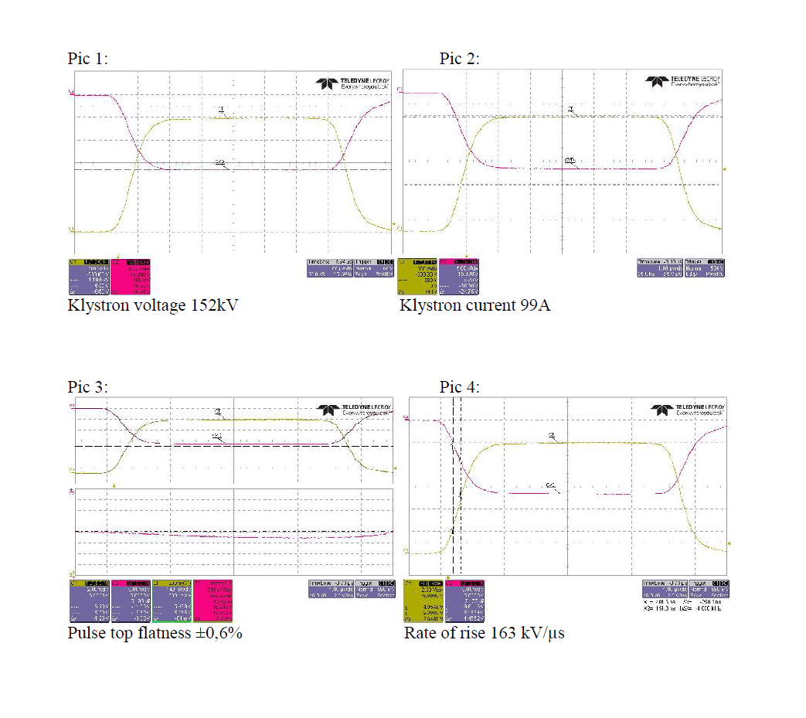
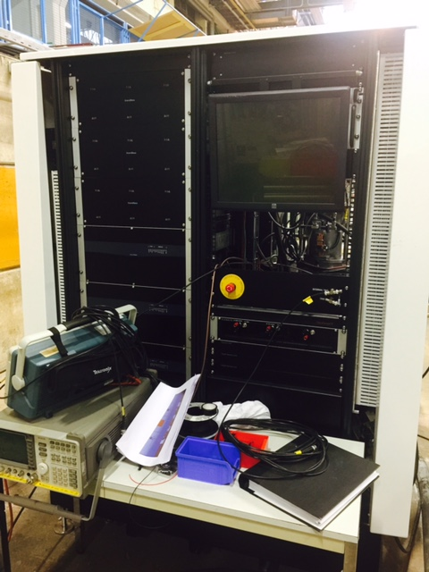
Xbox3 acceptance tests

Slide 11
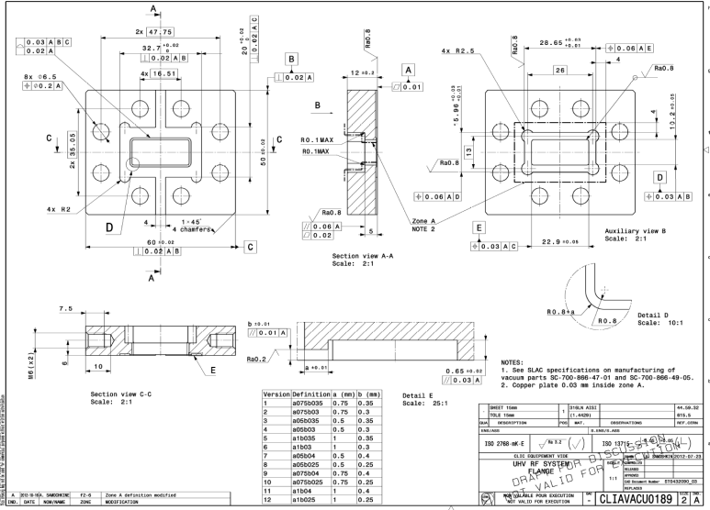
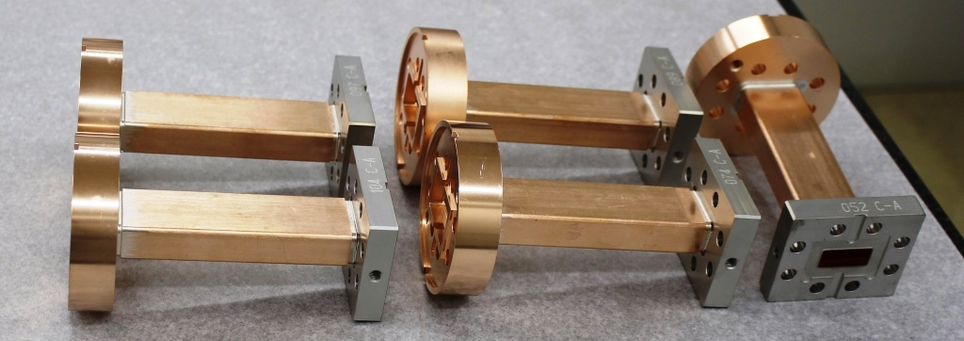
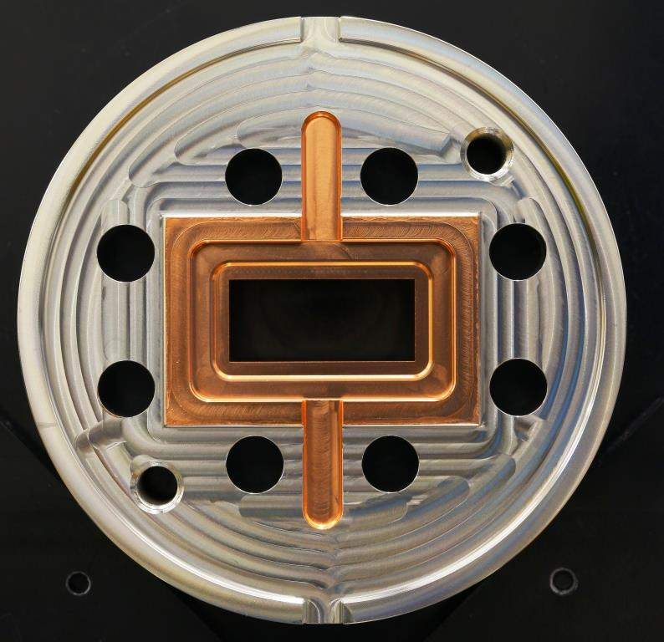
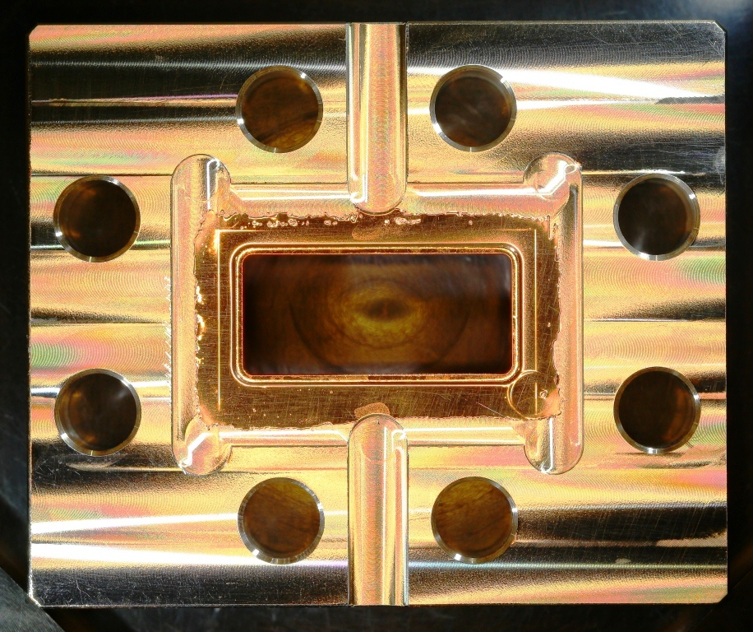
Achtung!! Flanges
Xbox1&2 Xbox3

Slide 12
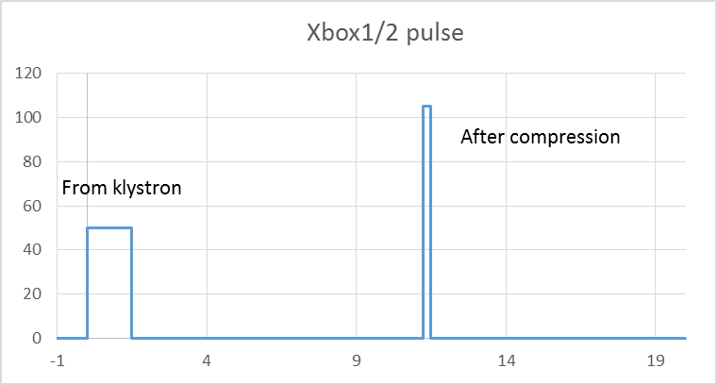
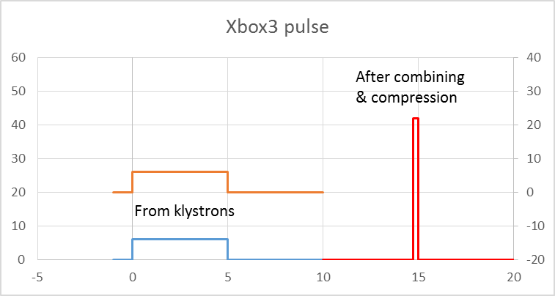
Xboxes comparison
 | Xbox1 | Xbox2 | Xbo3x
Modulator | Scandinova K2-3X (solid state 450kV, 350 A, 1.5us, 50 Hz) |  | Scandinova K1 (solid state, 170 kV, 100 A, 6us, 400 Hz
Klystron | SLAC-XL5/CPI 50 MW | CPI-2 50 MW | Toshiba E37113 6MW
RF amplifier | TWT 3kW | TWT 3kW | Solid state
Pulse compressor | SLED1 Gycom (x2.8) | SLED2 CERN (x3.5)
Flanges | SLAC |  | IUWR90
Number of testing slots | 1(CTF2/Dog-leg) | 1(+1) | 4 (2+2)

Slide 13
Dog-Leg experiment
12 GHz RF:
90 MW RF power
Up to 50 Hz rep. rate
XBOX1
12 GHz RF
CTF3 Injector
35 m low loss waveguide
Beam:
CTF3 Drive Beam modified
3GHz beam at ~1.2 A
Pulse length up to 250 ns
Energy ~125 MeV at structure
Up to 25 Hz pulse rep. rate
MKS02
3 GHz RF
High Gradient Accelerating Structure
MKS03
MKS05
MKS06
MKS07
Gun

Slide 14
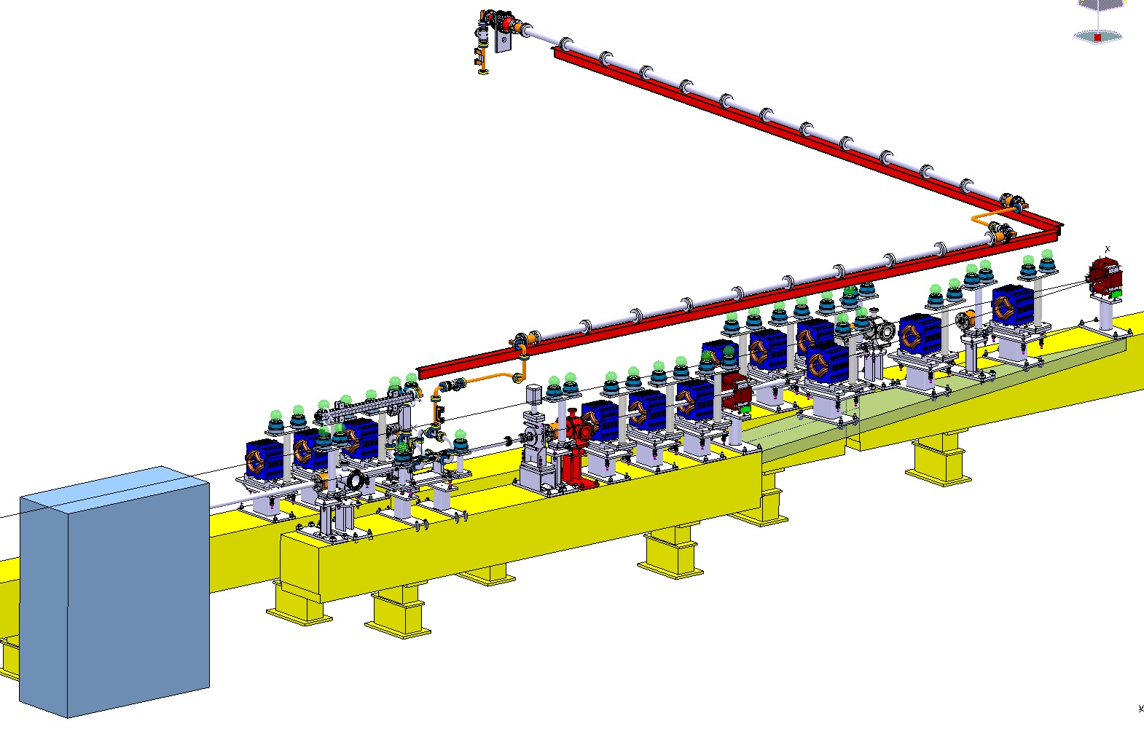
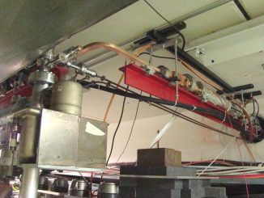
Dog-leg experiment. RF network
Thanks A. Solodko
RF network:
~ 35 meters from PC to structure
61% of transmission
230 ns round trip delay
Notes:
The RF is provided

Slide 15
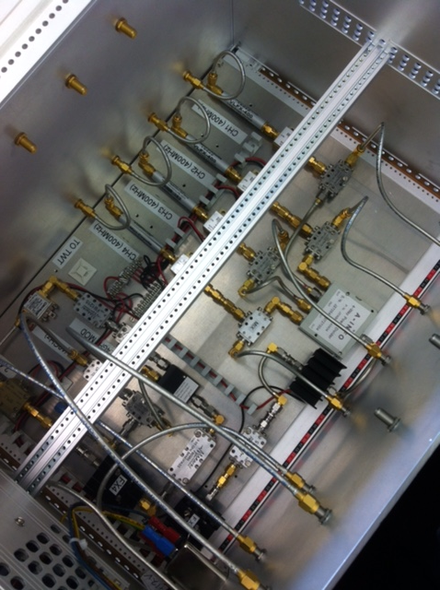
LLRF and acquisition system
Based on PXI system for timing signal generation, acquisition and interlocks
Frequency multiplication and down sampling in separate crates
Interlocks though FPGA card
Retrofitted to Xbox1
Extended to Xbox3

Slide 16
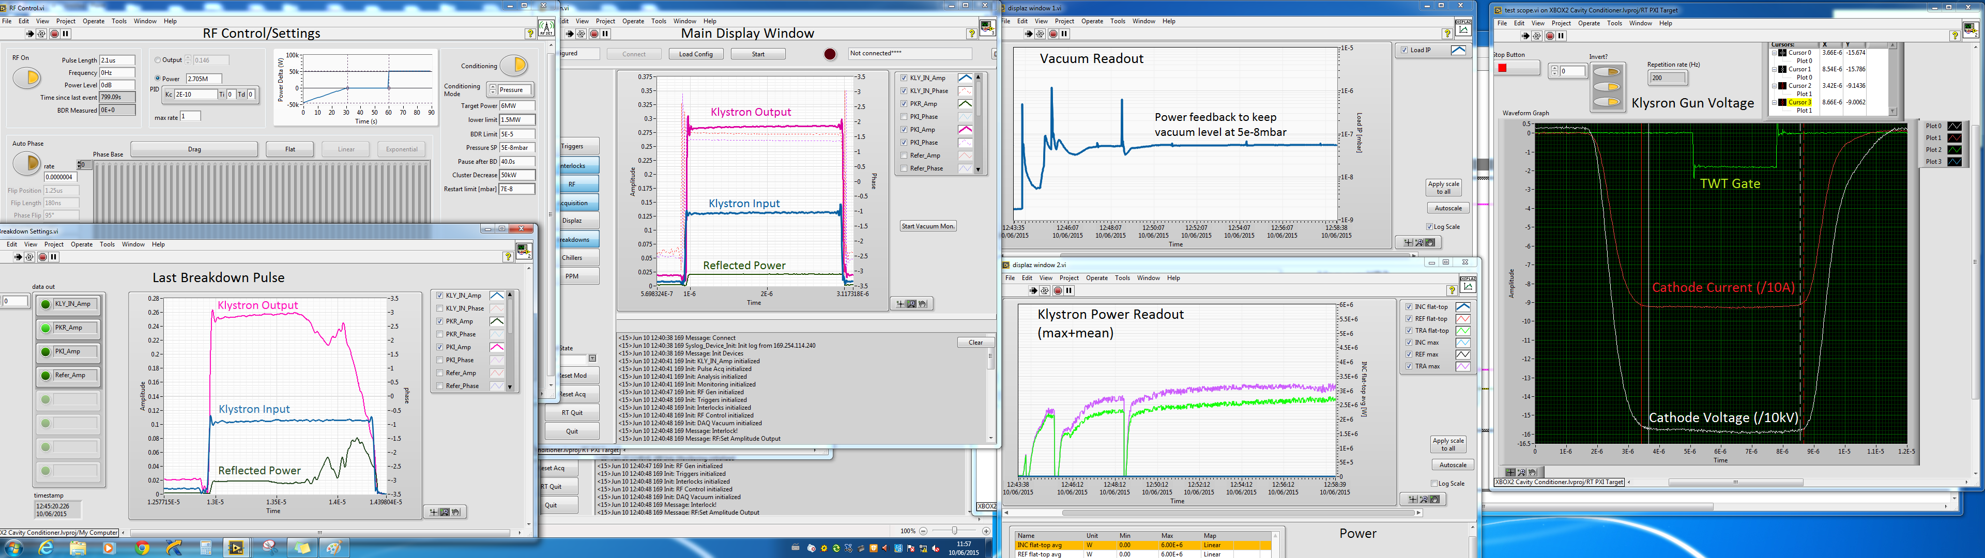
Control (Xbox3)
Based on NI LabVIEW. Runs in stand alone computer
Saves and plots RF data, temperature and vacuum signals.
Saves breakdown data and previous pulse
B. Woolley, J. Tagg

Slide 17
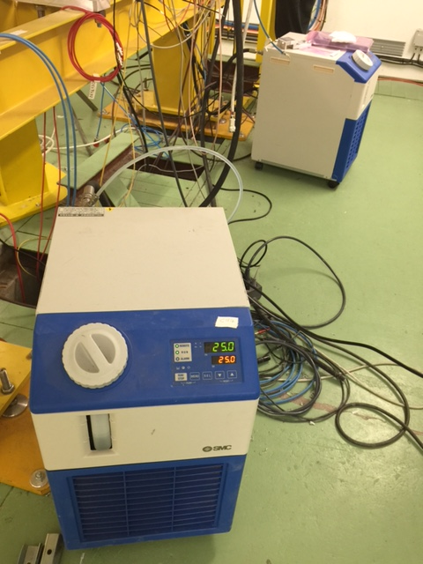
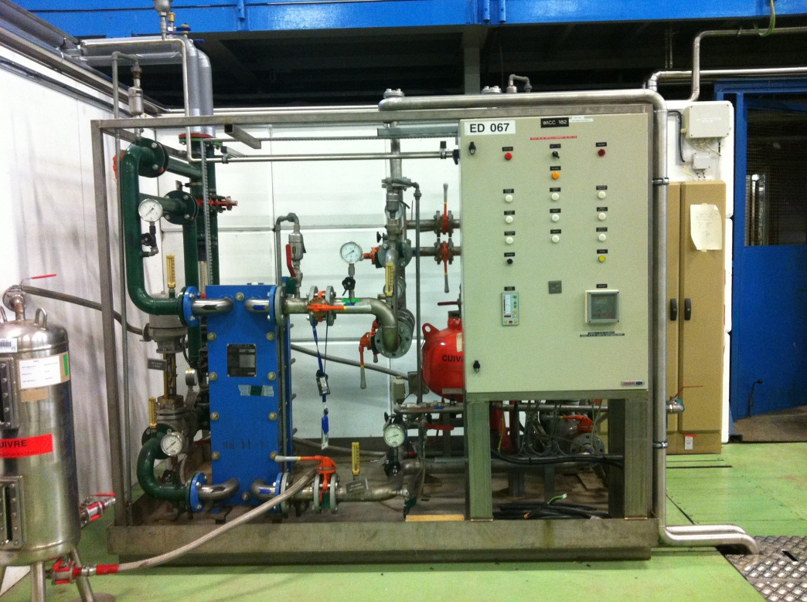
Cooling system
Independent demineralized water system for Xboxes
  DT=10, 8Pa
  Feeds modulator, loads
Special chillers with temperature stabilization for structures and pulse compressors
  2kW average power
  0.1 degrees stability
Notes:
ra

Slide 18
Operation: Conditioning
The final pulse length and power is defined for each case
Conditioning algorithm sets a target value for vacuum level (network conditioning) or BDR (structures)
Real conditioning speed follows a complicated algorithm and is a function of the state of the DUT.
  Faster for lower power, shorter pulses or conditioned structures
Power
target
Conditioning Parameter
Pulse length
Time

Slide 19
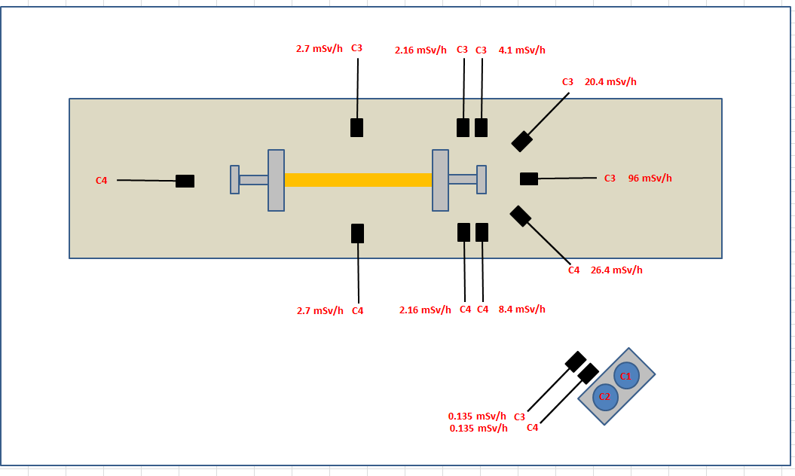
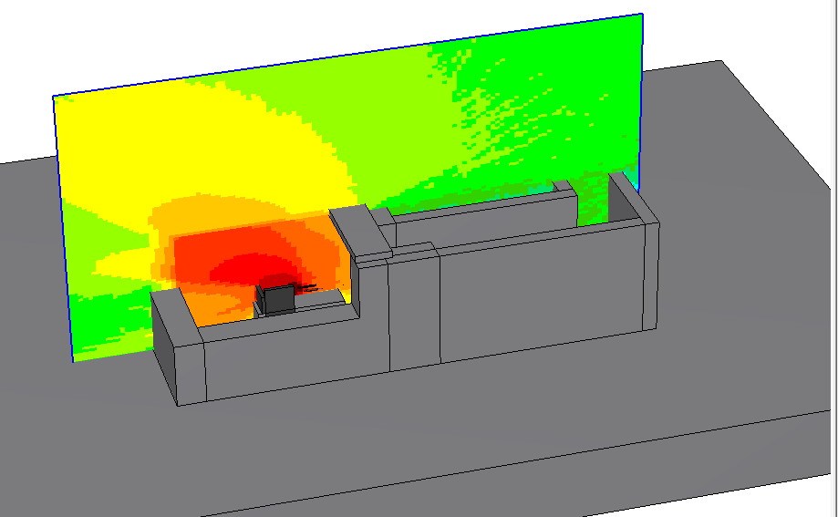
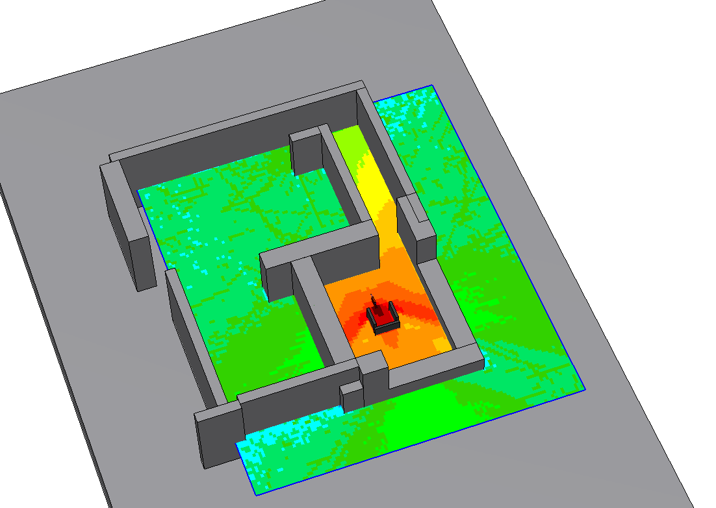
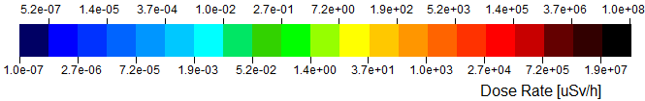
Operation: Radiation and shielding
Measurements done around Xbox1
Data used for simulations of Xbox2 bunker
80cm shielding blocks
J. Vollaire

Slide 20
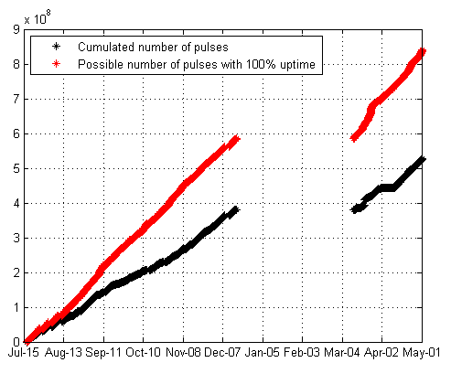
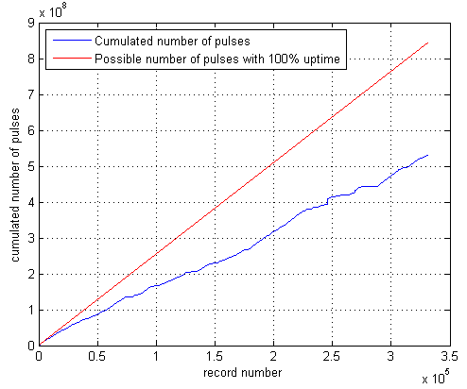
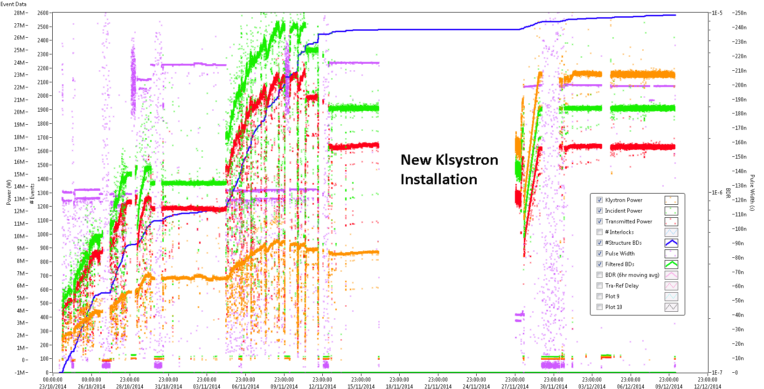
Operation: Availability
Xbox1 and dogleg availability
estimated 63%
Not yet well established yet for Xbox2
A. DeGiovanni, B. Woolley

Slide 21
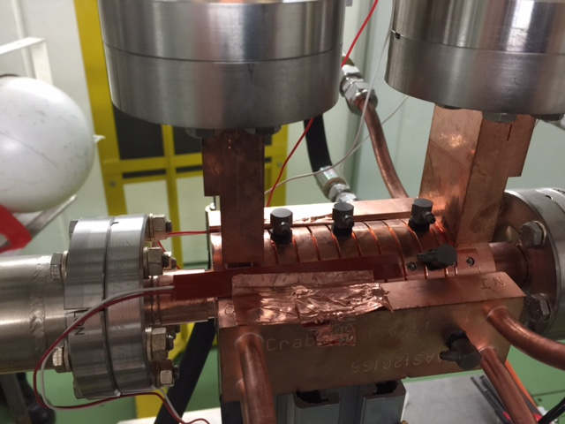

Diagnostics: Accelerometers
6 accelerometers installed with dynamic range +/- 500 g
Aim at breakdown location
Under tests in Xbox2 for crab-cavity. See A. Degiovanni presentation
Wilfrid Farabolini

Slide 22
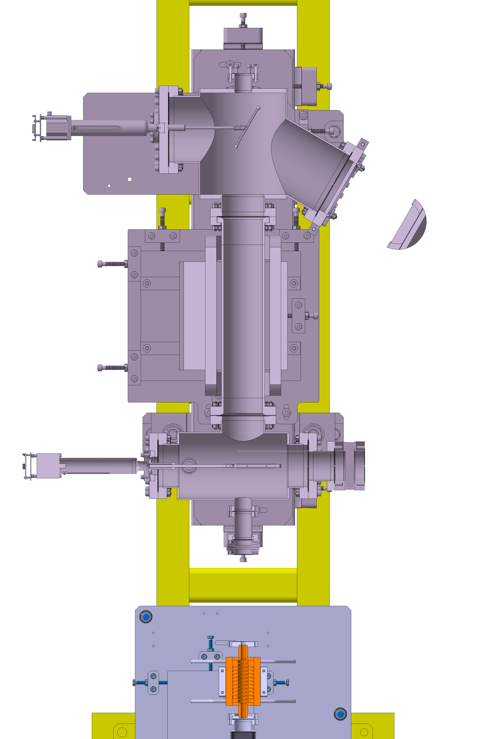
Diagnostics: Spectrometer
Maximum electron energy < 20MeV
Real energy spread (single slit) 10-25%
Full energy coverage through a magnetic field scan
System under commissioning. Interesting data at B. Woolley presentation
Marek Jacewicz and Uppsala accelerator group

Slide 23
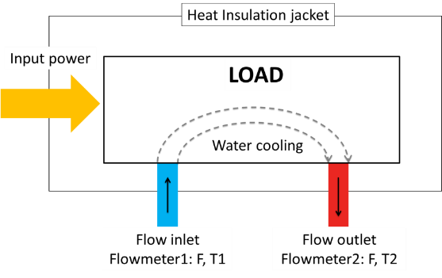



Diagnostics: Calorimetric power measurements
Average power comparison
Directional coupler ~ peak power*pulse width*repetition rate
Calorimeter ~ specific heat*flow-rate*temperature difference
Less than 7%!
Measurements taken in Xbox1 during CPI-1 commissioning
Good measurement in steady conditions
~50 s thermalisation delay
Tested in Xbox1
Being installed in Xbox2
Xiaowei Wu et al. “Calorimetric power measurements in X-band high power RF”. IPAC 2015

Slide 24
Schedule installation xbox3
Still procuring network waveguides, LLRF components and cables, solid state drivers.
Pulse compressors under fabrication with some brazing problems
  Last delivery expected in March
Installation from January.
  Some mimimum disruption to Xbox2

Slide 25
Test schedule until 2016
Xbox1:beam loading experiment after Xmas shutdown
Xbox2: SLAC halves structure and installation in the bunker
Xbox3: Waveguide installation, cabling etc. in January

Slide 26
x
Thanks for your attention!!!
Xbox

