Slide 1
Cancellation of CSR kicks with optics balance in transfer line, 4-dipoles chicane and arc compressor
S. Di Mitri, Elettra Sincrotrone Trieste

Slide 2
Outlook
CSR transverse kicks, linear model
Emittance growth in a 4-dipoles magnetic compressor
Optics balance in a locally isochronous transfer line
Emittance control in a periodic arc compressor
Final remarks

Slide 3

CSR 1-D Model
In the following we adopt a simplified picture for the CSR transverse effect. Experimental results suggest that it is accurate enough for describing most of the practical cases.
Photons are emitted in the beam direction of motion, at any point along the curved trajectory ⇒ CSR longitudinal effect, p_{z}(s) → p_{z}(s) – δp_{z}(s). We neglect direct CSR trasverse forces.
DIPOLE
e-
Remind: particle transverse motion is the linear superposition:
x(s) = x_{β}(s) + x_{η}(s)
γ
CSR instability is a tail-head effect, in which photons emitted by trailing electrons catch up with leading electrons.
Dipole magnet
$$s$$
head
tail
Radiation catches up
with electrons ahead

Slide 4
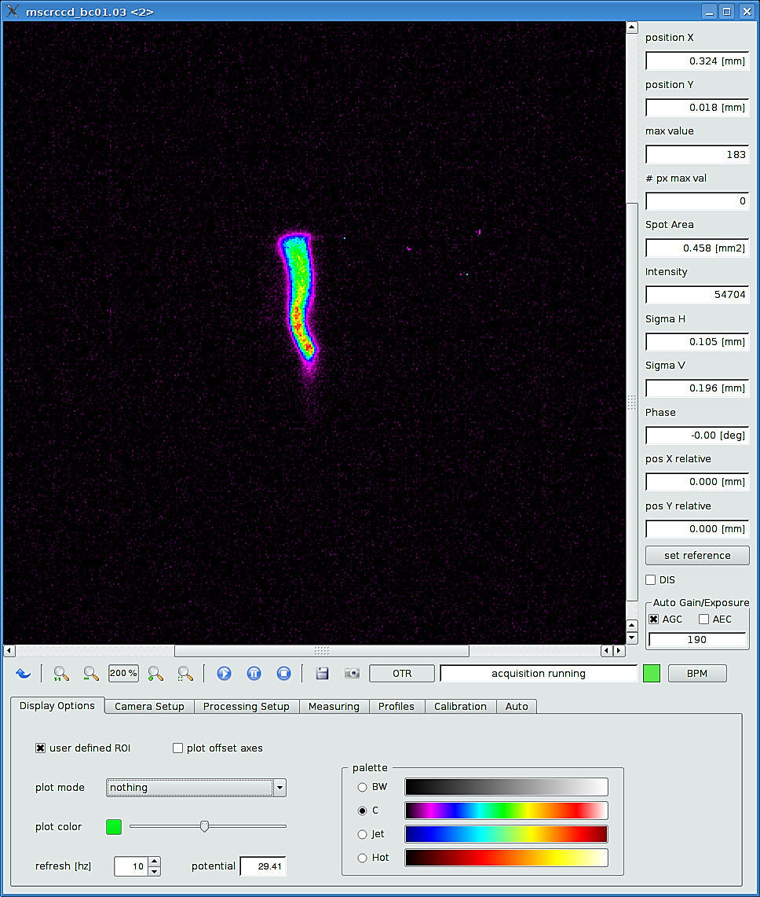
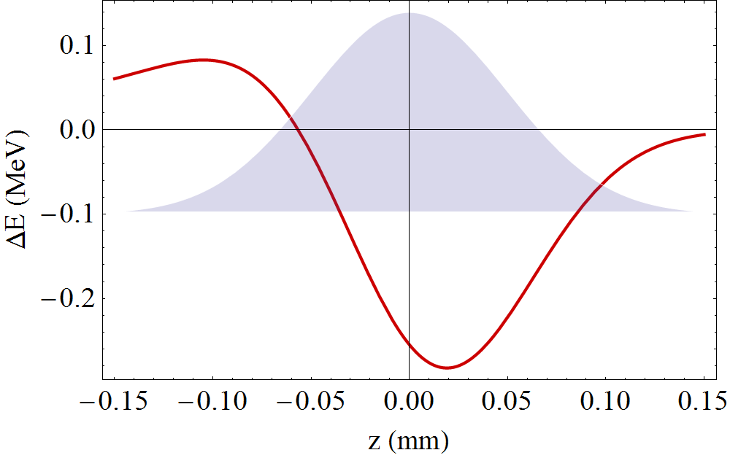
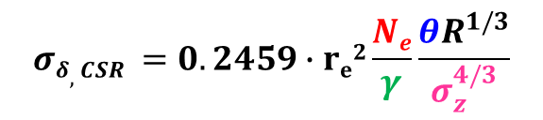
Energy Variation and Transverse Kick
Consider 1-D steady-state CSR emission, and linear optics.
Transient CSR effects and nonlinear dynamics will be included in the simulations.
RELATIVE ENERGY SPREAD of GAUSSIAN bunch, per DIPOLE:
$${σδ,CSR}_{ }=0.2459∙re2\frac{Ne}{γ}\frac{θR^{1/3}}{σ_{z}^{4/3}}$$
x
For a SINGLE PARTICLE:
For a BUNCH:
Photon emission/absorption,
Δx = Δx_{β}+ Δx_{η} = 0
z
New betatron amplitude,
Δx_{β,phot} = –ηδ_{phot}
Bunch head
gains energy
Bunch tail
is not affected
New dispersive
trajectory,
x_{η,phot} = x_{η} + ηδ_{phot}
head
tail
Bunch core
loses energy
Initial betatron oscillation, x_{β}
Initial reference (dispersive) trajectory, x_{η}
Note: distortion is both in x and x’

Slide 5
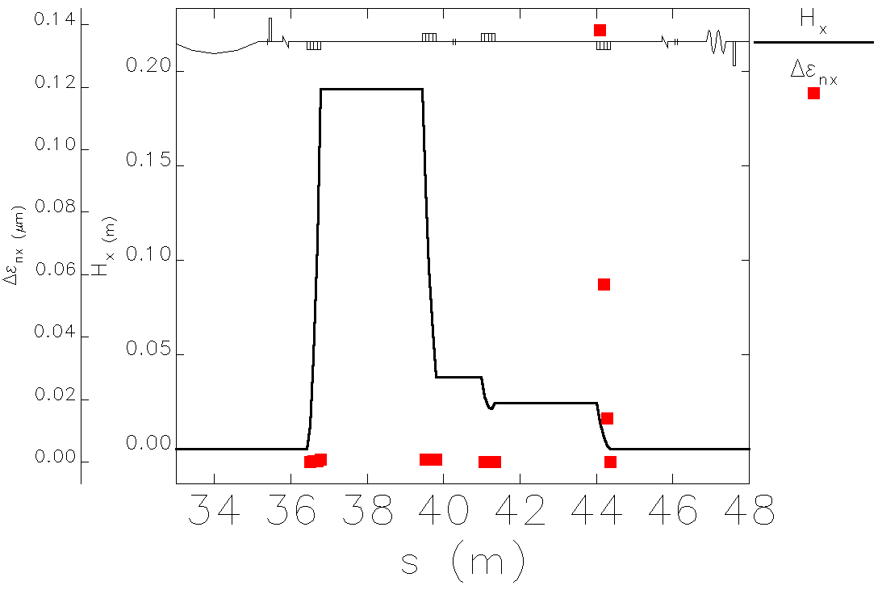


Emittance Growth in a 4-Dipoles Chicane
$$x′$$
Different bunch slices feel different CSR kicks, thus move on different β-trajectories. If the slice ellipses are not concentric, the projected emittance is larger, although individual slices may have the same slice emittance.
Use the ‘beam matrix’ to compute the CSR effect (single-kick approximation, average effect):
$$x$$
in 4-DIPOLES MAGNETIC COMPRESSOR:
NIM A 735, 60 (2014)
Consider a 4-dipole magnetic compressor, θ<<1 and beam waist at the chicane end:
σ_{z} shorter in the 4th dipole;
H ≈ βθ², larger at the entrance of the 4th dipole.
PR 539, 1 (2014)

Slide 6
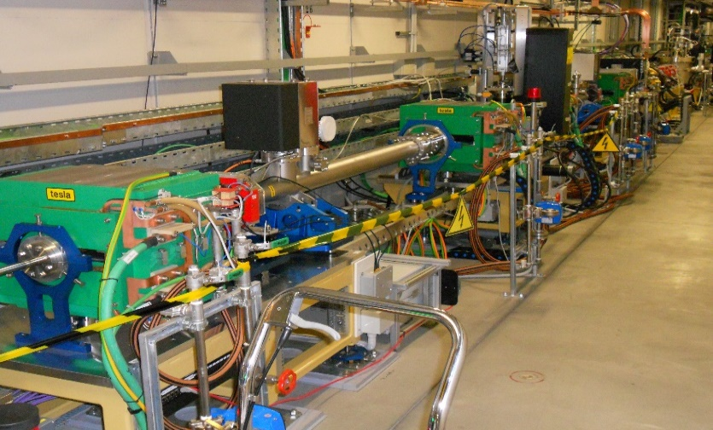
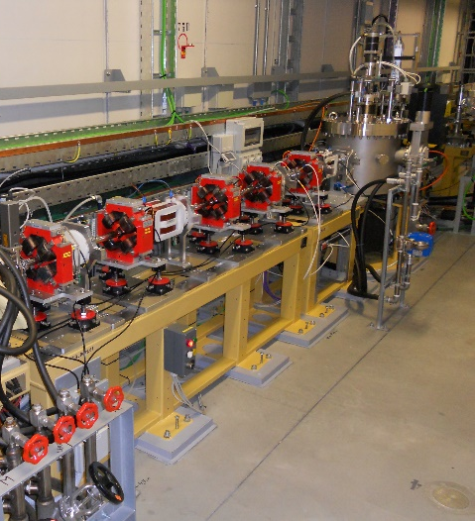
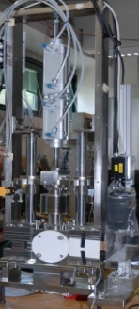
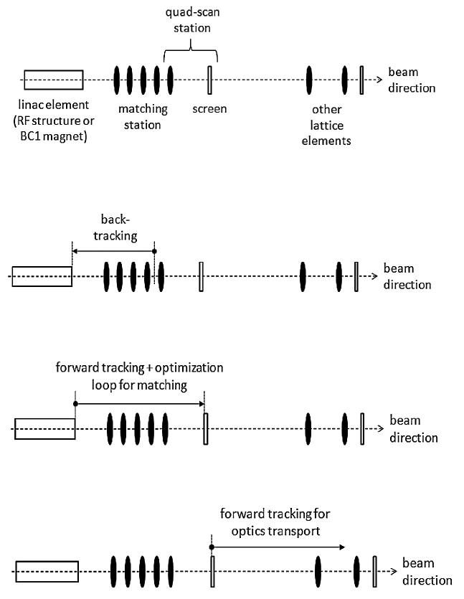
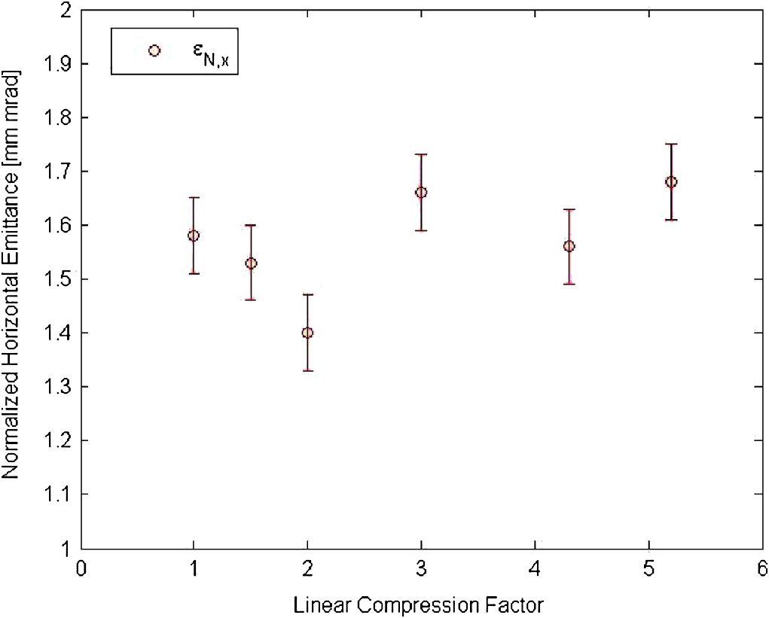
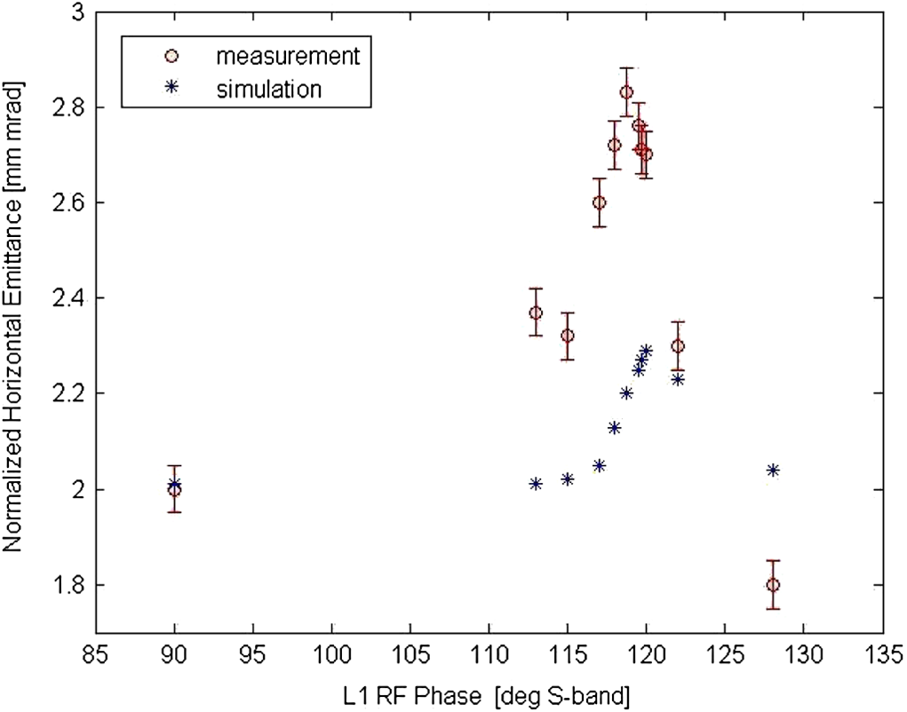
Projected Emittance Growth at FERMI BC1
Lower energy particles
Higher energy particles
path length difference
(bunch shortening)
particles’ energy difference
∝
QUADRUPOLES
SCREEN
1) Vary compression →
2) Re-match optics through BC1 region →
3) Measure ε_{x}
From injector: 200pC, 6ps fwhm
1.
before H-tuning,
Δε_{n,x} = 0.4 μm
@ CF=5
B
A
2.
after H-tuning,
Δε_{n,x} < 0.1 μm @ CF=5
3.
B
A
C
PRST-AB 15, 012802 (2012)
PRST-AB 15, 020701 (2012)

Slide 7
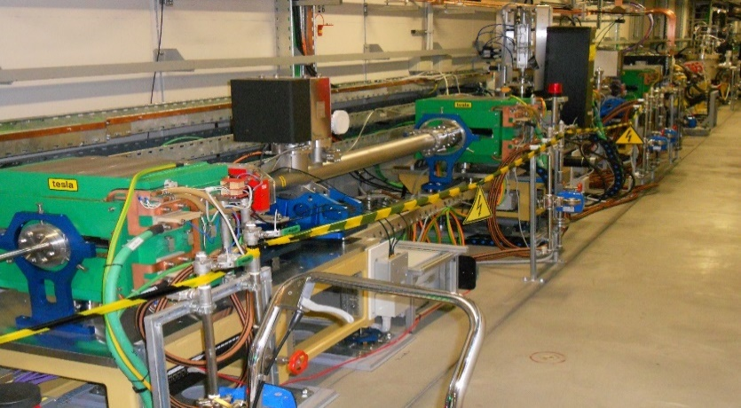

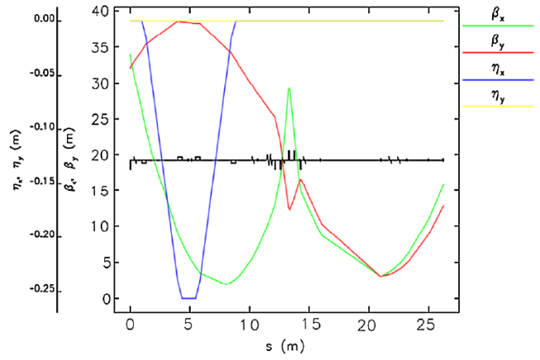

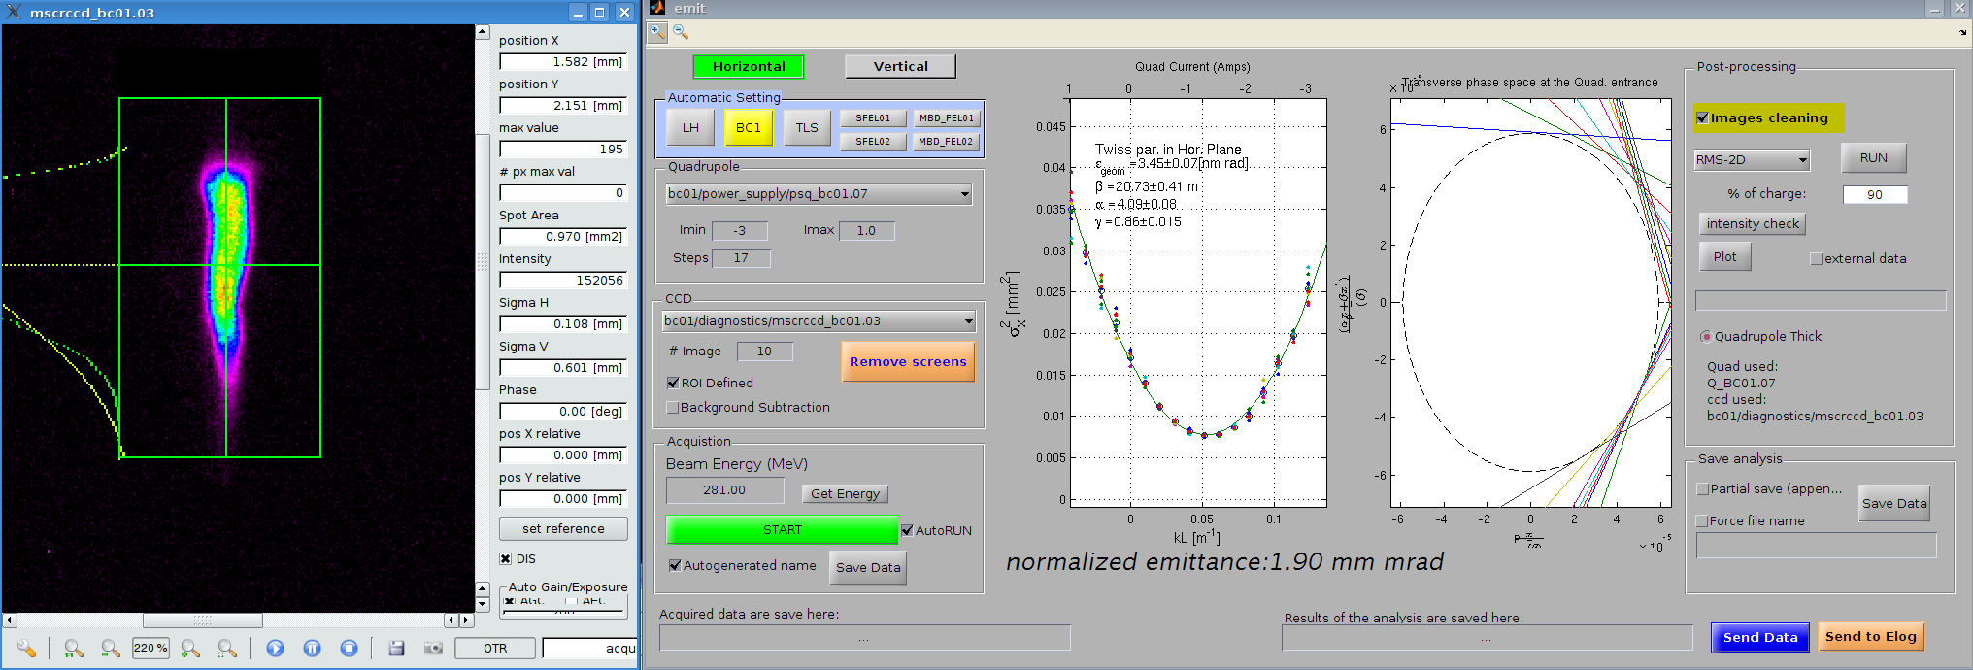
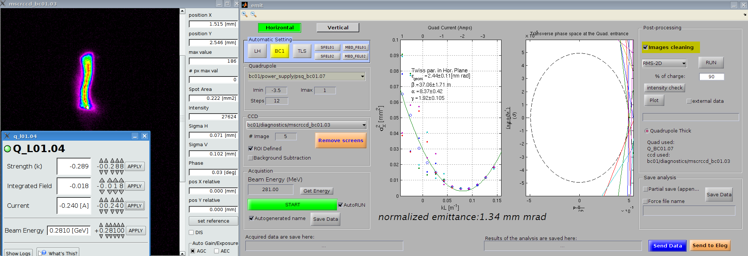
Dependence on Beam Optics
RF DEFLECTOR + QUADRUPOLES
SCREEN
1) Fix compression →
2) Tune H_{x}-function (β_{x}-min.) in BC1 →
3) Measure ε_{x} and (t,x)
From injector: 800pC, 10ps fwhm
ε_{n,x} = 2.1 μm
ε_{n,x} = 1.9 μm
ε_{n,x} = 1.3 μm
∼0.3 mm
∼0.2 mm
t
∼0.3 mm
BC1
SCREEN
∼2.4 mm
∼0.5 mm
QUAD
DEFL.
∼1 mm
x
Measurements by L.Fröhlich, L. Giannessi et al.

Slide 8
Emittance Growth in a Transfer Line
Problem.
When the bunch length is short and constant along a multi-bend line, we cannot recognize any «dominant» point of CSR emission (e.g., dipole-4 in a chicane).
Idea.
Adjust the optics along the line so that successive CSR kicks cancel each other. For symmetric CSR-source points, optics symmetry and π phase advance between dipoles promise to work. More general optics schemes work as well if Twiss functions and phase advance are properly «balanced».
Warnings.
This approach assumes identical CSR kicks in module, e.g. same bunch length emitting CSR in identical dipoles.
The simplest analysis assumes point-like optics functions in the dipoles (thin lens approximation). More accurate analysis implies dipoles’ thick length.
We neglect any transient CSR field at the dipoles’ edges, and CSR in drift sections. These effects can be taken into account in tracking codes, e.g. ELEGANT.

Slide 9
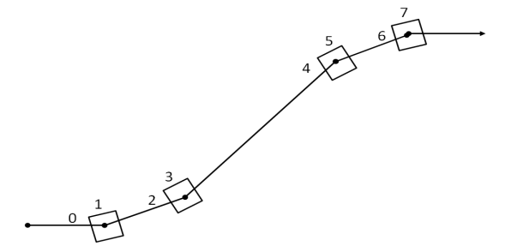
Optics Balance in a Locally Isochronous Transfer Line
Use the Courant-Snyder formalism for the particle coordinates, linear transport matrices, x₁=Mx₀, and J(0)=0.
When traversing a dipole, add the CSR induced η-terms. This leads to an increase of the particle’s C-S invariant:
0
Repeat until the end of the line. All kicks are identical in module, and we can write J_{f}=J_{f}(J₁). After averaging we find:
#5
#1
Final CSR induced C-S invariant is zero (cancellation).
#7
#3

Slide 10
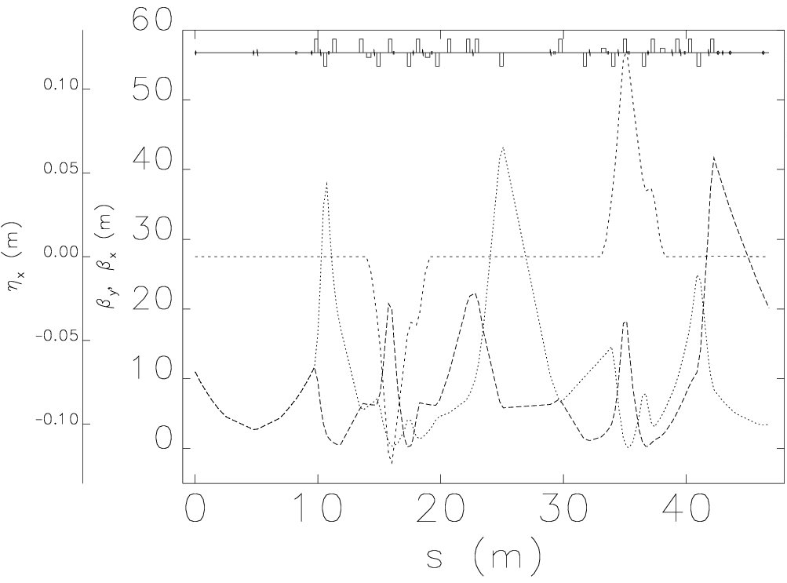
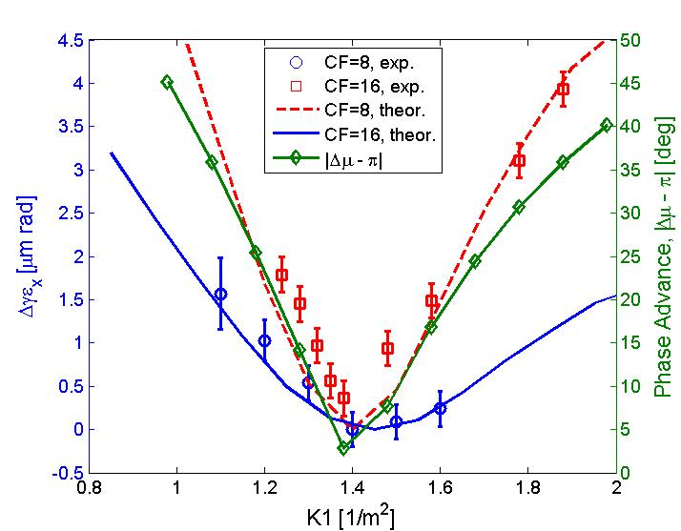
Projected Emittance Control at the FERMI Spreader
PRL 109 (2013); PR 539, 1 (2014)
Many quadrupoles ensure π-phase advance between dipoles and proper values of β_{x}, α_{x} to cancel the final emittance growth.
Quadrupoles
Dipole
Quadrupole for scan
One quadrupole’s strength is varied in the experiment to scan the phase advance between the two achromats.
Horiz. energy
dispersion, η_{x}
β_{y}
β_{x}
ε_{n,x} is measured at the line end as function of the quadrupole strength:
minimum ε_{n,x} for nominal optics (π-phase advance)
Larger ε_{n,x}–growth for shorter beam
500pC, 0.4 ps rms 0.2 ps rms

Slide 11
Bunch Length Compression in a DBA
For a single DBA, at the exit of the 2nd dipole we have:
where
CSR kick scales with σ_{z}
Look for the optimum Twiss parameters at the dipoles:
  as already in [Y. Jiao et al. PRTSAB 17, 060701 (2014)].

Slide 12
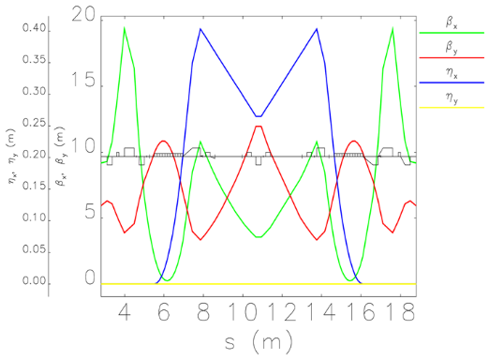
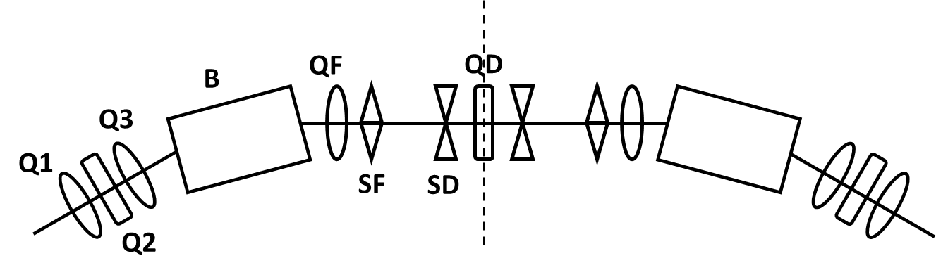
Periodic Arc Compressor
H_{x} has to be small at the dipoles ⇒ θ and β_{x} small
R₅₆ has to large enough to cumulate a C>30 ⇒ θ not too small
Suitable β_{x}, α_{x}, μ_{x} along the line for CSR cancellation ⇒ many quadrupoles
We want to linearize the longitudinal phase during compression ⇒ sextupoles
Possibly simple, robust and compact lattice
6 DBA cells (Elettra-like lattice, ECG).
180º, 125 m long at 2.4 GeV
R₅₆ = +35 mm per cell
Due to symmetry and short bends, Δμ_{x} ≈ π.
DBA cell

Slide 13
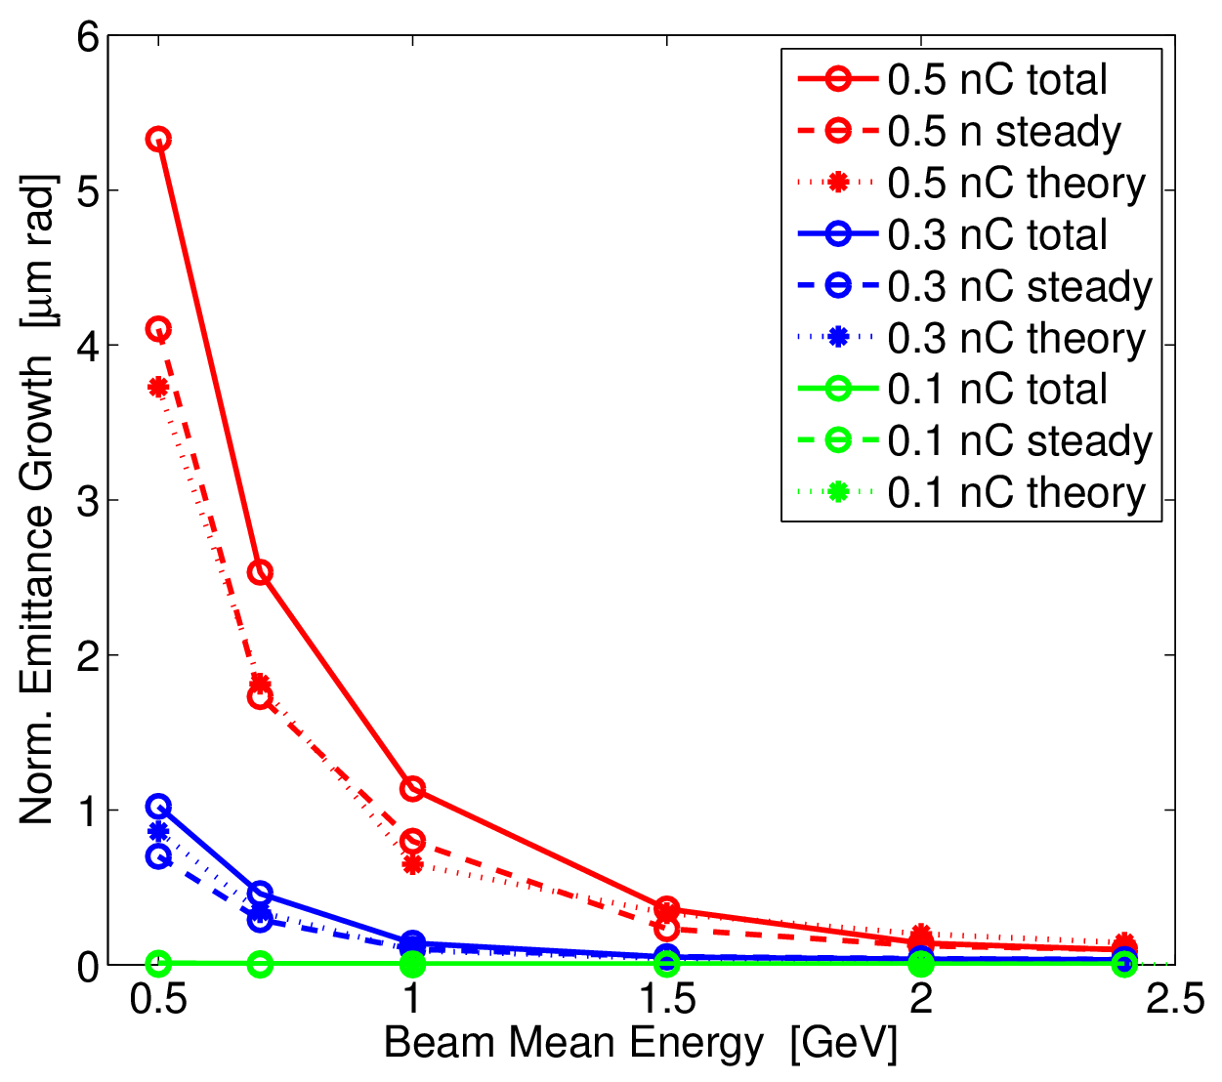
Simulation vs. Analytical Results
Ansatz: the emittance sums in quadrature after each DBA:
Theory: J_{i} as above.
Steady: 1-D CSR in Elegant.
Total: Steady + Edges + Drifts.
I_{f,0.5}=1.5 kA
I_{f,0.3}=1.0 kA
I_{f,0.1}=0.4 kA
This is:
sqrt[(ε_{nx,f})² – (ε_{nx,0})²],
and ε_{nx,0} = 0.8 μm.
We may achieve
Δε_{nx} ≤ 0.1 μm for, e.g.:
100pC, E > 0.5 GeV
300pC, E > 1.0 GeV
500pC, E > 2.0 GeV

Slide 14
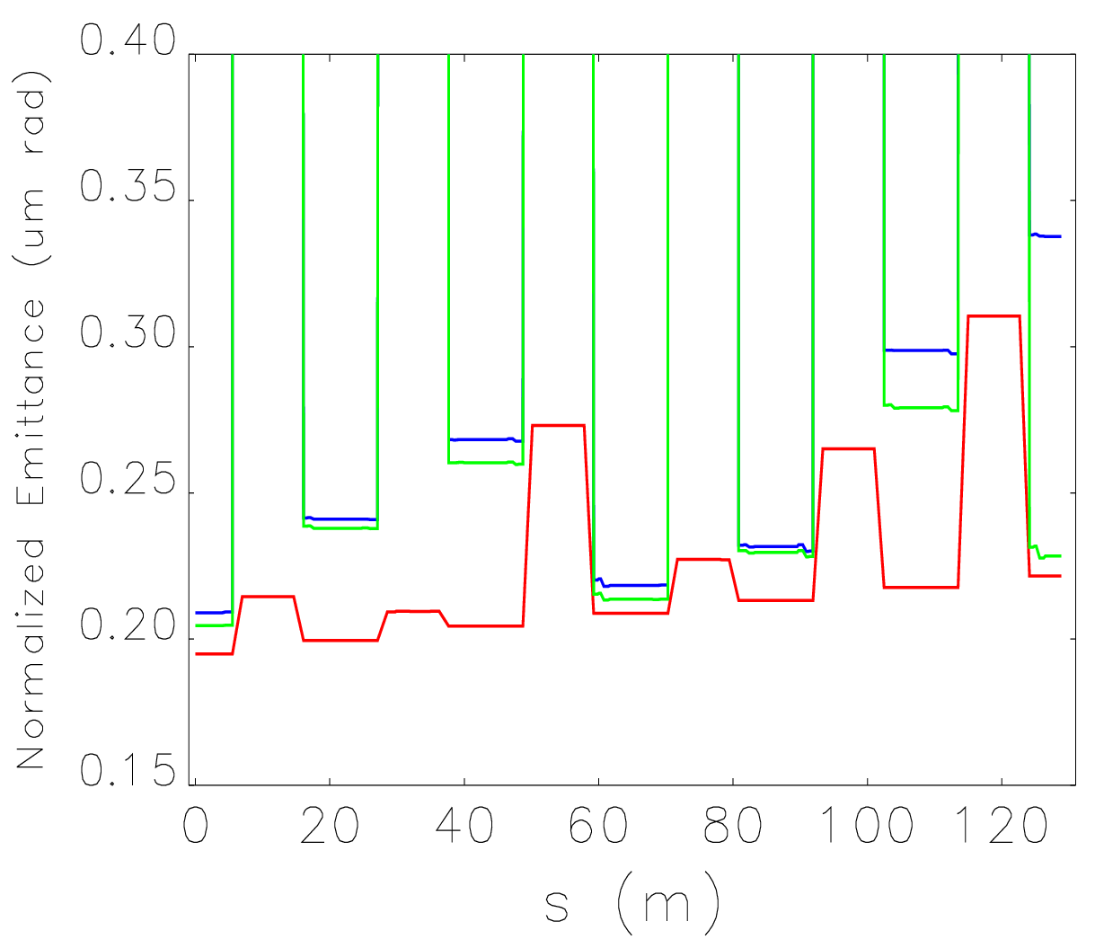
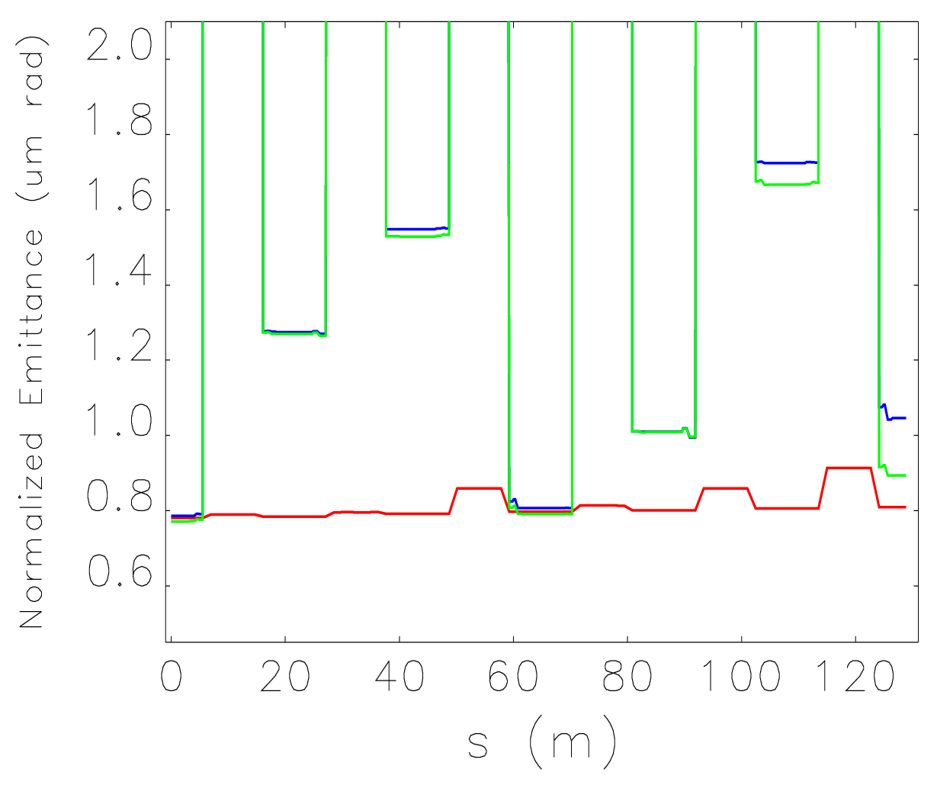
Nonlinear Dynamics
Nonlinearities in the longitudinal phase space evolve during compression due to:
Incoming RF curvature,
T₅₆₆ of the DBA cells,
Nonlinear CSR-induced energy chirp.
24 sextupole magnets linearize the compression. Strengths and positions optimized for minimizing chromatic aberrations (these are responsible for the emittance modulation along the line, see below).
Δε_{x,PROJ.} ≤ 0.13 μm
CSR
Δε_{x,PROJ.} ≤ 0.15 μm
3rd ORDER
ISR
EPL 109 (2015) 62002
NIM A (2015)
100pC
500pC

Slide 15
Final Remarks
The final emittance estimate in a 4-dipoles compressor is in reasonable agreement with 1-D tracking results.
Optics balance for emittance control turned out to work in a (almost) isochronous transfer line.
Optics balance may be extended to the case of varying bunch length, leading to a simple formula for a DBA-based periodic system.
Experimental evidences of emittance control are rather poor in literature:
  lack of data at very large compression factors, very high peak current,
  lack of codes benchmarking with experiments
Additional experiments are under consideration at the FERMI BC1 and Main e-Beam Dump line.

