Slide 1
Particle Physics @ DESY
Overview and Highlights
Joachim Mnich
AIDA2020 Workshop
16 June 2016

Slide 2
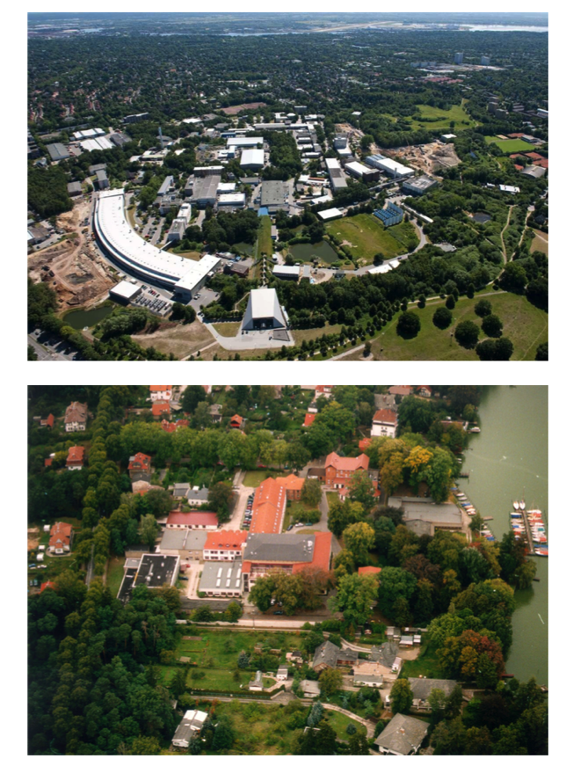

DESY
Deutsches Elektronen-Synchrotron –
German electron synchrotron
A national research centre of the
Established 1959 in Hamburg;
since 1992 also in Zeuthen
Annual budget ~200 million EUR
plus project funding
  90% Federal Ministry of Education
  and Research (BMBF)
  10% city of Hamburg and federal
  state of Brandenburg
2300 personnel, 3000 visitors / year
Helmholtz: 3 billion EUR, 17 centres, 30000 people

Slide 3
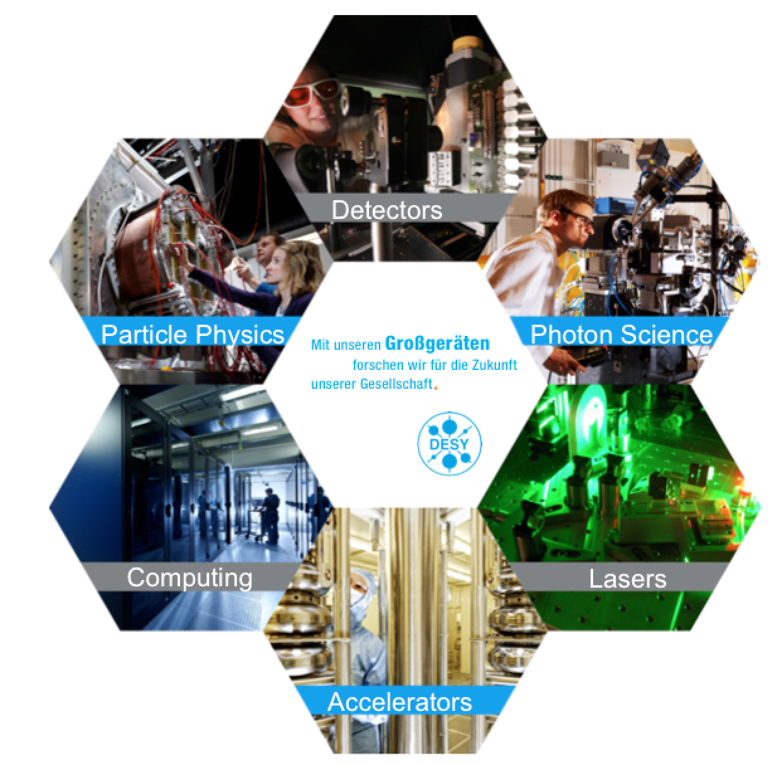
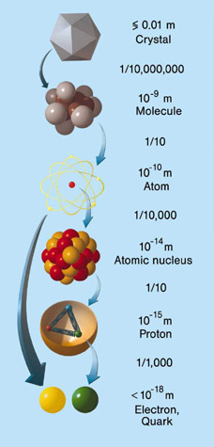
RESEARCH AT DESY

Slide 4
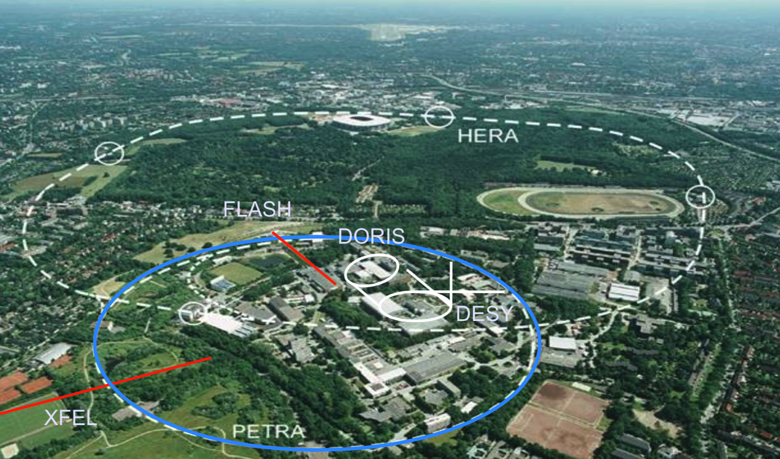
ACCELERATORS AT DESY

Slide 5
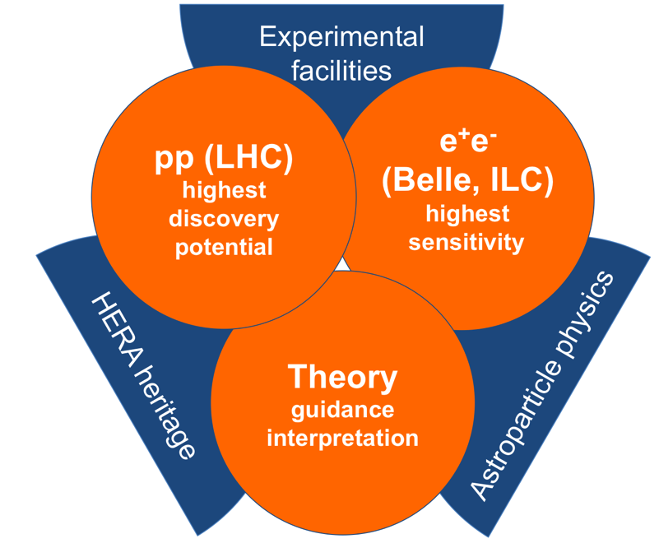
DESY PARTICLE PHYSICS: STRATEGY
Strategy builds on DESY core competencies
  DESY: > 50 years of design, construction,
  operation of large-scale facilities
  Strong in physics analysis, theory,
  detector R&D, computing
  National laboratory: Testbeam, Tier 2,
  Terascale Alliance
DESY strategy as laid down
in 5-year plan 2015-19 (“POF III”):
  pp physics: discovery potential
  e+e-: extreme sensitivity (ILC, Belle)
  Theory: guidance+interpretation
Supported by infrastructures
  Computing, testbeam, detector labs, …
In line with European and global strategies

Slide 6
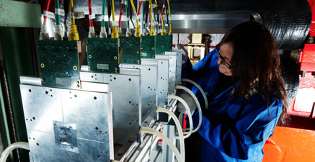
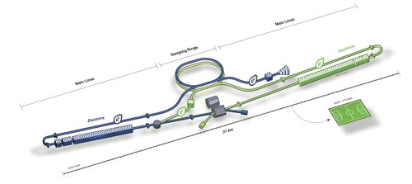
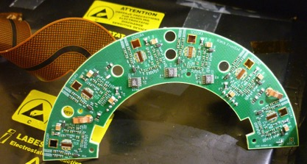

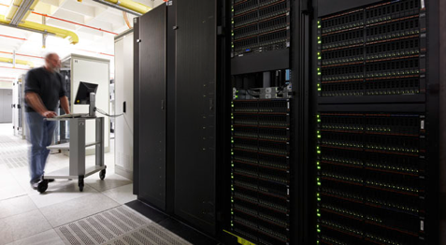
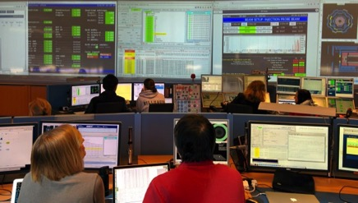
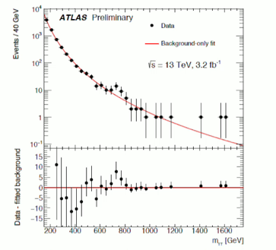
EXPERIMENT LIFECYCLE COMPETENCE
Development
Conception
Design
Construction
Data
Preservation
Operation
Physics
analysis
Interpretation

Slide 7
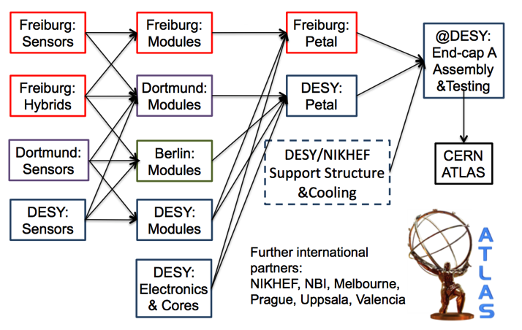
LHC PHASE 2 UPGRADE: ATLAS ENDCAP
Detailed scheduling started
Work on TDR started; due 12/2016
Delivery to CERN 2023/24
Production, construction and
integration in detector assembly
facility (DAF)
Collaboration DESY – universities: ATLAS
ATLAS endcap in numbers:
Silicon | 35 m²
Petals | 224
Modules | 4032
FE chips | 44352
Wire-bonds | 11 Mio.

Slide 8
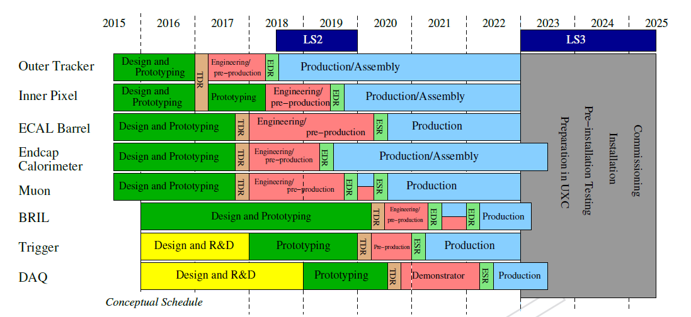
LHC PHASE 2 UPGRADES: CMS ENDCAP
Similar conditions as for ATLAS
Also here complex project with
German universities and other
partners
All in all German contribution to
phase II in excess of 100 MEUR
coordinated at DESY
Collaboration DESY – universities for the CMS endcap
Preliminary CMS upgrade schedule

Slide 9
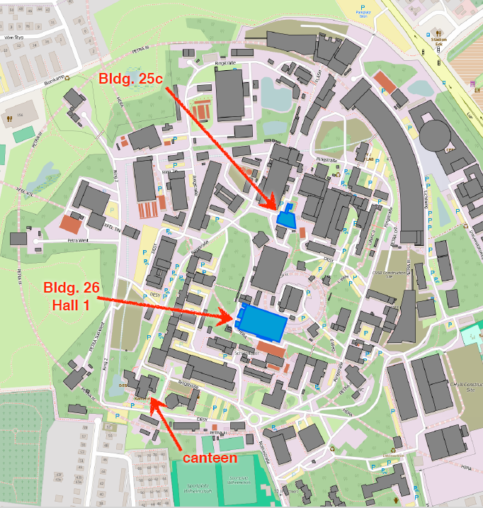
DAF: DETECTOR ASSEMBLY FACILITY @ DESY
Large project (10 MEUR) for construction and integration of ATLAS+CMS tracker endcaps
Building 25c
  Lab space & clean room for
  module production + testing
  Start NOW! Commissioned mid-2017
Building 26 (hall 1)
  Hall with cleanrooms for
  substructure assembly
  Endcap integration + system tests
  Commissioning 2018
Later use for other projects

Slide 10
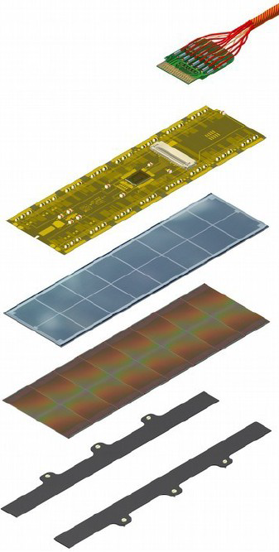
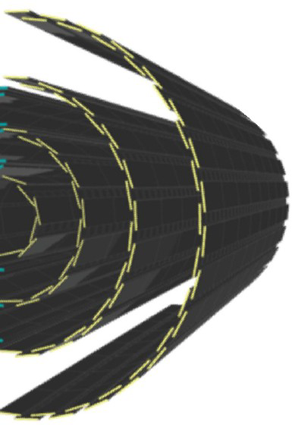
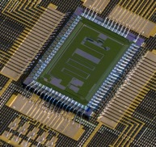
CMS PHASE-I BPIX UPGRADE
> New CMS barrel pixel detector: outer layer to be
built by DESY and German Universities
256 modules + 20 % spare.
Installation during LHC technical stop 2016/17.
Module production involves various high-precision steps:
Micro twisted pair cable
Token bit manager (TBM)
glued and wire bonded to
High-density interconnect (HDI)
glued to
Si sensor (16x64mm², 66560 pixels)
bump bonded to
16 read-out chips (ROCs)
wire-bonded to HDI
and glued to
base Strips (Si₃N₄)

Slide 11
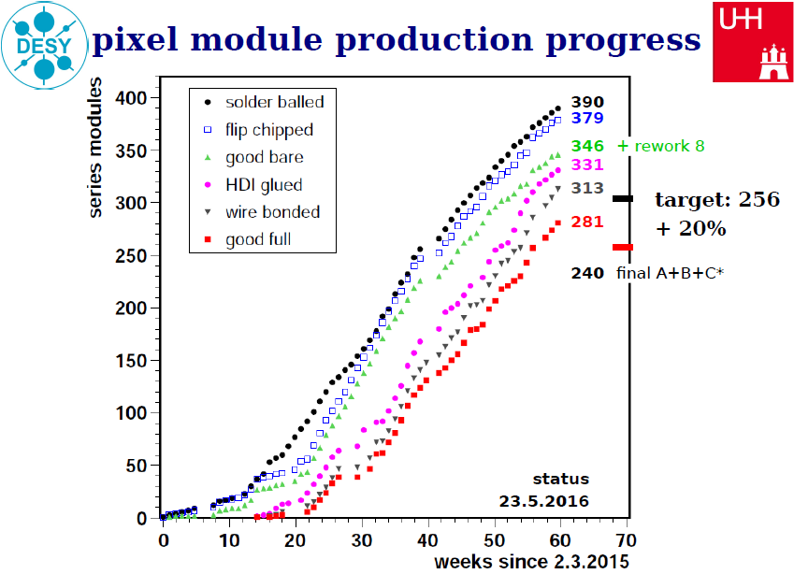
CMS PHASE-I BPIX UPGRADE

Slide 12













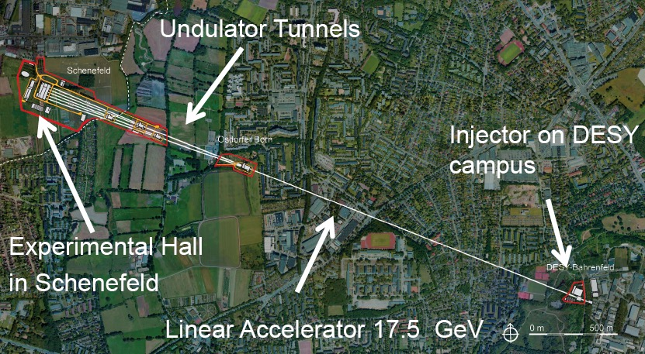
EUROPEAN XFEL
X-Ray Laser
Femto-Flashes
2,5 km
Ultrarelativistic Electrons

Slide 13
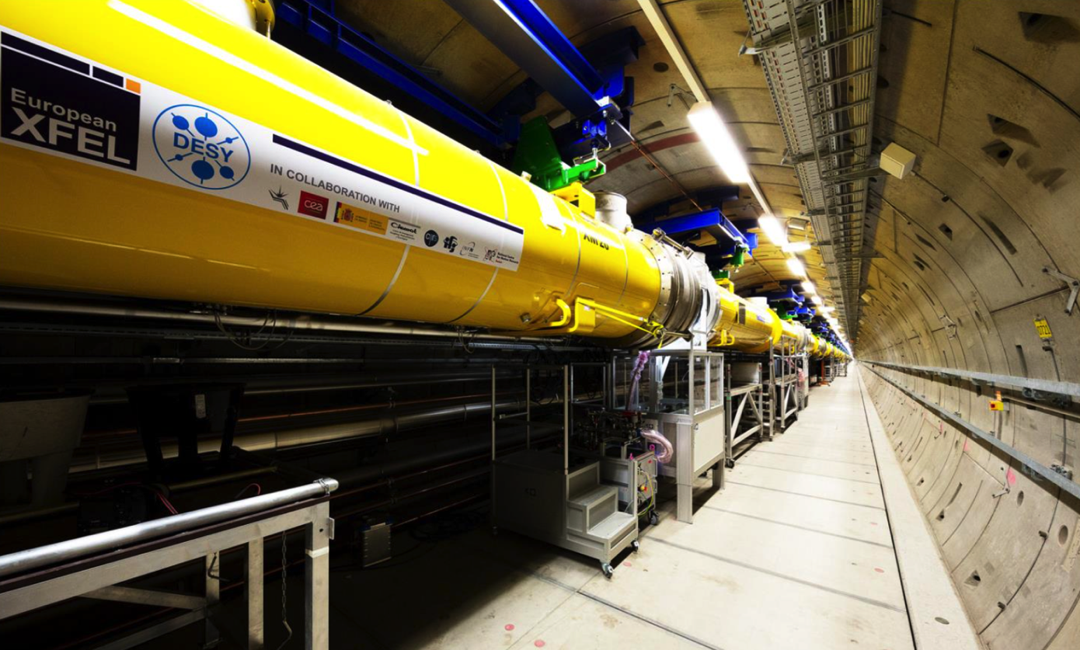
XFEL – CRYOMODULE STATUS
About 80 of 100 acc. modules installed
Almost all delivered to DESY
Last module expected 5 July

Slide 14
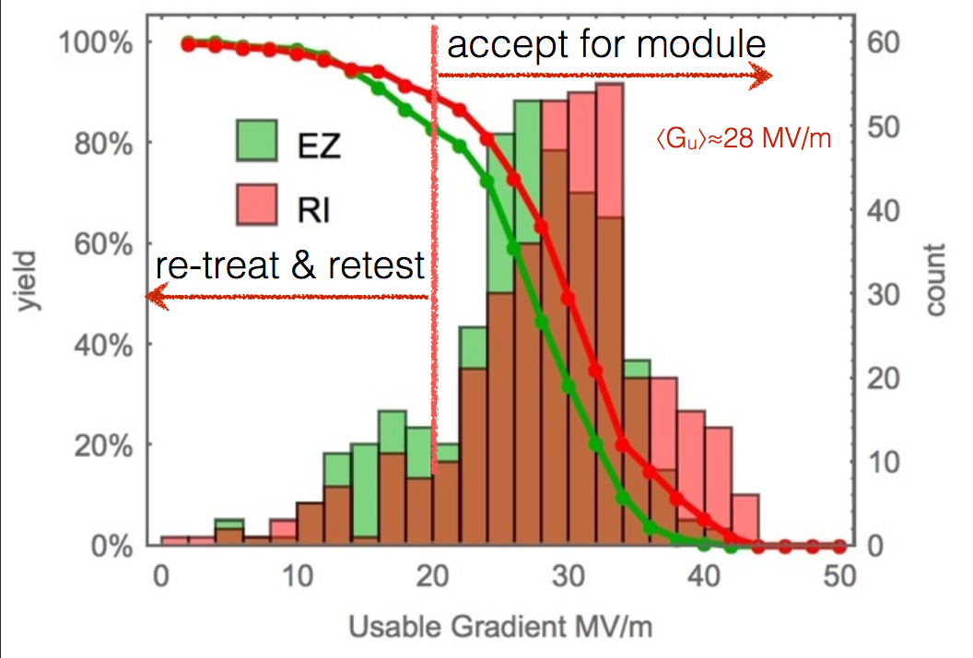
CAVITY PERFORMANCE AFTER RE-TREATMENT
Performance is close to ILC specs in industrial production!

Slide 15
ILC – THE VIRTUAL REALITY ROOM
In XFEL tunnel: 5% of the real ILC collider
Also at DESY: 100% of the (virtual) machine!
  3D projection+motion tracking: illusion of space
Complete ILC facility with tunnels, accelerator, experiments available
  Used for design studies (installation, transport, safety, …)
  Vision sharing between scientists, engineers, technicians, …
All information on machine in DESY EDMS system

Slide 16
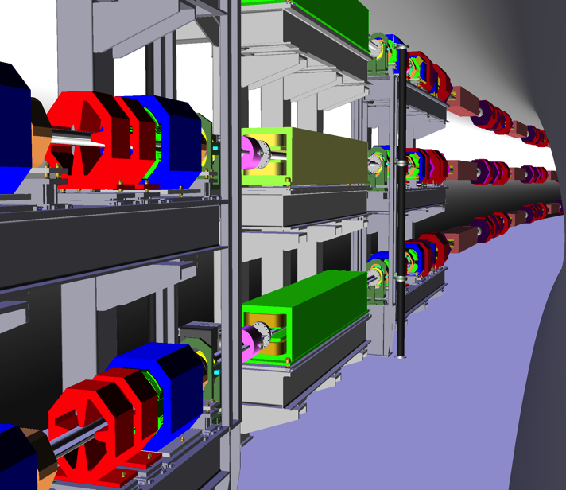
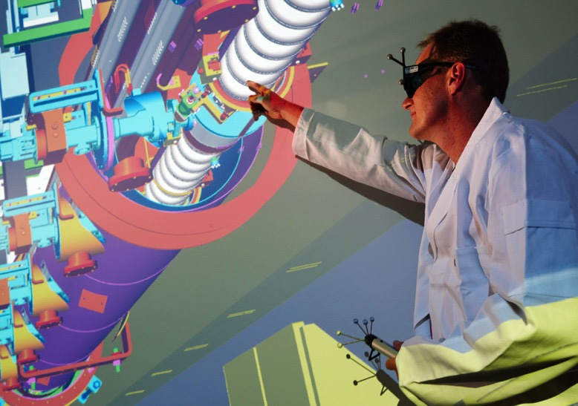
ILC – THE VIRTUAL REALITY ROOM

Slide 17
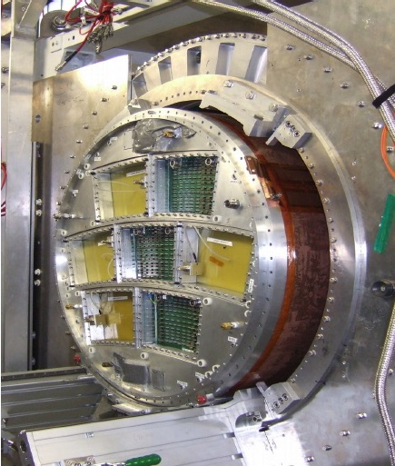
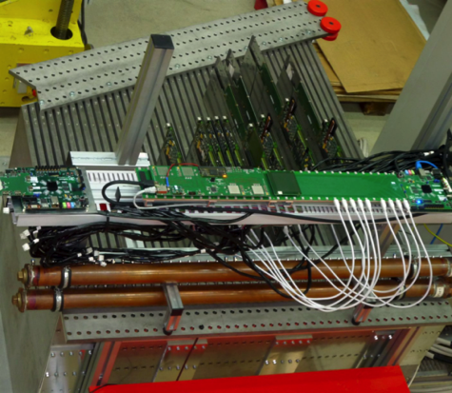
ILC DETECTORS & PHYSICS
TPC end-plate with read-out modules
Profiting from DESY’s HEP experience
in numerous former experiments
Significant contributions to
  HCAL–CALICE, TPC–LCTPC, FCAL,
  polarimetry, physics, integration, management
  TPC magnet and field cage – different read-out technologies; different calorimeter optical read-out technologies
  Accelerators: SCRF, positron source, …
Providing central supports to LC community
  Test beam, prototype integration,
  central software, MDI, documentation, …
Generic expertise useful for all potential
future machines
  FCC, CLIC, ILC, CEPC, …
CALICE stack

Slide 18
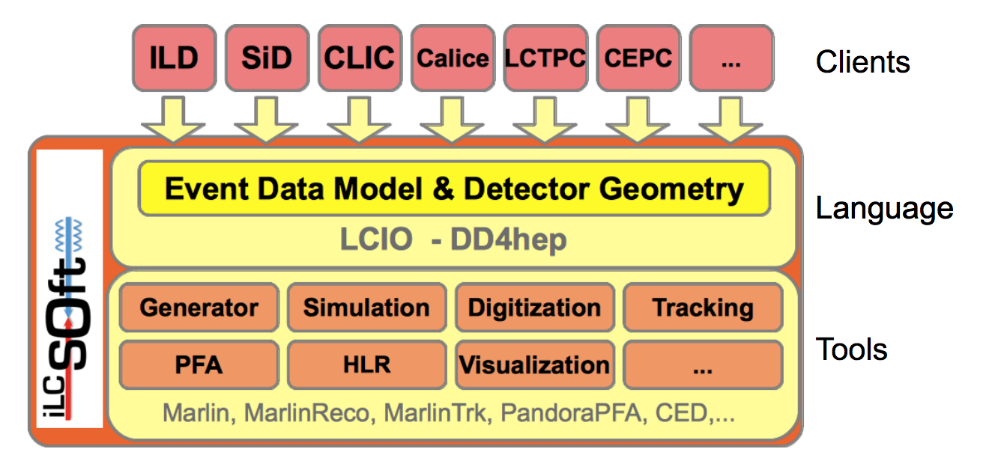
EXAMPLE: SOFTWARE FOR LC
DESY provides central software developments and support for the LC community
Also usable for other projects

Slide 19
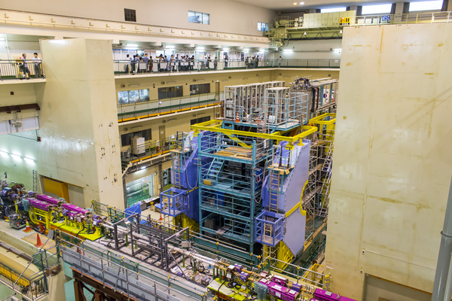
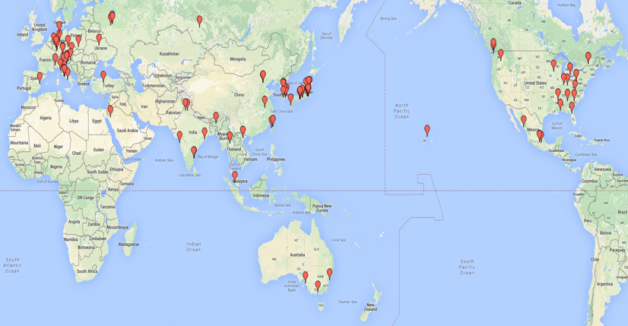
BELLE II + SUPERKEKB
First beams in upgraded SuperKEKB machine in February
Preparing for physics with Belle II
Belle II: a global endeavour
Germany second-largest
contributor
Main contribution: PXD –
pixel vertex detector
Q1+2 2016: Full VXD system test @ DESY
End 2016: Belle II in beam position
Q1 2018: VXD installation, then physics!

Slide 20
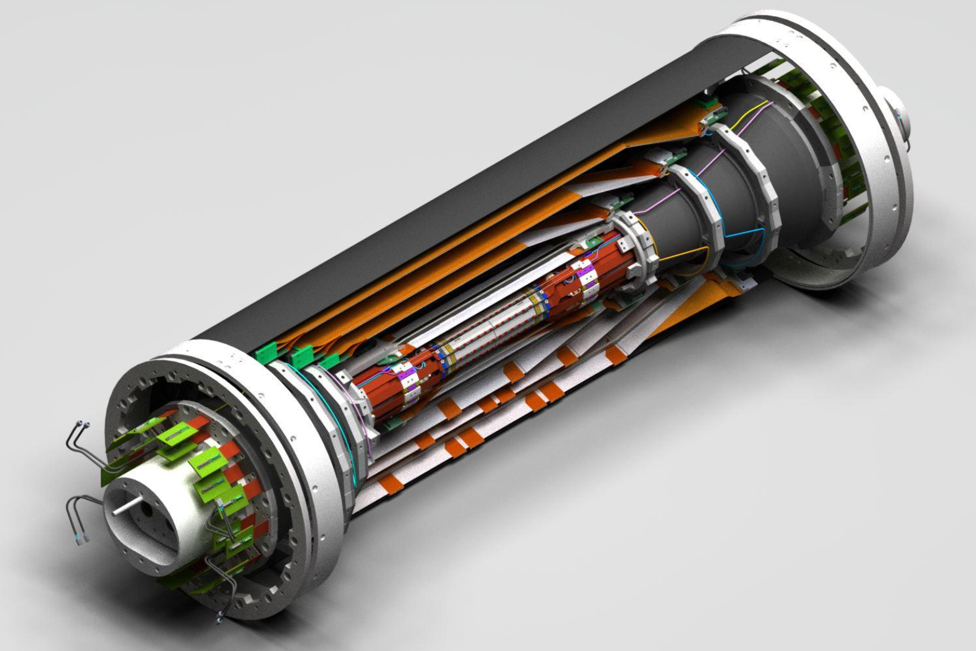
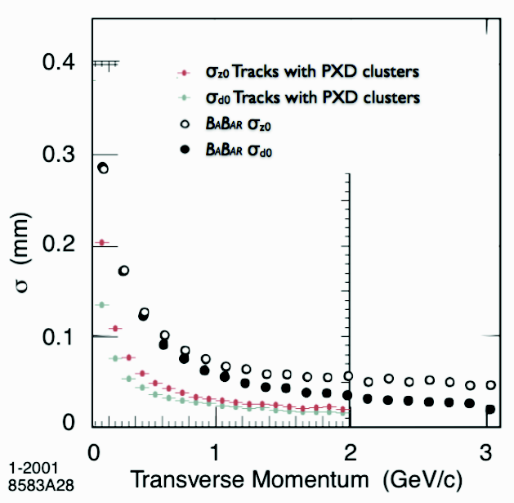
BELLE II –GERMAN CONTRIBUTION: PXD
PXD and SVD share common volume (“VXD”)
Consider as one integrated system:
Cooling, installation, commissioning
Other DESY contributions:
Remote vacuum connection
Thermal mock-up
DESY testbeam
Physics, Software,
Alignment, …
Transverse-momentum resolution
SVD
PXD
German
contribution

Slide 21
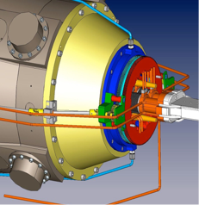
REMOTE VACUUM CONNECTION (RVC)
Nano-beam scheme requires complex superconducting final focus magnets very close to VXD
  Extremely tight space constraints around IP
  Challenging VXD installation
  Vacuum connection between machine vacuum
  and central beam pipe inaccessible
RVC proposed, designed and built by DESY
  Crucial interface between SuperKEKB and Belle II
  Prototype successfully tested and operation principle demonstrated
Presently ongoing at DESY
  Detailed installation and operation rehearsal using final system components
  System has to be ready at KEK for BEAST II operation in June 2017
Final focus quadrupole QCSL
RVC on QCSL

Slide 22
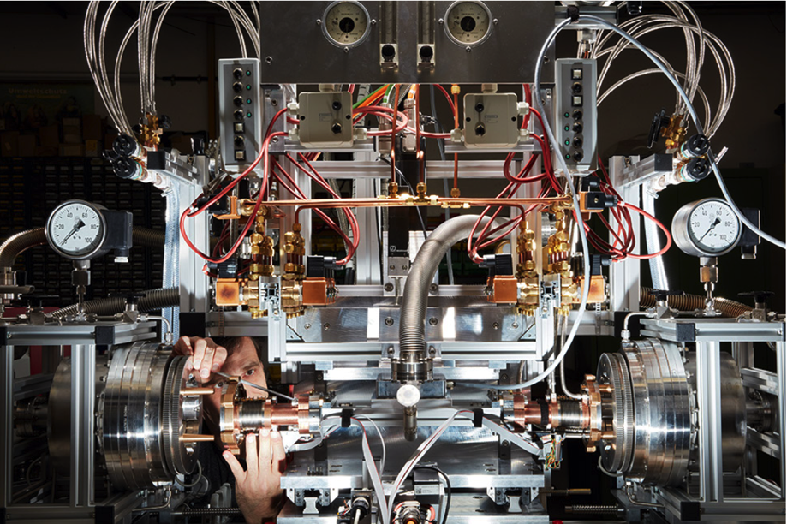
RVC TEST STAND @ DESY

Slide 23
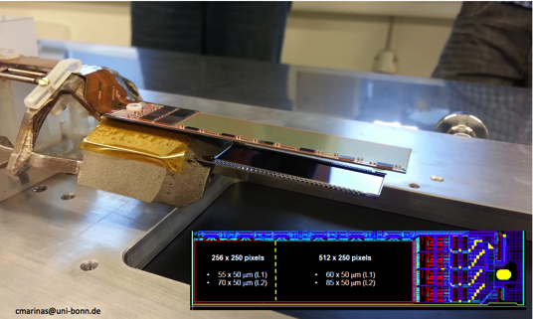
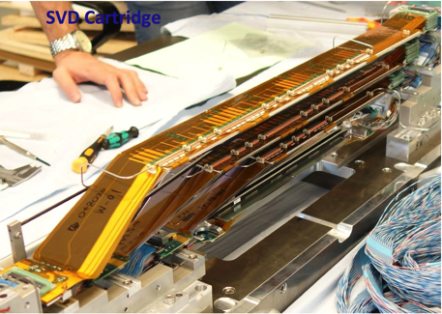
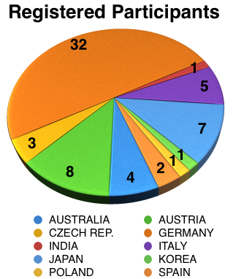
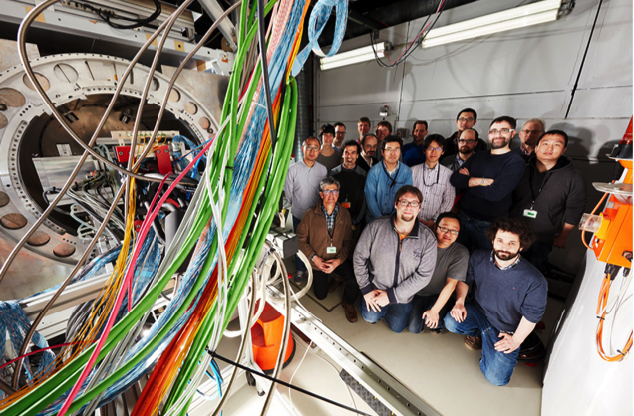
BELLE II VXD AT DESY TESTBEAM APRIL 2016
2-Layer DEPFET PXD
60 Participants
4-Layer SVD (DSSD)
Major Belle II milestone
  2 PXD + 4 SVD layers fully operational
  Almost final Phase 2 hardware
  Realistic environmental conditions
  (e.g. CO₂ cooling)
  Online data reduction (region-of-Interest finding)
  Alignment and track reconstruction
Next steps
  Detector integration and final beam test:
  Nov/Dec 2016 at DESY
  Preparation for BEAST II (Phase 2, 2017)
VXD telescope in 1.2 T magnet

Slide 24
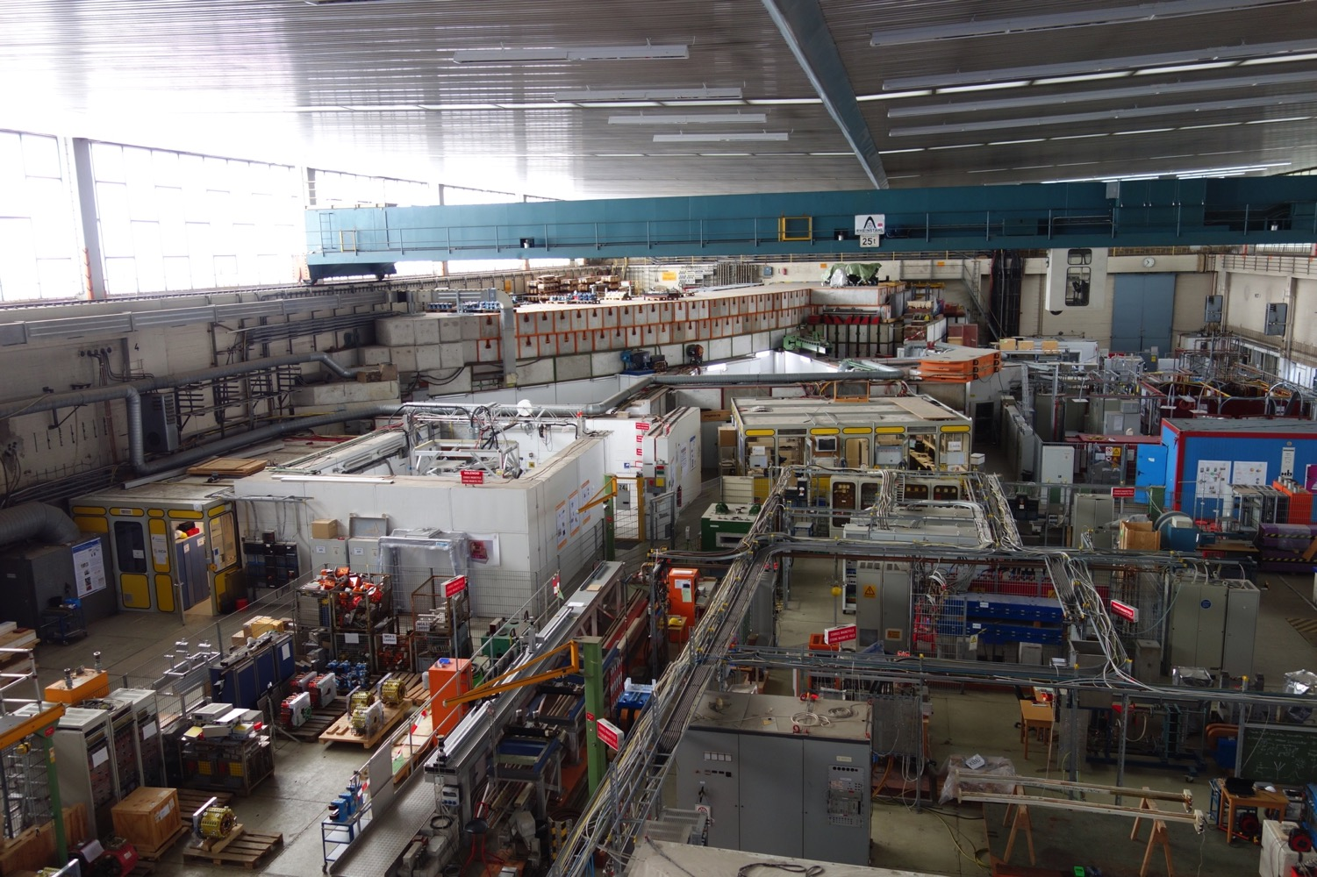
DESY-II TEST BEAM FACILITY

Slide 25
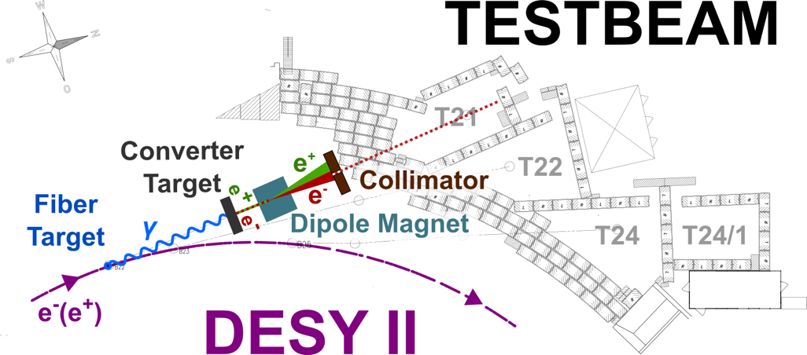
DESY-II TEST BEAM FACILITY

Slide 26
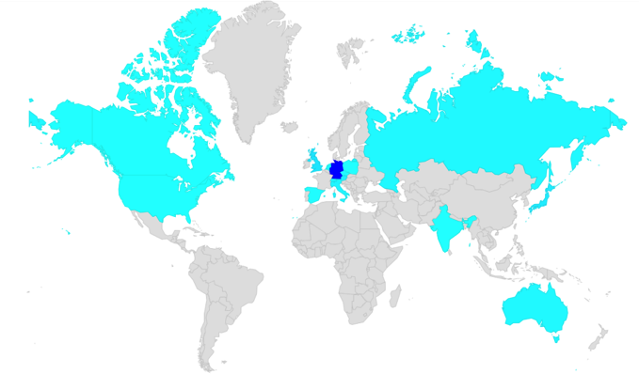
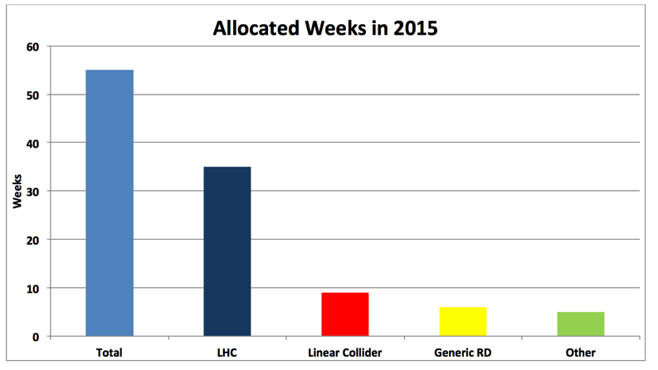
DESY-II TEST BEAM FACILITY
Summary 2015
  277 users from 17 countries
  42 projects in 55 test beam weeks
Run 2016
  March 14th -December 23rd, 57% already booked
  70% of all groups request telescopes; also PCMAG in
  high demand (unique!)
Highlights
  Belle-II tracking system test
  with 66 users
  First time: Physics teachers from Hamburg will do experiments at
  the facility
  2016 so far: 176 users
  from 15 countries

Slide 27


HISTORY: THE EUDET PROJECT
2006: EUDET – Detector R&D towards
the International Linear Collider
  Integrated Infrastructure Initiative (I3), framework for detector R&D with larger prototypes
  31 partners from 11 countries; 20 more associated.
  21.5 MEUR (7 MEUR from EU) for 4 years
  Transnational access scheme; significant networking activities
Three joint research activities (JRAs):
  Testbeam infrastructure: EUDET pixel telescope, large-bore magnet, …
  Tracking detectors: TPC prototype, Si TPC readout, Si tracking
  Calorimetry: scalable ECAL + HCAL prototypes, FCAL, DAQ etc.
6th Framework Progamme

Slide 28

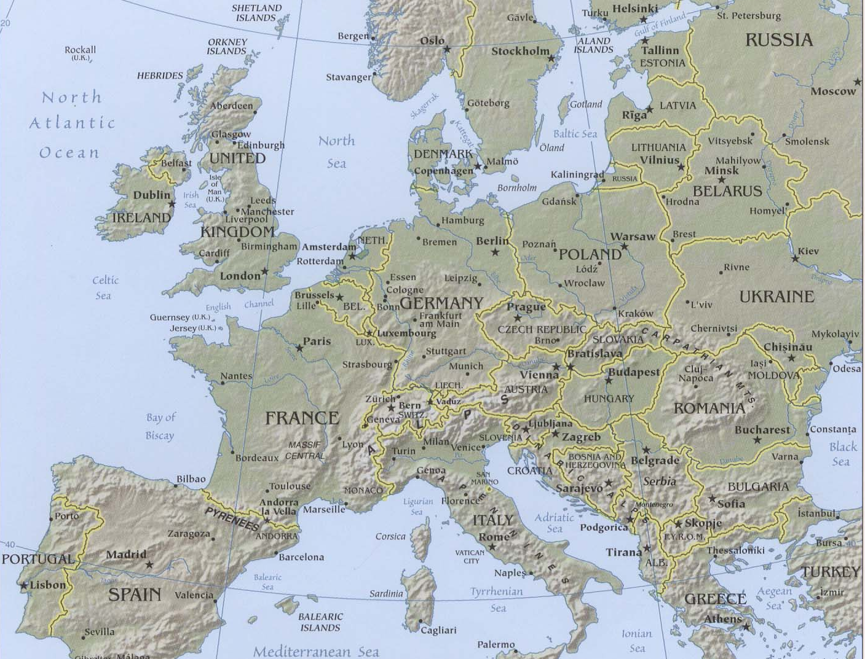
The EUDET Map
• EUDET partners
• EUDET associates
Novosibirsk
Protvino
ITEP
MPHI
MSU
Obninsk
KEK (Japan)

Slide 29

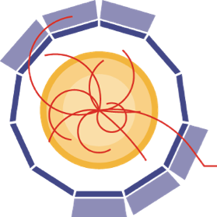


AIDA AND AIDA2020
2006-10: EUDET under FP6
2011-14: AIDA under FP7
2015ff: AIDA2020 under Horizon2020

Slide 30
Backup

Slide 31
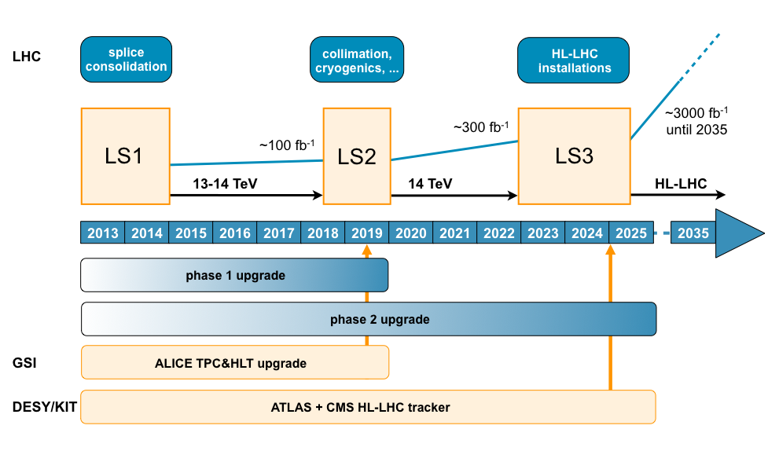
CONTRIBUTIONS TO LHC PHASE 2 UPGRADE
Now
ATLAS and CMS groups involved in phase 2 tracker endcap upgrades
Established coherent concept for all participating institutes in D

Slide 32
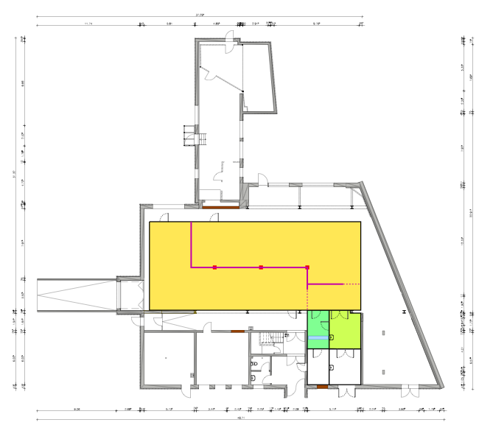
BLDG. 25c: LABS & ISO 6 CLEAN ROOM
Refurbishing just started, ready to use mid-2017
Exciting times at DESY!
  Looking forward to large project with collaborators from many institutes.
113 m²
114 m²
CMS
ATLAS
36 m²

Slide 33
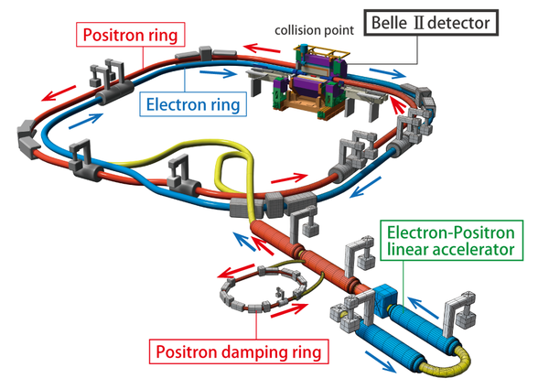
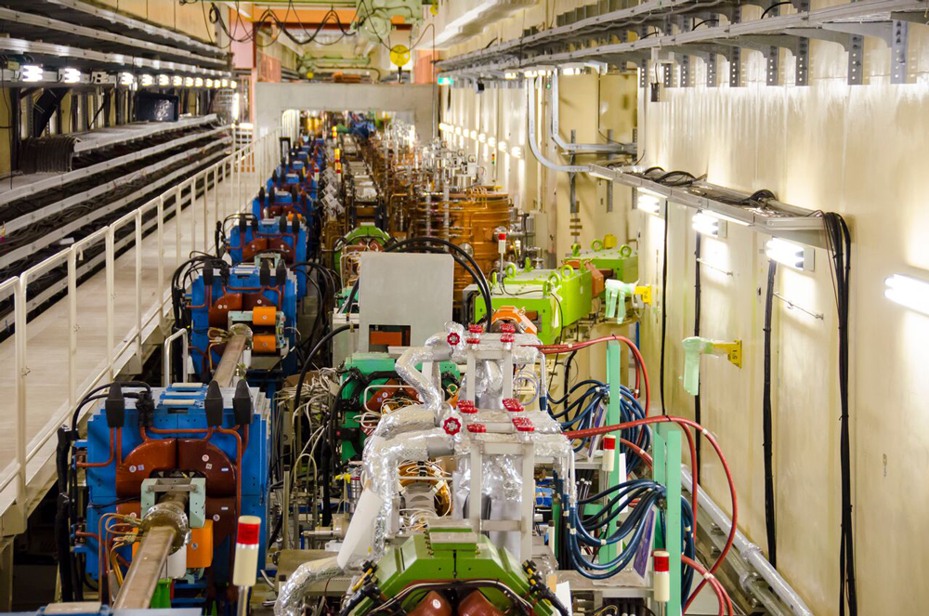
BELLE II + SUPERKEKB
First beams in upgraded SuperKEKB machine in February
Preparing for physics with Belle II

