Slide 1
WP6
…

Slide 2
WP Tasks
WP Coordinators: Gianluigi Casse, Ivan Peric
Goal: Exploration of an innovative tracking-detector technology based on active CMOS sensors
Task 1: Scientific Coordination (KIT, UNILIV)
Task 2: Simulation (CNRS-CPPM, UBONN, STFC-RAL, UNIGLA)
  Perform TCAD process simulations and Geant4 simulations for test structures and sensor prototypes for different CMOS processes
  Optimize sensor designs based on simulation results
  Organise simulation workshops
Task 3: Sensor Development (CEA, CNRS-CPPM, KIT, UBONN, STFC-RAL, UNIGLA, UNILIV)
  Design test structures and sensors
  Design pixel sensors matching different readout ASIC footprints
  Prepare designs for MPWR submissions exploring different foundries
  Characterise test-structures and sensors using electrical measurements, lasers, sources and test beams
  Perform irradiation campaigns to validate the radiation hardness of each process technology and sensor design
Task 4: Hybridisation (INFN-GE, IFAE, UNILIV)
  Perform basic R&D on capacitive interconnection
  Setup production facilities for full-prototype assemblies (chips on test boards)
  Deliver full assemblies to all participating projects
  Investigate options for future industrialisation of the interconnection process

Slide 3
WP Milestones
MS1: Simulation workshop on HV/HR-CMOS TCAD and Geant4 simulations. (M6)
MS2: Simulation tutorial on HV/HR-CMOS TCAD and Geant4 simulations. (M24)
MS3: MPWR submission. Design generic test structures for technology evaluations. Design HV/HR-CMOS active sensors matching the requirements of the target readout ASICs. (M12)
MS4: First test beam campaign with initial sensor prototype assemblies. (M16)
MS5: First irradiation campaign with sensor prototype assemblies. (M16)
MS6: First functional HV/HR-CMOS assembly with capacitive interconnection. (M16)

Slide 4
WP Deliverables
D1: TCAD libraries (M40)
  Extract performance parameters (depletion depth, charge-collection efficiency, timing, etc.)
D2: Sensor-design guidelines (M46)
D3: Performance characterisation results (M46)
  report on performance characterisation of test structures and sensors, including electrical, laser, source and test-beam measurements
D4: Radiation tolerance assessment
  report on measured radiation tolerance of optimised test structures and sensors
D5: Optimised interconnection process (M12)
  Basic R&D with different adhesives, dispensing and curing methods on electrical test structures to achieve precise alignment, high and uniform capacitance and sufficient yield and reproducibility. Mechanical and electrical characterisation of the glued assemblies
D6: Assemblies delivered (M40)
  Use the sensors produced in Task 6.3 (Sensor development) to produce assemblies of sensors and readout ASICs for all participating projects. Mount assemblies on test boards provided by the participating projects. Make wire-bond connections between chips and PCBs.
D7: Recommendation for industrialisation (M46)
  Investigate options for hybridisation of large-area assemblies. Adapt the interconnection technology for larger surface areas and make it suitable for mass production with high yield. Investigate wafer-to-wafer bonding options. Select industrial partners for initial tests.
D8: Final report (M46)

Slide 5
Task 2: Simulation Workshop
The two days workshop took place at the Centre de Physique des Particules de Marseille (CPPM), Marseille (FR) on the 12-13th of May 2016
Various aspects covered by the workshop included introductions for putting the simulation activity in the context of LHC experiments and the role of Geant-4 simulations
Followed by the introduction of device simulations using TCAD tools, comparison with measurements and hands-on sessions on TCAD simulation practice
Type of activity | Thematic Workshop
Title | WP6 workshop on simulations
Date | 12-13 May 2016
Place | Marseille (FR)
Type of audience | Scientific community, ESRs
Size of audience | 25
Scope of the workshop | International
Link | https://indico.cern.ch/event/497449/
Partners involved

Slide 6
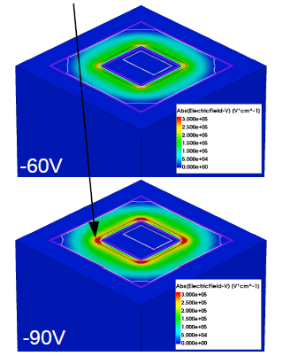
Task 2: Simulation Workshop
The two days workshop took place at the Centre de Physique des Particules de Marseille (CPPM), Marseille (FR) on the 12-13th of May 2016
Various aspects covered by the workshop included introductions for putting the simulation activity in the context of LHC experiments and the role of Geant-4 simulations
Followed by the introduction of device simulations using TCAD tools, comparison with measurements and hands-on sessions on TCAD simulation practice
Example: M. Buckland (Liverpool) Simulation of AMS H18 HVCMOS Pixel
Origin of breakdown detected -> new design submitted in February

Slide 7
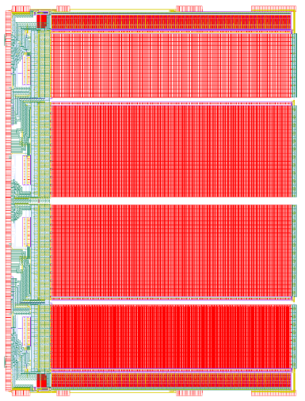
Task 3: Reticle size sensor in AMS H35 - H35DEMO
18.5 mm
Layout of the sensor
Producer AMS – technology H35 350nm
Pixel size is 250 µm x 50 µm.
The sensors have been produced on p-type substrates with four different substrate resistivities: 20, 80 (50-100), 200 (200-400) and 1000 (600-2000) Ωcm
Sensor type HVCMOS (see later)
Sensor contains four matrices
The first two pixel matrices contain 300 x 23 analog pixels each, that can be chip filpped to FEI4 and signals readout by bumps or capacitive coupling
Third matrix: 16 x 300 digital pixels - pixel electronics with comparator. Standalone (monolithic) readout possible
Third matrix: 16 x 300 digital pixels - pixel electronics with comparator. Standalone (monolithic) readout possible
Fourth matrix: 16 x 300 analog pixels with standalone readout
24.4 mm

Slide 8
Task 3: Reticle size sensor in AMS H35
Several test structures implemented
Structures for measurements of sensor capacitance
Diodes for laser measurements
Diodes with fast on-chip amplifier
H35DEMO detector can be used to test the quality of capacitive coupling.
It is possible to apply an externally generated test pulse to every bump bond pad.
Coupling capacitance can be determined
Capacitive coupling between large area chips can be tested

Slide 9
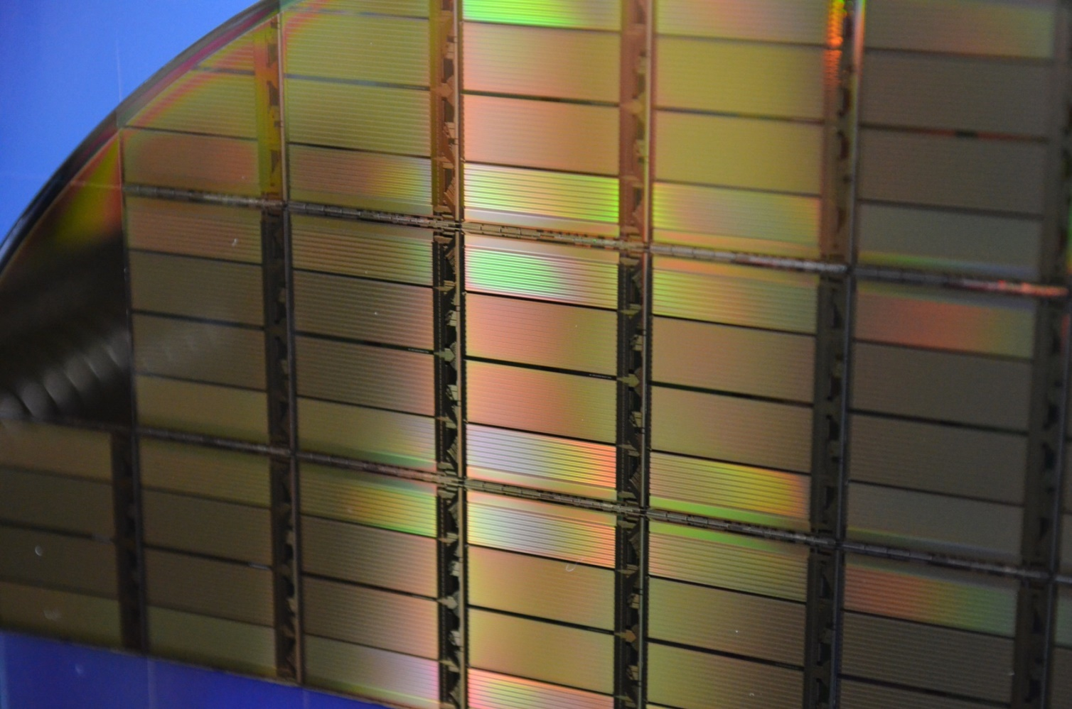
Task 3: Reticle size sensor in AMS H35
Photograph of diced wafer

Slide 10
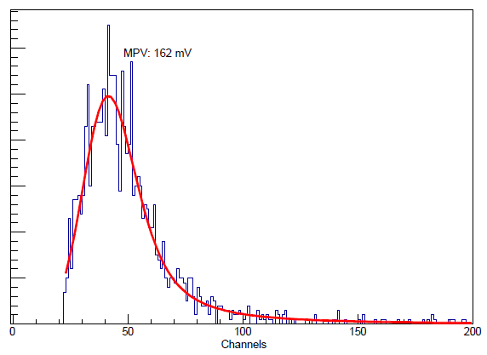
Task 3: Reticle size sensor in AMS H35
Chip on high resistivity substrate 80 Ωcm
Sr90 spectrum, HV bias ~ 100V (possible up to 160V)
Signal: 3700e – about 2x more than in the case of standard substrate

Slide 11
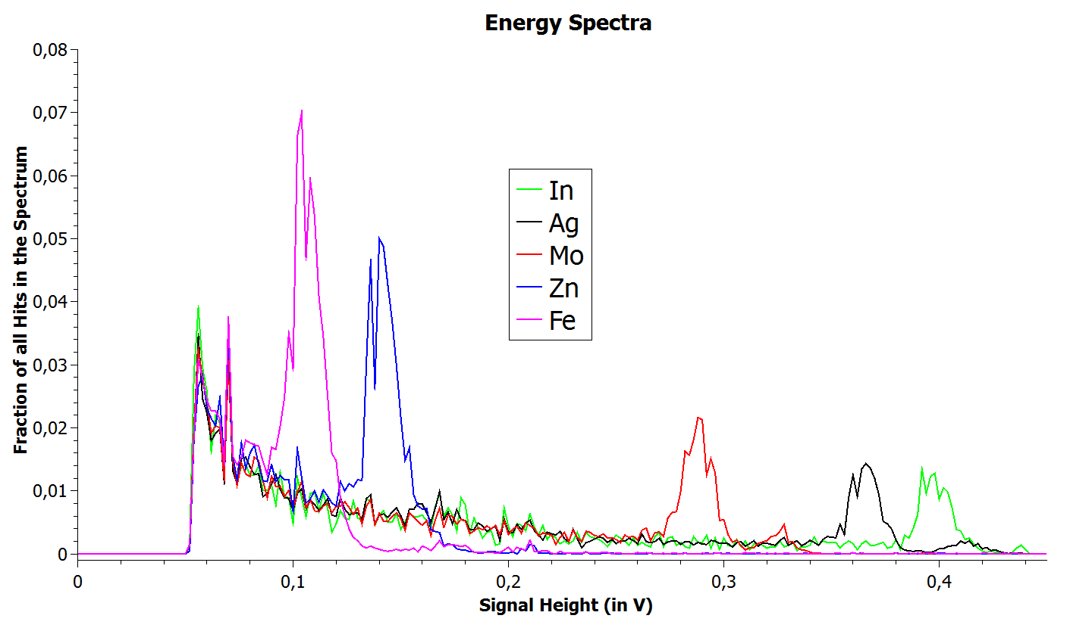
Task 3: Reticle size sensor in AMS H35
Spectra of different elements (targets irradiated with x-ray tube)

Slide 12
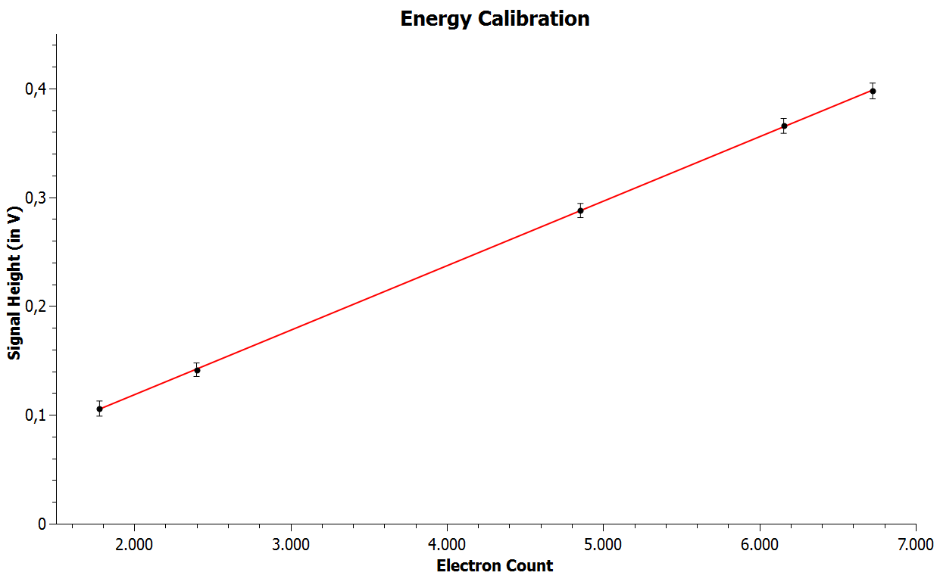
Task 3: Reticle size sensor in AMS H35
Energy calibration

Slide 13
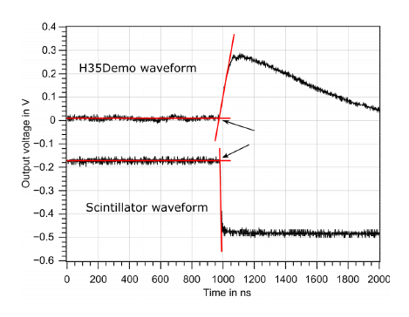
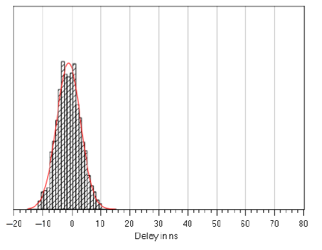
Task 3: Reticle size sensor in AMS H35
Time resolution
Fit of waveform
25ns

Slide 14
Task 3: Sensors in LFoundry
LFCPIX
LFCPIX sensors have been implemented in the LFoundry 150nm process.
LFCPIX submission – two similar sensor variants each with an area of 1cm x 1cm.
The chips contain three pixel matrices.
Matrix 1 contains the passive (“non CMOS”) pixels.
Matrix 2 contains pixels with amplifiers with attached CMOS comparator and a simple shift-register-based readout.
Matrix 3 contains analog pixels with amplifier.
The pixel size is 250 µm x 50 µm.
Chips will be implemented on a 2kΩcm p-type substrate.
Chips are expected to be delivered end of 2016

Slide 15
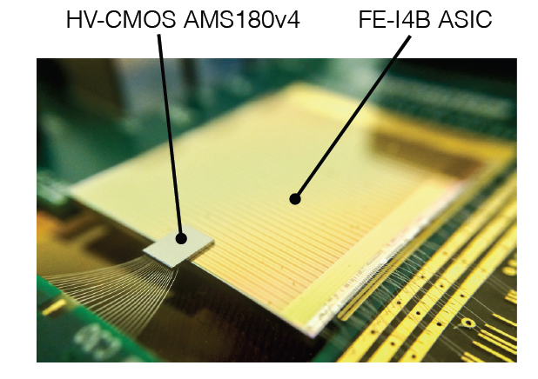
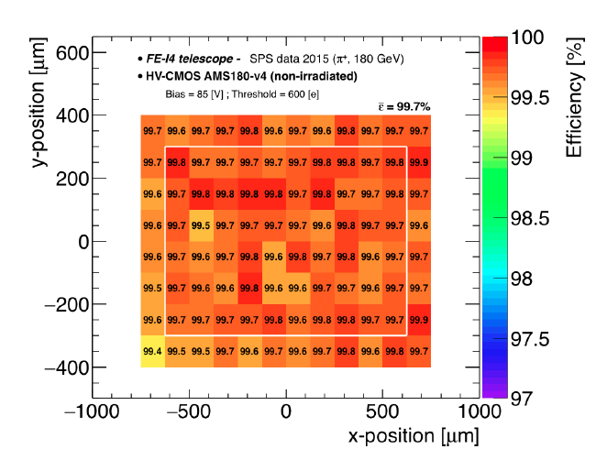
Task 4: Hybridization
Small capacitive coupled pixel detectors
CCPD for ATLAS
HVCMOS sensor glued onto FEI4

Slide 16
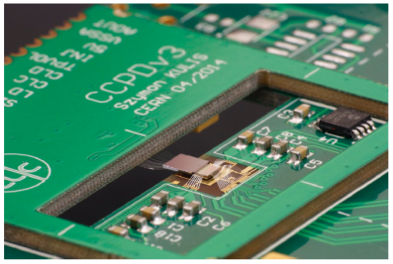
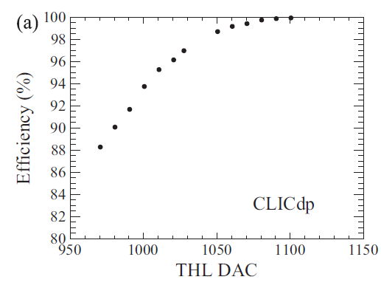
Task 4: Hybridization
Small capacitive coupled pixel detectors
CCPD for CLIC
CLICPIX glued onto the HVCMOS sensor
Single hit efficiency for single-stage amplification pixels versus threshold at 60V

Slide 17
Task 4: Hybridization
Tests of large area CCPDs
Preparation of test structures to perform systematic assembly tests for optimised AC coupling.
Large number of cheap test structures needed to test AC strength (minimised glue thickness), homogeneity on the area, repeatability of the assembling technique, etc.
Available devices : H35DEMO, dummy wafers
Available tools (see later)

Slide 18
Task 4: Hybridization
Dummy wafers (6”) from Genova.
Dummy wafers from FBK with 1 Al metal layer (1.2 μm). Each wafer has FEI4 size structures with 16x4 to 24x4 capacitors.
Each device can be split into 4 smaller devices with 16 to 24 capacitors each. There is also a mask to grow pillars on top of the 6” dummy
Full FE-I4 wafer dedicated for CCPD is available in Genova
Geneva is working to build 3 to 5um high pillars on blank wafers first and then on wafers with metal

Slide 19
Task 4: Hybridization
TOOLS available:
FC150 Suss flip-chip machine (0.5um precision) - for precision placing and pre-industrial tests.
SET ACCµRA 100 flip-chip machine for precision placing and pre-industrial tests.
Pick and place machine (fineplacer pico ma - 5um precision) - for prototyping
Pactech SB2-SM is a ball solder deposition machine (40um balls) - for prototyping of DC couple devices.
Climate chambers (e.g. Binder MK53 (<-40+180°C).
Plasma cleaning.
Mechanical profilometers (e.g. KLA Tencor P7:8”, 1 mm step, Repeatability/reproducibility: 4/15 Å, Vertical resolution: 0.01/0.60 Å.
Microscopes
LCR bridges
X-ray inspection machine: X-TEK-VTX160, 2μm resolution.

Slide 20
Summary
Task 2:
TCAD simulations of sensors structures in AMSH18 and H35 as well as in LFoundry technologies have been performed
Simulation results have been already used to improve the designs
The two days workshop took place at CPPM, Marseille – milestone M1 accomplished
18 talks in two days, 25 participant from 5 countries
Task 3:
Large scale (2cm x 2cm) HVCMOS sensors in AMS 350nm technology produced and tested
The sensor is implemented of 4 different substrate materials, it contains various tests structures and can be attached (capacitively or with bumps) and readout by FEI4. Monolithic readout is also possible. The sensor can be used for development of interconnection technology. Test beams and irradiations are planned
1cm x 1cm designs in LFoundry 150nm process have been submitted – can be readout by FEI4 or as monolithic sensors
HVCMOS CCPD Sensor with small pixels (25um x 25um) C3PD produced within CLIC project – it can be used for interconnect technology studies. Similar sensor is being designed in LFoundry
Task 4: Capacitive coupling works well on small chips – investigation of the interconnect technology of large chips ongoing
Several samples H35CCPD and FEI4 are available

