Slide 1
WP 11.1 Transnational Access to the GIF++ and IRRAD facilities at CERN
AIDA2020, 1st Annual Meeting, Hamburg, 13-17 June 2016
Sabrina El Yacoubi, Livia Elena Lapadatescu,
Michael Moll, Federico Ravotti, Roberto Guida
CERN, Geneva, Switzerland

Slide 2
EA-IRRAD Facility-Layout

Slide 3
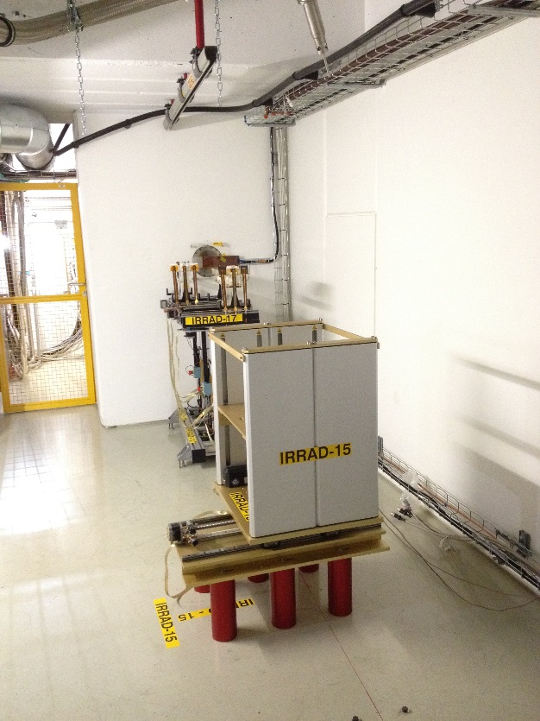
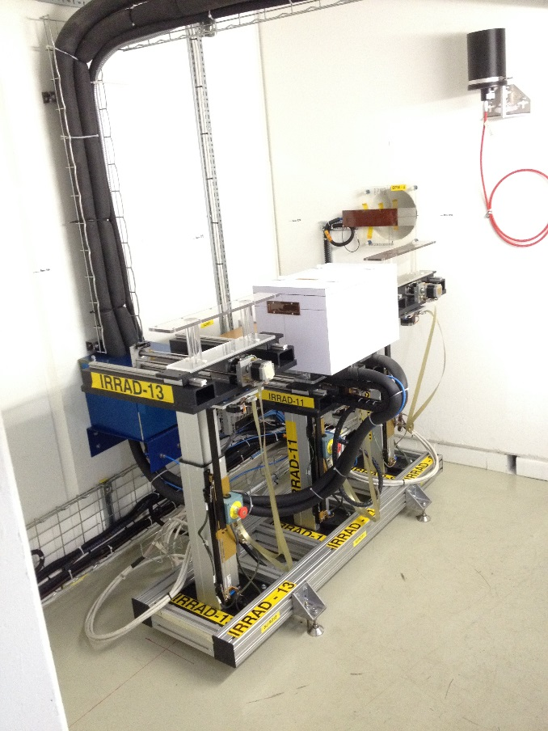
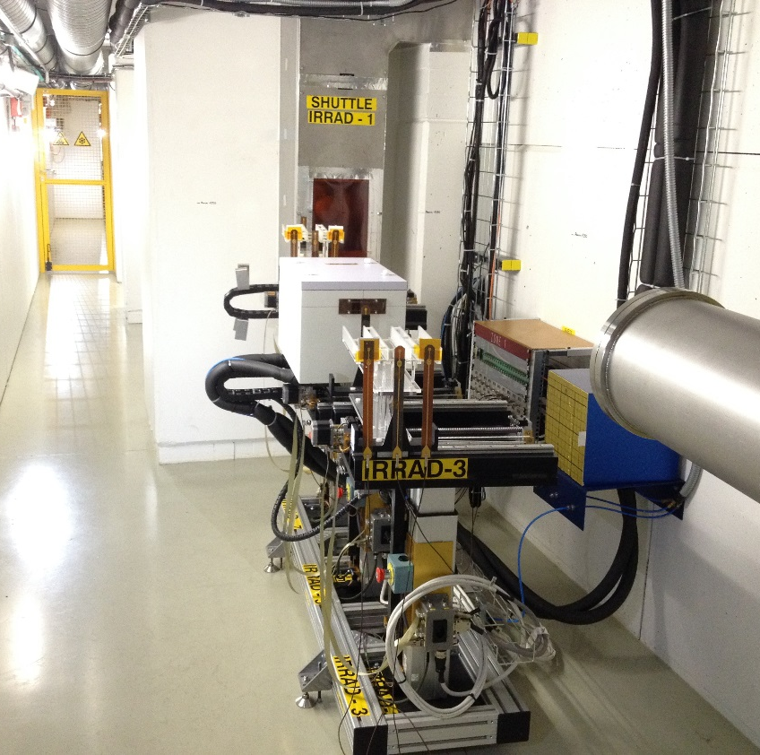
EA-IRRAD Facility Equipment
p⁺
p⁺
p⁺
Cryogenic
Setup
Cold Boxes
www.cern.ch/opwt/irrad
IRRAD Zone 3
IRRAD Zone 2
IRRAD Zone 1
  3 tables per IRRAD zone
  9 remote-controlled irradiation tables
    6x RT irradiation (IRRAD 3,7,9,13,17,19)
    2x water-cooled cold boxes down to -25°C (IRRAD 5,11)
    1x dedicated to the cryogenic setup (IRRAD 15)
  1 remote-controlled shuttle system (IRRAD 1)
  Pre-installed cabling infrastructure

Slide 4
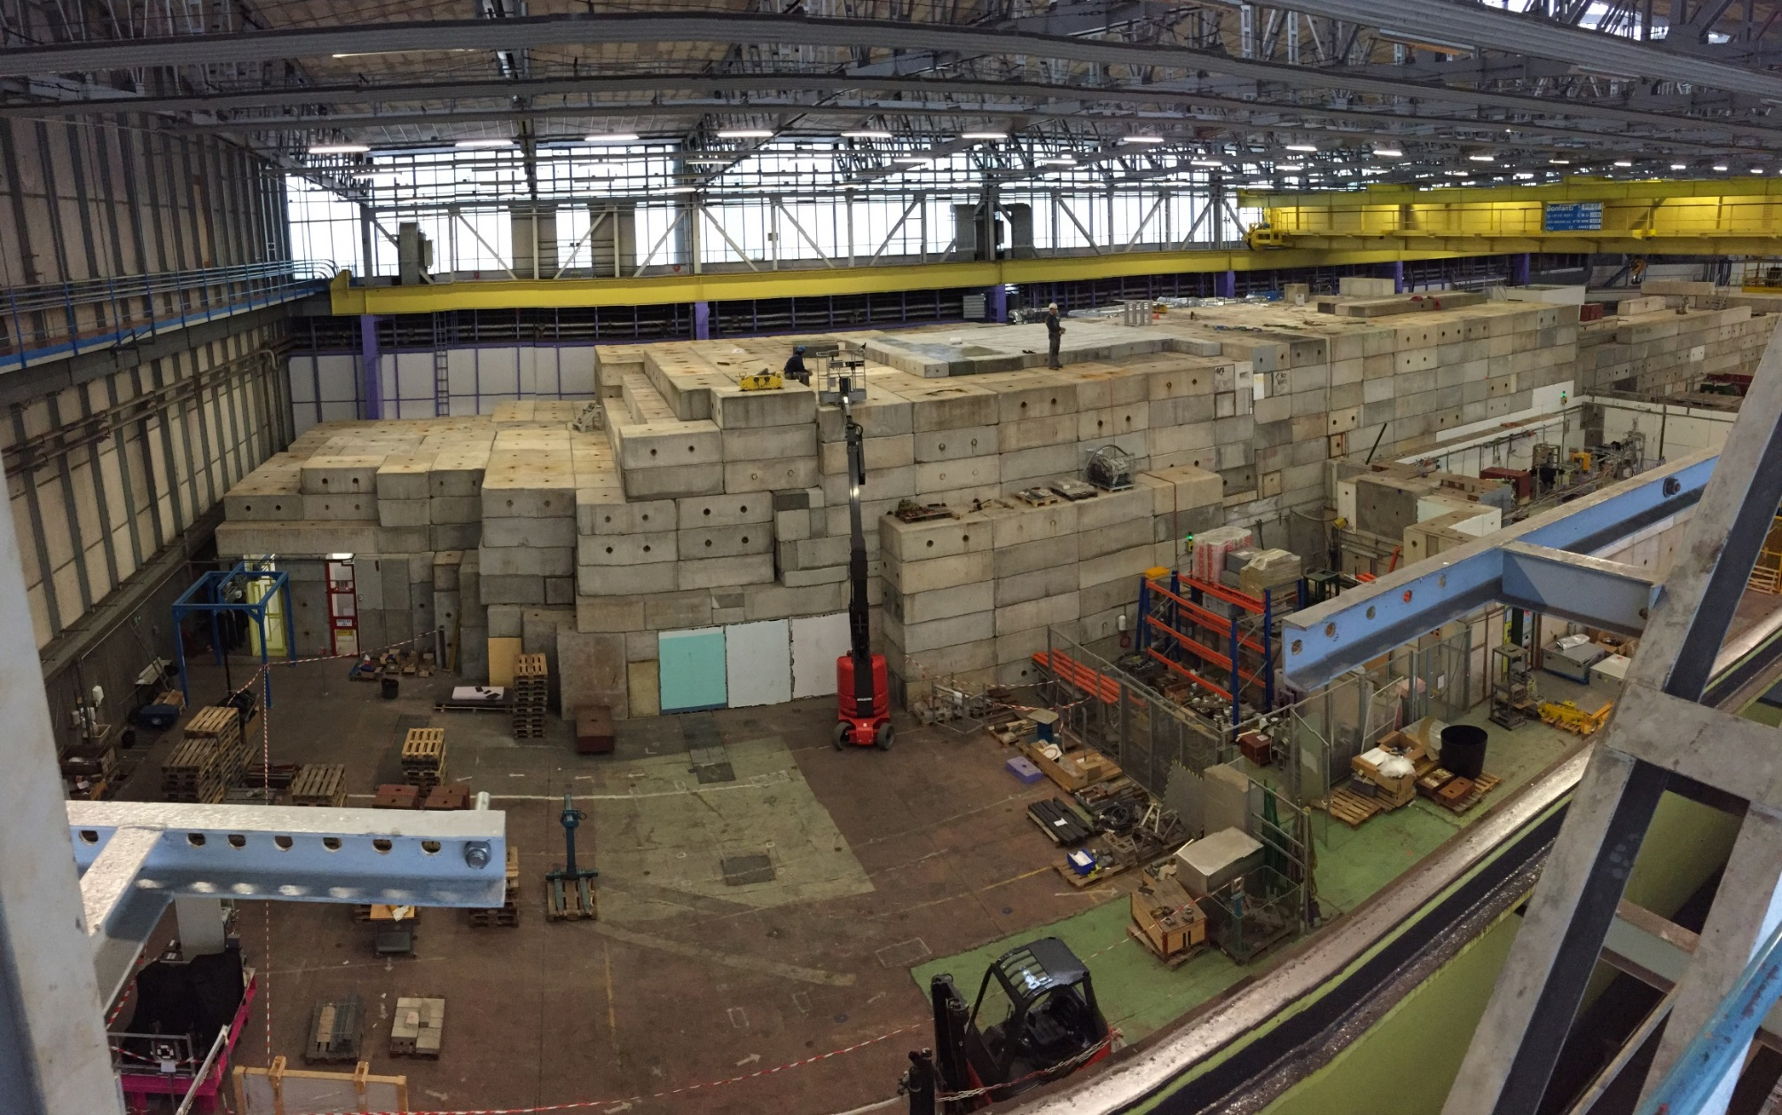
EA-IRRAD Arial View
IRRAD (proton)
CHARM (mixed-field)
T8 beam line
  IRRAD in numbers (run 2015)
  28 user teams
  from 18 institutes/experiments/R&D projects/CERN groups
  (ATLAS, CMS, LHCb, ALICE, RD18, RD39, RD50, RD53, BE/BI, DGS/RP)
  >300 objects irradiated
  >250 dosimeters measured
  30w of beam time (25w users + 5w setup/commissioning/RP)
4.5k tons of cast iron &
11.5k tons of concrete !

Slide 5
GIF++ Facility

Slide 6
GIF++ Aerial View
  GIF⁺⁺ in numbers (run 2015)
  10 setups being tested (muon systems of LHC experiments)
  belonging to 6 different types of detector technologies (CSC, DT, GEM, GRPC, MM, RPC)
  gamma irradiator operational 24/7 since end of April 2015
  28w of beam time (3w as main user)

Slide 7
AIDA Y1: IRRAD and GIF++
Data given in 1st annual report [M1 to M12]
Achieved: 17% 32% 28%
Achieved: 20% 26% 24%
1st year well in agreement with expectations given in proposal

Slide 8
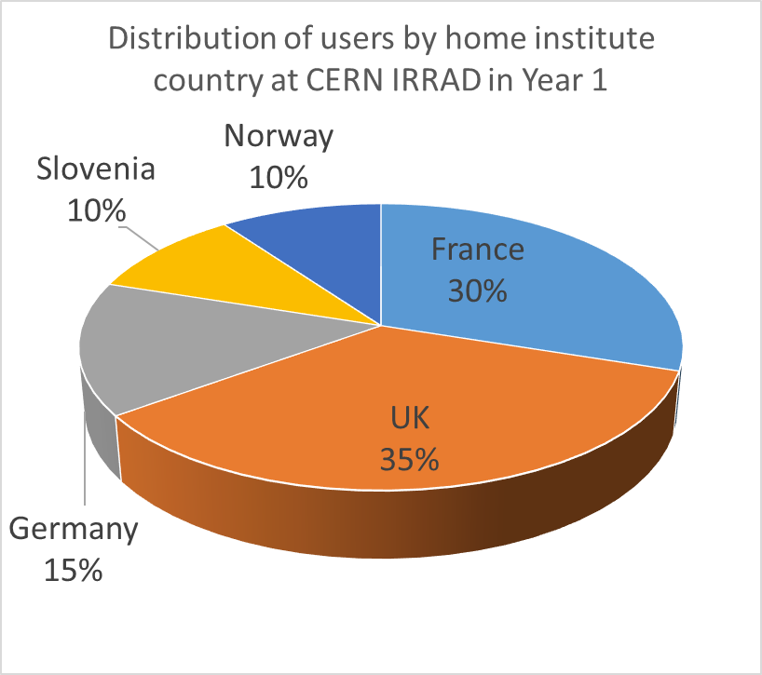
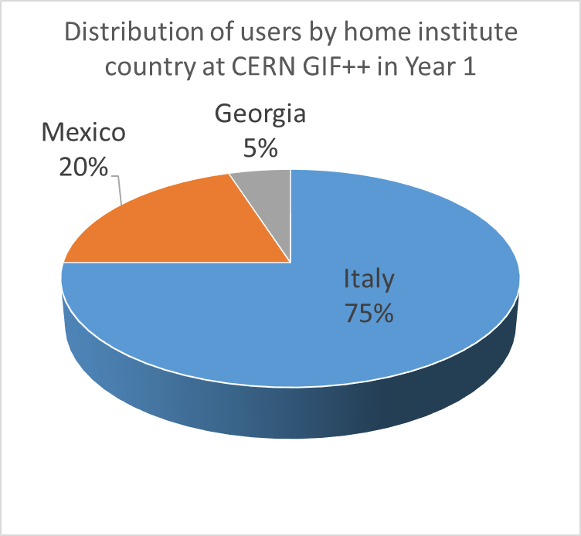
User community
User distribution by home institute country of origin
IRRAD: First 20 users GIF++: First 20 users

Slide 9
Status: IRRAD
Status of AIDA projects in IRRAD today
  TA on IRRAD facility (approved projects) versus aim given in proposal for AIDA 2020
  (4 years)
  53% of units delivered
  27% of projects
  62% of users
Spending: 50% of available financial support committed to projects
Conclusion:
  Number of users supported and units delivered in line with proposal
  Number of projects is less than anticipated (complexity of projects grown)
  Note:
    8 AIDA projects for the IRRAD facility, which is very small compared to the overall irradiations performed in this facility

Slide 10
Status: GIF++
Status of AIDA projects in GIF++ today
  TA on IRRAD facility (approved projects) versus aim given in proposal for AIDA 2020
  (4 years)
  70% of units delivered
  40% of projects
  80% of users
Spending: 70% of available financial support committed to projects
Conclusion:
  Number of users supported and units delivered ahead wrt. proposal
  Number of projects is less than anticipated (complexity of projects grown)
  Note:
    7 AIDA projects for the GIF++ facility
    (could be increased if also those colleagues using the facility without financial support would fill AIDA requests)

Slide 11
Conclusion
Number of supported users and number of delivered units
as assumed in proposal.
Less project applications for IRRAD and GIF++ than expected.
Less but more complex irradiation experiments have been performed with the AIDA TA
High demand and limited resources: Amount of financial support per project will be reduced in the coming year.
IRRAD and GIF++ access via AIDA2020 is a success

