Slide 1
Powering Schemes for the Strip Trackers
Peter W Phillips
STFC Rutherford Appleton Laboratory
and ATLAS ITk Strip Community
ACES, CERN, 8th March 2016

Slide 2
Outline
Proposed CMS Tracker Distribution Scheme
  Module concept & load
  Conceptual LV distribution scheme
  System Test with line drop recovery
ATLAS ITk Strip LV
  Strip Module Load
  Internal Power Distribution
  External Power Distribution
Conclusions and Commonality

Slide 3
Introduction
Both ATLAS and CMS Strip Tracker upgrades foresee the use DC-DC point of load conversion (upFEAST)
  LV power distributed to a group of modules at ~11V and converted locally to the required levels
  Increased system efficiency
  Reduced cable mass and cost
Whilst conceptually similar other constraints may come into play. For instance:
  CMS will use new cables
  ATLAS ITk are reviewing the possibilities for cable reuse

Slide 4
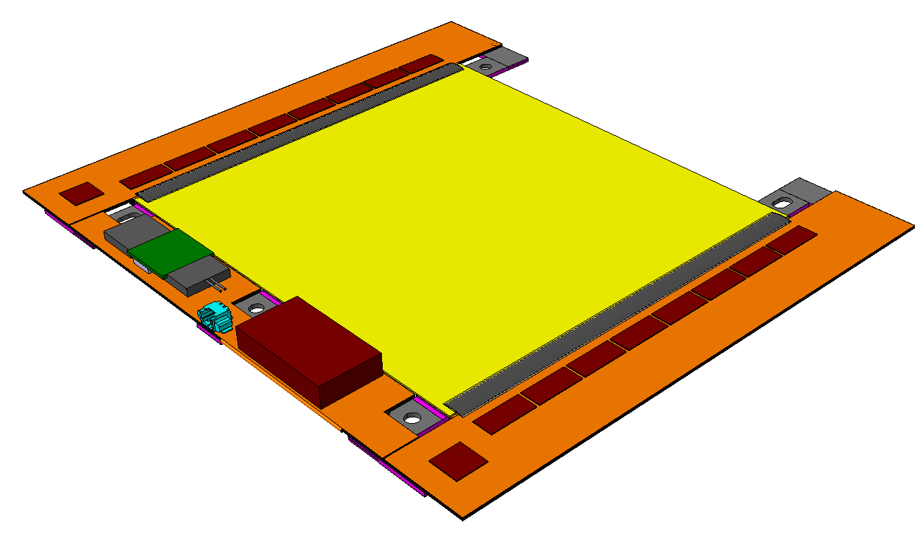
CMS p_{T} Module Concept
Tracker contributes to L1 trigger @ 40MHz
Data reduction by rejection of low p_{T} tracks
exploiting bending in B field (3.8T)
Compare hit patterns in closely spaced
layers → 2-cluster tracklets (“stubs“)
Level 1 tracks with p_{T} > 2 GeV formed
at back-end
2S modules: 2 strip sensors
PS modules:
1 strip + 1 macro-pixel sensor
2–step DC-DC conversion on module:
  UpFEAST: 12V → 2.5V (VTRx+, ~ 300mW)
  DCDC2S: 2.5V → 1.2V
  DCDC2S: 2.5V → 1.0V
~ 100µm
Pass
Fail
r
Upper sensor
~ 1mm
⊗ B
Lower sensor
rφ
Readout hybrids
with CMS Binary Chips
+ concentrator ASIC
~3W
Katja Klein

Slide 5
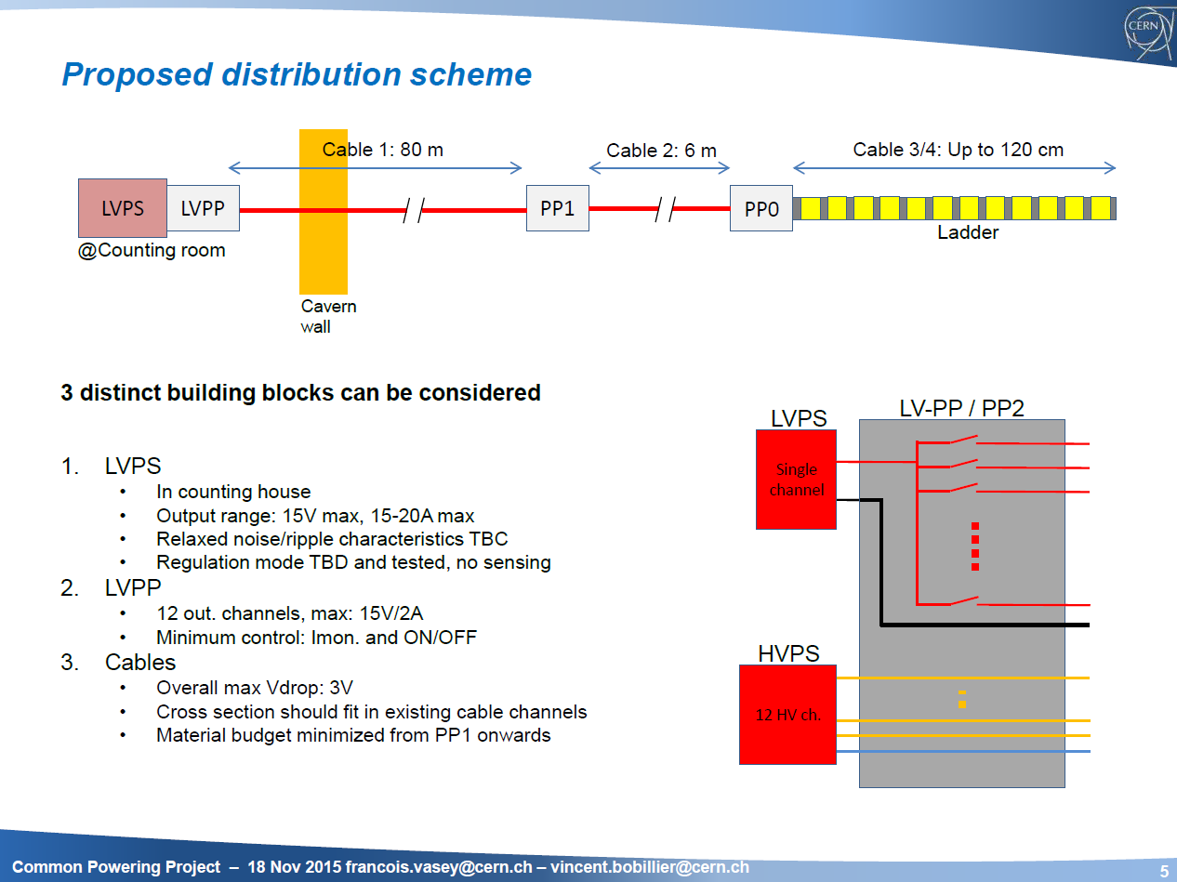
Conceptual CMS LV distribution scheme
New cables are foreseen throughout

Slide 6
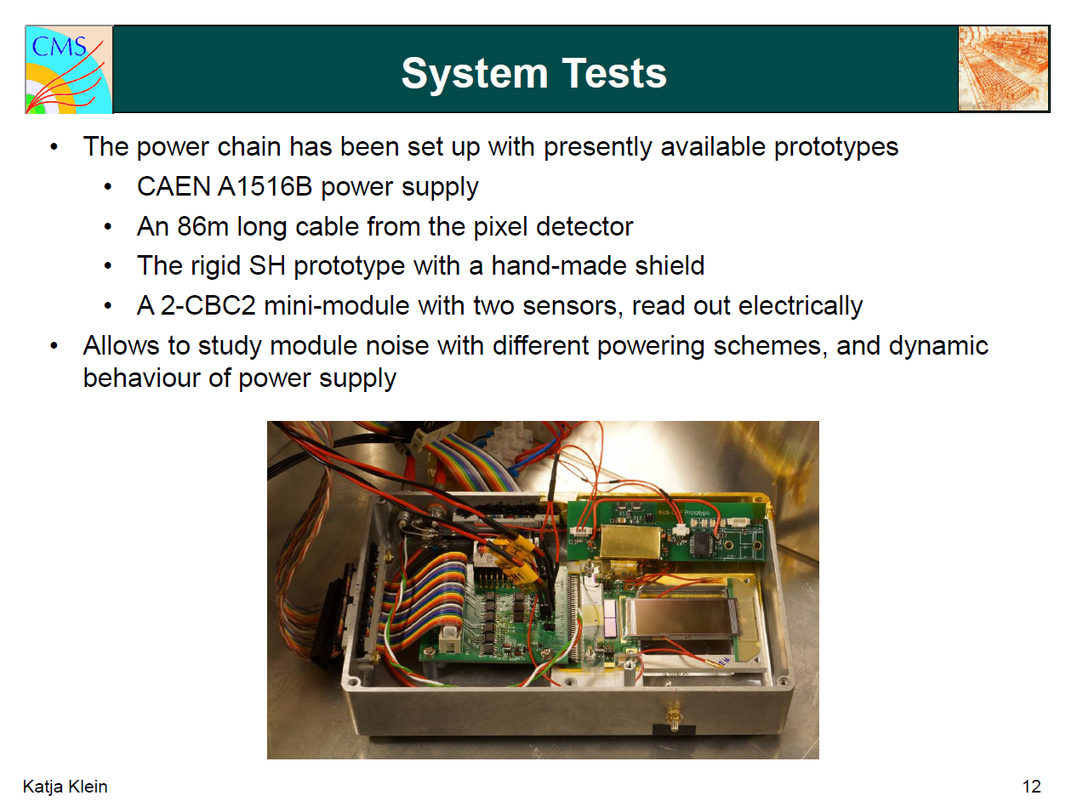

Slide 7
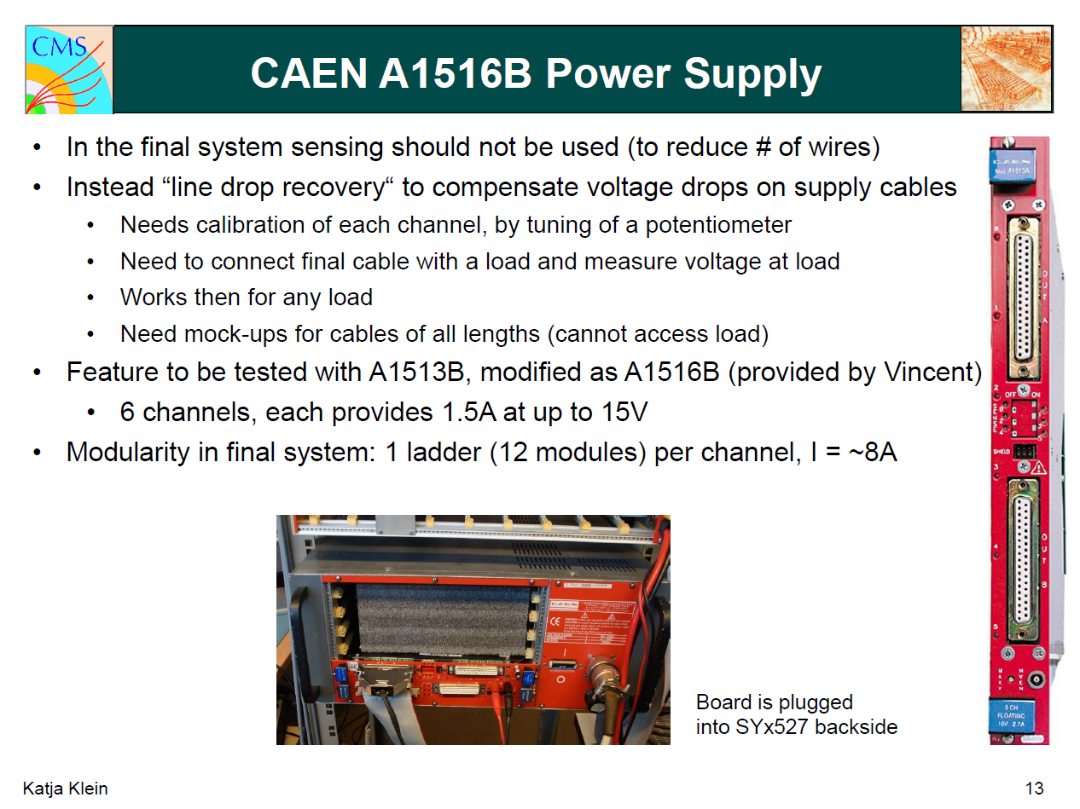

Slide 8
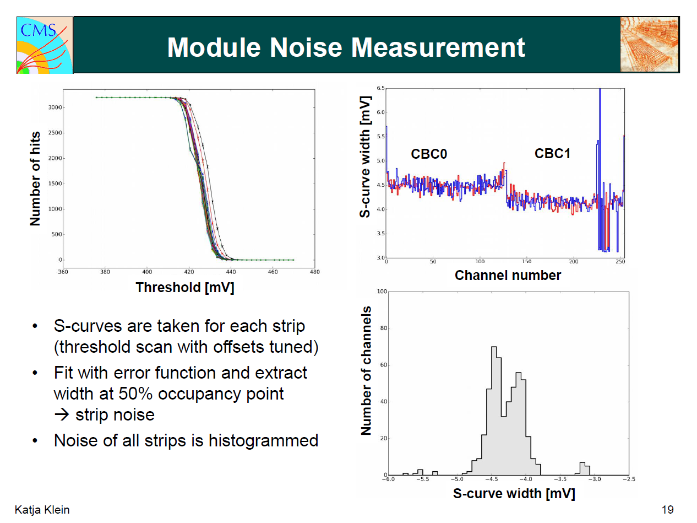
The line drop recovery scheme clearly works,
but its use has not yet been confirmed.

Slide 9

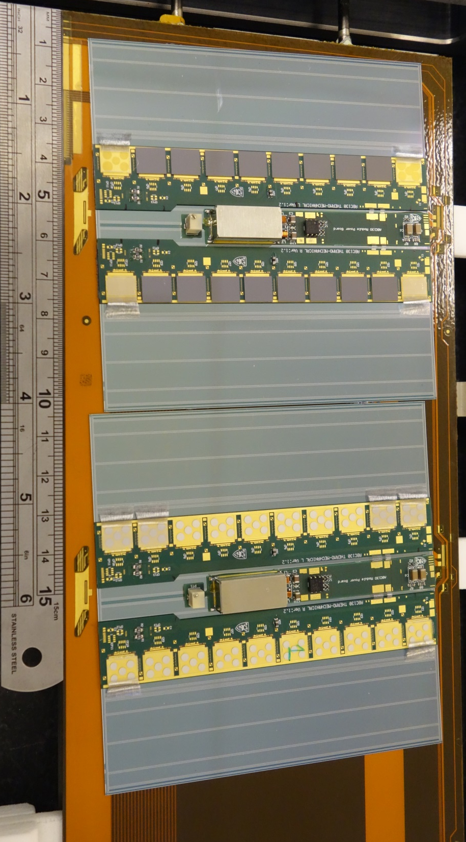
ITk Short Strip Stave
HCCstar
ABCstar
The image shows two thermo-mechanical modules mounted on a stave. The labels show the final parts at each location. The hybrids are resistive loads but the DC-DC converters which power them are working devices with FEAST2.
Each stave will have 14 modules per side. Each short strip module comprises:
1 x Sensor
  Maximum bias tbc (>=500V)
2 x Hybrid
  1 x HCCstar Hybrid Controller Chip
  10 x ABCstar front end chip
1 x Power Board
  1 x upFEAST DC-DC converter
  1 x High Voltage Switch (HV-MUX)
  1 x AMAC Autonomous Monitor And Control ASIC
The Long Strip Stave is similar but with one hybrid per sensor. In the forward region, the same electronics are assembled into several module types to form a petal geometry. All ASICs are in Global Foundries 130nm, so our powering scheme needs to carefully consider TID effects!
DC-DC
HV-MUX
AMAC
Stave with 2 Mechanical Modules

Slide 10
ITk Short Strip Stave Module Load
Module | n | V | Ityp | ΣItyp | Imax | ΣImax
HCC* | 2 | 1.5 | 300 | 2400 | 750 | 4700
ABC* | 20 | 1.5 | 90 |  | 160
AMAC core | 1 | 1.5 | 30 | 30 | 30 | 30
AMAC HV osc | 1 | 2.5/3.3 | 1 | 1 | 1 | 1
 |  | V | mA | mA | mA | mA
The projected peak demand of 4.7A at 1.5V exceeds the recommended mean load for upFEAST
  Subject to ongoing TID studies, we may need to request a revised limit
AMAC has important control functionality
  It enables DC-DC and autonomously monitors temperature and currents to interlock module power
  Its supply must be separate from the module’s 1V5 and “always on”
We are considering several options for powering AMAC
  Local regulation minimises voltage drop issues. Currents are low: linear regulators are appropriate.
  3V3 @1mA may be supplied from the regulator which powers the upFEAST core
  1V5 @30mA may be supplied by a second regulator, ideally in the same process as upFEAST
Assuming AMAC is powered by 100% efficient linear regulators and that the low mass upFEAST converter has 70% efficiency
  Short Strip Module draws 0.5A typical (0.92A max) at 11V
  Long Strip Module (not shown, half as many FE channels) draws 0.25A typical (0.45A max) at 11V

Slide 11
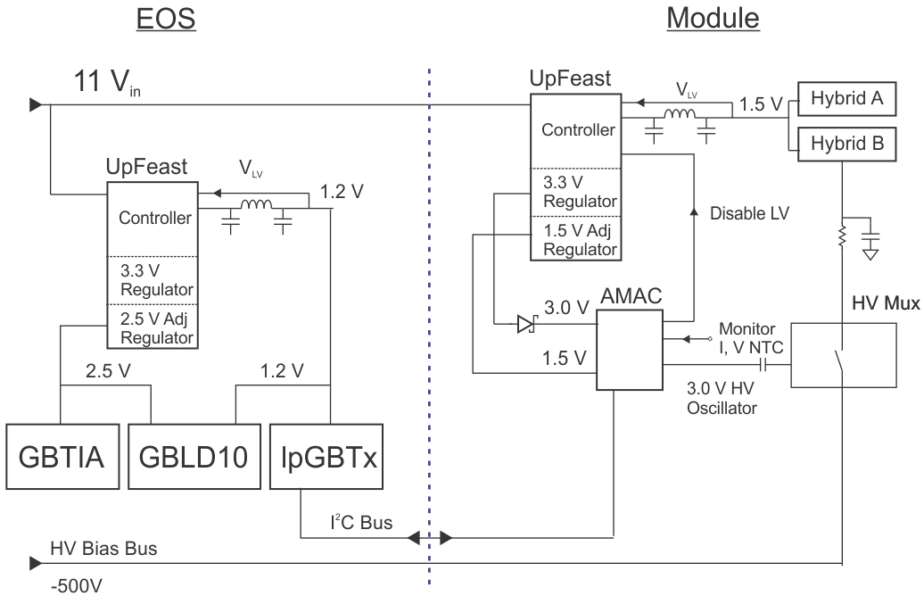
ITk Stave/Petal LV: LDO option
Within upFEAST
or separate die?
GBLD10 has a single 2.5V power rail, expect future versions to have 2.5V and 1.2V rails

Slide 12
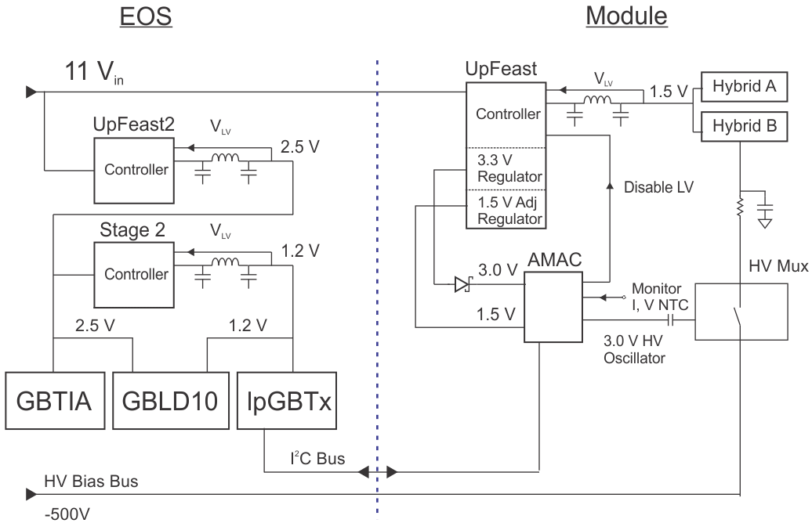
ITk Stave/Petal LV: Dual DC-DC Option

Slide 13
Estimating Stave and Petal Loads
End of Sub-structure Loads (SS Stave)
Linear Option (SS Stave)
EoS | n | V | Ityp | Imax | ΣItyp | ΣImax
GBTIA | 1 | 2.5 | 52 | 52 | 52 | 52
GBLD10 | 2 | 2.5 | 34 | 46 | 68 | 92
lpGBT | 2 | 1.2 | 625 | 625 | 1000 | 1000
 |  | V |  |  | mA
DC-DC | Vin | Vout | Efficiency | Ityp | Imax
upFEAST | 11 | 1.2 | 0.7 | 212 | 212
linear | 11 | 2.5 |  | 120 | 144
 | V | V |  | mA | mA
Current drawn at 2.5V worst case of order 150mA
  Three options under evaluation: Dual Stage Buck DC-DC, Switched Capacitor DC-DC or LDO.
Short Strip Stave Side: 14 modules plus EoS with two lpGBT/lpGBLD (neglecting resistance)
  Typical 14*0.50 + 0.31 => 7.4A
  Maximum: 14*0.92 + 0.32 => 13.2A
Long Strip Stave Side: 14 modules plus EoS with one lpGBT/lpGBLD (neglecting resistance)
  Typical: 14*0.25 + 0.20 => 3.7A
  Maximum: 14*0.45 + 0.23 => 6.6A
Petal Side: 6 modules of varying types plus EoS with two lpGBT/lpGBLD (neglecting resistance)
  Typical: 2.9 + 0.31 => 3.3A
  Maximum: 5.4 + 0.32 => 5.8A
The ITk cable task force is reviewing the possibility of cable reuse with these loads
  Two options for LV power supplies under consideration (next slides)

Slide 14
Power Distribution: Single Stage DC-DC
COTS LV in US(A)15?
New Type IV cables to TRT PP3
Reuse existing TRT cables between PP2 and PP3 (least accessible part)
Radiation Hard voltage clamp or regulation at PP2
  If turn off all the modules on SS stave, maximum dI ~12A. Must control dV to avoid damage!
New Type-II and Type-I
Counting room
New Type-IV
12-15 V
Edge of the cavern (UX)
PP3
Most similar to
CMS proposal
Existing
TRT Type-III
12 V
Cryostat inner bore
PP2
Inside muon spectrometer
New Type-I
PP1
New Type-II
Barrel A
Endcap support disk
Clamp or
Regulator
EC A

Slide 15
Power Distribution: Dual Stage DC-DC
Radiation Tolerant power supply at PP3
  Essentially a second DC-DC converter stage
  Radiation Levels? Space? Segmentation?
Possible cable reuse to SCT PP3 or TRT PP2
Radiation Hard voltage clamp or regulation at PP2 if power supply at PP3
  If turn off all the modules on SS stave, maximum dI ~12A. Must control dV to avoid damage!
New Type-II and Type-I
(Could be PP2 if sufficiently radiation hard)
Counting room
Type-IV
≥ 48 V
Edge of the cavern (UX)
PP3
New PS
Some similarities to
other subdetectors?
Type-III
12 V
Cryostat inner bore
PP2
Inside muon spectrometer
New Type-I
PP1
New Type-II
Barrel A
Endcap support disk
Clamp or
Regulator
EC A

Slide 16
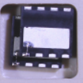
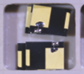
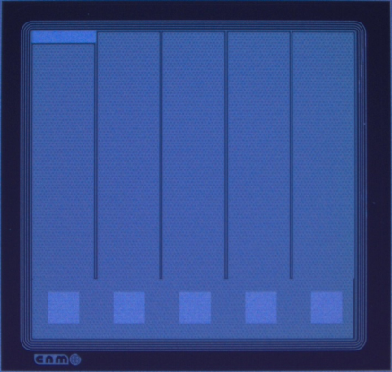
HV-MUX
Concept
  connect sensors to HV bus through a radiation hard HV switch
  Permits faulty sensors to be disconnected from the bus
We have irradiated and tested small batches from several vendors covering GaN, SiC and Si technologies
  GaN FETs from two vendors, each rated in excess of 500V, switching 550V with acceptable leakage after 1 x 10¹⁶ n/cm²
Alternate candidate: custom Si V-JFET from CNM
  Recently manufactured, working but evaluation continues
Next Steps
  Irradiation of larger batches of GaN FETs (bare die)
    Select preferred GaN option this year
  Further irradiation & reliability studies of CNM V-JFET and selected GaN FET
    Final selection 2017
  Procurement
GaN FET “A”
GaN FET “B”
CNM V-JFET

Slide 17
Conclusions and Commonality
Both strip trackers may be able to use bulk supplies to a common design
  This is dependent upon the conclusion of the ATLAS ITk cable task force, who are reviewing the possibilities for cable reuse in the light of the latest power projections.
A standalone linear regulator in the same technology as upFEAST would be a useful addition to our tracker powering toolkit
  This could be integrated within upFEAST or a separate die
A radiation tolerant 48V to 12V converter may help reduce the number of new cables needed
  GaN FET technology may be useful for this
The “line drop recovery” technique may be used to reduce wire counts by the omission of sense lines
  The CMS system test indicates this may work well in a system with Point of Load DC-DC
HV-MUX is a useful concept to reduce HV cable counts whilst retaining the possibility to isolate faulty sensors
  Radiation tolerance of GaN FET devices is promising.
  Studies of larger samples are now beginning.
  Alternate technology: custom silicon V-JFET.

Slide 18
BACKUP

Slide 19
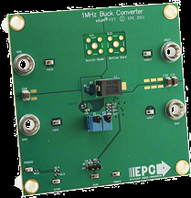
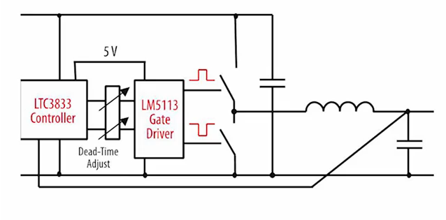
Buck Converter with GaN Technology?
Probably NOT
Radiation Hard
EPC9101
GaN FETs: Probably Radiation Hard
Whilst the ATLAS ITk HV-MUX community have been testing irradiated GaN FETs at low currents, Giulio Villani has tested one sample of “GaN FET A” irradiated to 6e15 neutrons, at 1.5A: overall it seems that the device can operate at high current. It may be interesting to make a demonstration DC-DC PCB to explore this possibility further.
V_{IN} 8V-19V
V_{OUT} 1.2V
I_{OUT} 18A
270nH @ 1MHz

