Slide 1
MDI for FCC-ee
One of the most striking conclusions of the FCC general meeting at Washington
was the need for a FCC-ee Machine Detector Interface (MDI) working group.
A mandate was drafted last year and the working group has been invited to convene
with Manuela Boscolo (INFN Frascati) and Nichola Bacchetta (INFN, Padova, CMS)
as convener and co-convener.
The MDI group establishes a bridge between the accelerator and physics studies.

Slide 2
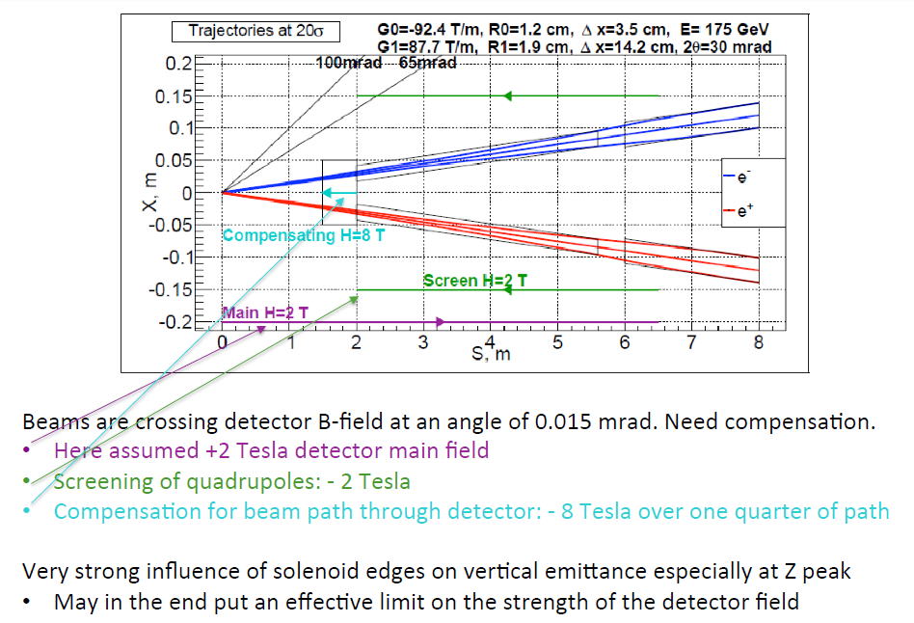
Luminosity
monitor
centered
on outgoing
beam
Bogomyagkov, Dam, Koratzinos

Slide 3
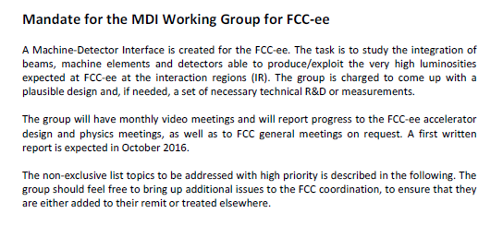

Slide 4
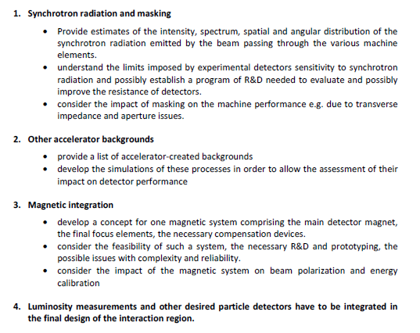

Slide 5
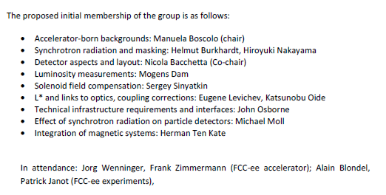
NB everyone has agreed except Michael Moll – we are looking for a replacement

