Slide 1
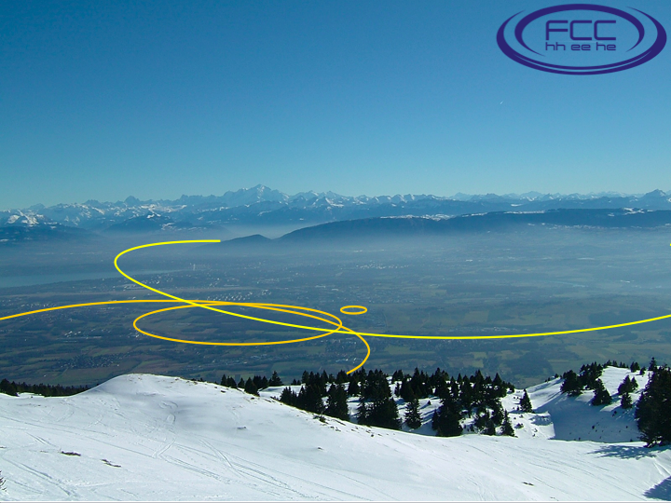
Global Analysis, Combination & Complementarity
The vision:
explore 10 TeV scale directly (100 TeV pp) + indirectly (e⁺e⁻)

Slide 2
The Objectives
How do FCC-hh, FCC-ee and FCC-he complement each other? Cf, LEP and LHC
What are the synergies between them?
  And between them and other accelerators (LHC)?
Depend on inputs from specific FCC-xx analyses
Broad subject: not really started
Illustrate with specific physics examples
  Higgs and precision electroweak
  Supersymmetry
  X(750)

Slide 3
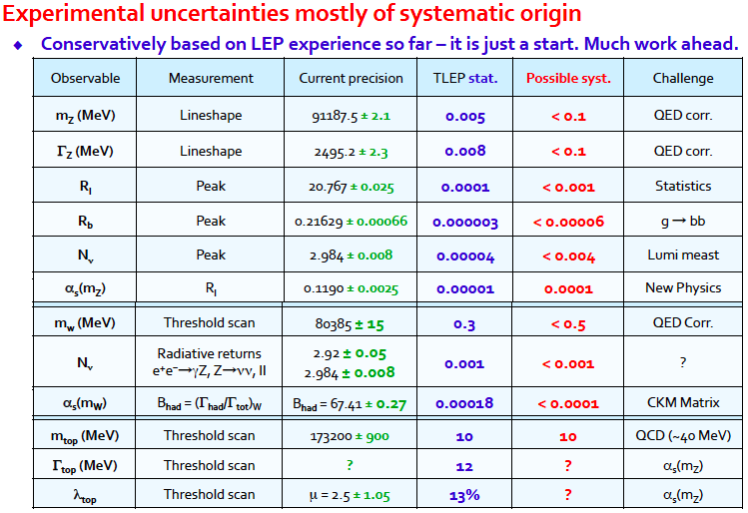
Possible FCC-ee Precision Measurements
FCC
Z peak
± 4 GeV
for α_{EM},
line shape
WW
threshold
t tbar
threshold

Slide 4
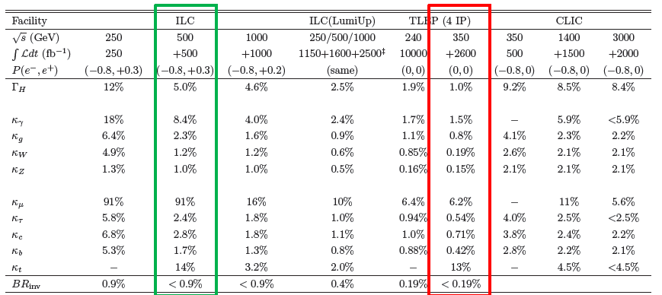
Possible Future Higgs Measurements
Need to reduce theoretical uncertainties to match
Essential for new physics interpretations

Slide 5
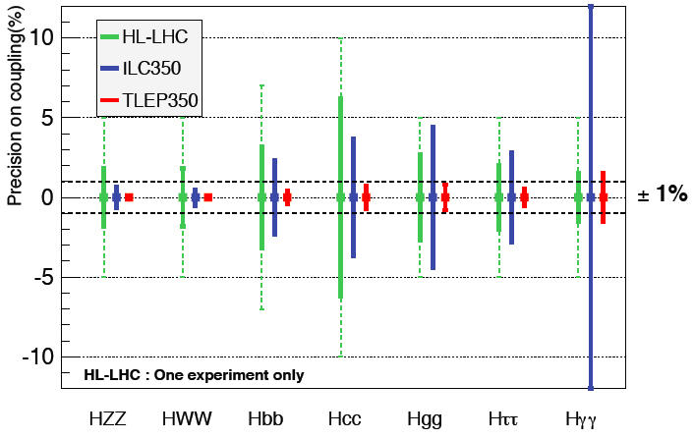
Possible Future Higgs Measurements

Slide 6

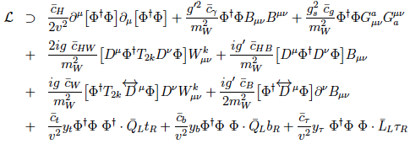
Standard Model Effective Field Theory
Higher-dimensional operators as relics of higher-energy physics, e.g., dimension 6:
Operators constrained by SU(2) × U(1) symmetry:
Constrain with precision EW, Higgs data, TGCs ...

Slide 7
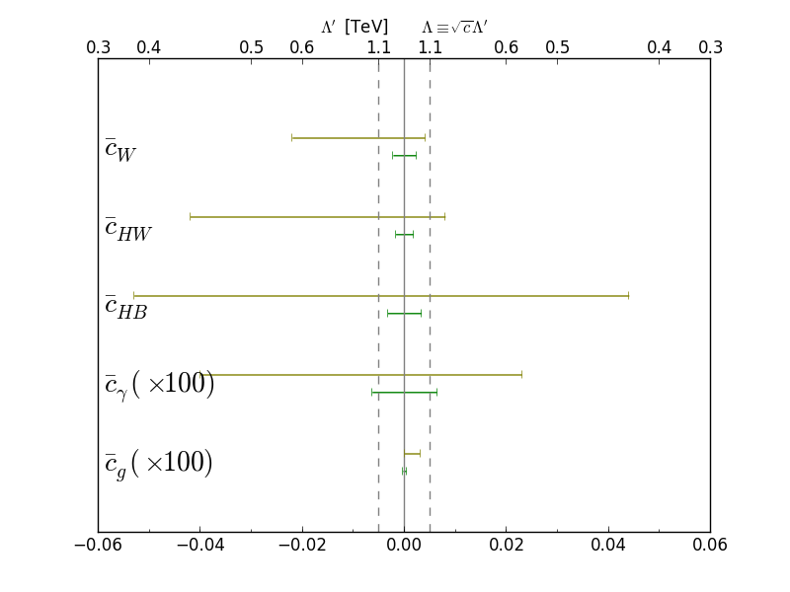
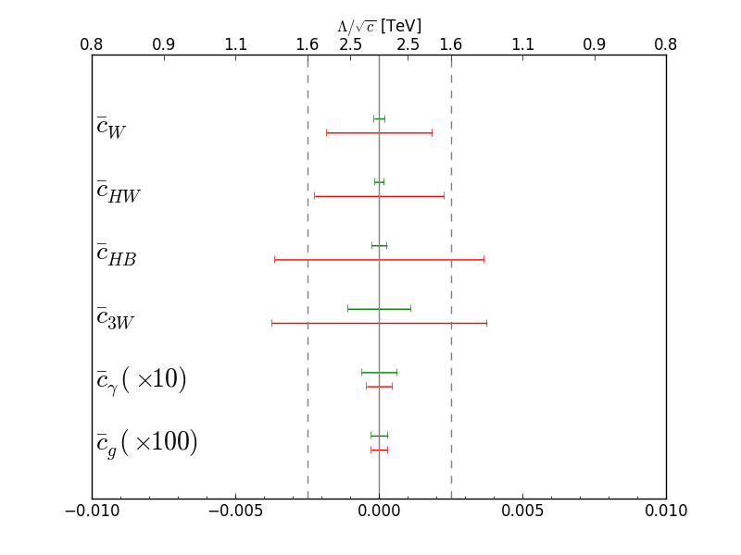
FCC-ee Higgs & TGC Measurements
LHC constraints
FCC-ee constraints: see Λ ~ 10 TeV?
JE & Tevong You, arXiv:1510.04561

Slide 8
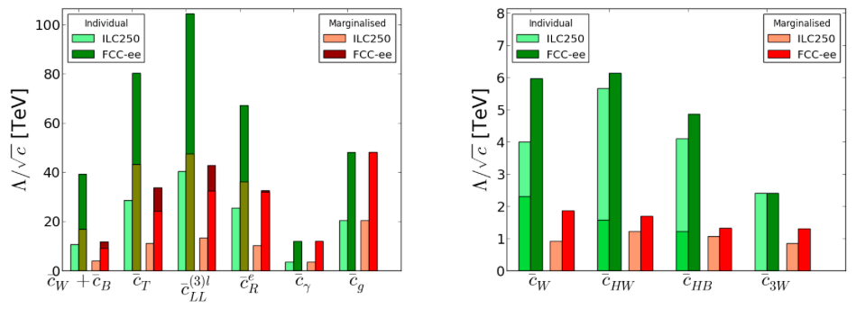
FCC-ee Higgs & TGC Measurements
JE & Tevong You, arXiv:1510.04561
Shadings:
  With/without theoretical EWPT uncertainties
EWPTs and Higgs
Shadings of green:
  Effect of including TGCs at ILC
Higgs and TGCs
Should extend to include prospective
FCC-hh measurements of TGCs, …

Slide 9
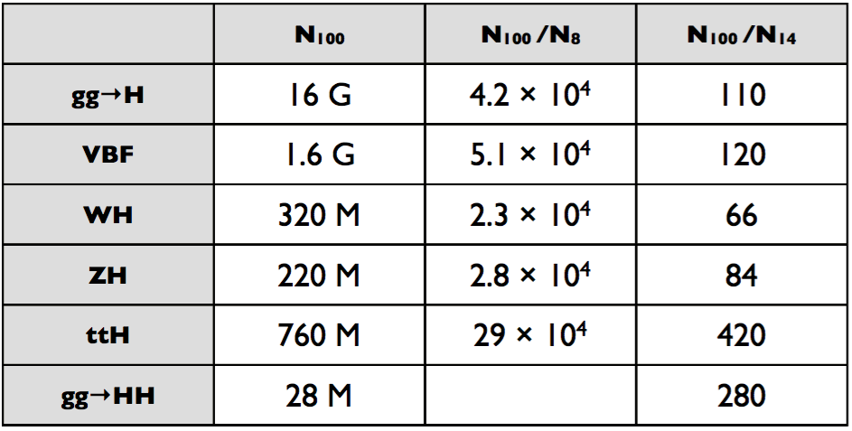
What H Physics can FCC-hh do?
Big statistics!
Sub-% measurement of H to 4l/γγ?
1% measurement of H to μμ
5% measurement of 3-H coupling?
Sensitive to 4-H coupling?
Mangano @ Hong Kong

Slide 10
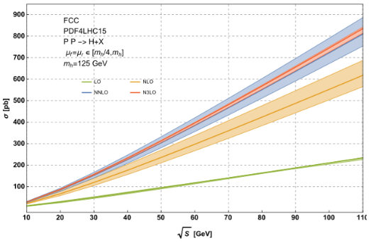

What H Physics can FCC-hh do?
One thing is to have a large σ
Another is to have small uncertainties
Mangano @ Hong Kong
Studies in progress

Slide 11
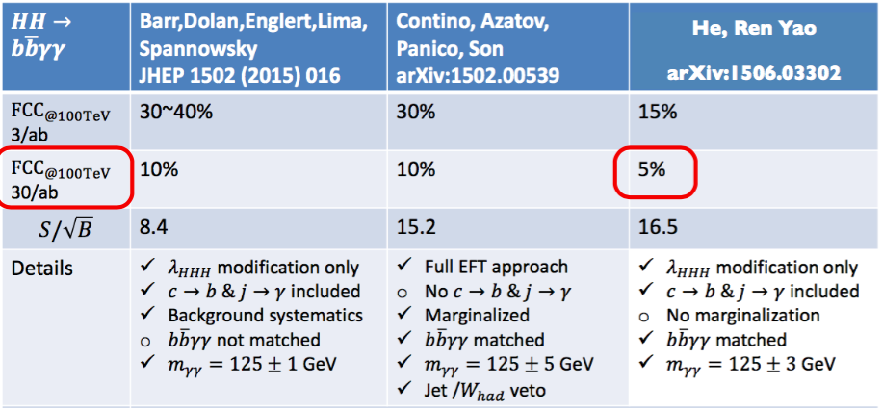
Measurement of 3-H Coupling
The story so far
More decay modes, improved selections, .
Studies in progress

Slide 12
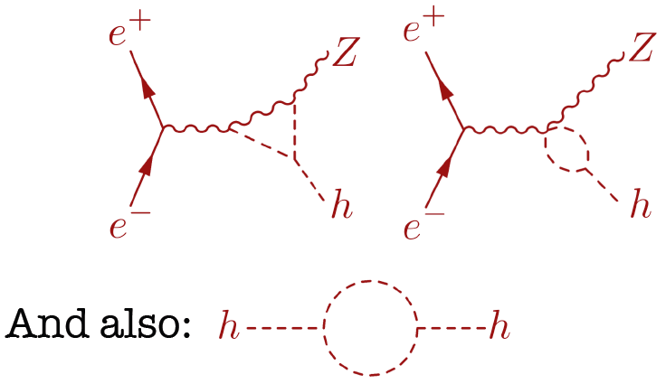
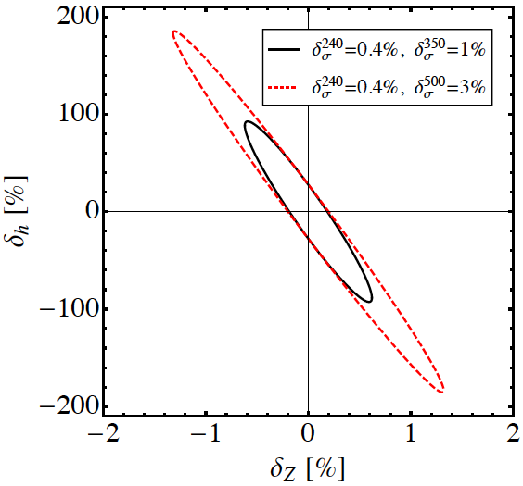

FCC-ee Sensitivity to 3h Coupling
Loop corrections to σ(H+Z):
3h correction δ_{h} energy-dependent
δ_{Z} energy-independent: can distinguish
McCullough

Slide 13
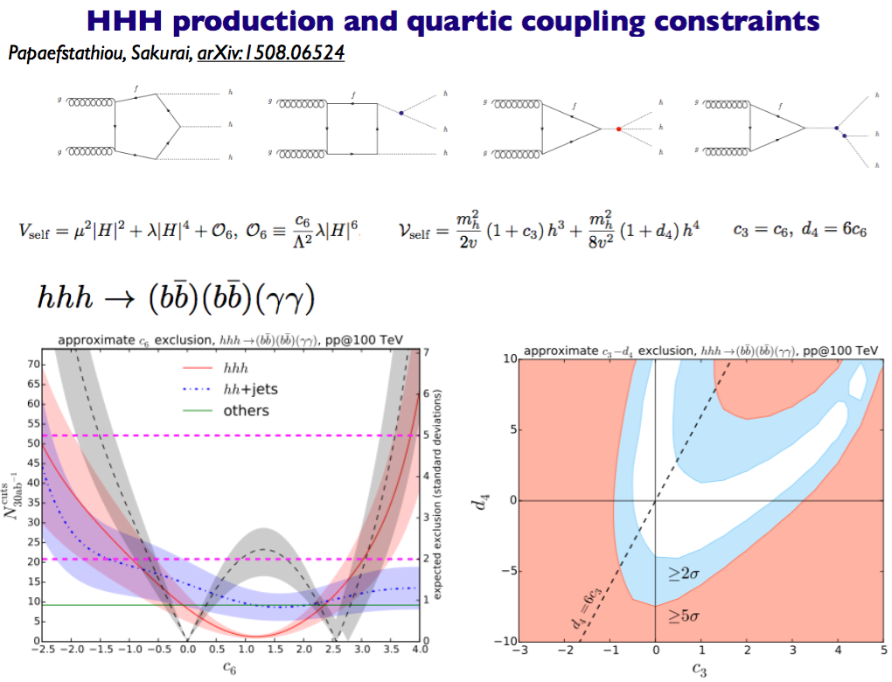
A First Look at 4-H Coupling
Is this possible?

Slide 14
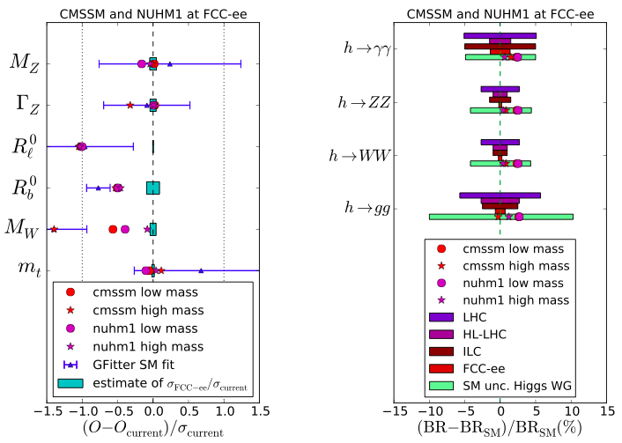
Precision FCC-ee Measurements
Buchmueller, JE et al: arXiv:1505.04702
Precision Electroweak
Precision Higgs

Slide 15
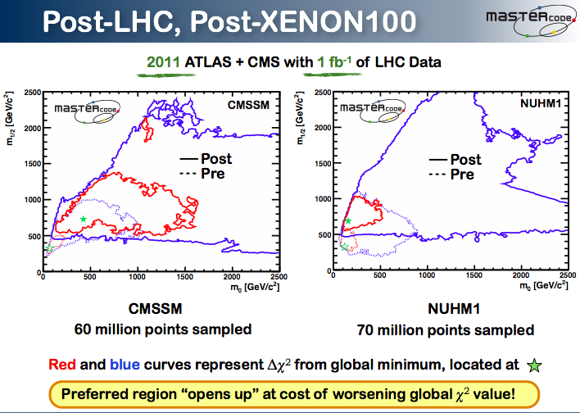
Measuring CMSSM with FCC-ee
FCC-ee
H measurements
FCC-ee
Z measurements
FCC-ee
+ LHC 3000/fb
Assuming best-fit point after LHC Run 1
68% CL region
95% CL region
Buchmueller, JE et al: arXiv:1505.04702

Slide 16
Where May CMSSM be Hiding?
Relic density constraint,
assuming
neutralino LSP
Stau
coannihilation
strip
HE-LHC
Stop
coannihilation/
focus-point
strip
Excluded because
stau or stop LSP
Excluded by ATLAS
Jest + MET search
LHC 3000
Excluded by
b → s γ, B_{s} → μ⁺μ⁻
LHC 300
JE, Olive & Zheng: arXiv:1404.5571

Slide 17
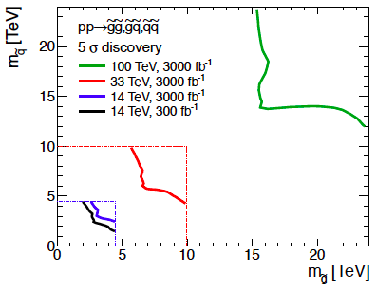
Squark-Gluino Plane
Discover 12 TeV squark,
16 TeV gluino @ 5σ

Slide 18
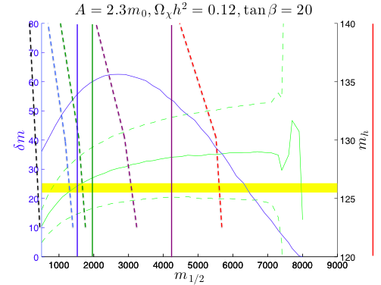
Exploring the Stop Coannihilation Strip
Compatible with LHC measurement of m_{h}
May extend to m_{χ} = m_{stop} ~ 6500 GeV
HE-LHC
(monojets), MET
LHC 8TeV
LHC 300
(monojets), MET
100 TeV
(monojets), MET
LHC 3000
(monojets), MET
JE, Olive & Zheng: arXiv:1404.5571

Slide 19
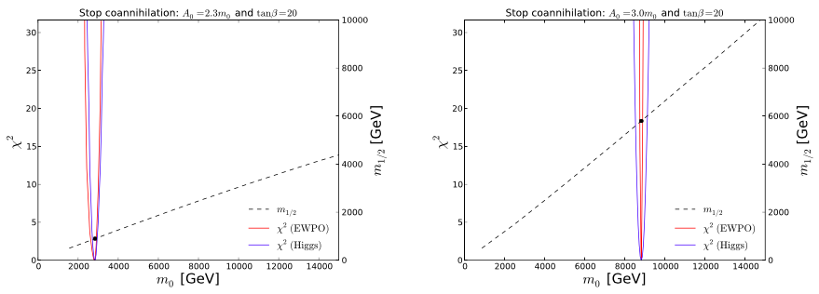
Impact of Precision and Higgs Measurements
Contributions of Higgs and electroweak precision observables to global χ² function along stop coannihilation strip
FCC-ee vs FCC-hh: possible test of supersymmetry at the loop level
Buchmueller, JE et al: arXiv:1505.04702

Slide 20
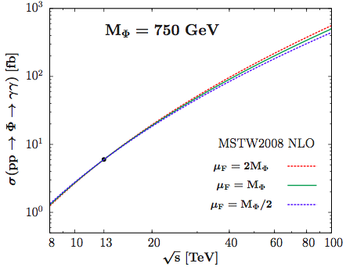
Possible Future X Signal
Assuming production by gluon-gluon fusion
Normalized to σB(γγ) = 6 fb
PDF, ren’n scale uncertainties @ 100 TeV ~ 30%
Djouadi, JE, Godbole, Quevillon,
arXiv:1601.03696

Slide 21
Alternative Higgs Doublet Scenario
After singlet, doublet?
Heavy Higgses in 2 Higgs doublet model: Φ = H, A
Nearly degenerate in many versions, e.g., SUSY
Expect t tbar decays to dominate
Can accommodate Γ_{Φ} ~ 45 GeV (ATLAS)
Need larger enhancement of loops compared to singlet model
Rich bosonic phenomenology
Djouadi, JE, Godbole, Quevillon, arXiv:1601.03696

Slide 22
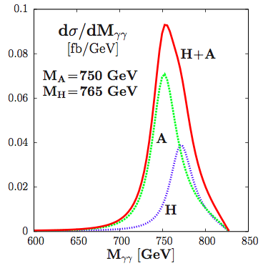
Lineshape in pp Collisions
+MSSM: tan β = 1
M_{H} – M_{A} ~ 15 GeV
Γ_{H}, Γ_{A} ~ 32, 35 GeV
σB(A➔γγ) =
2 ✕ σB(H➔γγ)
Asymmetric
‘Breit-Wigner’
Resolvable?
Djouadi, JE, Godbole, Quevillon, arXiv:1601.03696

Slide 23
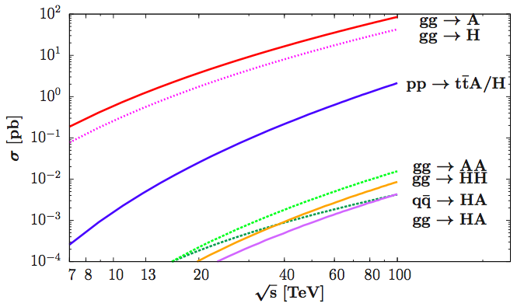
Possible Φ = H,A Signals
Normalized to σB(γγ) = 6 fb @ 13 TeV
Djouadi, JE, Godbole, Quevillon, arXiv:1601.03696

Slide 24
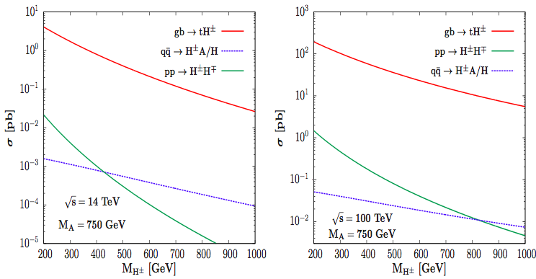
Possible H± Signals
@ 14, 100 TeV for varying M_{H±} ≠ M_{Φ} in general
Djouadi, JE, Godbole, Quevillon, arXiv:1601.03696

Slide 25
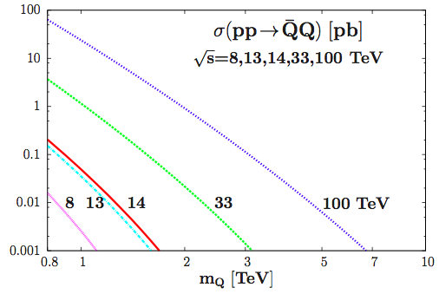
Cross Sections for Vector-Like Q
Pair-production at LHC, future circular colliders
Present lower mass limit ~ 800 GeV
Djouadi, JE, Godbole, Quevillon,
arXiv:1601.03696

Slide 26
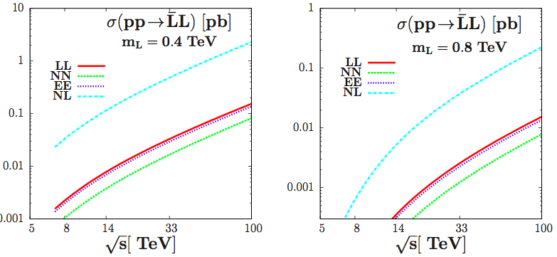
Cross Sections for Vector-Like L
Pair-production at LHC, future circular colliders
Present mass limit < 400 GeV
Djouadi, JE, Godbole, Quevillon,
arXiv:1601.03696

Slide 27
Indirect Sensitivity of FCC-ee?
To mixing between H(125) and X(750)?
To vector-like fermions via electroweak precision and Higgs measurements?
To other indirect effects in two-Higgs doublet models?
Other models?
Should we wait and see?

Slide 28
Global Analysis, Combination
& Complementarity
Will depend upon inputs from both FCC-ee and FCC-hh (and FCC-he)
Core business: probes of any new physics at the quantum level
  E.g., Higgs, supersymmetry, X(750) (?)
Effort needed from both sides:
  Accuracy of possible FCC-hh measurements?
  FCC-ee sensitivity to new physics ≠ H, SUSY
If X(750) exists, it will change everything!

Slide 29
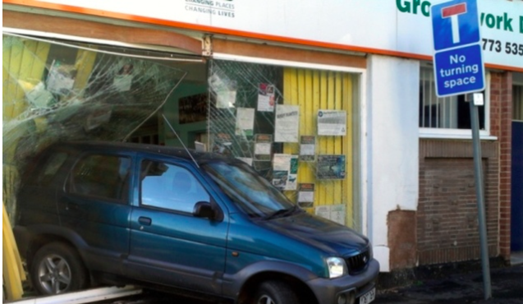
Back-ups

Slide 30
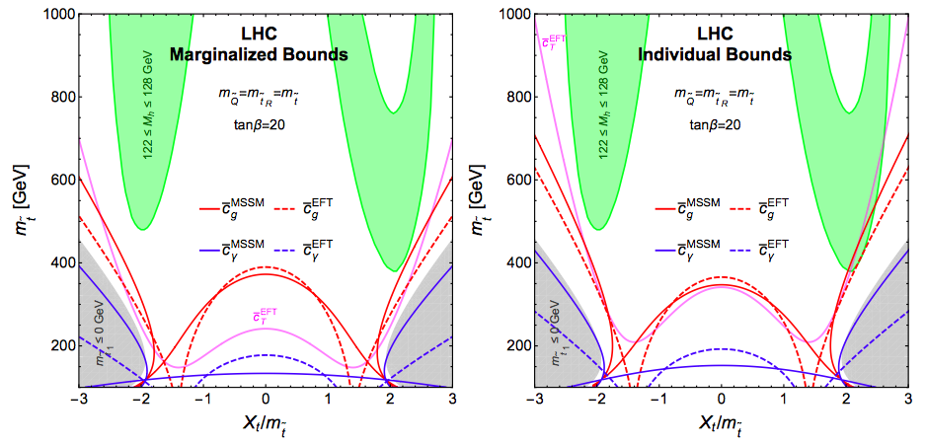
Indirect Stop Limits from Precision EW Data
Solid lines = full calculation, dashed lines = EFT
Drozd, JE, Quevillon & You: arXiv:1504.02409

Slide 31
Possible FCC-ee Precision Measurements

Slide 32
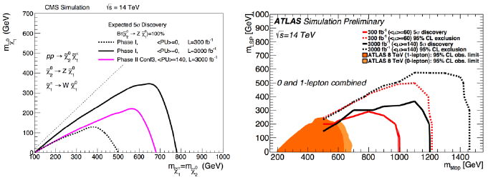
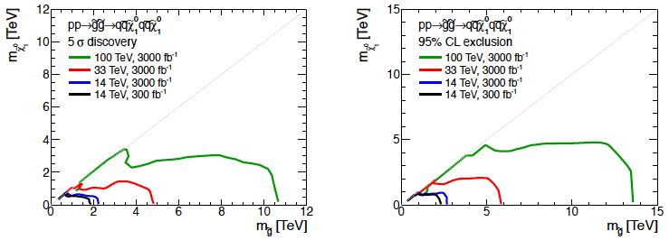
Reaches for Sparticles
LHC:
HE-LHC,
FCC-hh

Slide 33
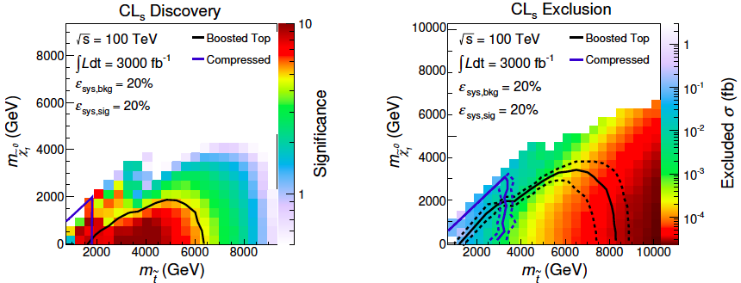
Reach for the Stop
× possible tip of stop
coannihilation strip
Discover 6.5 TeV stop @ 5σ, exclude 8 TeV @ 95%
Stop mass up to 6.5 TeV possible along coannihilation strip

Slide 34
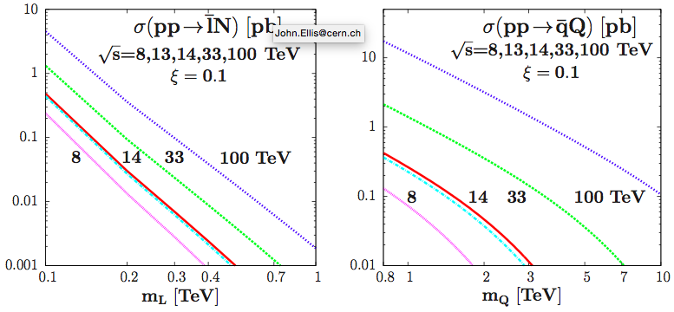
Single Vector-Like Q, L Production
Single production at LHC, future circular colliders
Assuming mixing angle with light fermions ξ = 0.1
Djouadi, JE, Godbole, Quevillon,
arXiv:1601.03696

Slide 35
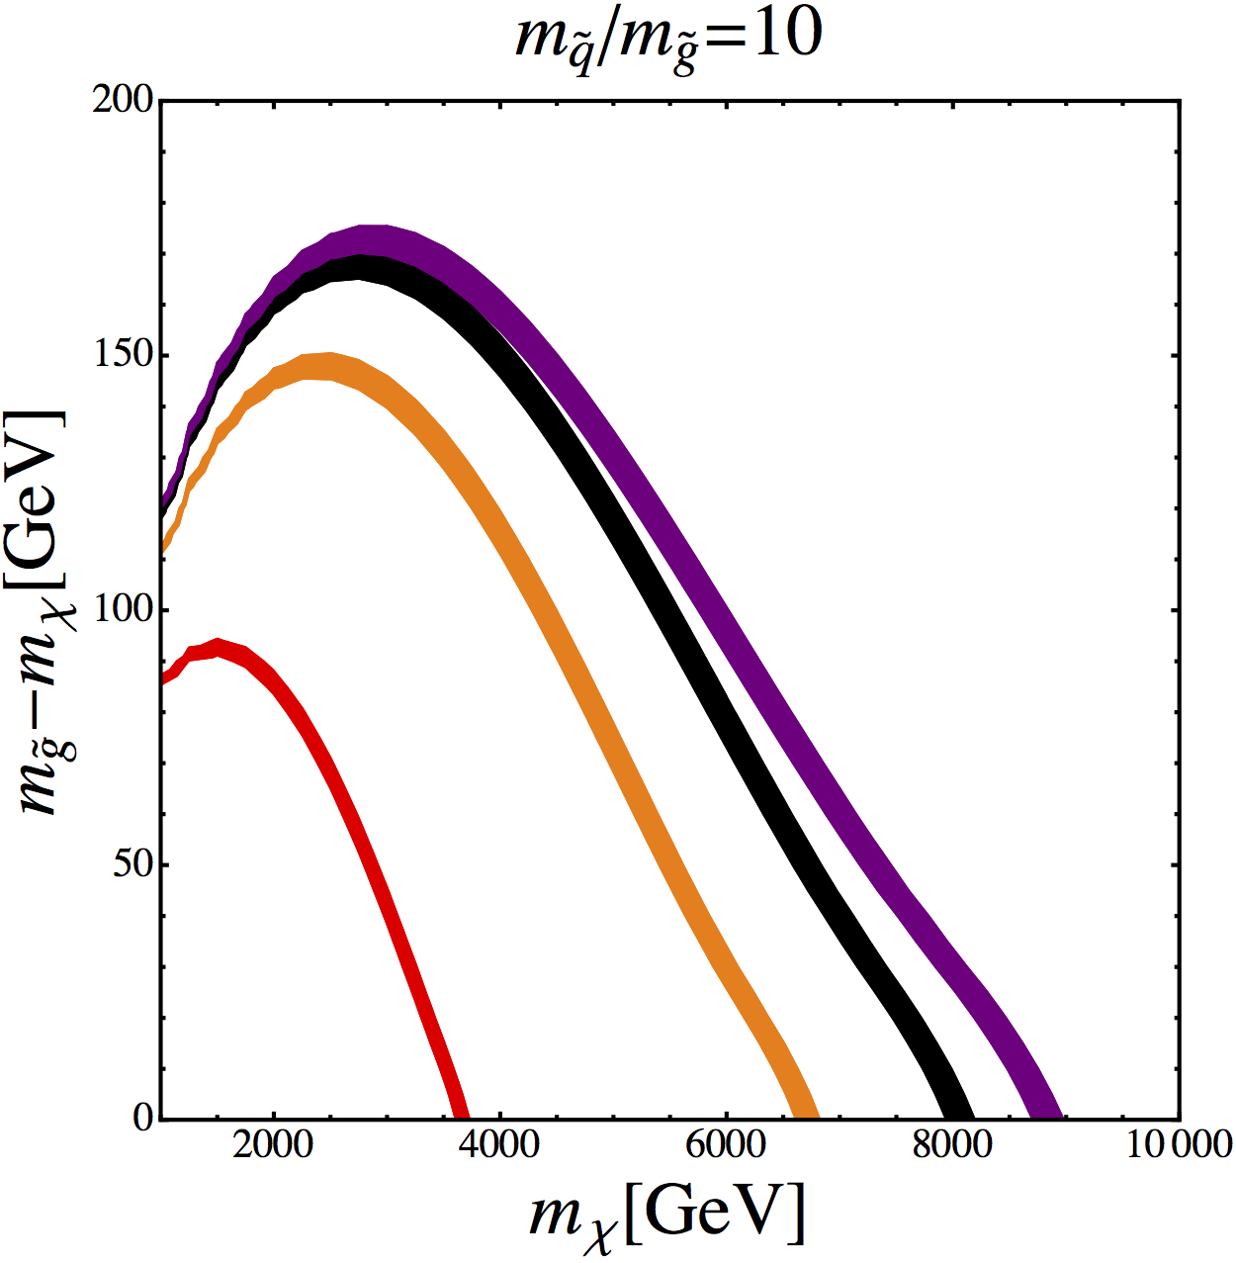
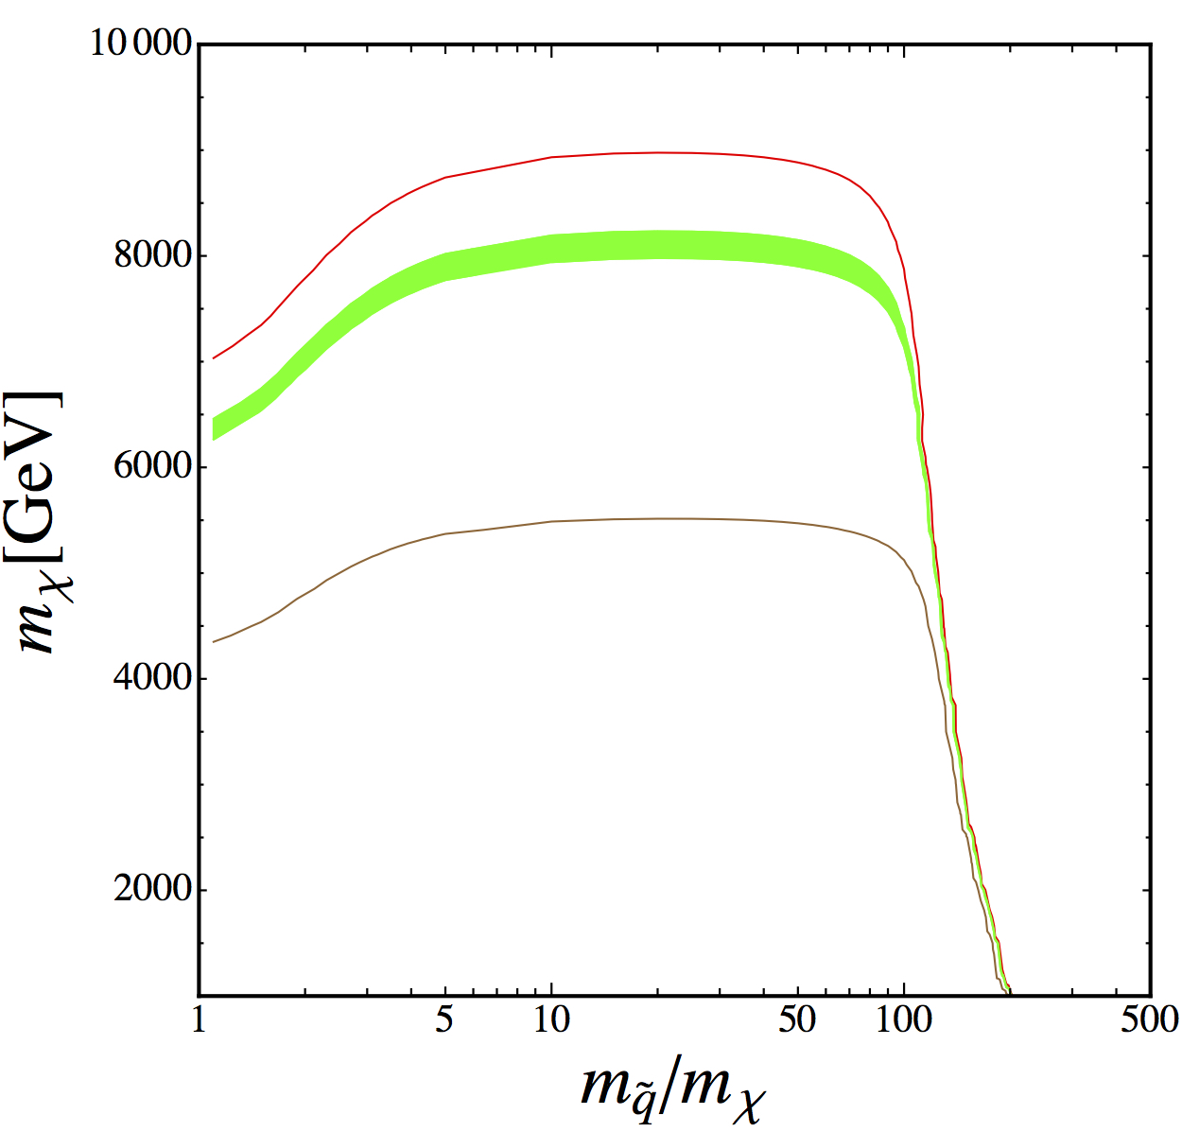
How Heavy could Dark Matter be in pMSSM?
Largest possible mass in pMSSM is along gluino coannihilation strip: m_{gluino} ~ m_{neutralino}
Extends to m_{χ} = m_{gluino} ~ 8 TeV
Cosmological
dark matter
density
Nominal
calculation
JE, Luo & Olive: arXiv: 1503.07142

Slide 36
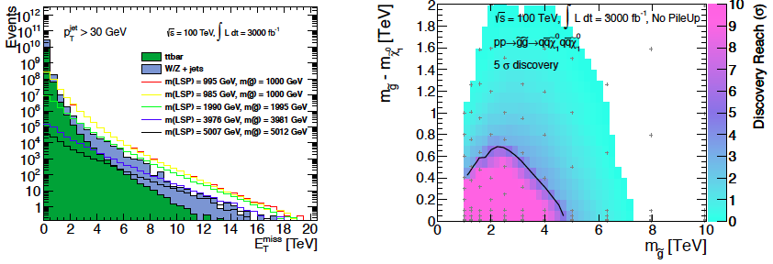
Reaches for Sparticles
Model with compressed spectrum: small gluino-neutralino mass difference
⬆
Large mass possible in gluino coannihilation scenario for dark matter

