Slide 1
Introduction to the QUACO project
Marcello Losasso, CERN
OMC – CERN – March 30th 2016

Slide 2
Practical information
08:30 Welcome coffee and distribution of badges
09:00 Start of meeting
10:30 Coffee break
13:00 End of meeting
13:00 -13:50 Light lunch
13:50 Shuttle bus for the technical visit. Please take your personal belongings and passport with you
14:00 -15:30 Technical visit
15:30 End of visit
Drop-off at CERN reception (building 33)
If you need a taxi/transport to the airport or train station, please contact Julia Cachet, phone +41 75 411 4162, email julia.cachet@cern.ch

Slide 3
Agenda
Information session (9:00 -12:00 CET)This session will be webcast. This session will include a series of presentations that will provide an overview of the QUACO project and consortium, the pre-commercial procurement process and the objectives of the procurement activity. It will include information about the technical scope and requirements as well as the legal and contractual framework in which the procurement will be executed.
Information session (14:00 -15:30 CET) This session will NOT be webcast. This interactive session between the QUACO Consortia and potential suppliers present at the open market consultation will be organized in a visit format in the CERN lab. During the visit it will be shown examples of tools and fabrication methods that could be used in the frame of QUACO project. It will be explored the requirement of the procurement in terms of tooling, how it matches current market offerings and where developments will be necessary.

Slide 4
Agenda
08:30 Welcome coffee and distribution of badges
09:00 Introduction to the HL-LHC (HiLumi) Project
09:30 Introduction to the QUACO Project
10:00 Introduction to the technical contents - The Q4 magnet
10:30 Coffee break
11:00 Introduction to the PCP process
11:40 Next steps & Time plan
12:00 Public session of Q&A
13:00 -13:50 Light lunch
14:00 -15:30 Technical visit
15:30 End of visit

Slide 5
Scope of the OMC
To inform and prepare the market to the upcoming CfT
To share information about the status of development of the Q4 magnets
To gather feedbacks and suggestions from potential bidders to complete the tender documentation

Slide 6
QUACO Project
What we want to procure
Who is involved
Where we are
Why using the PCP (Pre-commercial-Procurement)

Slide 7
What we want to procure
The scope of the project is to develop and procure 2 pilot superconductive quadrupole magnets valid for use in the frame of the Hi-Lumi project, the Q4.
The Q4 are part of the IR magnets in Hilumi-LHC providing the strong focusing of particle beams.
The technical content is detailed in the Helene Felice presentation.

Slide 8
Who is involved
The QUACO project partners are:
CEA - Commissariat à l’Energie Atomique et aux Energies alternatives, Fr
CERN - European Organization for Nuclear Research , CH
CIEMAT - Centro De Investigaciones Energeticas, Medioambientales Y Tecnologicas, ES
NCBJ - (Narodowe Centrum Badan Jadrowych, Poland
CERN will act as the lead procurer that will coordinate and lead the joint procurement for the benefit of the aforementioned organizations. The presentation from CV, KE, FJ will detail the legal & administrative aspects

Slide 9
Implementation in 3 phases of QUACO project
After preparatory phase including Market Survey, and after request for tender, bidders have 2 M to prepare the offer for Phase 1 & binding costs up to phase 3.
CONCEPTUAL DESIGN
3- 4 Months
ENGINEERING DESIGN & PROTOTYPING
10 Months
PILOT
Max 22 Months
Contractors perform conceptual
design of magnet solutions
Selects ≥ 3 designs
Contractors perform engineering
design of magnet solutions
identified and of necessary prototyping.
2 eng design selected to become
pilot developments.
Each awarded Contractor
develops 1 pilot
First of a kind magnets.
Passage from one phase to
another is on a competitive basis

Slide 10
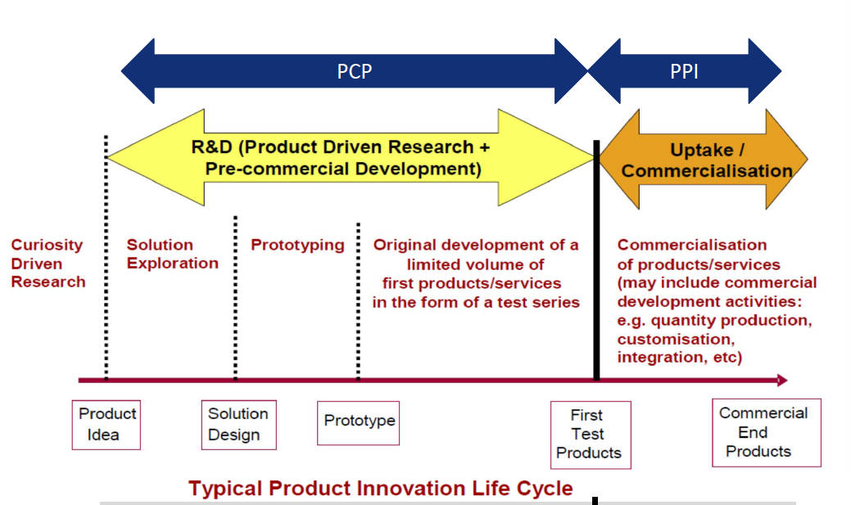
Where we are
Product idea
Conceptual design
Engineering design & prototyping
First test products
Commercial end products

Slide 11
Why a PCP
Disseminate accelerator magnet design in EU (our basic desing is a good starting point)
Increase competition, trying not to disfavor SME
Favoring dissemination of construction competence and also tooling in EUU Industry
For this we are to pay a price: two prototypes instead of one, more follow up.

Slide 12
Why a PCP
No off-the-shelf technology is ready to meet the challenge represented by HL-LHC needs.
The small volume of the market and the technologic risk are obstacles to a “conventional” tender.
The PCP instrument can serve the purpose of enlarging the market basis (by reducing financial barrier for SMEs), to attract SMEs (by sharing the technological risk of committing into difficult R&D), to mitigate risk of over or under specifications, by engaging industries at the early stage).

Slide 13





QUACO PCP
Quaco Consortium has committed >1.9 M€ of funds to specify and prepare the development of innovative superconductive magnets and to follow-up their procurement and manufacture
The pilot magnets will be made available to end-users accelerator community for the needs of Hi-LUMI project
Co-funded via H2020 (March ’16-Feb ’20) under Grant Agreement 689359
Total QUACO budget 6.5M€
Total procurement budget 4.6M€

Slide 14
Before the QUACO PCP
Development of new challenging technology in accelerator area has always required long R&D programs.
The funding of these programs has been almost always in-kind contributed.
This mechanism, while proved successful for the final result of the R&D, is demonstrated not optimal to enlarge the market basis and to shorten time to commercialization.

Slide 15
Going beyond QUACO PCP
QUACO is the first PCP project in the area of sc magnets.
We want to make it a « first-of-a-series » for this EC co-funded type of business.
We aim to:
  Progress from R&D of pilots magnets to small series production
  To broaden and extend the project for similar scope in the accelerator area.
  To speed up the technical background and the transfer of technology from national labs to industry

Slide 16
Going beyond QUACO PCP
  Progress from R&D of pilots magnets to small series production
  → it is expected that Public Procurement of Innovation (PPI) will be the small series production following of the Quaco project
  To broaden and extend the project for similar scope in the accelerator area.
  → the PCP example can set a benchmark in the market sector
  To speed the adoption of technical background and technology transfer from national labs to industry
  → by using a mechanism of risk sharing to transfer and develop know-how able to enhance the industries capability.

Slide 17
Technical Background from the
Consortium to QuaCo
QUACO Consortium will provide a possible magnetic design of the Q4, including a configuration of coil ends and quench protection scheme, based on know-how developed in our laboratories.
Contractors will be free to pursue a different design, provided it answers the functional requirements specified.

Slide 18

Questions?

