Slide 1


The PCP Principles
Open Market Consultation 30th of March
Christophe Veys
Procurement Service
Procurement Legal Adviser
christophe.veys@cern.ch

Slide 2
1. Objective
2. Types of Innovation Procurement
3. Differences PCP/Traditional Procurement
4. PCP Method
5. PCP Legal Principles
6. Time Table

Slide 3




1.PCP Objective
stimulate innovation
main driver for growth
the policy mix
subsidies,
R&D support
Supply side instruments
Demand side instruments
regulation, tax measures, standards,
Public Procurement
* Innovation Procurement
* Innovation friendly procurement
* PCP/PPI
Results
Heavily supported by EU-MS
Did not bring innovation performance and productivty to desired levels
New instruments needed
Expectation
Rather unexplored
Tremendous purchasing power
* pull the demand
* launching customer=
diffusion of innovation

Slide 4
2.Types
Public procurement
Innovation
Innovation Procurement
Innovation- friendly
PPI
PCP

Slide 5
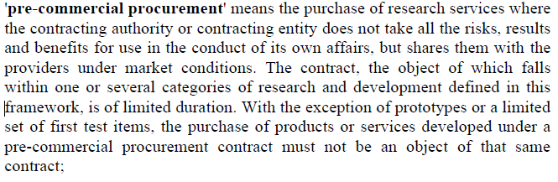
Innovation-friendly procurement encourage procurers to leave room for innovation in their purchasing process (mind-set and procedural aspects)
Public Procurement of Innovation (PPI): purchase of innovative solutions available (or partly available) on the market (new for the procurer)
Pre-commercial procurement
is a phased approach of purchasing R&D services by procurers for the development of innovative products, services or processes (not yet available on the market) by enterprises/ research centers with the goal of:
Solving socio-economic challenges
Improving the performance, functionality of public services

Slide 6
Risks
PCP
R&D
PPI
Innovation- friendly
Distance of the solutions to the market

Slide 7
3.Differences PCP & Procurement
Traditional Procurement
‘Tendering procedures’ = National/CERN Procurement Rules apply
Legal framework
Contractor’s obligation to produce results
Degree of innovativeness is low/medium
Solutions to be developed are close to the market (engineering)
Pre-commercial Procurement
Exemption for R&D services = under EU Directive
Specific legal framework (H2020)
Contractor’s obligation to use “its best efforts”
High degree of innovativeness R&D-efforts required
High R&D-efforts required (fill the gap STOA vs. innovation needs)

Slide 8
Traditional Procurement
Technical specification
Short-term needs
Market sounding
Risks are low/medium
One supplier, 1 contract awarded to 1 company
Development in 1 phase
IPR generated (e.g. shall be vested in CERN (General Conditions ART. 14))
Pre-commercial Procurement
Functional specification
Long-term needs
Market consultation with engagement
Risks are high = risks assessment
Competitive development, several contracts to several suppliers
Development in different phases (de-risking)
IPRs - business case - Risk-benefit sharing

Slide 9




the PCP-concept
4.Method
4 steps
Step 0: Preparation Phase
Step1:
Market consultation
Step 2:
Pre-commercial Procurement
Step 3:
Commercial Tender
Notes:
9

Slide 10

Phase 0: The Preparation phase
LIST OF ACTIVITIES
A. Needs assessment
What is the innovation potential from an end-user perspective? Added-value for the end-user ? Which needs are being answered ?
B. State-of-the-art
Ensure the envisaged solution goes beyond the state-of-the-art
C. Standardisation
Can the innovation expectation be developd within the boundaries of known harmonized standards and directives?
D. Risk assessment
F. Validation of the legal framework
Notes:
10

Slide 11




Phase 1: The Open Market Consultation (OMC)
Step 0: Preparation phase
Step 1:
Market consultation
Step 2:
Pre-commercial Procurement
Step 3: Commercial Tender
Notes:
11

Slide 12


OMC Goals
Bridging the demand and supply side
State-of-the-art ➔ double check your findings with the market + inform the market about the innovation step you want to realize with the project
Attract the suitable stakeholders
Identification of the innovation potential
  Technological point of view
Feasibility-check = capacity & capability to supply the innovation
Technological risks assessment
Forum for the supply side to meet each other (consortia)
Inform potential tenderers about the PCP - legal issues and particularities
Results
Final report
Preparation of PCP tender documents
Notes:
12

Slide 13
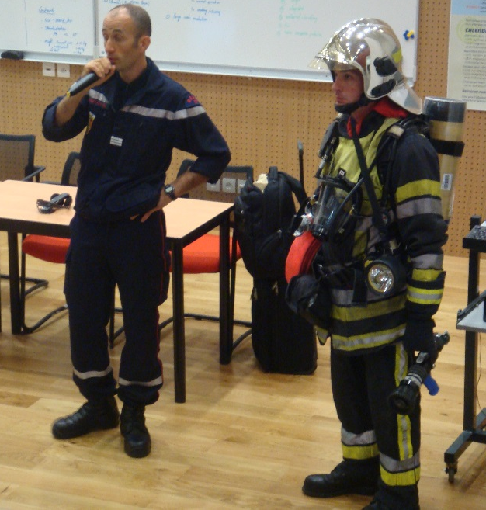
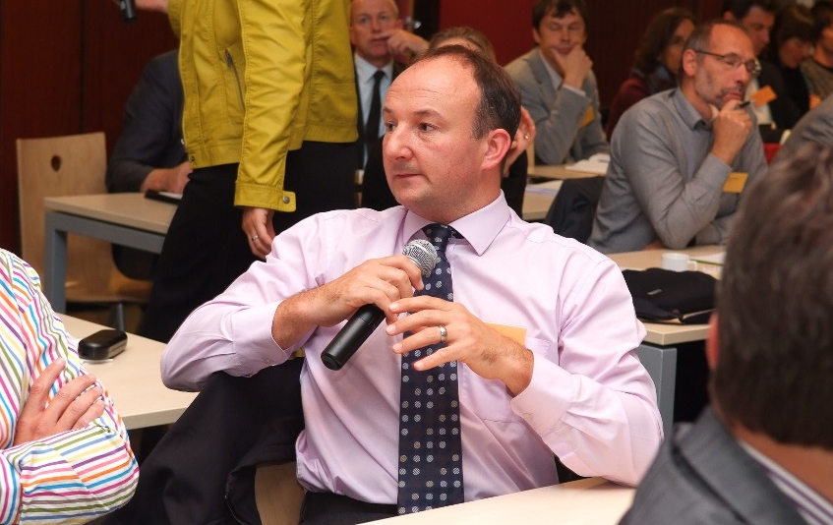
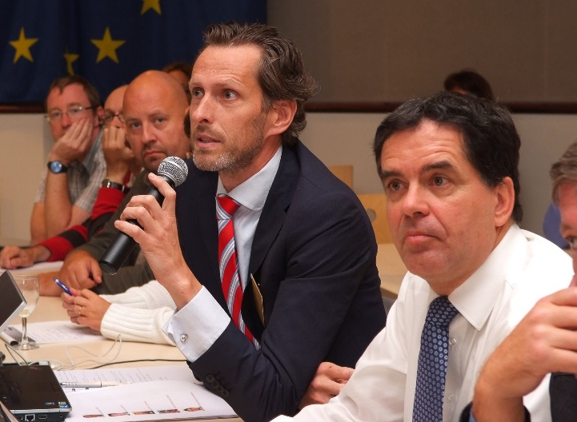


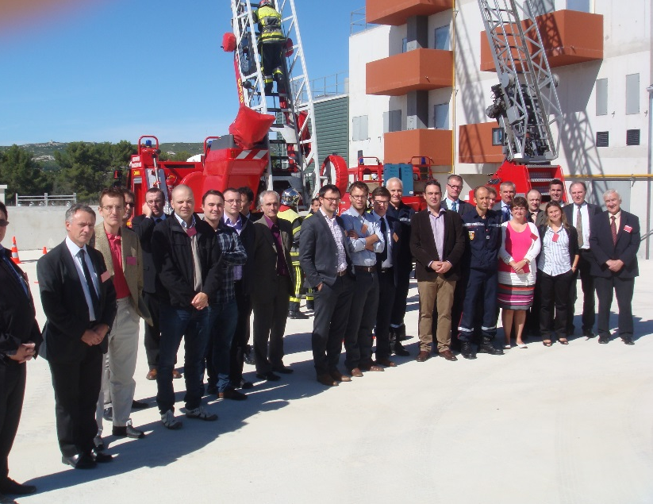
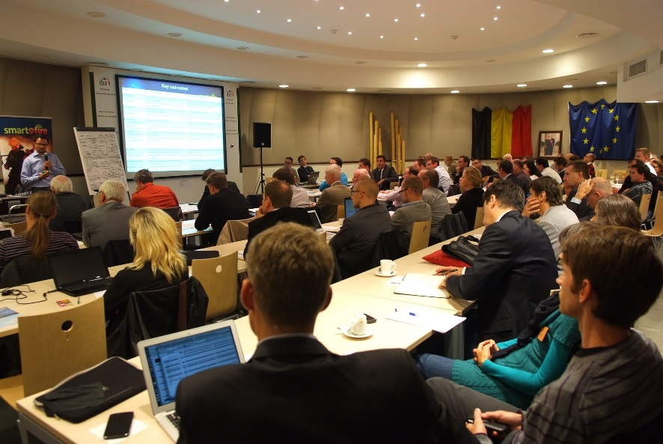
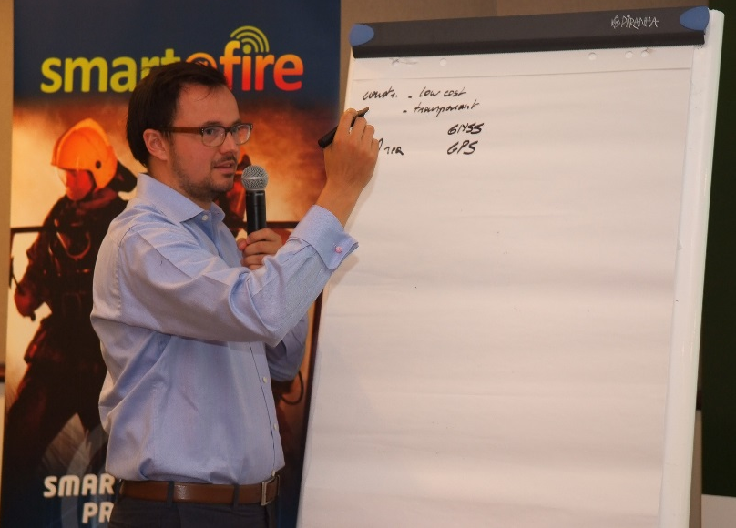
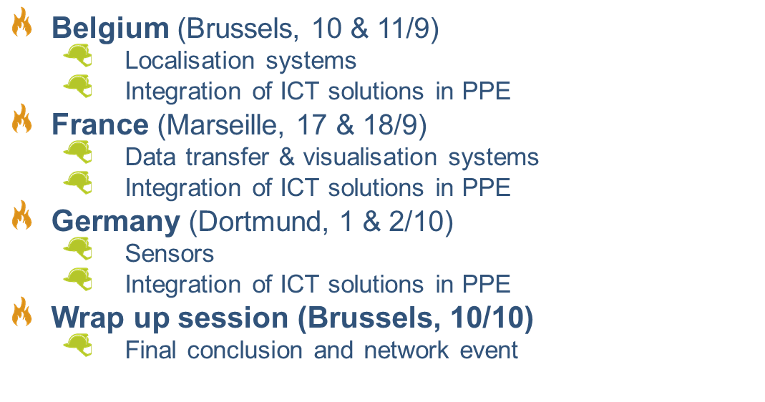
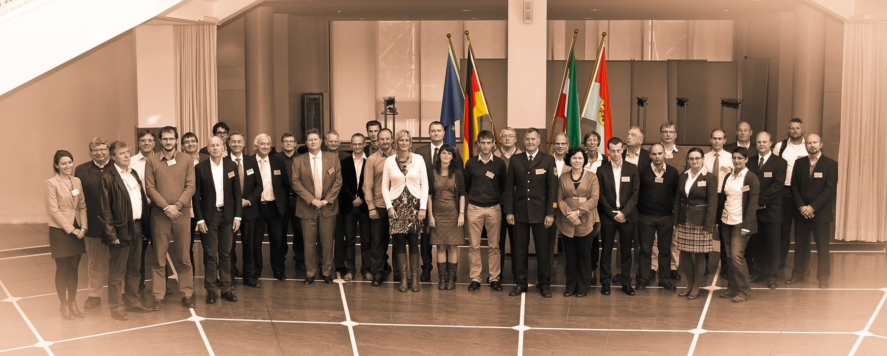

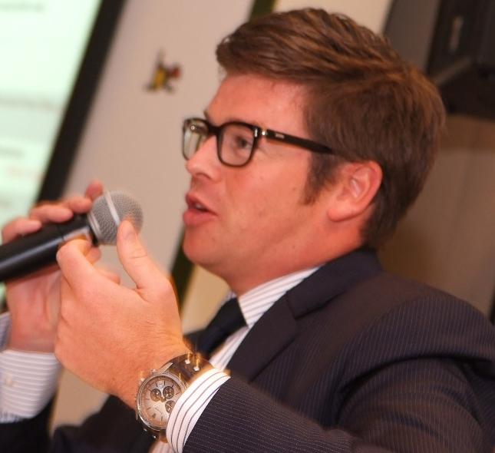
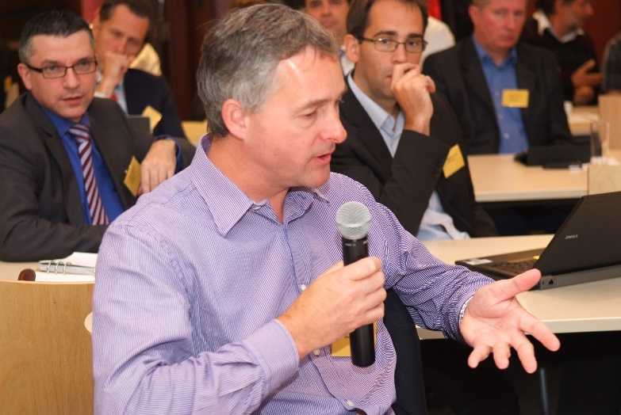
PCP in 4 phases
Phase 2: Market consultations
September – October 2013
Notes:
13

Slide 14
Results
Prototype Scope: value vs. risk
H
DO
DERISK
PCP
Innovative for end-user
= +
Significant technological risk
Added
Value
Innovation potential from
end-user perspective
PPI
Innovation- friendly
L
Avoid if possible
Off-the-shelf
L
H
Risk
Innovation potential from technological perspective

Slide 15


Phase 2: Pre-commercial Procurement
Step 1:
Market consultation
Phase 2:
Pre-commercial Procurement
Step 0: Preliminary stages
Step 2:
Pre-commercial Procurement
Step 3: Commercial Tender
Stage 1: Preparation of the Market Consultation
Phase 2
Phase 3
First of a kind
Engineering Design
phase 1
Solution Design
Stage 2: Informing the Market
Notes:
15

Slide 16

Competitive Deployment in 3 Phases
Public Procurement of
Innovative Solutions (PPI)
Pre-commercial Procurement (PCP)
Phase 1
Conceptual Design
Phase 2
Engineering Design
and Prototyping
Phase 3
First of a Kind (Pilot) and Acceptance
Supplier A
Supplier B
Supplier B
Supplier C
Supplier B
Supplier C
Supplier D
Supplier D
Supplier D
Also normally multiple sourcing here to keep competition going
4 Months
10 Months
22 Months
Commercial
End Products
5

Slide 17


5.PCP Legal Principles
Exemption on the Use of the EC Procurement Directive
Own procedure
Conditions:
  General Principles of Law
  Directive 2004/17/EU and 2004/18/EU: Art. 16f and Art. 14 Directive 2014/24/EU
  COM(2007)799: Communication of the EC: Driving innovation to ensure sustainable high quality public services in Europe
  SEC(1688) 2007: EC staff working document
  Transparency and openness
  Equal treatment (no preferential treatment for the final purchase of products)
  Competition
  Best Value for Money
Notes:
17

Slide 18

Specific PCP Principles
  Risk-benefit sharing principle
  IPR retained as much as possible by contractors
  No exclusive development (for 1 procurer) reflected in price reduction for government = competitive development
  No Commercial development activities =
  clearly separation R&D and final product
  Subsequent phases: three phases
  Price paid at market condition (not the R&D costs) The price reduction should reflect the market value (commercialisation) of the benefits received (IPR ownership) and risks assumed by the procurer(s). In the offer two prices will have to be submitted! (IPR-IN –IPR-OUT)
  R&D Services > min. 50% services of the total value of the contract
  Place of performance in EU Member States and associated countries to H2020 (vs. country of origin of bidders )
  Standards and certification
  Single Framework Agreement
  No illegal State-Aid

Slide 19
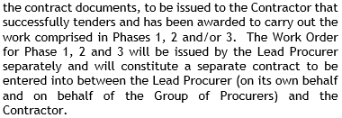

  Tendering Approach
Two stages: Tendering and Execution Stage
Tendering Stage
Similar to an open procedure (no pre-qualification)
Exclusion Criteria: submission of a set of administrative documents
Selection Criteria e.g. ability to perform R&D
Compliance Criteria: R&D services, place of performance, compliance with standards , …
Awarding Criteria: announce at the launch of the Tender (weighting can vary for each phase )
Evaluation
Execution phase
3 Phases
Fixed term for each phase (4-10-22 months)
Max. budget available for each phase (carry-over budget to next phase)
Work Order awarded for each phase
End of phase report
Payment based on satisfactory completion of milestones/deliverables
Eligibility for the next phase based on successful completion of a phase
19

Slide 20
Compliance Criteria
Min. 50% of the total value of the framework agreement for R&D services
Compatibility with other public financing
Place of performance: min. 50% of the total value of activities in EU MS or H2020 Associated countries
Ethics and Research integrity
Security: dual-use goods or dangerous materials and substances; no classified information

Slide 21
6.Time Table
TENDERING STAGE of Phase 1: Conceptual design
Receipt of tenders
Offers assessment & selection
Internal validation procedures!
Request for clarification
Finalization and signature
Information session
Call for tenders notice in TED
Deadline offers receipt
Framework contracts and Work order contracts for phase 1 signed
T0
T0 + 4 weeks
T0 + 2
months
T0 + 3,5
months
T0 +4
months

Slide 22
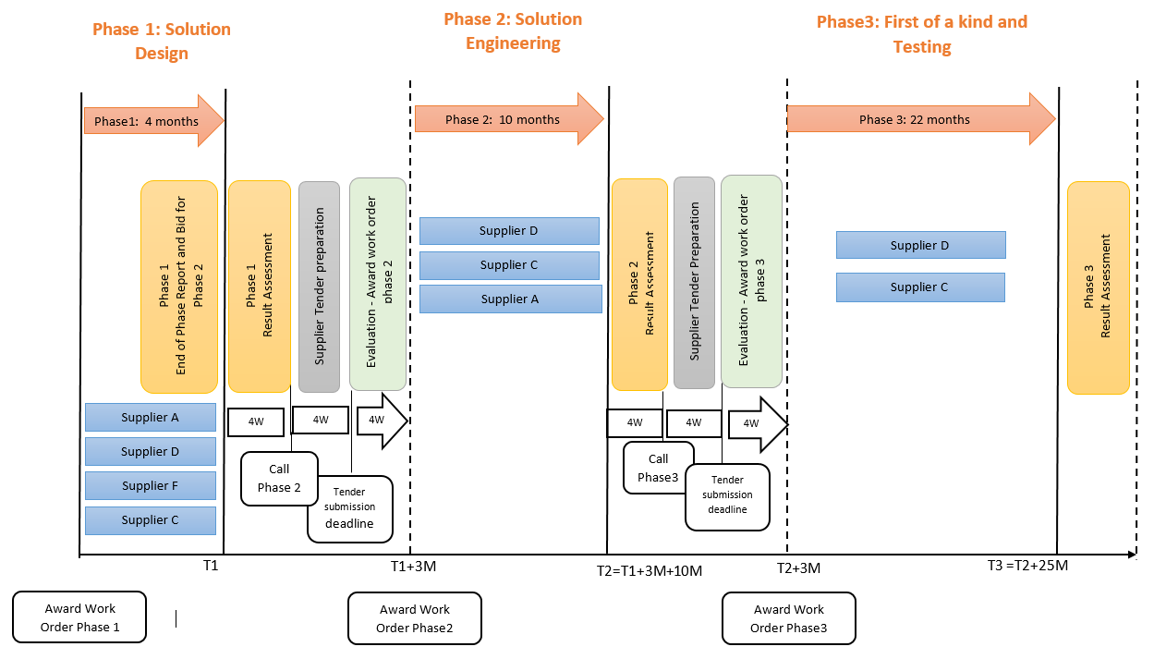
Phase 1: Conceptual Design
Phase 2: Engineering Design and Prototyping
Phase 3: First-of-a-kind and Acceptance
To be adapted for QUACO

Slide 23
Preliminary Procurement Budget Allocation
 | Max Total Budget | Min amount of Tenderers | Maximum fixed Duration
Procurement budget | 4,656,000
Phase 1: Solution Design | 399,000 | 4 | 4 months
Phase 2: Prototyping | 2,447,000 | 3 | 10 months
Phase 3: First of a kind | 1,810,000 | 2 | 22 months

Slide 24


Phase 3: Commercial tender
Step 1:
Market consultation
Step 2
Pre-commercial Procurement
Phase 3: Commercial Tender
Step 0: Preliminary stages
Step 3:
Commercial Tender
Stage 1: Preparation of the Market Consultation
Stage 2: Informing the Market
up to 2,5 years
Notes:
24

