Slide 1



Stable 2+1d CFT at the Boundary of a Class of 3+1d Symmetry Protected Topological States
Cenke Xu
许岑珂
University of California, Santa Barbara

Slide 2
Stable 2+1d CFT at the Boundary of a Class of 3+1d Symmetry Protected Topological States
Outline:
1, brief introduction to topological insulator, more generally symmetry protected topological states, and connection to gauge anomalies at the boundary;
2, numerical evidence for the existence of the novel stable CFT in 2+1d;
3, an attempt of a controlled analytical RG calculation for the stable CFT.
4, possible connection to high energy physics

Slide 3
“Oversimplified” Introduction to TI/SPT states:
Topological Insulator:
d-dimensional bulk: massive Dirac/Majorana fermion;
(d-1)-dimensional boundary: gapless Dirac/Weyl/Majorana fermions, gapless spectrum protected by symmetry, i.e. Symmetry forbids fermion mass term.
(d-1)-dimensional
d-dimensional
Mirror sector
(d-1)-dimensional boundary cannot exist as a (d-1)-dimensional system without the bulk. i.e. Once symmetries are gauged, will have gauge anomaly. Full classification of noninteracting topological insulator: (Ryu, et.al., Kitaev, 2009)

Slide 4
“Oversimplified” Introduction to TI/SPT states:
Topological insulator and anomalies at the boundary
The boundary of TI without any symmetry must have gravitational anomaly.
Example: topological superconductor with no symmetry at all
Classification (Ryu, et.al., Kitaev, 2009)
Gravitational Anomaly of single Majorana fermion (Alvarez-Gaume, Witten, 1983)
P
P
G
G
P

Slide 5
“Oversimplified” Introduction to TI/SPT states:
Topological insulator and anomalies at the boundary
The boundary of TI with unitary symmetry G will have gauge anomaly once G is “gauged”.
Example: topological insulator with U(1) symmetry
Classification (Ryu, et.al., Kitaev, 2009)
U(1) gauge anomaly at the boundary:
P
P
P
P
P

Slide 6
“Oversimplified” Introduction to TI/SPT states:
Topological insulator and anomalies at the boundary
The boundary of TI with unitary symmetry G will have gauge anomaly once G is “gauged”.
Example: topological superconductor with SU(2) symmetry
Classification (Ryu, et.al., Kitaev, 2009)
SU(2) gauge anomaly at the boundary:
P
G
G
P
P

Slide 7

“Oversimplified” Introduction to TI/SPT states:
Free fermion TI: Full classification: S. Ryu, et.al. 2009, A. Kitaev 2009;
Phase transition between free fermion SPT states:
Gapless Dirac/Majorana fermion in the d-dimensional bulk. Simplest example is the IQH plateau transition, described by a single 2+1d Dirac fermion, with mass m tuned to zero:
Interacting TIs:
Interaction can reduce the classification of fermion SPTs,
1d: Z reduce to Z8, Fidkowski, Kitaev, 2009
2d: Z reduce to Z8, Qi, 2012, Ryu, 2012……
3d: Z reduce to Z16, He3B, Xie Chen et.al. and…

Slide 8


“Oversimplified” Introduction to TI/SPT states:
Symmetry Protected Topological States: Generalization of TI and TSC, i.e. the bulk is gapped and nondegenerate, with gapless boundary.
Bosonic SPT states:
There is no free boson version; always strongly interacting;
simplest example; 1d Haldane phase of spin-1 chain:
Field theory description: O(3) NLSM + Θ-term, for π₂[S²] = Z.
Haldane 1988, Ng 1994, Coleman 1976.
Θ = 2π
Θ = 2π and Θ = 0 have the same bulk spectrum, but fundamentally different wave function, and different edge spectrum.

Slide 9


“Oversimplified” Introduction to TI/SPT states:
Symmetry Protected Topological States: Generalization of TI and TSC, i.e. the bulk is gapped and nondegenerate, with gapless boundary.
Bosonic SPT states:
Higher dimensional bosonic SPT states, much more complicated, can be classified mathematically: Chen, Gu, Liu, Wen 2011
can also be classified through more “physical” approaches, for instance Chern-Simons theory for 2+1d (Lu, Vishwanath, 2012)
Or, nonlinear sigma model for 2+1d and 3+1d (Vishwanath, Senthil 2012, Xu 2012, Xu, Senthil 2013……)

Slide 10

“Oversimplified” Introduction to TI/SPT states:
1+1d edge of 2+1d bosonic SPT state:
With full SO(4) symmetry, it is well-known that this theory is a CFT, i.e. g flows to a stable fixed point under RG.
g=0
g=Infity
When the SO(4) symmetry is reduced to its discrete subgroup, this theory could have spontaneous symmetry in its ground state. Both scenarios are consistent with the definition of SPT state.

Slide 11
“Oversimplified” Introduction to TI/SPT states:
2+1d edge of 3+1d bosonic SPT state:
Possible ground states of this theory:
1, ordered phase which spontaneously breaks the global symmetry, happens with weak coupling g;
2, with strong coupling g, the system is in a quantum disordered phase, but this disordered phase has topological order and topological degeneracy;
3, the quantum disordered phase with strong coupling g, is a stable 2+1d CFT, at least this is allowed by the definition of SPT state.

Slide 12
RG flow of the coupling constant g with the WZW term
2+1d edge of 3+1d bosonic SPT state:
3, the quantum disordered phase with strong coupling g, is a stable 2+1d CFT, at least this is allowed by the definition of SPT state.
g=0
g=Infity
It is much harder to perform a reliable RG calculation for 2+1d, because usual controlled expansion method (2+ε and 1/N expansion) both fail here. For example, a O(N) vector has no topological term in 2+1d for large-N. And a topological term is difficult, if not impossible, to generalize to fractional dimensions.

Slide 13
Stable 2+1d CFT at the Boundary of a Class of 3+1d Symmetry Protected Topological States
Outline:
1, brief introduction to topological insulator, more generally symmetry protected topological states, and connection to gauge anomalies at the boundary;
2, numerical evidence for the existence of the novel stable CFT in 2+1d;
3, an attempt of a controlled analytical RG calculation for the stable CFT.
4, possible connection to high energy physics

Slide 14

Evidences for the existence of this stable CFT
The 2+1d O(5) NLSM with a topological Wess-Zumino-Witten term can reduce to a 2+1d O(4) NLSM with a Θ-term with Θ=π:
Choose n₅ = 0 (break the SO(5) to SO(4) x Z₂), this field theory reduces to
This model can be generated by integrating out massive Dirac fermions in 2+1d (Abanov, Wiegmann, 2000). Thus we can simulate this model using 2d lattice fermion. But Θ is a tuning parameter in this 2d lattice model, rather than being fixed at π by symmetry.
(situation similar to 3+1d chiral fermion: with a compact U(1) global symmetry, a famous no-go theorem guarantees that chiral fermions do not exist on lattice model, but without the compact U(1) symmetry, chiral fermion can emerge on lattice)

Slide 15
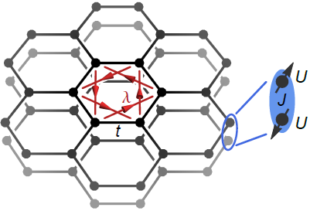


Sign problem free lattice model to simulate 2+1d O(4) NLSM with a Θ-term
This model has an exact O(4) symmetry = spin x layer rotation.
We fix t, λ. Treating J as a tuning parameter.
Some simple limits of this model:
(1) J=0: bilayer quantum spin Hall, boundary c=2 CFT;
(2) Weak J: fermion modes gapped at the boundary, boson modes gapless at boundary. Bosonization proves that boundary is described by 1+1d O(4) NLSM with a WZW term at level-1. Which implies that the bulk corresponds to a 2+1d O(4) NLSM with Θ~2π.
(3) Strong J: trivial Mott insulator, effective Θ=0.

Slide 16
Sign problem free lattice model to simulate 2+1d O(4) NLSM with a Θ-term
So in this lattice model, tuning J is like tuning Θ in the O(4) NLSM field theory.
Θ=0, J >> t
g=0
g=Infity
Θ=2π, J ~ 0+

Slide 17
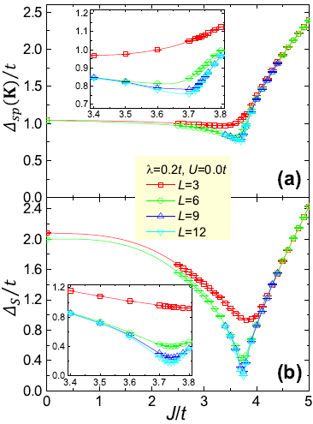
Sign problem free lattice model to simulate 2+1d O(4) NLSM with a Θ-term
Tuning J in the lattice model is equivalent to tuning Θ in the field theory. Determinant QMC (arXiv:1508.06389) shows that the fermion gap is always finite while increasing J, but bosonic modes, the vector n, becomes gapless at the SPT-trivial Quantum critical point.
This supports the conclusion that the disordered phase of the 2+1d O(4) NLSM with Θ=π is a CFT.
Θ=2π
Θ=π
Θ=0

Slide 18
Stable 2+1d CFT at the Boundary of a Class of 3+1d Symmetry Protected Topological States
Outline:
1, brief introduction to topological insulator, more generally symmetry protected topological states, and connection to gauge anomalies at the boundary;
2, numerical evidence for the existence of the novel stable CFT in 2+1d;
3, an attempt of a controlled analytical RG calculation for the stable CFT.
4, possible connection to high energy physics

Slide 19
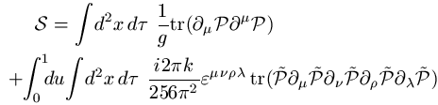


RG flow of the coupling constant g with the WZW term
We need to design a special large-N generalization of this theory with a WZW term for arbitrary N:
The target manifold is , which has a topological WZW term in 2+1d for arbitrarily large N.
For n > 1 and N - n > 1,
M is an n x (N-n) dimensional manifold.
The original theory can be viewed as N=2n=4 after weakly breaking part of the global symmetry, because

Slide 20
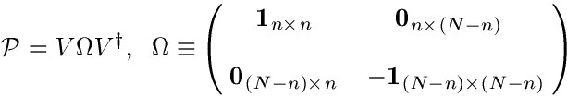



RG flow of the coupling constant g with the WZW term
Step 1: Choosing a convenient parametrization, which can make the WZW term a “local term” in 2+1d:
The complex vectors φ_{α} now have a U(n) gauge freedom:

Slide 21


RG flow of the coupling constant g with the WZW term
Now the WZW term becomes a “local term” in 2+1d, and it is a Chern-Simons term written formally in terms of gauge field a.
When n=1, φ becomes the familiar CP^{N-1} fields. The WZW term can still be defined, because although the integral of f ˄ f is zero on S⁴, it is still quantized on T⁴.
When n=1, N=2, φ becomes the familiar CP¹ fields, and this WZW term reduces to the Hopf term, and it is a quantized integral in 2+1d, because π₃[S²] = Z.

Slide 22

RG flow of the coupling constant g with the WZW term
Step 2: Solve the constraint on φ_{α} and fix the gauge:
Block decompose φ_{α} as follows:
Choose a gauge, to make the n x n matrix Ф Hermitian, which removes all the continuous gauge degree of freedom, then the constraint on φ_{α} dictates that:
ϕ is an n x (N-n) matrix, it has precisely the same number of degrees of freedom as the original order parameter P.

Slide 23

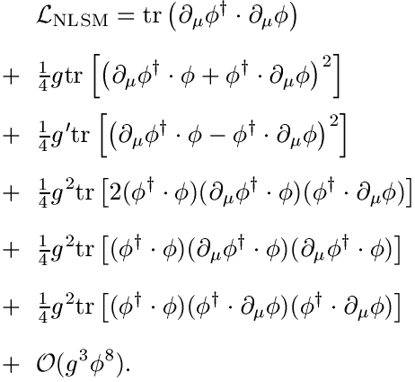
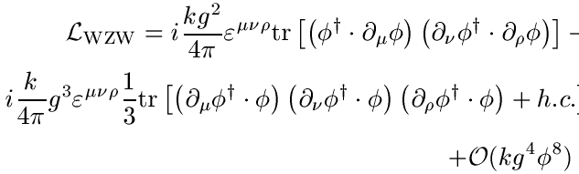
RG flow of the coupling constant g with the WZW term
Step 3: Now the entire action written in terms of ϕ is

Slide 24



RG flow of the coupling constant g with the WZW term
Step 4: RG flow without the WZW term, very simple beta functions in the large-N limit.
The starting point of the RG flow has g = g’. Along this line, there is a quantum phase transition controlled by the fixed point
g’
g

Slide 25
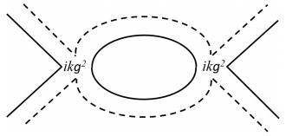
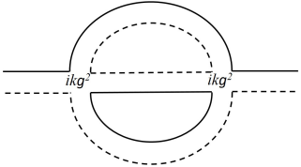
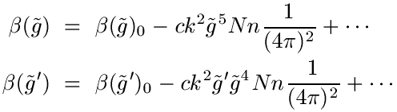
RG flow of the coupling constant g with the WZW term
Step 5: RG flow with the WZW term.
The one loop diagram on the right does not renormalize g or g’, thus the lowest order contribution to g and g’ are two-loop diagrams, for example the wave function renormalization:

Slide 26
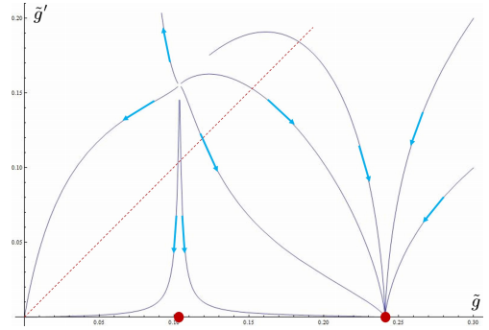
RG flow of the coupling constant g with the WZW term

Slide 27
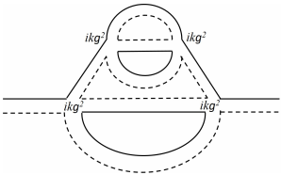
RG flow of the coupling constant g with the WZW term
Unfortunately, this calculation is not reliable. To reliably identify a new fixed point in the disordered phase, we need to make sure that the system is still perturbative at the new fixed point. This implies that all terms in the beta functions should be comparable in the large-N limit. This means that k ~ N^{3/2}. But then infinite diagrams will contribute at the same order:

Slide 28


RG flow of the coupling constant g with the WZW term
This infinite diagram problem only arises with the WZW term, this theory has a controlled large-N limit without the WZW term.
Step 6: We need to find another (artificial) smaller parameter to control the calculation.
Previous example: 1+1d Gross-Neveu model with a nonanalytic dispersion: Gawedski and Kupiainen, 1985
A CFT at g ~ ε, which corresponds to a phase transition of spontaneous chiral symmetry breaking.

Slide 29
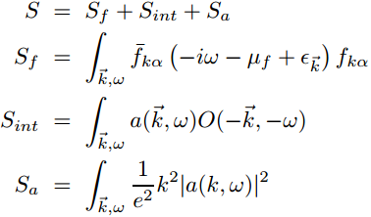


RG flow of the coupling constant g with the WZW term
Previous example: 2d Fermi surface coupled to a U(1) gauge field, need to sum up infinite diagrams in the large-N limit (S.S.Lee 2009)
But, one can introduce a small parameter with nonanalytic dispersion (Nayak, Wilczek, 1994, Mross, McGreevy, Hong Liu, Senthil, 2010)

Slide 30
RG flow of the coupling constant g with the WZW term
These previous studies motivate us to make a nonanalytic generalization of the original NLSM to include another “small” parameter ε through changing the scaling dimension of g.
This generalization, especially the WZW term, had better satisfy the following criteria:
1, under RG flow, no more relevant nonanalytic terms are generated, and all renormalization can be absorbed into finite number of coupling constants (can be proved in the large-N limit).
2, the generalized WZW term keeps all the basics of the original WZW term, for example the parameter k (level) is always dimensionless.

Slide 31
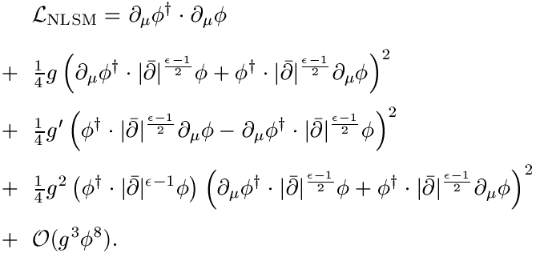

RG flow of the coupling constant g with the WZW term
One generalized form of the NLSM, which satisfies these criteria:

Slide 32
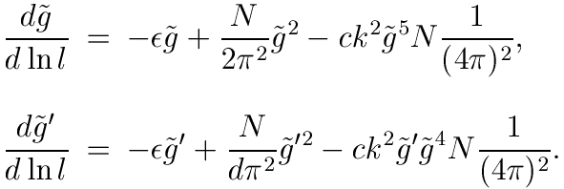
RG flow of the coupling constant g with the WZW term
Beta function of this new theory, in the large-N limit and leading order in ε:
Now we need to take
to keep all the terms at the same order. And all the fixed points will be around

Slide 33


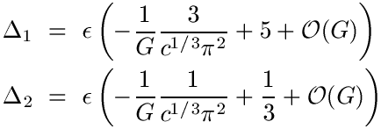
RG flow of the coupling constant g with the WZW term
Exponents: we take with small G.
At the order-disorder transition:
At the stable fixed point inside the disordered phase:
When G is reduced, the fixed points can merge and annihilate each other.

Slide 34
Stable 2+1d CFT at the Boundary of a Class of 3+1d Symmetry Protected Topological States
Possible connection to high energy physics: hierarchy problem
My (naive) understanding: how to construct a theory that can give us stable (almost) massless (space-time) scalar bosons?
Possible route 1: little Higgs, (almost) massless scalar boson is a (pseudo-)Goldstone mode, associated with a spontaneous continuous symmetry breaking;
New route: a topological WZW term can give us a stable CFT of scalar bosons, without any spontaneous symmetry breaking.

