Slide 1
Anatomy of particle production and azimuthal anisotropy in small and large systems
Roy A. Lacey
Stony Brook University

Slide 2
Backdrop
A+A
collision
S. Bass
p+A
collision
P. Chesler
Hydrodynamic expansion dynamics for sizes as small as RT ~ 1
p+p
collision
Essential question
Whether hydro-like expansion dynamics is maintained
with reduced system size, and how do we tell?

Slide 3



Backdrop
Strategy
Test for similarities in
the particle production
mechanism for
p+p, p+A, A+A(B) collisions
$\left\langle N_{chg}\right\rangle$and $\frac{dN_{chg}}{dη}$ scaling
Test for similarities in
the expansion dynamics
for
p+p, p+A, A+A(B) collisions
Acoustic scaling of $v_{n}$
HBT radii, etc
RT
link
The scaling properties of $\left\langle N_{chg}\right\rangle ,$ $\frac{dN_{chg}}{dη}$ , $v_{n}$ , etc can provide key insights
      Scaling coefficients provide crucial constraints for transport coefficients

Slide 4
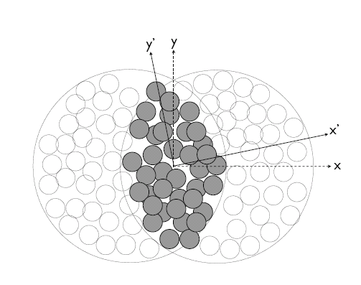
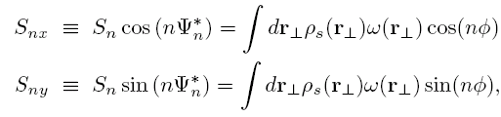


Geometric quantities for scaling
Nucleon Glauber
Phys. Rev. C 81, 061901(R) (2010)
A
B
Quark Glauber
n-n cross section
p-p profile
  Elastic scattering measurements
rms radius
Consistency of approach for nucleon and quark Glauber
  Geometric fluctuations included
σ_{x} & σ_{y} → RMS widths of
density distribution

Slide 5
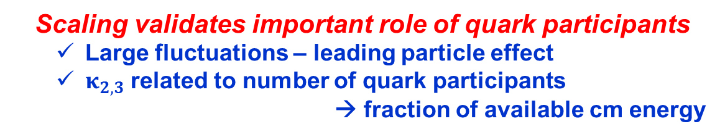
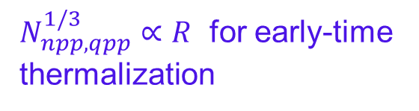


$\left\langle N_{chg}\right\rangle$and $\frac{dN_{chg}}{dη}$ scaling
Operational Ansatz
$N_{npp, qpp}^{1/3}$ $∝R$ for early-time
thermalization
$\left\langle N_{chg}\right\rangle ,$ $\frac{dN_{chg}}{dη}$ $∝S$
Scaling validates important role of quark participants
  Large fluctuations – leading particle effect
  $κ_{2,3}$ related to number of quark participants
  → fraction of available cm energy

Slide 6


$\frac{dN_{chg}}{dη}$ scaling p+p
Further scaling validation over full range of $\sqrt{s_{NN}}$ for p+p
    Similar $\sqrt{s_{NN}}$ trend for quark and nucleon scaled multiplicity density

Slide 7

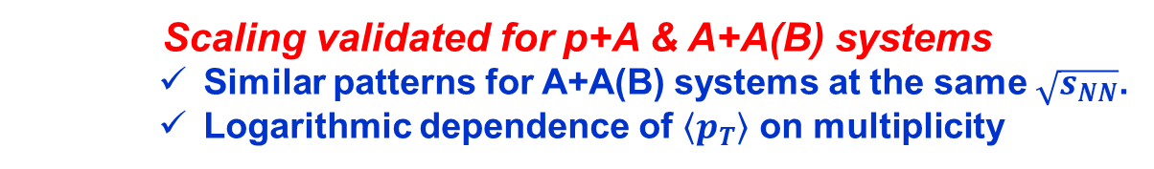
$\frac{dN_{chg}}{dη}$ scaling p+A & A+A(B)
Scaling validated for p+A & A+A(B) systems
    Similar patterns for A+A(B) systems at the same $\sqrt{s_{NN}}$.
    Logarithmic dependence of $\left\langle p_{T}\right\rangle$ on multiplicity

Slide 8
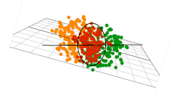
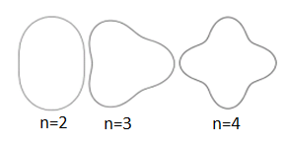

Expansion Dynamics
Initial Geometry characterized by many shape harmonics (ε_{n}) → drive v_{n}
Flow is acoustic
Acoustic viscous modulation of v_{n}
Staig & Shuryak arXiv:1008.3139
Scaling expectations:
Straightforward to include bulk viscosity
n² dependence
v_{n} ‘s are related
System size
dependence
Each of these scaling expectations has been validated

Slide 9
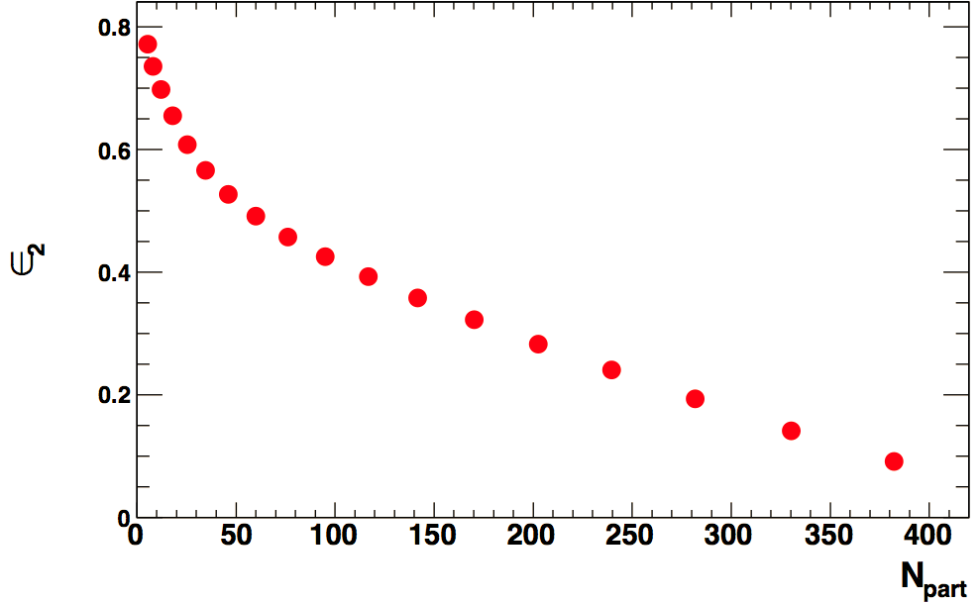

Acoustic Scaling - RT
ecccentricity
Eccentricity change alone is not sufficient
Characteristic 1/(RT) viscous damping validated
Similar patterns for other p_{T} selections
Important constraint for η/s & $ζ/s$

Slide 10

Acoustic Scaling - RT
Characteristic 1/(RT) viscous damping validated
Important constraint for η/s & $ζ/s$

Slide 11

Acoustic Scaling – n²
10-20%
Characteristic n² viscous damping validated
Similar patterns for other centrality selections
Important constraint for η/s & $ζ/s$

Slide 12
System-size dependence
Similar acoustic patterns for p+Pb and Pb+Pb
Similar results for other small systems

Slide 13
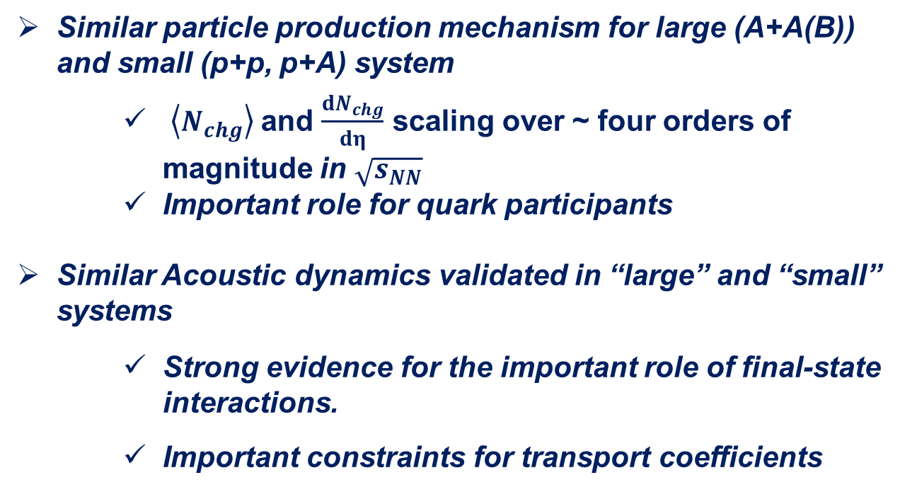
Epilogue
No fundamental change in the particle production mechanism and expansion dynamics, with reduced system size
Similar particle production mechanism for large (A+A(B)) and small (p+p, p+A) system
    $\left\langle N_{chg}\right\rangle$and $\frac{dN_{chg}}{dη}$ scaling over ~ four orders of magnitude in $\sqrt{s_{NN}}$
    Important role for quark participants
Similar Acoustic dynamics validated in “large” and “small” systems
    Strong evidence for the important role of final-state interactions.
    Important constraints for transport coefficients

Slide 14
End

Slide 15

Scaling properties of flow
$Combined scaling understood$

Slide 16
flow
In-plane
Out-of-plane

Slide 17
Comparison of Au+Au and d+Au collisions – m_{T} dependence
Similar m_{T} dependence for
Both systems
d+Au indicates a smaller freeze-out volume!

Slide 18
Scaling of the transverse radii
d+Au, Cu+Cu and Au+Au radii scale for the same beam energy
Expansion dynamics of the d+Au system appears to be
strongly influenced by final state effects
Larger expansion rate at the LHC

Slide 19
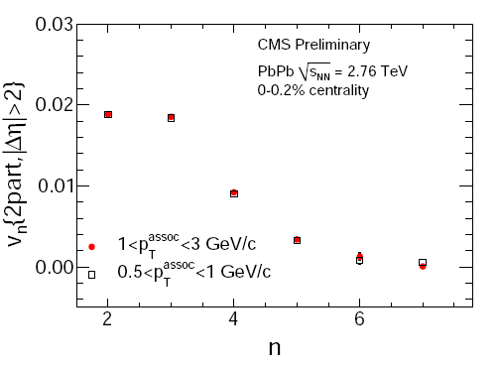

Extraction of η/s
arXiv:1301.0165 & CMS PAS HIN-12-011
Viscous Hydro
Slope sensitive
to η/s
Characteristic $n2$ viscous damping validated in viscous hydrodynamics; calibration → 4πη/s ~ 2$.2±0.2$
Extracted η/s value (LHC) insensitive to initial conditions

