Slide 1


Early time dynamics:
Pressure and 3+1D Flow From Classical Gluon Fields
Initial Stages 2016
LisboN, May 24 2016
Rainer J Fries
Texas A&M University

Slide 2
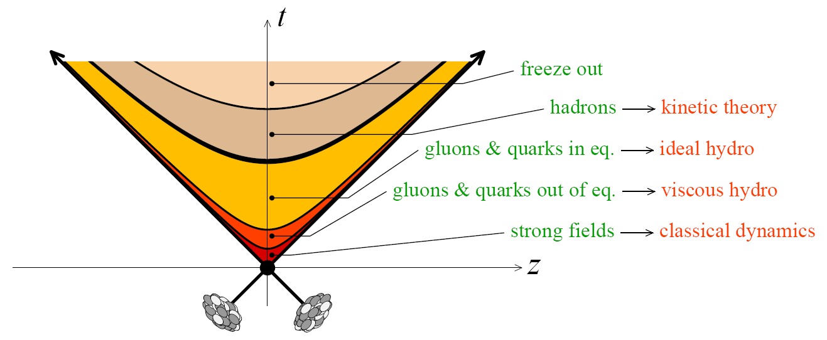
Little Bang: Macroscopic Evolution
Initial nuclear wave functions
Strong Longitudinal gluon fields
Local equilibration/isotropization
QGP/HG fluid close to local equilibrium
Hadron gas in the kinetic regime and freeze-out
Consensus Model for Phase II (times ≥ τ_{th}): fluid dynamics and hadronic transport.
No consensus on Phase I: early time dynamics and equilibration.

Slide 3
Early Time Evolution I
Large body of work on early time dynamics
  Phenomenological models
  Weak coupling limit
  Color glass condensate
Recently much progress on strong coupling scenarios
Chesler, Kilbertus, van der Schee (2015)
van der Schee, Schenke (2015)
van der Schee, Romatschke, Pratt (2013)
…

Slide 4
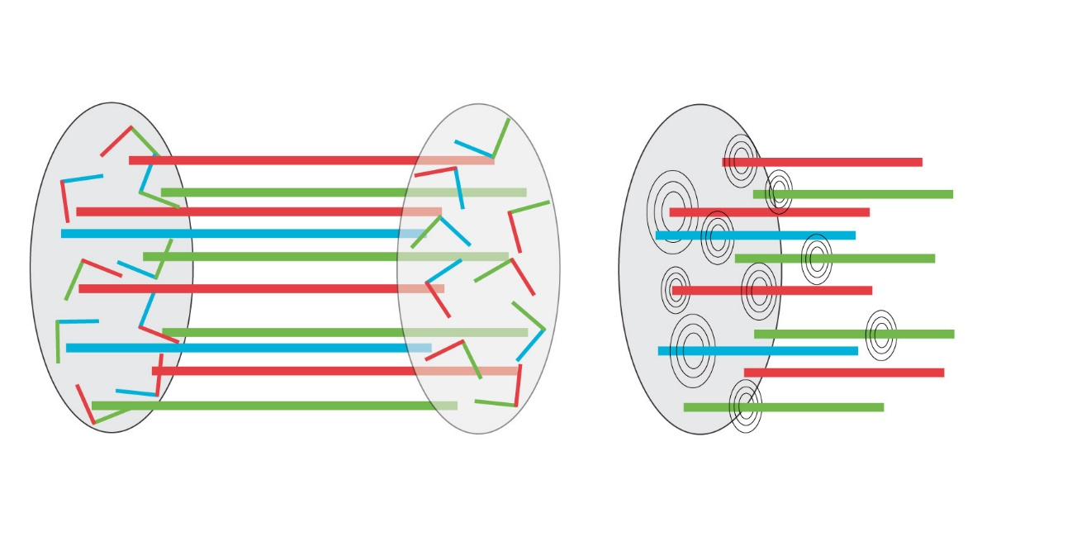
Early Time Evolution II
Initial wave function can be calculated approximately using Color Glass picture.
Overlap mechanism of nuclear fields known (in the light cone limit) = boundary conditions for further time evolution.
Dominance of longitudinal (chromo) electric and magnetic fields (“flux tubes”)
Kovner, McLerran, Weigert (1995)
McLerran, Lappi (2006)
RJF, Kapusta, Li (2006)

Slide 5

Classical MV Approximation
Nuclei/hadrons at asymptotically high energy:
  Saturated gluon density ~ Q_{s}² → scale Q_{s} >> Λ_{QCD}.
  Low-x wave function = classical gluon field with large-x partons as sources.
Solve Yang-Mills equations $\left[D^{μ},F^{μν}\right]=J^{ν}$ for gluon field $A^{μ}\left(ρ\right)$.
  Source = light cone current J (2-D color charge distributions ρ).
  Calculate observables O(ρ ) from the gluon field A^{μ}(ρ).
  ρ from Gaussian color fluctuations of a color-neutral nucleus.

Slide 6


Solving Yang-Mills for $τ≥0$
Numerical Solutions → Successful Phenomenology
Here: Analytic approach, expansion of gauge field in time $τ$
Recursive solution:
0th order (boundary conditions at $τ=0$): Immediately leads to longitudinal fields
Krasnitz, Nara, Venugopalan (2003); Lappi (2003)
… ; Schenke, Tribedy, Venugopalan (2012)
RJF, Kapusta, Li (2006)
Chen, Fries, Kapusta, Li (2015)

Slide 7


Energy Momentum Tensor at $O\left(τ^{2}\right)$
Minkowski Components
0th order: Color Capacitor
1st order: Poynting vector → Transverse Flow
IS 2016 - RJF
$$ε_{0}=\frac{1}{2}\left(E_{0}^{2}+B_{0}^{2}\right)$$
RJF, Kapusta, Li (2006)
Chen, RJF (2013)
Chen, RJF, Kapusta, Li (2015)
Like hydrodynamic flow, gradient of
transverse pressure p_{T} = ε₀; even in rapidity.
Beyond hydro; odd in rapidity

Slide 8



Early Energy Density and Pressure
Event-by-event calculations (semi-analytic) $ρ_{1},ρ_{2}→A_{1}^{i}$, $A_{2}^{i}$
Here: event averages with MV model, $\left\langle ρ_{1}^{2}\right\rangle \sim μ_{1},\left\langle ρ_{2}^{2}\right\rangle \sim μ_{2}$
  Initial energy density
Order by order in time $τ$ → Analytic results for early time evolution of pressure and energy density, consistent with numerical evaluations
Simplified pocket formulas
  $ε=ε_{0}\left(1−\frac{1}{2}{\left(Qτ\right)}^{2}+O\left(τ^{4}\right)\right)$
  $p_{T}=ε_{0}\left(1−{\left(Qτ\right)}^{2}+O\left(τ^{4}\right)\right)$
  $p_{L}=ε_{0}\left(1−\frac{3}{2}{\left(Qτ\right)}^{2}+O\left(τ^{4}\right)\right)$
Lappi (2006)
$$p_{T}/ε$$
Analytic 4th order
Varying log Q²/m²
Epelbaum & Gelis
SU(2), g=0.5
$$p_{L}/ε$$
Chen, RJF, Kapusta, Li (2015)

Slide 9
Transverse Flow
Transverse Poynting vector: Transverse plane
Transverse Poynting vector: Event Plane
  (long. component suppressed)
Radial and elliptic flow
Rapidity-odd directed flow
Angular momentum
Pb+Pb, b=6 fm
Chen, RJF (2013)
α only
β only
Linear comb.

Slide 10

Origin of Flow in YM
Initial longitudinal fields E₀, B₀ → transverse fields through QCD versions of Ampere’s, Faraday’s and Gauss’ Law.
  Here abelian version for simplicity.
Gauss’ Law at fixed time t
  Difference in long. flux → transverse flux
  rapidity-odd and radial
Ampere/Faraday as function of t:
  Decreasing long. flux → transverse field
  rapidity-even and curling field
Full classical QCD at $O\left(τ^{1}\right)$:
Chen, RJF (2013)

Slide 11

Field And Flow Patterns
Transverse Poynting vector for random initial fields (abelian example).
$η=0$: “Hydro-like” flow from large to small energy density
$η≠0$: Quenching/amplification of flow due to the underlying field structure.
Transverse Fields
Energy Flow
Chen, RJF (2013)

Slide 12

Switching to Hydro
No equilibration in classical YM.
Pragmatic solution: interpolate between clYM and viscous fluid dynamics, enforce conservation laws.
Direct matching = rapid thermalization assumption
  Mathematically equivalent to imposing smoothness condition on all components of T_{μν} (a la Schenke et al.).
  Decompose YM energy momentum tensor into hydro fields at some matching time $τ_{0}$
  $$T_{f}^{μν}=\left(ε+p+Π\right)u^{μ}u^{ν}−\left(p+Π\right)g^{μν}+π^{μν}$$
p
T
τ
L

Slide 13
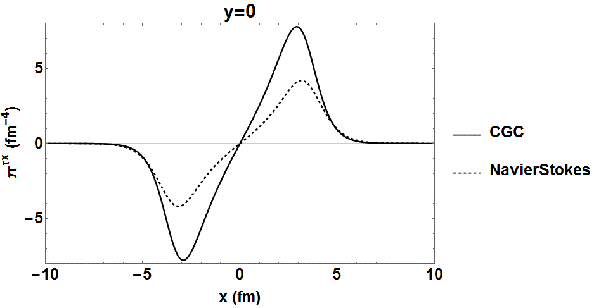
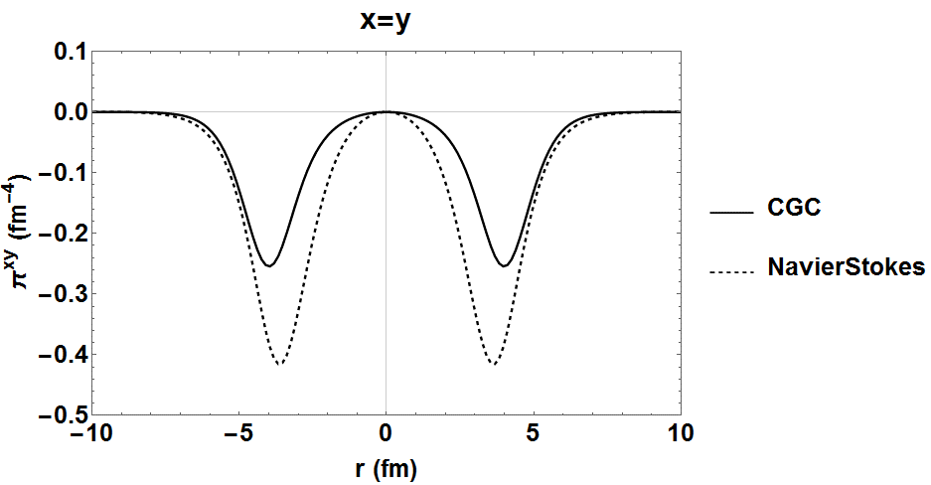

Yang Mills in Terms of Hydro Fields
We keep viscous stress even if it is large (otherwise we violate conservation laws at $τ=τ_{0}$).
Viscous stress extracted from YM generally follows Navier-Stokes behavior.
Samples
Expected?
Now feed into viscous fluid dynamics

Slide 14
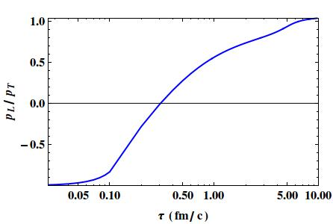
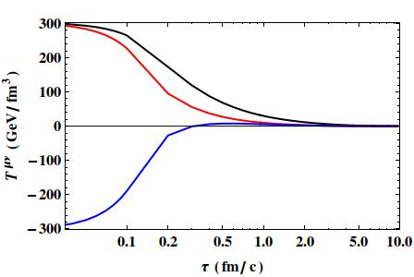
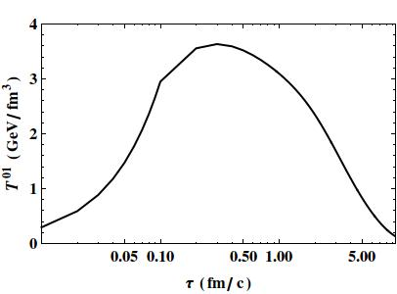




Hydro Evolution
Pressure and flow fields evolve smoothly
  Here Pb+Pb, b = 6 fm, not fitted to a particular energy, $η/s=1/{4π}$.
  Match at $τ=0.1$fm.
Not tuned to data.
$$ε$$
$$p_{T}$$
$$p_{L}$$

Slide 15



Gauss Law vs Shear Viscosity
Angular momentum realized as shear flow, not rotation (due to boost invariance)
$η−x$ (event plane) velocity vector in Milne coordinates:
Shear flow decreases rapidly in the hydro evolution.
$τ=0.1$ fm
$τ=9.6$ fm

Slide 16

Gauss Law vs Shear Viscosity
Angular momentum conserved locally but not globally (sources on the light cone!)
Yang-Mills phase: Gauss Law builds up shear flow.
Viscous fluid dynamics works against the gradient.
  $$\frac{∂v_{z}}{∂t}=\frac{η}{ε+p}\frac{∂^{2}v_{z}}{∂x^{2}}$$
Discontinuity in the time evolution.
Missing microscopic information could be vital.
Conclusive study of angular momentum needs to break boost invariance.

Slide 17



On Boost Invariance
Naïve boost invariance:
This is also allowed:
ε
$$v_{z}$$
η
η
Boost invariance does not have to pick the lab frame for the node $v_{z}=0$.
An asymmetry between $ρ_{1}$ and $ρ_{2}$ can lead to a shift of the node away from the lab frame.
Locally determined for each point in the transverse plane.
$$v_{z}$$
η

Slide 18
Beyond Boost Invariance?
Real nuclei are slightly off the light cone.
Classical gluon distributions calculated by Lam and Mahlon.
Using approximations valid for R_{A}/γ << 1/Q_{s} we estimated the rapidity dependence of the initial energy density ε₀.
Lam, Mahlon (2000)
Ozonder, RJF (2014)

Slide 19

Resummation of the Time Evolution
Generic arguments: convergence radius of the recursive solution ~1/Q_{s}.
“Weak field” approximation to Yang Mills
  Can be rederived from the recursive solution.
Resumming ${\left(Qτ\right)}^{k}$ terms: semi-closed form
Li, Kapusta, 1602:09060
See Poster

Slide 20
Summary
(Semi)-analytic results available for clQCD/MV early time evolution.
Order by order in powers of time, usually good up to ~ 1/Q_{s}.
Partial resummations available.
Flow driven by QCD Gauss/Ampere/Faraday.
Rapidity odd (but boost invariant) contributions.
Matching to hydrodynamics: smooth evolution of energy density and pressure.
Discontinuities of other important aspects.
Beyond boost-invariance: work in progress.

Slide 21
Backup

Slide 22
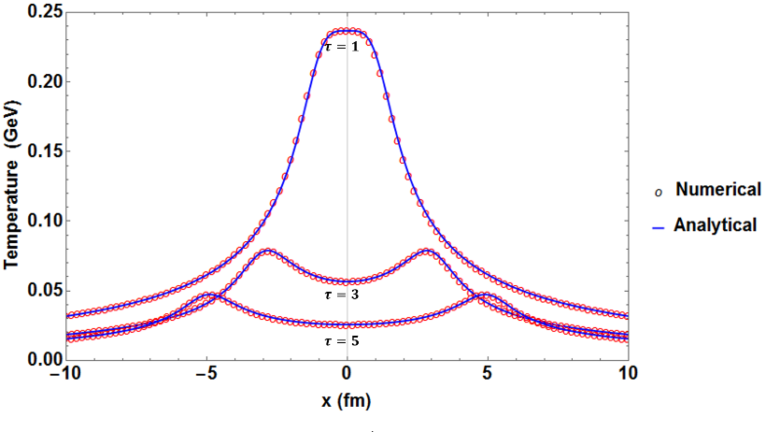
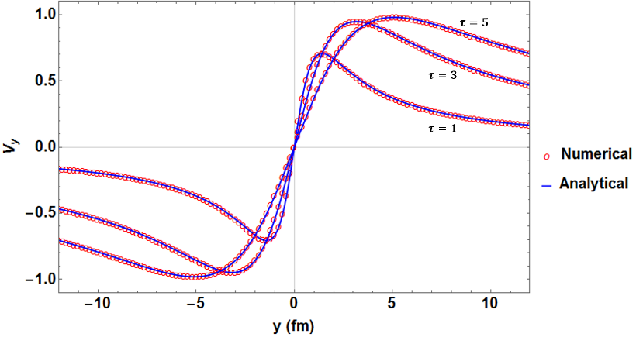
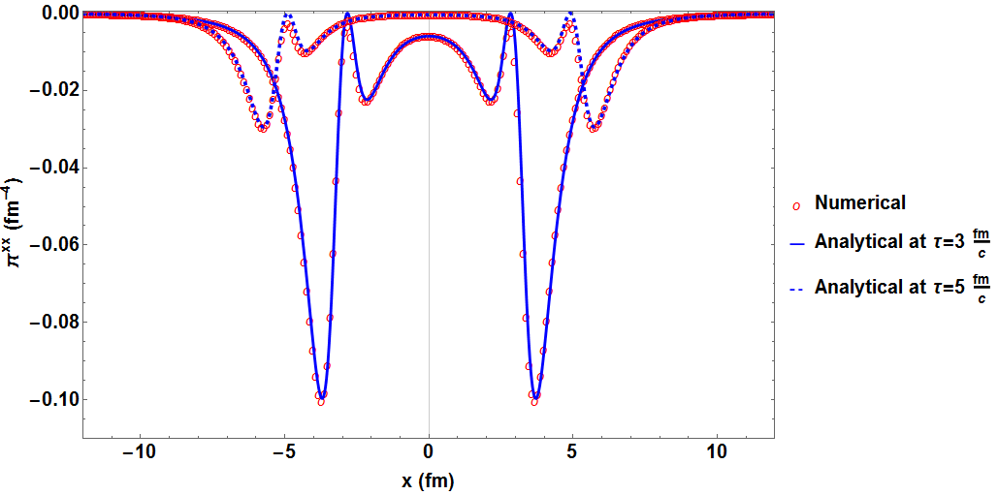
Texas 3+1 D Fluid Code
KT for fluxes, 5th order WENO for spatial derivatives, 3rd order TVD Runge Kutta for time integration.
Bulk and shear stress, vorticity
Gubser and Sod-type tests:

Slide 23
Matching to Hydrodynamics
Hydro fields in Minkowski components

