Slide 1

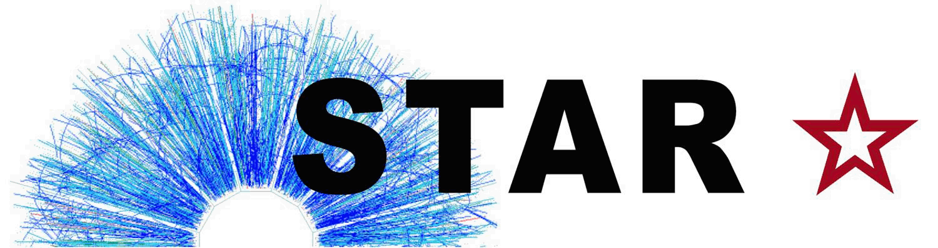
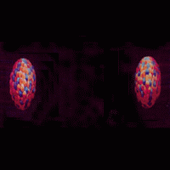
Beam Energy Dependence of Azimuthal Correlations in Au-Au Collisions at Mid and Forward Rapidity
Niseem Magdy
STAR Collaboration
Stony Brook University
niseem.abdelrahman@stonybrook.edu
Initial Stages 2016

Slide 2

Outline
Introduction
QCD Phase Diagram
STAR Detector
Correlation function technique
Results
$v_{n}$ $p_{T}$ dependence
$v_{n}$ $η$ dependence
$v_{n}$ beam energy dependence
Viscous coefficient
III. Conclusion

Slide 3
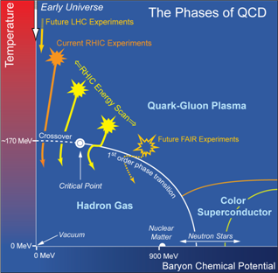
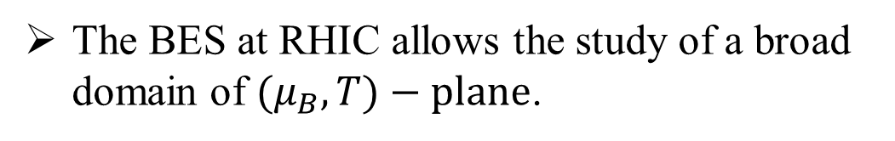

QCD Phase Diagram
The BES at RHIC allows the study of a broad domain of ${(μ}_{B},T)−plane$.
Rapidity dependence of ${(μ}_{B}$)
200 GeV
F. Becattini, PoSCPOD07:012,2007
$μ_{B} \&$T variations via beam energy or rapidity selections.

Slide 4
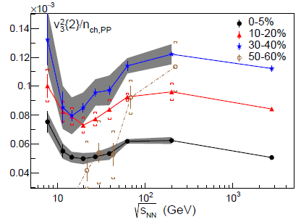
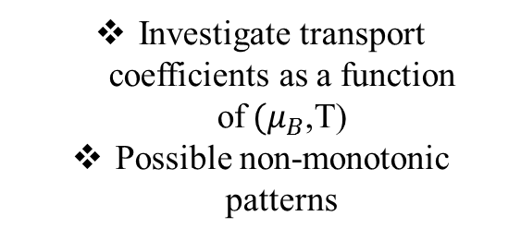
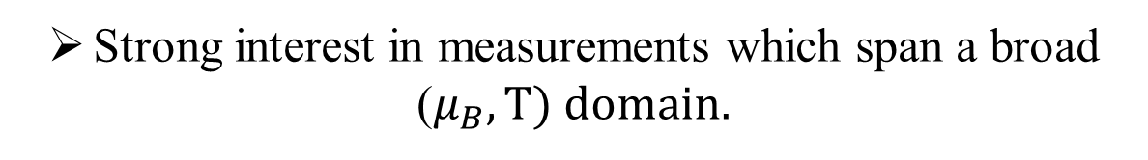
QCD Phase Diagram
Strong interest in measurements which span a broad
($μ_{B},T) domain.$
Investigate signatures for the first-order phase transition
Search for critical fluctuations
Investigate transport coefficients as a function of$(μ_{B}$,T)
Possible non-monotonic patterns
PRL 112,162301(2014)
PRL 112, 032302 (2014)
PRL 116, 112302 (2016)

Slide 5
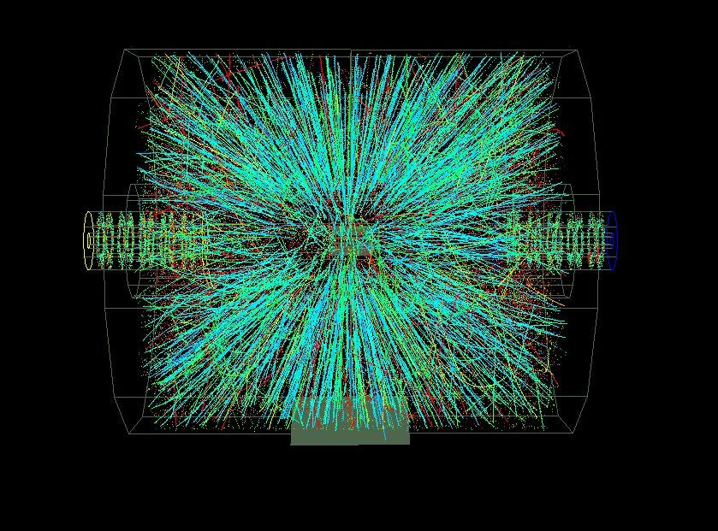
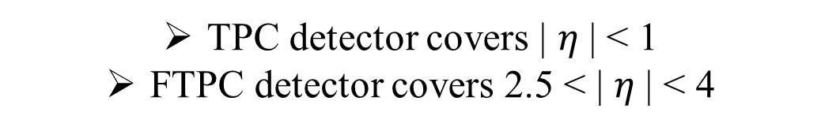
STAR Detector at RHIC
TPC detector covers | $η$| < 1
FTPC detector covers 2.5 < | $η$| < 4

Slide 6
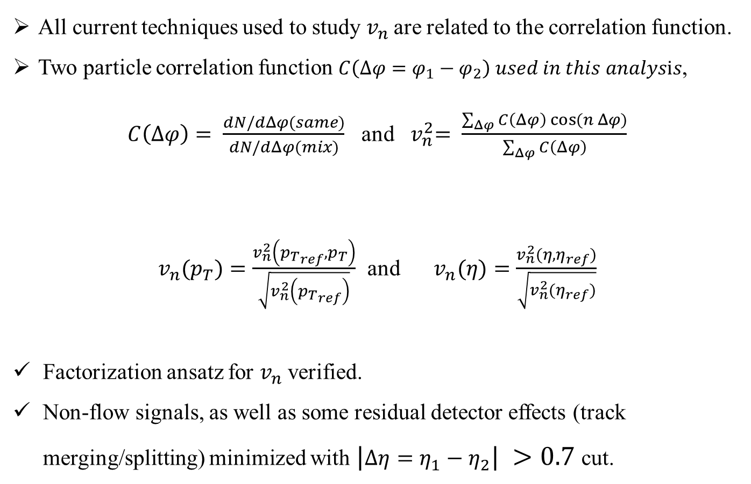
Correlation function technique
All current techniques used to study $v_{n}$are related to the correlation function.
Two particle correlation function $C\left(Δφ=φ_{1}−φ_{2}\right) used in this analysis$,
$C\left(Δφ\right)= \frac{dN/dΔφ(same)}{dN/dΔφ(mix)}$ and ${ v}_{n}^{2}= \frac{\sum_{Δφ}{C\left(Δφ\right) cos⁡(n Δφ)}}{\sum_{Δφ}{C\left(Δφ\right)}}$
$v_{n}(p_{T})=\frac{v_{n}^{2}\left({p_{T}}_{ref},p_{T}\right)}{\sqrt{v_{n}^{2}\left({p_{T}}_{ref}\right)}}$ and $v_{n}(η)=\frac{v_{n}^{2}(η,η_{ref})}{\sqrt{v_{n}^{2}(η_{ref})}}$
Factorization ansatz for $v_{n}$ verified.
Non-flow signals, as well as some residual detector effects (track merging/splitting) minimized with $|Δη=η_{1}−η_{2}| >0.7$ cut.
1
PLB 708, 249 (2012)
2

Slide 7

Results
$v_{n}\left(pT\right)= \frac{v_{n}^{2}\left({p_{T}}_{ref},p_{T}\right)}{\sqrt{v_{n}^{2}\left({p_{T}}_{ref}\right)}}$
    $\left|η\right|<1$
${ v}_{n}\left(η\right) = \frac{v_{n}^{2}(η,η_{ref})}{\sqrt{v_{n}^{2}(η_{ref})}}$
    $\left|η_{ref}\right|<1 and \left|η\right|<4$
    $0.2<p_{T}<4GeV/c$
$v_{n}\left(\sqrt{s_{NN}}\right)$
Viscous coefficient
Data presented
with only statistical uncertainties

Slide 8
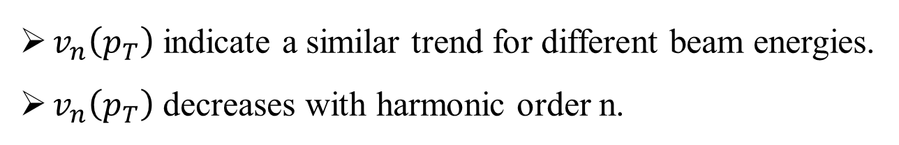
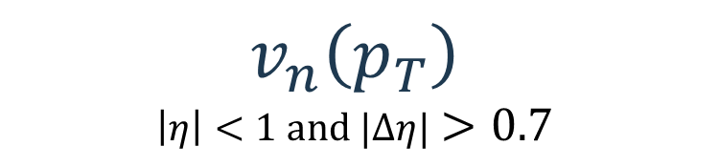
$$v_{n}\left(p_{T}\right)$$
$$\left|η\right|<1 and |Δη|>0.7$$
$v_{n}\left(p_{T}\right)$ indicate a similar trend for different beam energies.
$v_{n}\left(p_{T}\right)$ decreases with harmonic order n.

Slide 9
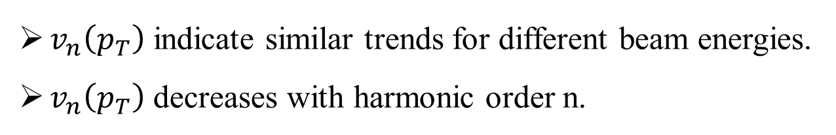
$$v_{n}\left(p_{T}\right)$$
$$\left|η\right|<1 and |Δη|>0.7$$
$v_{n}\left(p_{T}\right)$ indicate similar trends for different beam energies.
$v_{n}\left(p_{T}\right)$ decreases with harmonic order n.

Slide 10
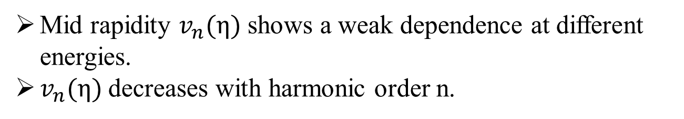
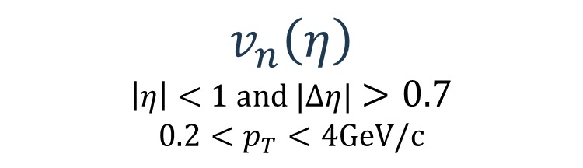
$$v_{n}\left(η\right)$$
$$\left|η\right|<1 and |Δη|>0.7$$
$$0.2<p_{T}<4GeV/c$$
Mid rapidity $v_{n}(η)$ shows a weak dependence at different energies.
$v_{n}(η)$decreases with harmonic order n.

Slide 11
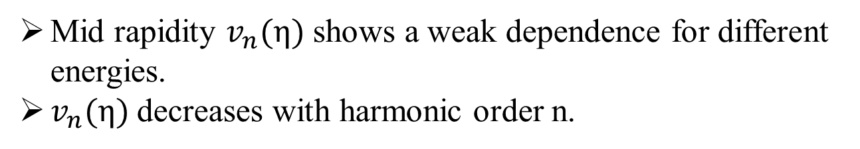
$$v_{n}\left(η\right)$$
$$\left|η\right|<1 and |Δη|>0.7$$
$$0.2<p_{T}<4GeV/c$$
Mid rapidity $v_{n}(η)$ shows a weak dependence for different energies.
$v_{n}(η)$decreases with harmonic order n.

Slide 12
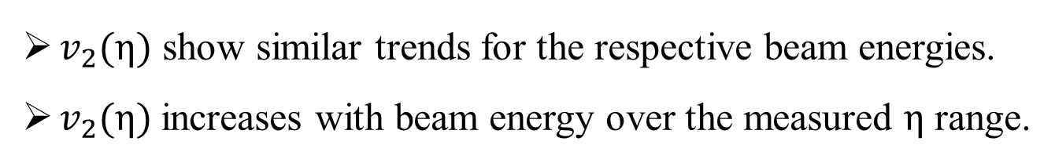
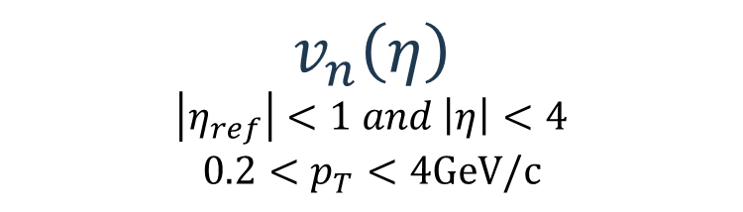
$$v_{n}\left(η\right)$$
$$\left|η_{ref}\right|<1 and \left|η\right|<4$$
$$0.2<p_{T}<4GeV/c$$
$v_{2}(η)$ show similar trends for the respective beam energies.
$v_{2}(η)$increases with beam energy over the measured $η$ range.

Slide 13
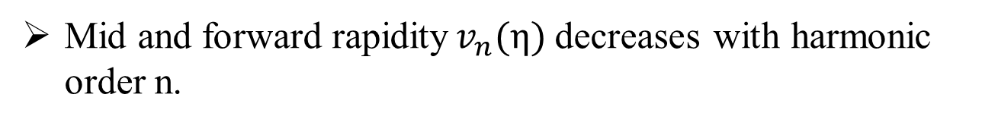
$$v_{n}\left(η\right)$$
$$\left|η_{ref}\right|<1 and \left|η\right|<4$$
$$0.2<p_{T}<4GeV/c$$
Mid and forward rapidity$v_{n}(η)$decreases with harmonic order n.

Slide 14
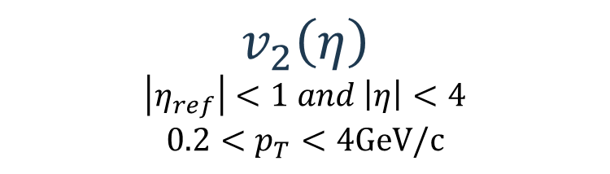
$$v_{2}\left(η\right)$$
$$\left|η_{ref}\right|<1 and \left|η\right|<4$$
$$0.2<p_{T}<4GeV/c$$
Reasonable agreement between the STAR and PHOBOS measurements.

Slide 15
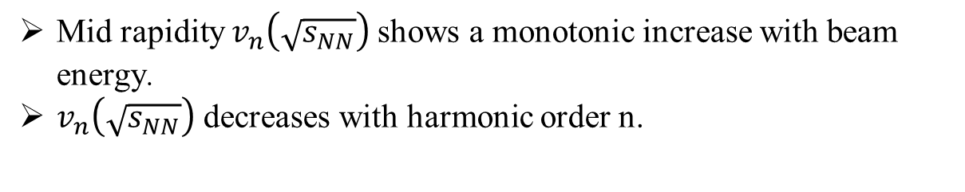
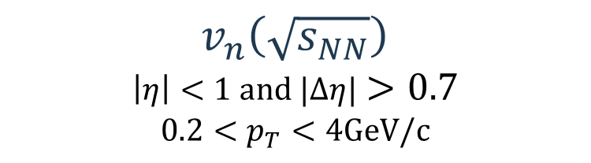
$$v_{n}\left(\sqrt{s_{NN}}\right)$$
$$\left|η\right|<1 and |Δη|>0.7$$
$$0.2<p_{T}<4GeV/c$$
Mid rapidity$v_{n}\left(\sqrt{s_{NN}}\right)$ shows a monotonic increase with beam energy.
$v_{n}\left(\sqrt{s_{NN}}\right)$ decreases with harmonic order n.

Slide 16
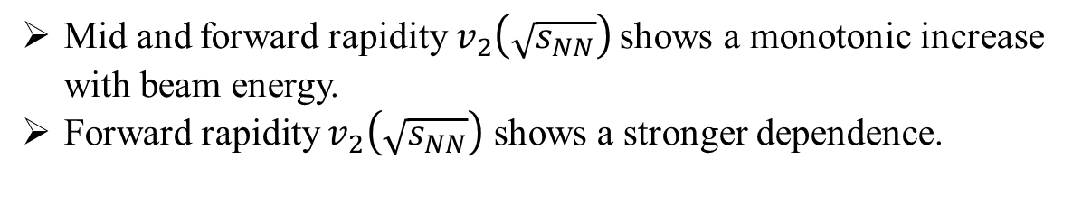

$$v_{2}\left(\sqrt{s_{NN}}\right)$$
$$TPC and FTPC$$
$$0.2<p_{T}<4GeV/c$$
Mid and forward rapidity$v_{2}\left(\sqrt{s_{NN}}\right)$ shows a monotonic increase with beam energy.
Forward rapidity $v_{2}\left(\sqrt{s_{NN}}\right)$ shows a stronger dependence.

Slide 17
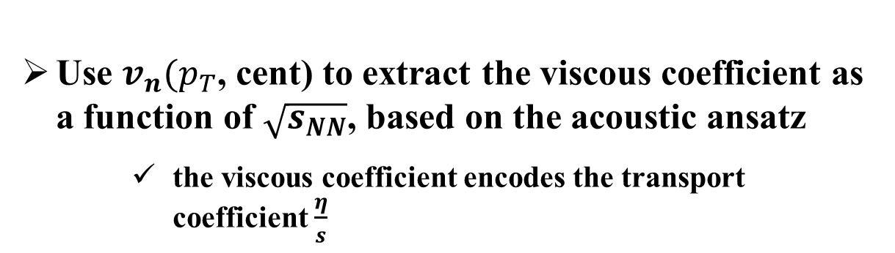
Viscous coefficient
Use $v_{n}(p_{T}$, cent) to extract the viscous coefficient as a function of $\sqrt{s_{NN}}$, based on the acoustic ansatz
    the viscous coefficient encodes the transport coefficient $\frac{η}{s}$

Slide 18
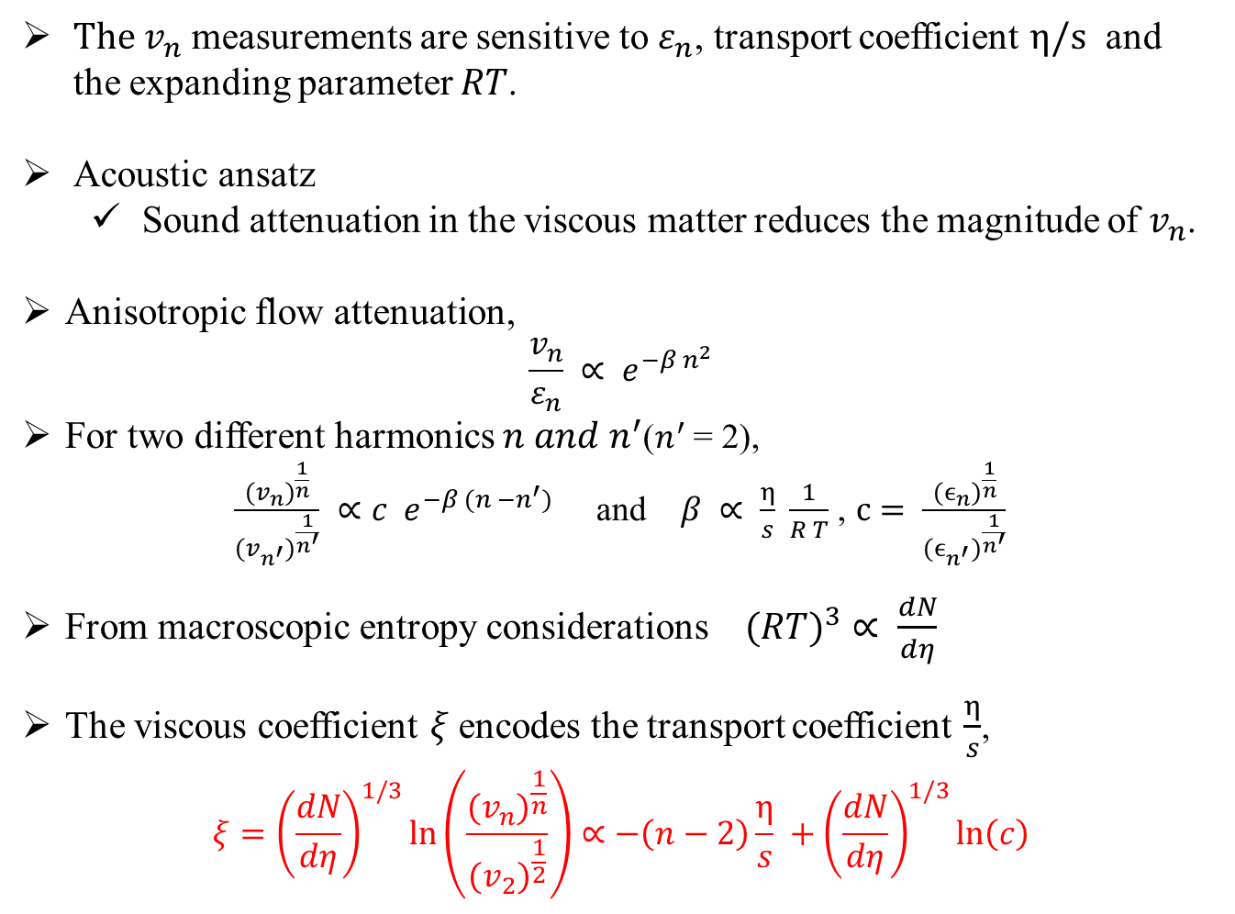
Viscous coefficient
$The v_{n}$ measurements are sensitive to $ε_{n}$, transport coefficient $η/s$ and the expanding parameter $RT$.
Acoustic ansatz
  Sound attenuation in the viscous matter reduces the magnitude of $v_{n}$.
Anisotropic flow attenuation,
$$\frac{v_{n}}{ε_{n}} ∝ e^{−β n^{2}}$$
For two different harmonics $n and n^{′}$($n^{′}$ = 2),
$\frac{{{(v}_{n})}^{\frac{1}{n}}}{{{(v}_{n^{′}})}^{\frac{1}{n^{′}}}} ∝c e^{−β (n −n^{′})}$ and $β ∝ \frac{η}{s} \frac{1}{R T}$ , $c= \frac{{{(ϵ}_{n})}^{\frac{1}{n}}}{{{(ϵ}_{n^{′}})}^{\frac{1}{n^{′}}}}$
From macroscopic entropy considerations ${(RT)}^{3}$ $∝$ $\frac{dN}{dη}$
The viscous coefficient $ξ$encodes the transport coefficient $\frac{η}{s}$,
$$ξ={\left(\frac{dN}{dη}\right)}^{1/3}\ln\left(\frac{{{(v}_{n})}^{\frac{1}{n}}}{{{(v}_{2})}^{\frac{1}{2}}}\right)∝−\left(n−2\right)\frac{η}{s} +{\left(\frac{dN}{dη}\right)}^{1/3}\ln\left(c\right)$$
arXiv:1305.3341
3
4
arXiv:1601.06001
5
6

Slide 19
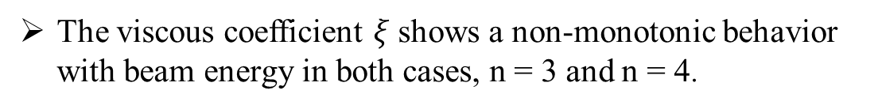
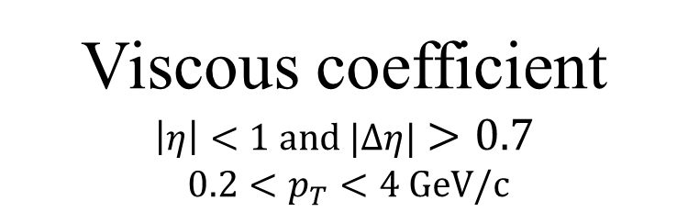
Viscous coefficient
$$\left|η\right|<1 and |Δη|>0.7$$
$0.2<p_{T}<4 GeV/c$
The viscous coefficient $ξ$shows a non-monotonic behavior with beam energy in both cases, n = 3 and n = 4.

Slide 20
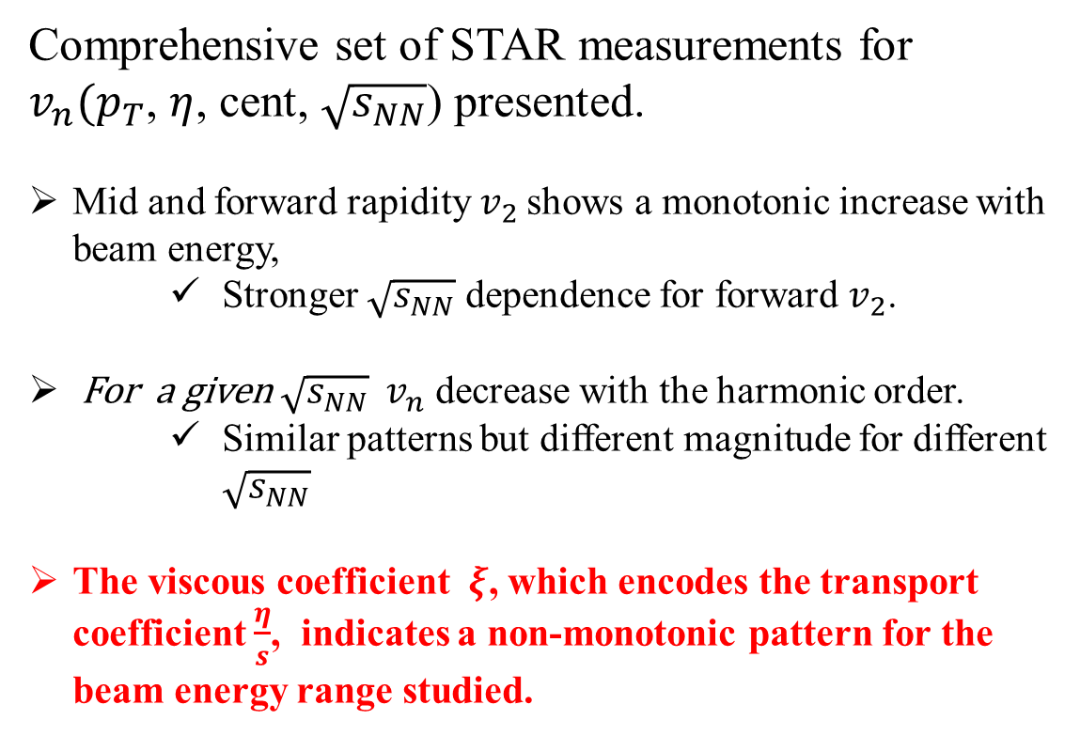
III. Conclusion
Comprehensive set of STAR measurements for
$v_{n}(p_{T}$, $η$, cent, $\sqrt{s_{NN}}$) presented.
Mid and forward rapidity$v_{2}$ shows a monotonic increase with beam energy,
    Stronger $\sqrt{s_{NN}}$ dependence for forward $v_{2}$.
For a given $\sqrt{s_{NN}}$ $v_{n}$ decrease with the harmonic order.
    Similar patterns but different magnitude for different $\sqrt{s_{NN}}$
The viscous coefficient $ξ$, which encodes the transport coefficient $\frac{η}{s}$, indicates a non-monotonic pattern for the beam energy range studied.

Slide 21
THANK YOU

