Slide 1
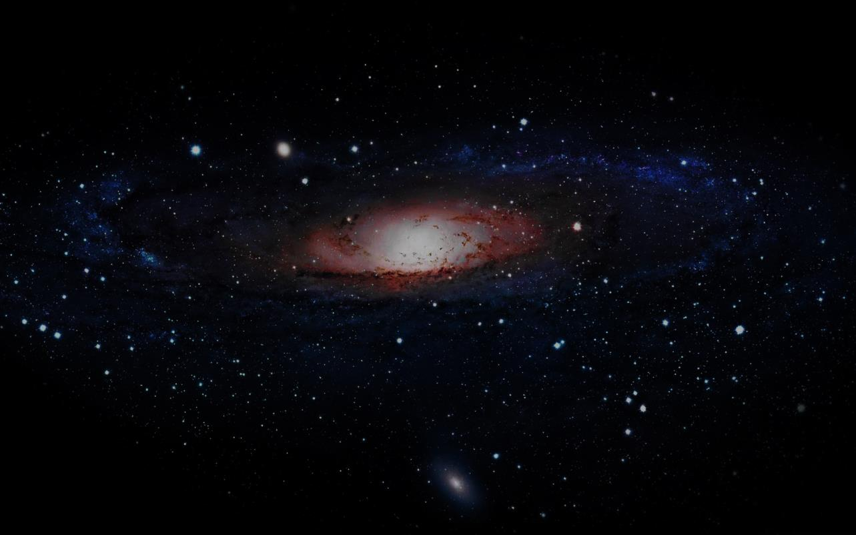
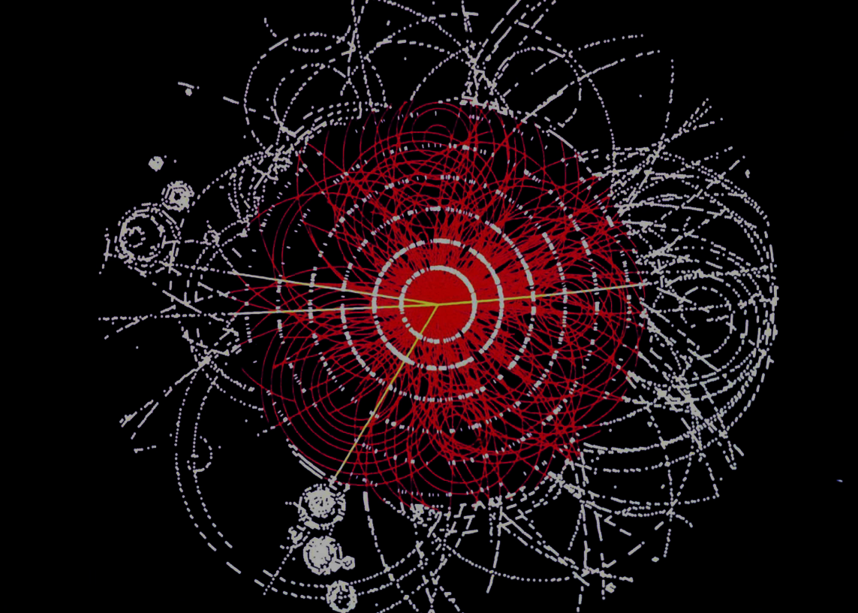
Towards the
APPEC strategy
APPEC
AstroParticle Physics European Consortium
Frank Linde, TeV Particle Astrophysics, CERN, September 12-16

Slide 2
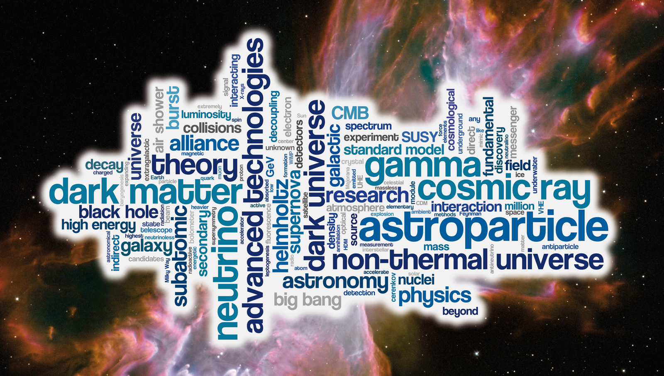

Slide 3
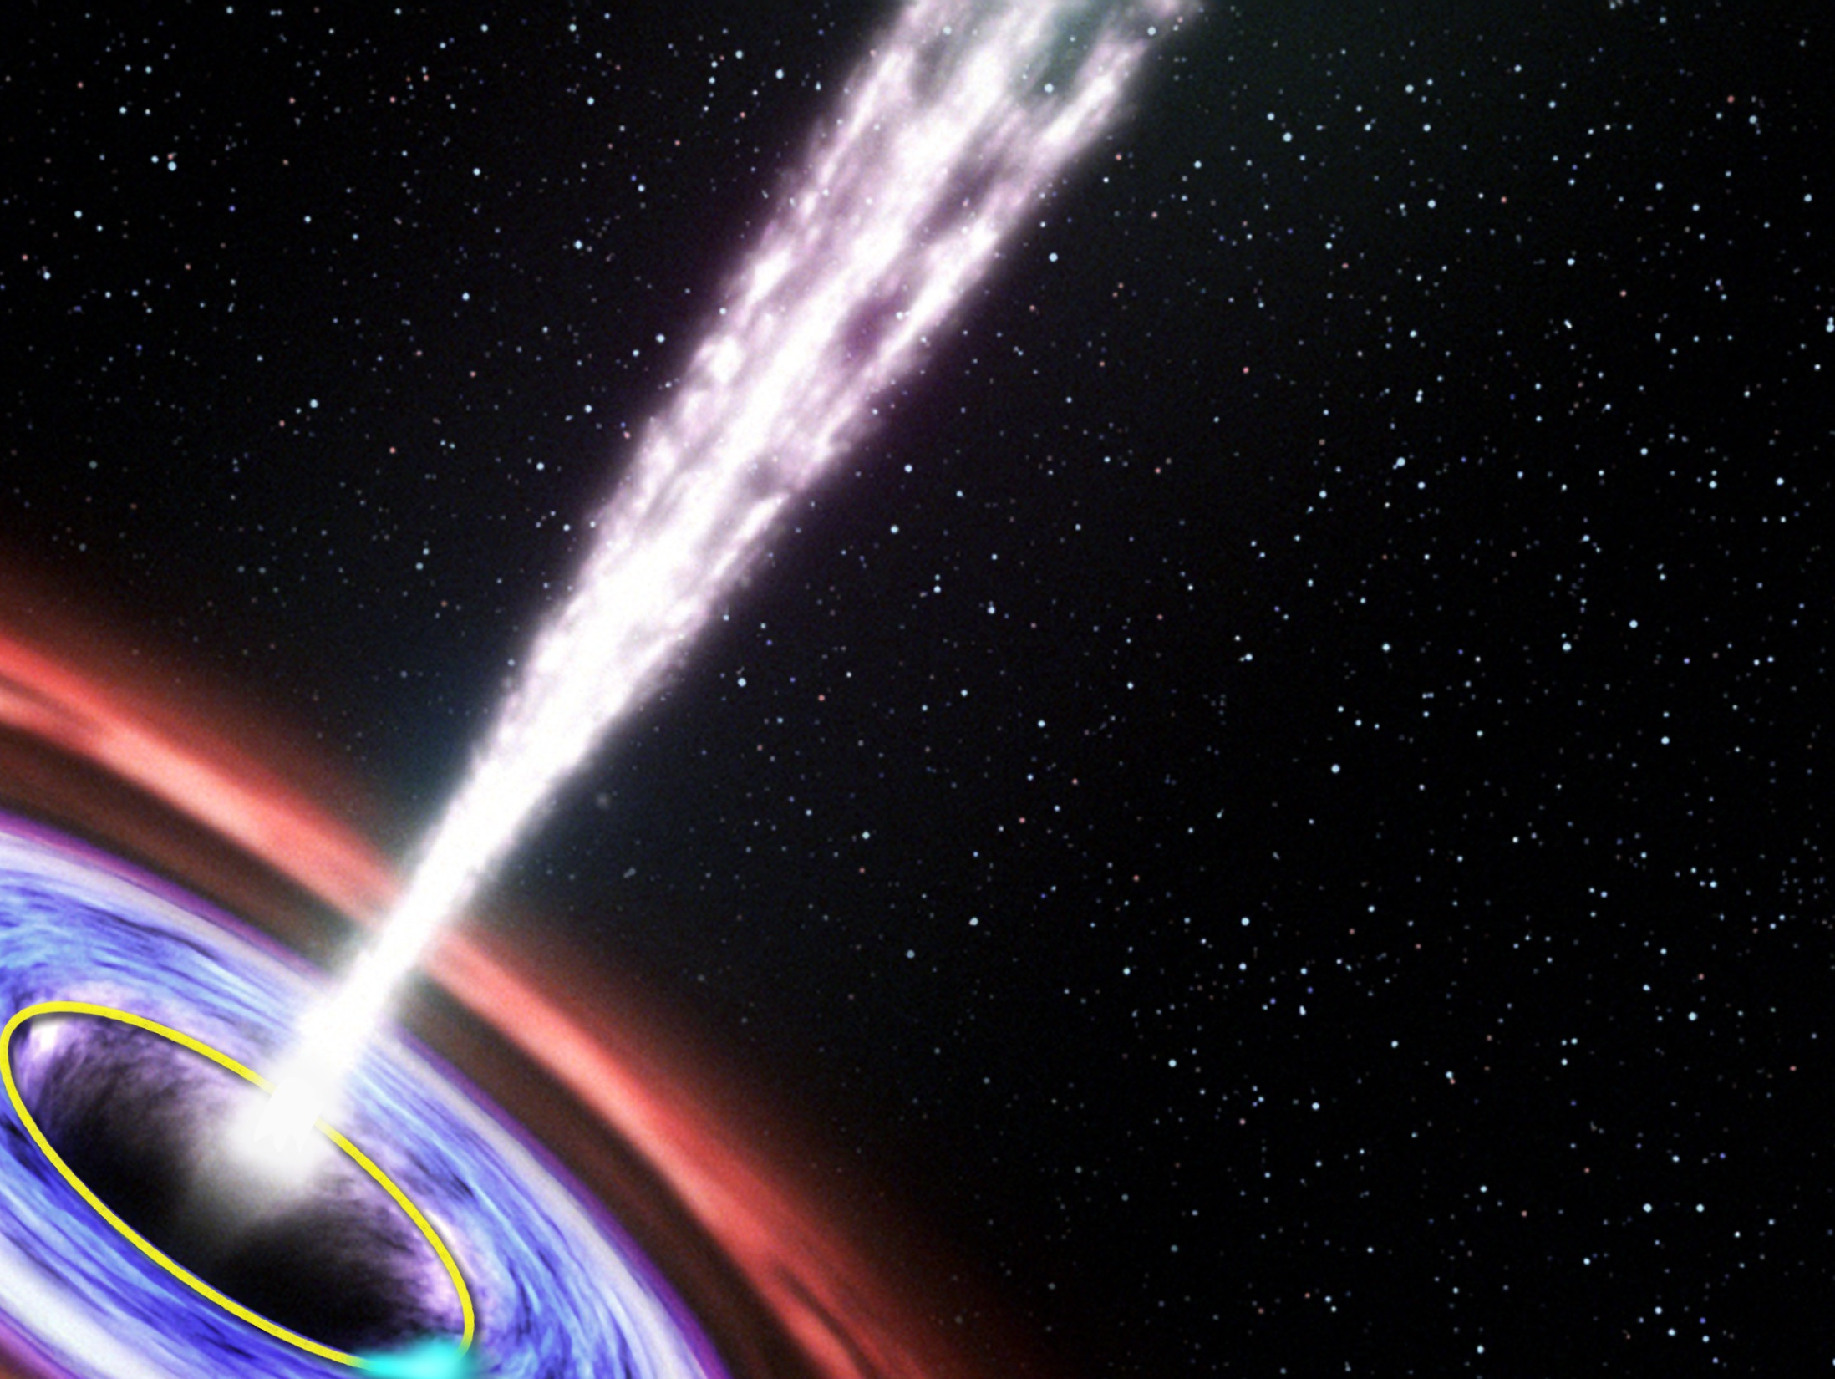
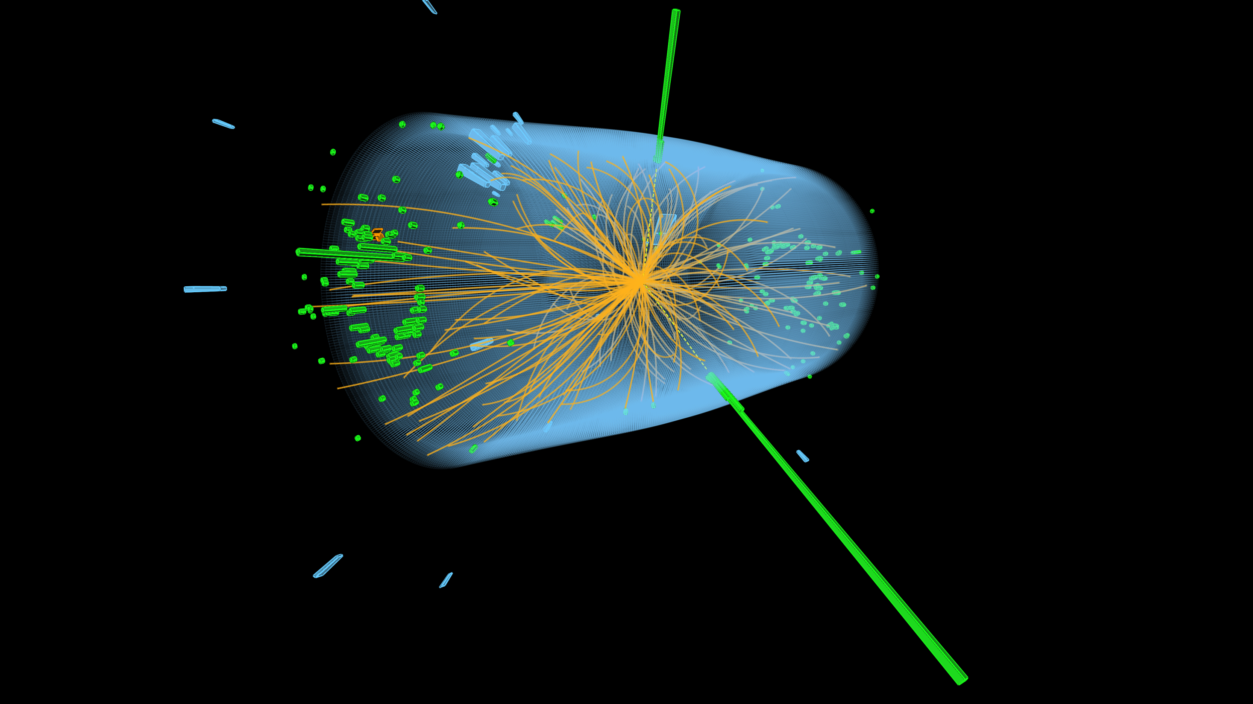
A
S
T
R
O
N
O
M
Y
A S T R O P A R T I C L E P H Y S I C S
APPEC
dark energy
gravitational waves
CMB
HE neutrinos
gamma-rays
cosmic rays
P
A
R
T
I
C
L
E
dark matter
P
H
Y
S
I
C
S
neutrino
properties

Slide 4
A
S
T
R
O
N
O
M
Y
A S T R O P A R T I C L E P H Y S I C S
APPEC
dark energy
2011
gravitational waves
1993
CMB
1978
2006
HE neutrinos
gamma-rays
cosmic rays
1936
P
A
R
T
I
C
L
E
dark matter
P
H
Y
S
I
C
S
neutrino
properties
(1988)
1995
2002
2015

Slide 5
A
S
T
R
O
N
O
M
Y
A S T R O P A R T I C L E P H Y S I C S
2015
LVC
APPEC
dark energy
gravitational waves
CMB
IceCube
2013
PeV neutrinos
gamma-rays
cosmic rays
P
A
R
T
I
C
L
E
dark matter
P
H
Y
S
I
C
S
dark matter
next one?
neutrino
properties
collider
indirect
direct

Slide 6

Crucial ingredients
community
EU:
few 1000
scientists
science
excellent
€ …
technology
state-of-the-art

Slide 7
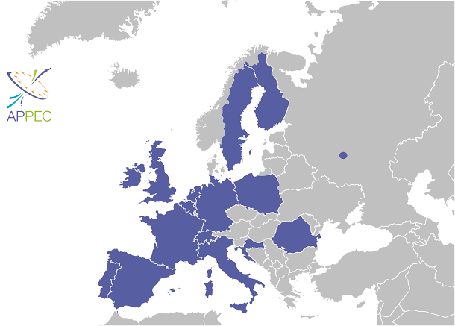
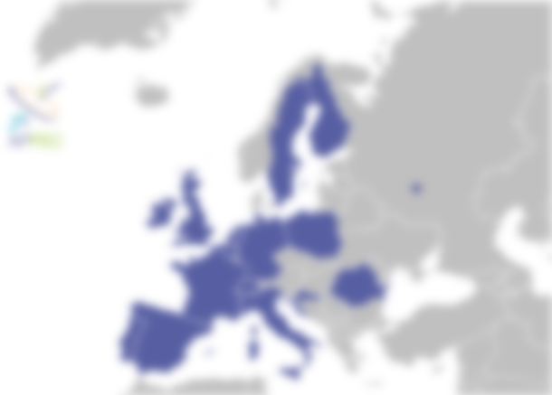

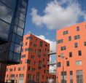
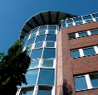
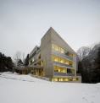
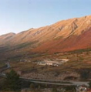
APPEC: (expanding) organisation
AstroParticle Physics European Consortium
Scientific
Advisory
Committee
cash budget: ∼ 80 k€ /year …
+ CERN
ESO
(members invest a lot more!)
APPEC functional centers
STFC – Swindon/UK
DESY - Hamburg/D
Outreach, Web pages
Management, Computing & Industry
APC - Paris/F
Roadmapping, Common Calls, Interdisciplinary
LSC - Canfranc/S
Web host
LNGS - L'Aquila/I
Networking, Theory, Graduate Schools

Slide 8
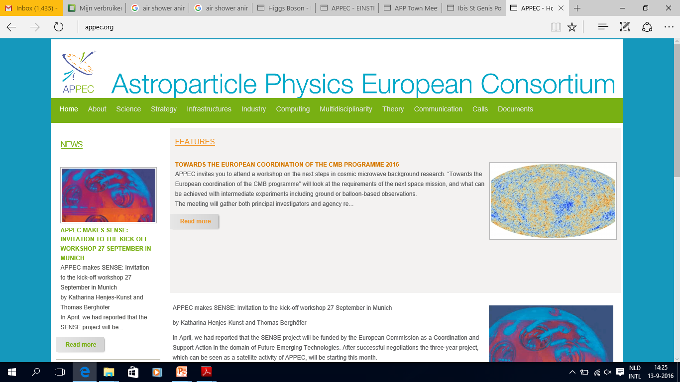
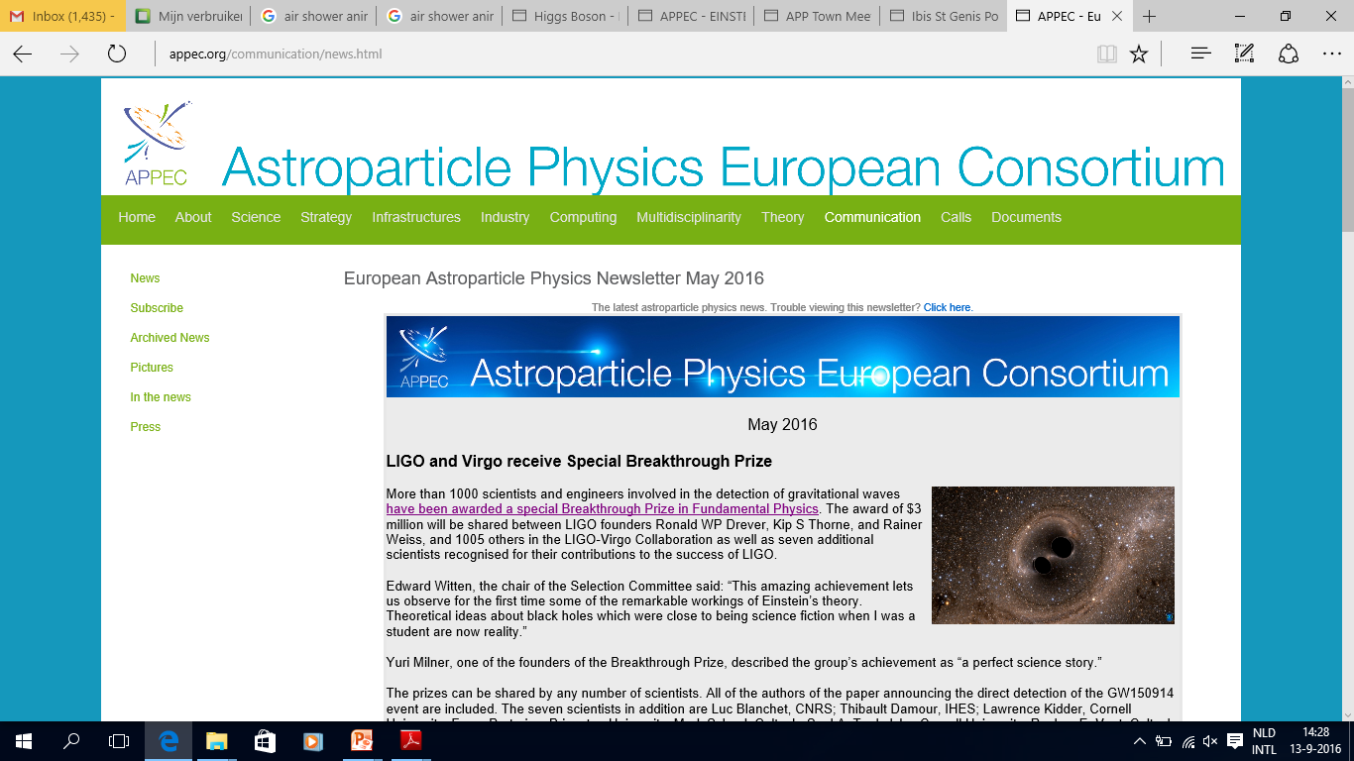
APPEC: website & newsletter
www.appec.org

Slide 9
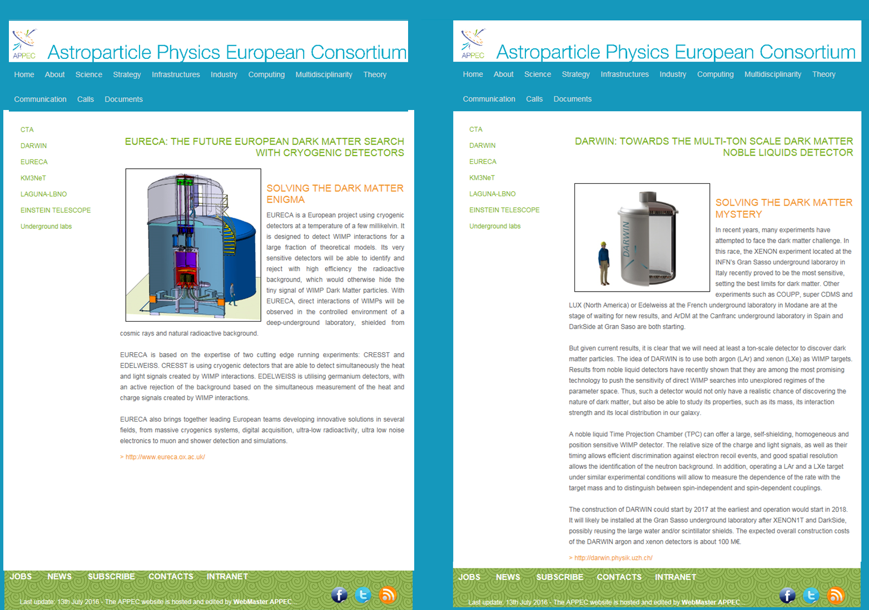
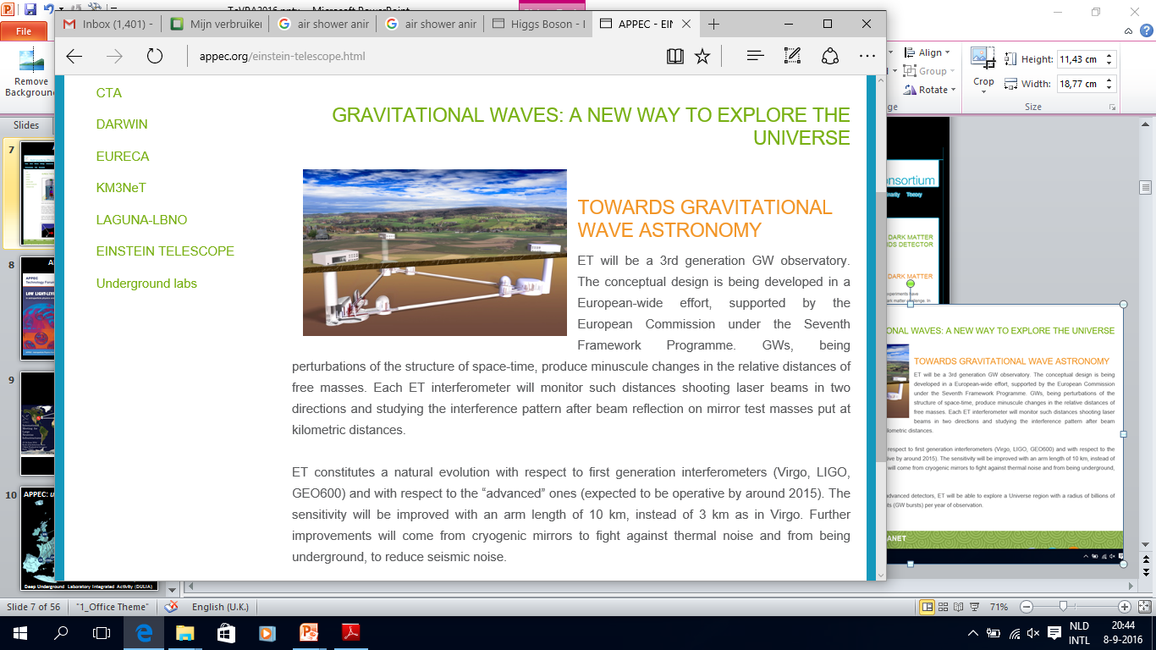


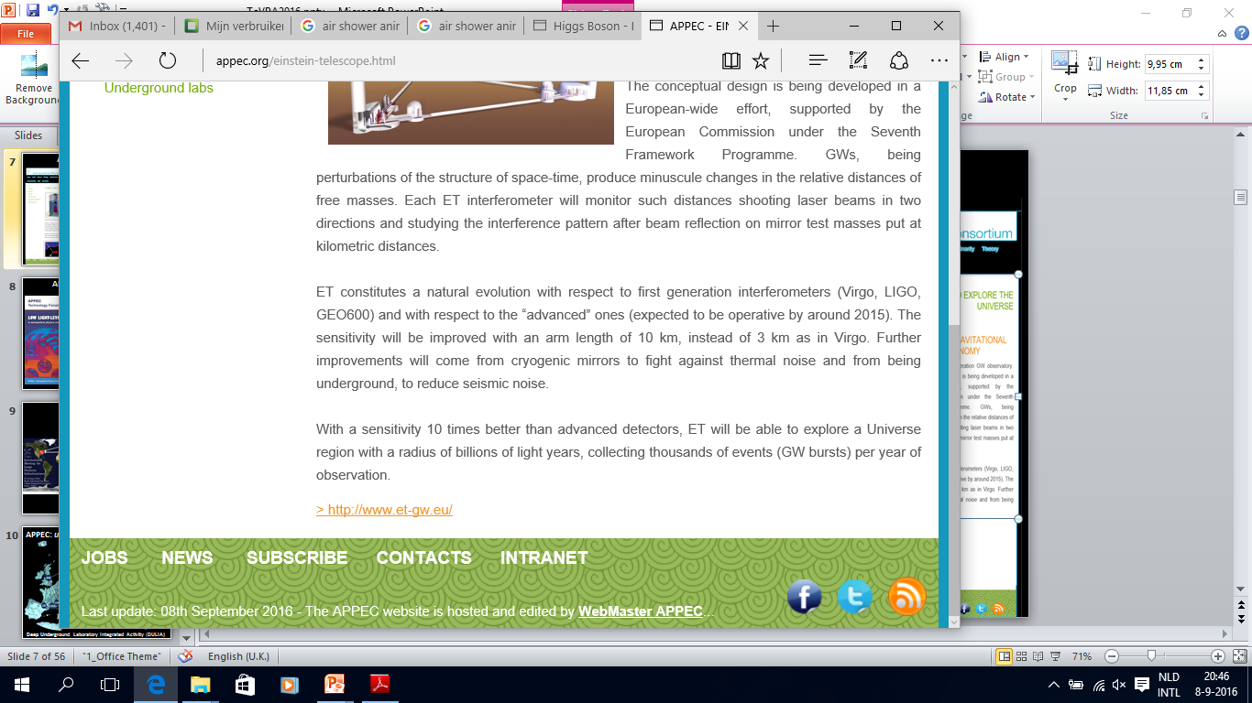
APPEC: common calls

Slide 10
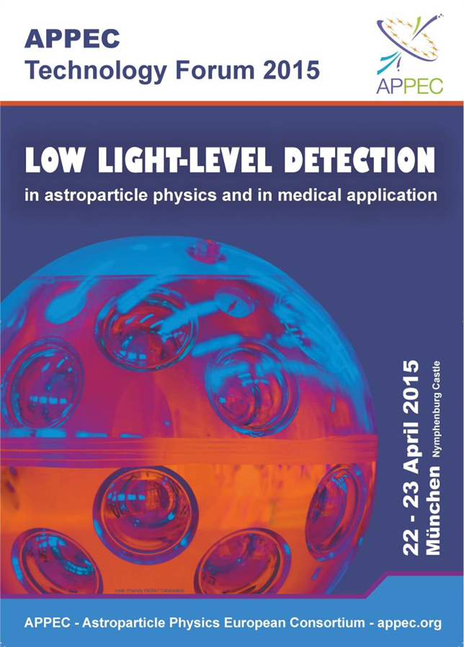
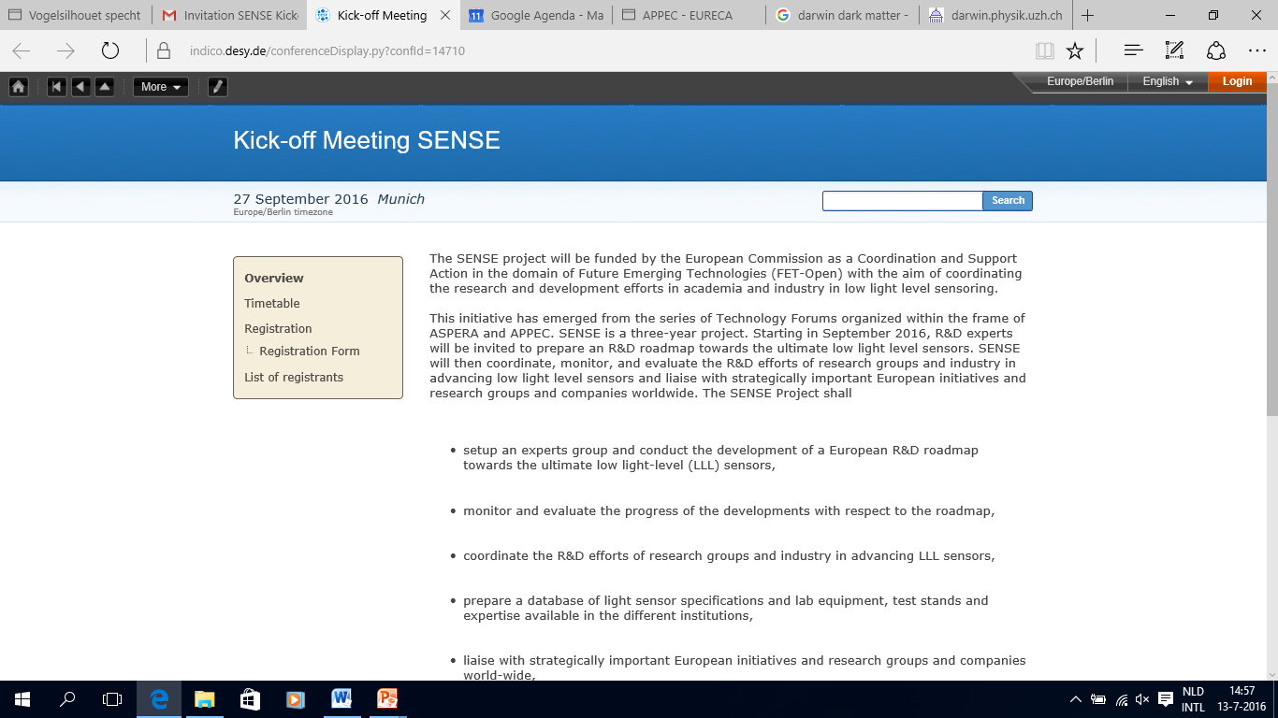
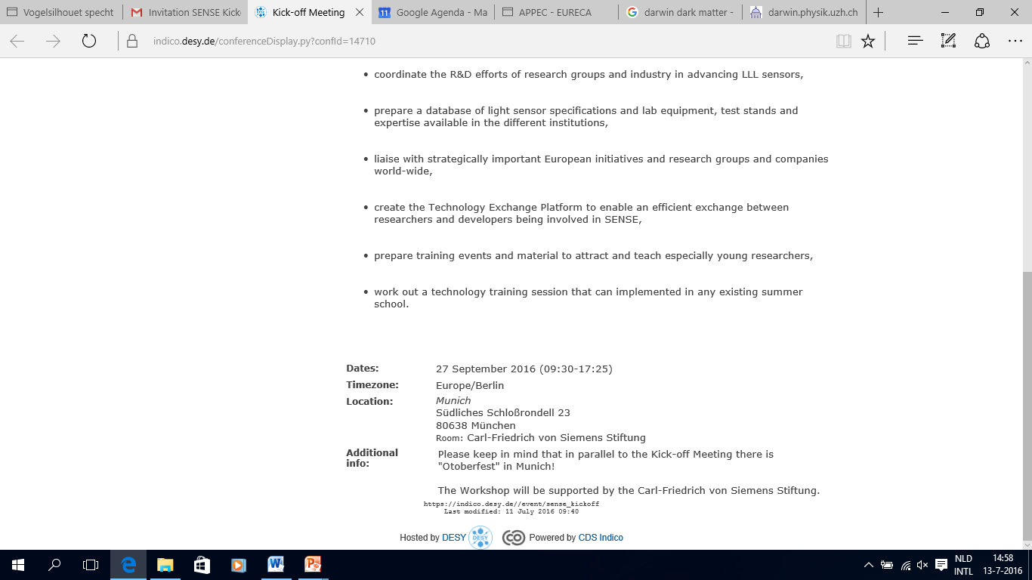
APPEC: technology fora
SENSE
EU FET-Open: low-level light sensing

Slide 11
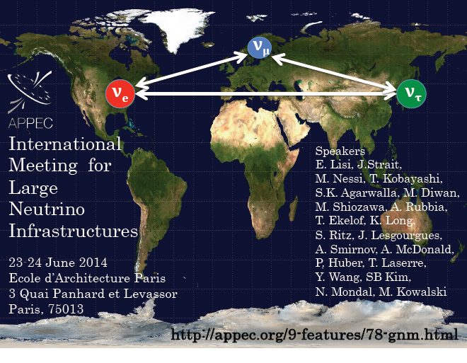
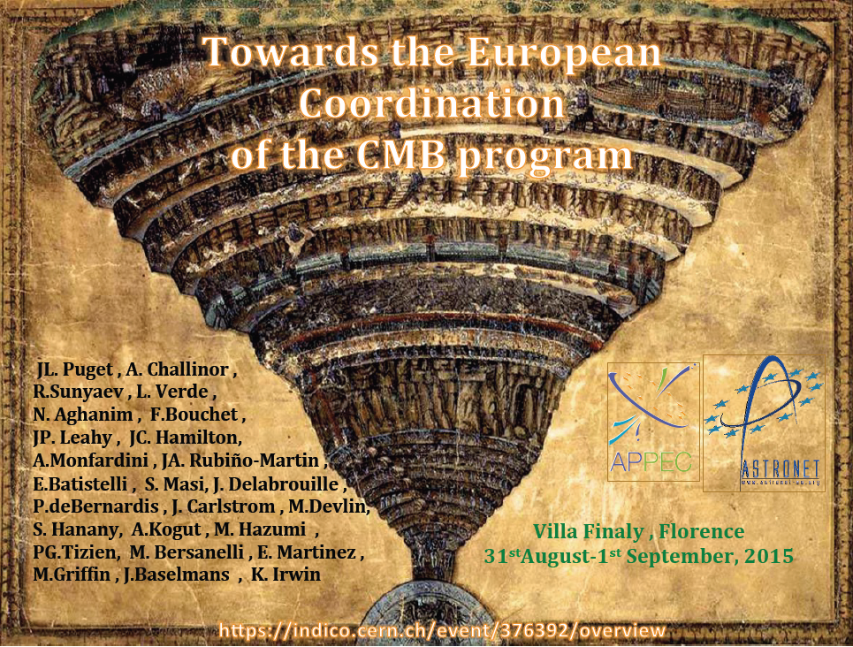
APPEC: workshops
International meeting
for large ν -infrastructures
Florence
CMB workshop
1. June 2014 (Paris)
2. April 2015 (Chicago)
3. May 2016 (Tokyo)
→ LBNF/DUNE
1. September 2015 (Florence)
2. September 2016 (Florence)
→ EU ground-based
CMB experiment?
+ CORE
(ESA)

Slide 12
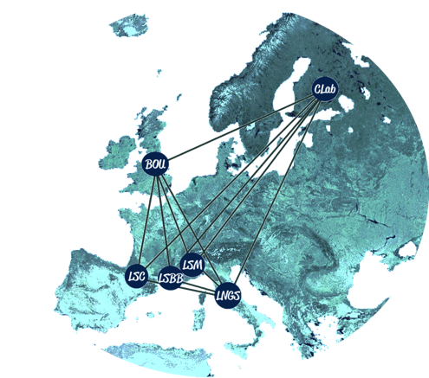
APPEC: unique infrastructure
deep-underground
low-background
laboratories
dark matter
0νββ decay
BUL – Boulby/UK
LNGS – Gran-Sasso/I
LSC – Canfranc/ES
LSM – Modane/F
CallioLab – Pyhäjärvi/SF
LSBB – Rustrel/F

Slide 13
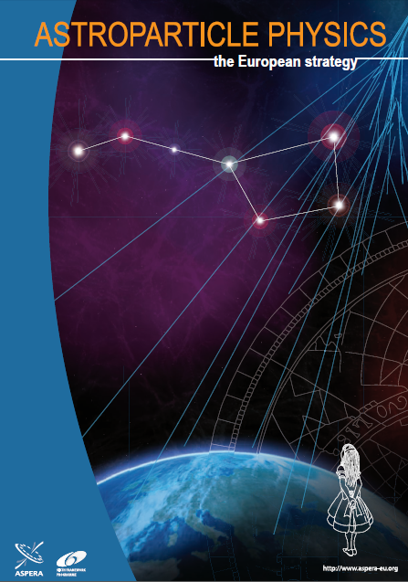
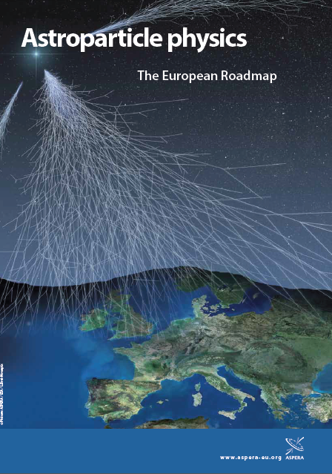
APPEC: roadmapping
‘Magnificent 7’
2008
2011
HE gammas
HE neutrinos
HE cosmic rays
Gravitational waves
Dark matter
ν-mass
ν-mixing & p-decay

Slide 14
APPEC: roadmapping
Magnificent 7
2008
2011
HE gammas
HE neutrinos
HE cosmic rays
Gravitational waves
Dark matter
ν-mass
ν-mixing & p-decay
In 2008: still lots of speculation • • •

Slide 15
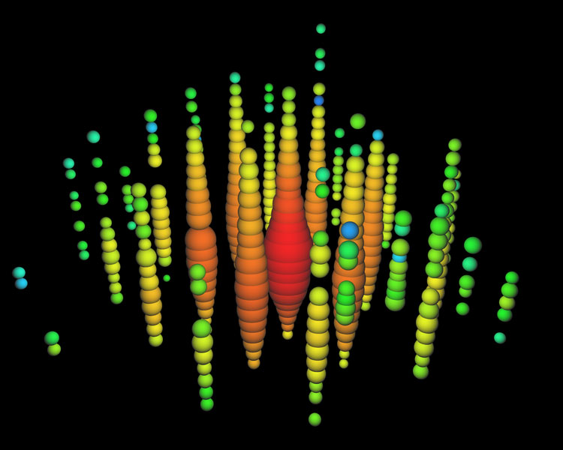
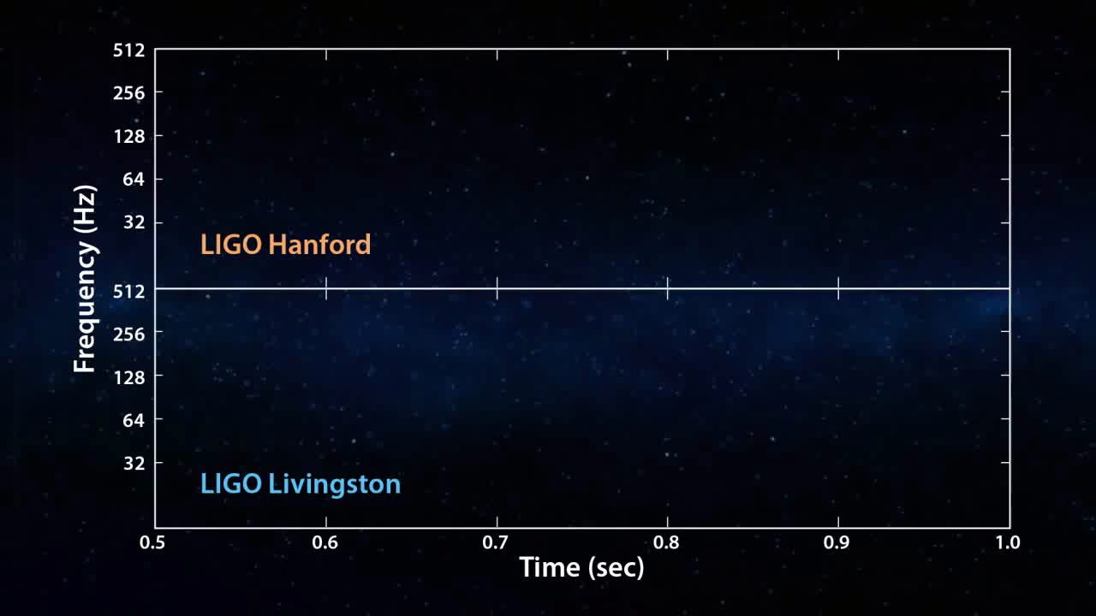
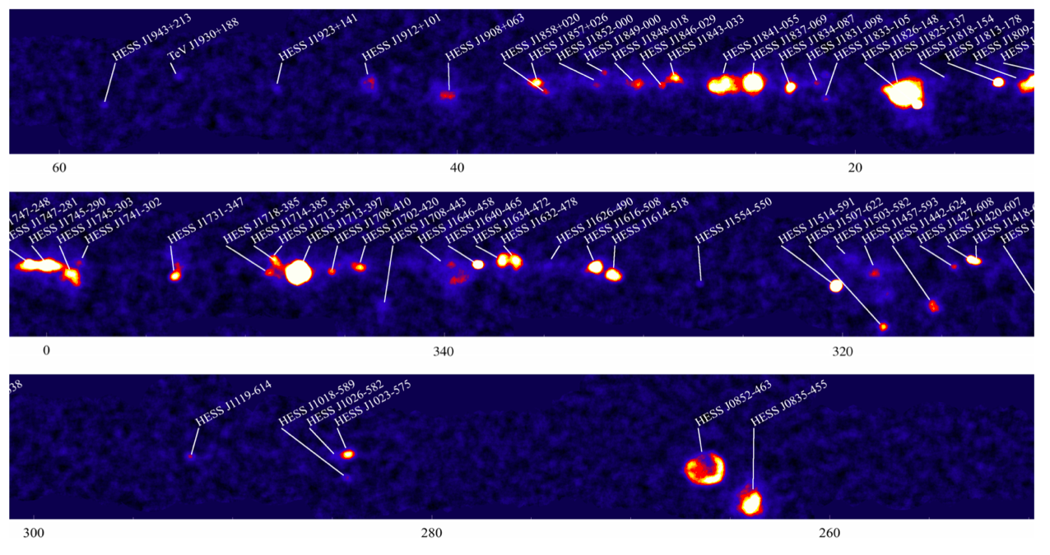
Today: detections!
GW150914
PeV neutrinos
HE cosmic-rays
HE γ-rays

Slide 16
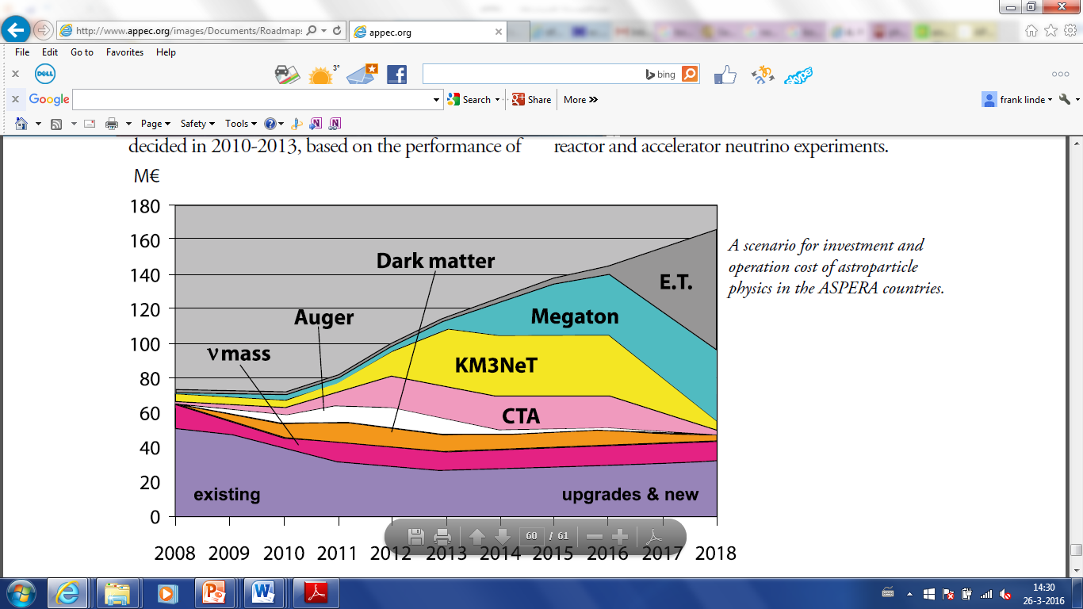
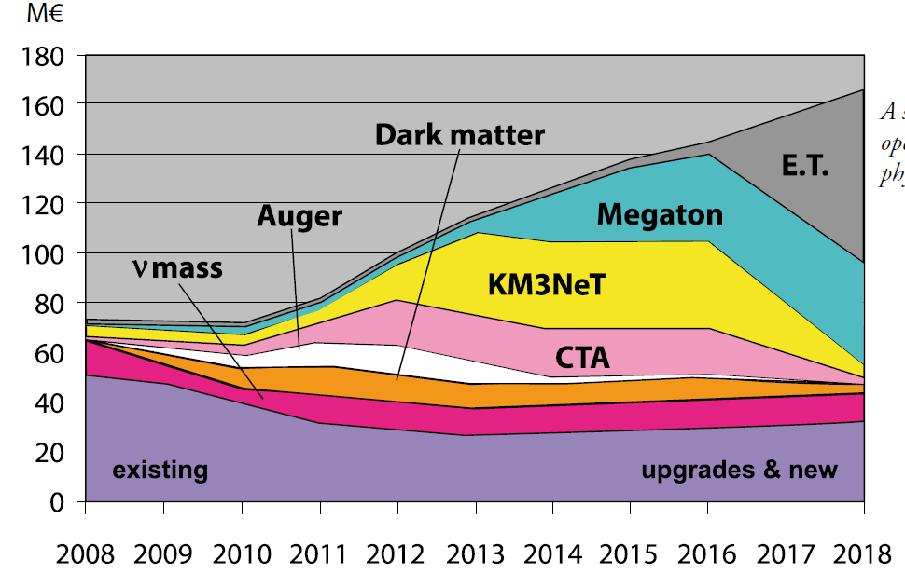
Ambitions APPEC’s 2008 roadmap …
T
O
D
A
Y

Slide 17

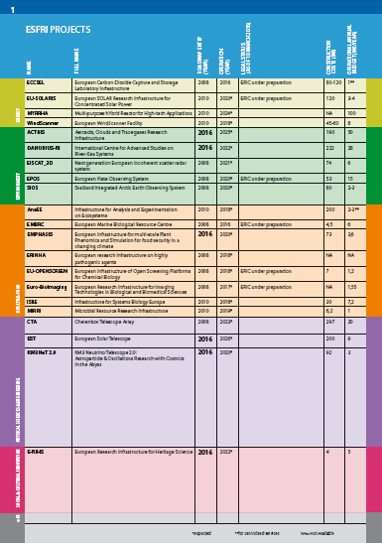
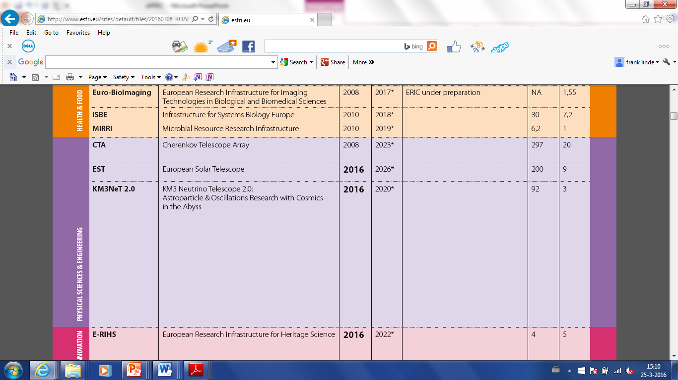
European research infrastructures roadmap: ESFRI

Slide 18
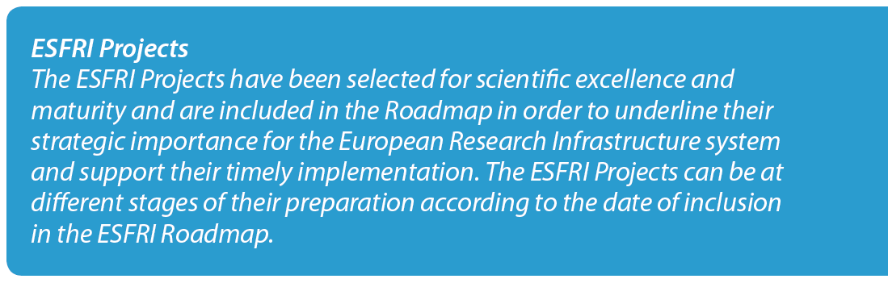
European research infrastructures roadmap: ESFRI

Slide 19
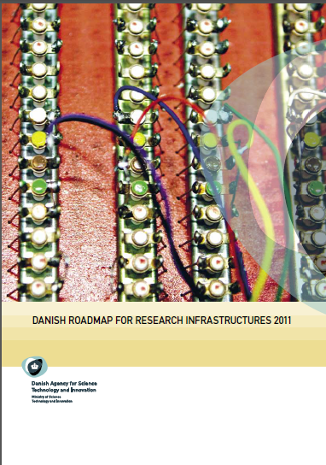
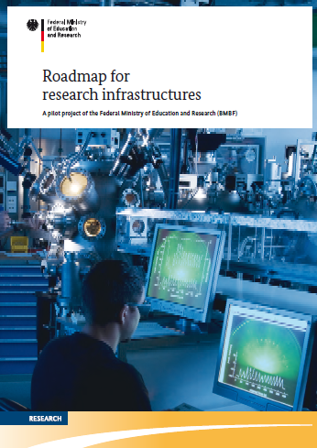
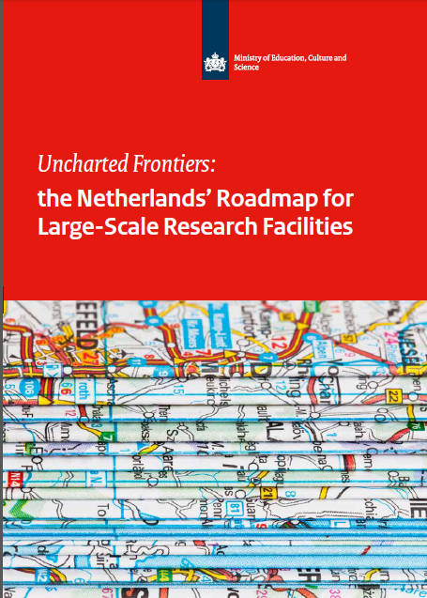

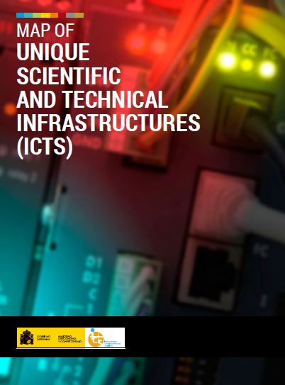
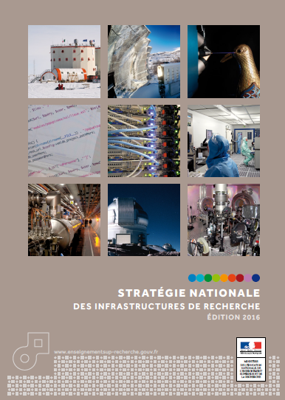
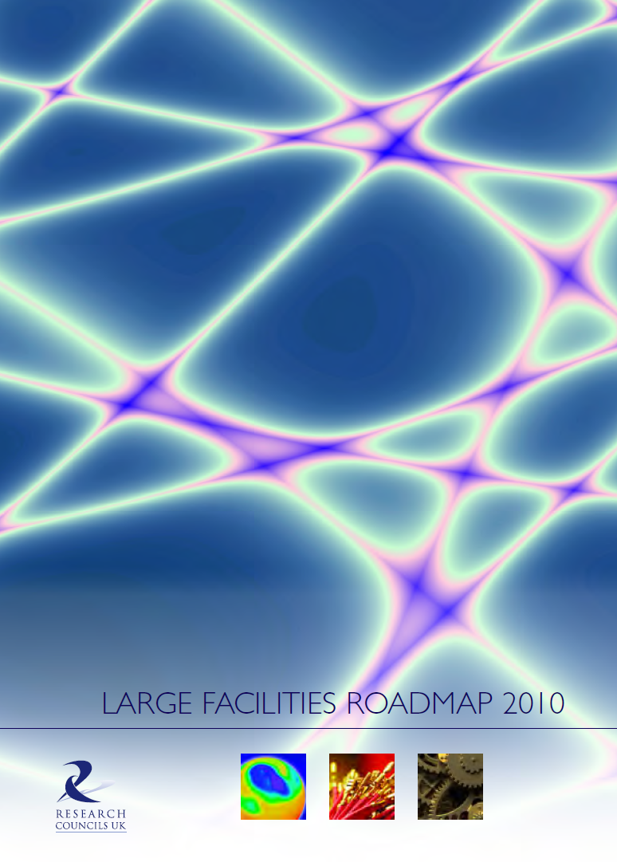
National roadmaps: APP well represented
Next steps:
funding alignment,
cost savings, staging, …

Slide 20
APPEC: roadmapping
HE universe
gammas
neutrinos
cosmic rays
gravitational waves
Dark universe
dark matter
dark energy
Early universe
CMB
ν-properties
mass, mixing, …
2008
2011

Slide 21
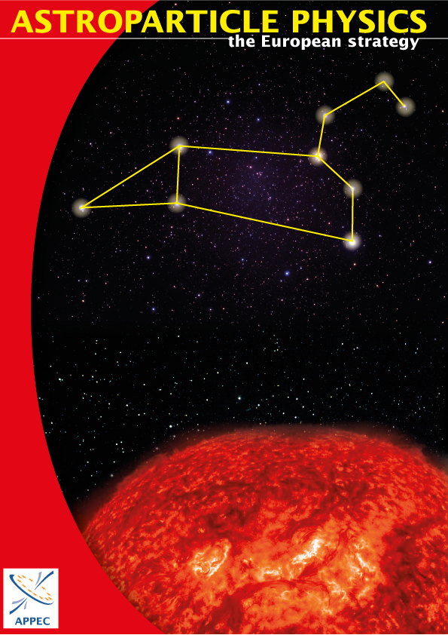
APPEC: roadmapping
2008
2011
2016
resource aware

Slide 22
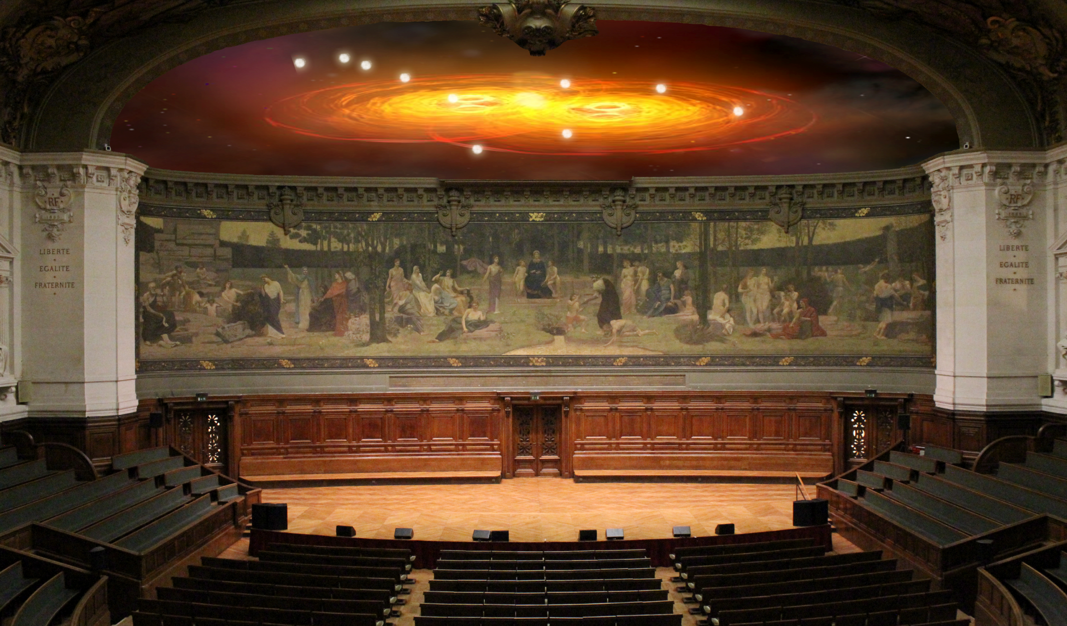
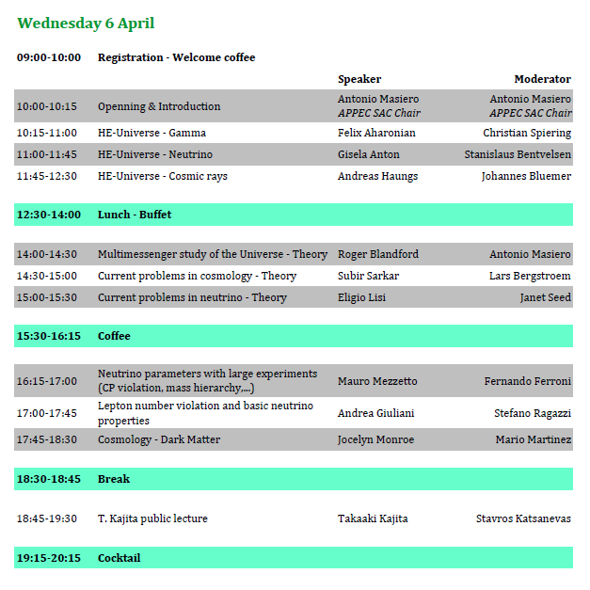
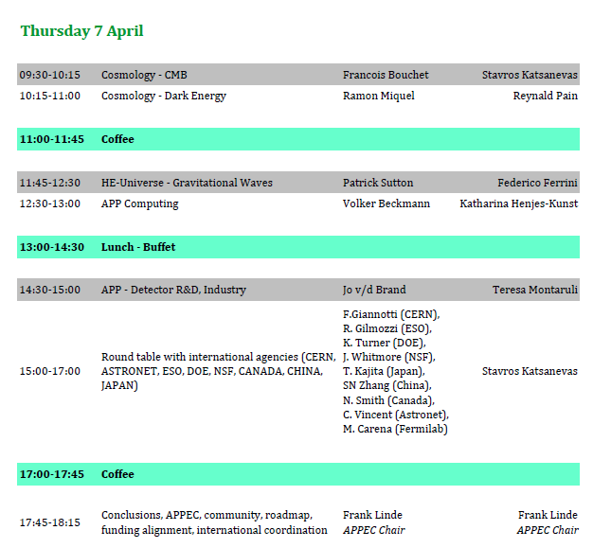
APPEC: Town Meeting→ roadmap
Paris, April 6-7

Slide 23
with community
Executive summary
Science
Extreme universe
Mysterious neutrinos
Dark universe
Early universe
Fundamentals
Theory
Detector R&D
Computing
Organisation
Recommendations
APPEC GA & SAC
SEP
2015
OCT
NOV
draft roadmap
DEC
JAN
FEB
considerations
MAR
2016
APR
town meeting
MAY
anyone interested
=you!
JUN
13+5+3=21
JUL
recommendations
• • •
final roadmap
DEC ?
→
launch event
JAN ?
roadmap
2017
2017
implementation!
& beyond

Slide 24
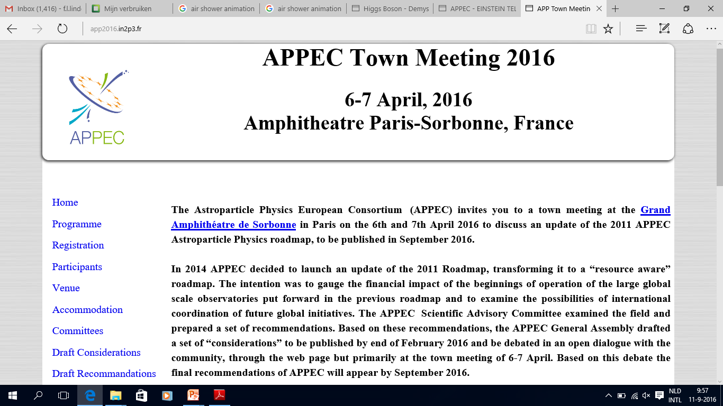
Status: http://app2016.in2p3.fr/

Slide 25
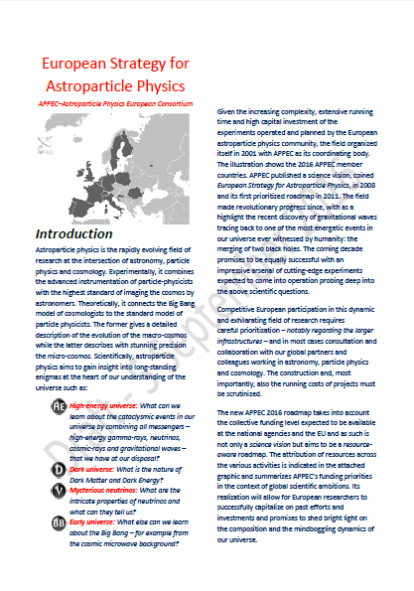
Status: http://app2016.in2p3.fr/
Scientific issues (13)
large-scale (CTA, ν-telescopes, Auger, GW)
medium scale (dark matter, ν-mass, 0νββ)
synergies with PP, ASTRO & COSMO
foundations:
theory, R&D, computing, DU-labs
Organisational issues (5)
EU-Commission
collaboration: EU & global
collaboration: PP, ASTRO & COSMO
Inter-disciplinary aspects
Societal issues (3)
gender
education & outreach
industry
+ data policy

Slide 26

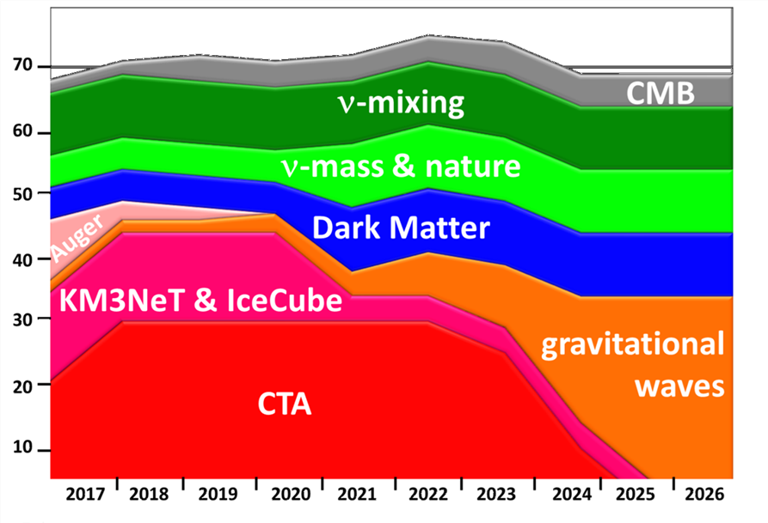
Resources & spending (in progress)
Capital investment (APP agencies only!)
Running costs
Substantial & increasing
e.g. DU-labs: ∼ 10 M€/yr
EGO site: ∼ 10 M€/yr
CTA (observatory!): ∼ 15M€/yr
Common methodology needed
e.g. include shift duties?
Scientific exploitation
+ EU funding (KM3NeT, CTA, ARGO, ET, …)
+ other communities (DUNE, CMB, DE, …)
+ Asia, America, … (LBNF/DUNE, CTA, …)
not addressed at all
PhDs, Postdocs, Staff, …

Slide 27

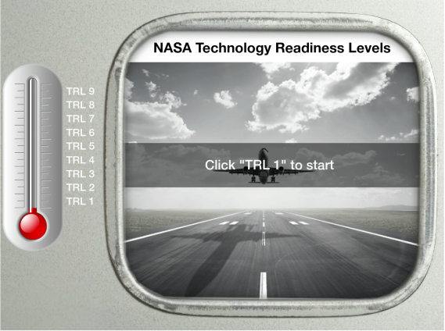

Concerns
coherent program
connected community
Technical readiness /convergence
(notably in view of costs)
Realistic time schedules
Alignment of EU national funding …
(harder in EU than in USA, Japan, China)
Exploitation costs?
Astro-particle physics = astronomy + particle physics
Bottom line: in EU we need stronger organisation …
(& more €’s would help as well)

Slide 28
Links to CERN, ESO/ESA, …
Both ESO & CERN represented in APPEC General Assembly
European Particle Physics Strategy 2006:
A range of very important non-accelerator experiments take place at the overlap between particle & astroparticle physics ….
Council will seek to work with APPEC to develop a coordinated strategy in these areas of mutual interest.
European Particle Physics Strategy update 2013:
A range of very important non-accelerator experiments … particle & astroparticle physics, such as searches for proton decay, 0νββ decay and dark matter and study of high energy cosmic-rays …
In the coming years CERN should seek a closer collaboration with APPEC on detector R&D with a view to maintaining the community’s capability for unique projects in this field.
ESA: Euclid & hopefully LISA, CORE, …
ESO: negotiating with CTA for Southern hemisphere site

Slide 29
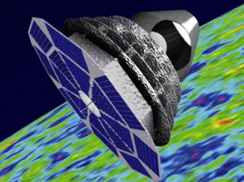
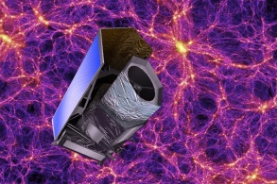
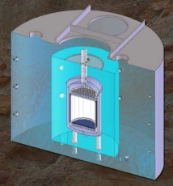

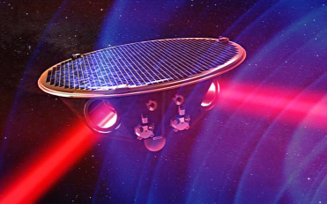

Promising – very bright – future ahead!
C
O
S
M
O
L
O
G
Y
N
E
W
PIXIE
CORE/LiteBIRD
+ ground-based
CMB
DESI, LSST
Euclid
DE
multi-ton
argon/xenon
+ other technologies
DM
2016
2018
2020
2022
2024
2026
2028
2030
2032
2034
1t 0νββ
JUNO, …
DUNE/HK
ν
+ direct ν-mass …
neutrinos
AdvVirgo/LIGO+
ET
LISA
GWs
H
E
U
Auger+, TA
CTA
Icecube, KM3NeT, GVD
HE CR-, γ- & ν-observatories

Slide 30


