Slide 1
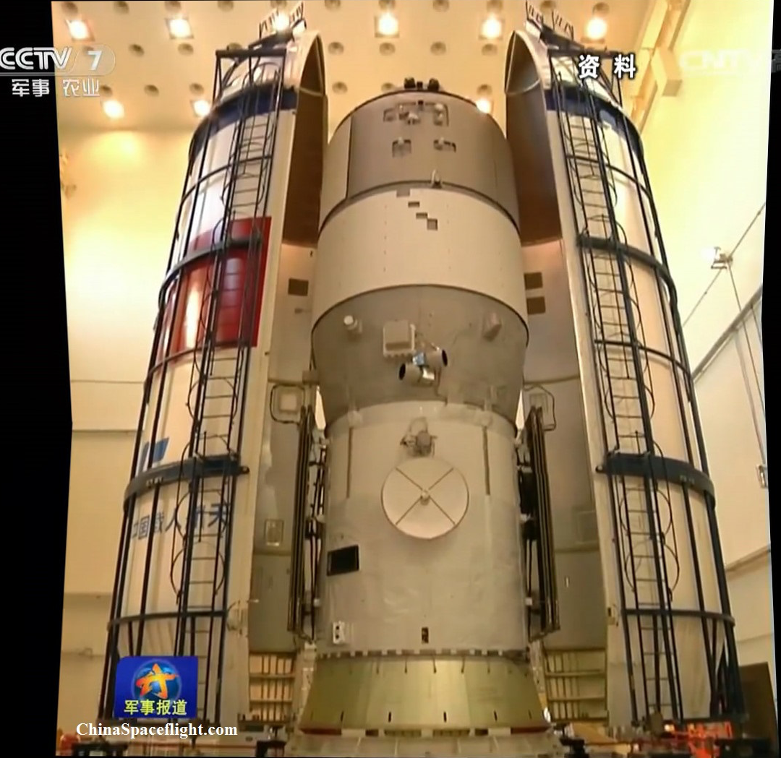
POLAR: GRB Polarimeter on the Chinese TG-2 Space Lab
Launched: September 15 2016!
5 institutes from 3 countries: Switzerland (UniGE, PSI), Poland (NCBJ) and China (IHEP)

Slide 2
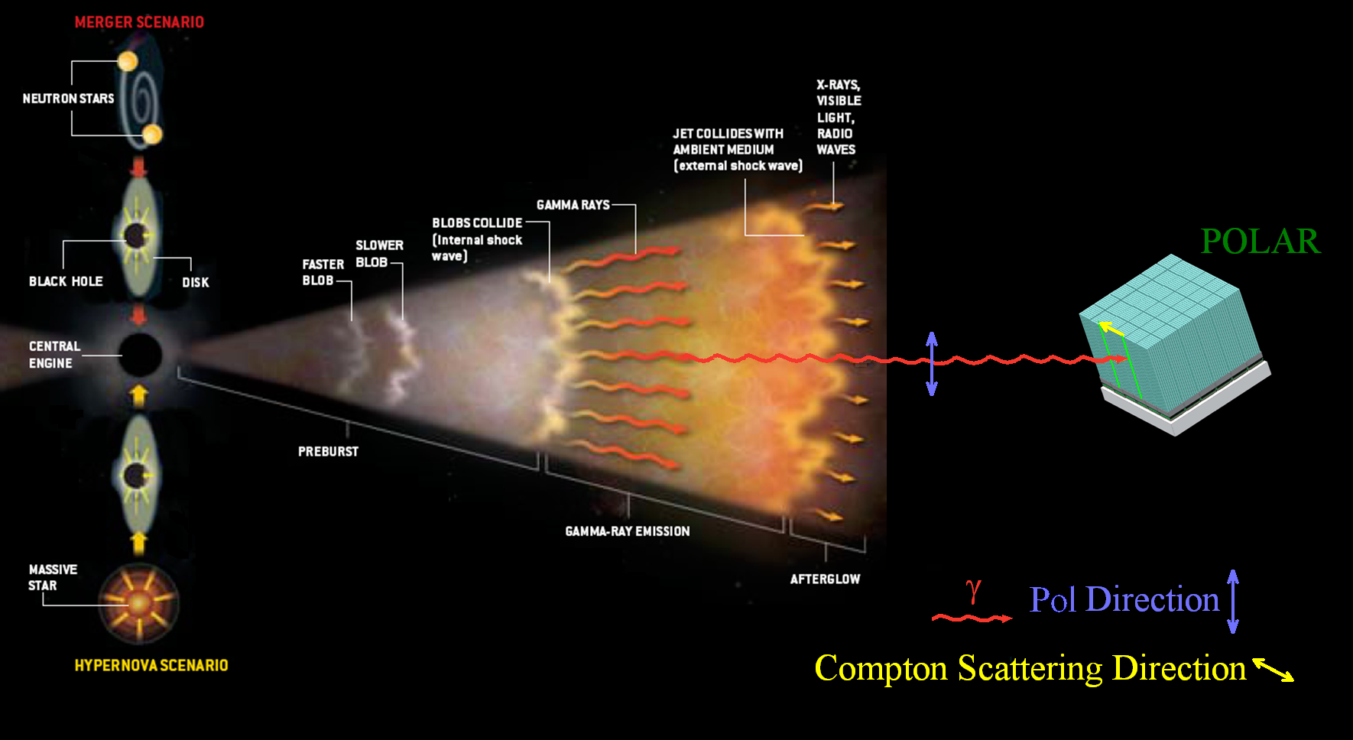
Gamma-Ray Bursts
Most energetic events observed in the Universe
  Occurred in distance galaxies, believed to be results of a supernova or hypernova explosion or a merger of 2 neutrons stars or black holes
  So far away that typically the gamma burst is observed first
Timing, Direction and Energy spectrum has been measured in great detail
  Two parameters remain: polarization degree and polarization angle

Slide 3
Compton Polarimetry
Detect photons and measure the polarization with Compton scattering
  Azimuthal scattering angle dependence on polarization
  Require 2 interactions of the incoming photon in the detector

Slide 4
The POLAR Instrument Idea
Heritage from particle physics with compact segmented plastic scintillator array detectors
  Optimal for Compton scattering in the 50-500 keV energy range
POLAR: 1600 plastic scintillators bar (6x6x176 mm) in 25 modules
  Lightweight allows a relatively large effective area, with low mass (30kg)
  Small granularity results in high angular resolution thus high sensitivity for polarization measurements

Slide 5
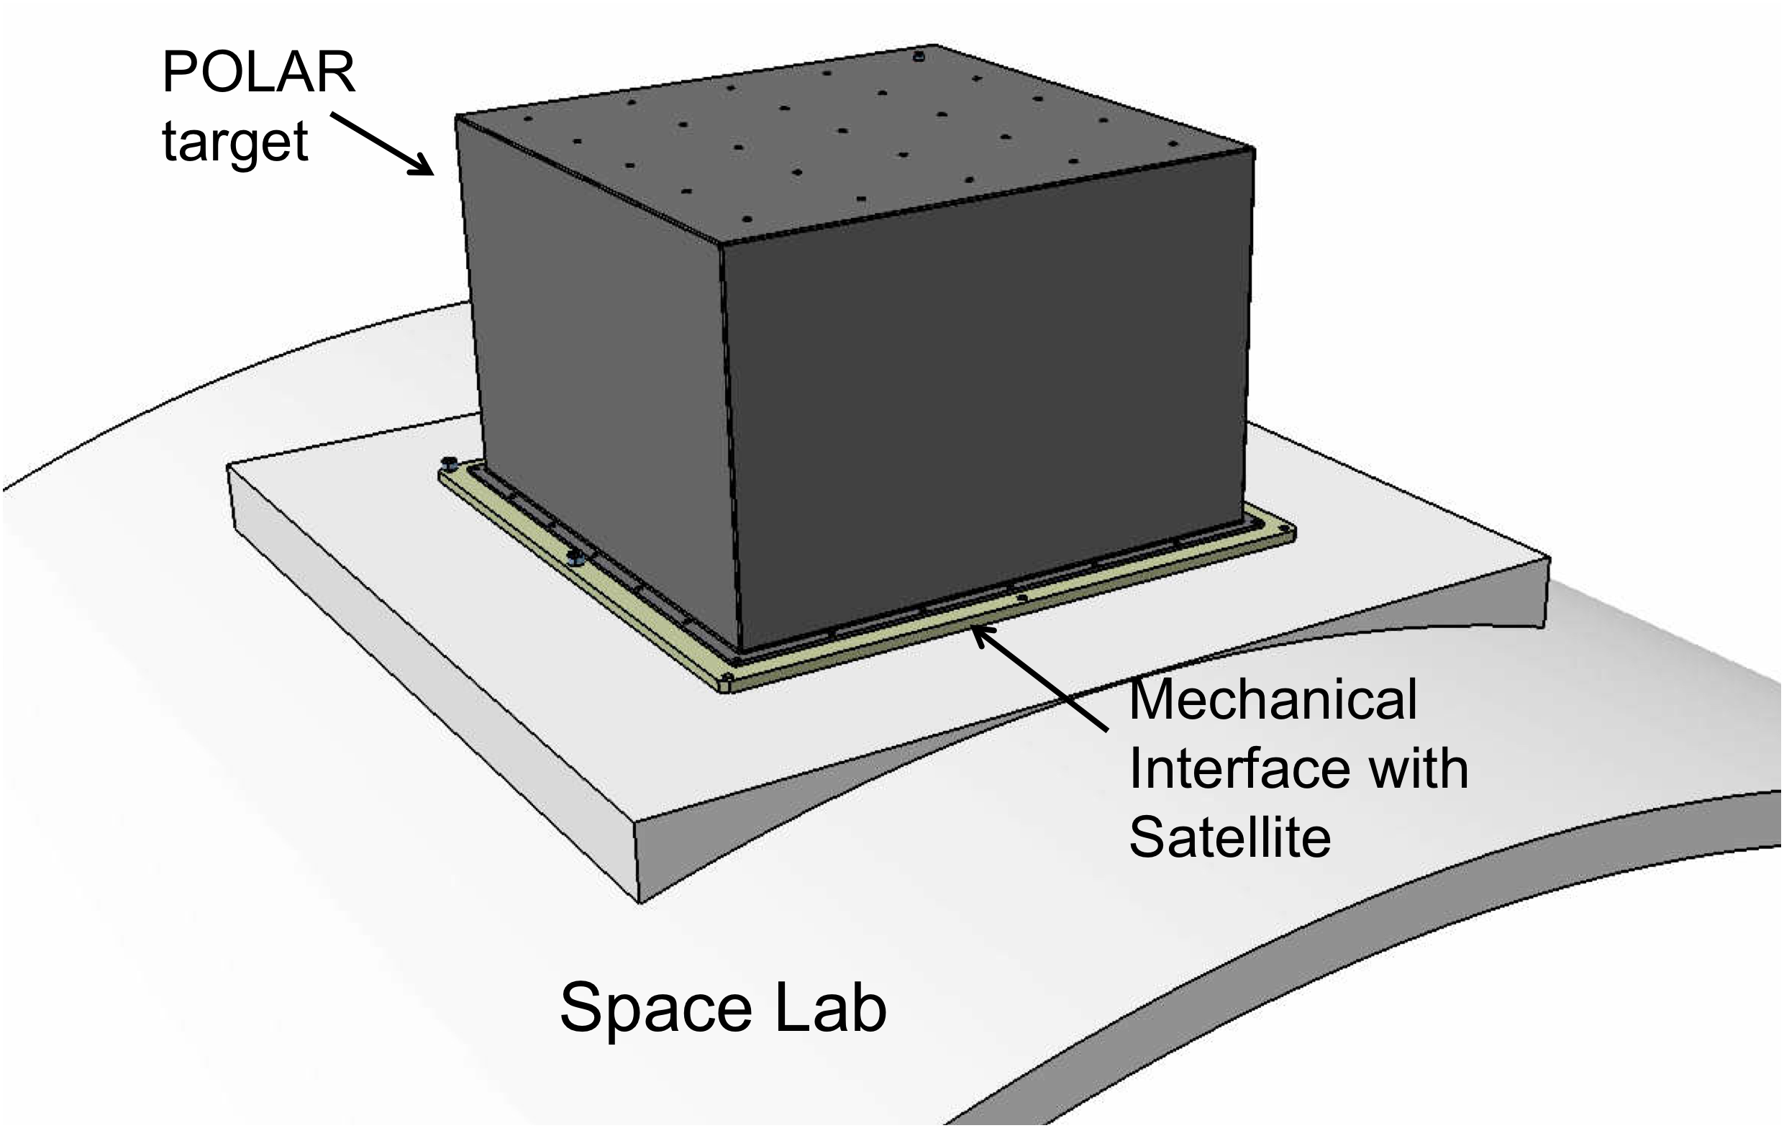
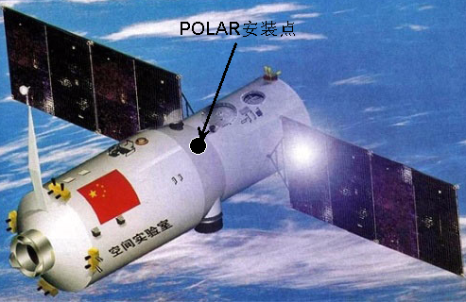
POLAR on Tiangong 2
Polarimeter:
Photon polarisation from GRB
Hard x-rays, 50 keV < Eγ < 500 keV
FoV 30% of sky
OBOX (Europe):
5x5 modules in carbon fibre box
Central trigger and power supplies
Switzerland: UniGE (DPNC, ISDC), PSI Poland: NCBJ Swierk
IBOX (Chinese Academy of Sciences):
Space craft interfaces
Central computer, data transmission

Slide 6
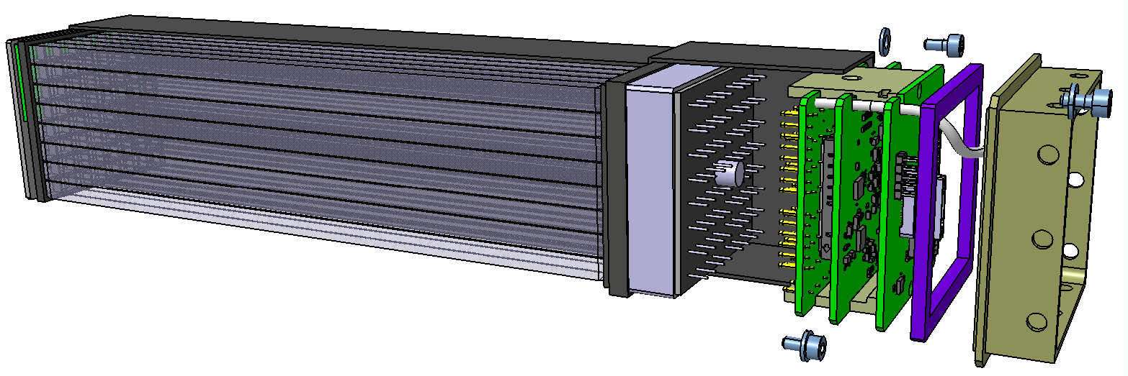
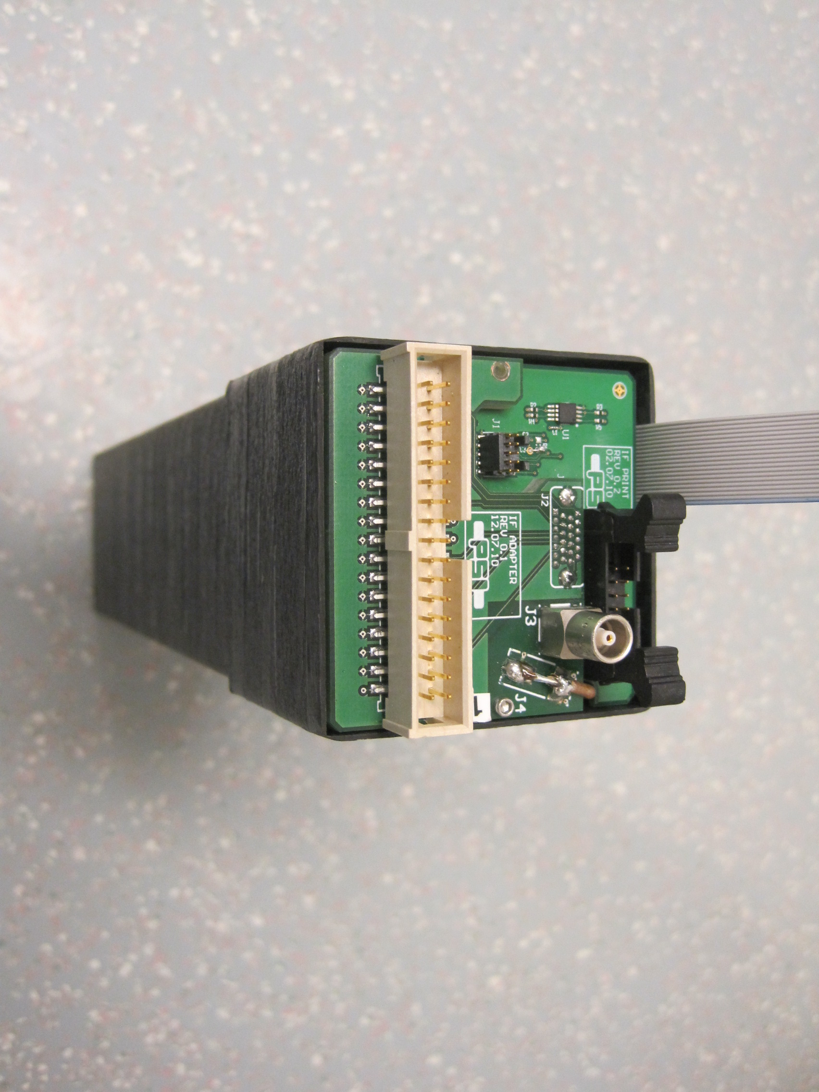
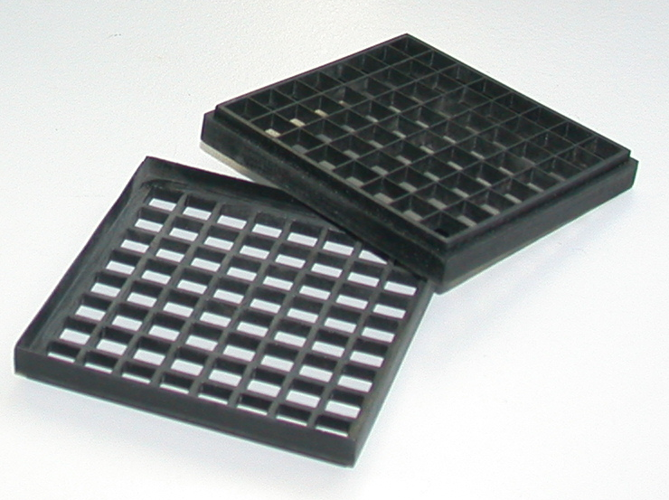
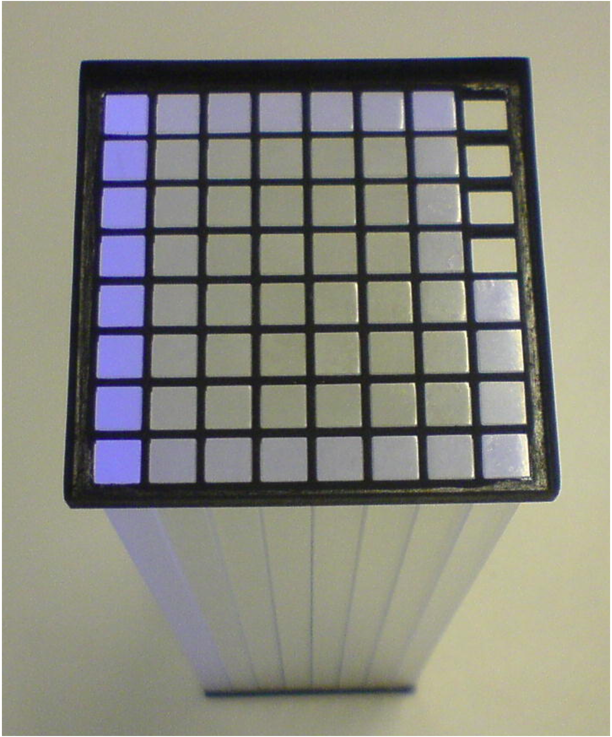
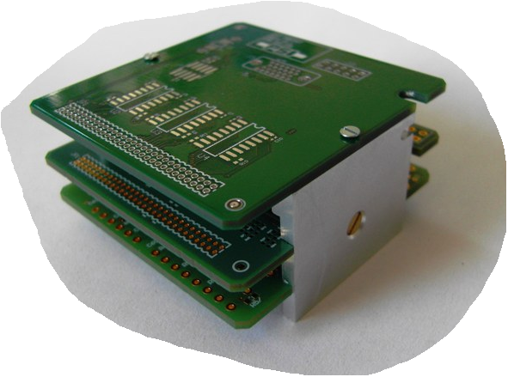
POLAR Module
CFRP socket (1mm thick carbon prepreg)
Back seal
End Cap
64 Bars
PMT
Baffles
FEE
(PSI Villigen)

Slide 7
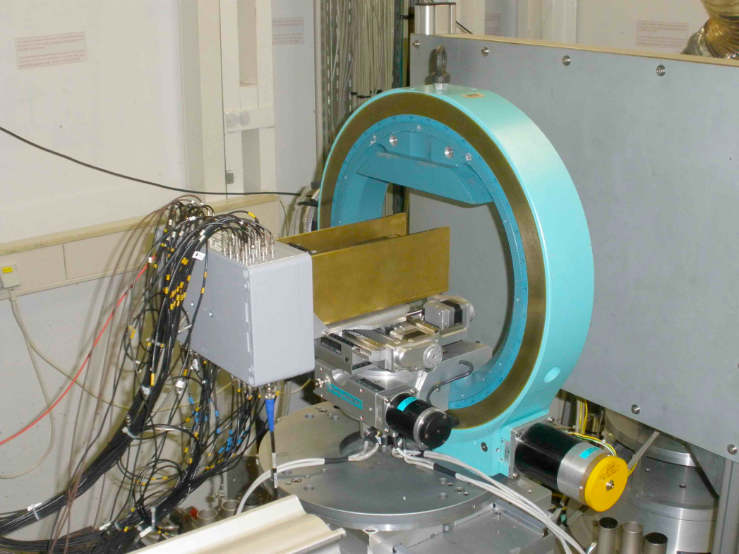
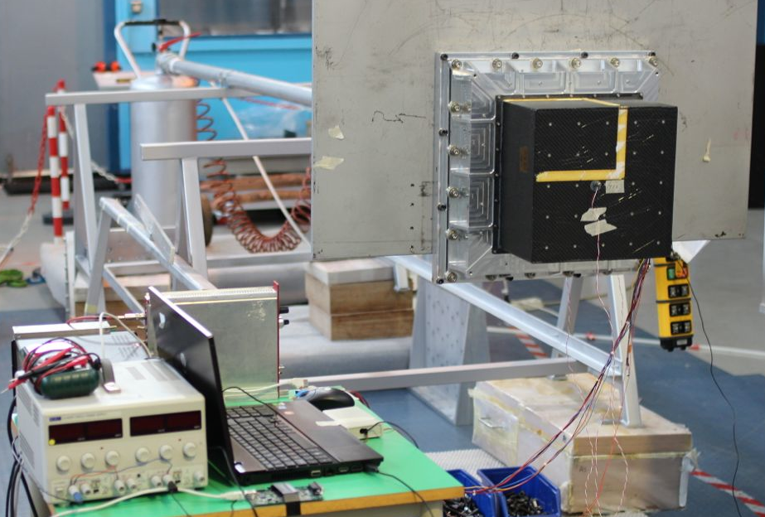
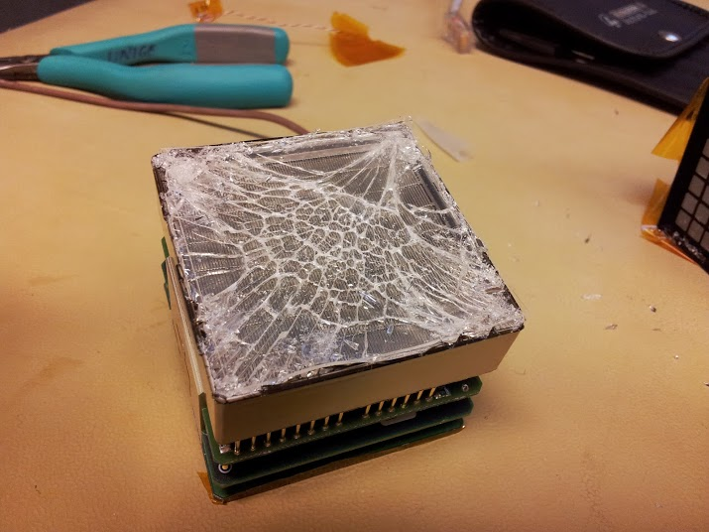
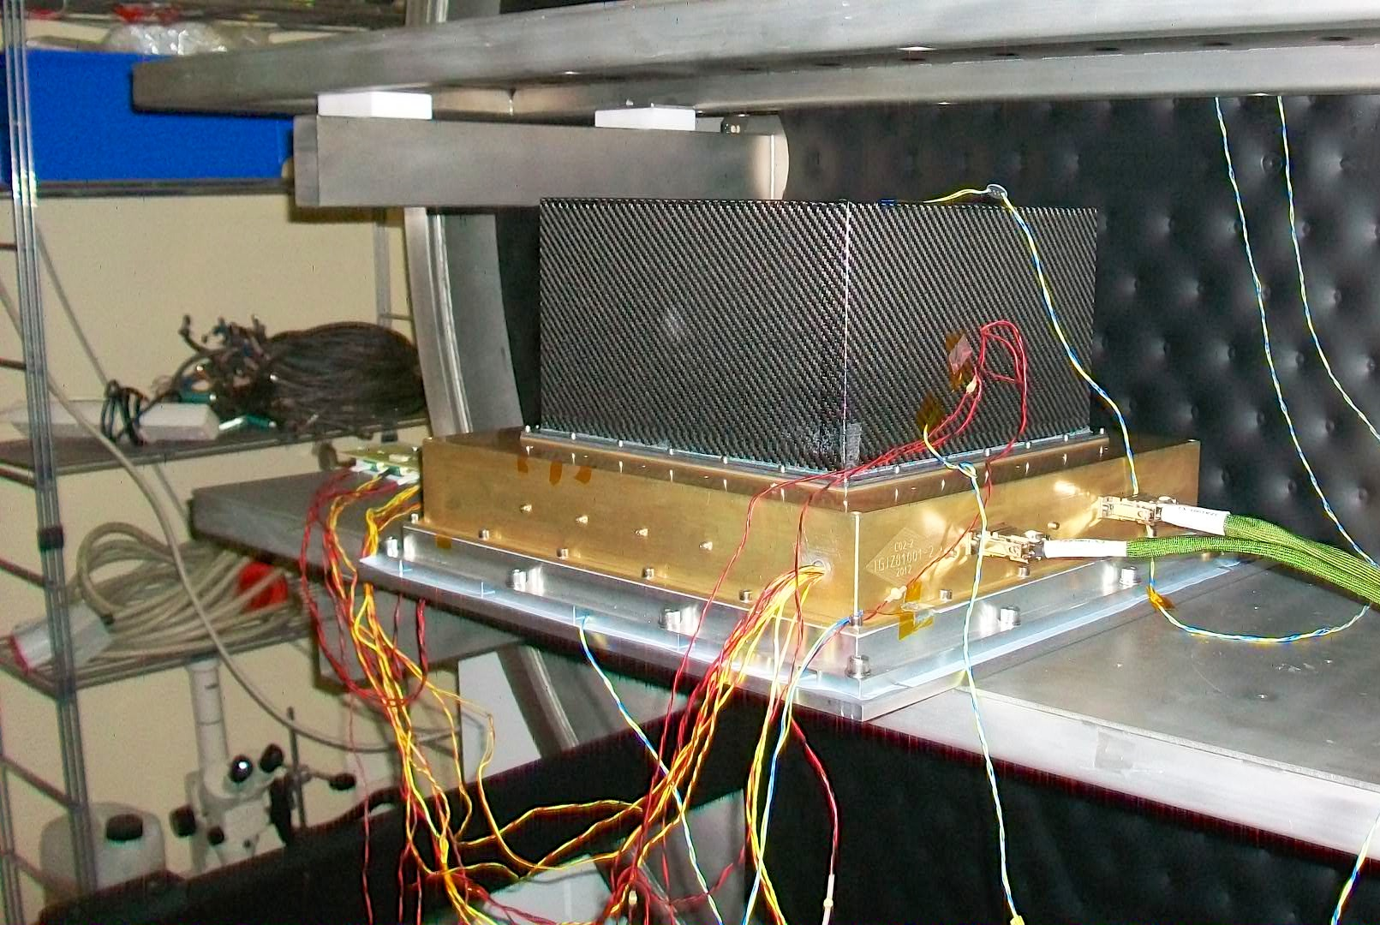
The POLAR Timeline
2005 | Phase 0 | NIM Publication
2007-2009 | Phase A | DM, EQM I
2010-2011 | Phase B | EQM II
2012-2016 | Phase C/D | FM, FMS
2016–2020 | Data analysis | Science publications

Slide 8
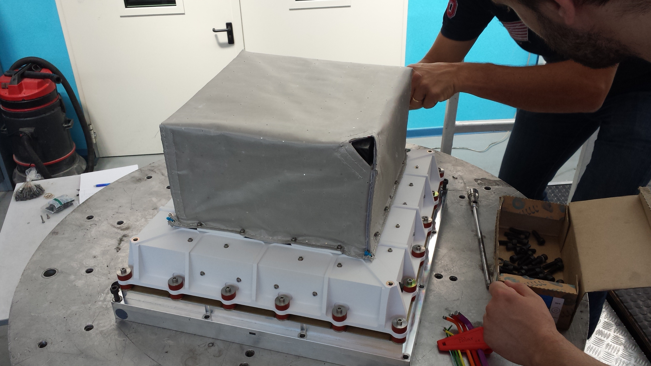
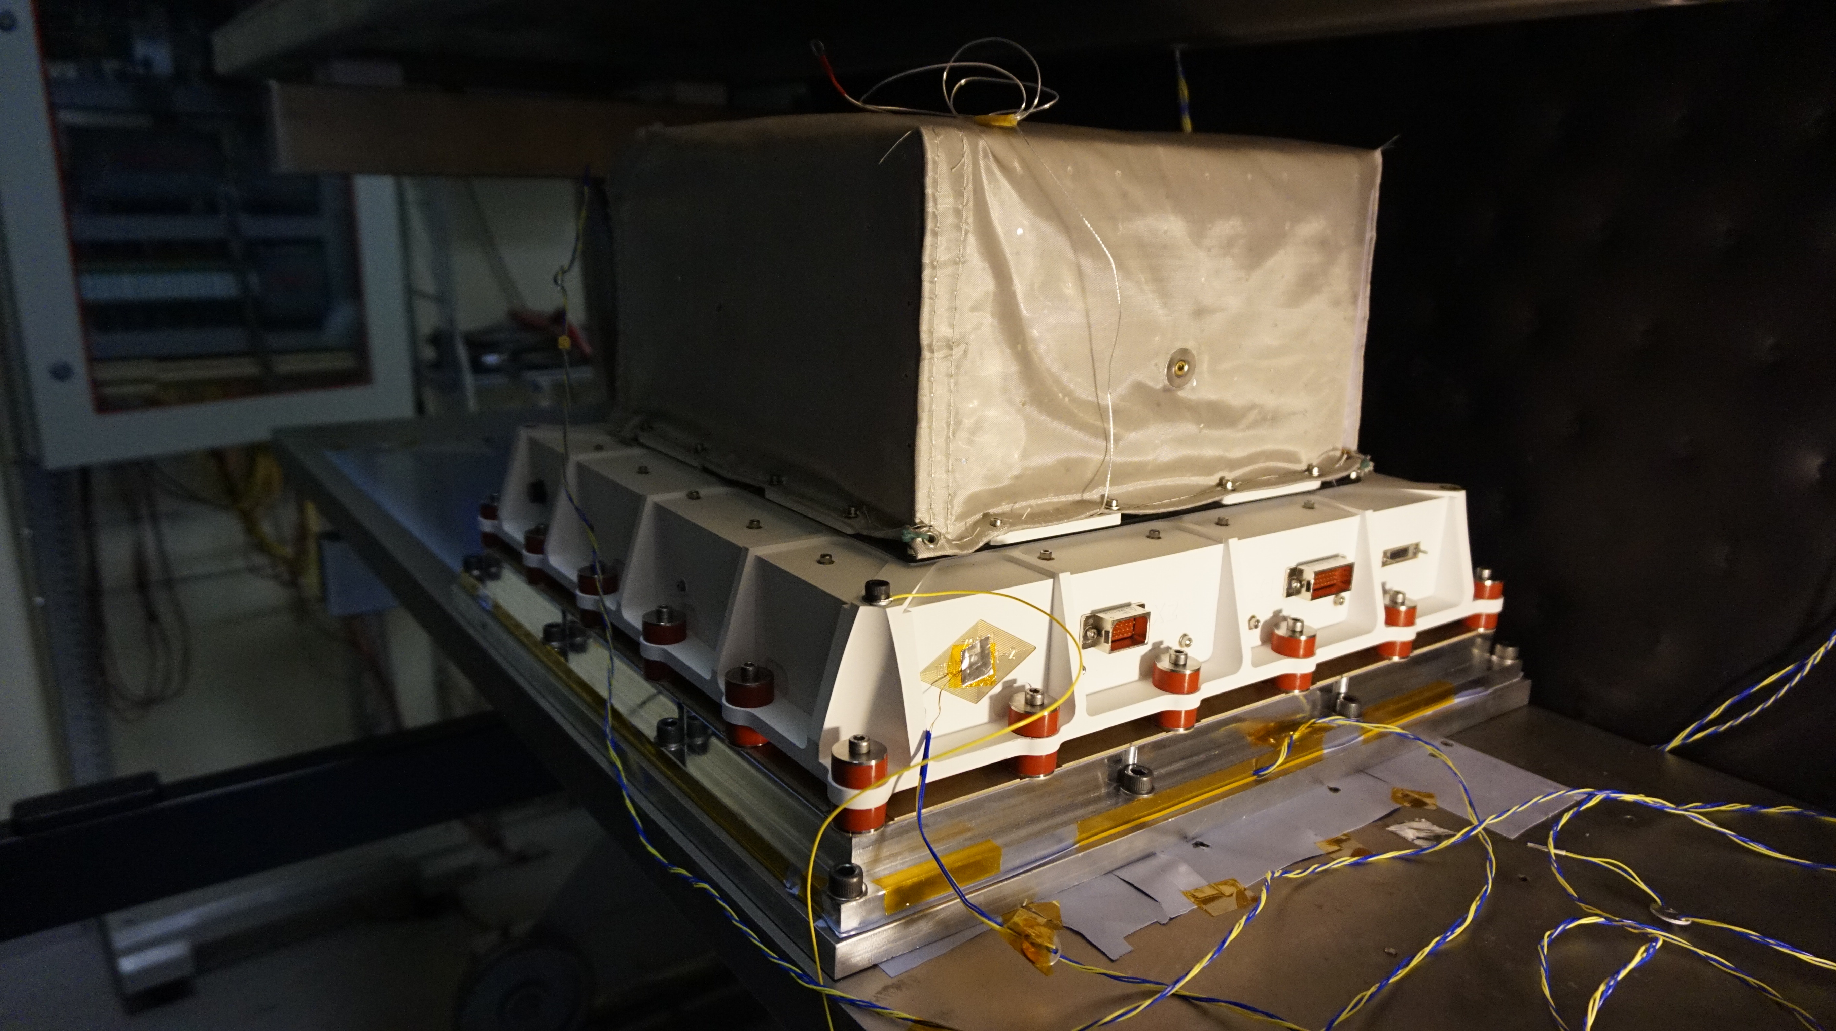
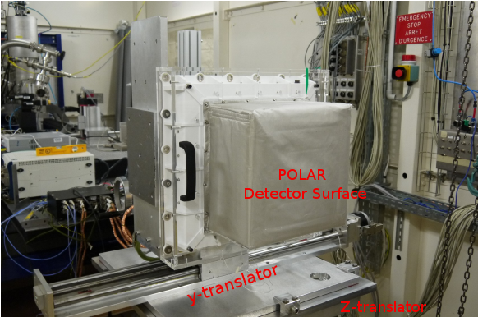
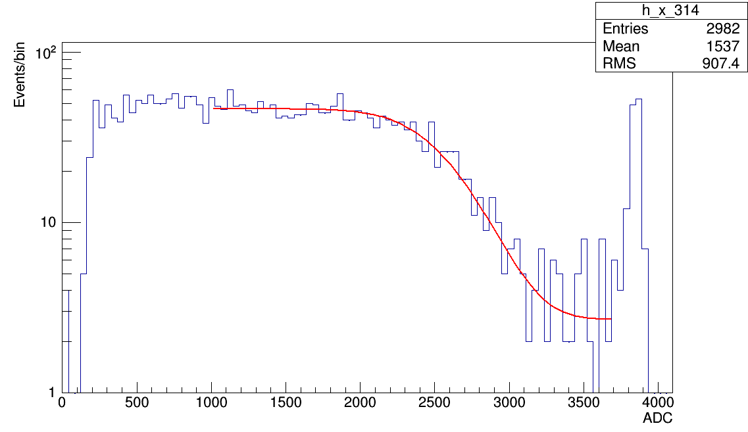
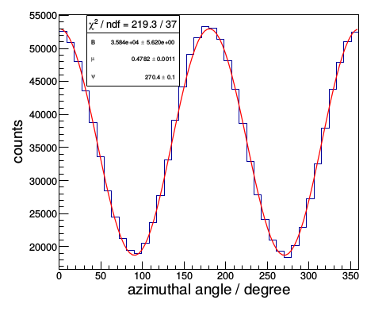
POLAR Constructed and Qualified
Vibration
TVT
Calibration at ESRF
Full Flight Model calibrated on ground with polarized beams, performance confirmed!

Slide 9
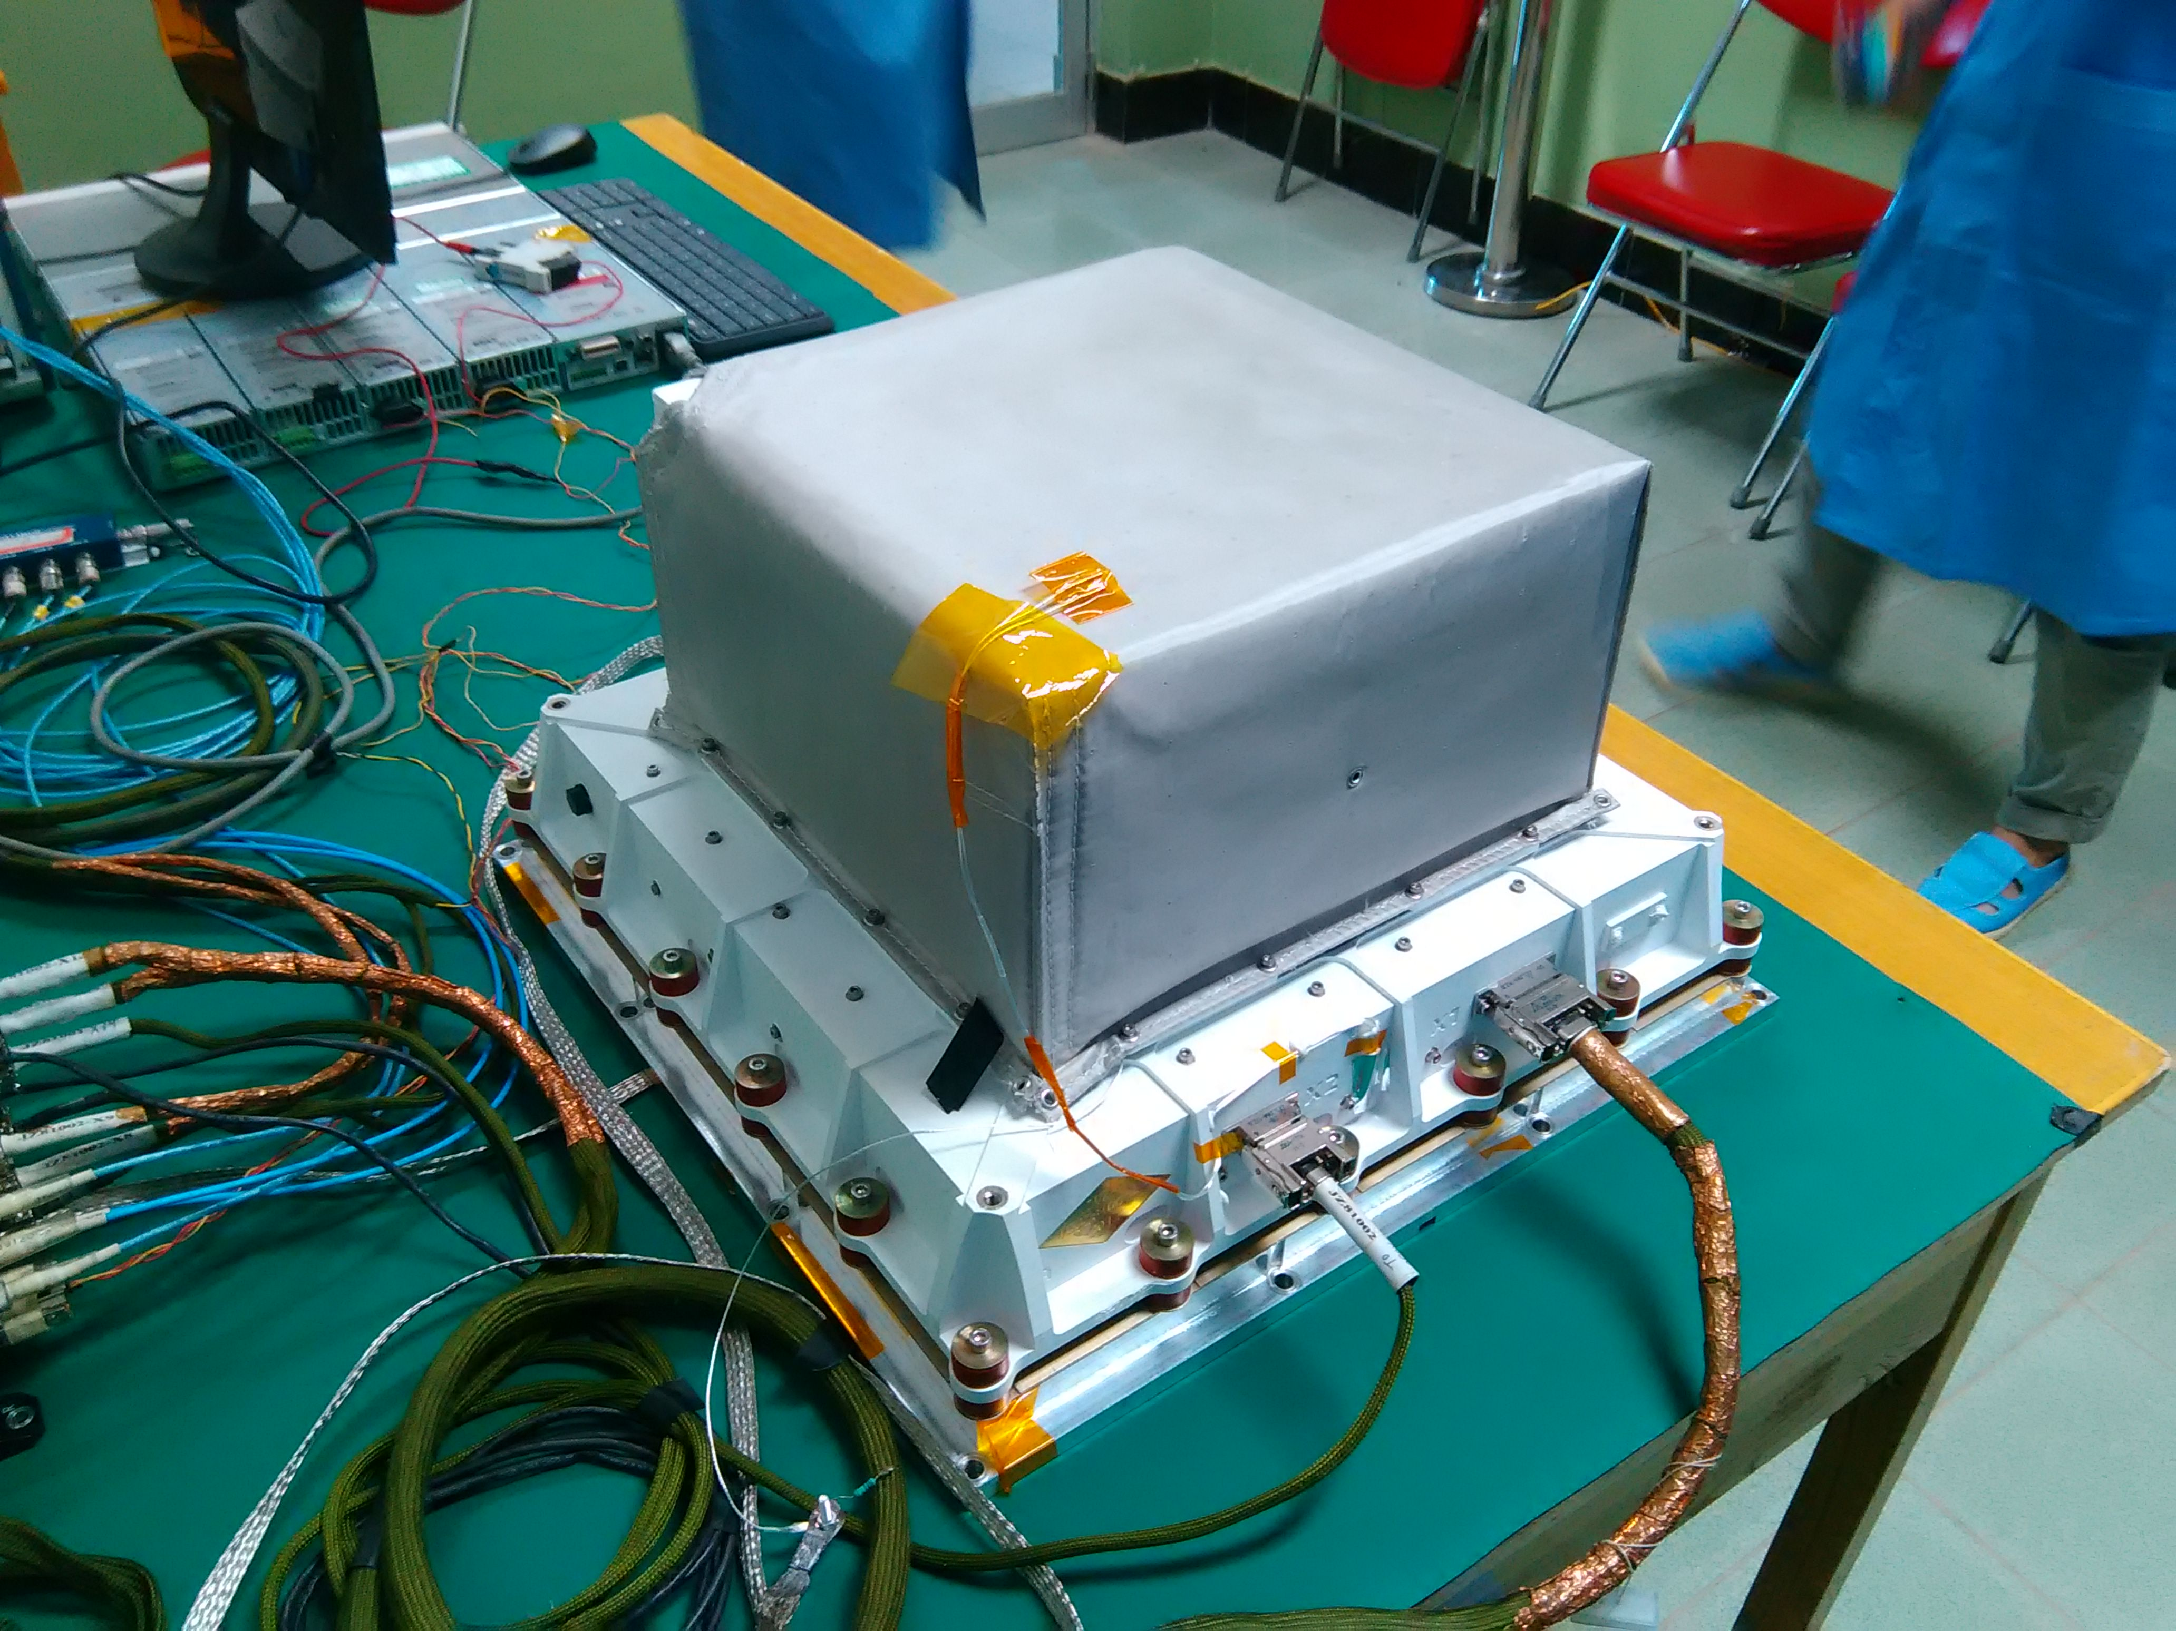
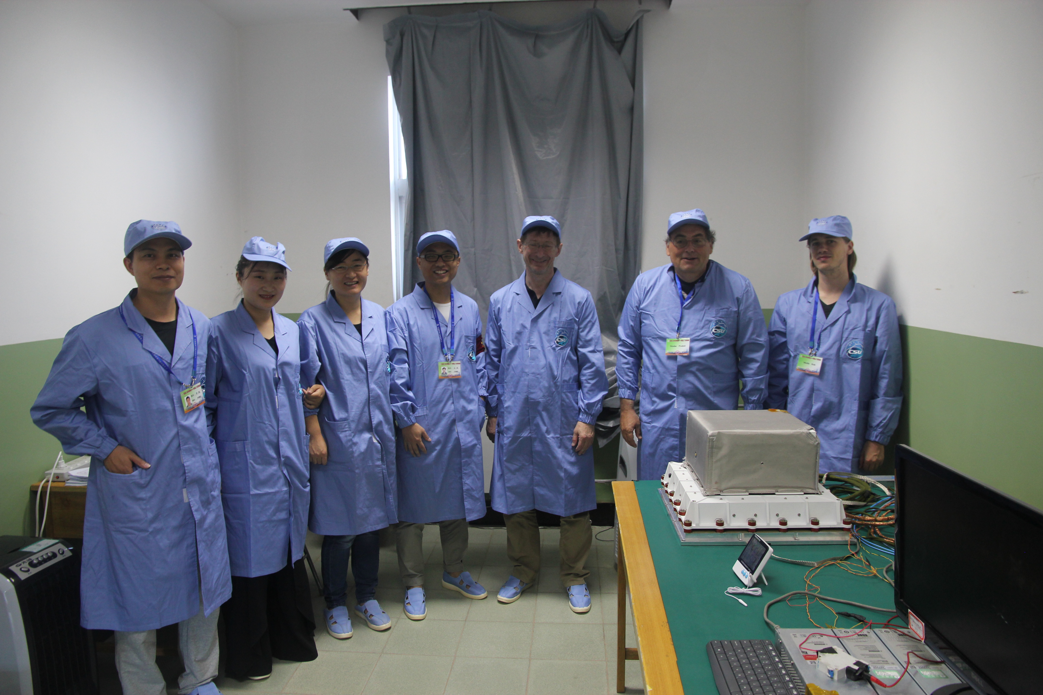
POLAR at launch site
POLAR FM shipped to the Jiuquan Satellite launch center at the end of June
  Final tests at the launch site completed, FM now mounted on TG-2!
The launch site test team

Slide 10
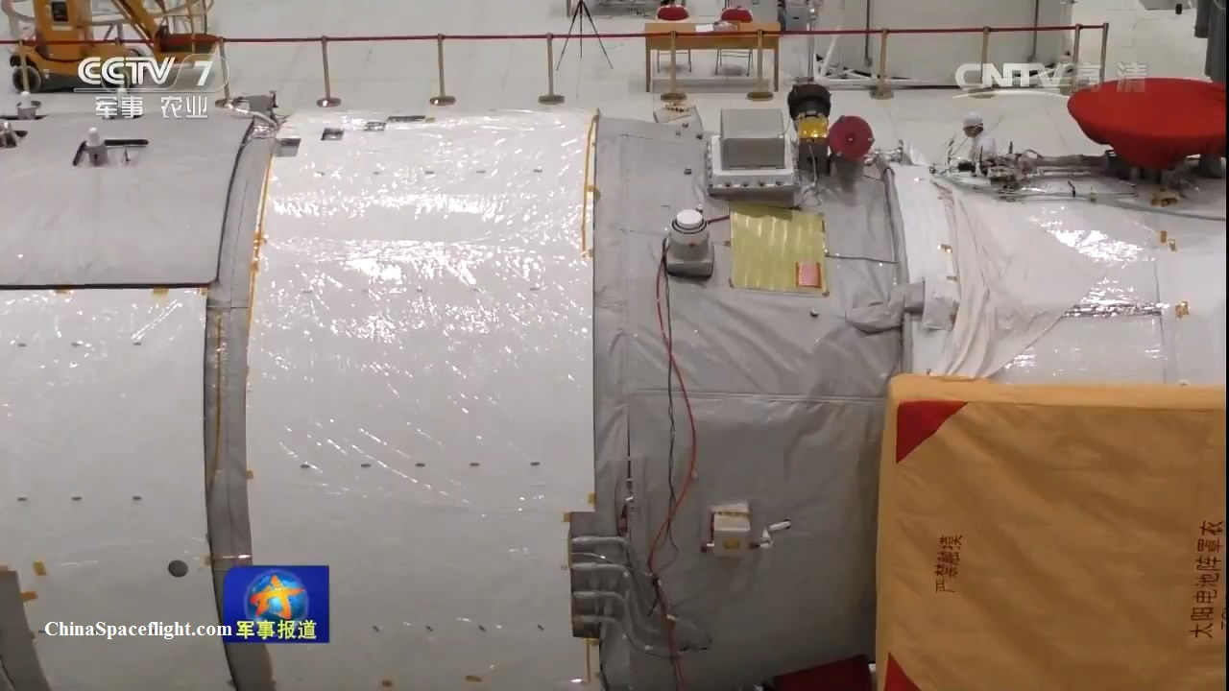
POLAR ready for space!
The launch site test team
The happy technical coordinator!

Slide 11
Towards the first light …
Successfully launched on Sept. 15, 2016
  t0 + 22.5h: INBOX turns on
  t0 + 7d: OUTBOX turns on
  T₀+ 28d: first observation period
  …
Operation period: at least 2 years
  Expected to detect 50 GRBs per year and measure the polarization of 2 or 3 strong GRBs with an unprecedented precision!

