Slide 1
The vacuum insulated transfer lines for CMS CO₂ cooling: performances and lessons learnt
Forum on Tracker Detector Mechanics – Bonn – 23-26 May 2016
P. Tropea, J. Daguin, N. Frank, H. Postema

Slide 2
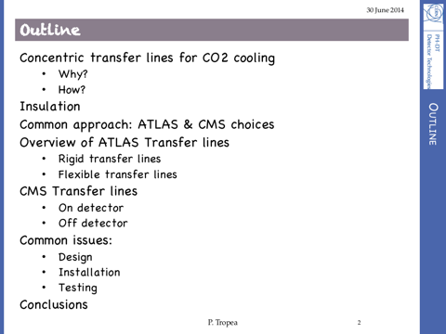
today…following 2014 presentation... http://indico.cern.ch/event/287285/contributions/1640696/attachments/534388/736812/140630_TransferLines.pdf
Vacuum insulation choice
The different flavors
The CMS troublemaker section
Issues & solutions put in place
Looking forward
Forum 2014 @ Desy

Slide 3
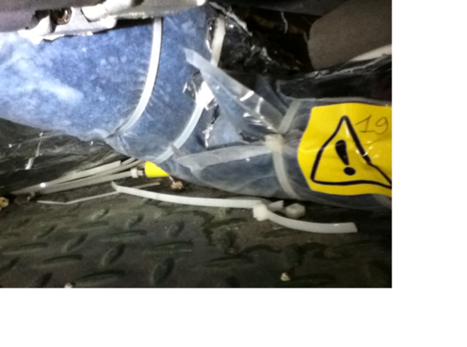
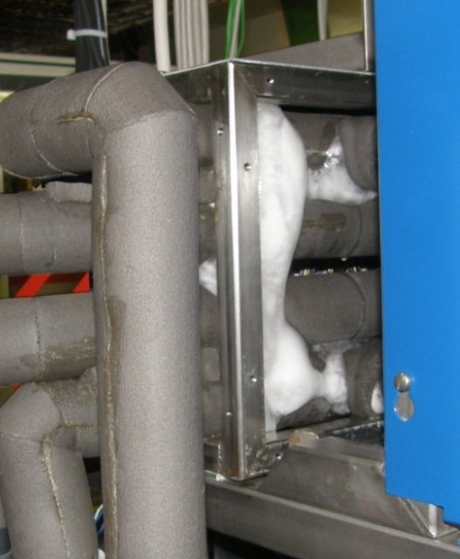
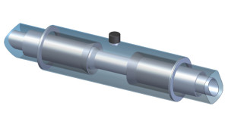
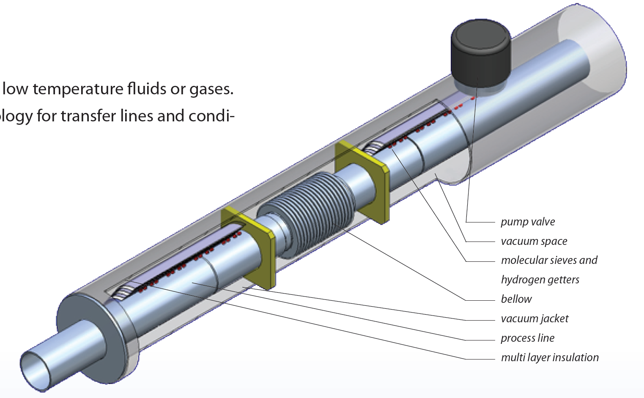

Vacuum insulation: why?
Low T (<<0 C) is the trend in detector cooling (silicon & not)
Both monophasic & evaporative cooling share insulation needs
Condensation is the enemy & foam insulation quality is not always trivial to be achieved + lifetime is frequently limited
Vacuum insulation applied in cryogenic since ever, industrial practice is good and looks appealing.
Both static & pumped vacuums are used
Differences in operation range for CO2 with respect to Cryo:
  Min T about -40 C
  Max process P about 130 bar
CMS Tracker system
LHCb-Velo system

Slide 4
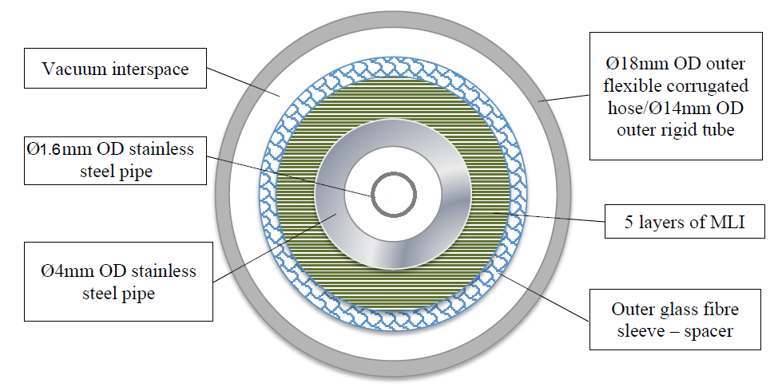
Which vacuum?
Pumped systems
Static vacuum
+ you can go well beyond standard sizes
- you need an additional active system (with controls, alarms, etc)
See Claudio’s talk at the Forum last year for the flex lines of ATLAS IBL
+ they are “industrial components”
+ no need of controls, active parts, nothing can break!
- you carefully need to stick to industrial sizes or do careful testing….
SUBJECT OF THIS TALK!
Credits: C. Bortolin, Forum on Tracking Detector Mechanics, 2015
(ALMOST) NOT DISCUSSED HERE….

Slide 5
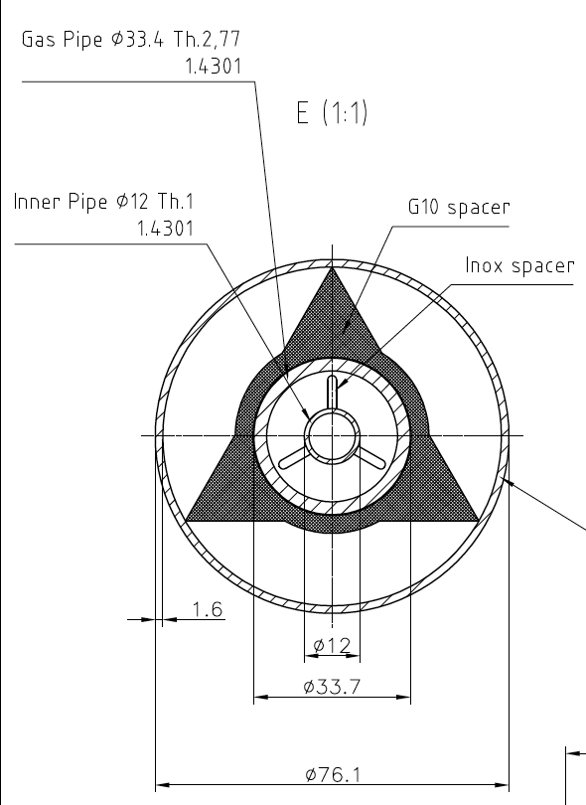
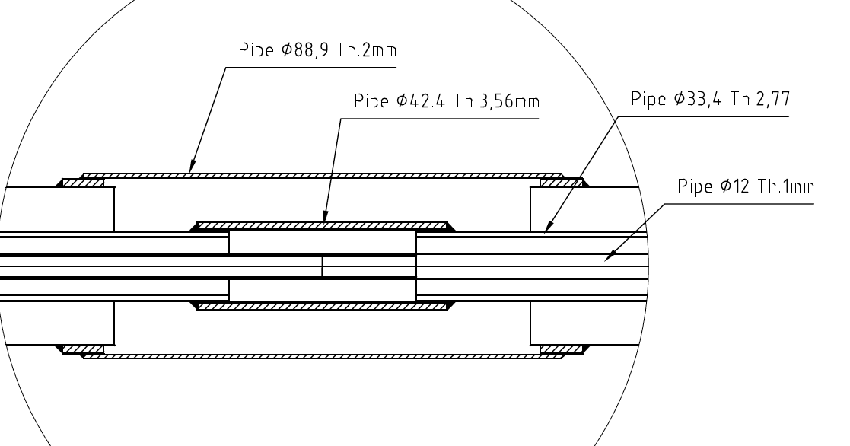
Options: layout & sizes
Typical for permanent vacuum systems
CMS USC to UXC
….and most of this space occupied by MLI
 | Inlet (Liquid) |  | Return (vapour) |  | Vacuum |  | distance cold/warm surface
 | ⍉ out | Thickness | ⍉ out | Thickness | ⍉ out | Thickness
 | mm | mm | mm | mm | mm | mm | mm
CMS YB0 | 6 | 1 | 12 | 1 | 28.0 | 1.0 | 7.0
CMS Yoke-Manif | 6 | 1 | 12 | 1 | 63.5 | 1.5 | 18.3
 |  |  | 12 | 1 | 76.1 | 1.5 | 30.6
CMS US to UX | 12 | 1 | 33.4 | 2.77 | 76.1 | 1.6 | 19.8
ATLAS US to UX | 10 | 1 | 21.3 | 2.11 | 63.5 | 1.5 | 19.6
 |  |  | 21.3 | 2.11 | 50.0 | 1.5 | 12.9
CMS Manifold to Yoke
Vacuum jacket
Vacuum jacket
2-phase return
2-phase return
Liquid line
Liquid line

Slide 6
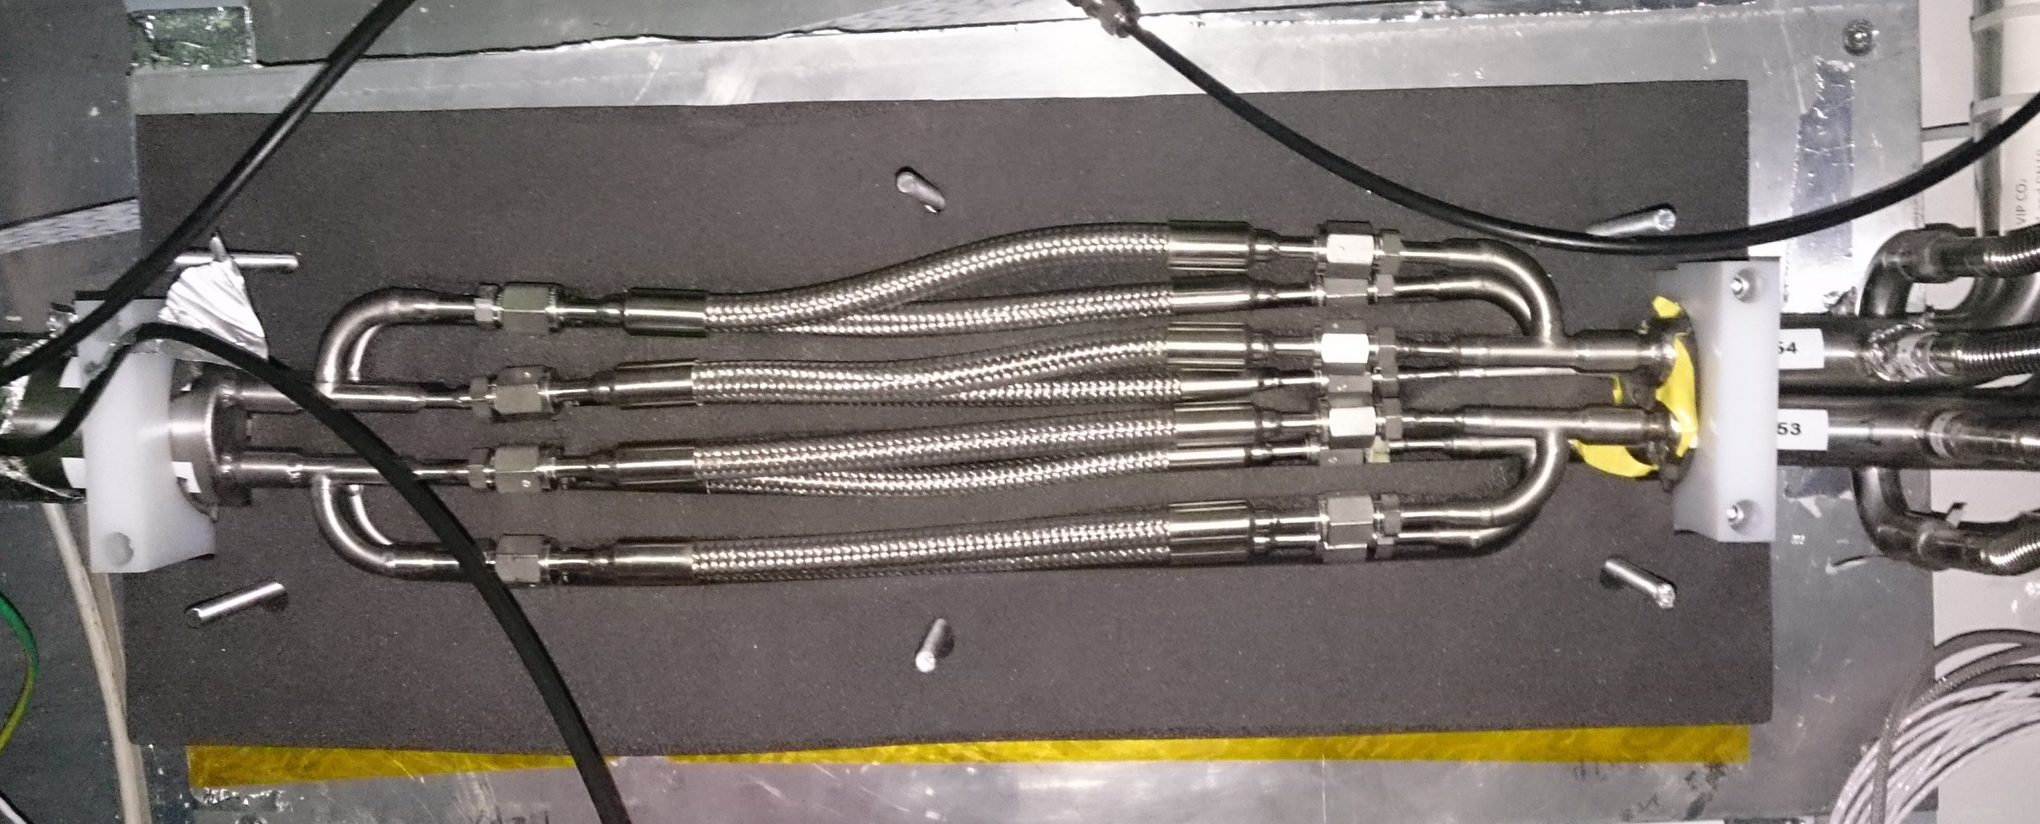
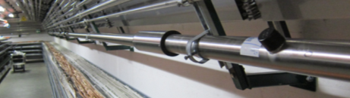
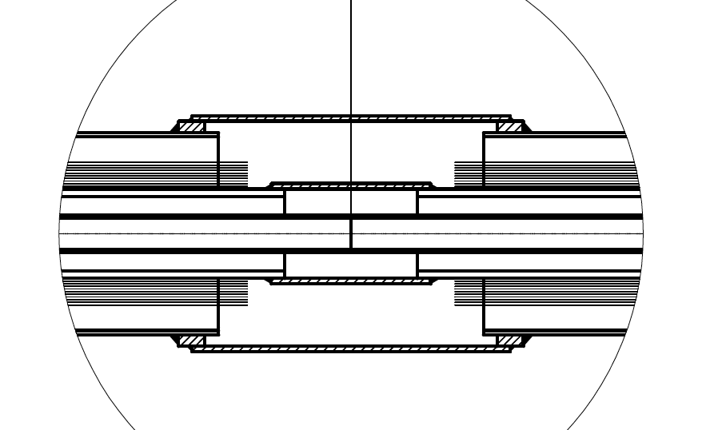
Junctions between different sections
Process: connector (VCR)
Vacuum: connector (VCR)
Insulation: local foam box
ON SITE PUMPING REQUIRED
Process: butt or socket welded
Vacuum: broken sections
Insulation: foam
Process: butt or socket welded
Vacuum: butt or socket welded
Insulation: butt or socket welded
  Local vacuum section
  Continuous vacuum section

Slide 7
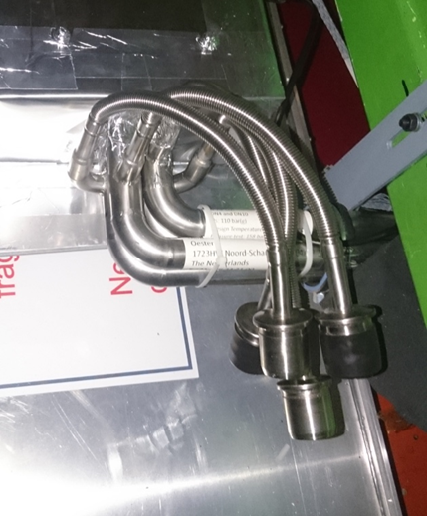
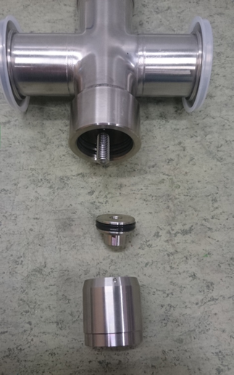
Options: performance monitoring
Surface temperature monitoring
  Regular thermal camera pictures
  Online T measurements
Pressure monitoring in vacuum jackets
  Permanent monitoring on each section
  Local measurement during accesses for check
PLC + rad hard & magnetic field compatible instrumentation
Port valves
Local p measurements with no permanent instrumentation ask for tools & accessibility

Slide 8
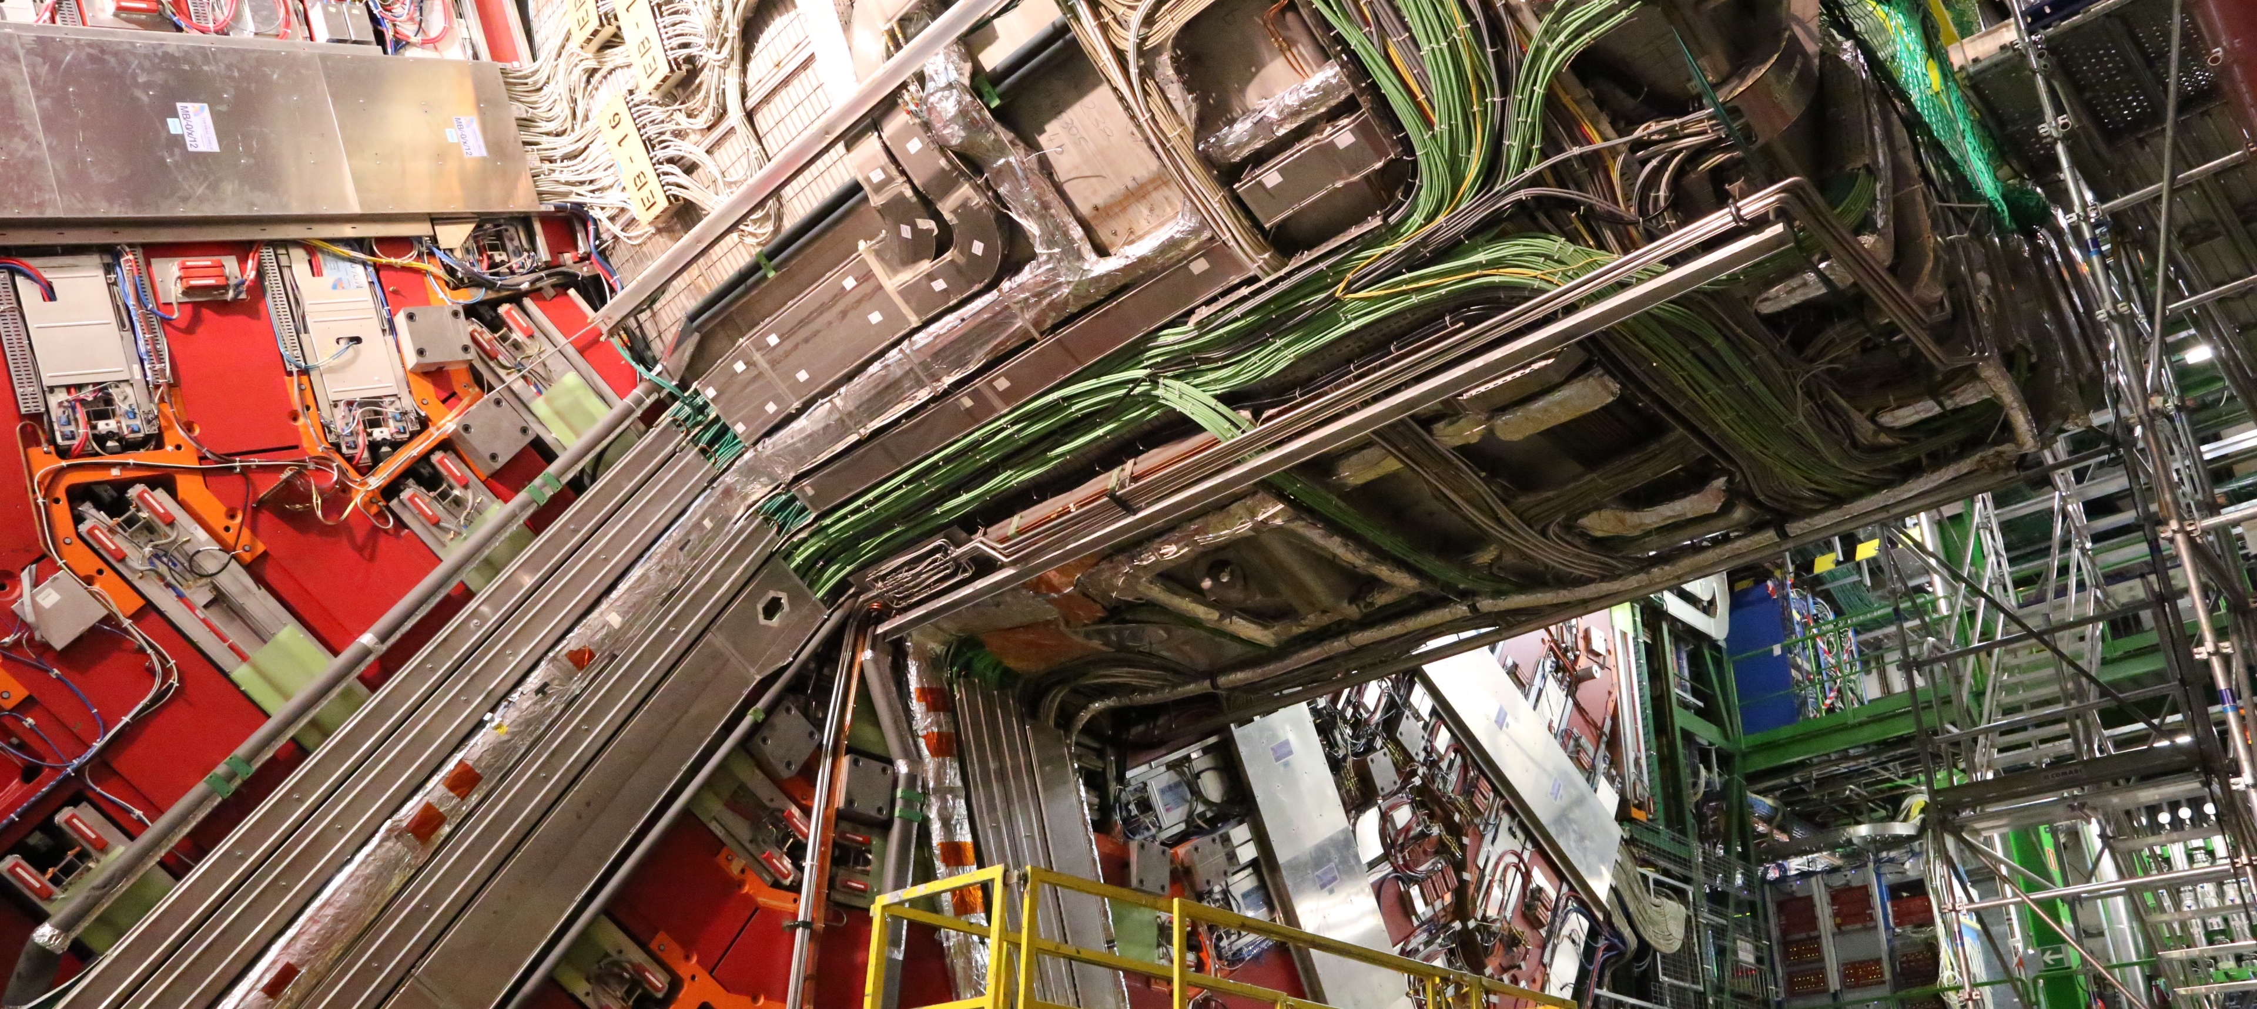
The troublemakers: CMS YB0 transfer lines
…and how we have finally implemented a working solution....

Slide 9
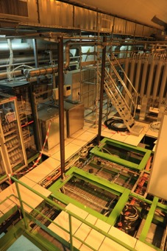
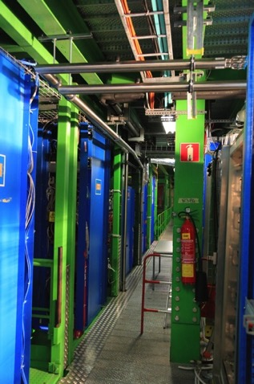
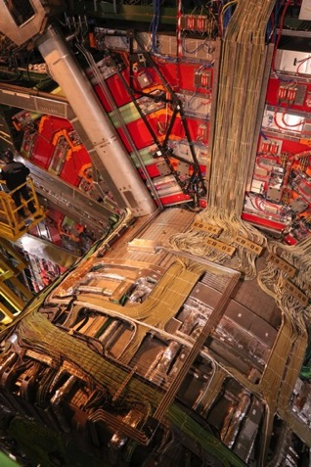
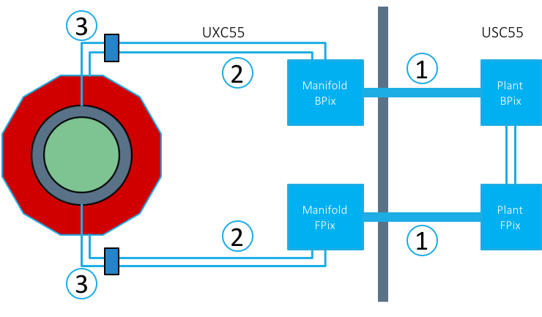
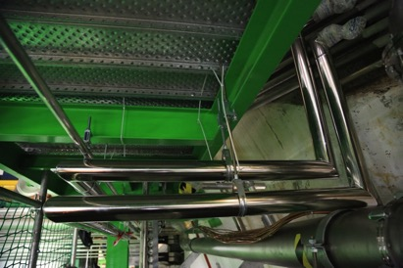
The CMS transfer line zoo
Section 1: USC to UXC (2 x vacuum insulated concentric lines)
  Installed by CRIOTEC in Fall 2014
Section 2: Manifold to top and bottom of YB0 periphery (4 x 1 common vacuum jacket for 4 concentric lines)
  Installed by DEMACO in August/September 2014
Section 3: YB0 periphery to PP1 (4 x 4 vacuum jackets for 4 concentric lines)
  Installed by DEMACO in February/March 2014
1
2
3
1
1
2
3

Slide 10
Some history of the YB0 section
Jan-March 2013: feasibility study and engineering
July 2013: 3D model verification
Sept 2013: order placed
Jan 2014-March 2014: Installation @ CERN
March 2014: acceptance based on company QA (vacuum better than 2*10-4 after 24 hours retention test)
May 2015: first performance tests possible with circulating CO₂ – 2 technical issues spotted
  Thermal performances overall: surface T <13 C when cold CO₂ circulates
  Junction boxes local insulation not sufficient: T gradient after the end of normal insulation
June 2015-Dec 2015: measurements, tests, pumping, study….
January 2016: technical solution by Demaco approved for installation
February 2016: SAES HV200 getter pumps installed
May 2016: verification of long term performances on going....

Slide 11
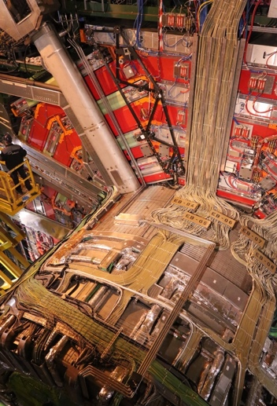
YB0 transfer lines design
4 paths along YB0 from periphery of Yoke to PP1 (-6, -15, +5, +14)
Each sector has 4 pipes, running parallel or 2x2 depending on the zone
Independent vacuum jackets for each pipe, unique volume between Yoke edge and PP1
Each pipe is split in 2 at the level of YB0/Vac tank junction
Ex sector -6
Vacuum jacket 28 mm OD
2-phase return
(12 mm x1)
Liquid line
(6 mm x1)

Slide 12
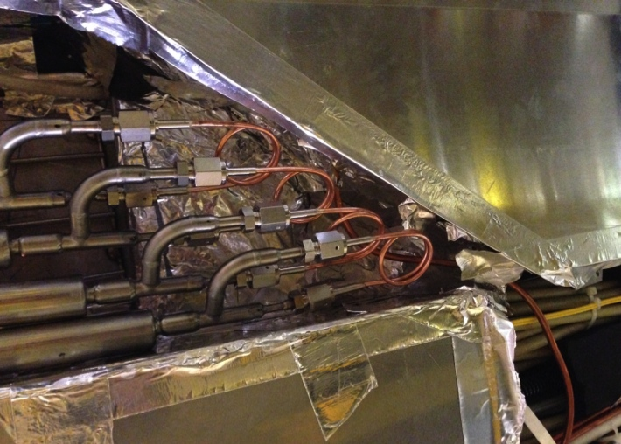
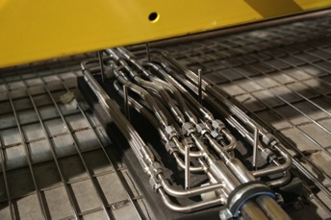
YB0 transfer lines design
Section: | +5 | +14 | -6 | -15
PP1-Conn. Box (mm) | 7252 | 10358 | 7983 | 7544
Conn. box- End box (mm) | 5084 | 6839 | 6414 | 10165
Total length (mm) | 12336 | 17197 | 14397 | 17709
PP1 by-passes
Sector -6
Connection box
PP1 +14
Details on welding process https://edms5.cern.ch/document/1343199/1

Slide 13
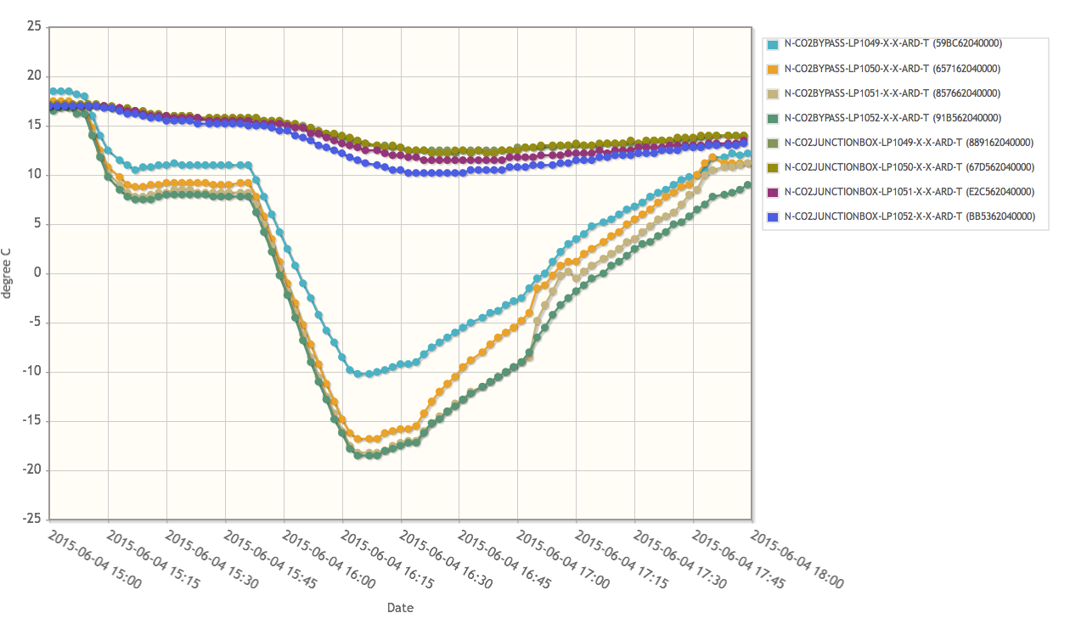
The first circulation tests: April-June 2015
Sector -15
Vacuum jacket temperatures (near junction boxes)
Min temp = 10.2 °C
PP1 bypasses temperatures
+ 5 °C SETPOINT
-25 °C SETPOINT
Plant OFF

Slide 14
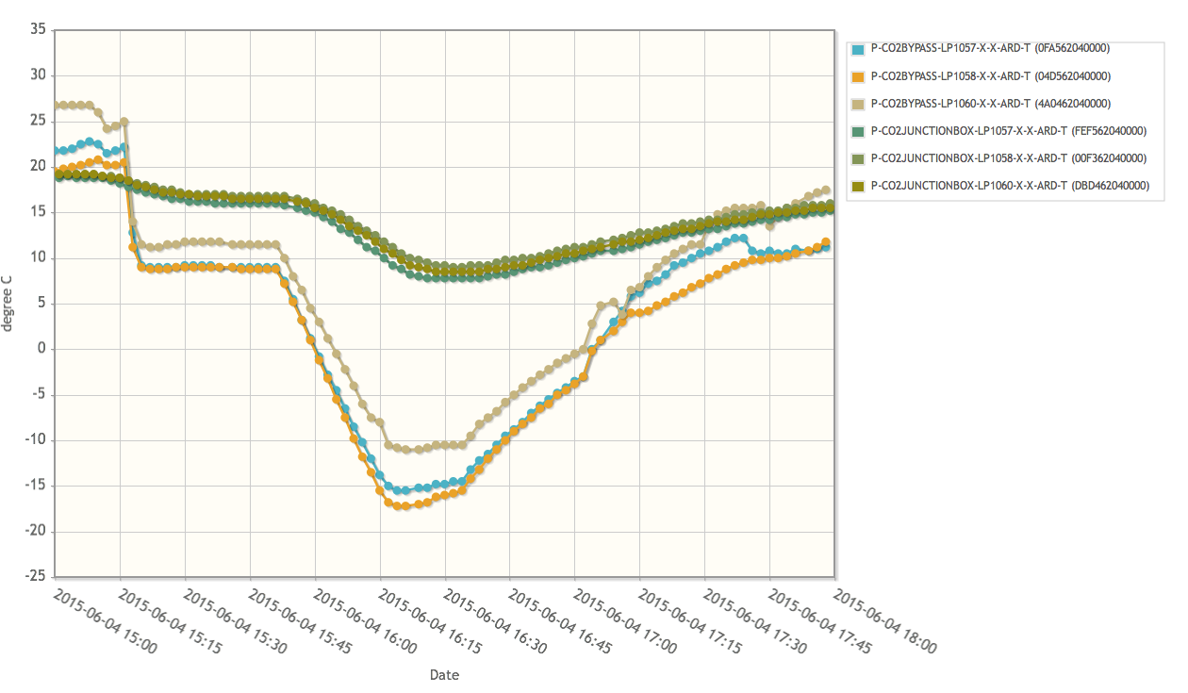
The first circulation tests: April -June 2015
Sector +14
Vacuum jacket temperatures (near junction boxes)
Min temp = 7.8 °C
PP1 bypasses temperatures
+ 5 °C SETPOINT
-25 °C SETPOINT
Plant OFF

Slide 15
Investigations & actions in 2015
Static pressure measurement taken on all vacuum jacket sections: acceptance in February 2014 @ 10⁻⁴ mbar, during summer 2015 the best ones are reading 10-3, the worst one few mbar.
Culprit? Outgassing or leak or humidity pockets?
Flushing with pure gas & re-pumping is considered adequate (pumping on each section for no more than 1 week at installation)

Slide 16
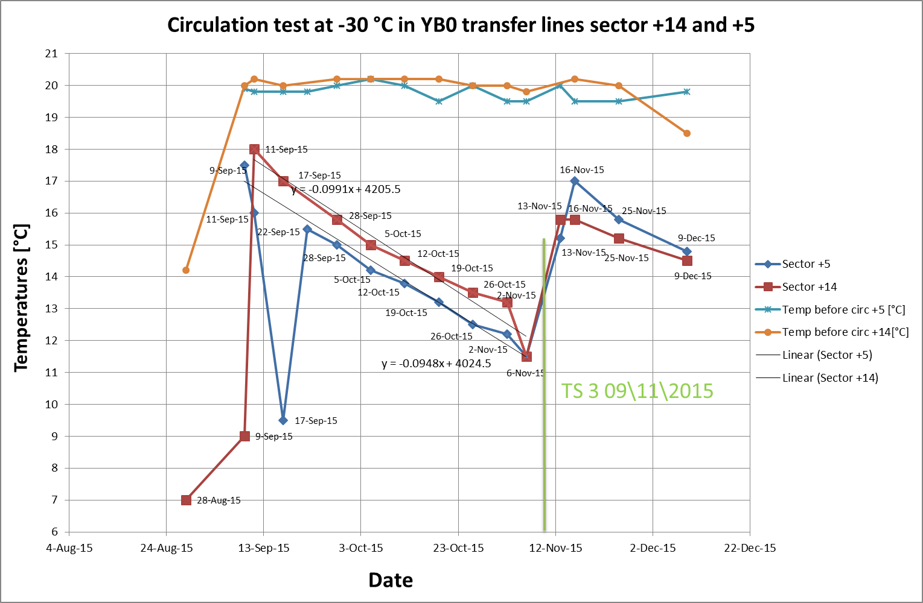
Performance summary: after several flushing & pumping cycles (Sept-Nov 2015)
NEW ISSUE SPOTTED: one line does not improve even with pumping

Slide 17
Further investigations awaiting for full access in YETS
CERN TE-VCS team involved, guiding us for further tests:
Pressure rise tests
  What is the outgassing rate of each vacuum jacket?
Helium leak measurement
  Air in vacuum jacket (external leak)?
  Permeation through port-valves with Viton seals ?
  CO2 return line pressurized with Helium (internal leak)?

Slide 18
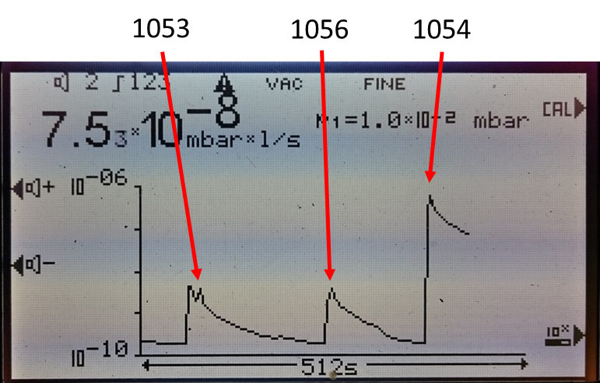
Helium leak test on sector +5
He measurement after retention test
He at 20bars
He leak detector
No internal leak, but line 1054 shows a dangerous high peak…

Slide 19
Pressure rise test on sector +5
All lines look like reaching a stable value, compatible with outgassing + permeation through Viton seals

Slide 20
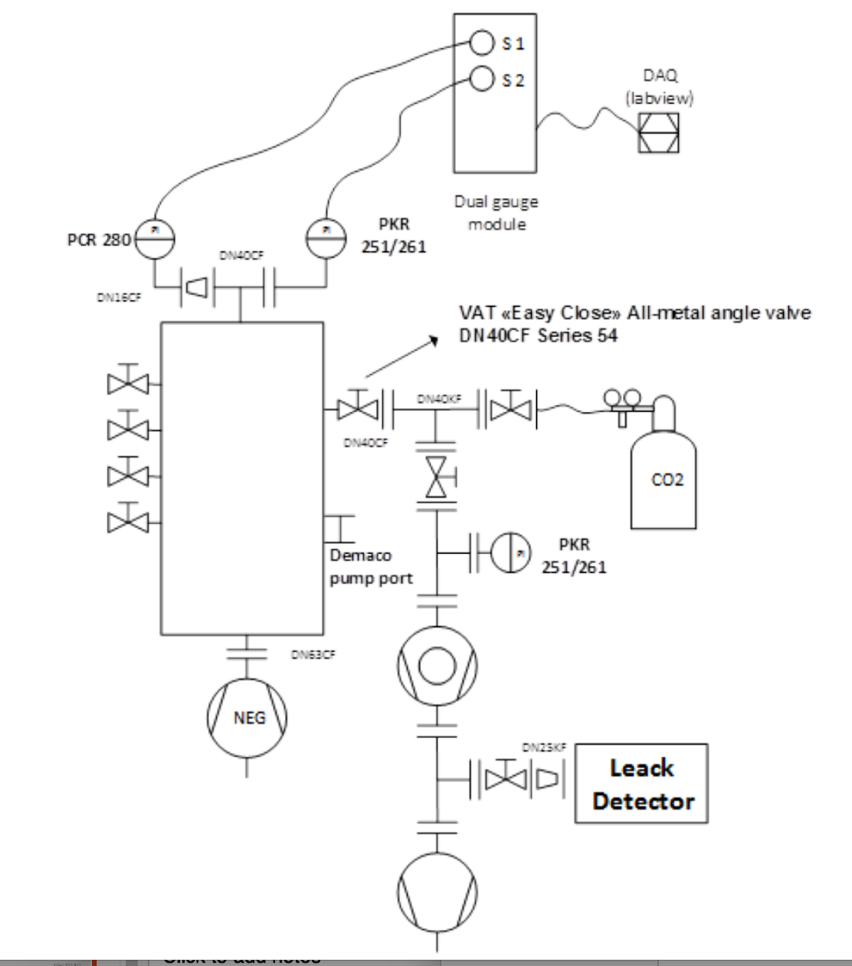
Long term proposal by supplier
On each sector: 1 manifold with full metal valves welded to the existing ports, one pressure gauge, one vacuum pump
Capacitorr® HV200 by SAES

Slide 21
What is a getter
NEG are reactive metals or alloys which capture gases , such as H₂O, CO, CO₂, O₂ and N₂. by a chemical reaction on their active surface.
The reaction generates carbides/oxides/nitrides on the getter surface: Gases are permanently removed from the vacuum system.
Hydrogen does not react to form a chemical compound but dissolves in the bulk of the getter forming a solid solution.
A getter does not pump noble gases as they do not chemically react.
Magnetic field compatible, no active components

Slide 22
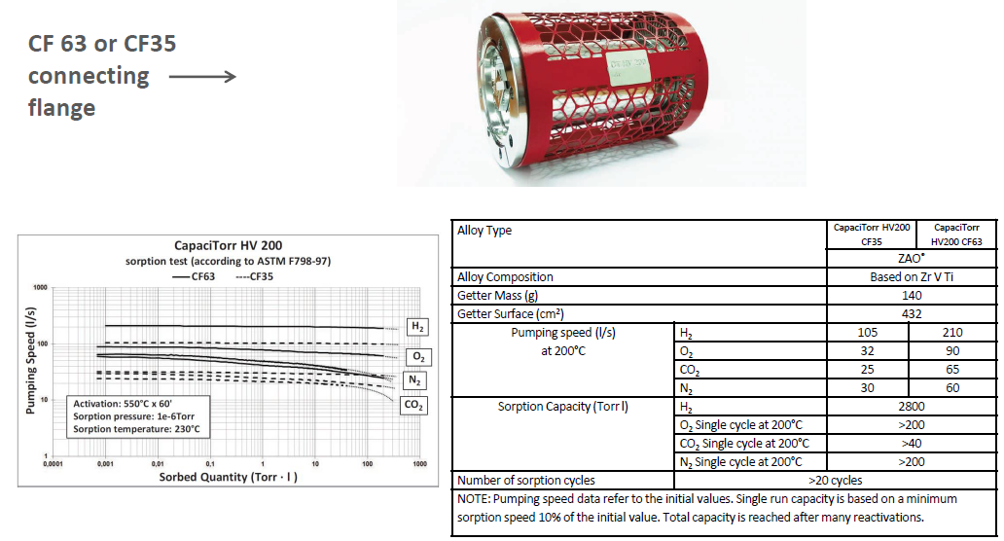
Capacitorr® HV200 (ZAO® sintered getter alloy)
Pumping speed compatible with turbo, regeneration can be done without additional vacuum groups if needed
- The performances of the CapaciTorr HV pump is defined in terms of number of sorption cycles.
- Each cycle corresponds to 1 year of operation at ≈10⁻⁸ mbar.

Slide 23
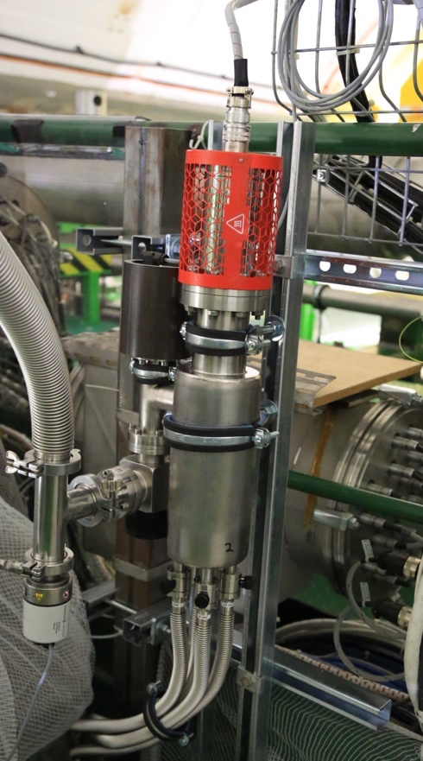
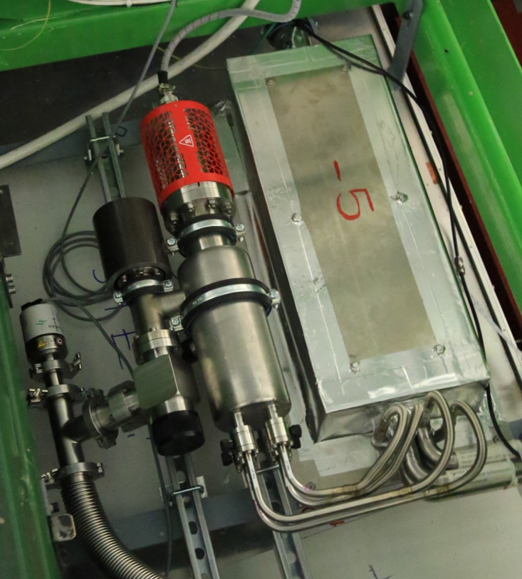
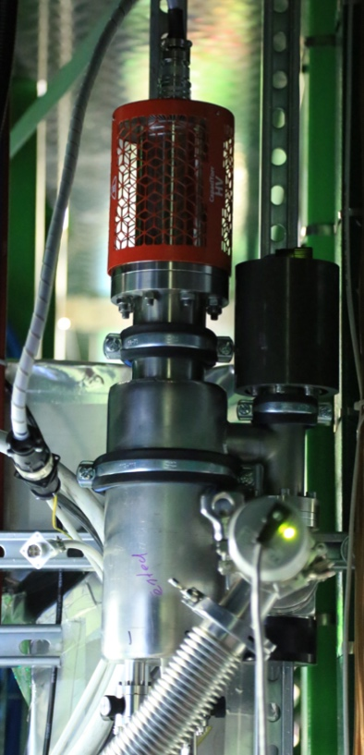
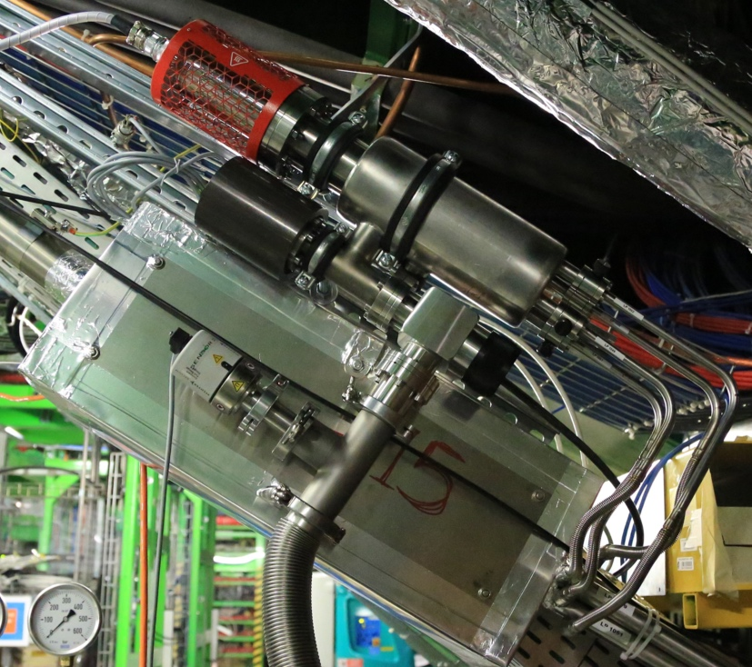
Getter pumps installed
Sector -15
Sector -6
Sector +5
Sector +14

Slide 24
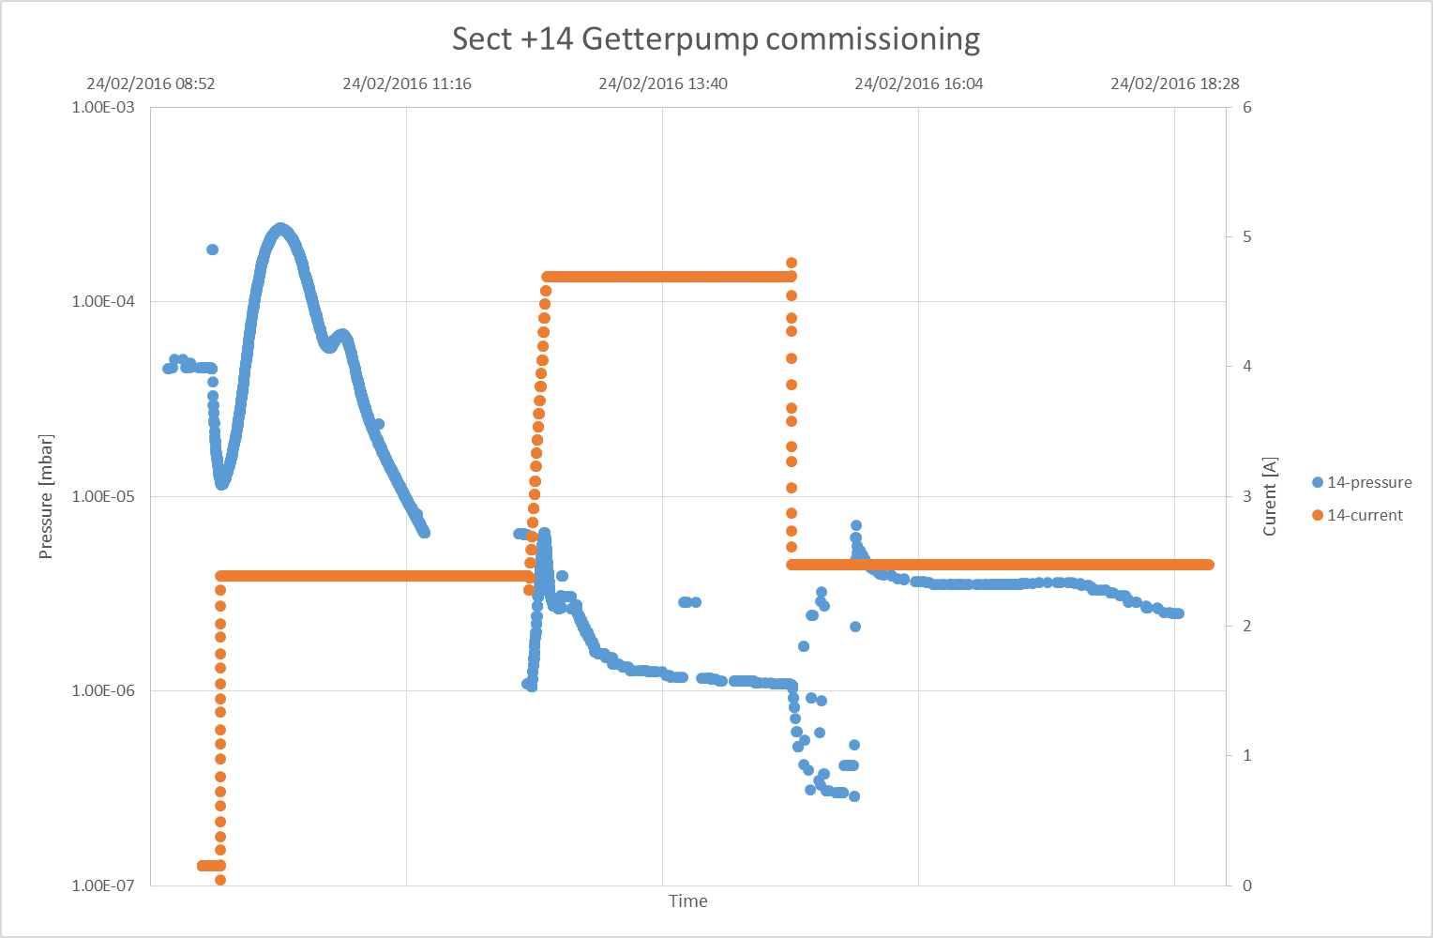
Getter pump start-up
Getter pump start-up procedure:
Turbo pump unit connected to the manifold
2h of getter pump conditioning (2.3A =230⁰C bulk temperature)
2h of getter pump activation (4.8A=500 ⁰C bulk temperature, flange and electrical connector stay at about 55⁰C)
Back to 230⁰C (2.3A)
Opening loop valves disconnection of the turbo pump unit (only getter pump pumping in the manifold)
2
3
4
1

Slide 25
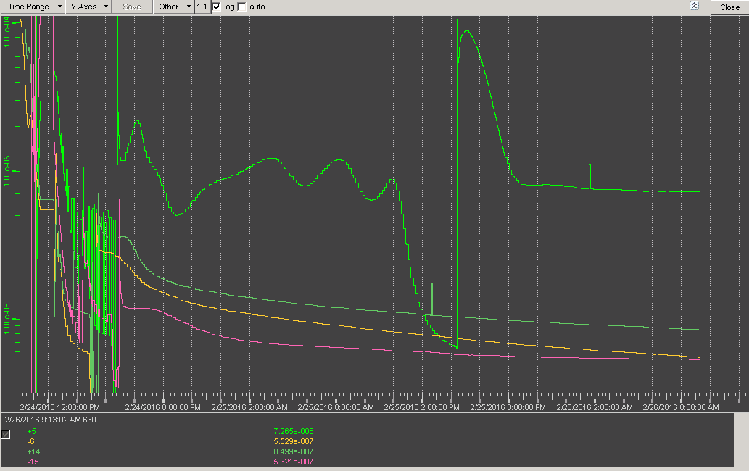

Vacuum values 2 days after Getter pump start-up
Issue on Sector +5 still present
Vacuum in sector +5
2

Slide 26
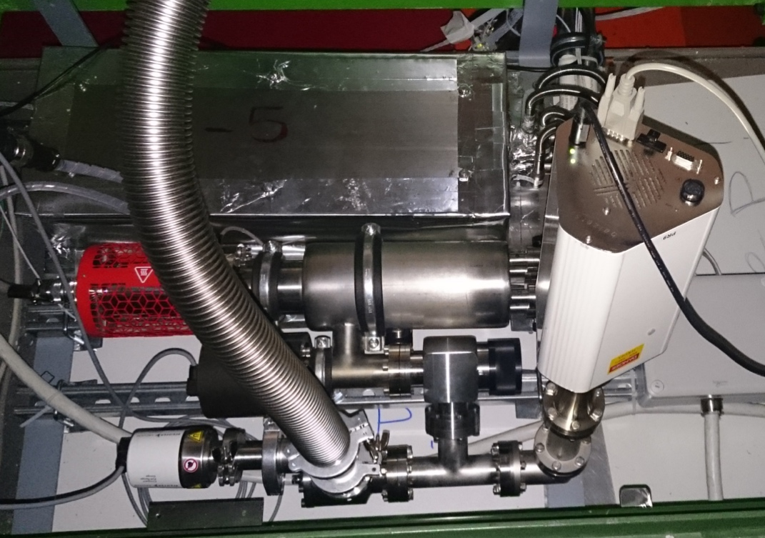
Residual Gas analysis on sector +5
With help of the team of TE-VSC-VSM, the gas pumped out of the vacuum jackets on sector +5 has been analysed with RGA

Slide 27
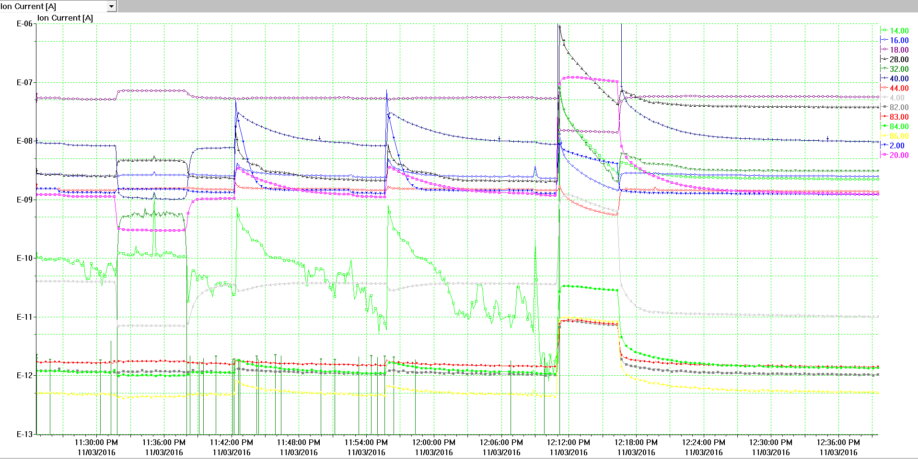
RGA tests on sector +5
Ar
Open 1054
N2
Open 1055
Close 1055
Open 1056
Close 1056
Pumping with turbo
O2+N
‘bad’ line 1054 ->clear sign of components which are present in air
(Ar, He, Krypton, N2, N, O2)
He
Kr

Slide 28
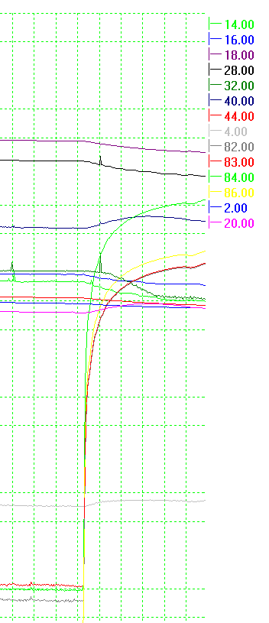
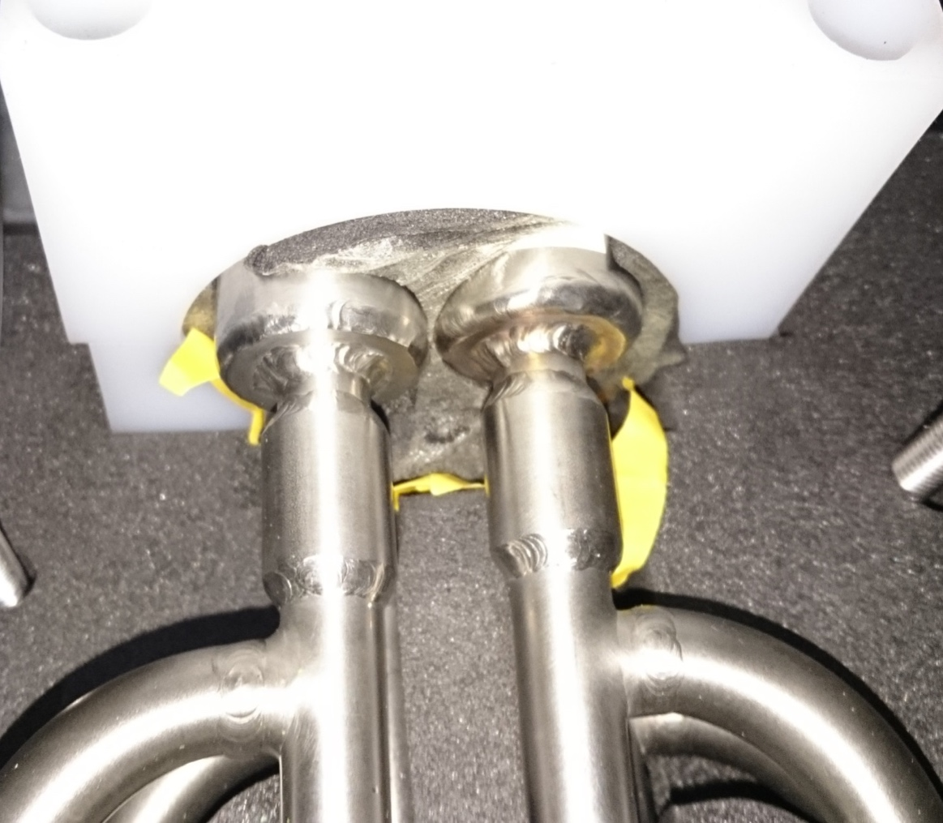
Residual gas in ‘bad’ line 1054 on sector +5 during flushing with krypton the outer connection box (closed to the getter pump manifold on top of X5)
-> Detection of krypton which means that there is an external leak.

Slide 29
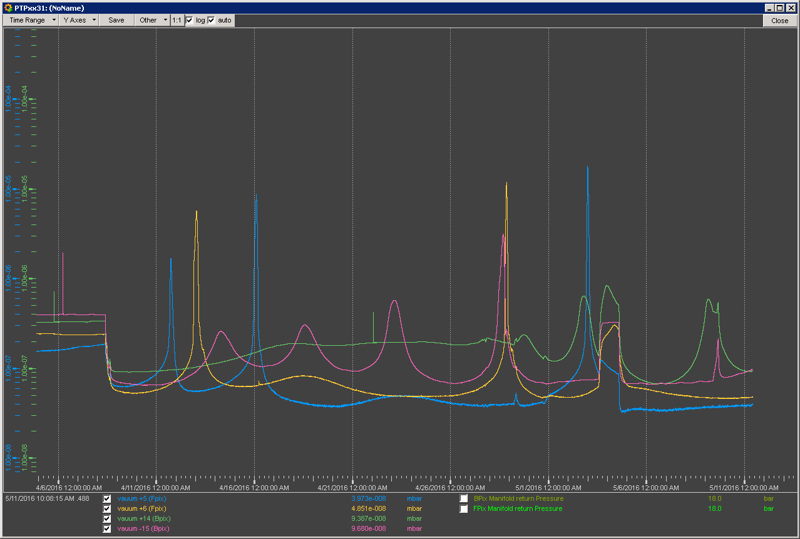
Vacuum performances with getter pumps installed
Since April 8th : CO2 flow @ -23/-30 C
All pressures measurements <<10-5 mbar (even when spikes)
2E10-4 mbar
CO2 to -23 ͦC
CO2 from 20 ͦC to -30 ͦC
10-7 mbar
10-8 mbar

Slide 30
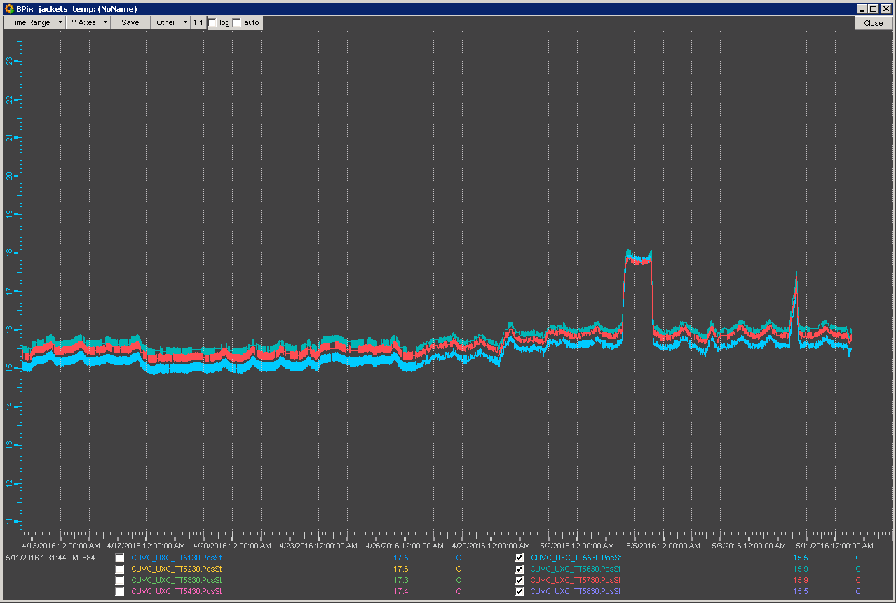
Temperature performances with getters operational
Average temperature (11.05.2016):
S+5: Taverage – 17.5 ͦC
S-6: Taverage – 18.7 ͦC
S-15: Taverage – 16.2 ͦC
S+14: Taverage – 18.4 ͦC
CO2 at 20 ͦC
Temperature
CO2 at -23 ͦC
CO2 at -30 ͦC
13 ͦC
Last 30 days

Slide 31
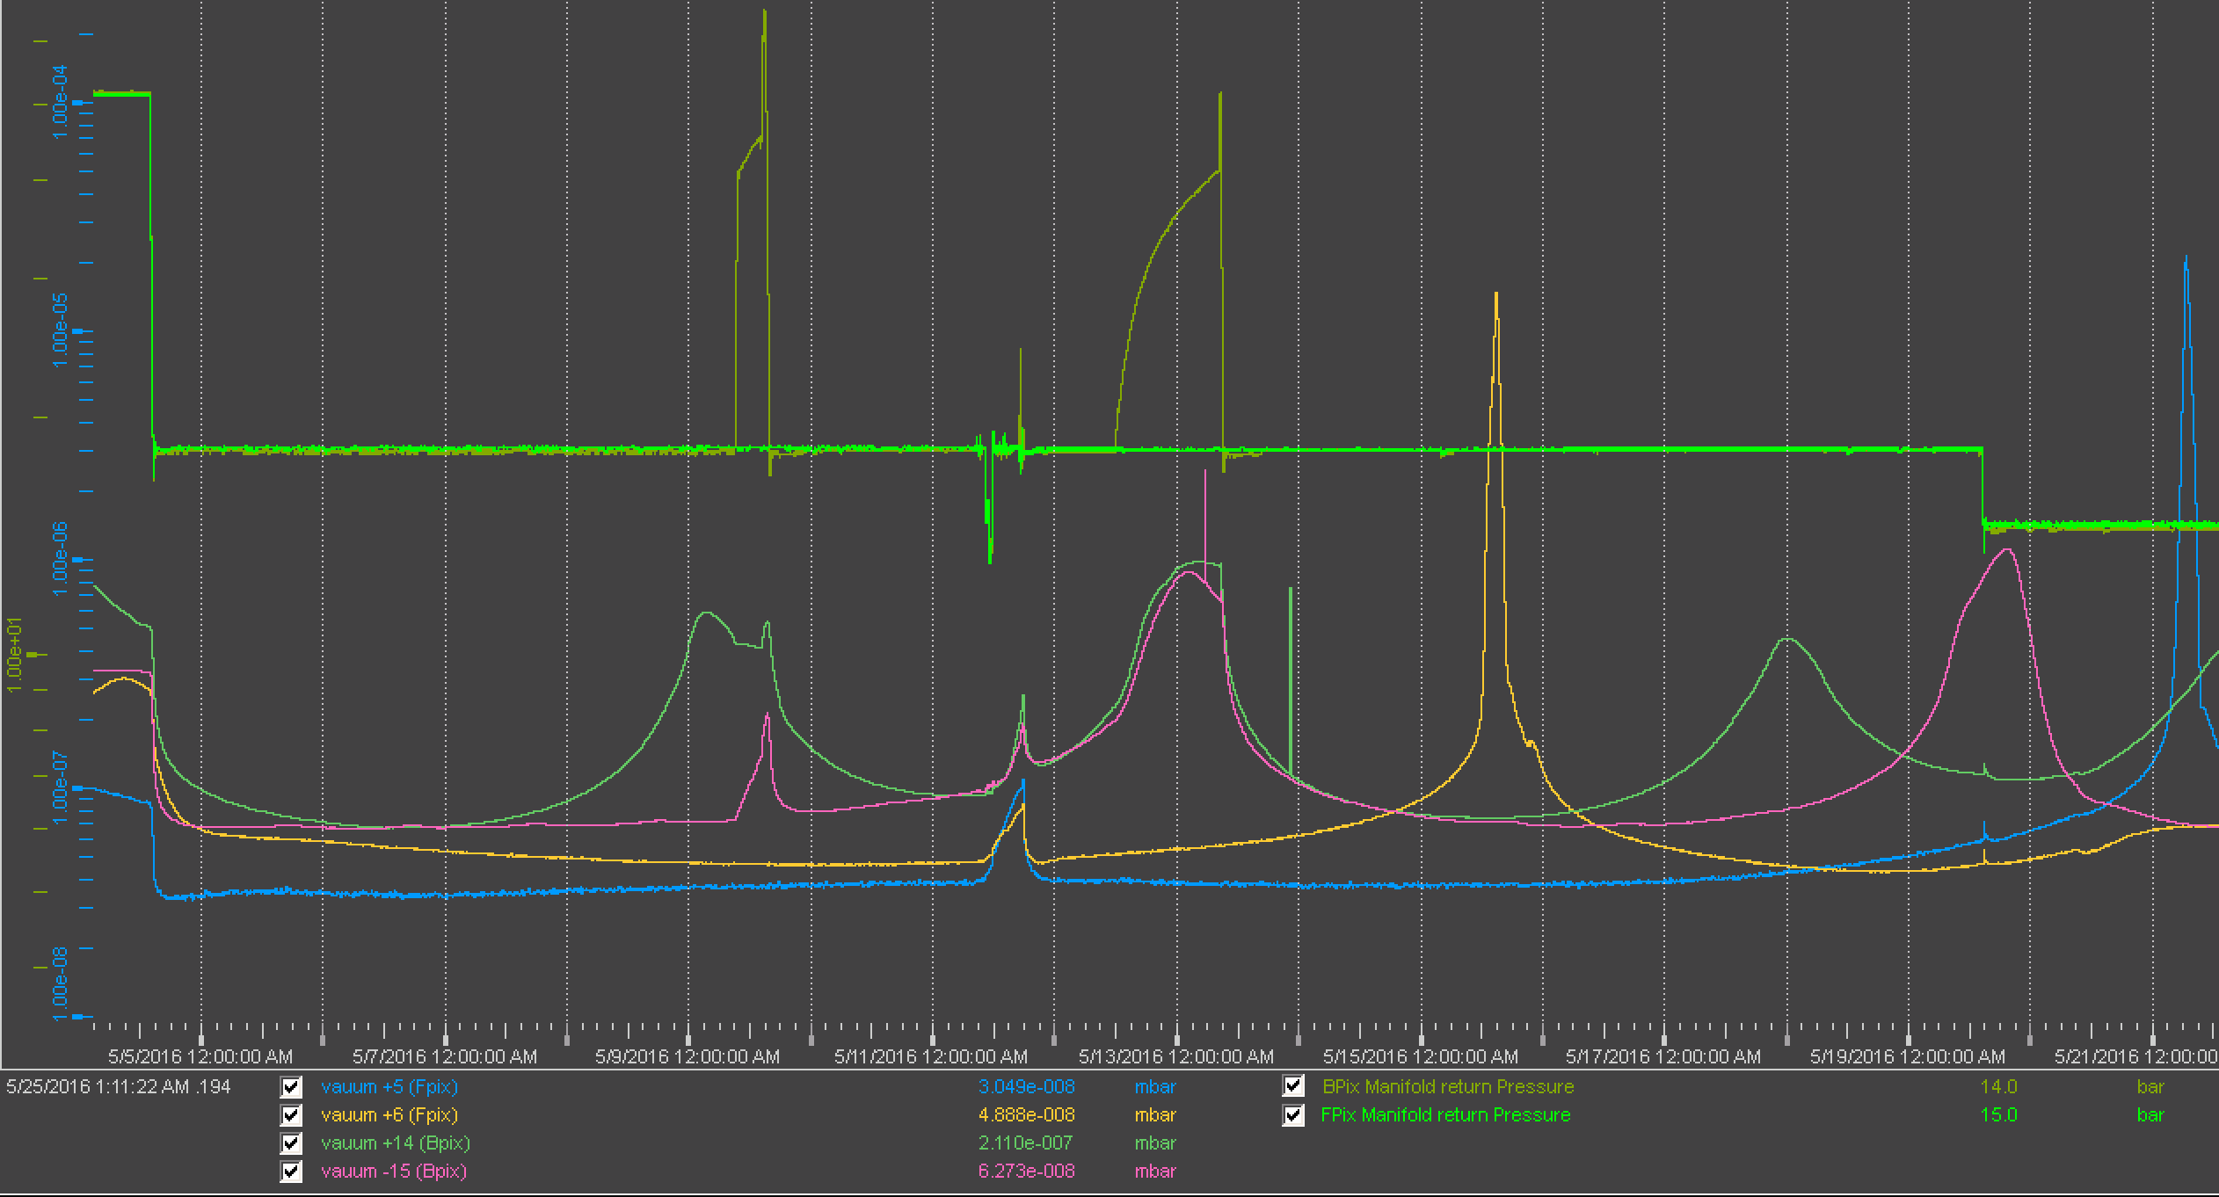
The retention test: can we operate without getter pumps?
Agreed with company: 23 weeks after installation of getter pumps, do a 400 hours “retention test” and verify if the pressure in all lines do get stable below 2*10-4 mbar. Test started on Friday the 20th @ 9 am – Is the pressure behavior going to be the same?

Slide 32
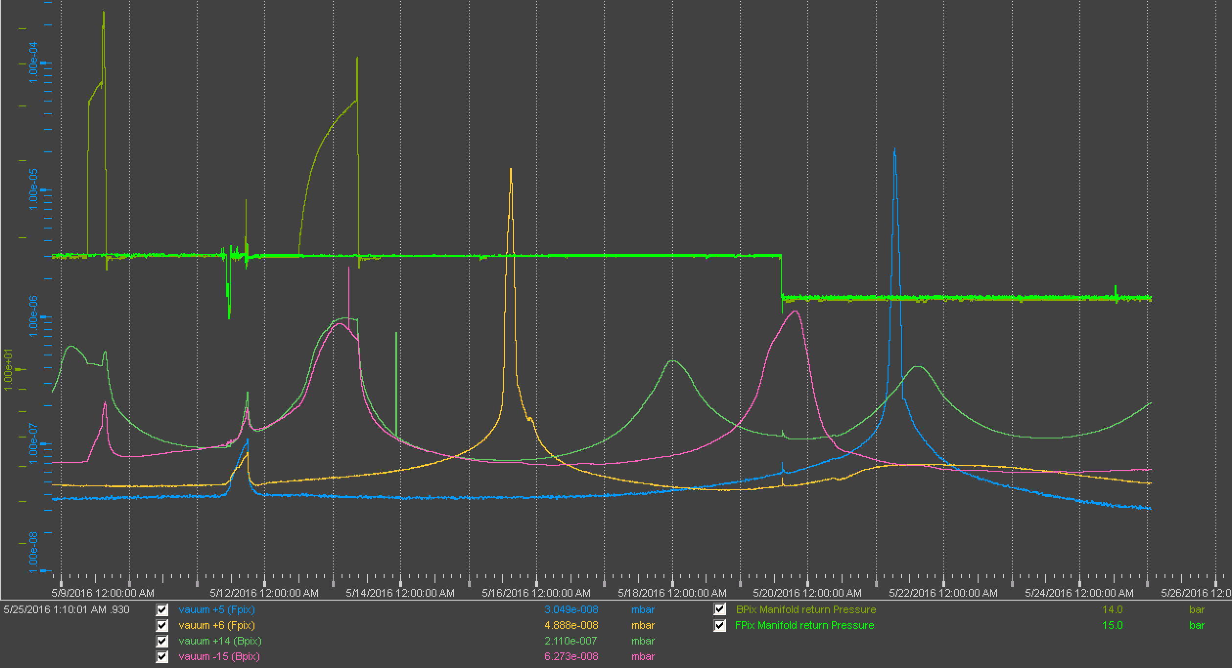
Retention test latest news
Start of retention test with CO₂ @ -30 C
Wed 25th, 1h12
Temperatures still perfectly stables, pressures behaving the same

Slide 33
CMS YB0 transfer line: outlook
With getter pumps on: ok for operation down to -30 C (78 days pumping in total sector +14, -15, -6; 34 days pumping at -30/-23 ͦC)
Acceptance tests started 20.05. for 400h (switch off the getter pumps and monitor the pressure in the vacuum jackets and temperature on transfer line surface)
  IF pressure in vacuum jacket < 2E10-4 mbar AND temperature on transfer line surface > 13 ͦC with CO2 circulating at -30 ͦC
    No getter pump needed (keep as ‘backup’)
  IF pressure in vacuum jacket > 2E10-4 mbar OR temperature on transfer line surface < 13 ͦC with CO2 circulating at -30 ͦC
    Getter pump needed (further test in order to estimate the frequency of regeneration)
After acceptance test, regeneration of all getter pumps during TS1/2016
SAES preliminary estimation of regeneration frequency is about 1 year

Slide 34
Summary
Vacuum insulation is an interesting & known technology for transfer line insulation in cooling systems
Cooling ranges (>-50 C) are more critical than cryogenic ones because of no cryo-pumping effects helping
The static vacuum system of CMS transfer lines works perfectly for two sections out of three
The YB0 transfer lines of CMS have now become a “hybrid” system, with getter pumps working great!
Careful design & TESTING needed for “out of standard” sizes
  Permanent vacuum solution to be tested in advance & validated
  Pumped system can be used to push towards smaller dimensions
The choice of joining techniques would strongly influence maintenance & risks at later stage: think twice!

Slide 35
CREDITS
TE-VSC (Berthold Jenninger, Sophie Meunier, Cesar Vazquez Pelaez, Sergio Calatroni)
EP-DT-DI (Sylvain Ravat, Pascal Blanc)
TE-CRG (Johan Bremer)
SAES
DEMACO
CMS Integration Office

Slide 36
Further info

Slide 37
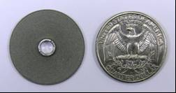
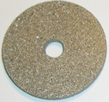
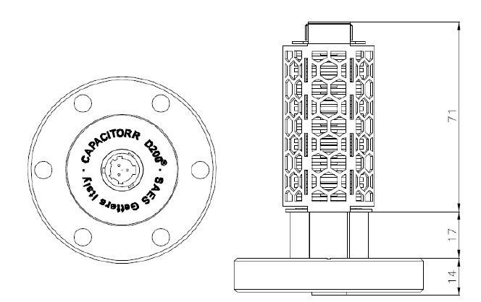
NEG Pumps
NEG pumps are based on one or more stacks of getter disks
1 sintered
getter disk
(ZAO: Ti-Zr-V-Al)
The sintering process is key to ensure speed, capacity and particles retention.
The heater wire is positioned through the middle hole

Slide 38
NEG pump features
NEG need to be heated under vacuum : “ACTIVATION”
a) Modest activation temperature : 400-500°C
b) short time : ≈ 60 minutes
After activation, the pump sorb gases at room temperature without requiring power (surface adsorption)
When the surface capacity is reached (or after a venting), the pump must be reactivated.
In presence of high gas load, the pump can be operated at 250-350°C This increases its efficiency to remove molecules since also the bulk getter capacity is used (surface adsorption + bulk diffusion).

Slide 39
NEG Activation Process
Activation:
Diffusion of surface protective layer
Diffusion phenomena:
Depend exponentially on the
temperature: D=D_{o}exp(-E/KT)
Depend on the square root of the time
Thus, the same effect can be obtained with the increase of temperature or with the increase of time
T (°C)
700
600
500
1 10 100
Time (min)

Slide 40
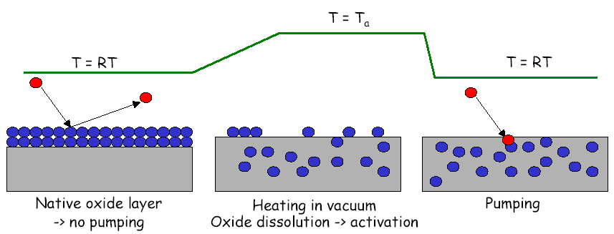
Getter activation

Slide 41
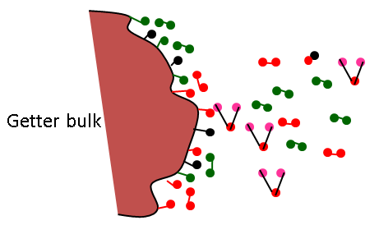
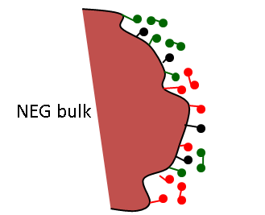
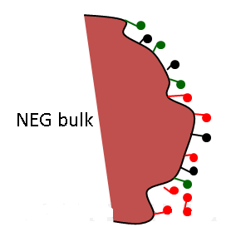
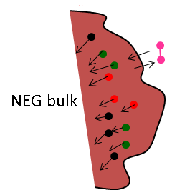
NEG Activation Process & Adsorption mechanisms
1) Before evacuation
2) After evacuation
Vacuum chamber
Vacuum chamber
3) After bake out at 100-200°C
4) During NEG activation (400-500°C for 1h)
Vacuum chamber
Vacuum chamber
(-carbides, nitrides and oxides are diffused into the bulk
- Hydrogen partially released)

Slide 42


Getter Activation Process & Adsorption mechanisms
6) H2O, CO, CO2, N2, O2 gas adsorption mechanism
5) After NEG activation
Vacuum chamber
Vacuum chamber
NEG bulk
Fresh material to sorb gases
NEG bulk
Molecules are dissociated and adsorbed into the getter surface
7) Hydrogen absorption
Vacuum chamber
Hydrogen is absorbed into the volume like liquid solution
NEG bulk

Slide 43
Capacitorr® HV200 (ZAO® sintered getter alloy)
- The performances of the CapaciTorr HV pump is defined in terms of number of sorption cycles.
- Each cycle corresponds to 1 year of operation at ≈10⁻⁸ mbar.

Slide 44

Capacitorr HV Temperature

Slide 45

Capacitorr HV200 vs other pumping technologies

