Slide 1




Magnet Temperature Measurement LHC
Máté Patalenszki
Electronics engineering students @
University of Debrecen
Balázs Nagy
NI Big Physics Summit @ CERN Conference 2016

Slide 2
The Team
Ádám Papp
Balázs Nagy
Máté Patalenszki
Undergraduate Electronics Engineering Students
Kornél Sarvajcz
László Kazup
PhD Students
Angéla Váradiné Szarka Dr
Acc Professor at Dept. of Electrical and Electronic Engineering
Márta Bajkó
Leader of SM18, CERN
Maryline Charrondiere
Technician at SM18, CERN

Slide 3
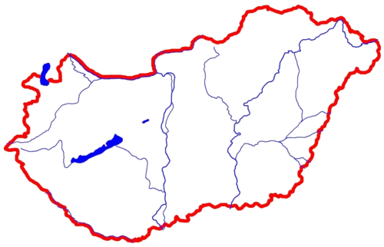


University of Debrecen
LabVIEW Academy Institution

Slide 4
EuCARD-2
Enhanced European Coordination for Accelerator Research & Development
13 Work Packages
MagNET@CERN

Slide 5
SM18 – Cryogenic Test Facility
Testing superconducting magnets & instrumentation
10 test benches in horizontal or vertical position
Test on 1.9°K using up to 20kA current
Serial and prototype testing

Slide 6





Testing Superconducting Magnets
Temperature measurement
from ambient down to 1.9K
LHC Superconducting Magnet
Signal Conditioner for Each Sensor
Up to 20 sensors to measure
0.5% accuracy in the whole measurement range
Outputs of Each Signal Conditioner
Notes:
Let’s talk about testing superconducting magnets. Superconductors works at 1.9K, so it’s very important to keep them at this temperature because a little increase can cause quench that means the

Slide 7


Aim of the Project
Switching Level
One Signal Conditioner
of Each Type
Up to 20 sensors to measure
0.5% accuracy in the whole measurement range
Outputs of Each
Signal Conditioner

Slide 8
Challenges
Accuracy: 0.5% in the whole measurement range
3 different measurements on each sensors:
- CERN signal conditioners
- NI DMM 4 wire measurement
- Direct resistance mesurement between each 2 wires
Compact & mobile instrument

Slide 9





NI Hardware - Requirements
Voltage, 4 wire resistance measurement
Control of the switching level
Mobility
Data storage
Wireless communication

Slide 10
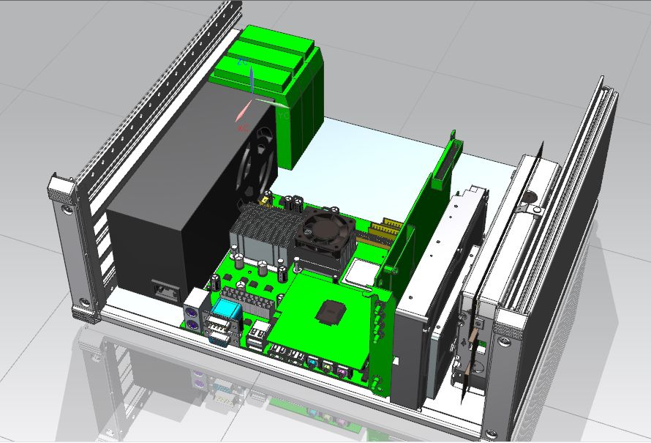
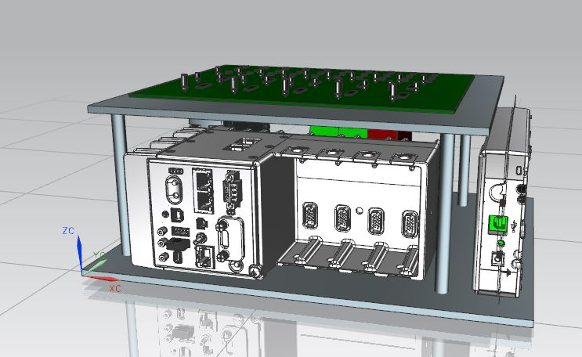
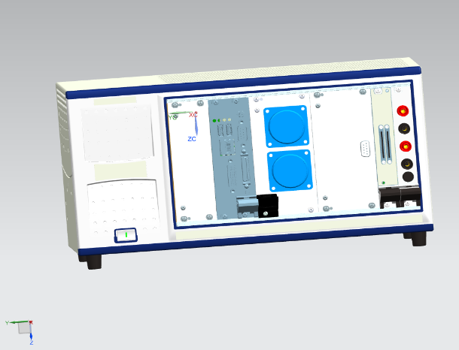
NI Hardware - Configurations
PCIe
PC is included in the chassis
DAQ card
cDAQ
Controller
AI module
PXI
Controller
DMM card
DIO module
DMM (USB)
DAQ card
DMM card

Slide 11


Block Diagram of the Instrument
Switching Level
One Signal Conditioner
of Each Type
DMM
DAQ
Outputs of Each Signal Conditioner

Slide 12
Hardware – The Switching Level
Connecting sensor wires to the appropriate signal conditioner
Providing direct measurement for verification
Not exceeding 0.2% relative measurement error

Slide 13
Switching Level - Specifications
Because of circuit considerations we decided to use analog switches
Final circuit based on the same specifications as NI PXI Modules
Switch caused realitve error <= 80 ppm

Slide 14
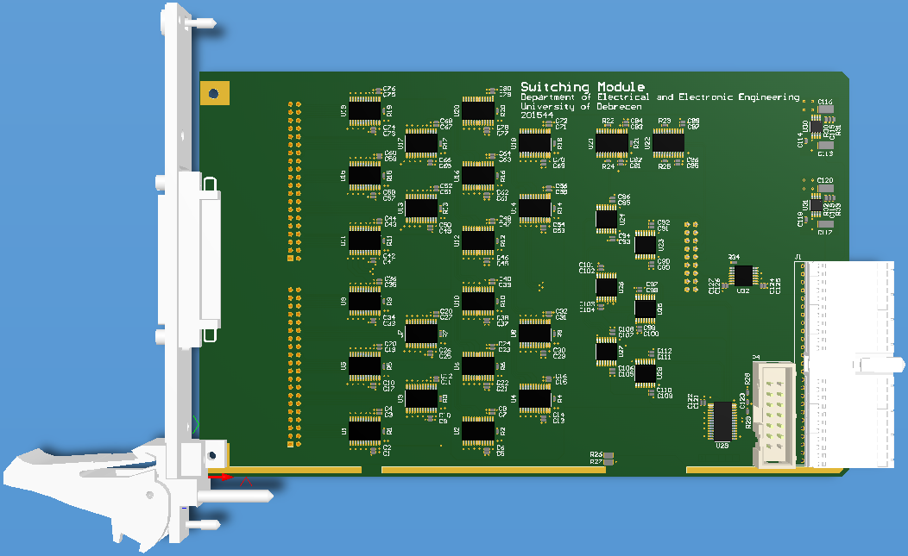
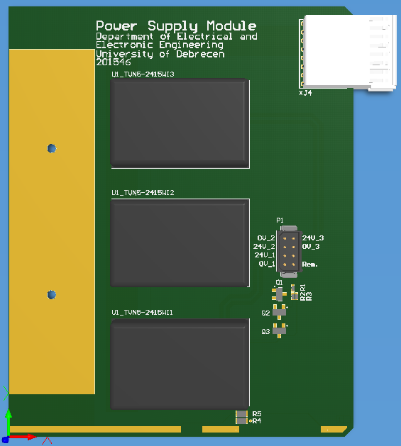
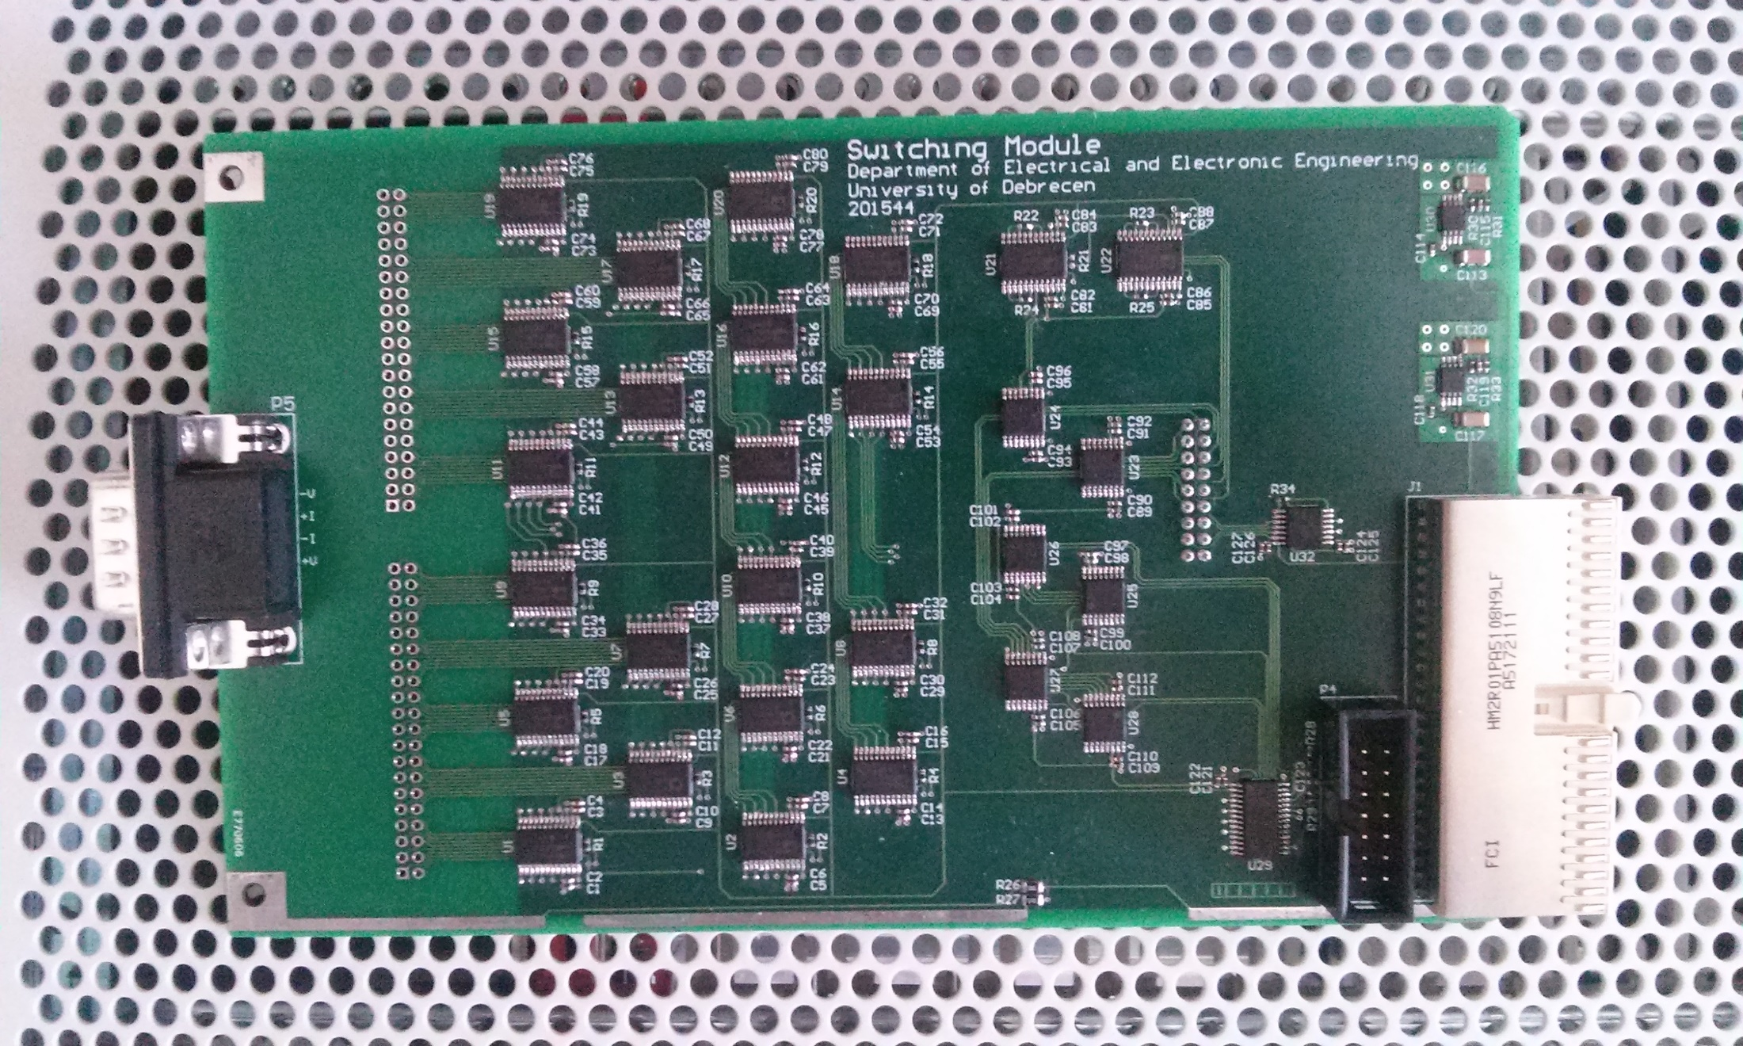
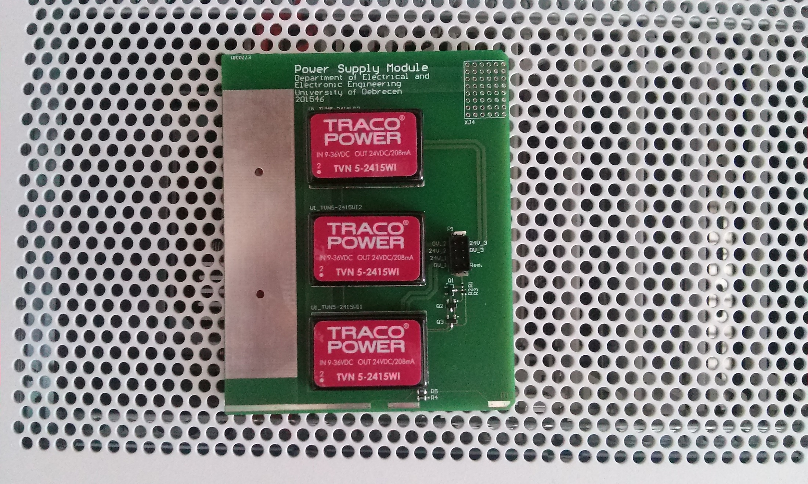
Switching Level - Realisation

Slide 15
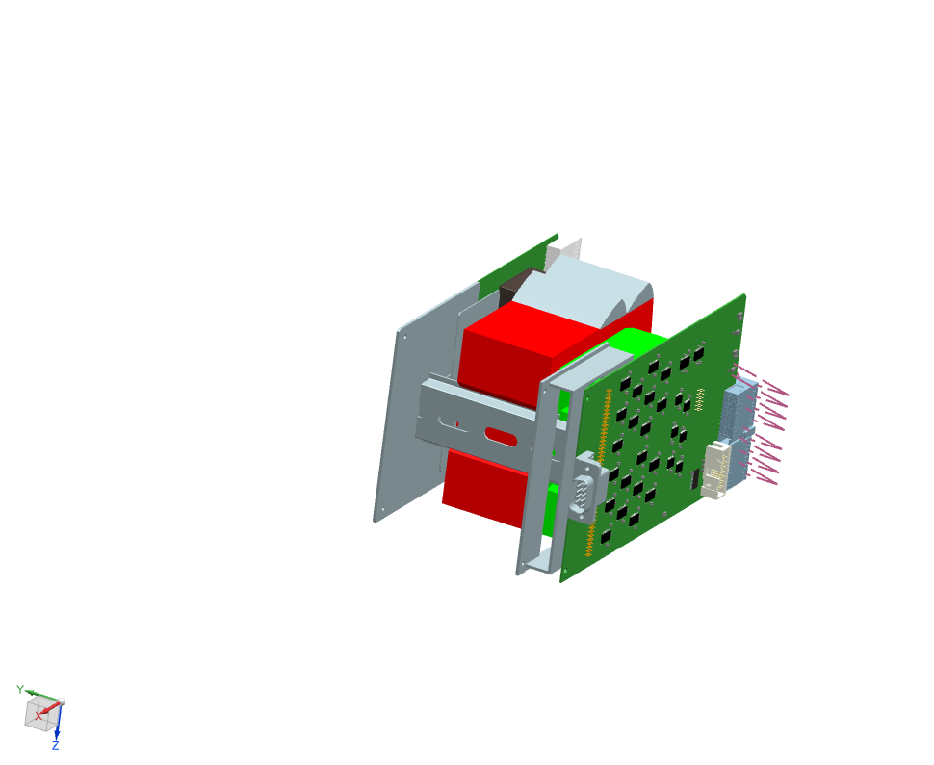
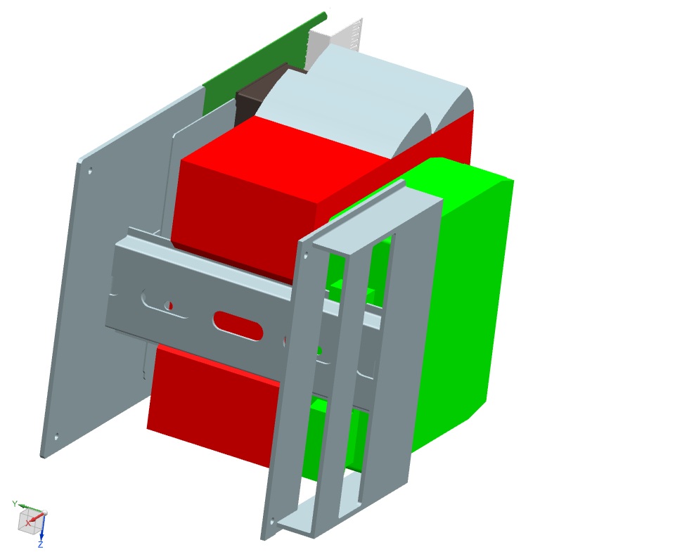
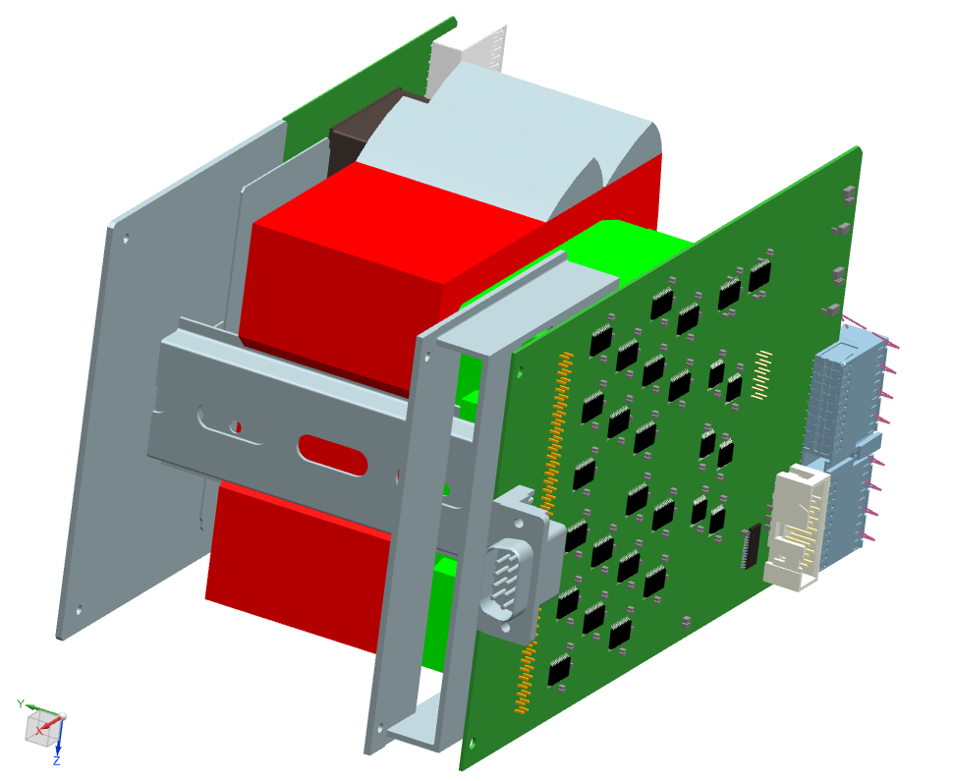
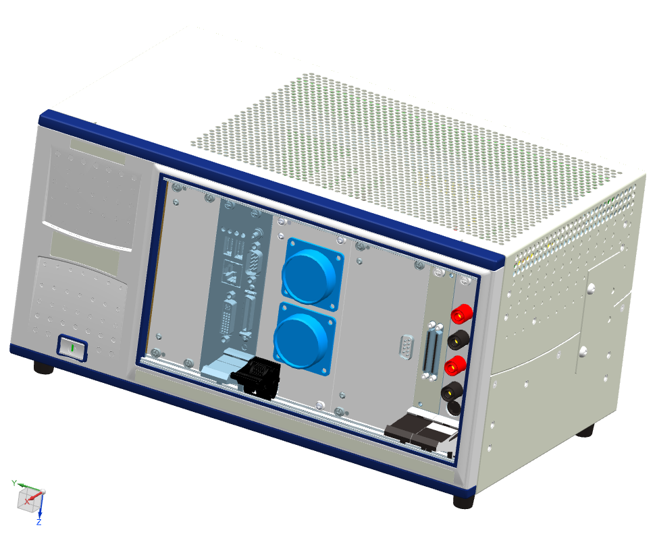
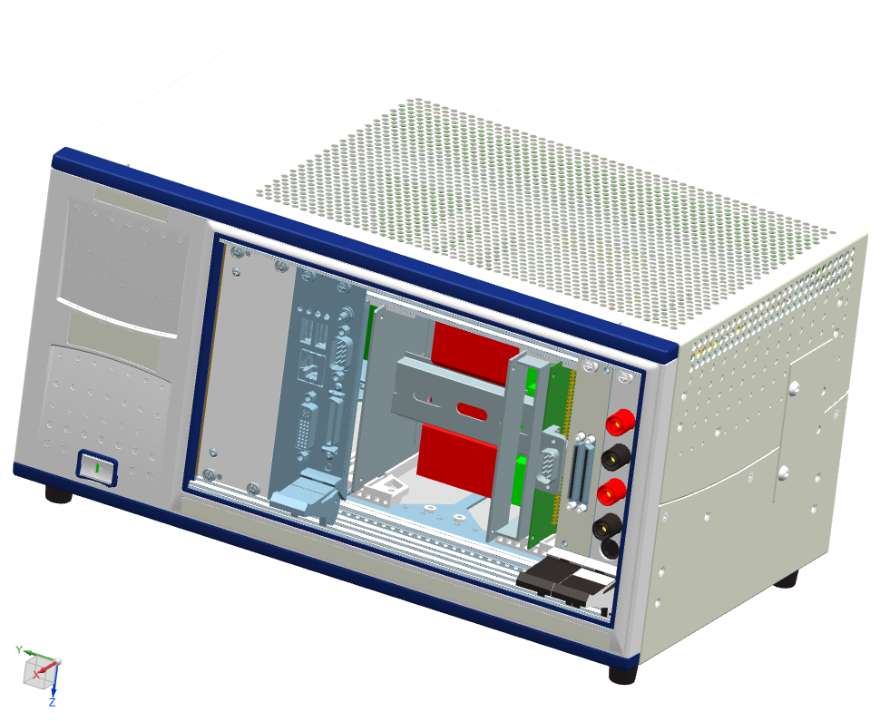
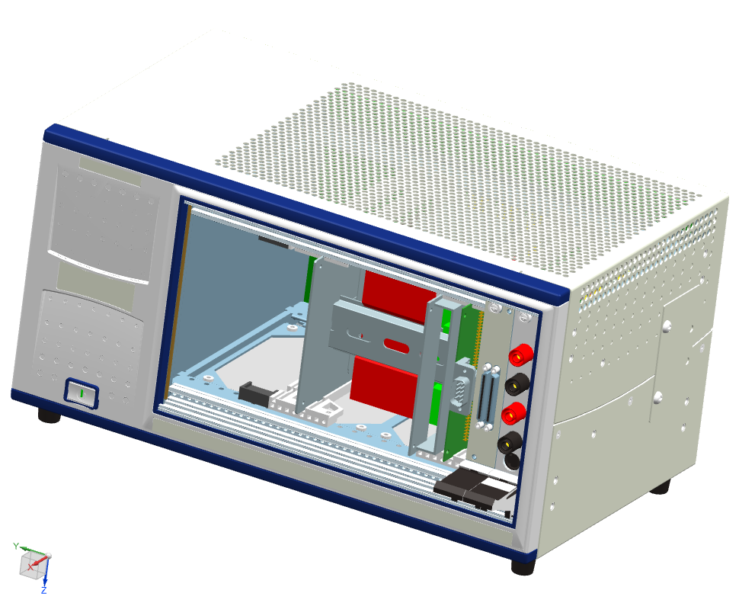
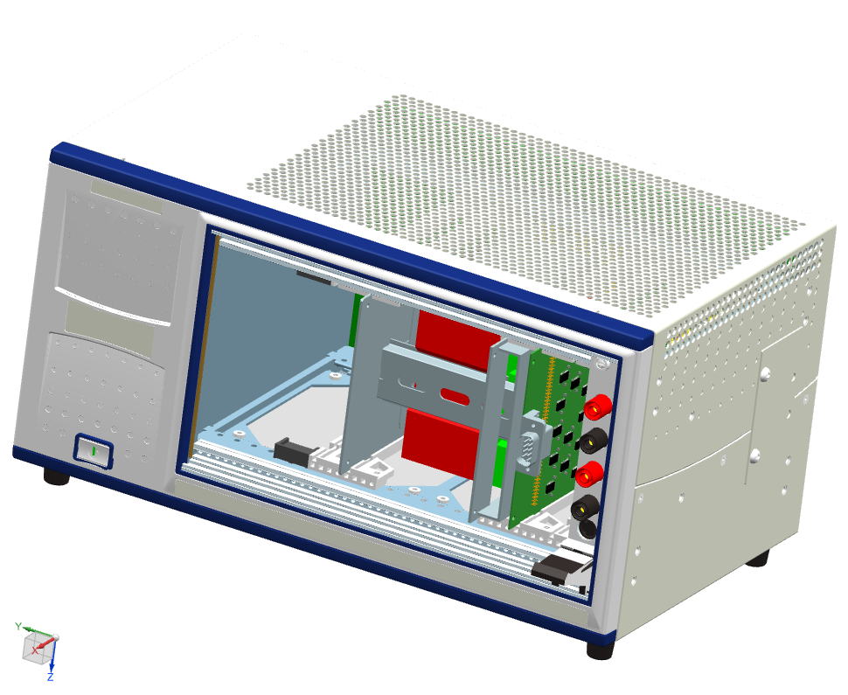
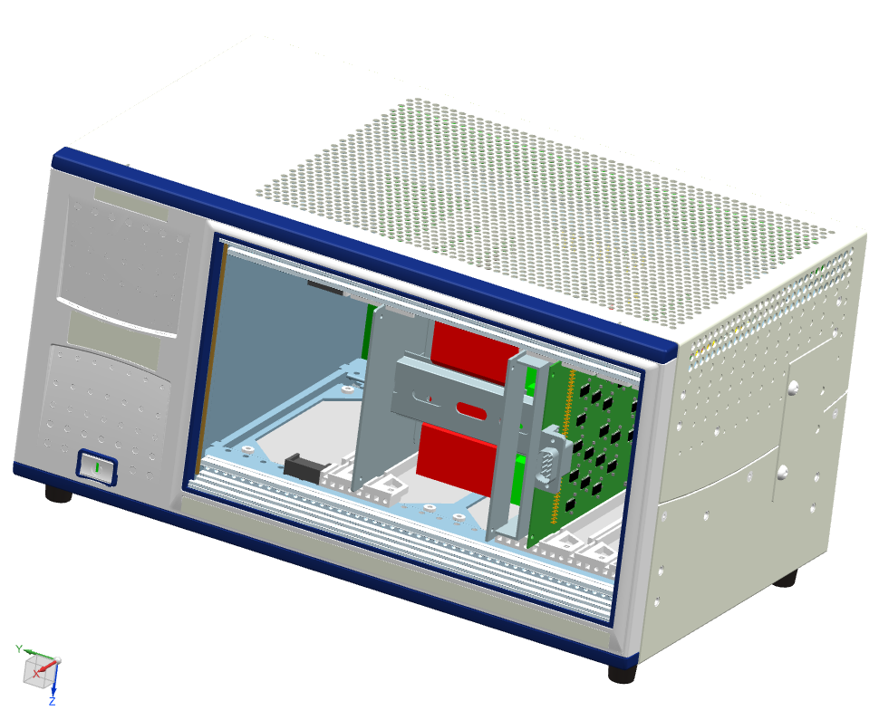
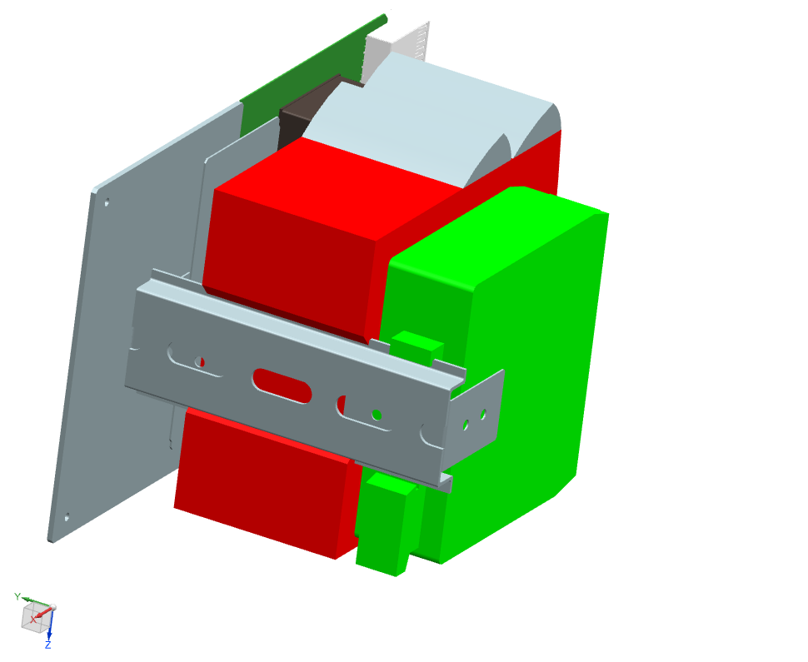
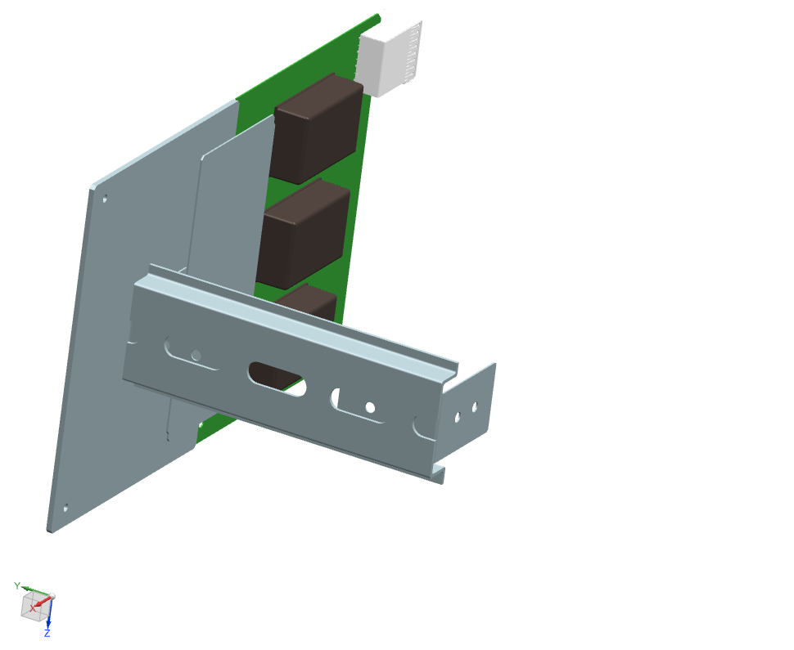
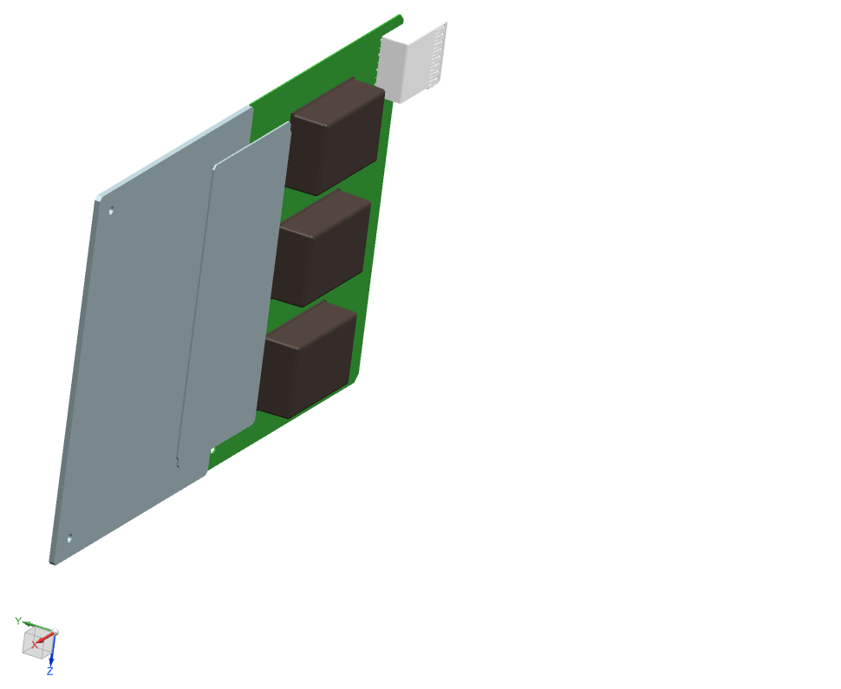
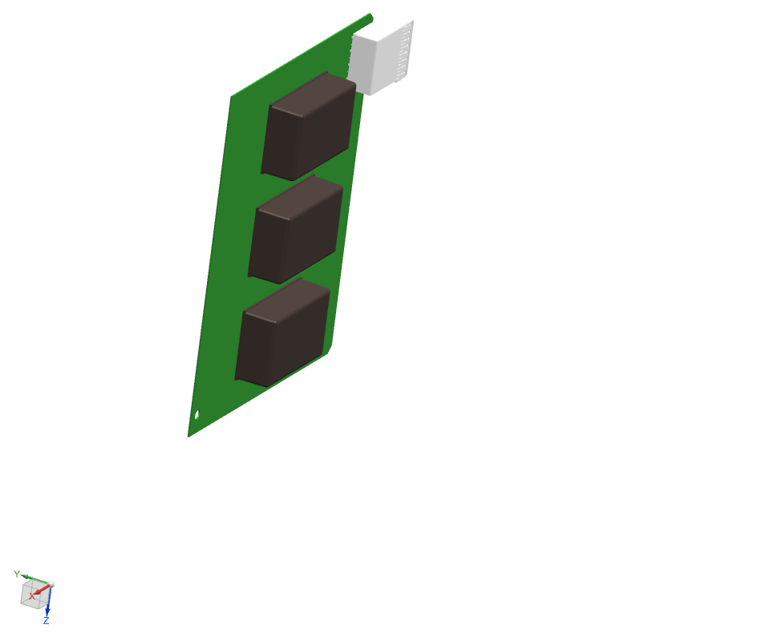
Instrument Integration

Slide 16

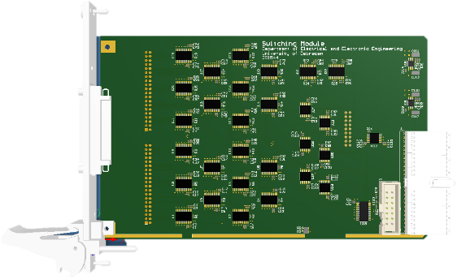
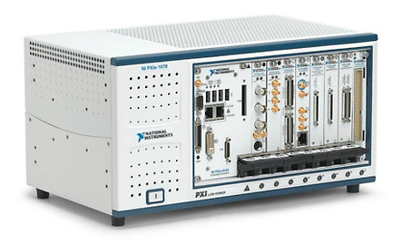
Software

Slide 17
Software
Producer/Consumer Design Pattern
User Interface Loop
Measurement Loop
Load/Save sensor data
Load/Save configuration
Show online the result
Control the switches
Make measurements
Make data conversion
Save data

Slide 18
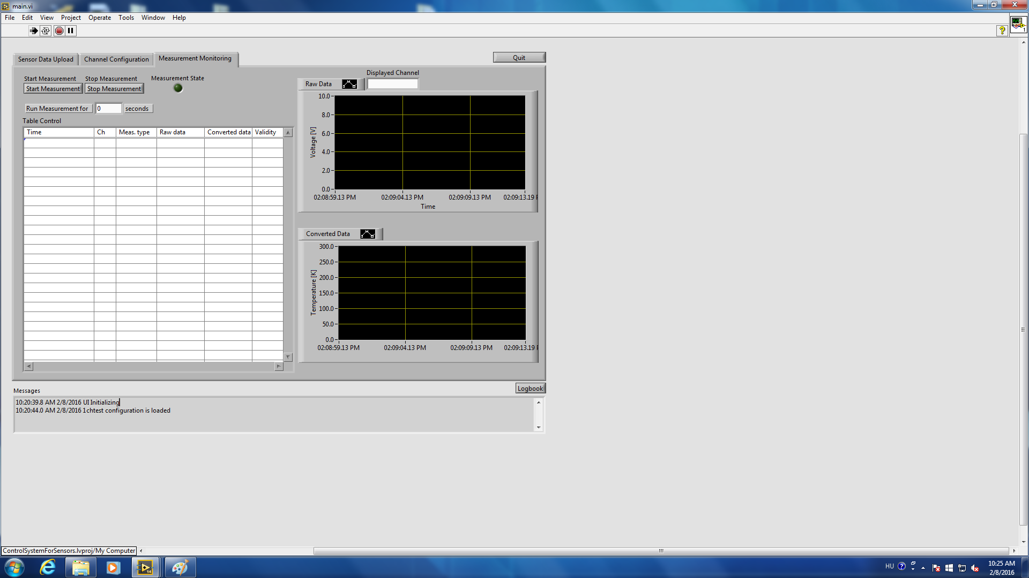
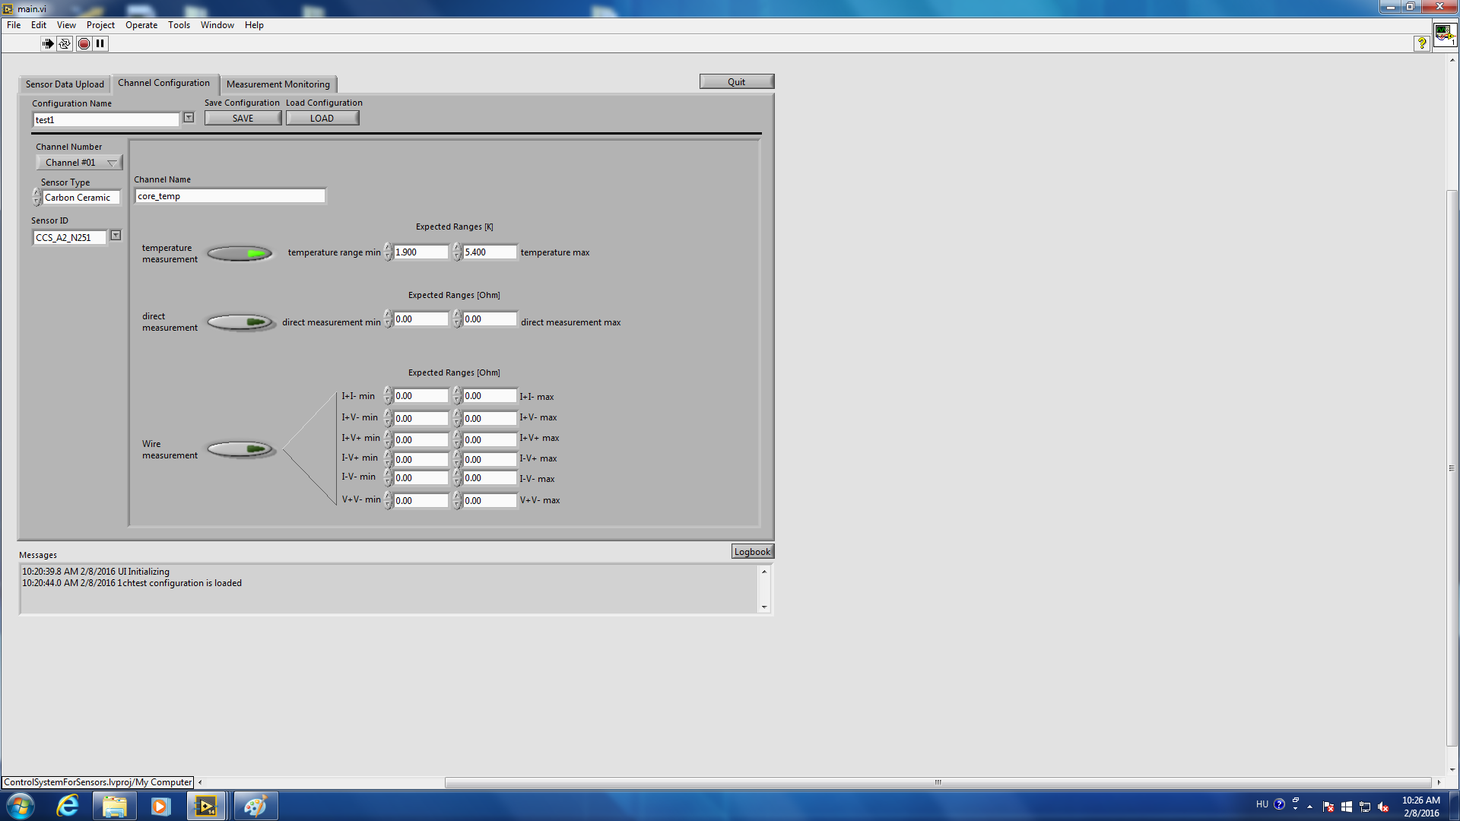
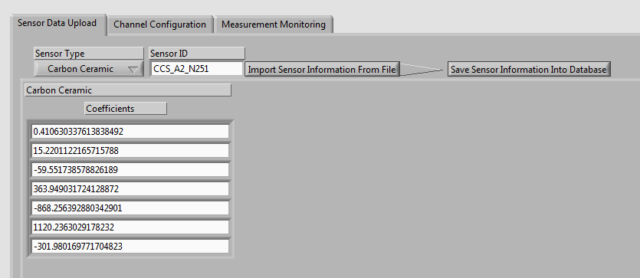
Software – User Interface
Measurement Monitoring
Channel Configuration
Sensor Data Upload

Slide 19
Software - Measurement
Initialize
(Create report file)
Measure
Convert
Between
Save
Save data to the result file
Show online the results
Voltage
Resistance
Temperature
Configure switches
Select the proper analog input or the DMM
Take measurement

Slide 20
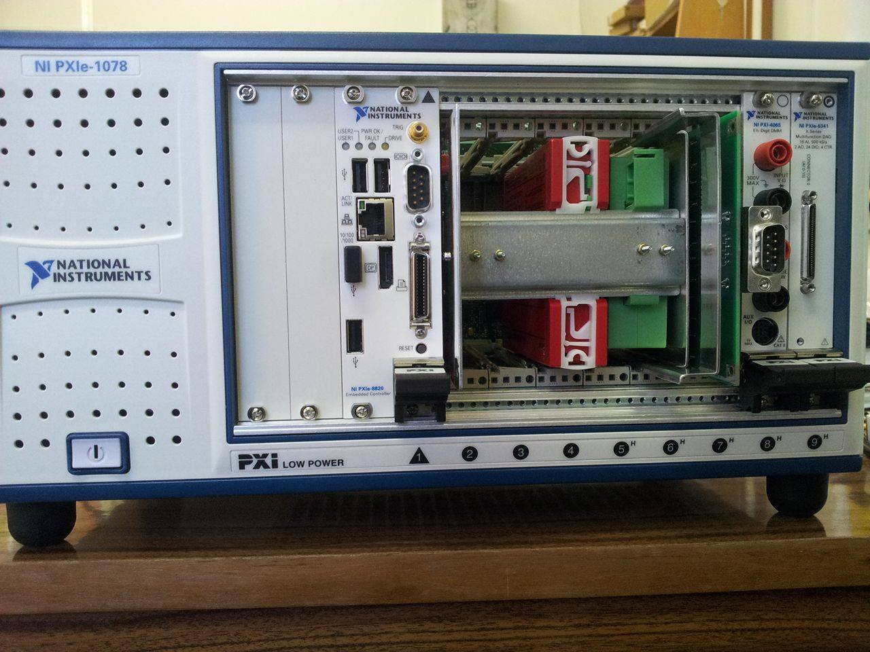
Summary

Slide 21
Acknowledgement
The research is part of the EuCARD-2 co-funded by the partners and the EC-Capacities-FP7 under Grant Agreement 312453.
Speakers would like to thank the cooperation possibility to CERN, and to express special thanks for contribution and help to Marta Bajko, Maryline Charrondiere, Maria de Fatima Gomez de la Cruz, Huber Raymond.
Also the team wishes to express their appreciation to NI Hungary for accepting and hosting this project in the Open Laboratory, and personal thanks to Botond Barabás who has been done his best to provide all the necessary hardware for research, development and tests.

Slide 22
Thank you for your attention

