Slide 1
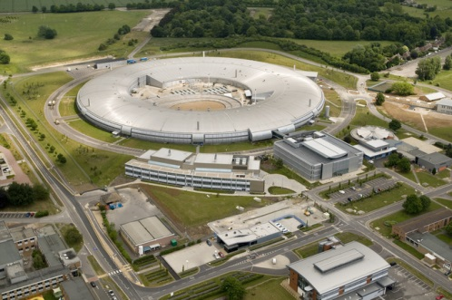
NI Big Physics Summit CERN
Medipix3
+
National Instruments
=
Merlin
A brief case study
Ian Horswell
Diamond Light Source
Detector Group
February 2016

Slide 2
Presentation Outline
Introduction to the Medipix chips
Readout Requirements
Readout options
Merlin System
Excalibur
From Single to Quad
Timepix3
Summary and Looking Forward

Slide 3

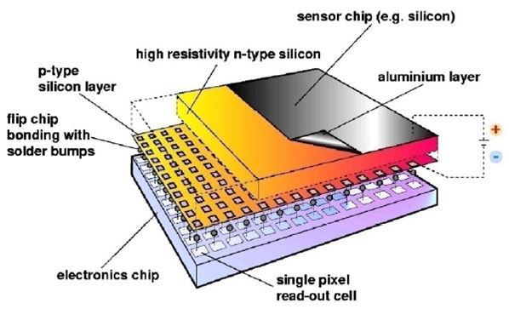
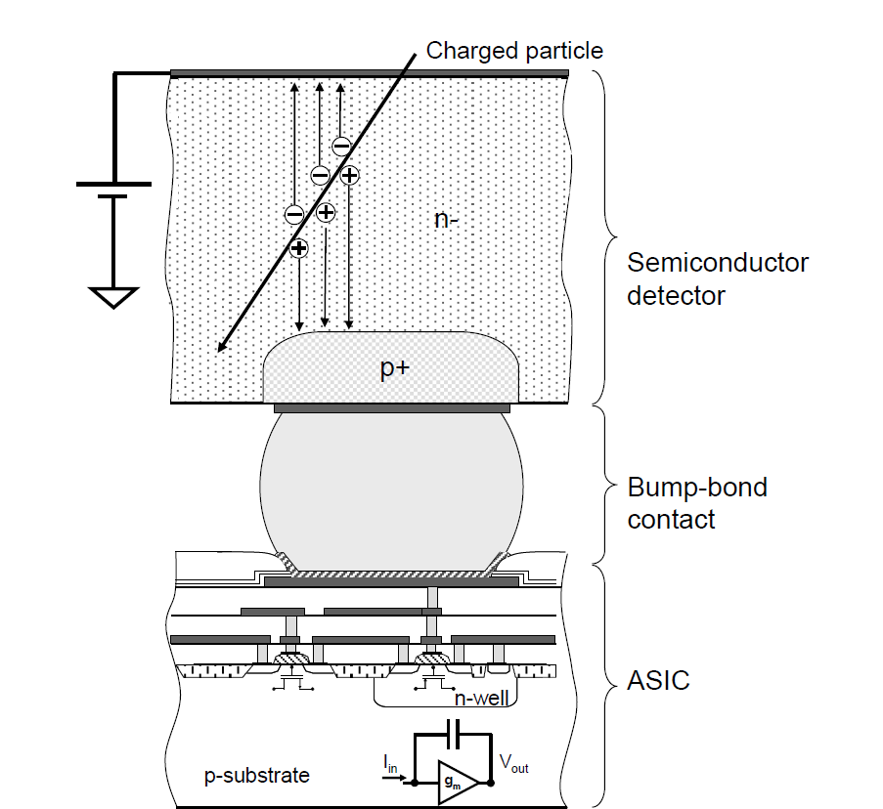
The Medipix Collaboration
Based in CERN, the Medipix3 Collaboration has about 22
International members.
Has designed at least 3 Imaging chips and 2 Time resolving.
The Medipix family are hybrid photon counting readout chips
Images R Ballabriga & CERN

Slide 4
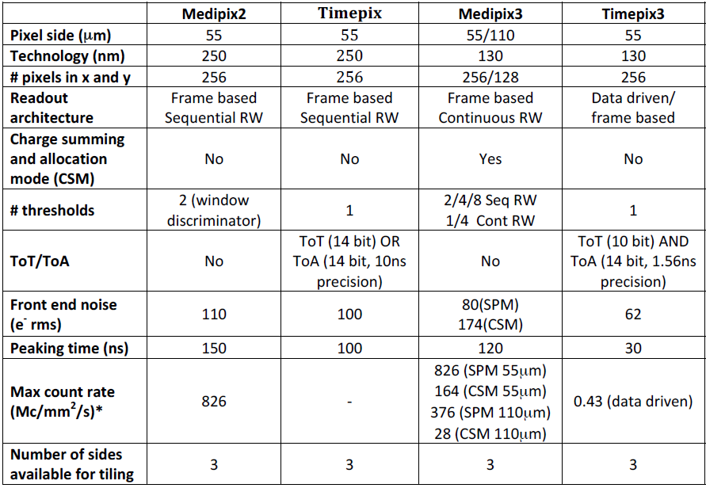
Characteristics of the Medipix Readout Chips

Slide 5
Medipix3 Readout Requirements
Provide all low and high voltages power supplies.
Enable chip to be equalised and run in all modes.
Use all 8 output data lines for maximum speed.
Achieve 100 frames/sec in 12bit mode continuously.
Achieve 1000 frames/sec for >1 sec, burst mode.
Provide test and diagnostic facilities to test the chip.
User Interface (Graphical?)

Slide 6
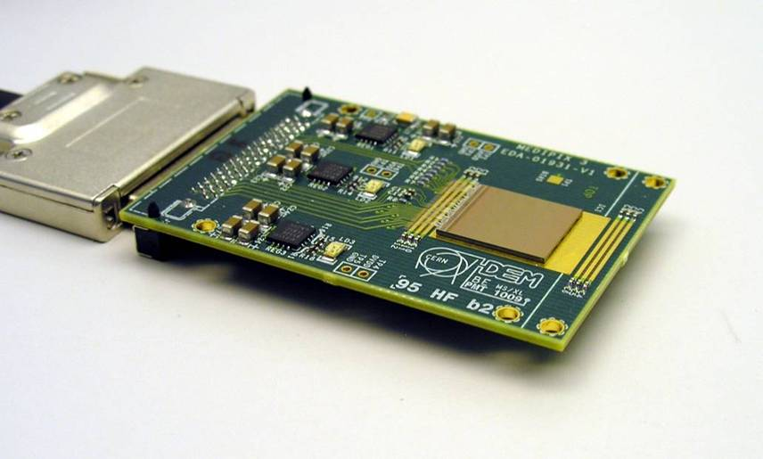
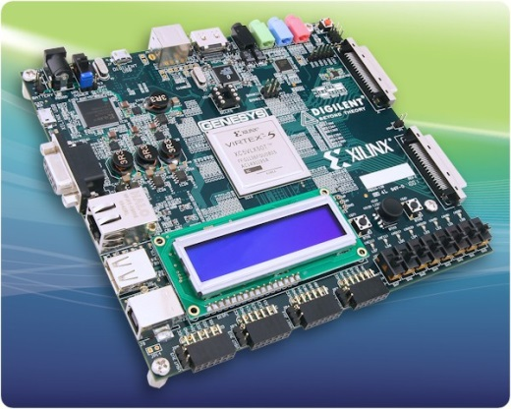
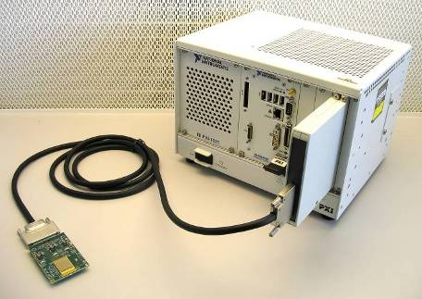
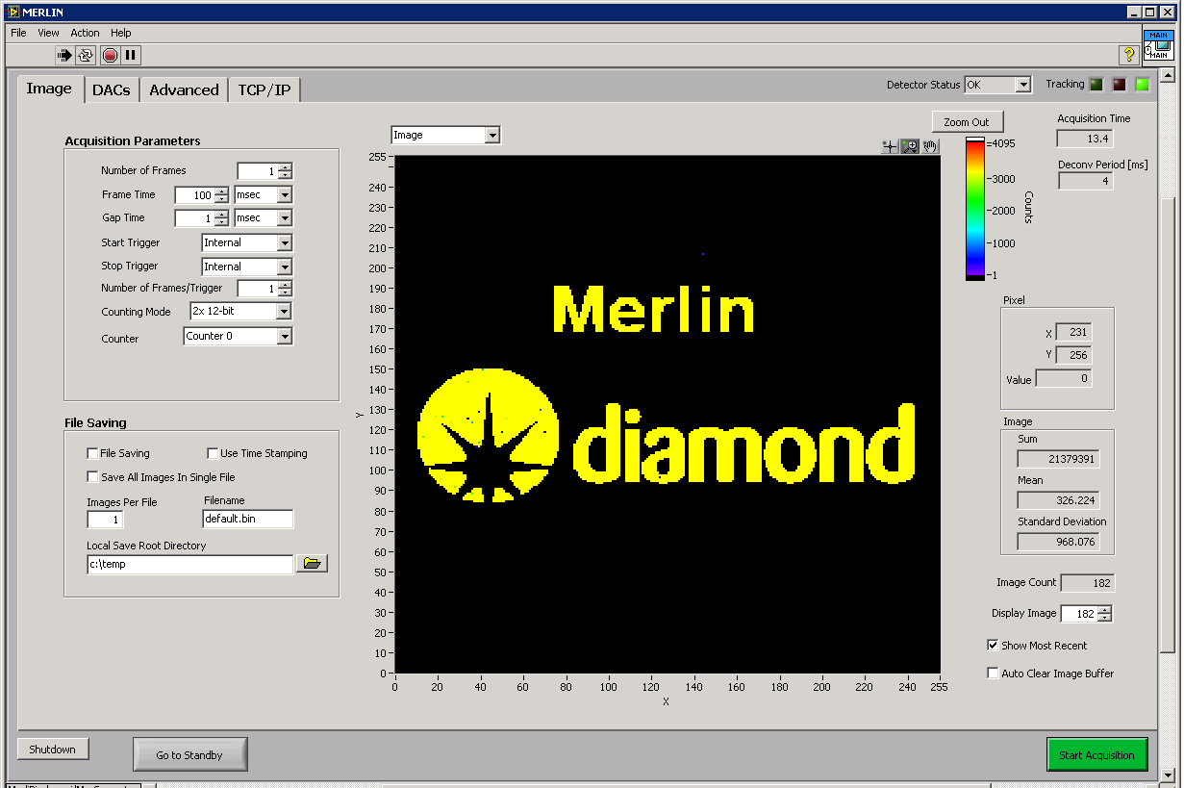
Medipix3 Readout Options
LV Power Supplies
HV Bias Supply
Services (ADC,DAC)
Enclosures
User Interface
+
+
OR
Ni FlexRIO

Slide 7
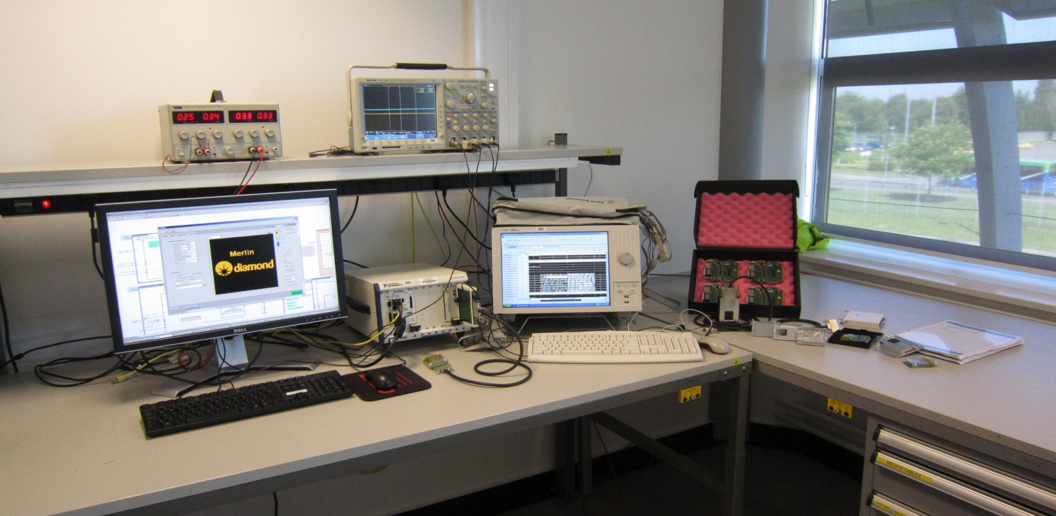
Merlin
Developed as a precursor / development tool for EXCALIBUR system
Versatile, high speed readout system for Medipix3
Seems to have significant value in its own right

Slide 8
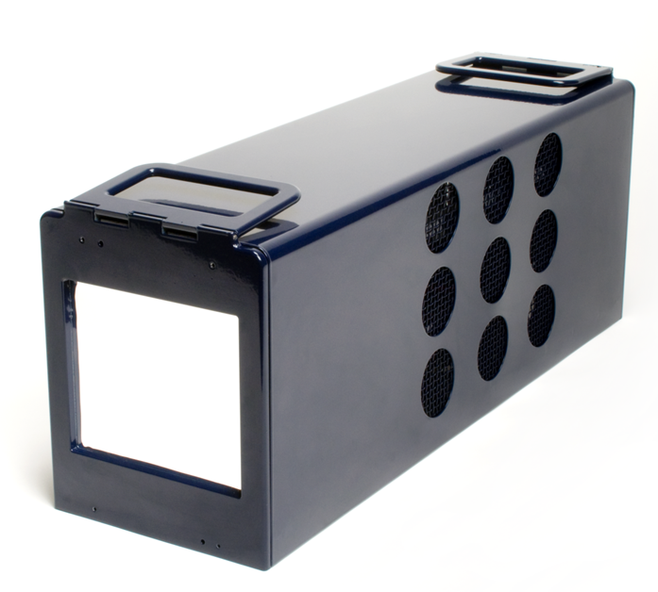
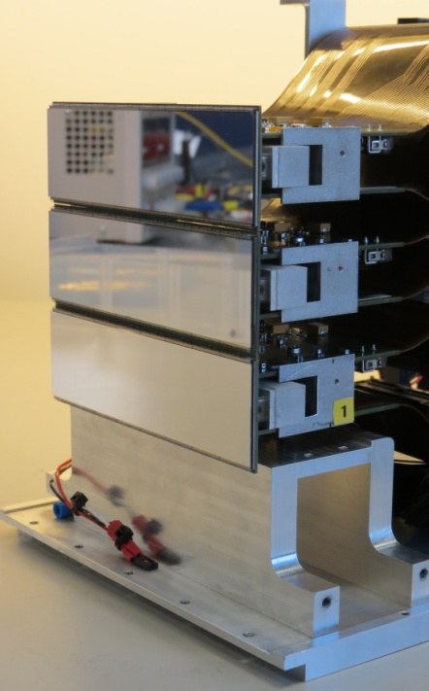
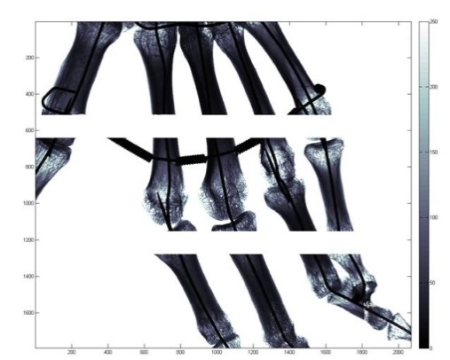
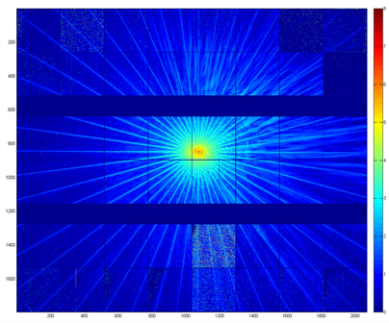
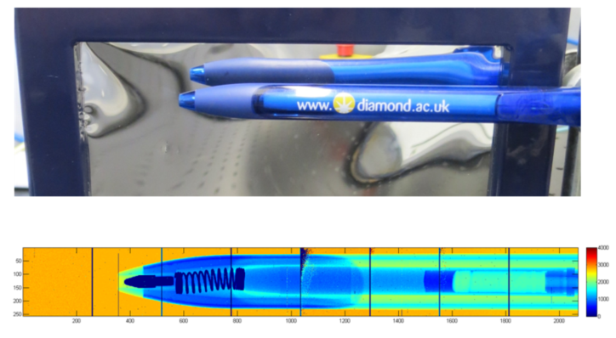

Excalibur
48 Medipix 3 chips in 3 modules of 8 X 2.
One of the largest monolithic silicon sensors ever made.
6 Virtex 5 FPGA readout cards.
In operation on Beamline I13

Slide 9
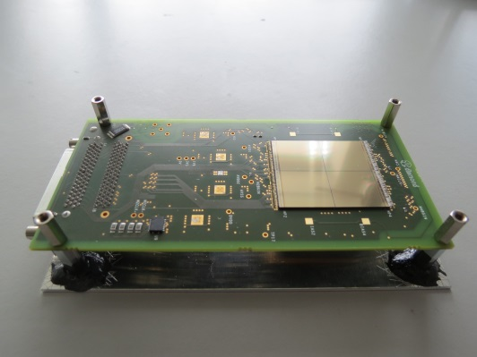
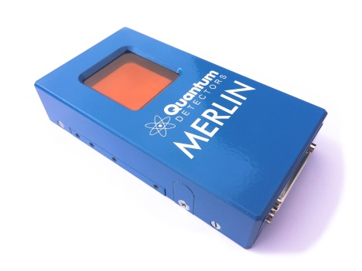
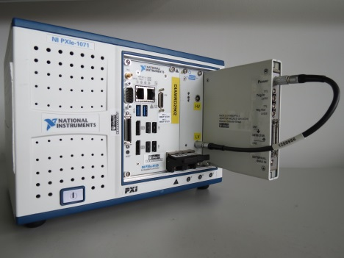
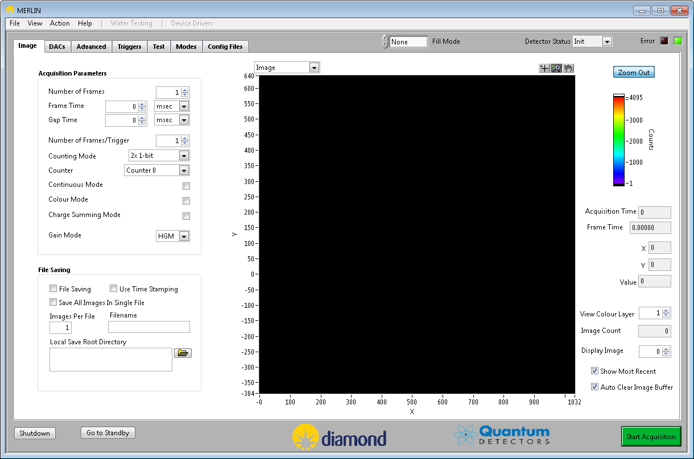
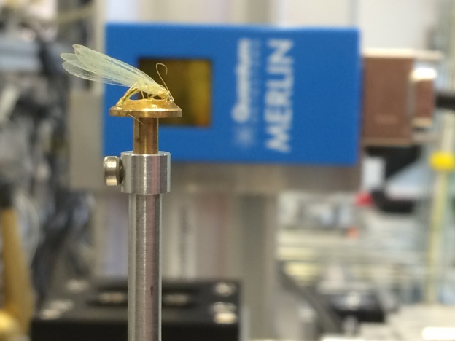
Merlin - From Single to Quad
Same readout performance required but from 4 chips.
Move from PXI chassis to PXIe.
Move from NI-7952R to NI-7962R, bigger FPGA and more memory.
New FlexRIO Adapter card, extra facilities and cables.
Images courtesy of R Goldbrough Quantum Detectors

Slide 10
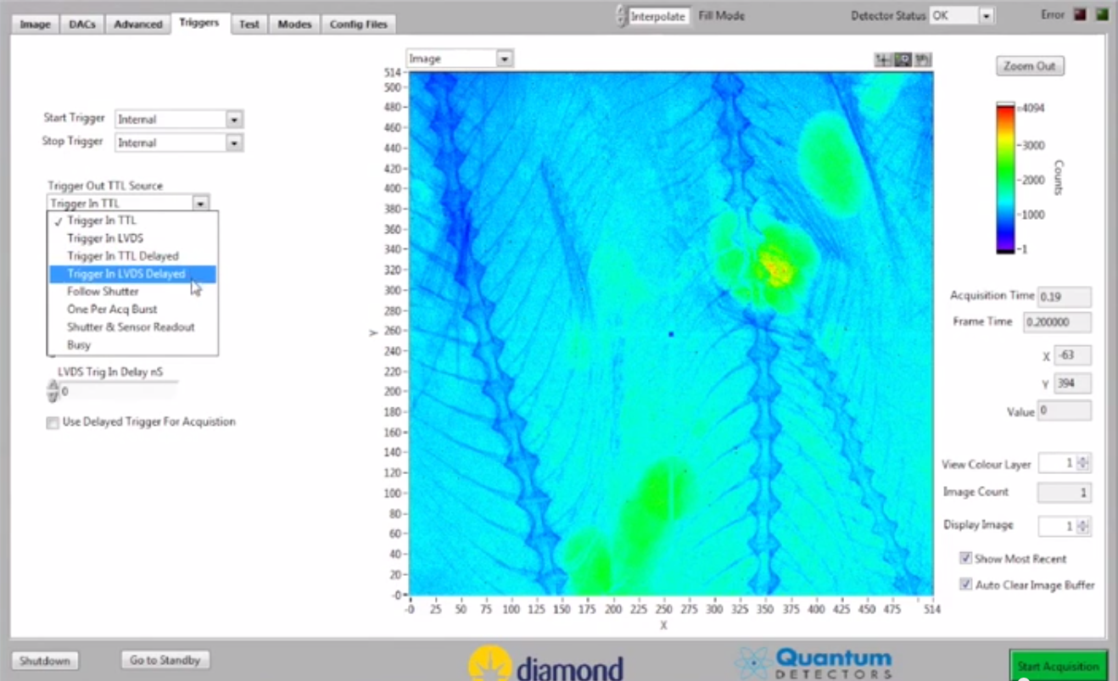
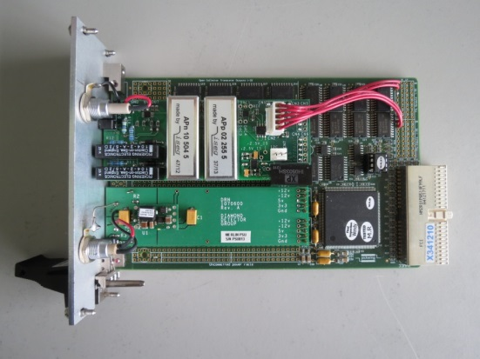
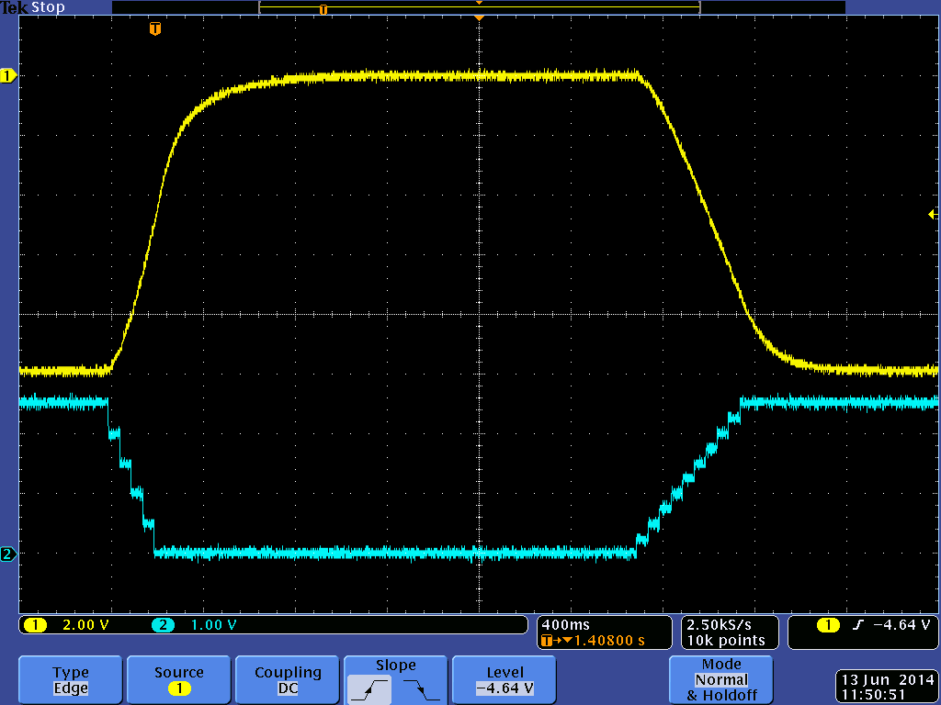
Merlin Quad
Software not simply scaled, too many variables and too much data.
New structures and techniques required :-
DVRs, Classes and objects, multiple free running loops passing
data via queues.
Command and data links via TCP/IP to EPICS, TANGO, MATLAB etc.
New sensors, thicker silicon, CdTe, GaAs needed a new
HV/LV power card (+/-1000Vdc)
ADC & DAC for control and monitoring
PXI prototype card + PCB controlled from LabVIEW

Slide 11
Timepix3
Characteristics
Pixel Arrangement | 256 X 256
Pixel Size | 55µm X 55µm
Technology | 130nm CMOS – 8 metalization layers
Acquisition Modes | Time of Arrival (ToA) Time over Threshold (ToT) Energy Event counting Integral ToT
Readout Modes | Data Driven (zero suppressed) Frame based (zero suppressed)
Dead time per pixel | 475 ns (pulse measurement and packet transfer time)
Minimum Timing resolution | 1.56 ns
Minimum detectable charge | 500e-
Output bandwidth | 1 to 8 SLVDS lines @ 640Mbps (DDR)

Slide 12

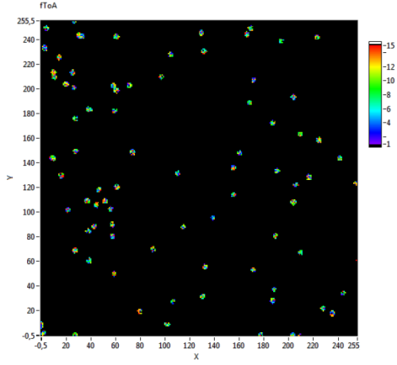

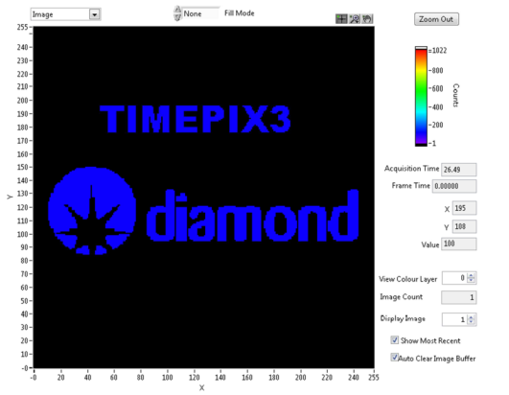

Timepix3
One Masters student + Merlin system + Timepix chipboards
+ 6 months
Adapter board modified
LabVIEW FPGA code changed and VHDL added for critical areas
Host LabVIEW modified to suit the Timepix chip.
Demonstrator up and running, Masters Thesis accepted.
Tests with Alpha source
ToA
ToT
Fast TOA

Slide 13
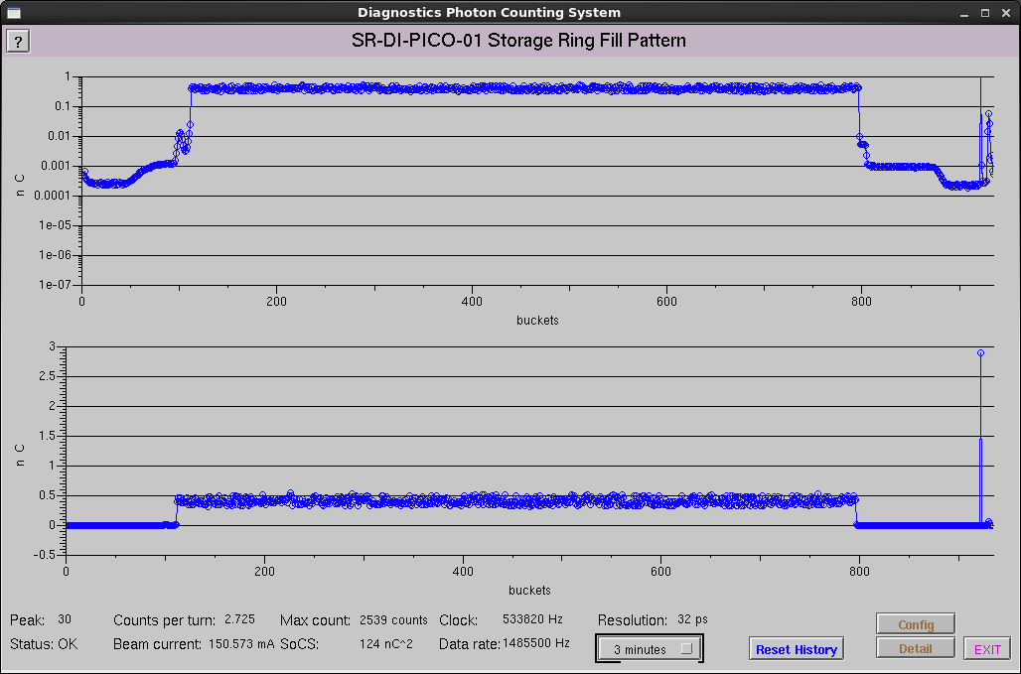
Diamond Fill Pattern
Maximum of 936 bunches, Hybrid Mode 686 bunches + 1 in gap

Slide 14
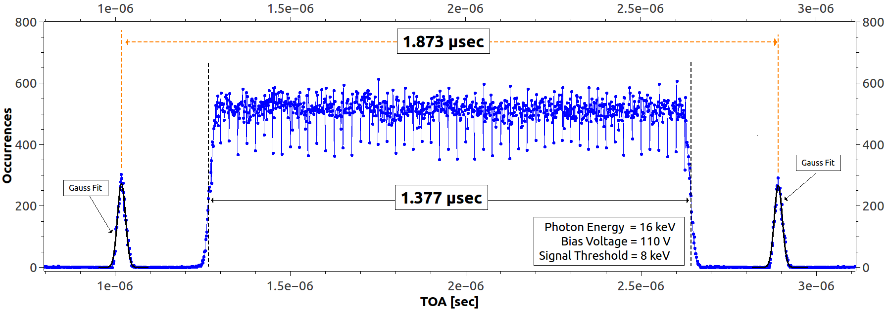
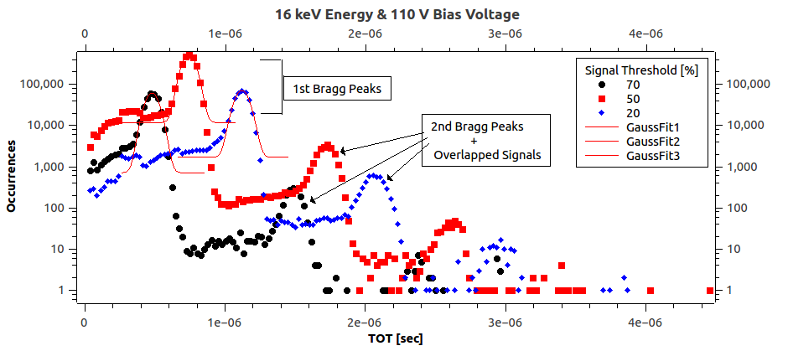
MEASURED BUNCH STRUCTURE
Energy Measurement
ToT

Slide 15
Summary and Future Work
Quad Medipix3 Detector system, Merlin, implemented using
the NI FlexRIO, commercially available via Quantum Detectors.
Installed on 5 Diamond beamlines, used in the HiZPad project.
Timepix3 demonstrator system produced, test bed for VHDL code
To be used in Time Resolving system below.
Proposals for:-
72 Medipix3 chip system arranged in a 100deg arc
for XPDF measurements. 18 slot NI chassis, 12 FlexRIO cards and
MXI bridge to server for processing and 10Gbps links.
(Controller + FPGA card with 10Gbps transceiver?)
160 Timepix3 chip Large Area Time Resolving Detector, 10sGBytes/s

Slide 16
Thank you for listening!
Acknowledgements:
None of this work would have been possible without the support and help of members of the Medipix3 Collaboration and my colleagues in the Diamond Detector Group.

