Slide 1

Neutron Measurements Using Time of Flight Calculations on FLexRIO
Contact info
ANTE Kft.
info@ante.hu
Building 6, KFKI Campus
Konkoly Thege 29-33, H-1121 Budapest
Phone: +36 1 392 2281
Péter HARMAT PhD
General Manager
Email: harmat@ante.hu
www.ante.hu

Slide 2
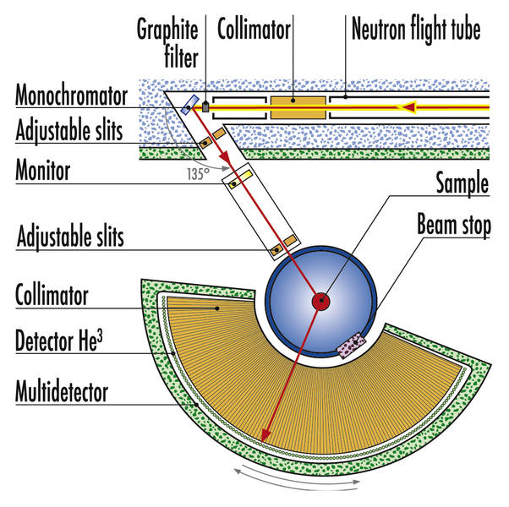
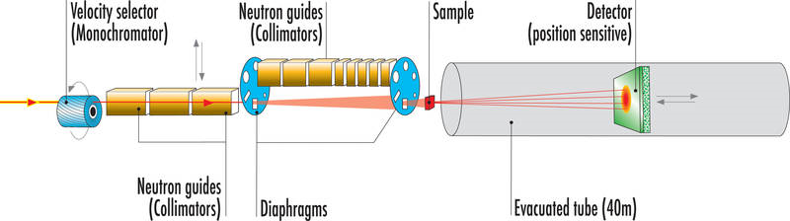
ANTE profile:
Instruments for neutron scattering
ANTE delivers new generation
signal processing and data acquisition
with built-in event recording capability
Absolute timestamp:
100 ns (8 ns internally)
48 bit time resolution (1 year)

Slide 3
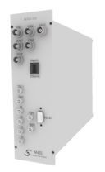
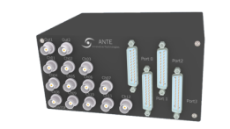
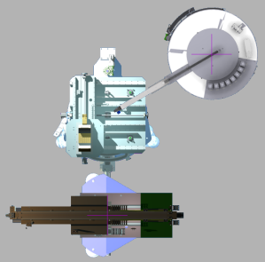
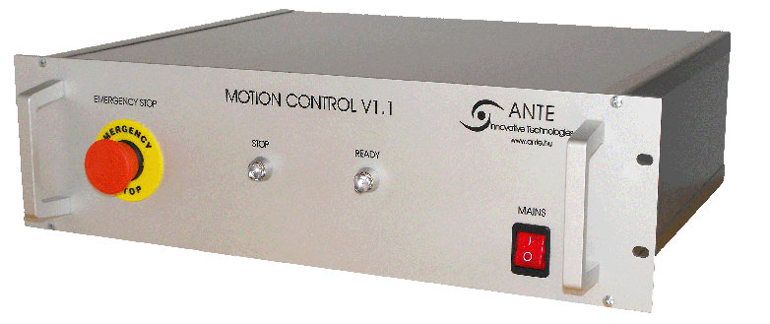
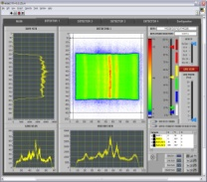
Summary of ANTE Neutron Scattering Products
  SpecTDC Unit for 2D PSD detectors
    Detectors with delay line outputs
  LisTDC Unit also for 2D PSD detectors
    with extra preferences for
    Time of Flight (TOF) measurements
  LisTOF Unit with event recorder software
    For point detectors
Instrument Control
    Complete spectrometer control
    e.g. motion, temperature, magnetic field
    Motion Control
    hardware + software
    Scientific Application
    Comprehensive scientific software for the users
FPGA inside

Slide 4
Main professional relations
BNC Budapest
Atomki, Debrecen
Wigner FK, Budapest
Mirrotron, Budapest
Chinese Academy of Sciences, Mianyang
National Instruments
ISIS UK (Signal processing)
HZB Berlin (NEAT-II)
IFE, Norway (Odin)
ANSTO, Australia (SANS)

Slide 5








Worldwide Customers
Institute of Nuclear Physics and Chemistry, Mianyang, China

Slide 6
The NEAT II Instrument at HZB

Slide 7
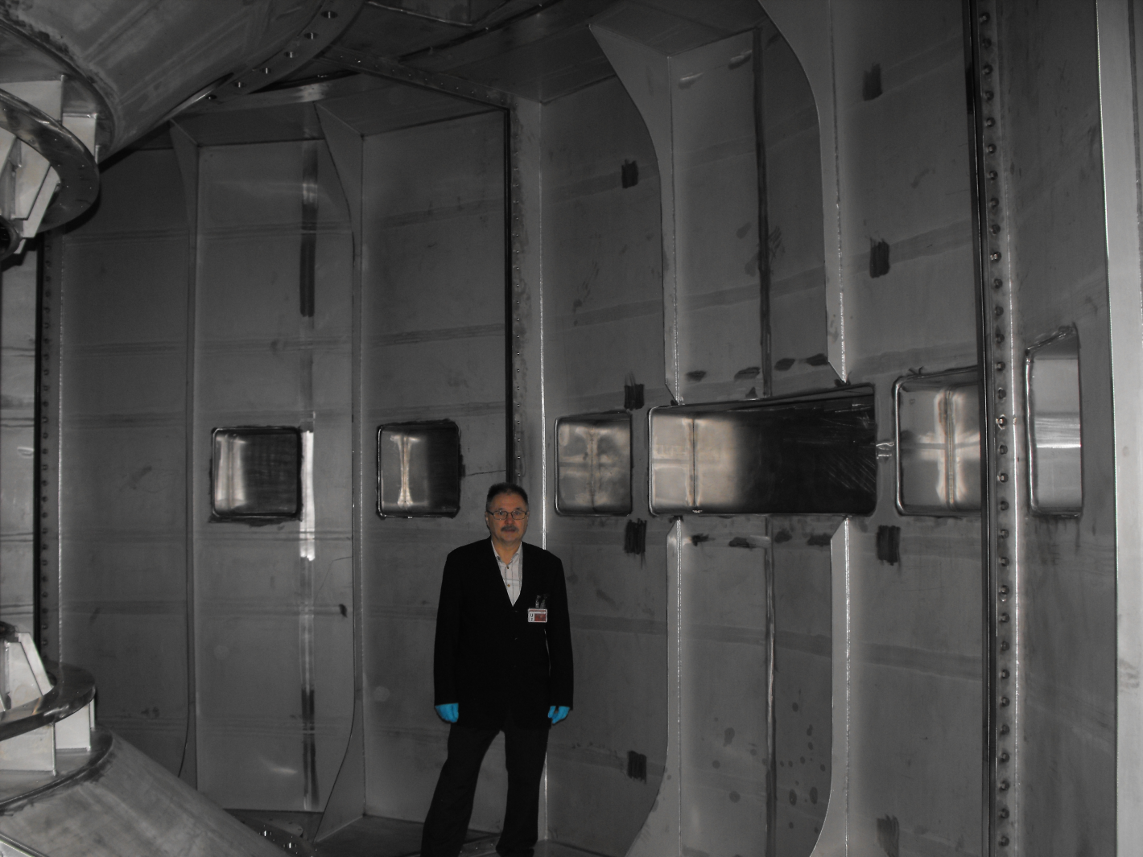
Inside the vacuum chamber

Slide 8
Requirements
416 Neutron detectors – ³He tubes
20 mm resolution on 2000 mm detectors
50kS/s load per detector (!) with 10% dead time:
  T_{DAQ} < 0.1* 1/50kHz = 2μs
1MS/s load over all 416 detectors – uneven load
TOF measurement with a 7 chopper system
  Minimizing the background
  More detailed signal analysis than usual…

Slide 9
Neutron detection with ³He tube
Basic operation

Slide 10
Neutron detection with ³He tube
Position sensitive detectors (PSD)
Charge division method:
Charge “A” Charge “B”
1 0 -1
Position = (A-B)/(A+B)

Slide 11
DAQ solution
Instead of old “integrating” (slow) electronic –
digital charge integration with quick analog electronics (T<60ns)
Sampling ADC
  20ns sampling time
FPGA
  for continuous reading out of sampling ADC data
  Trigger state detection („peak is coming”)

Slide 12
Summary of High Level Requirements
Computer
FPGA
I/O
I/O
I/O
I/O
Floating-point processing
Communications GigE
Synchronized time scale
Continuous signal sampling
Analog trigger condition
Pre-triggering
High-speed processing
100 ns accurate time stamp
832 analog input channels
Sampling ADCs
12 bit resolution
50 k events/sec/channel
max 1M event/system

Slide 13
ANTE unique efforts vs. routine solutions from NI
Computer
FPGA
I/O
I/O
I/O
I/O
Multicore programming
VHDL development
with fixed-point algorithms
Custom solution for coupling A/D devices to FPGA
Custom digital interface/buses
Custom timing for different types of I/O
Such a „usual way” of development needs much more effort, source allocation than ….

Slide 14
ANTE unique efforts vs. routine solutions from NI
Computer
FPGA
I/O
I/O
I/O
I/O
LabView + C++ programming
LabView only
Predefined data communication by using DMA, interrupt and
bus control drivers
Ready made hardware
Predefined I/O drivers both for digital lines and ADCs
    … using LabVIEW Graphical Programming Environment for Computer and FPGA

Slide 15
Electronics
He³ 1D PSD tube ends
Choppers, monitors
preamplifier & pattern generator
Proprietary electronics (ANTE)
preamplifier & pattern generator
Direct digital inputs
Pattern generator controller
sampling ADC
FPGA unit
Timestamp generator
Time synchronization
National Instruments
Signal processing unit (computer based)

Slide 16
Choosing the right ADC card
model | resolution [bits] | channels | speed [MS/s]
NI 5731 | 12 | 2 | 40
NI 5732 | 14 | 2 | 80
NI 5733 | 16 | 2 | 120
NI 5734 | 16 | 4 | 120
NI 5751 | 14 | 16 | 50
NI 5752 | 12 | 32 | 50
NI 5761 | 14 | 4 | 250
NI 5762 | 16 | 2 | 250
NI 5771 | 8 | 1 | 3000
 | 8 | 2 | 1500
NI 5772 | 12 | 1 | 1600
 | 12 | 2 | 800
2 bits in resolution
vs. 2x channels
too low resolution

Slide 17
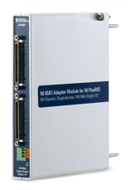
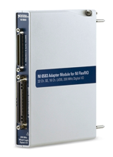
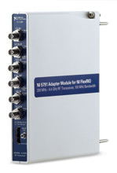
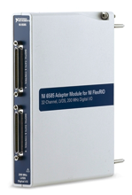
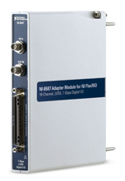
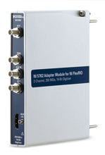
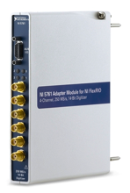
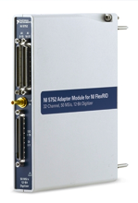
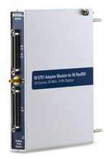
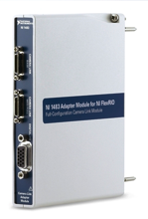
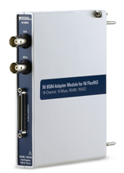
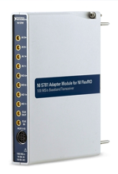
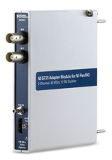
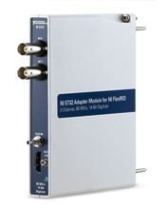
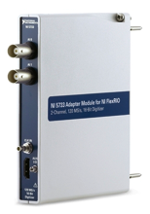
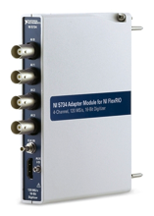
NI FlexRIO Adapter Modules
Digital
Analog
100 Mbps
SE DIO
300 Mbps
LVDS DIO
100MHz BW,
4.4 GHz RF I/O
200MHz BW,
4.4 GHz RF Rx
200MHz BW,
4.4 GHz RF Tx
2 ch. 3 GS/s,
8-bit AI
2 ch. 1.6 GS/s,
12-bit AI
300 Mbps
SE/LVDS DIO
1 Gbps
LVDS DIO
2 ch. 250 MS/s,
14-bit AI/16-bit AO
2 ch. 250 MS/s,
16-bit AI
4 ch. 250 MS/s, 14-bit AI
32 ch.
50 MS/s, 12-bit AI
16 ch. 50 MS/s,
14-bit AI
2 GS/s
14-bit AO
Camera Link
RS-485/422
2 ch. 100 MS/s,
14-bit AI/16-bit AO
2 ch. 40 MS/s, 12-bit AI
2 ch. 80 MS/s, 14-bit AI
2 ch. 120 MS/s, 16-bit AI
4 ch. 120 MS/s, 16-bit AI
2 ch. 1.25 GS/s, 14-bit AO
Notes:
23 modules all in all and growing. A mix of speeds and I/O standards for digital, a wide range of resolutions, sample rates, channel counts, bandwidths in analog.
Focusing back on the FPGA…

Slide 18
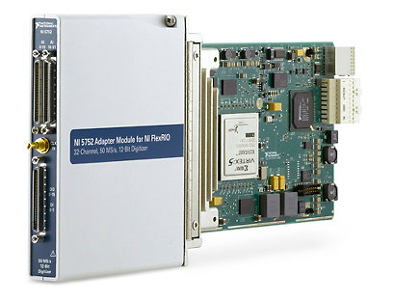
NI 5752
32 simultaneous 50 MS/s, 12-bit channels
Uses TI AFE5801 analog front end including variable gain amplifiers and ADCs
2 Vpp, 100 Ω differential inputs with AC coupling
Built-in antialias filters and programmable time-variable gain control
2 digital input channels
16 digital outputs with per-channel phase control that can be coupled to pulser arrays

Slide 19
Choosing the FPGA module
Device Utilization
---------------------------
Total Slices: 100.0% (4798 out of 4800)
Slice Registers: 48.7% (9342 out of 19200)
Slice LUTs: 96.6% (18556 out of 19200)
Block RAMs: 6.2% (2 out of 32)
DSP48s: 0.0% (0 out of 32)
Model | Bus/Form Factor | FPGA | FPGA Slices | FPGA DSP Slices | FPGA Memory (Block RAM) | Onboard Memory (DRAM)
NI PXIe-7965R/7966R | PXI Express | Virtex-5 SX95T | 14720 | 640 | 8,784 kbit | 512 MB
NI PXIe-7962R | PXI Express | Virtex-5 SX50T | 8160 | 288 | 4,752 kbit | 512 MB
NI PXIe-7961R | PXI Express | Virtex-5 SX50T | 8160 | 288 | 4,752 kbit | 0 MB
NI PXI-7954R | PXI | Virtex-5 LX110 | 17280 | 64 | 4,608 kbit | 128 MB
NI PXI-7953R | PXI | Virtex-5 LX85 | 12960 | 48 | 3,456 kbit | 128 MB
NI PXI-7952R | PXI | Virtex-5 LX50 | 7200 | 48 | 1,728 kbit | 128 MB
NI PXI-7951R | PXI | Virtex-5 LX30 | 4800 | 32 | 1,152 kbit | 0 MB

Slide 20
DAQ solution using FlexRIO
Digital charge integration with quick analog electronics (T<60ns) using sampling ADC:
  26 pcs. NI 5752 12-bit, 50 MS/s, 32 Channel
  20ns sampling time
FPGA
  26 pcs. NI PXI-7951R FlexRIO FPGA (Virtex-5 LX30)
  16 tubes/32 channels per FPGA

Slide 21
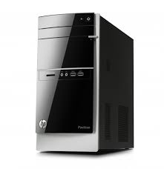
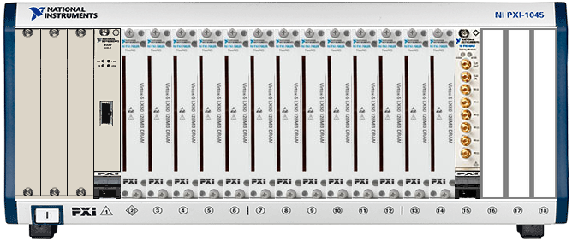


System Architecture
Data Bus
(PCIe-PXI Bridge)
PXI Chassis
FPGA Boards & Analog Front Ends
Timing & Synchrinization
Data Bus
(PCIe-PXI Bridge)
PC Functions:
Control of PXI Chassis
CPU Post processing
Data Storage
User Interface
PXI Functions:
Analog Data Acquistion
FPGA Preprocessing
Timming & Synchronization
Data Transfer to CPU

Slide 22
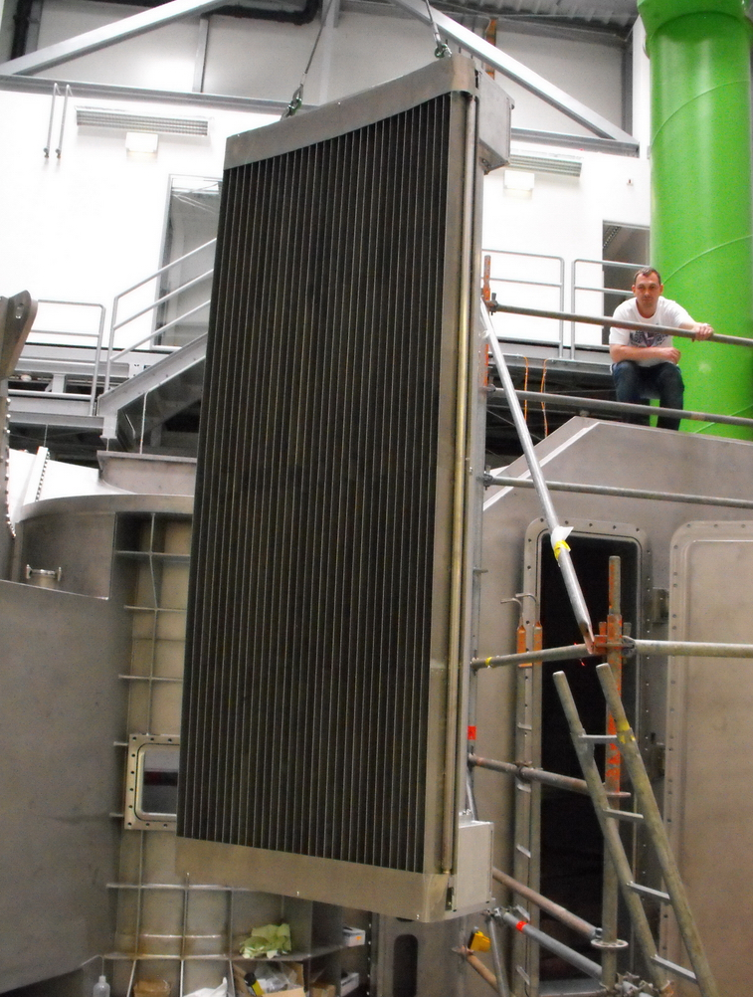
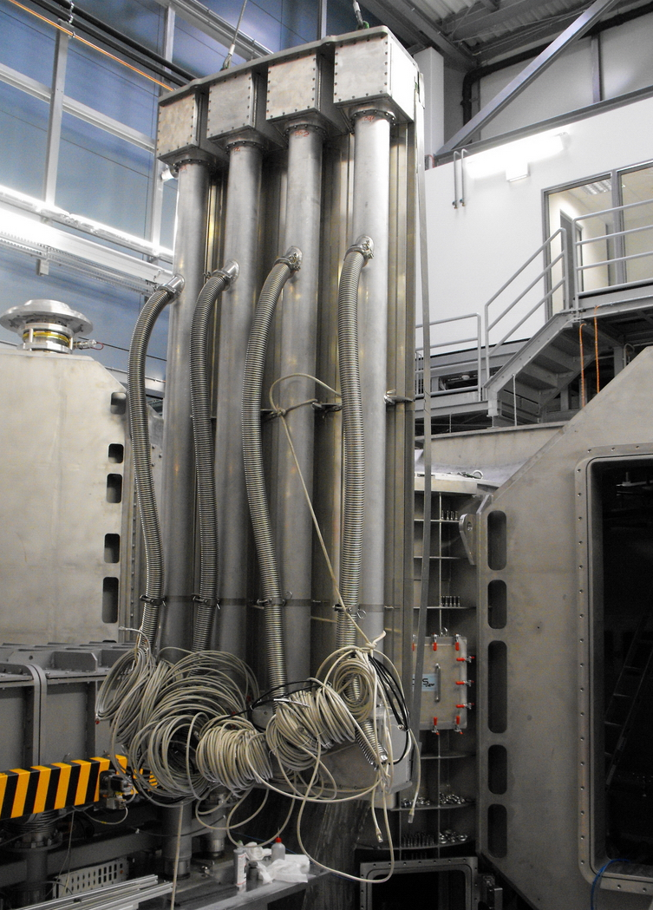
Manufacturing…

Slide 23
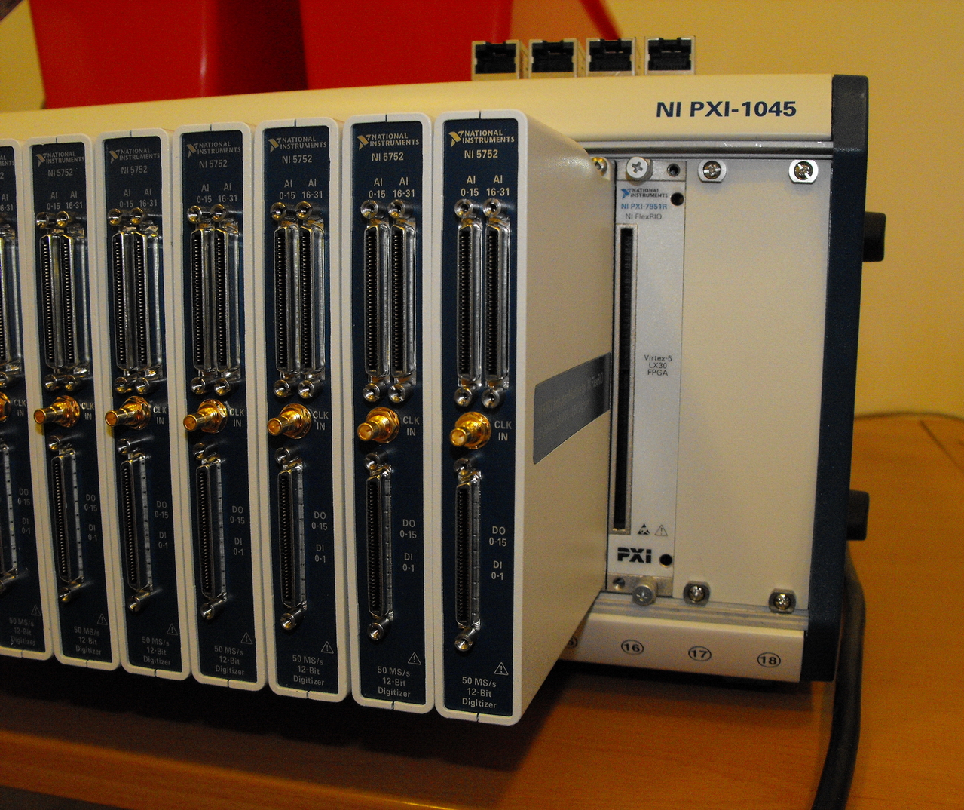

Slide 24
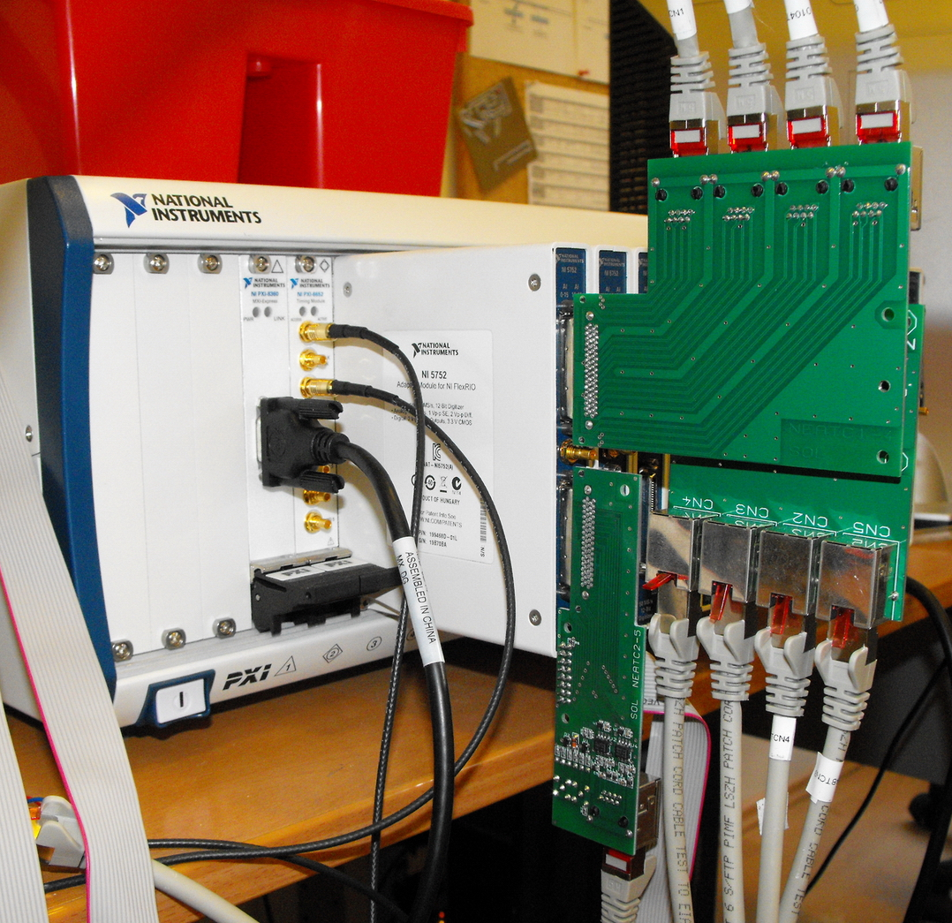

Slide 25
Neutron detection with ³He tube
Typical signal shapes for sampling ADC
“Single bump”
  1H-3H axis parallel to tube
“Double bump”
  1H-3H axis perpendicular to tube
“Gamma”
  non-neutron signal – pulse shape discrimination (PSD)
“Pileup”
  more than one neutron during T_{DAQ}

Slide 26
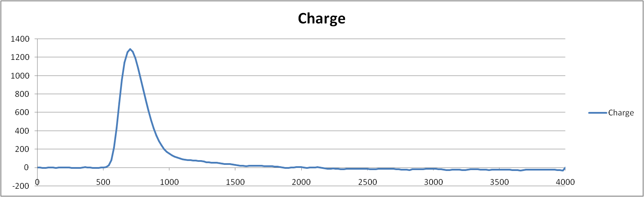
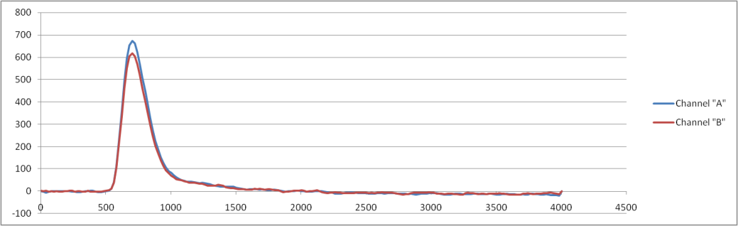
Signal shapes
“Single bump”

Slide 27
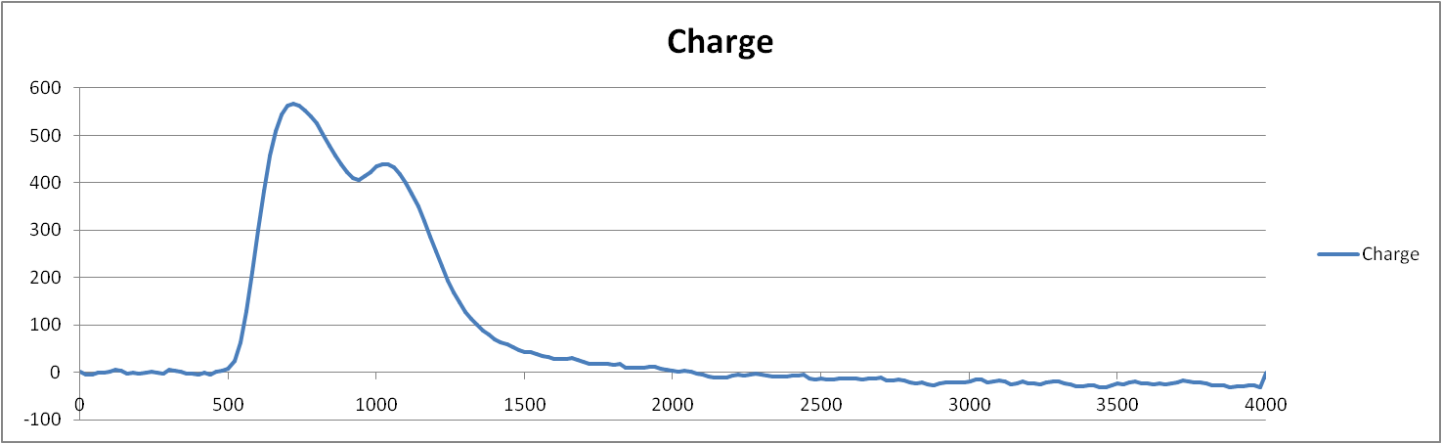
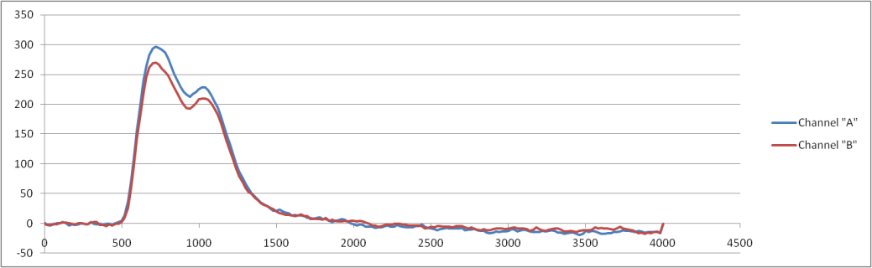
Signal shapes
“Double bump”

Slide 28
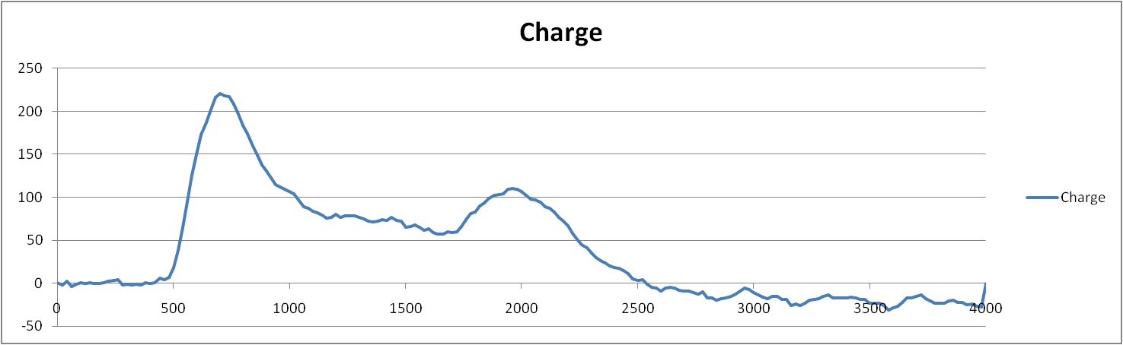
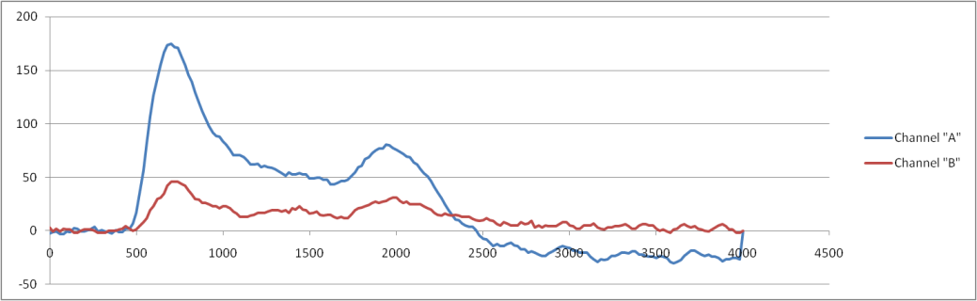
Signal shapes
“Gamma”

Slide 29
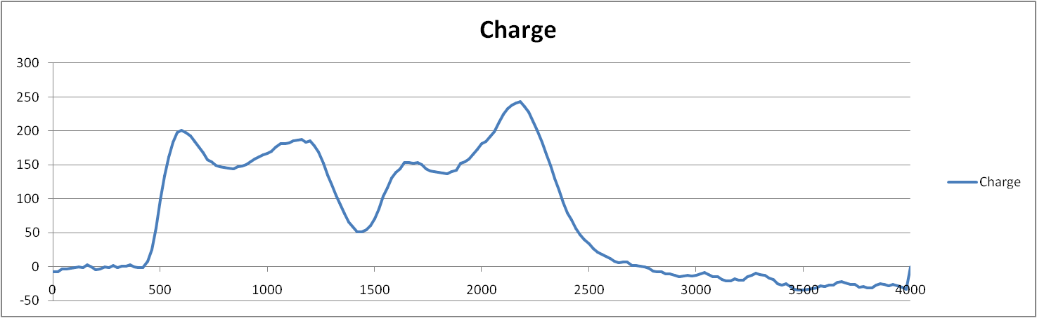
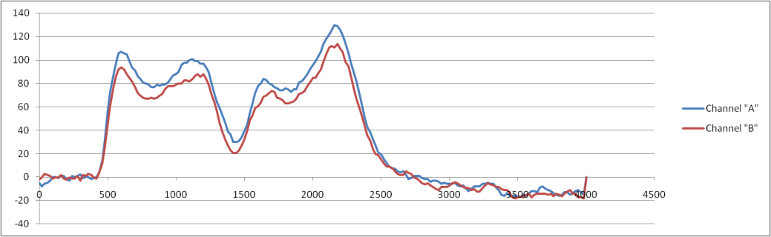
Signal shapes
“Pileup”

Slide 30
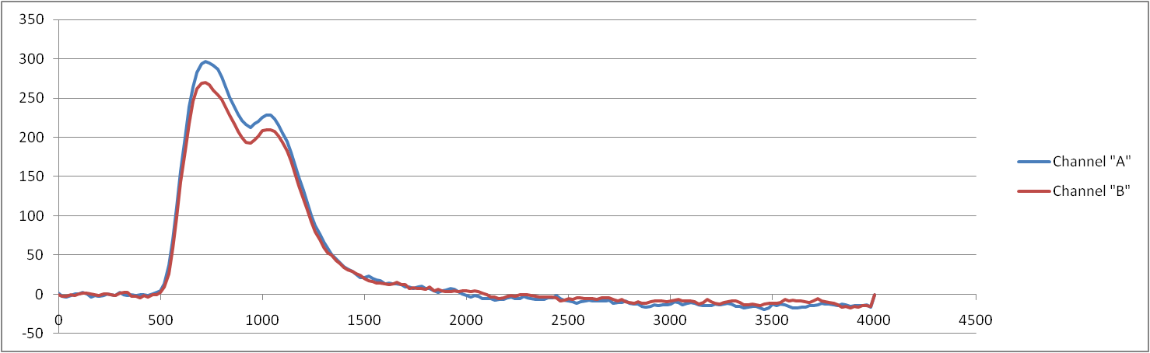
Signal processing
T=0 T_{DAQ}

Slide 31
Signal processing
Reserved for baseline restore

Slide 32
Signal processing
T_{N1} T_{N2}

Slide 33
Signal processing
Position: (A-B)/(A+B)
  From N1: better Signal to Noise Ratio
  From N1+N2: full information
Phase Shape Discrimination
  Charge in N1 vs Charge in N2
  PSHDISC = Ch_{N2} / Ch_{N1+N2}

Slide 34
Signal processing – minimizing the background
Position: (A-B)/(A+B)
  From N1: better SNR
  From N1+N2: full information
Phase Shape Discrimination
  Charge in N1 vs Charge in N2
  PSHDISC = Ch_{N2} / Ch_{N1+N2}
How to spot pileup
  From PSD?
  Other shape parameters?

Slide 35
Conclusion
ANTE realized the following advantages by choosing NI solution both in the hardware and software:
  Construction efforts (hardware, firmware, software) have been minimized during the development
  Enough development capacity remained for concentrating to the substantial neutron detection specific problems like
    Position calculation algorithms
    Shape discrimination
    Signal classification
for minimizing the background

Slide 36
Thanks for the attention
Contact info
ANTE Kft.
info@ante.hu
Building 6, KFKI Campus
Konkoly Thege 29-33, H-1121 Budapest
Phone: +36 1 392 2281
Péter HARMAT PhD
General Manager
Email: harmat@ante.hu
www.ante.hu

