Slide 1
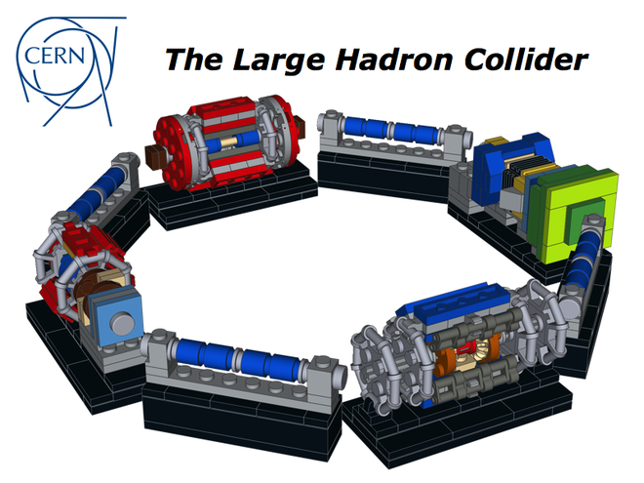
LabVIEW and the LHC

Slide 2

Rapid Application Development Environment
ADE
based on LabVIEW

Slide 3
Outline
MTA
Why RADE?
The challenge
The Scope
Coping with large applications
RADE today
Future

Slide 4
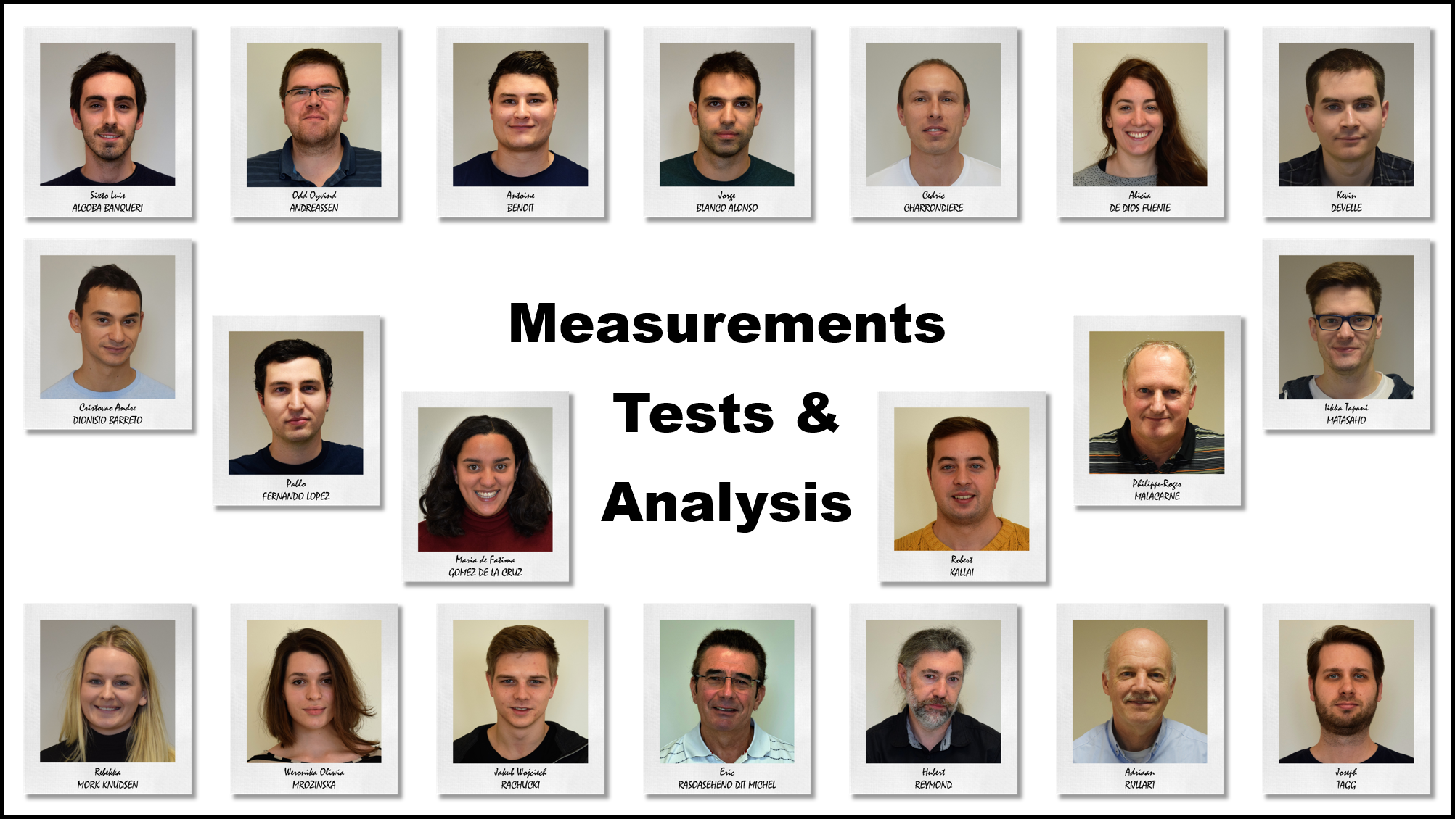
EN-STI-ECE-MTA
labview.support@cern.ch
Notes:
The MTA team
Engineering Department (EN), Industrial Controls and Engineering Group (ICE), Measurements, Tests and Analysis section (MTA)

Slide 5
Outline
MTA
Why RADE?
The challenge
The Scope
Coping with large applications
RADE today
Future

Slide 6
Why was RADE developed?

Slide 7
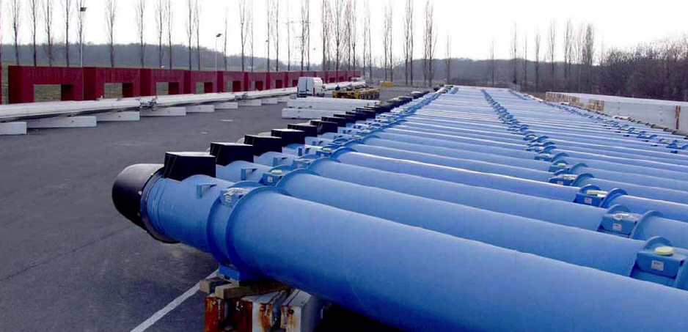
The Origin
10.000+ Magnets
1750 Circuits
13000+ Tests
Notes:
SM18 -> years of work started, asked to be done in a few months.
Magnetic measurements, measuring and analyzing
Post Mortem -> Same story.
We started in the Magnetic measurement business, around LabVIEW 4-5 (some of the team members have been doing this since LabVIEW 1-2)
We got the job of measuring voltages, currents, temperatures and all kind of values on superconducting magnes.
To do so there where many things we had to cope with…. Which brings us to the next topic:

Slide 8
Outline
MTA
Why RADE?
The challenge
Coping with large applications
RADE today
Future
Notes:
The challenge.

Slide 9
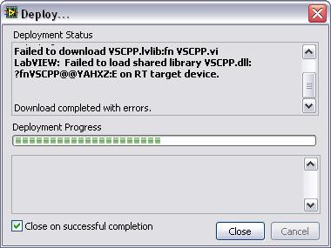
The Challenge
Notes:
Installing on Pharlap or VXworks

Slide 10
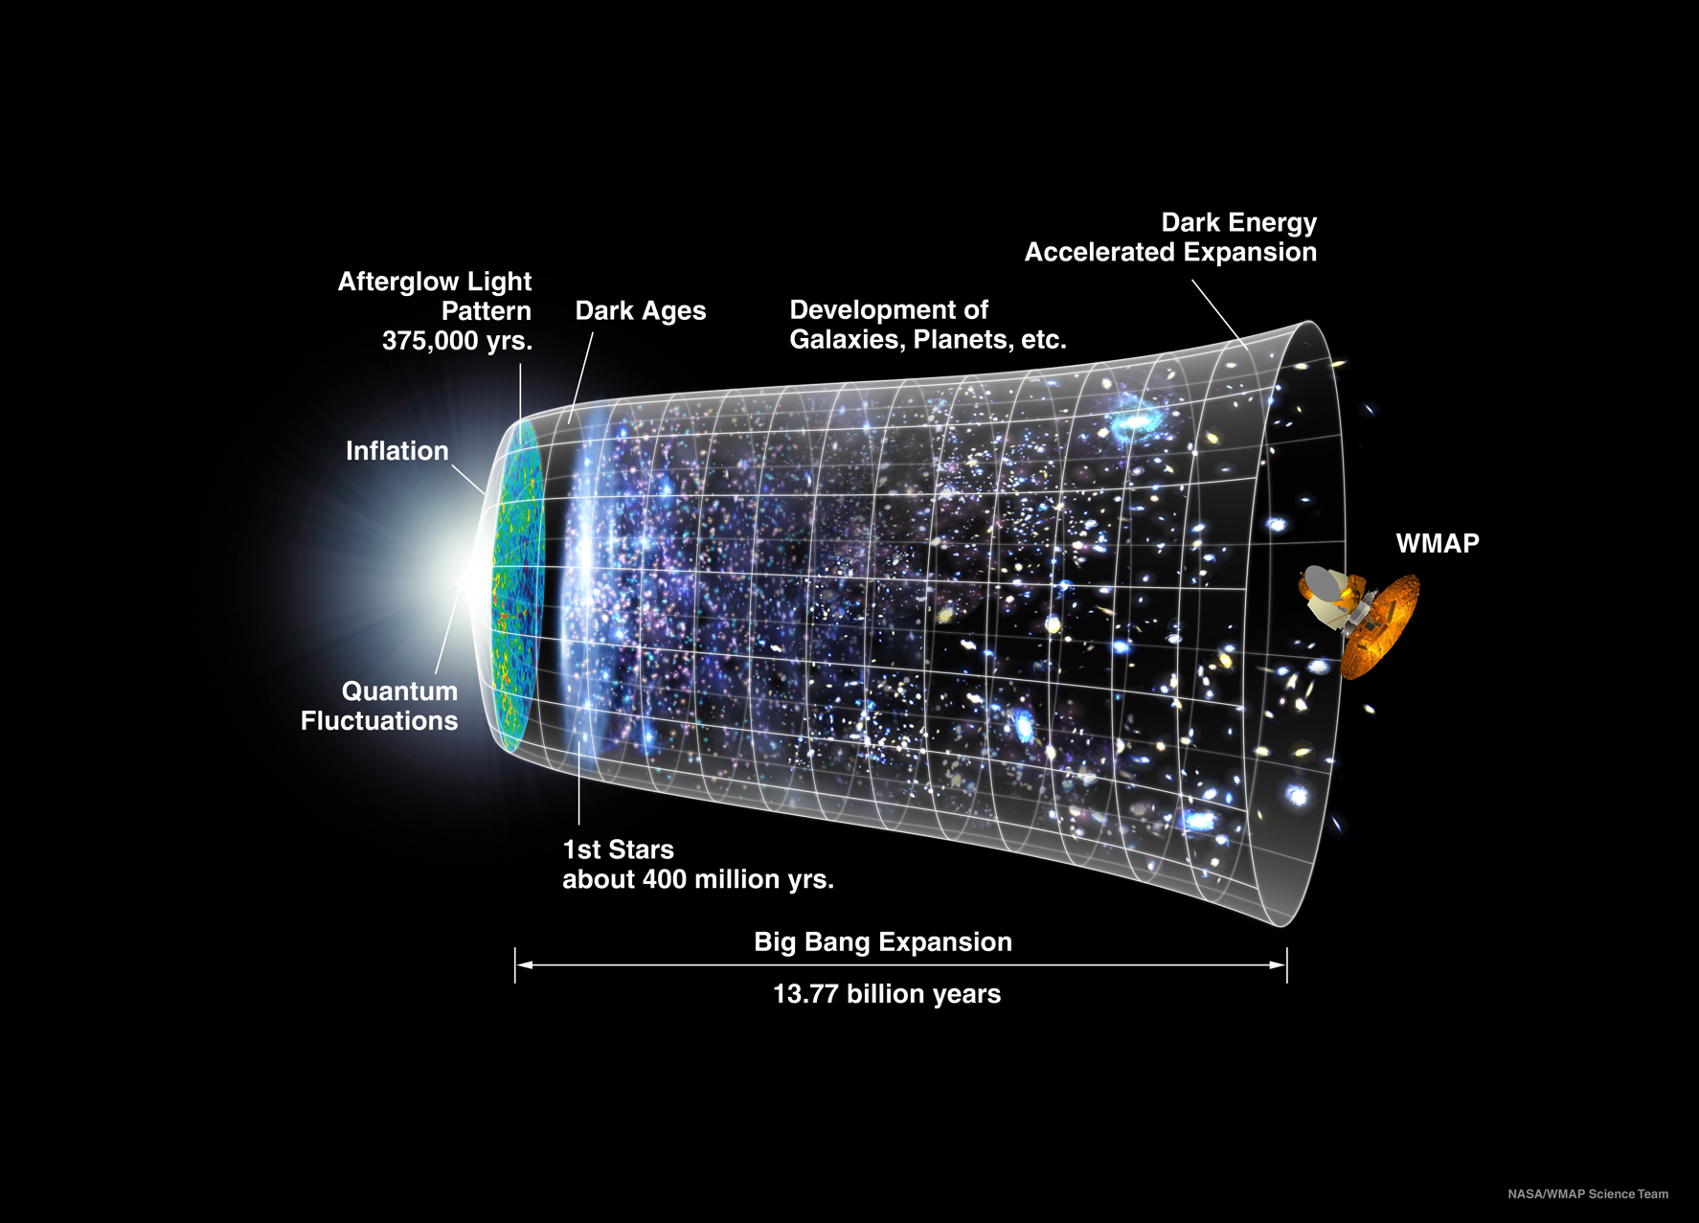
The Challenge
Notes:
Obviously we also have some other “minor” things we would like to study, using these tools ☺

Slide 11




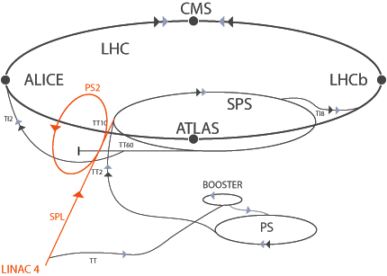
The Challenge
Linux
Windows
Mac
GPN
TN
DB
CMW
RBAC
Timing
Files
PLC
DAQ
Notes:
1. On one side you have your every day high energy particle accelerator, the LHC and on the other side LabVIEW.
2. Both, Which we love.
3. But to be able to get from one to the other, there are several layers we have to cross. First we have all the different tools, databases, files and middleware that LabVIEW have to understand.
4. Then we have all the different platforms that LabVIEW have to run on,
5 and just to make our life easier, we have to cross several networks to make this happen.
6. This is all solved by creating what we call the RADE framework.
Many developers (500+)
Wide range in experience (basic to CLA,)
Many complex and simple problems problems (show basic accelerator math, show “did you plug it in?”)

Slide 12
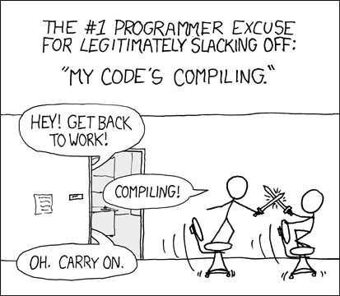
RAD(E)
RAD(E) (rapid application development) is a concept that products can be developed faster and of higher quality through:
Gathering requirements
Prototyping
Defer design improvements to the next release
Less formality in reviews and communication
Re-use of software components

Slide 13
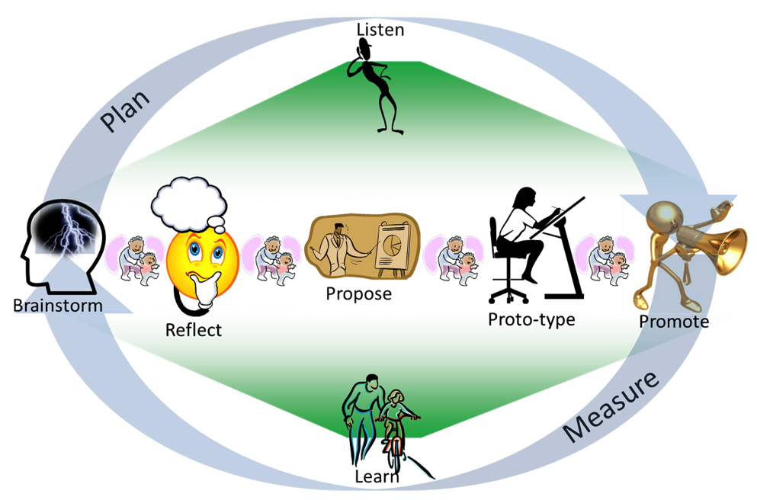
Development Methods
Extreme Programming methods
Small increments
Minimal planning
Cross-functional team working on all aspects
Demonstrated to the stakeholders frequently
Minimizing risks
Fast changes and adaptations.
ICALEPCS Paper ID MOMIB08
Notes:
Agile methods
small increments
minimal planning
cross-functional team working on all disciplines:
planning,
requirement analysis
design
Coding
unit testing and
acceptance testing.
product or result is demonstrated to the stakeholders,
minimizing risks
fast changes and adaptations.

Slide 14
Outline
MTA
Why RADE?
The challenge
The Scope
Coping with large applications
RADE today
Future

Slide 15
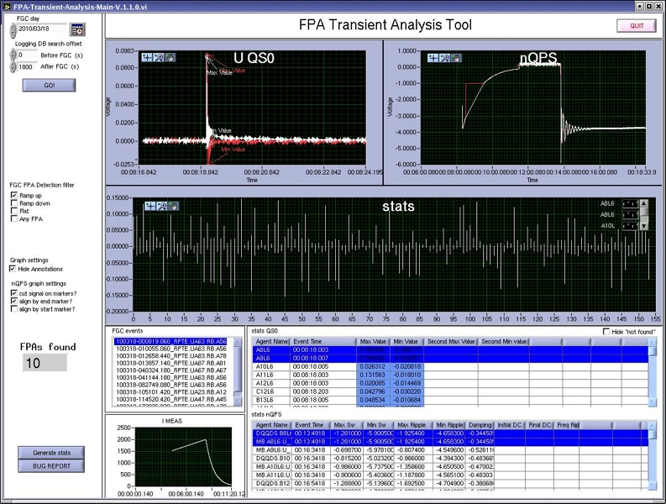
The Scope
Application characteristics:
Short development time
Rapidly evolving
Light and independent
Notes:
We started with these requirements
Long-lived analysis systems

Slide 16
Initial Requirements
  Fast programming
  Rapid learning curve
  Drag and drop GUI development
  Wide range of analysis libraries
  Light/independent environment
LabVIEW
  Integration with CERN infrastructures
Notes:
Applications that are developed rapidly, that can be easily maintained even though the implementation time is short.
LabVIEW all ready give us most of these features, and by providing the connectivity, we had the basic tools we needed to get the job done.

Slide 17
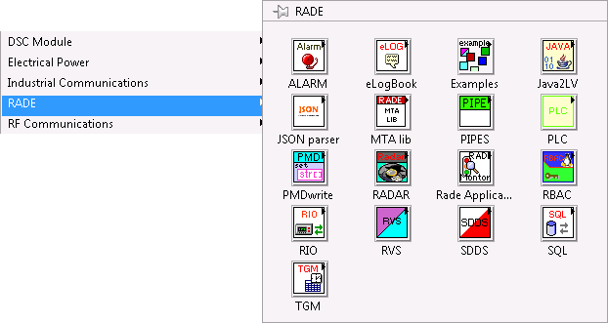
RADE Palette
Notes:
The RADE palette
Many CERN specific tools, but quite a few generic and general ones as well. The MTA palette gives us bot in house tools from MTA and OpenG.

Slide 18
RADE Core Technology
LabVIEW user application
LabVIEW
C/C++ shared lib
Server
Server
Server
Java
SDDS
PLC
MTA-lib
RBAC
RIO
SQL
TGM
ALARM
eLogBook

Slide 19
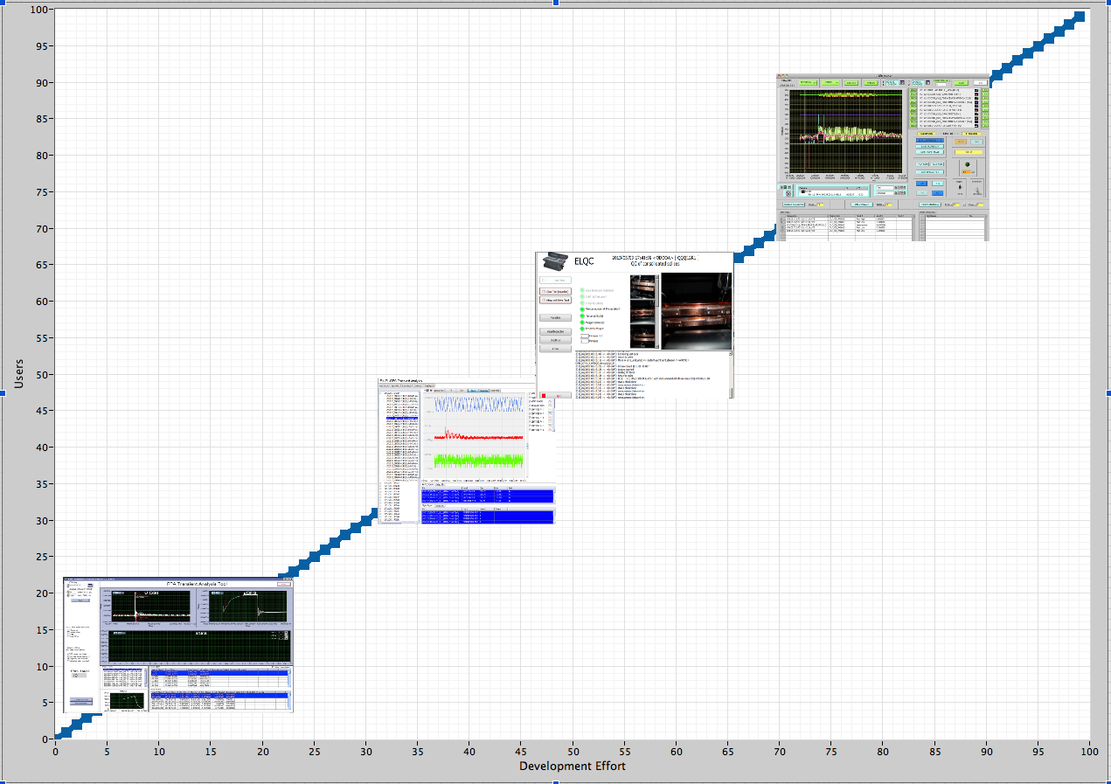
RADE Applications
Notes:
Some applications developped using RADE

Slide 20
Outline
MTA
Why RADE?
The challenge
The Scope
Coping with large applications
RADE today
Future

Slide 21
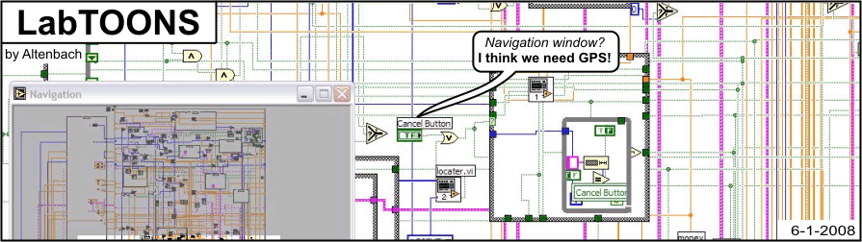
Coping With Large Applications
Notes:
RADE Faze one gave complicated applications that have to be maintained. Taking us to the next step, taking care of the applications.
Large applications, maintenance, multiple developer communication etc.
Short lived applications becoming part of the infrastructure (totem, post mortem)
Ten different ways of doing the same thing

Slide 22
Large Application Requirements
  Fast programming
  Rapid learning curve
  Drag and drop GUI development
  Wide range of analysis libraries
  Light/independent environment
LabVIEW
  Integration with CERN infrastructures
  Source control and distribution
  Instance generation
  Templates and documentation
  Automated tests and builds
Notes:
Applications that are developed rapidly, that can be easily maintained even though the implementation time is short.
Two aspects:
Animate new req. After existing

Slide 23
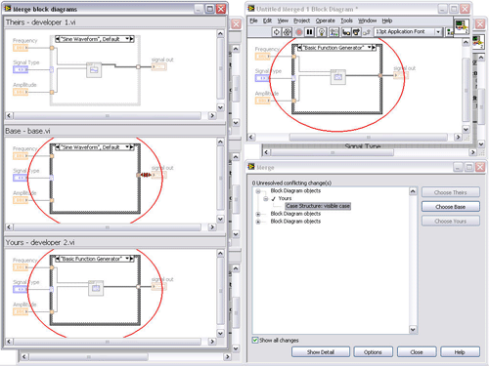

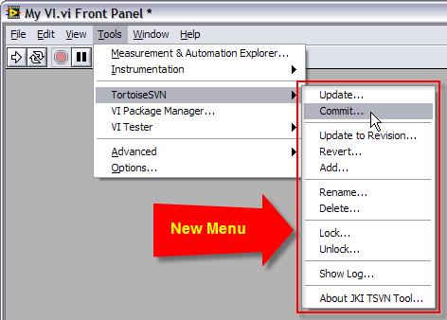
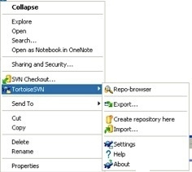
Source Control
Notes:
The main source control system at CERN is Subversion
Why not Tsvn or JKI svn plugin? -> cross platform integration prevents this
Why don’t we use GIT, mercurial or other vendors?

Slide 24
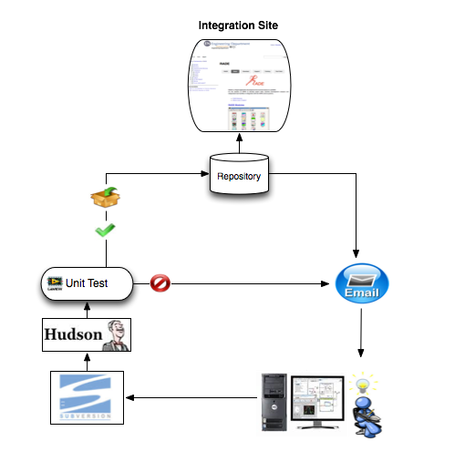
Continuous Integration
Notes:
Several design patterns and concepts in the form of templates, adapted to RADE and CERN specific requirements
Custom built LabVIEW Vis to cope with build system
Why doesn’t the disable structure work when loading vis!!!?? Have to declare a dummy case/flag in a project and call the vis outside the project for it to work…
Why can’t we tell labview to programmatically “save all vi’s in memory” and which are running??

Slide 25
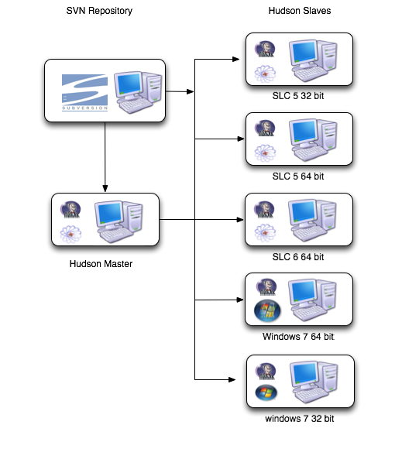

Continuous Integration
Linux Windows and Mac
Open stack and VPN
Notes:
Several design patterns and concepts in the form of templates, adapted to RADE and CERN specific requirements

Slide 26
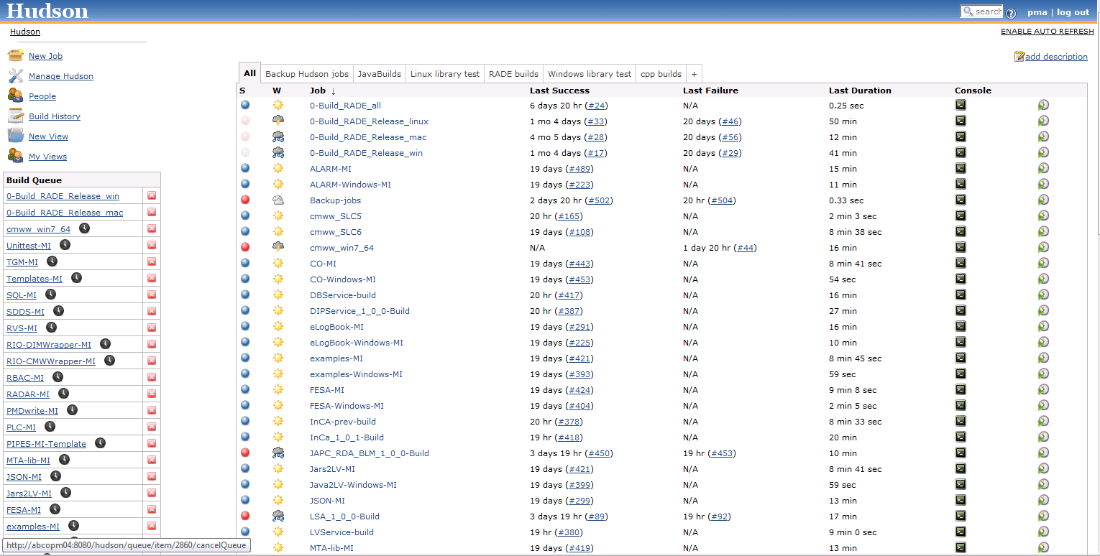
Continuous Integration

Slide 27
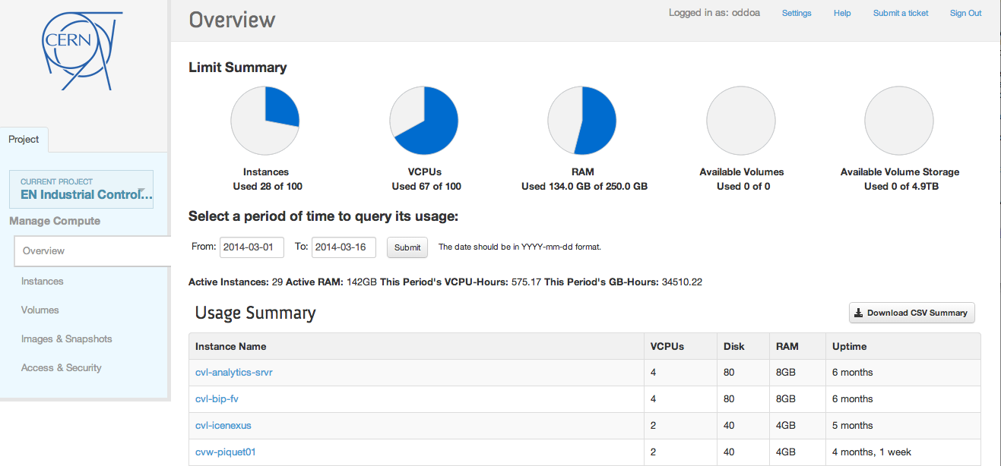
Continuous Integration

Slide 28
Continuous Integration

Slide 29
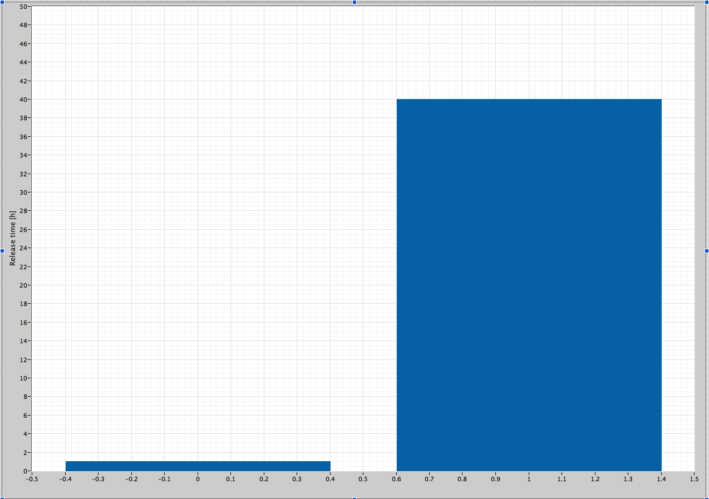
Continuous Integration
RADE build time
40h
Continuous Integration (CI)
Manual
1h
Notes:
Release time reduced from 1 week to 1 hour (and no interaction)

Slide 30
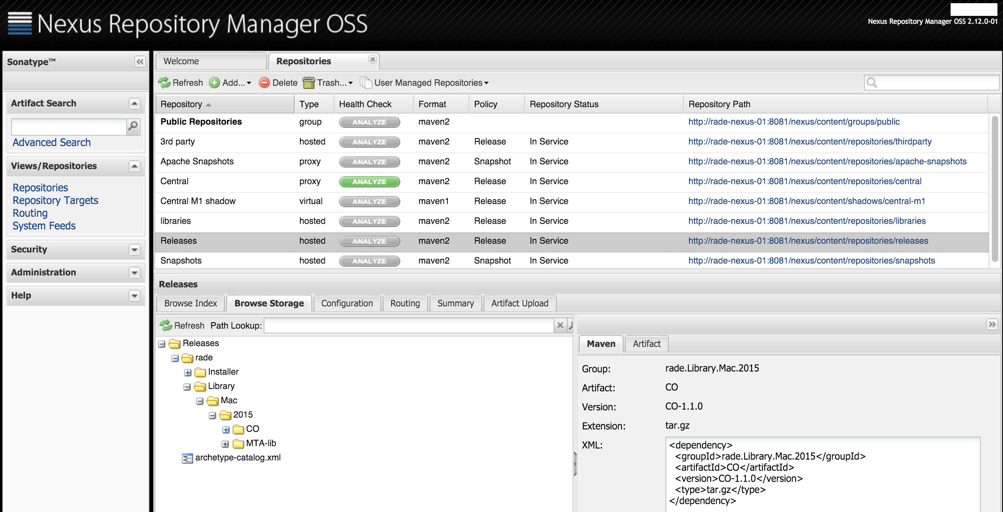

Software repository

Slide 31
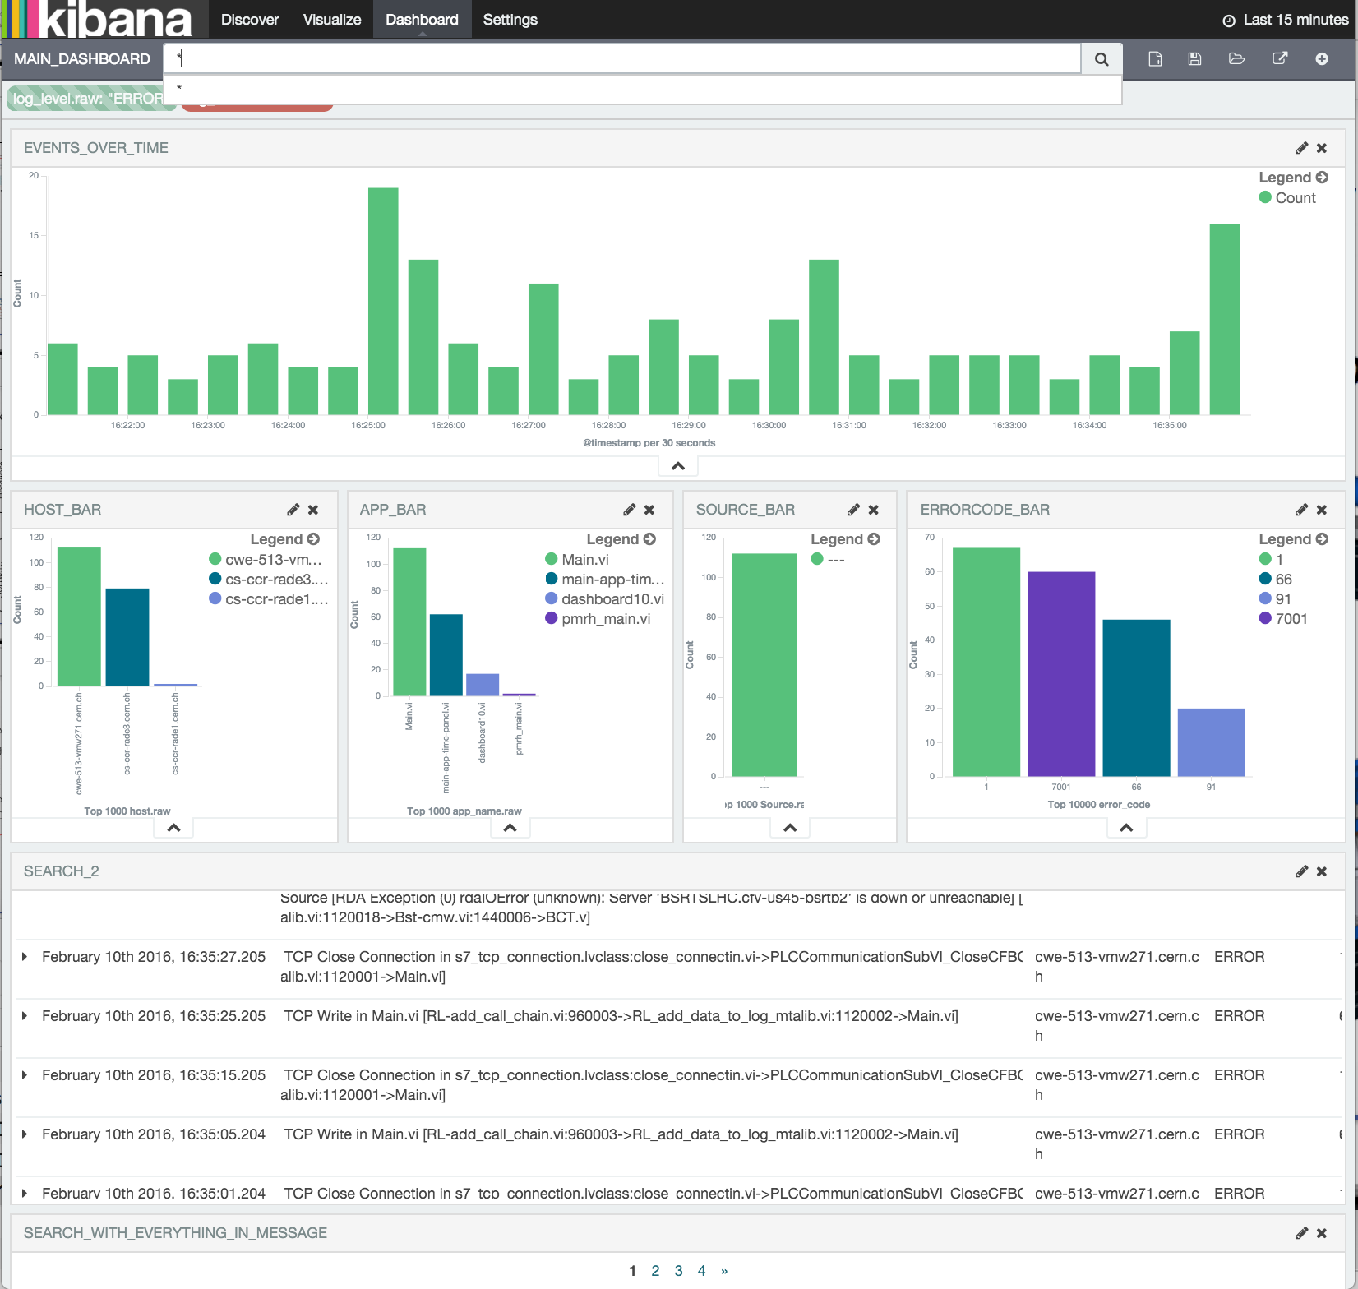
Logging and diagnostics
(“ELK”)

Slide 32

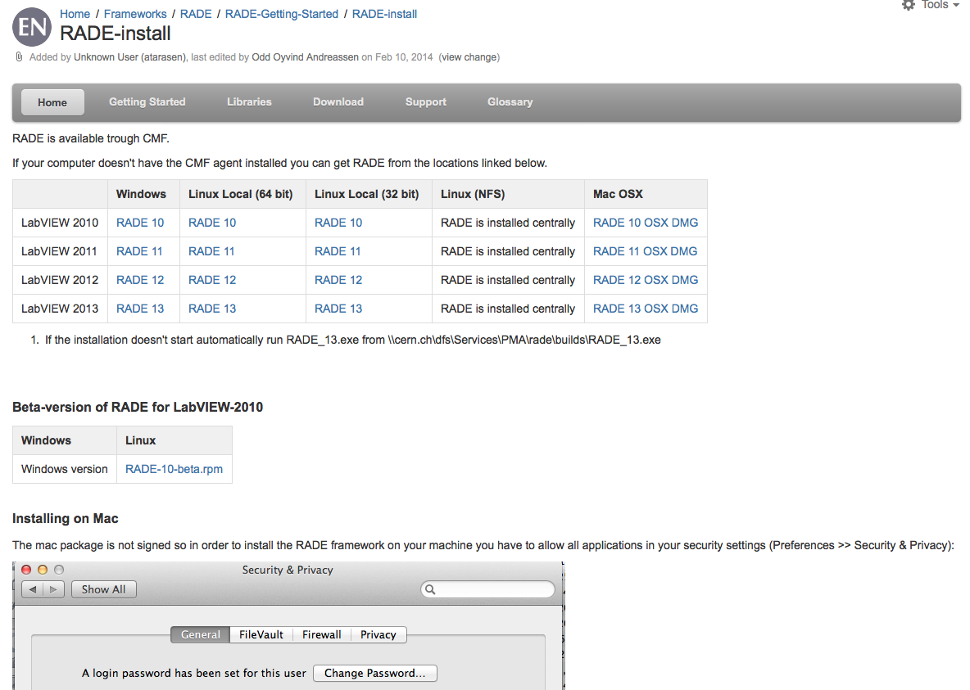
Distribution
Online Installer
Notes:
RADE homepage used to distribute the packages. One pr LV version and platform so that you don’t have to mass compile once installed. (lack of admin rights, time etc)

Slide 33
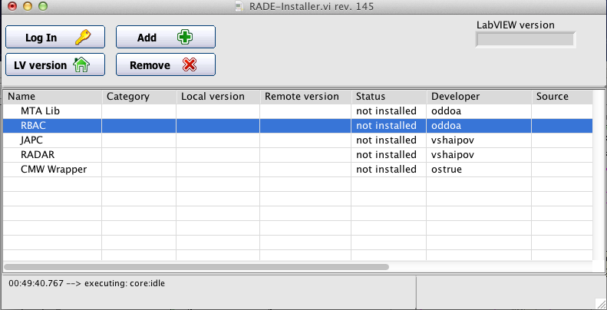
Distribution
RADE Installer
Notes:
Custom installer for those who only wants to install certain components. Will (probably) be expanded using maven and Nexus.

Slide 34
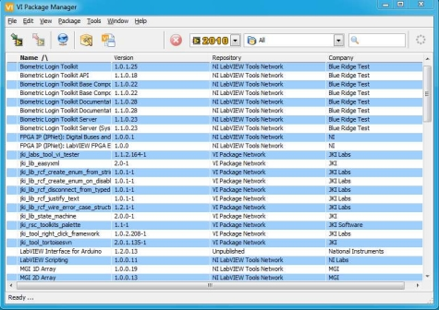


Distribution
Notes:
We also use the VI package manager in our CI system to download the latest releases of the packages, embed them in our release and build the distributable.

Slide 35
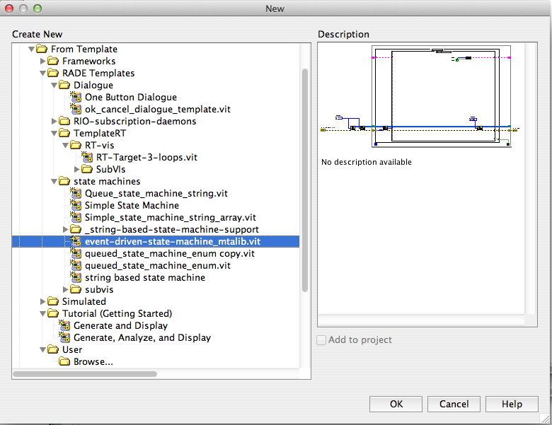
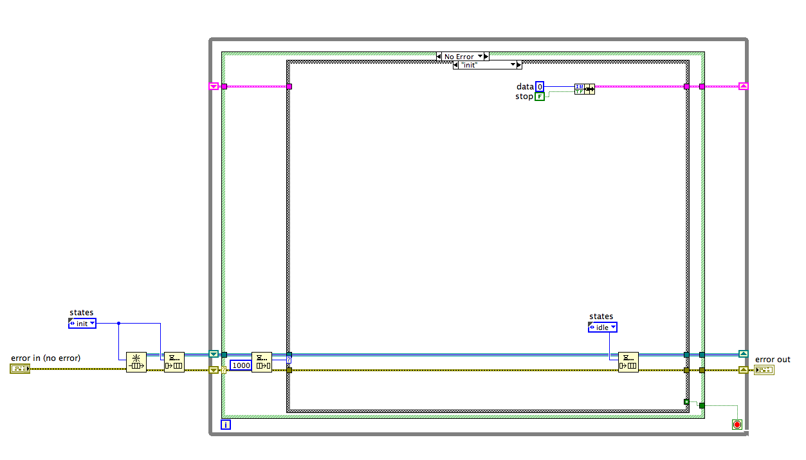
Dedicated Templates
Notes:
Several design patterns and concepts in the form of templates, adapted to RADE and CERN specific requirements

Slide 36
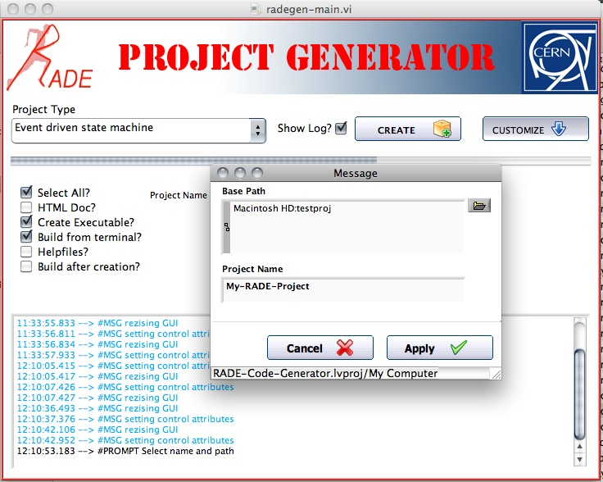
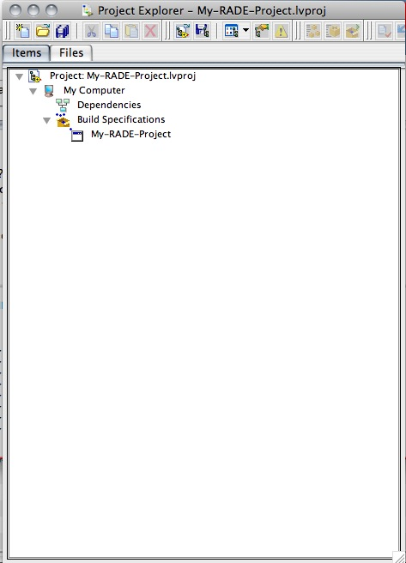
Project Generation
Notes:
Project generation to work around the drawbacks of templates which basically gives you a copy.
The generator can support a

Slide 37

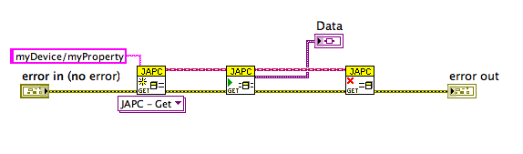
Typical design
Create, Use & Destroy
Notes:
Class based,
Polymorphic,
Dynamic dispatch

Slide 38
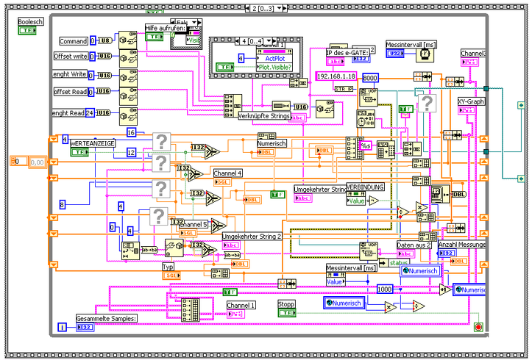
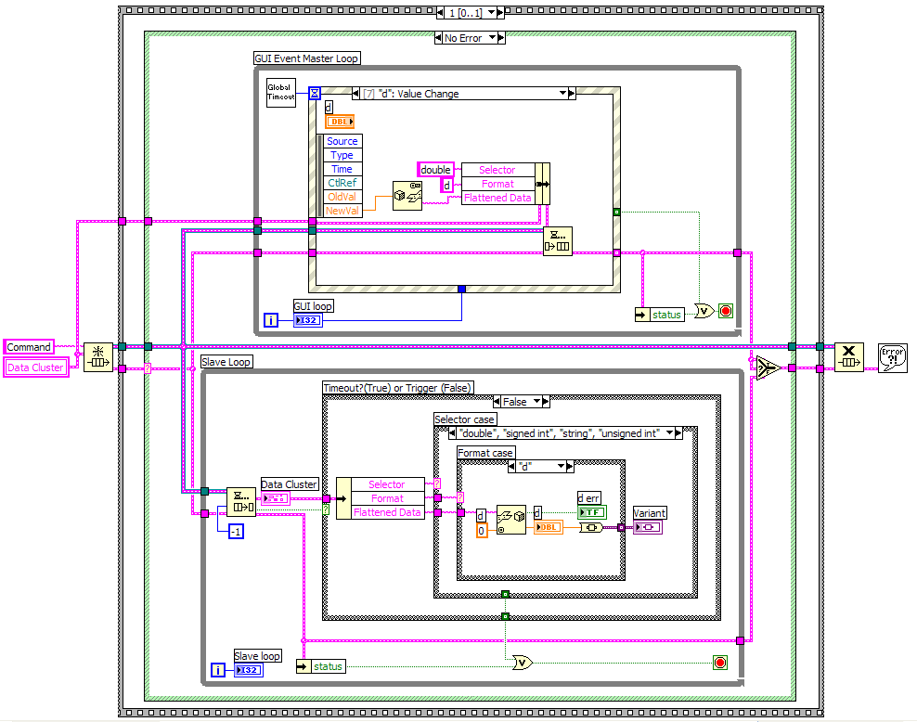
Development help
Design patterns and templates in RADE
LabVIEW Guides http://j2eeps.cern.ch/wikis/display/EN/LabVIEW+Guides
Code review: make maintainable, and performant
Notes:
The code on the right might not be perfect, but I would choose a producer consumer based state machine ANY TIME over the code on the left.
Our overall goal is not to make everyone produce perfect code, but at least get the base level for all on a basic CORE 2 level, implementing similar code which uses common naming schemes, layout and syntax

Slide 39

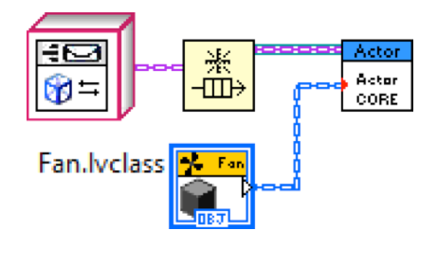
Peer Programming

Slide 40
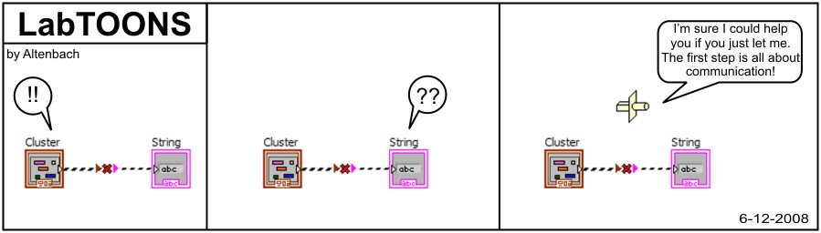
The missing link

Slide 41

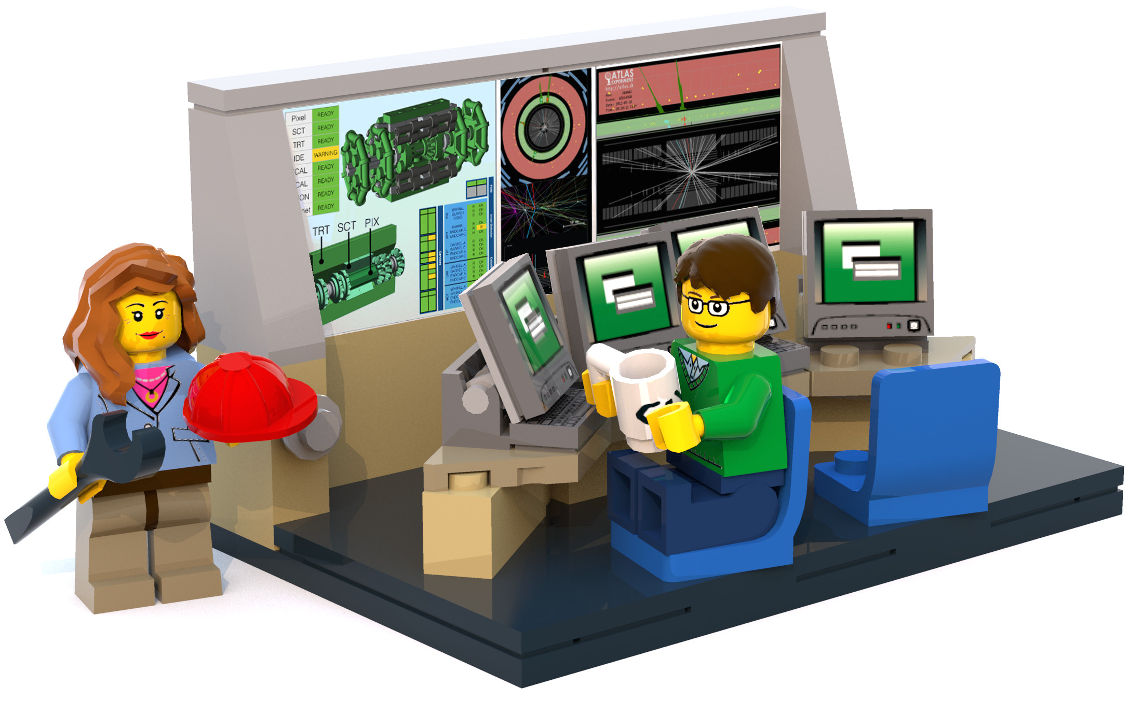
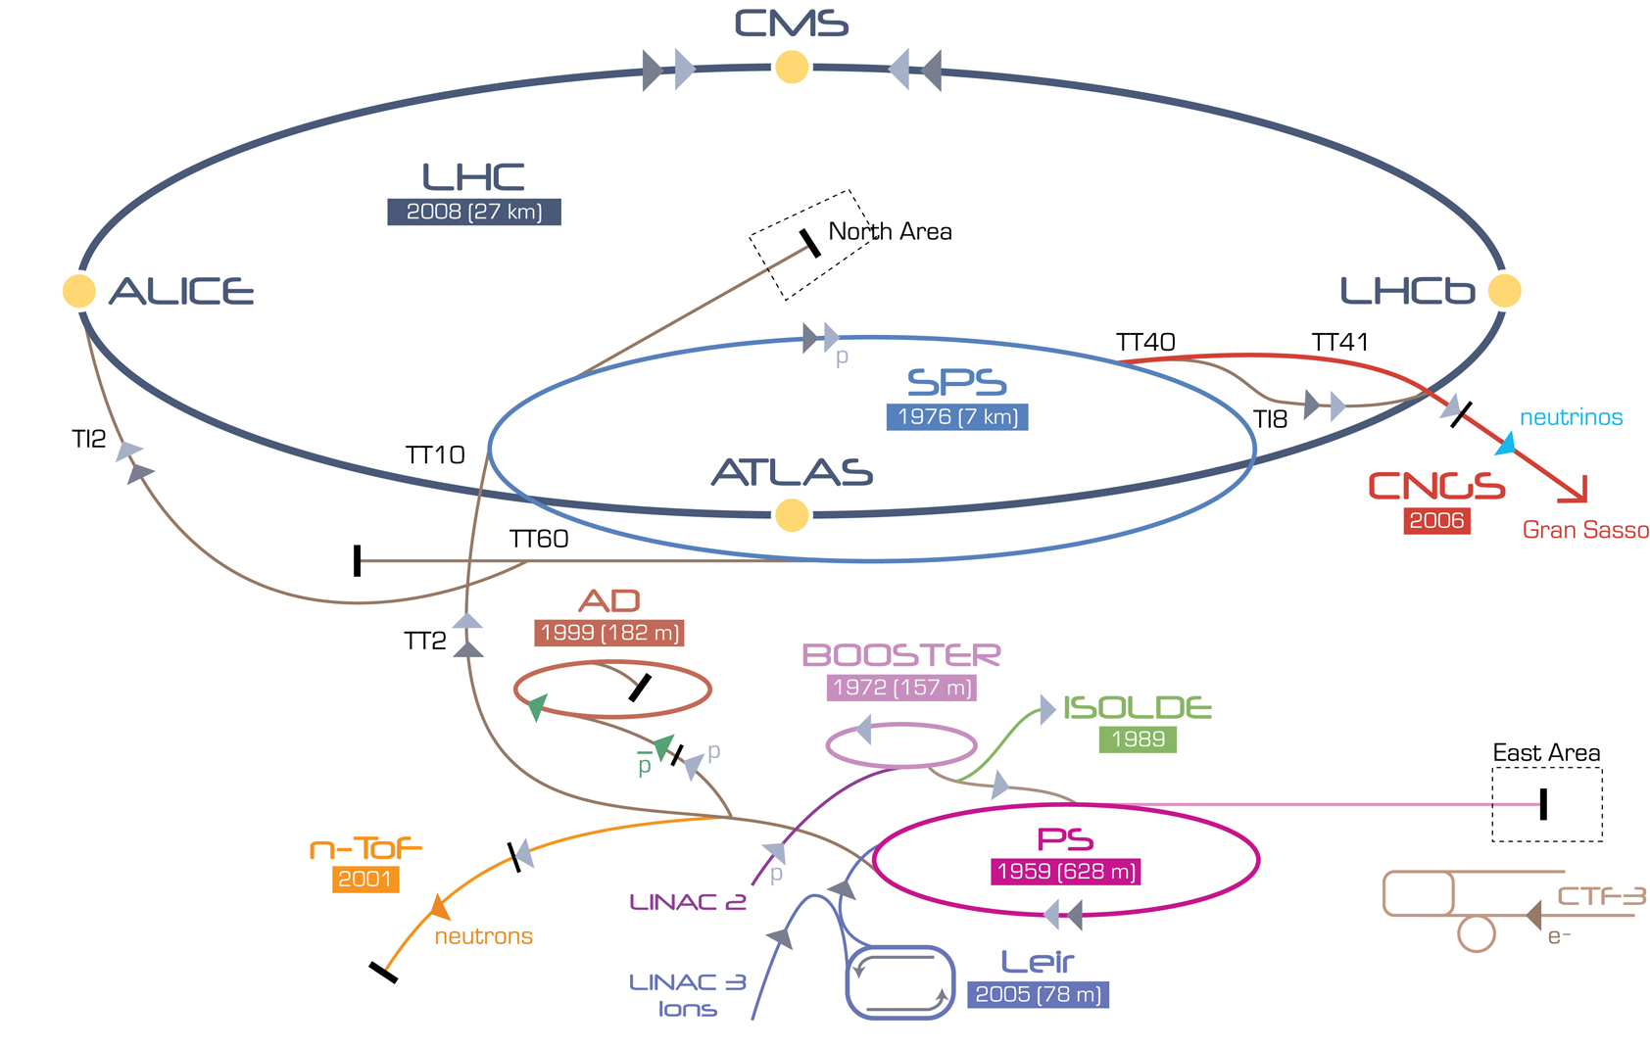
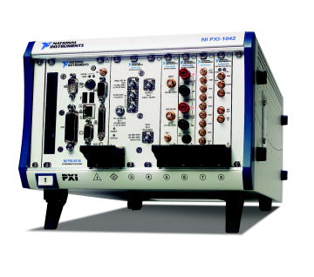
Middleware integragion
Clients
RIO palette (Rade Input/Output)
  Get, Set and Subscribe
User Application
Operators
CERN Middleware
CMW Server
Server
Device/property/field definitions
PXI on the accelerator complex

Slide 42
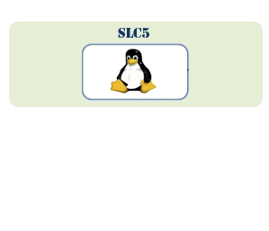
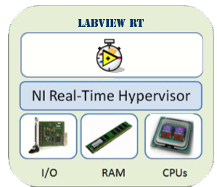


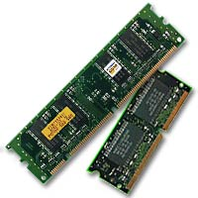
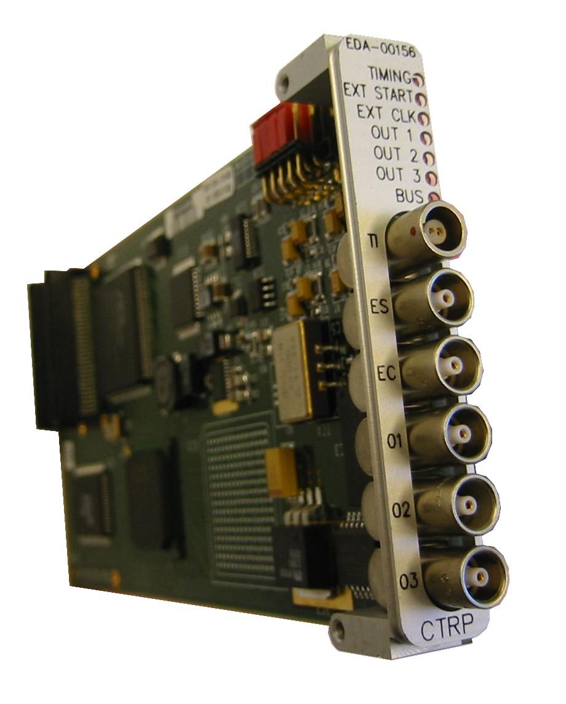
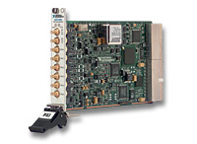
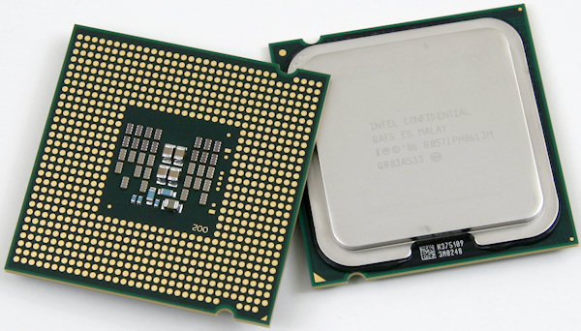
Distributed Architecture
LabVIEW RT
SLC
Shared Memory
System I/O
NI Real-Time Linux
NI Real-Time Hypervisor
Trigger
CPUs, RAM
I /O
I /O
CPUs, RAM
Notes:
Hypervised system giving us the CERN GMT timing (nanosecond prec) on the PXI platform!

Slide 43
Outline
MTA
Why RADE?
The challenge
The Scope
Coping with large applications
RADE today
Future

Slide 44
RADE today
RADE has become adult
LabVIEW has started getting out of the Lab
Copes with the classical software development challenges
Enables LabVIEW to be used for accelerator applications

Slide 45
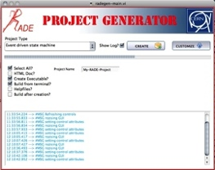









The Framework
Templates
Configuration files
Documentation
Training
LabVIEW
libs
Support
JAPC
Java
CMW
DB
Files
PLC

Slide 46

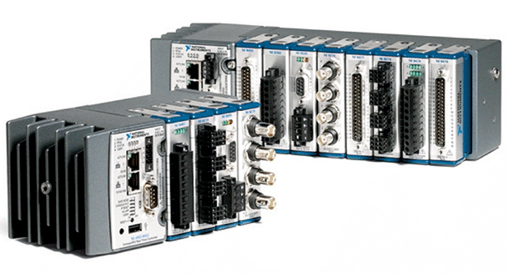
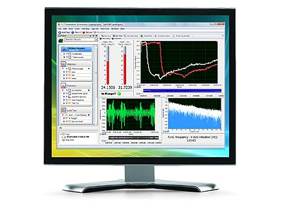
Hardware Support
Hardware
PXI
CompactRIO
DAQ
&
LabVIEW
TestStand
DIAdem
and other NI products
Software

Slide 47
Outline
MTA
Why RADE?
The challenge
The Scope
Coping with large applications
RADE today
Future

Slide 48
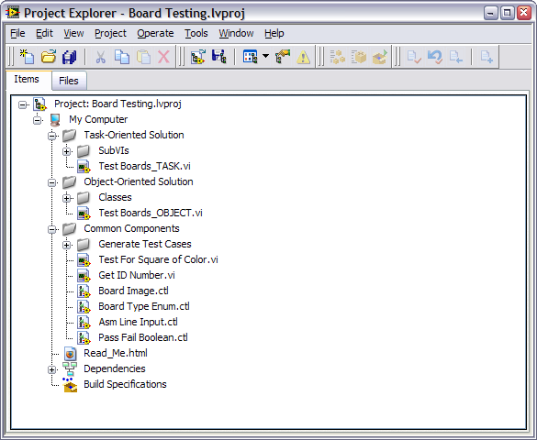




Future Challenges
Notes:
Give me what I want and what we need!
(on all platforms)
You might argue that this has all ready been implemented (TSVN and JKI’s plugin) but they both rely on Tortoise SVN and windows!
Similar to the previous request. But this is somewhat more acheivable trough the project provider framework.

Slide 49
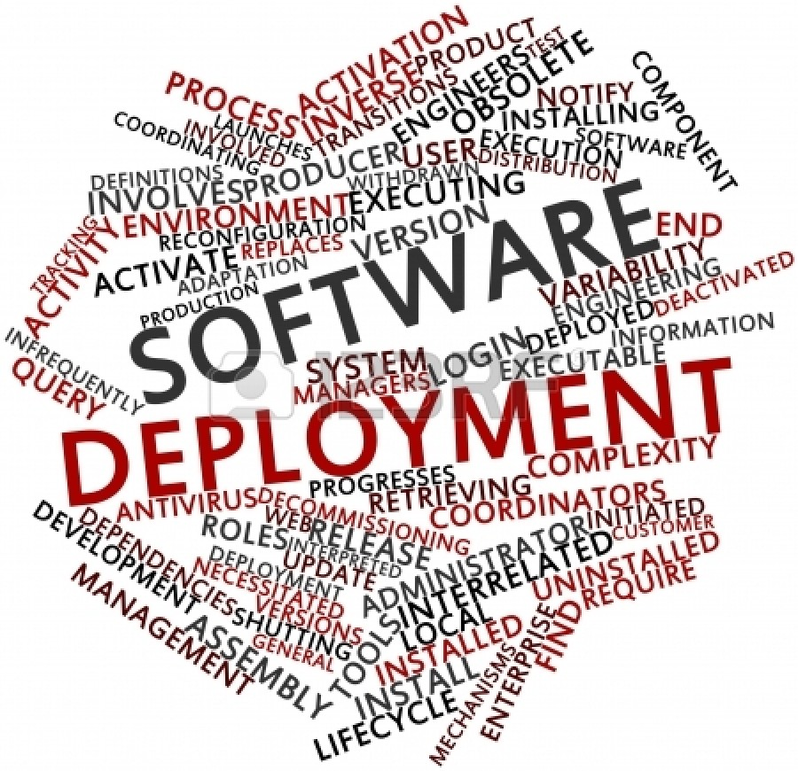

Future Challenges
Notes:
We need a tool for m to n deployment, not a replication system!

Slide 50
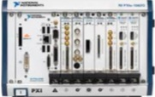
Large system management
  How to manage a large installation?
Management System
Monitoring
Security
Re-install
Updates

Slide 51
Watch these!
The LHC by Brian Cox
Extreme programming by Elisabeth Hendrickson
What the agile manifesto left out by Brian Marick
Practicing Continuous Integration by David Cramer
The Actor Framework by Stephen Mercer
ZMQ is the answer by Ian Barber
Notes:
Since we are all graphical programmers, I thought we might enjoy some of these videos, describing many of the concepts and ideas we use in RADE.

Slide 52
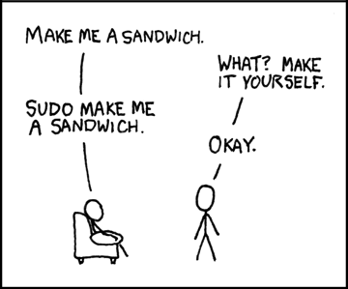
Questions

Slide 53

www.cern.ch/RADE

